Slide 1
PTWS WG2 – Task Team of TSPs
Chip McCreery, PTWC Director
charles.mccreery@noaa.gov
808-725-6301

Slide 2
PTWS WG2 Task Team of TSPs - TOR
Terms of Reference
WG2 Task Team: Tsunami service Providers (TSPs)
1. Share with each other their response to significant events including a timeline of actions,
analyses made and the result of those analyses, decisions made and the basis for those
decisions, the timeliness and accuracy of products issued, and any other notable
successes or challenges.
2. Share with each other information about existing and any new methodologies for rapidly
detecting and characterizing tsunami source events, for detecting and measuring tsunami
waves, and for forecasting tsunami propagation and impacts.
3. Share with each other information on the effectiveness of products including format and
content to make them understandable and actionable, dissemination methods and their
testing, and any other support to customers prior to and during events.
4. Report to ICG on Task Team activities during the intersessional period as well as any
resulting findings, changes, or recommendations regarding TSP operations.
The Task Team will be composed of representatives of PTWS Tsunami Service Providers
(TSPs) and a representative from ITIC.

Slide 3
Task Team of TSPs – Meeting January 15, 2023
AGENDA
1. Opening (5 minutes) Dr. McCreery (the chair of the Task Team) will make a welcome and opening address.
2. Adoption of agenda (5 minutes) Dr. McCreery (the chair of the Task Team) will present the agenda items of the meeting. The agenda will be approved as is or with some changes after discussion among the participants.
3. Report on the IOC 55th Executive Council (10 minutes) Mr. Nishimae, ICG/PTWS chair, will reports the outcomes of the discussion on the agenda item of the tsunami warning system in the IOC Executive Council 55th session held in June 2022.
4. Report of TSPs (10 minutes for each TSP) Each TSP will report its activities about issuance of tsunami bulletins as well as improvement of the tsunami warning system.
4.1. PTWC
4.2. NWPTAC
4.3. SCSTAC
4.4. CATAC
5. Revision of TSP’s User’s Guide with unified format (30 minutes) WG2 is considering unifying the formats of users guides of the TSPs. In this regard, Dr. McCreery has taken a lead on this matter. He will report progress about unifying the format and TSPs will discuss a future action on revision of each users guide.
6. Navigational Warning to Maritime Community in the ICG/PTWS (30 minutes) TOWS-WG recommends that ICG TSPs cooperate with the NAVAREA coordinators to provide tsunami information for navigational warnings. TSPs will discuss how their tsunami information is provide to the NAVAREA coordinators in the Pacific.
7. Any other business (5 minutes)
8. Closing (5 minutes) Dr. McCreery will provide any closing remarks.

Slide 4
Generally Common to All 4 Users’ Guides
Introduction / Background
Governance and Approval
Implementation Timeline
Coastal Area of Service
Tsunami Sources
Earthquake Source Zone (ESZ)
If outside ESZ
Non-seismic tsunami sources
Methodologies and Procedures
Criteria – Source regions, magnitude thresholds
Forecasting method(s) – ETAs, Amplitudes
Limitations
Exceptions
Timeline
Description of Products
Text messages - Template
Graphical products
CAP format

Slide 5
Generally Common to All 4 Users’ Guides
Dissemination and Testing
Dissemination Methods
Receipt Verification (routine tests with feedback)
Appendices
Sample Products
Place names
Countries and Territories
Forecast Points
Observation Gauges
Glossary
Acronyms

Slide 6
Overview of TOWS-WG Proposal to the World-Wide Navigational Warning Service Sub-Committee (WWNWS-SC) on
Tsunami Service Provider Messages for the Maritime Community
Only for potential or confirmed tsunamis >0.3m in TSP’s Area of Service (AOS)
Disseminated to IMO/IHO NAVAREA Coordinators covering that TSP’s AOS
Issued when TSP issues a Quantitative, not Qualitative, forecast
Only reissue if forecast changes
Issue a final message when threat mostly passed
NAVAREA Coordinators turn into maritime safety messages issued via SafetyNet to ships at sea.
Message Content
NAVAREA names (21 of these world-wide)
General Area (e.g., Western Pacific, South China Sea)
Key Subject (e.g., Confirmed Tsunami Threat, Final Message)
Tsunami Source (e.g., a magnitude 8.4 earthquake on May 17, 2020 at 0718 UTC in the Solomon Islands)
List of countries and islands with threat >0.3m and corresponding harbors
Amplifying remarks (e.g., strong currents, coastal flooding, etc.)
Cancellation Details – up to local authorities to determine

Slide 7
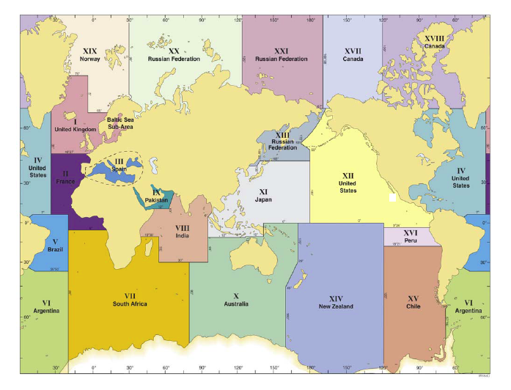
Global NAVAREAs

Slide 8
Thank You

