Slide 1
Date and Venue of the PTWS –XXX Session
PTWS-SC, 6-9 March 2023
Ofa Fa’anunu, Tonga Meteorological Service

Slide 2
ICG/PTWS XXX – VENUE & DATE
DATE: 11th -15th September, 2023
VENUE: NUKU’ALOFA, TONGA
Proposed Meeting Venue: Tanoa International Dateline Hotel
https://www.tanoahotels.com/tanoa-dateline-hotel/

Slide 3
ICG/PTWS XXX – LOCAL ADVISORY
RECOMMEND EARLY BOOKINGS FOR FLIGHTS AND ACCOMODATION
TONGA TWFP WILL CIRCUALTE ACCOMODATION OPTIONS & ADDITIONAL INFORMATION IN THE NEXT 2 WEEKS
VISA ON ARRIVAL FOR 3 MONTHS
SUNDAY IS DAY OF REST AND WORSHIP-ITS AGAINST THE LAW TO WORK ON SUNDAY
SHOPS ARE ALSO CLOSED ON SUNDAY
FLIGHTS TO TONGA VIA AUKLAND, SYDNEY AND NADI-FIJI
TRAVEL POCKET GUIDE - https://www.youtube.com/watch?v=NaZaJevnxAc

Slide 4
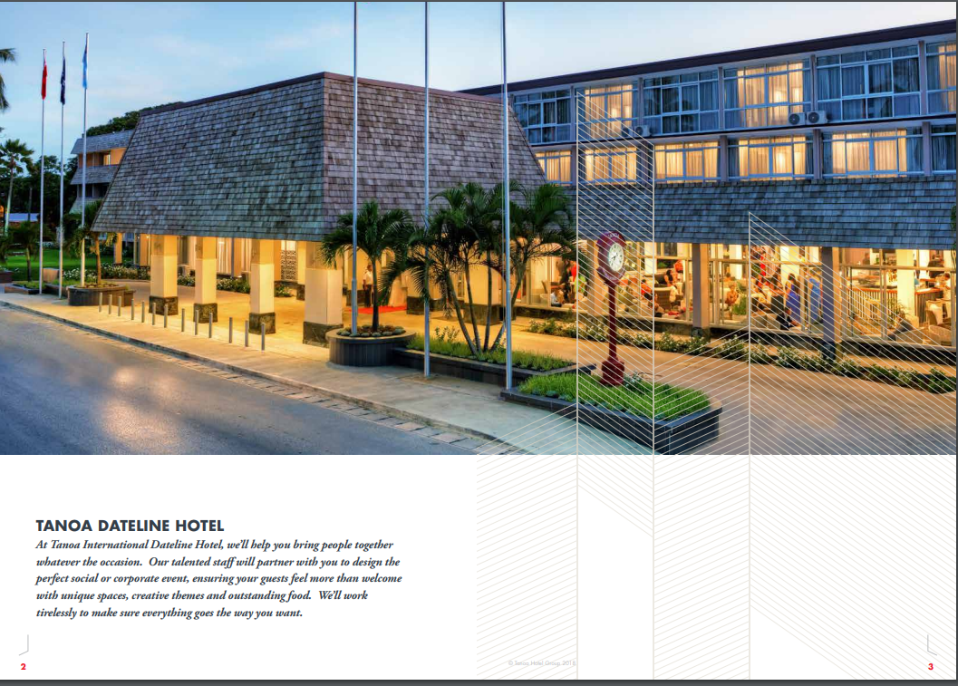

Slide 5
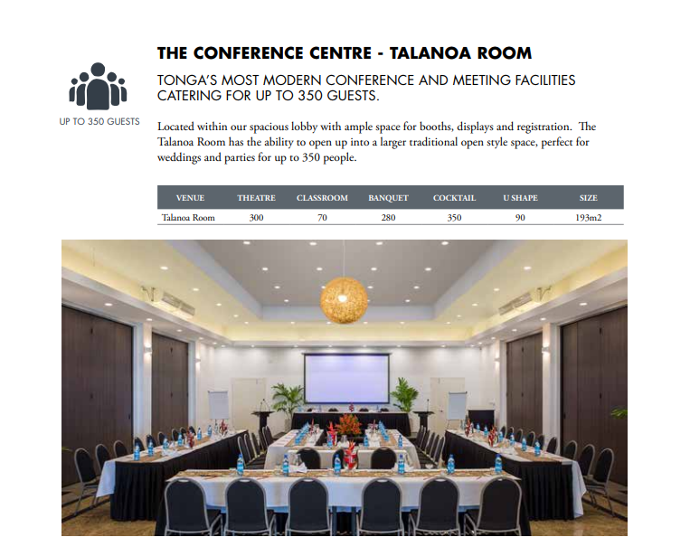

Slide 6
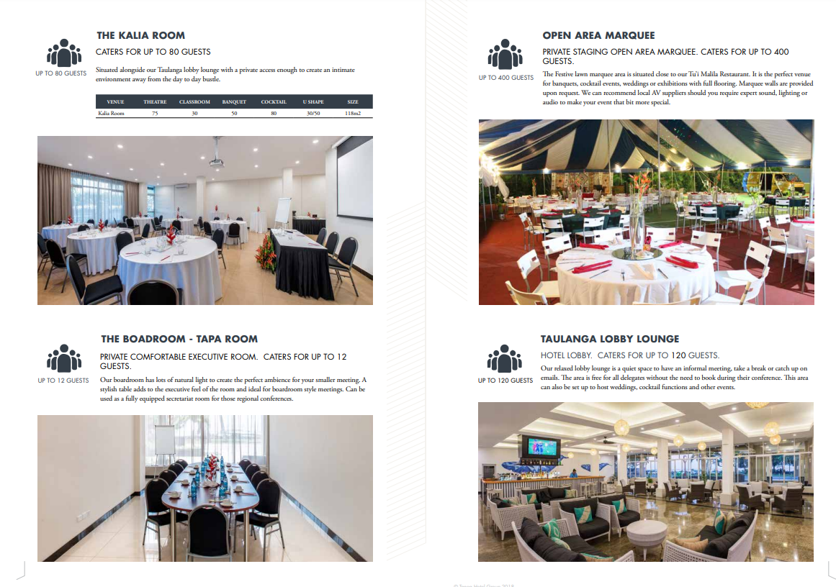

Slide 7
MALO’AUPITO FOR YOUR ATTENTION

