Slide 1
PTWS
and
Tsunami Ready Coalition
PTWS-SC, 6-9 March 2023
Dr. Laura Kong, ITIC

Slide 2
Tsunami Ready Coalition
IOC Decision EC-55/3.5.1 (July 2022) Warning and Mitigation Systems of Ocean Hazards. Part IV: Working Group on Tsunamis and Other Hazards related to Sea Level Warning and Mitigation Systems (TOWS-WG)
Approves the establishment of the UNESCO/IOC Tsunami Ready Recognition Programme as described in the working document “Tsunami Ready Programme – Proposal for endorsement by IOC” dated 21 February 2022;
Approves also
(ii) the Terms of Reference for the Tsunami Ready Coalition, as included under Annex 2 to this decision;
Annex 1. Revised Terms of Reference of the Working Group on Tsunamis and Other Hazards Related to Sea-Level Warning and Mitigation Systems (TOWS-WG)
The membership of the TOWS-WG will be constituted by:
a) The Chairpersons of the four ICG-TWSs, the Scientific Committee of the UN Ocean Decade Tsunami programme, the special Tsunami Ready Coalition, and representatives of the GOOS Steering Committee and IODE,
b) …

Slide 3
Annex 2. Terms of Reference
Goal: Contribute to increasing the number of Tsunami Ready recognized
communities as part of the UN Ocean Decade.
Objectives:
The goal should be achieved through the following objectives:
Raise the profile of Tsunami Ready in collaboration with critical stakeholders across the UN system, interested regional organizations, national disaster management agencies and the public,
Increase funding resources for the implementation of Tsunami Ready,
Advise the TOWS-WG, TTDMP, and TTTWO on the implementation of Tsunami Ready, including on measures related to:
flexibility with regards to accomplishing the indicators to allow for circumstances where formal bureaucratic frameworks/requirements may pose barriers,
consideration of unique regional and/or local circumstances,
recognition of similar standards already in place in some countries

Slide 4
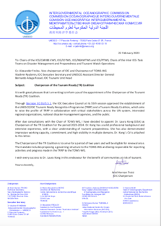
Annex 2. Terms of Reference
The Coalition will not have a programmatic role with regards to the Tsunami Ready initiative; the technical aspects (i.e. IOC Manual & Guides, 74: Standard Guidelines for the Tsunami Ready Recognition Programme) will remain the mandate and responsibility of the TT-DMP and the respective ICGs.
Organizational structure
Given the potential size of the Coalition, the Chair of the Coalition will propose a governing structure to the TOWS-WG at its sixteenth meeting.
The Chair of the Coalition will be appointed by the Chair of IOC in consultation with the Chair of the TOWS-WG.
Reporting:
The Coalition will report activities and progress to the TOWS-WG

Slide 5
Annex 2. Terms of Reference – Membership
Membership could include, as appropriate, representatives from international, regional and national organizations, such as:
National:
AID National Agencies/Organizations
Emergency Management Agencies/EDMAs
French Inter- Ministerial for the Antilles Estate Major Zone (EMIZA)
IOC & Tsunami National Contacts (TNCs) & Tsunami Ready Focal Points (TRFPs)
National Commissions for UNESCO
National Youth organisations, and
relevant Members of the UN Ocean Decade Alliance with a focus on commitments towards Tsunami Ready actions;
International:
IFRC
International Association of Emergency Managers (IEAM)
International Council for the Exploration of the Sea (ICES)
Relevant ICG Working Groups and Task Teams
Save the Children
Tsunami Information Centres
UNDP
UNDRR
Regional:
Arab League Educational, Cultural and Scientific Organization (ALESCO) • ASEAN Caribbean Disaster Emergency Management Agency (CDEMA)
CARIDIMA Youth Platform for DRM in the Caribbean.
Coordination Center for Disaster Prevention in Central America and the Dominican Republic (CEPREDENAC)
Directorate-General for the European Civil Protection and Humanitarian Ais Operations of the EC (DG-ECHO-EC)
Islamic World Educational, Scientific and Cultural Organization (ICESCO) (Headquarters in Rabat, Morocco).
Joint Research Centre of the European Commission (JRC-EC)
Pacific Community (SPC)
U-INSPIRE Alliance (Asia and the Pacific Alliance of Youth and Young Professionals in Science, Engineering, Technology, and Innovation for Disaster Risk Reduction and Resilience)
UNESCAP

Slide 6
Thoughts
Gather, Listen, Ponder, Imagine
Broad, Narrow, Conservative, Wild
Looking Outside in, Inside out
Innovative, High-tech, Low-tech

Slide 7
PTWS support to Tsunami Coalition
Raise the profile of Tsunami Ready in collaboration with critical stakeholders across the UN system, interested regional organizations, national disaster management agencies and the public
Increase funding resources for the implementation of Tsunami Ready,
Advise the TOWS-WG, TTDMP, and TTTWO on the implementation of Tsunami Ready, including on measures related to:
flexibility with regards to accomplishing the indicators to allow for circumstances where formal bureaucratic frameworks/requirements may pose barriers,
consideration of unique regional and/or local circumstances,
recognition of similar standards already in place in some countries

Slide 8
PTWS support to Tsunami Coalition
Raise the profile of Tsunami Ready in collaboration with critical stakeholders across the UN system, interested regional organizations, national disaster management agencies and the public

Slide 9
PTWS support to Tsunami Coalition
2. Increase funding resources for the implementation of Tsunami Ready,

Slide 10
PTWS support to Tsunami Coalition
Advise the TOWS-WG, TTDMP, and TTTWO on the implementation of Tsunami
Ready, including on measures related to:
flexibility with regards to accomplishing the indicators to allow for circumstances where formal bureaucratic frameworks/requirements may pose barriers,
consideration of unique regional and/or local circumstances,
recognition of similar standards already in place in some countries
EXAMPLES – PRESENTATION OF PROGRESS
NZ
USA

Slide 11
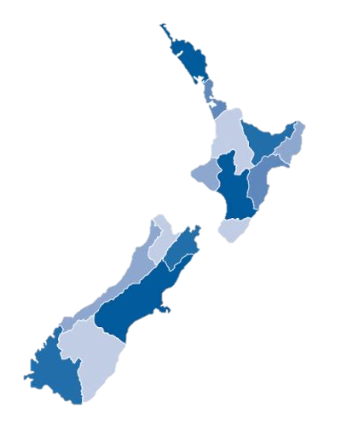
Tsunami Ready in New Zealand
There is interest at a national level to encourage the regional implementation of Tsunami Ready Recognition Programme, in support of the Ocean Decade Goal of 100% of all at risk communities “Tsunami Ready”.
This would be preferentially undertaken at the Civil Defence Group Level - committees of local authorities within regional boundaries.

Slide 12
Tsunami Ready in New Zealand – key challenges
Tsunami risk reduction and preparedness is incorporated in an multi hazards approach within existing risk reduction strategies and emergency plans, rather than explicitly.
We need a single national framework for this (avoiding multiple)
Ensuring that applying a global framework still empowers our ‘locally led, regionally coordinated, nationally supported’ approach to risk reduction and emergency response
Some Groups are already facing potential changes (with associated cost) as part of a push for national alignment – so have to be careful that extra work is truly to improve the tsunami readiness of a community and not to solely obtain recognition.

Slide 13
Tsunami Ready in New Zealand – our way forward
NEMA’s ultimate goal is to empower the CDEM Regional Groups to be able to apply for Tsunami Ready recognition using near-to existing reporting requirements.
What already aligns with Tsunami Ready requirements?
Administratively, Tsunami Reference Group exists, consisting of central Government, regional CDEM Group, and science agency representatives.
CDEM Groups are required to submit Plans every 5 years – but not specifically for tsunami
A National Tsunami Warning and Advisory Plan, and mechanisms for early warning, are consistent across the country

Slide 14
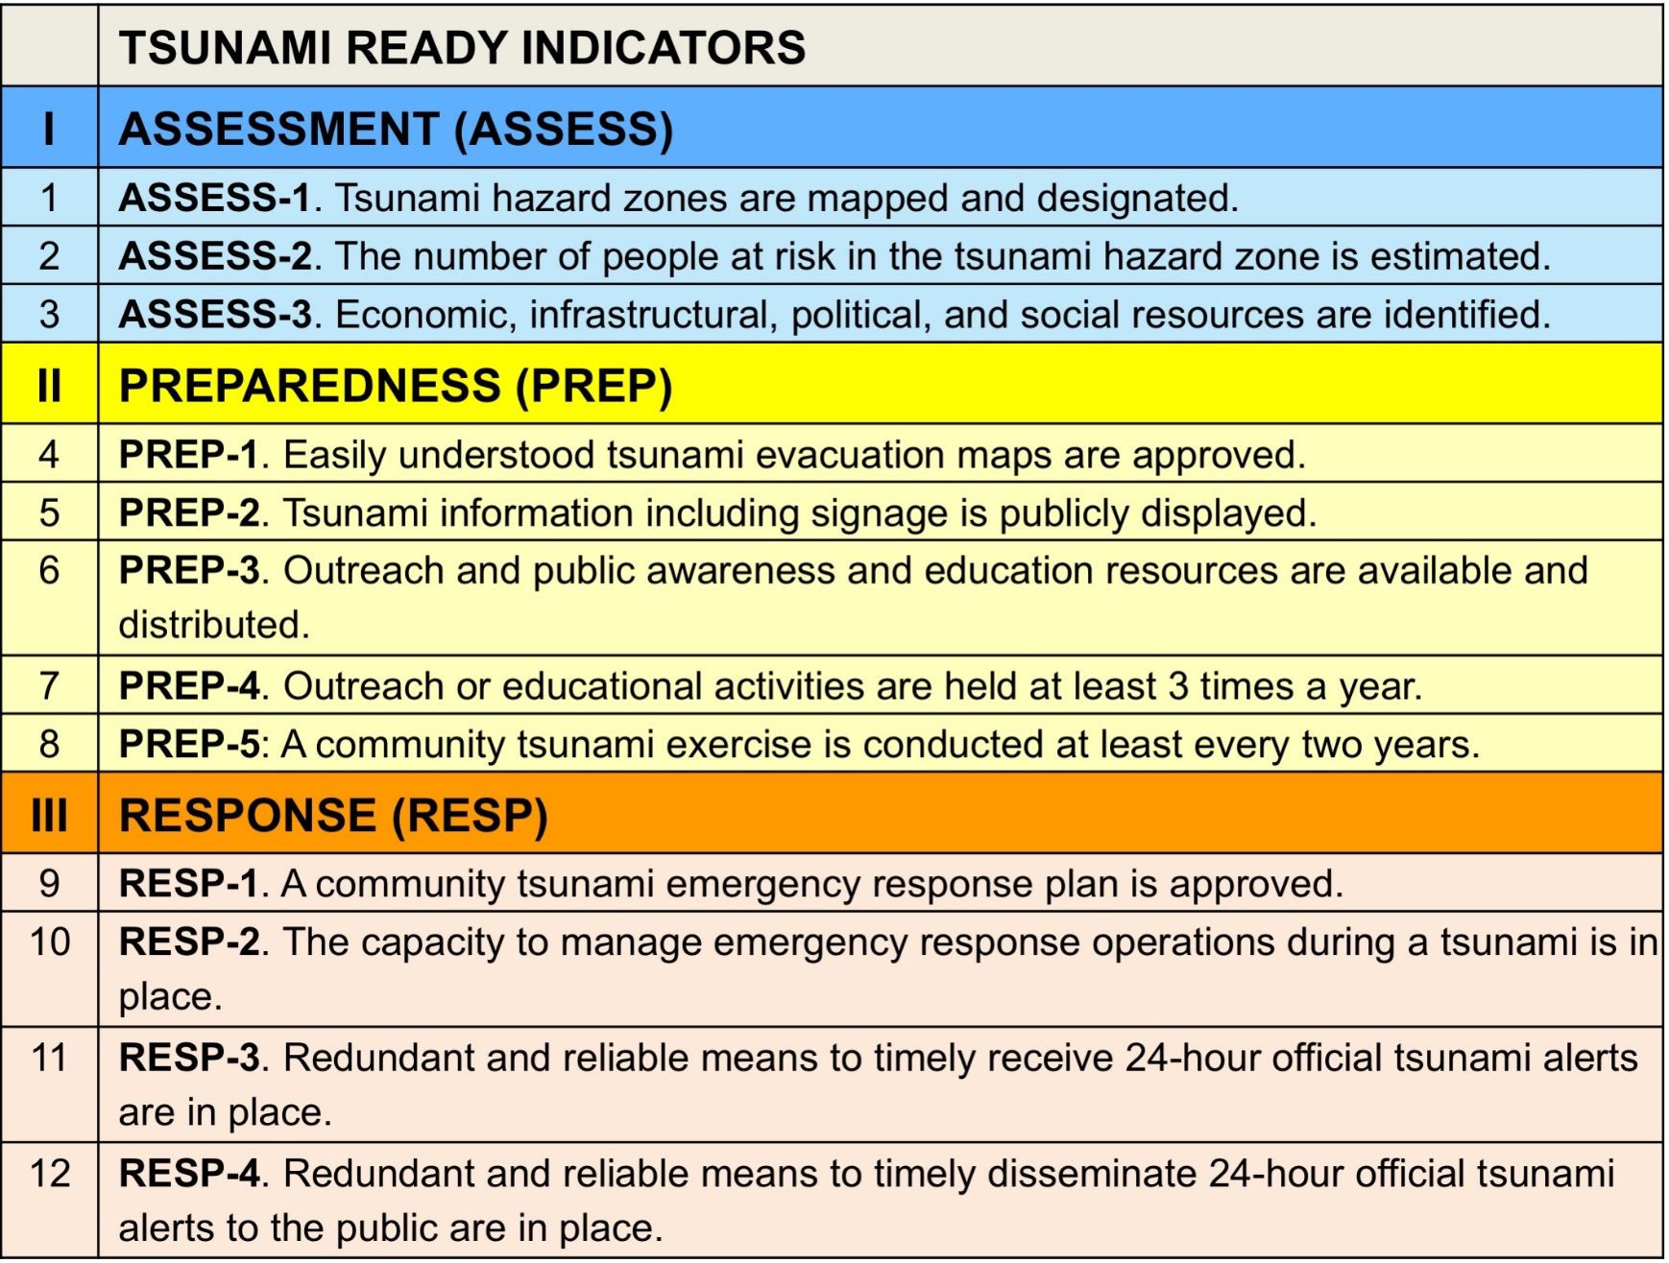
Tsunami Ready in New Zealand – our way forward
Regionally done
Regionally done as part of risk assessment, not explicitly reported
Regionally done
Nationally supported
National exercise – but focused largely on earthquake preparedness
Regionally required
National capability

Slide 15
Tsunami Ready in New Zealand – the concept
Some indicators can be met “as standard” across the entire country as they are either national capability OR legislatively required to be reported in the CDEM Group Plan. Some work is required at the national level to describe how these cross-reference to the Tsunami Ready indicators.
Groups could then apply with supplemental information on remaining indicators, where these are optional national activities.
New Zealand’s Tsunami Reference Group (or sub set) can be designated as a NTRB
Through this, with agreement from the CDEM Groups, we think we can move towards much of NZ being recognised as Tsunami Ready, OR report to the ICG progress towards the goal even without formal recognition

Slide 16
Tsunami Ready in New Zealand – an example
The UNESCO/IOC Tsunami Ready were used as the start point in the design of a Tsunami Work Programme at the initiative of a regional CDEM Group.
This Group considered the indicators in the context of the Region. The criteria for these were defined as must:
Have assessment of the start state as the baseline.
Have application and compliance with national standards.
Consider local-regional-national implications.
Be community-centric.
Be culturally appropriate.

Slide 17
TSUNAMI READY INDICATORS | CDEM GROUP TSUNAMI READY INDICATORS
 | QUALITY MANAGEMENT
 | Project Team representation and collaboration of all local authorities
 | Developed funding mechanisms to support Tsunami Ready Programme
 | Develop transition plan for enduring Tsunami Ready Programme
I ASSESSMENT (ASSESS)
ASSESS-1 Tsunami hazard zones are mapped and designated | Up-to-date Tsunami Evacuation Zone Maps for complete coastline informed from science and with application of national standards.
ASSESS-2 The number of people at risk in the tsunami hazard zone is estimated | Develop a regional tsunami impact assessment with identification of economic, infrastructural, political, and social impacts for the region.
ASSESS-3 Economic, infrastructural, political and social resources are identified | Develop a regional tsunami impact assessment with identification of economic, infrastructural, political, and social impacts for the Bay of Plenty.
Notes:
.

Slide 18
TSUNAMI READY INDICATORS | CDEM GROUP TSUNAMI READY INDICATORS
II PREPAREDNESS (PREP)
PREP-1 Easily understood tsunami evacuation maps are approved | Consistent Evacuation Zone Maps accessible through multiple platforms which have a community-centric focus
PREP-2 Tsunami information, including signage is publicly displaced | Have publicly displayed tsunami evacuation zone maps in compliance to national standards
PREP-3 Outreach and public awareness and education resources are available and distributed | Public education campaign specifically for tsunami hazard tailored for the region which is culturally appropriate and community centric
PREP-4 Outreach or educational activities are held at least 3 times a year | Develop targeted Public education for at risk communities
PREP-5 A community tsunami exercise is conducted at least every two years | Conduct Tsunami Hikoi exercises which are consistent across the region
 | Develop tsunami-scenarios for inclusion in all-hazards exercise programme

Slide 19
TSUNAMI READY INDICATORS | CDEM GROUP TSUNAMI READY INDICATORS
III RESPONSE (RESP)
RESP-1 A community tsunami emergency response plan is approved | Have a Tsunami Response Plan at a regional level
 | Tsunami hazard planning to be included in all Community Response Plans and community outreach activities
RESP-2 The capacity to manage emergency response operations during a tsunami is in place | Develop ‘all agency’ roles and responsibilities in response and recovery from a tsunami event that are realistic and proportionate to capability
RESP-3 Redundant and reliable means to timely receive 24-hour official tsunami alerts are in place | Have reliable 24-7 public alerting mechanisms to ensure coverage across all the region
RESP-4 Redundant and reliable means to timely disseminate 24-hour official tsunami alerts to the public are in place
 | RECOVERY
 | Have a CDEM Group Recovery Plan that includes tsunami consequences from impact assessment

Slide 20
Tsunami Ready Coalition
PTWS-SC, 6-9 March 2023
Dr. Laura Kong, ITIC

