Slide 1
Tsunami Coastal Assessment Tool
TsuCAT
Christopher Moore, NOAA Center for Tsunami Research (NCTR)
Dr. Laura Kong, ITIC
Dr. Charles McCreery, PTWC
TsuCAT v4.3, Feb 2023

Slide 2

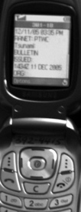
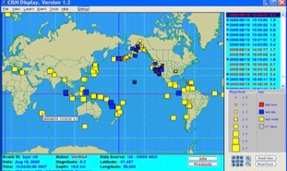
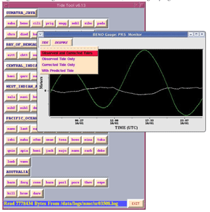
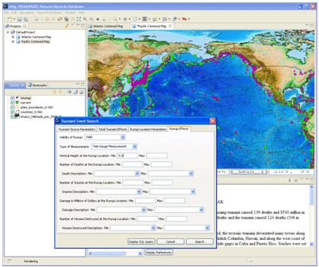
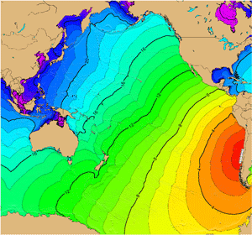
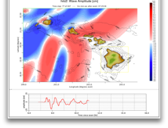
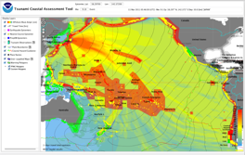
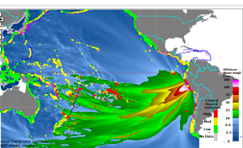
Tsunami Warning Decision Support Tools
ITIC-distributed, supported
Tsunami Bull Board (ITIC, 1995) ~469 science/tsu/govt
Real time EQ Display (v3.7.039 (CISN, USGS / NTHMP, 2005), 350+
Real-time Sea Level monitoring
  Tide Tool v10.70 – TWC operations monitoring (PTWC, 2005)
  IOC Sea Level Monitoring web site (IOC, 2008)
Tsunami Travel Time Software v4.0.01 (ITIC, NCEI, 2007) – TTSDK4.0.1
Tsunami Historical Database Online (WDS-NCEI), Offline (TsuDig, NCEI, ITIC, 2009)
Tsunami Hazard Assessment Tools – PMEL, ITIC
  ComMIT/MOST inundation modeling (2015 TEMPP; put under OTGA for Tsunami Ready)
  Tsunami Coastal Assessment Tool (TsuCAT) v4.3 Feb 2023 – situational exercise injects

Slide 3
TsuCAT update: v4.3, February 2023
Java security update in bundled Java Runtime Environment
Proxy configuration for outbound firewall networking configuration
PTWS Messages now password protected. Contact ITIC or PMEL for access to feature.
PTWC Messages feature includes Exercise Injects option to generate Excel spreadsheet of injects to react to when testing SOPs.
Updates to NCEI Tsunami event database and runup database: observations of real event runups through 2022.
Updates to Seismic Expert Sources
  Lesser Antilles (IOC Workshop Rpt 291, 2019) – included
  Colombia-Ecuador (IOC Workshop Rpt 295, 2020) – later, download PMEL

Slide 4
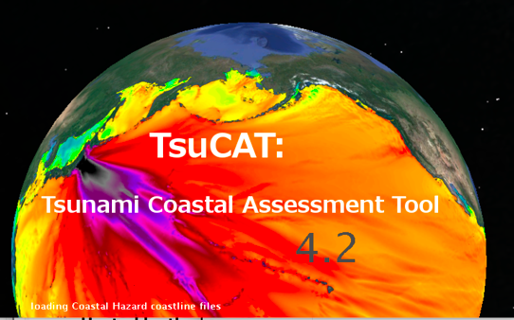
TsuCAT: Tsunami Coastal Assessment Tool (NCTR, ITIC)
Why / What: Request by Pacific Islands for warning DSS Gives country capacity to assess tsunami hazard
Who: Country agencies with Tsunami Hazard Assessment, Warning and Emergency Response responsibilities
Tool use:
  Planning tool - assess threat before – ‘energy beams’
  Decision system support tool – Customize country sub-regions (polygons), Quick, early assessment through DB lookup
  Exercise tool – develop scenarios to use (from v4.0, 2019)
Features:
  Database: ~5400 earthquake scenarios from along active subduction zones, Pacific, Caribbean, Indian Ocean (M6.5-9.5)
  Scenarios from Expert Meetings (Caribbean, Pacific)
  Results from NOAA models (MOST/SIFT (M8+), RIFT (M6.5-7.9)
    Offshore max amplitude / coastal wave amplitude (Green’s Law)
    PTWC or User custom forecast polygons
  Exercise Messages and Injects

Slide 5
TsuCAT - Background
Requirements:
  Offline (no internet required) - portable Online (internet, adds geographic map tiles (OpenStreet, ESRI)
  Platform: Windows, Linux, Macintosh; Java v1.8
  Storage: 27 GB; No installation - run from flash drive
  Bathymetric grid resolution: MOST (compute 4 arc-min), RIFT (compute 4 arc-min decr to 30 arc-sec)
Layers
  Offshore Wave Amplitude, Coastal Hazard Guidance, Travel Time
  PTWC coastal polygons, or user-customized
  Results export – model, regional report
  Reference information: Historical Seismicity(USGS, NOAA NCEI Significant), Tsunami Observations (NOAA NCEI), USGS Plate boundaries, Place names
  User-supplied maps (polygon shape files), Quick guide tutorial
  PTWC Enhanced Products Exercise messages

Slide 6
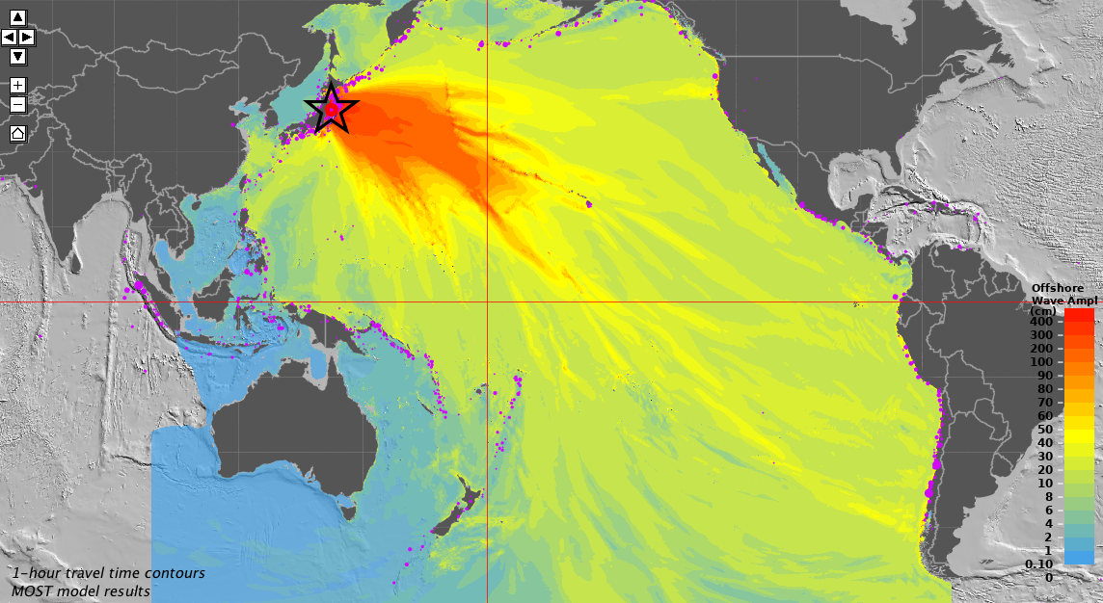
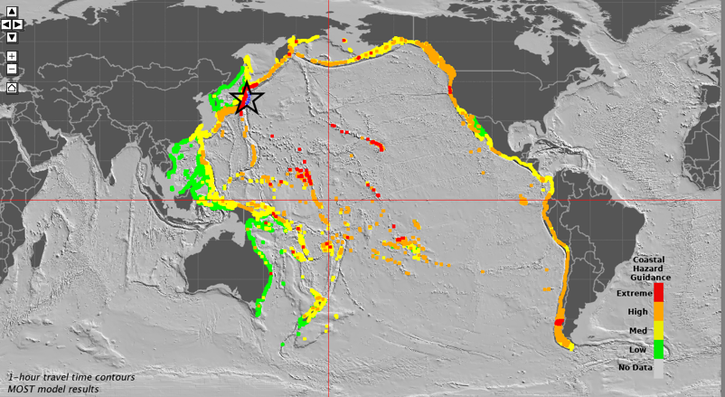
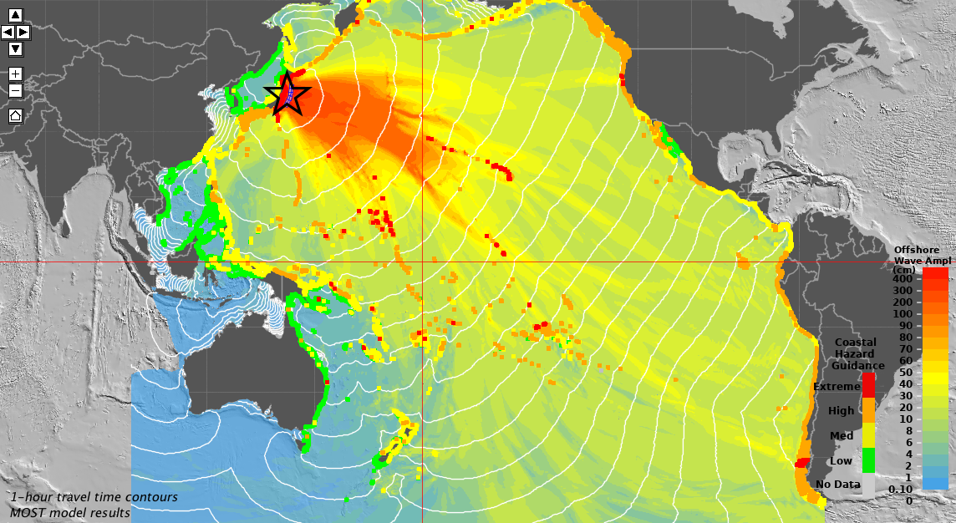
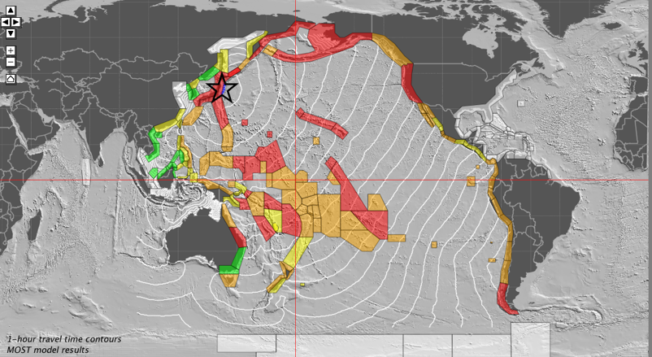
TsuCAT: Coastal Impact DB Tool
Deep-Ocean Offshore Max Ampl – Historical seismicity
Coastal Hazard Guidance Ampl (CHG)
Offshore – CHG – Tsunami Travel Times (TTT)
PTWC Coastal Polygons – TTT

Slide 7
TsuCAT – Tool Applications
Hazard Assessment - conduct study to determine worst case, or likely impact, to a country’s coast from different scenarios
Exercise development - decide which scenario to use for a tsunami exercise, generate PTWC exercise messages
Response Planning – use scenarios to develop tsunami response plans, protocol and procedures (SOPs)
Warning decision making – estimate tsunami impact using the nearest similar scenario during a real event (early assessment prior to receiving PTWC forecast products

Slide 8
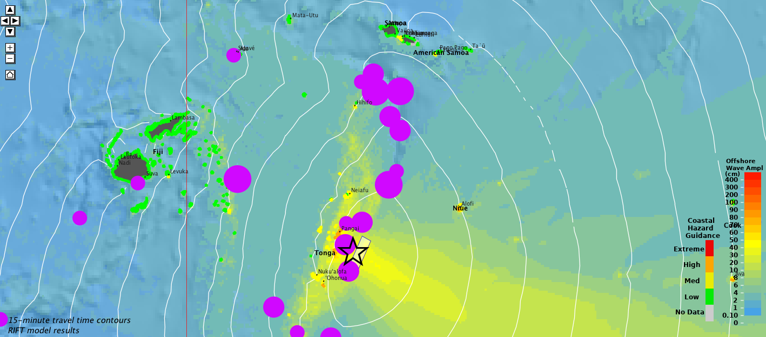
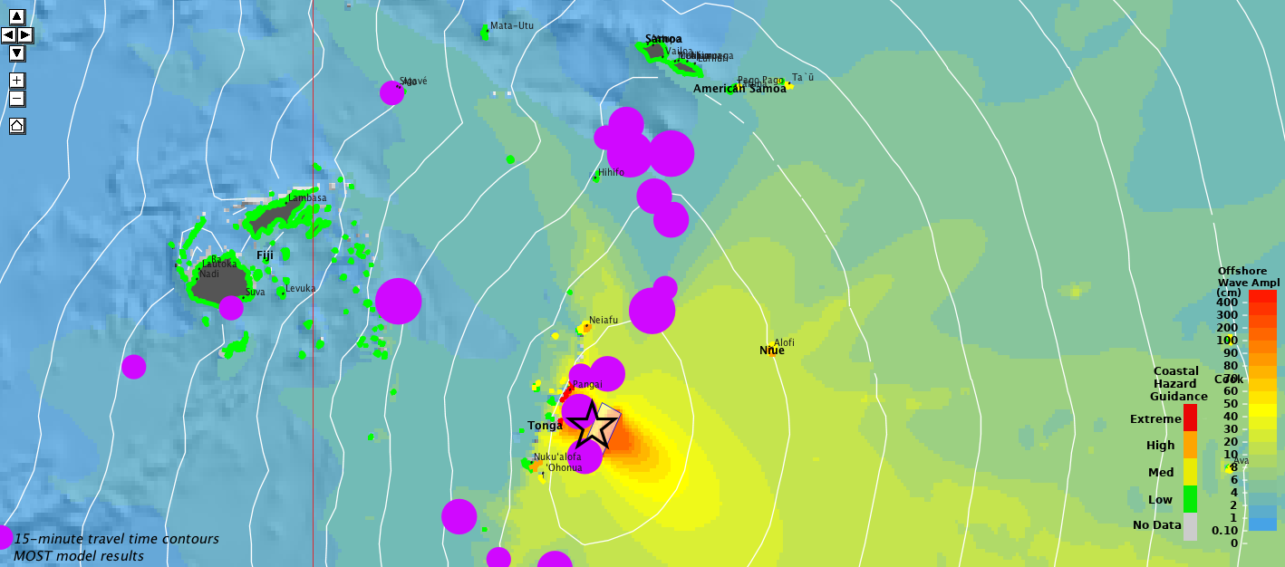
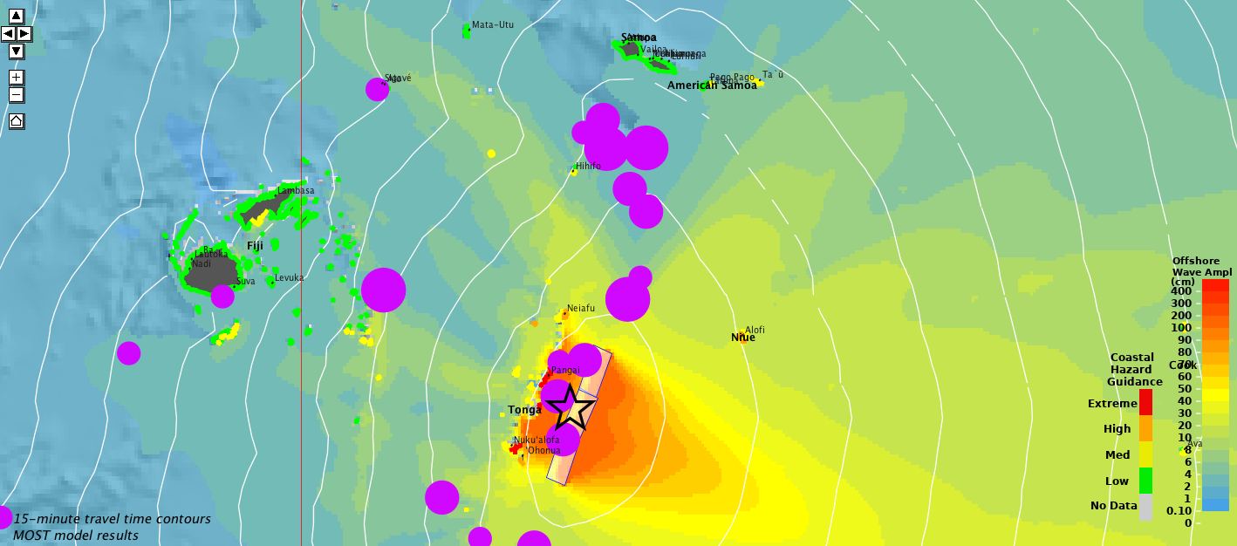
Uses: Threat Assessment
M7.7
M8.0
What size earthquake is most dangerous to Tonga?
Central Tonga source
M7.7, 8.0, 8.3
M8.3

Slide 9
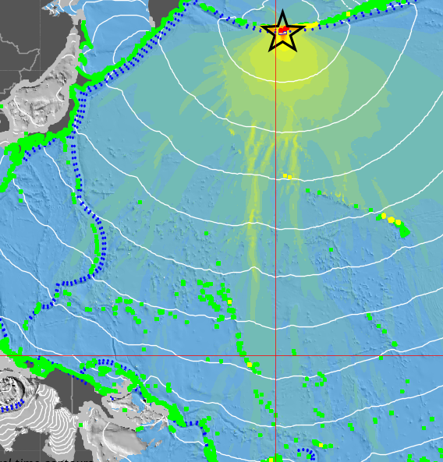
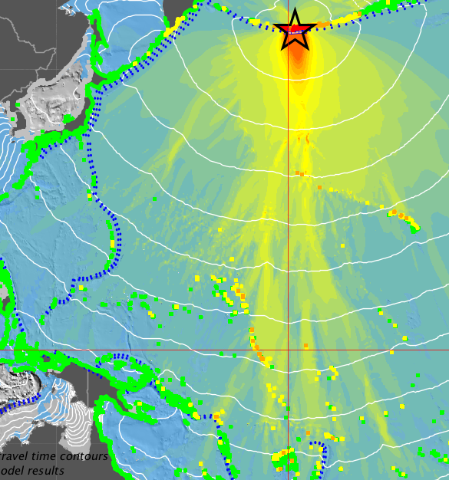
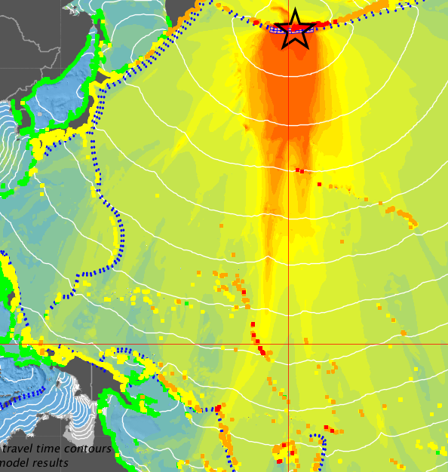
Uses : Threat Assessment
What size earthquake is most dangerous?
Aleutian Trench source: M8.0, 8.5, 9.0
Uses: Uses:
M8.0
M8.5
M9.0

Slide 10
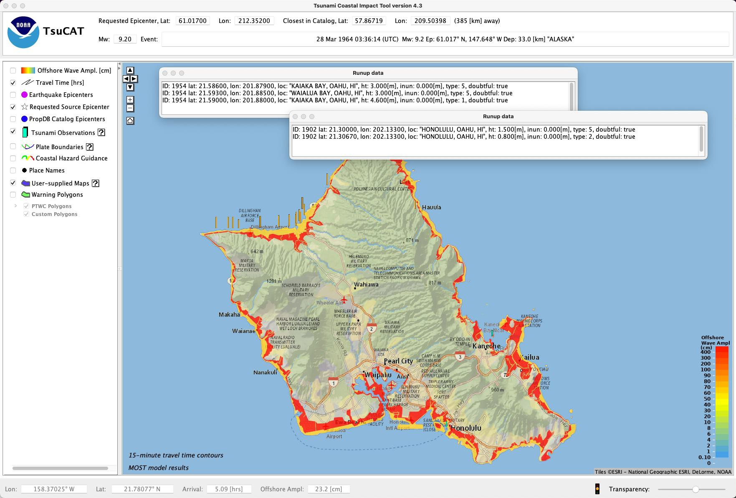
Uses : Overlay of additional data layers
Oahu, Hawaii
Evacuation map
NCEI runup data

Slide 11
Uses: Generate Exercise messages with Injects
PTWC Public Text and Enhanced Products for events in TsuCAT pre-computed Pacific and Caribbean database
Situational Injects for responding to based on selected scenario
Password: genr8mess
Select Menu - “Export Exercise Messages”
  Set Event (historical database or by mouse, origin time, magnitude)
  Choose Generate (PTWC Text Messages, Enhanced Products (graphical, polygon table, kmz file)
  Output folder, e.g., message/2019-04-02_0000_M9.0_Russia_PTWCproducts
Varying issue time and magnitude update

Slide 12
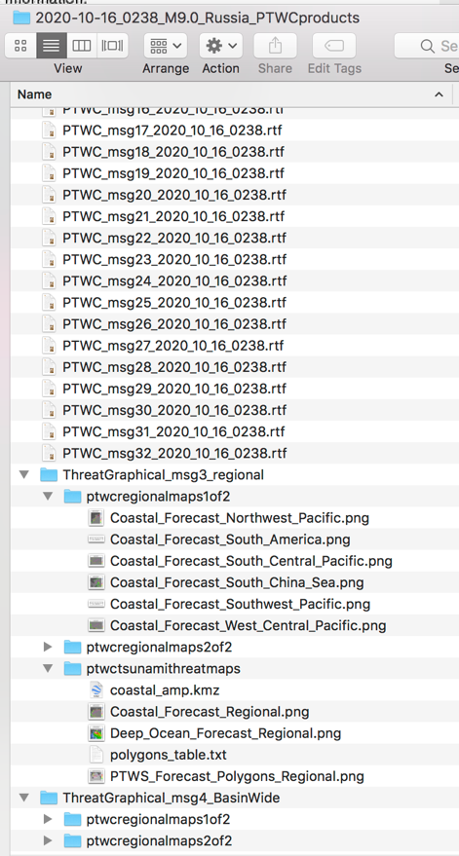
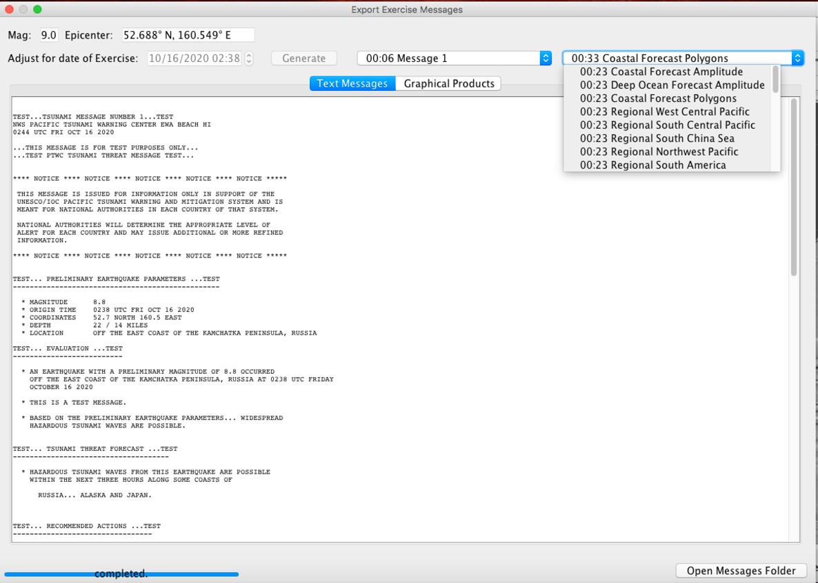
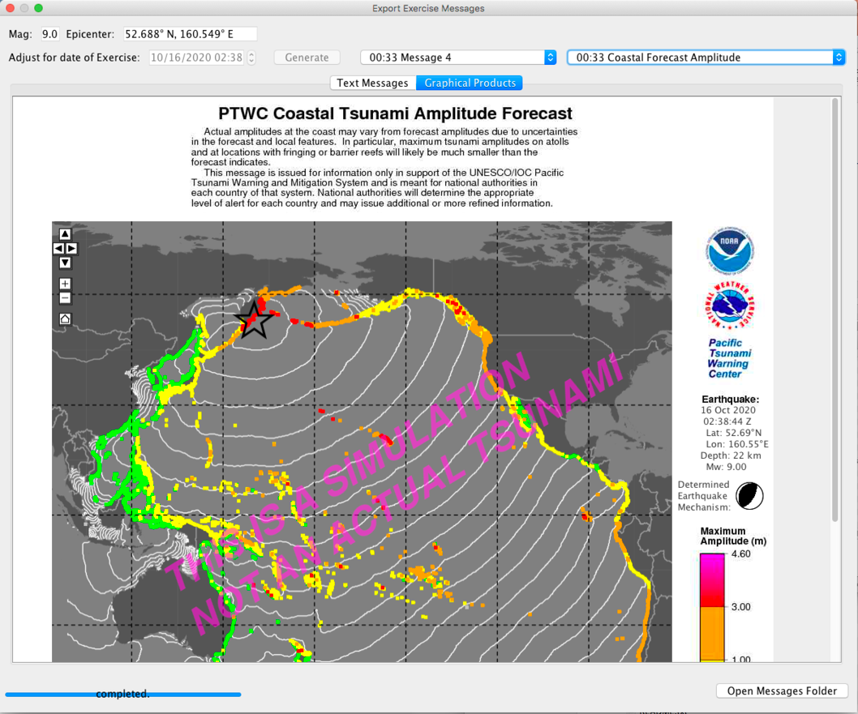
GUI – Export PTWC Exercise Messages
1957 Kamchatka M9.0

Slide 13
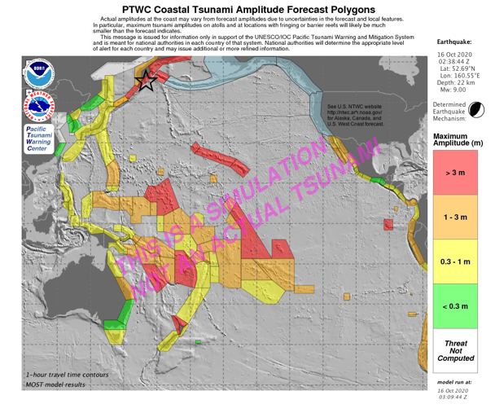
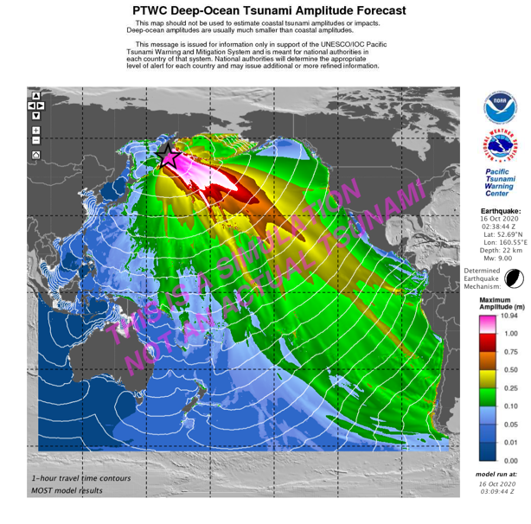
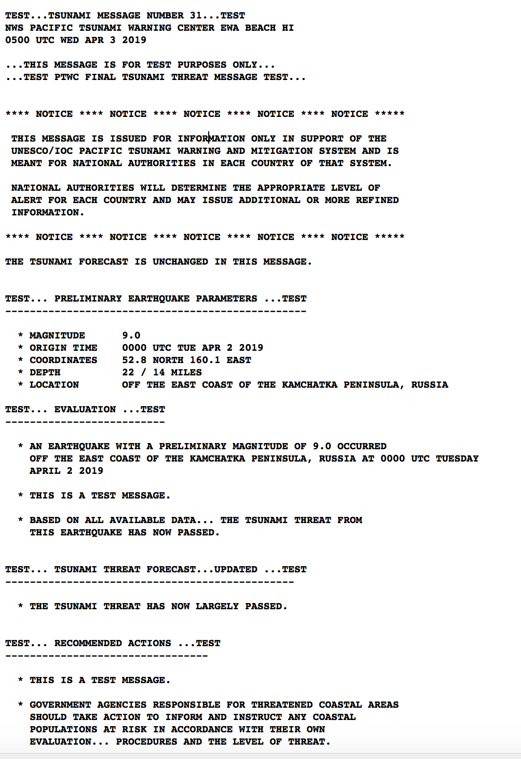
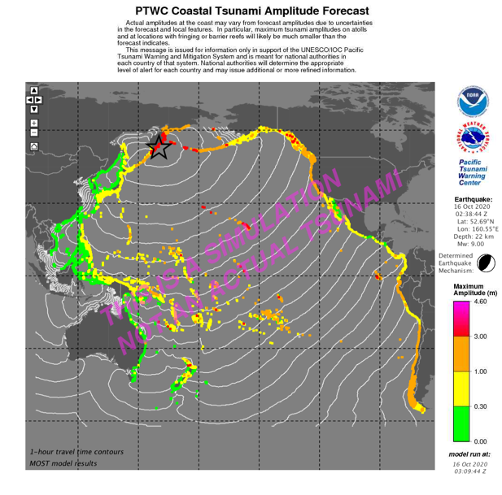
PTWC Messages – THIS IS A SIMULATION NOT AN ACTUAL TSUNAMI
1957 Kamchatka M9.0

Slide 14
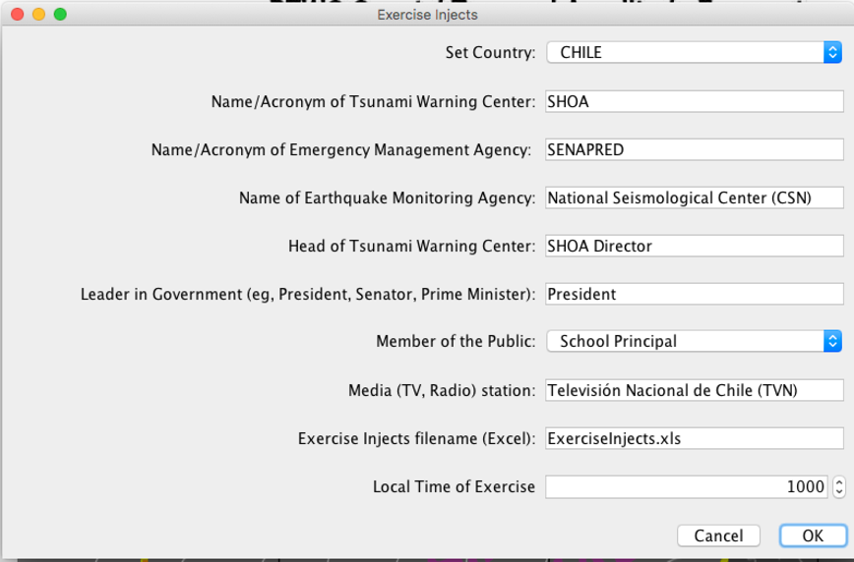
Exercise Situational Injects
Injects enable customization
Injects are unexpected scenario questions, inquiries additional to PTWC messages
Excel format

Slide 15
How to use
Run from flash drive (or can copy to hard disk, 28 GB)
Requirement – Java 1.8x installed
  https://java.com/en/download/
Click on application (Window, Mac, Linux)
  On 1st time opening, set password (unique to user)
  Default is ‘No Internet’
  With Internet, will
    Seek updates EQ &Tsunami database files (not needed often)
    Use additional online map databases (more detailed but requires bandwidth
  Enter ‘start’ password, Set ’personal’ password. ‘start’ = Inund8ed
  For exercise messages/injects tool, password = genr8mess

Slide 16
Summary Information
    2018-23 improvements (v3 and v4):
      2018 (v3.0) – security, global bathymetric DB (remove seam), higher-resolution SIFT/RIFT runs
      2019 (v4.0) - PTWC messages (text and enhanced graphical products) so countries able to conduct exercises on their own)
      2019 - 2023 (v4.x) – Include Scenarios from Expert Meetings (Caribbean, Pacific); input addtl data layers (such as ComMIT layer/inundation); Exercise situational Injects
Information, questions, feedback: Web site http://itic.ioc- unesco.org/index.php?option=com_content&view=category&layout=blog&id=2239&Itemid=2763
  Email ITIC, NCTR:
  itic.tsunami@noaa.gov, laura.kong@noaa.gov
  Christopher.Moore@noaa.go

Slide 17
Thank You
Christopher Moore, NOAA Center for Tsunami Research (NCTR)
Dr. Laura Kong, ITIC
Dr. Charles McCreery, PTWC
TsuCAT v4.3, Feb 2023

Slide 18
TsuCAT hands-on activity
Open TsuCAT, set your password
Explore TsuCAT features
  Understand user preferences. Setting Coastal Hazard Guidance ranges.
  Selection and variation of source using menu and mouse
  PTWC polygons and Customized polygons
  Understand what is (and what is not) in regional reports
Hazard Assessment – Country response planning
  Create a summary of what distant or regional source region is most hazardous to your country
Tsunami Warning – Country TWC Warning Criteria
  Based on the database assessment and your country’s warning criteria, what will you place your country in for the following:
  MX1 earthquake in Y1 trench (or off Z1 country)
  MX2 earthquake in Y2 trench (of off Z2 country)
Generate PTWC messages for exercise - Choose scenario, create messages

Slide 19
How to obtain / update
If you have older version, request Flash Drive with entire software loaded (28 GB). Send request to laura.kong@noaa.gov
  Recommended since it will be clean installation.
  You may run it from the flash drive or copy folder to hard drive
  You may not need administrator privileges to load
If you have v4.0 - 4.2, you can download v4.3 executable and other data files from PMEL server (or request Flash Drive). More info, contact: laura.kong@noaa.gov, christopher.moore@noaa.gov
  URL: https://sift.pmel.noaa.gov/ComMIT/TsuCAT/software
  User: tsucat Password: Inund8ed
  Place in your existing TsuCAT folder
  On startup, will automatically download additional source files
  You may need administrator privileges to download/load

