Slide 1
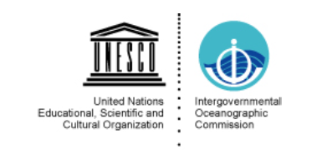
ICG/NEAMTWS Steering Committee
12 April 2023, Paris/online
WG1 « Hazard assessment and modeling »
Audrey Gailler & Mauricio Gonzalez
2023+ Actions (WG1)
Elaborate a draft ToR of WG1, including Risk assessment (draft).
Discuss methodologies and procedures for hazard assessment (deterministic vs probabilistic) for different applications: preparation, mitigation, evacuation (TsunamiReady). Portugal, Spain, France, Italy,….
Collect benchmark data for NEAMTWS. Spain, France, Greece,…
Start with WG4 a guideline on risk application (preparation, mitigation, evacuation)
CoastWave EU Project interaction: guidelines evacuation maps for Tsunami Ready
Interact and support WG4 and TT on Tsunami Ready

