Slide 1

10. Planning and Organization of NEAMWAVE23 EXERCISE
co-chairs: Ceren Ozer Sozdinler (Turkey)
Marinos Charalampakis (Greece)
Steering Committee of the ICG/NEAMTWS
Teleconference, 12-13 April 2023

Slide 2
in the future…
NEAMWave in the future:
1. Opportunity for greater synergies within Tsunami Ready recognized communities.
2. Strengthening networks and partnerships with Civil Protection Agencies/Organizations.
3. Greater use and application of enhanced products, including proper effective use of Probability Tsunami Hazard Information
MEETING OF THE INTER-ICG TASK TTT-DMP
Online, 21–22 February 2022

Slide 3
Objectives (1/2)
NEAMWave objectives:
● Validate and evaluate the Tsunami Service Provider (TSP) dissemination process of issuing Tsunami Messages in the NEAM region.
● Validate and evaluate the procedures for countries to receive the Tsunami Messages issued by the TSP through their National Tsunami Warning Centres (NTWC), the country Tsunami Warning Focal Points (TWFP) or the country Tsunami National Contacts (TNC).
● Test the dissemination of the warning messages to the relevant agencies that are responsible for emergency response (CPA).
● Assess the organizational decision-making process about public warnings and evacuations thus raising awareness of launching and contributing to the development of a national policy to tackle the tsunami risk.

Slide 4
Objectives (2/2)
NEAMWave objectives:
● Identify best practices (to be shared), criticalities (to be addressed by the program in the future activities) and room for improvements in the entire process (including the procedures already tested between TSPs and TWFPs/NTWCs and also the heterogeneous panorama of national capacities to handle tsunami risk).
● Test procedures for international assistance between the European Commission and participating Member States
NEAMWave23 specific objective:
● Participation of CoastWAVE project countries in NEAMWave Exercise
● Engagement of the Civil Protection Authorities

Slide 5
Issues to take into account
● Close cooperation is needed between CoastWAVE partners, the Task Team on Tsunami Exercise and the secretariat.
● Proposed time for having the CoastWAVE exercise, in regard to the NEAMWave23.
● The level of alert simulated in the exercise. For some cases, it is very likely the alert level to be rather low, due to the possible large distance from the epicenter.
● For the secretariat: additional workload and increased logistics to handle both the NEAMWave23 exercise and the separate CoastWAVE exercise activities.
● Bridging the gap between the national Tsunami Warning Focal Point that will receive the tsunami warning messages of the NW23 and the local emergency managers of the CW community that they should receive the messages.

Slide 6
Ongoing Preparations
● Proposal to the TSPs (in TSP meeting of September 2022) for having NEAMWave23 in combination with CoastWAVE partners’ exercises. - Done
● Request Civil Protection Authorities (through TNCs) with experience in NW exercises to prepare a one-page guiding document to share with other non-experienced CPAs, describing their experience in implementing Phase B of NEAMWave Exercises. – NO RESPONSE
● Prepare a concept information paper to inform CPAs about the general concept of NEAMWave. - Submitted to Secretariat
● Online meeting with CoastWAVE coordination team. - Done

Slide 7
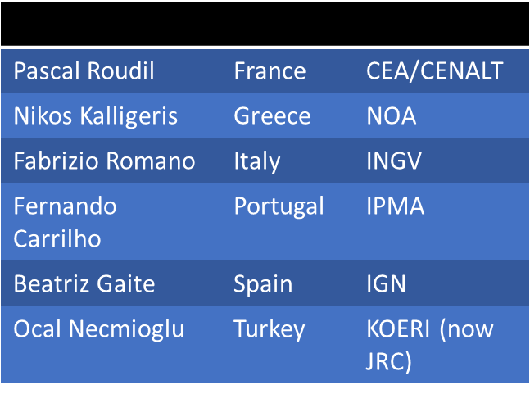
Ongoing Preparations - pending
● Finalization of concept paper to distribute CPAs
● Revision of online tools (subscription & evaluation)
● Having online meetings with DG-ECHO and CPA representatives
● Preparation of Scenarios in collaboration with TSP representatives
● The exercise team members will have to be decided in the
next ICG. However, TT-TE will start the preparation of
NEAMWave23 by contacting the TSPs’ representatives until
the ICG.
NEAMWave21 Exercise Team

Slide 8
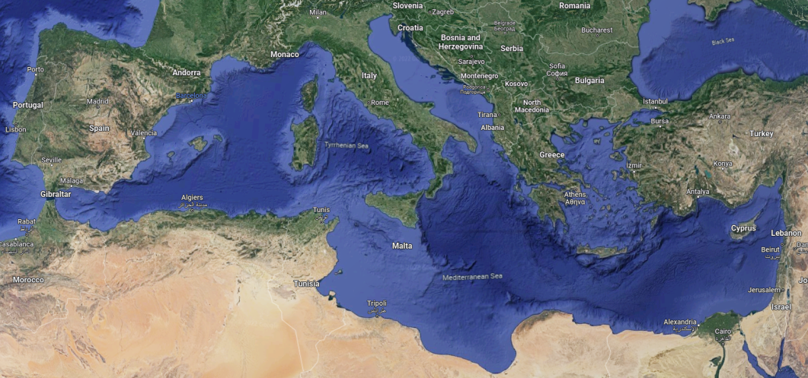
NEAMWave23 possible Scenarios
Three TSPs (NOA, INGV & KOERI) are willing to have a joint scenario in the Mediterranean Sea as a 3TSP joint scenario for the first time (CoastWAVE project partners: Cyprus, Greece, Egypt Malta).
Istanbul
Chipiona
Samos
El Jadida
Larnaka
Malta
Two TSPs (CENALT & IPMA) intend to make a joint scenario in NE Atlantic (CoastWAVE project partners: Spain & Morocco).
Alexandria

Slide 9
Recommendations
● Share a concept paper to the CoastWAVE partners.
● Share Part I of the Exercise manual, with all the general information about the NEAMWave, which is not expected to change. DONE
● Give options for participating in the exercise:
Have a functional/full-scale exercise, on the day of NW23, with the scenario provided.
Have a functional/full-scale exercise, on a different date, with the scenario provided for NW23 (like TLM2 in Malta).
Have a orientation seminar/table-top exercise, on the day of NW23, with the scenario provided (it is common to have a OSX/TTX before a FSX).
● Exercise date, close, but NOT on the 5th of November (Sunday) or later…

Slide 10
TIMELINE OF
NEAMWave23
Prepara-tion of scenarios; discus-sions with TSPs
Submis-sion of scenarios by TSPs
Submission of NEAMWave23 subscribers; sharing the exercise actors’ lists with TSPs
Prepara-tion of exercise manual
Final prepara-tios by TT-TE & the IOC Secreta-riat
Distribu-tion of exercise manual; meeting with CPAs through ERCC
30-31 Oct.
or
6-7 Nov.
March
April
May
June
Sept.
Oct.

Slide 11
Best Practices
NEAMWave Best Practices:
1. Use online tools for the subscription and evaluation of the exercise.
2. Make only the essential changes to the exercise manual (e.g. scenarios and specific objectives), in order to sustain a general knowledge about the exercise.
3. Balance between the minimum number of scenarios and the maximum potential participating MS.
4. Use joint scenarios to strengthen the cooperation among the TSPs.
5. Organize targeted workshops for different types of participants (e.g. TSPs, CPAs etc).
6. Tailor made national messages (language) and enhanced products (maps) to users.
7. Carry out exercise in a multi-hazard crisis context and within World Tsunami Awareness Day framework.

Slide 12
Thank you for your attention!
Steering Committee of the ICG/NEAMTWS
Teleconference, 12-13 April 2023

