Slide 1
16th session of the intergovernmental coordination group for the tsunami and other coastal hazards warning systems for the Caribbean and adjacent regions:
Task Team Tsunami ready programme
Prepared by
Mr. Fabian Hinds
Co-Chair, Task Team Tsunami Ready Programme
Coastal Planner, Coastal Zone Management Unit, Barbados

Slide 2
Task Team tsunami ready programme – Confirmed members (2021-2023)
Fabian Hinds, Co-chair, CZMU, Barbados
Matthieu Péroche, Co-chair, France
Brian Dyer, St Kitts & Nevis
Christa von Hillebrandt-Andrade, ITIC-CAR
Danielle Howell, CZMU, Barbados
Kerry Hinds, Department of Emergency Management, Barbados
Dr. Leo Brewster, CZMU, Barbados
Marie-Noëlle Raveau, France
Stacey Edwards, SRC, UWI
Celine Tiffay, ex officio, Tsunami Unit, IOC UNESCO
Alison Brome, ex officio, CTIC
Bernardo Aliaga, ex officio, CARIBE EWS Technical Secretary

Slide 3
Process of Reestablishing the Task team
Establishing communication between co-chairs via email in 2021.
Networking began with CTIC and UNESCO/IOC via email and virtual meetings.
Supporting documents were reviewed.
Learning process!
Identifying and contacting past Task Team Tsunami Ready members via email.
Seeking confirmation of Task Team membership – (i.e., previous and new members)
Defining the role of the Task Team

Slide 4
Participation in Meetings of the ICG/CARIBE EWS Regional Tsunami
Recognition Programme Board
Co-chairs participation - observer status only
The British Virgin Islands (BVI) Tsunami Ready Renewal, Online, November 02, 2021
St. Kitts and Nevis (SKN) Tsunami Ready Renewal, Online, February 04, 2022
Provided the co-chairs with insight into the process of :
  Reviewing the progress of the BVI and SKN in maintaining the Tsunami Ready Guidelines over the 2018 - 2021 period
  Determining the eligibility of the BVI and SKN for renewal under the Tsunami Ready Programme

Slide 5
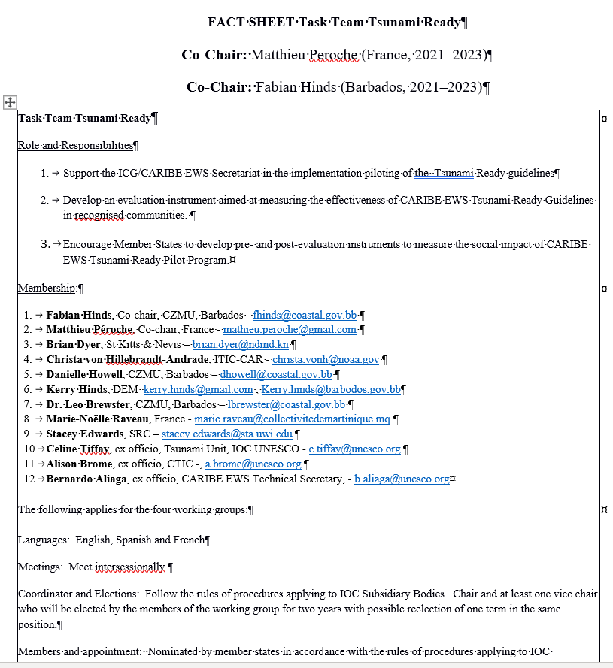
FACT SHEET Task Team Tsunami Ready:
Other matters
Task Team renewal also involved the preparation/updating of a Fact Sheet for Task Team Tsunami Ready

Slide 6
Task Team Role and responsibilities
Support and provide guidance to the CARIBE EWS in the implementation of the UNESCO IOC Tsunami Ready Recognition Programme.
Develop an evaluation instrument aimed at measuring the effectiveness of UNESCO IOC Tsunami Ready Recognition Programme in recognized communities.
The Task Team will implement the evaluation instrument and analyze its findings in collaboration with ITIC-CAR and CTIC.
Facilitate Member States to conduct pre- and post-evaluation instruments to measure the social impact of UNESCO IOC Tsunami Ready Recognition Programme.
Assist CTIC, in association with member states, in determining the target number of communities pursuing the Tsunami Ready Recognition.

Slide 7
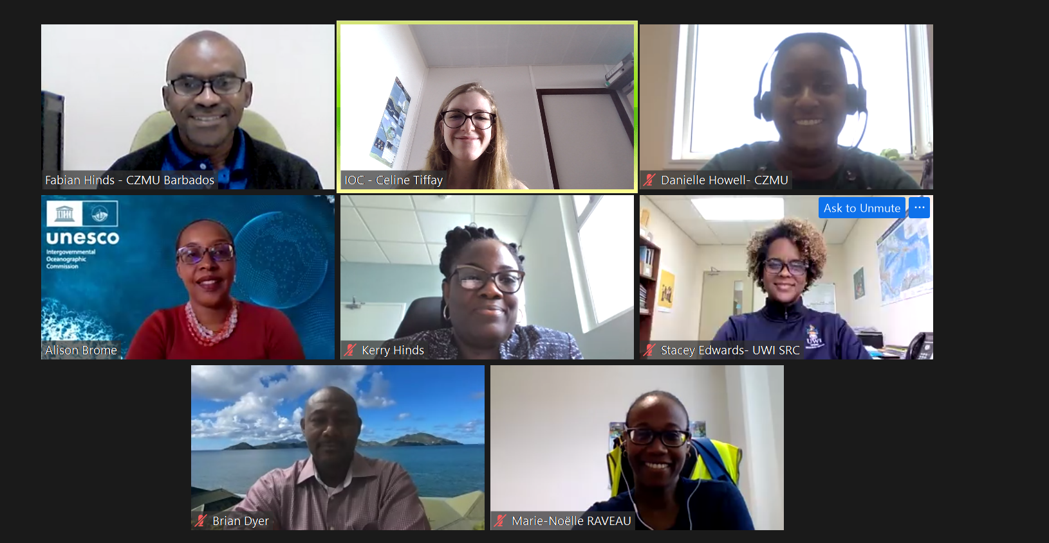
Some of the Task Team Tsunami Members:
May 18, 2022 meeting

Slide 8
First meeting of the Task Team members
First meeting occurred on May 18, 2022 via the ZOOM platform.
Selection of Secretary for the meeting (Ms. Celine Tiffay)
Opportunity for the participating team members to introduce themselves to each other
Discussion on the draft Terms of Reference for Task Team Tsunami Ready
  A ToR was not previously prepared specifically for the Task Team
  A ToR would serve to provide clarity regarding the composition and responsibilities of the Task Team
  A ToR should serve future Task Team Tsunami Ready members
  The draft ToR will be up for approval at the 16th Session of the Intergovernmental Coordination Group for the Tsunami and Other Coastal Hazards Warning Systems for the Caribbean and Adjacent Regions, scheduled for April 24-28, 2023, in Costa Rica.

Slide 9
First meeting of the Task Team members
Discussion and forward planning regarding the draft questionnaire on the implementation of the UNESCO IOC Tsunami Ready Program
The Task Team agreed to review and make any necessary comments and edits to the draft questionnaire via the Google Docs platform by Friday May 27, 2022
The draft questionnaire will be up for approval at the 16th Session of the Intergovernmental Coordination Group for the Tsunami and Other Coastal Hazards Warning Systems for the Caribbean and Adjacent Regions, scheduled for April 24-28, 2023, in Costa Rica.

Slide 10
second meeting of the Task Team members
Second meeting occurred on July 07, 2022 via the ZOOM platform.
Draft ToR was finalized. Ready for submission at the appropriate time. The Task Team collectively contributed to the document via Google Docs.
Draft questionnaire/evaluation instrument was finalized. Ready for submission at the appropriate time. The Task Team collectively contributed to the document via Google Docs.

Slide 11
Terms of Reference
Role and Responsibilities
The Task Team will:
Support and provide guidance to the CARIBE EWS in the implementation of the UNESCO IOC Tsunami Ready Recognition Programme.
Develop an evaluation instrument aimed at measuring the effectiveness of UNESCO IOC Tsunami Ready Recognition Programme in recognized communities.
The Task Team will implement the evaluation instrument and analyze its findings in collaboration with ITIC-CAR and CTIC.
Facilitate Member States to conduct pre- and post-evaluation instruments to measure the social impact of UNESCO IOC Tsunami Ready Recognition Programme.
Assist CTIC, in association with member states, in determining the target number of communities pursuing the Tsunami Ready Recognition.

Slide 12
Terms of reference
Meetings
Task Team members will meet virtually as often as is required for the purposes of executing its mandate. A quorum will be achieved when the number of members present are equivalent to 50% or greater of the membership.
Chairmanship
Chairmanship of the Task Team shall be shared between the co-chairs, or by one of the co-chairs where the other is unavailable. The co-chairs will be responsible for:
The conduct of the meetings
Ensuring that an accurate record of the discussions and decisions of each meeting is prepared and forwarded to all members
Ensuring that there is adequate follow-up on the undertakings of the Task Team

Slide 13
Terms of reference
Secretary
A member of the Task Team will be elected/volunteer to serve as secretary of the team.
Communication
Minutes of the official meetings of the Task Team shall be prepared by the Secretary and shall be forwarded to all members not later than two (2) weeks after the conclusion of each meeting.
Duration
The membership of the Task Team Tsunami Ready Programme shall be convened for a period of two (2) years, renewable once. At each ICG the leadership and membership of the Task Team will be reviewed.

Slide 14
The way forward
The Task Team has served for the intersession period 2021 – 2023.
Therefore, renewal of the Task Team membership is now pending.
Work plan of the Task Team as outlined in the Terms of Reference to be evaluated and implemented under the renewed Task Team for the next intersessional period.

Slide 15
The way forward
Subject to the approval of the draft ToR and the Draft evaluation instrument/questionnaire, the work plan for the renewed Task Team should involve the following:
  • Support and provide guidance to the CARIBE EWS in the implementation of the UNESCO IOC Tsunami Ready Recognition Programme.
  • The Task Team will implement the approved evaluation instrument and analyze its findings in collaboration with ITIC-CAR and CTIC.
  • Facilitate Member States to conduct pre- and post-evaluation instruments to measure the social impact of UNESCO IOC Tsunami Ready Recognition Programme.
  • Assist CTIC, in association with member states, in determining the target number of communities pursuing the Tsunami Ready Recognition

Slide 16
Thank You
Any Questions?

