Slide 1

National Report
Costa Rica
ICG/CARIBE-EWS
Silvia Chacón Barrantes
SINAMOT

Slide 2
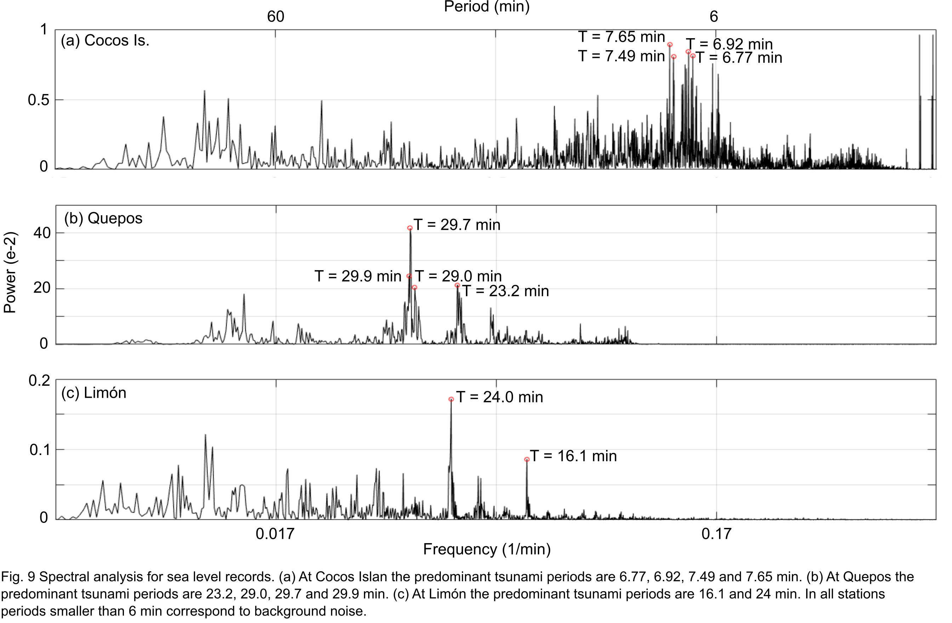
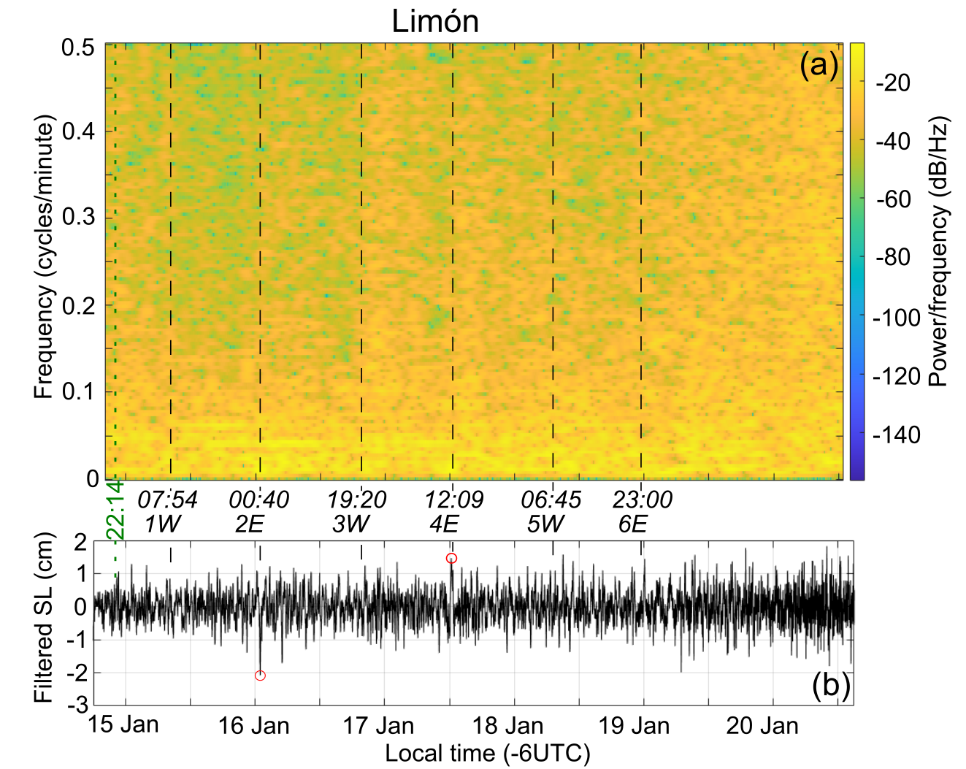
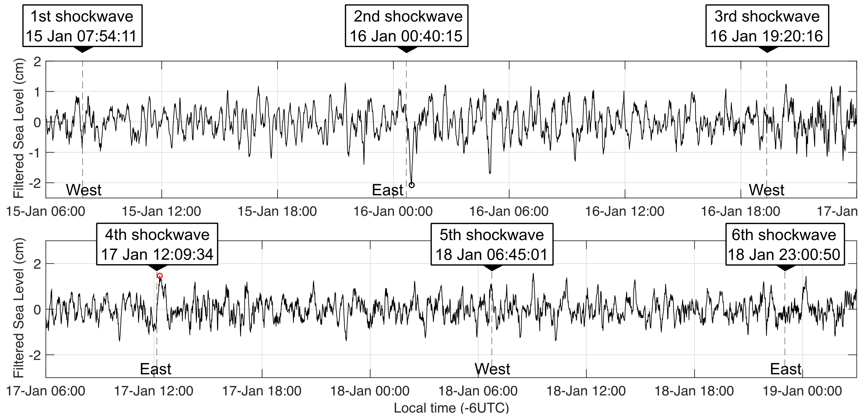
Events
Our tide gauge in Limón registered the HTHH tsunami
First tsunami registered in that gauge (est. 1940)

Slide 3
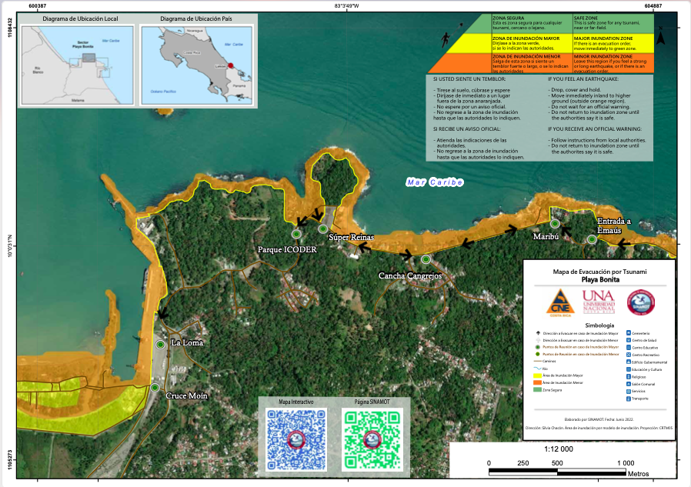
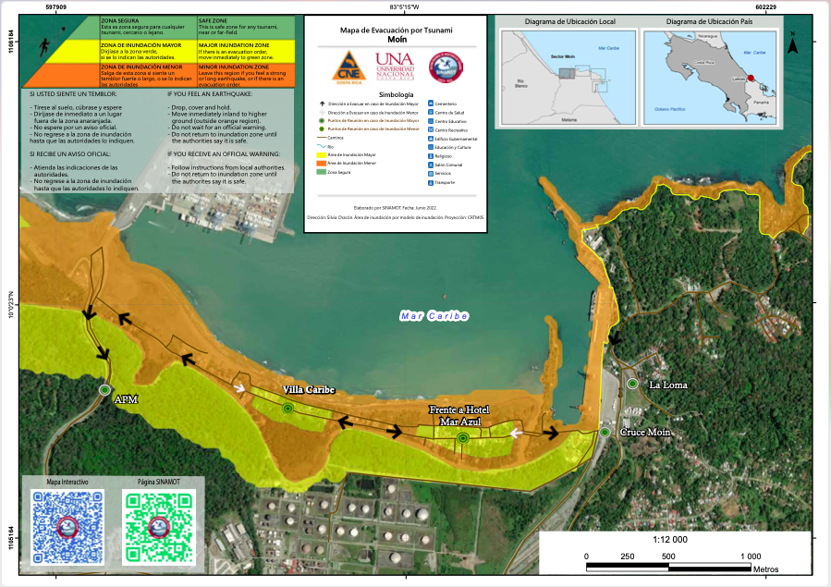
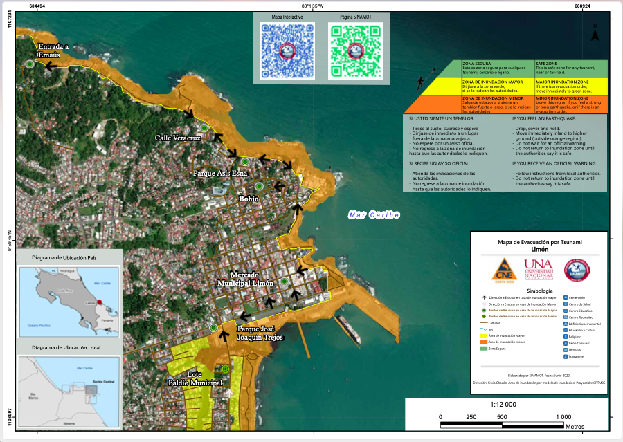
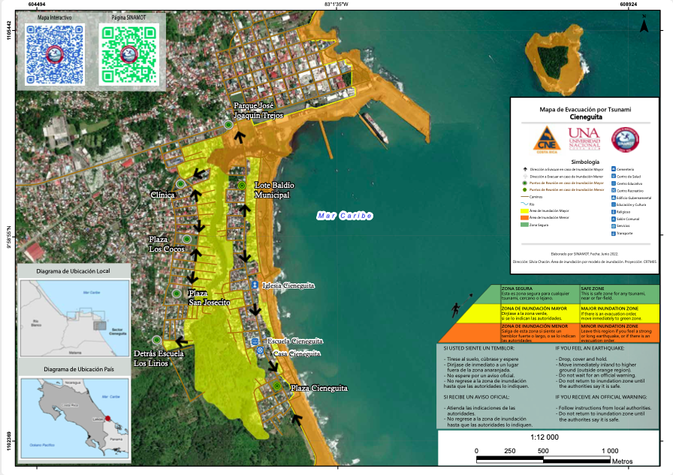
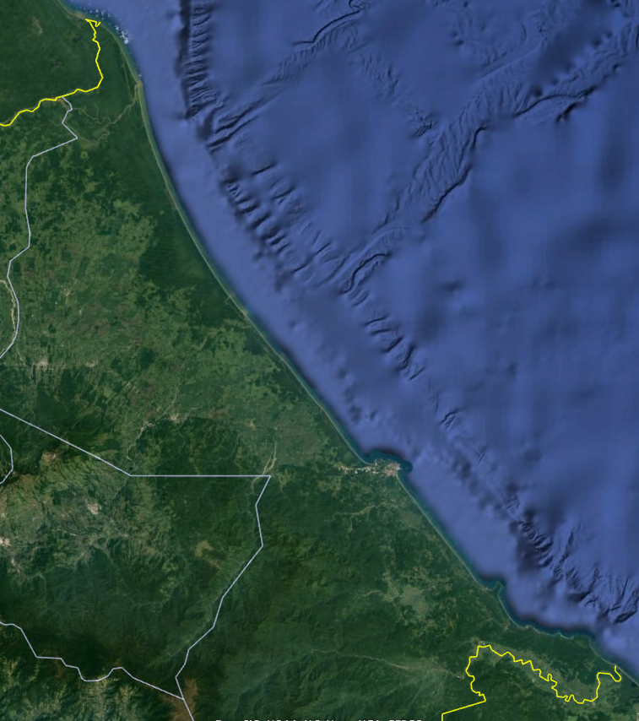
Barra del Colorado
Tortuguero
Tsunami Evacuation Maps

Slide 4
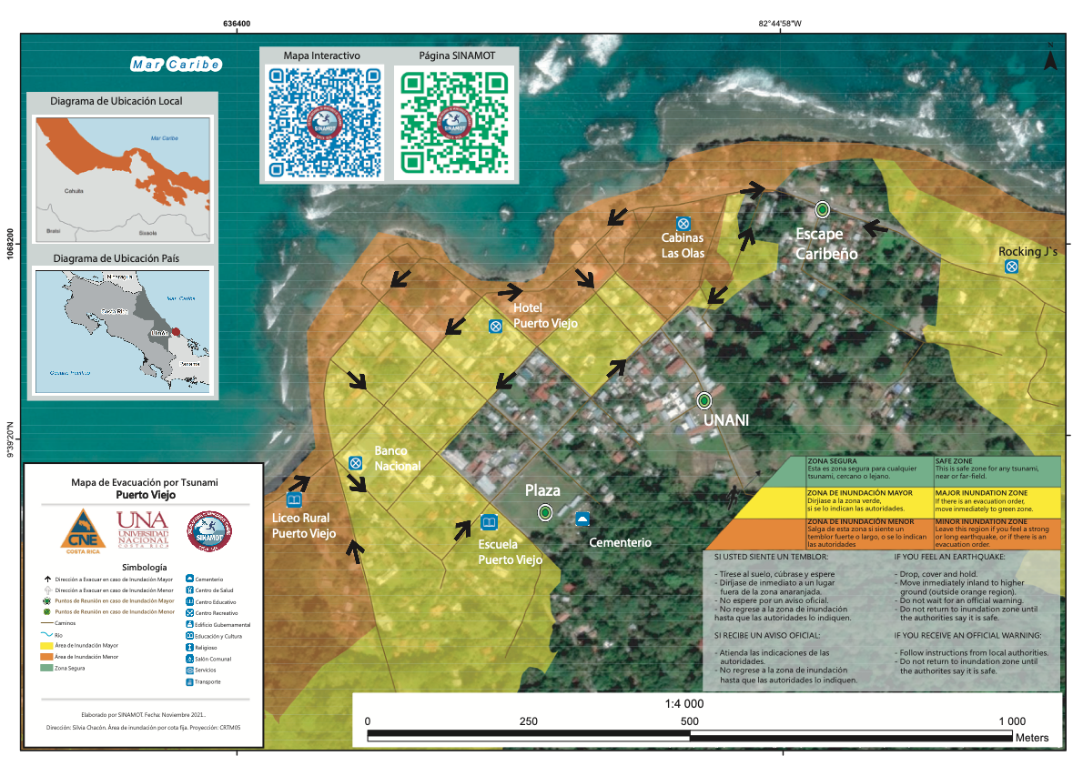
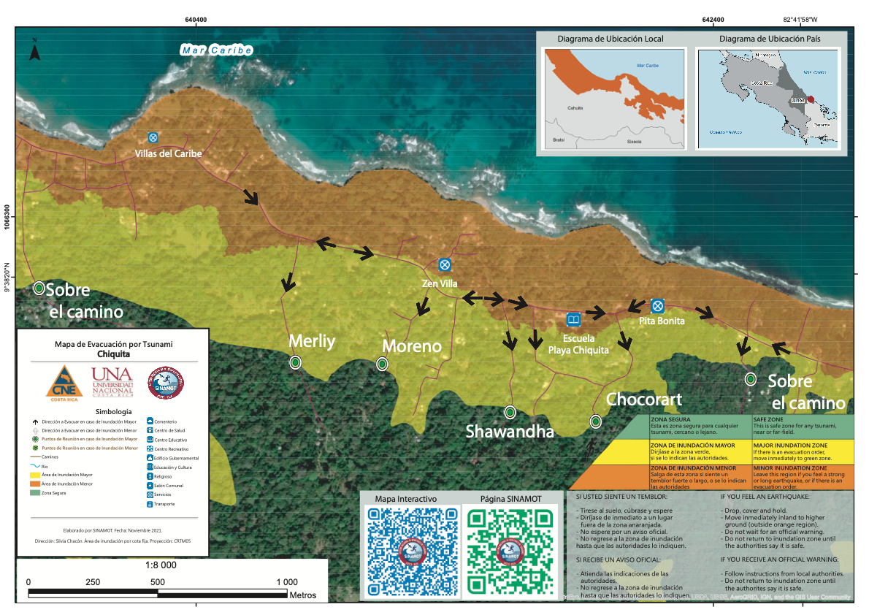
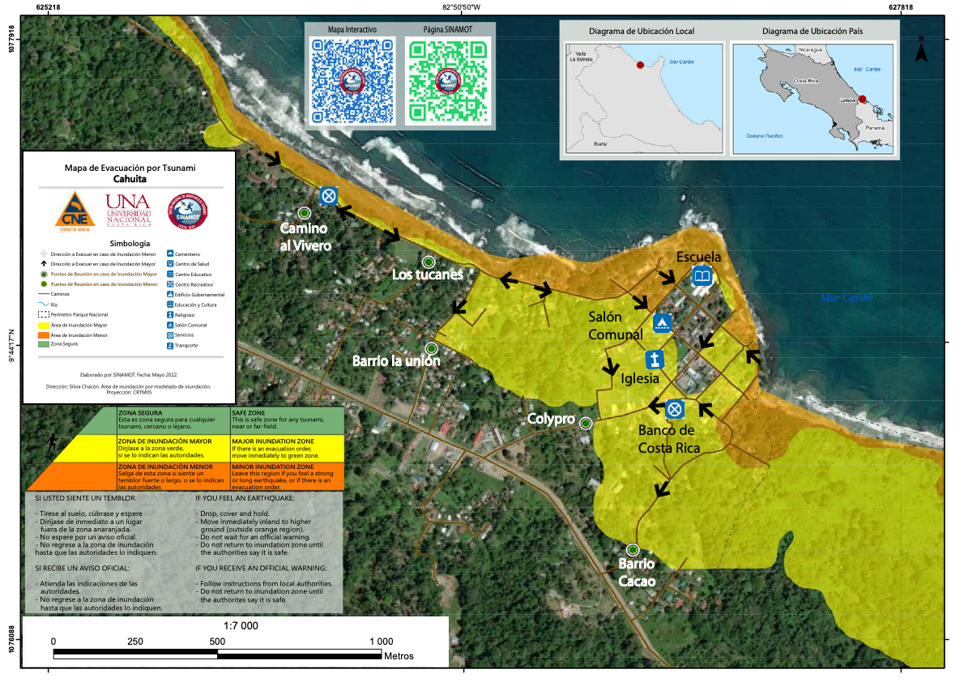
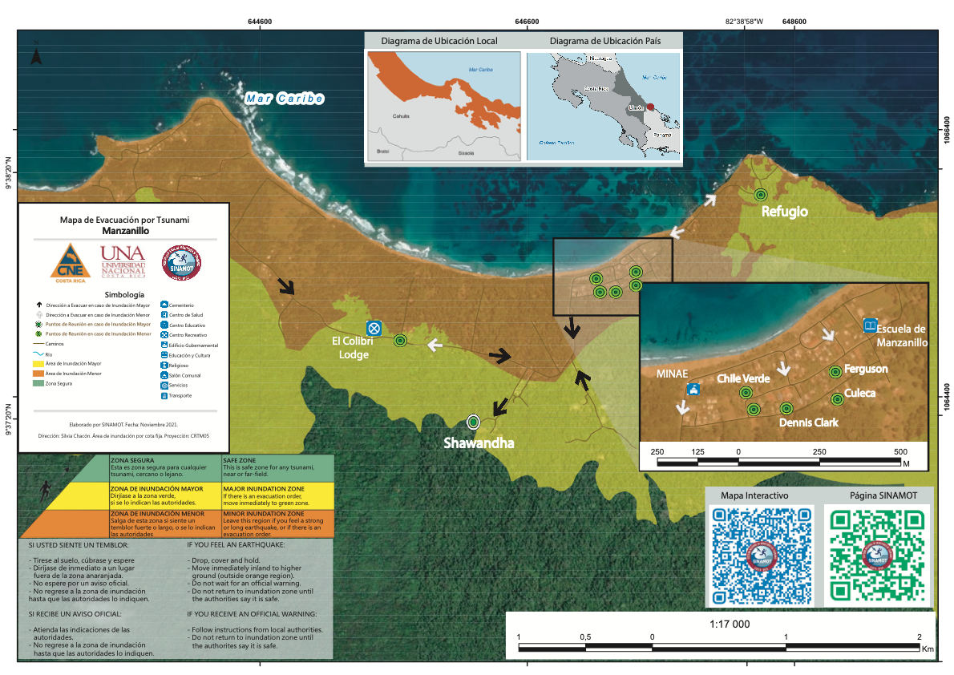
Tsunami Evacuation Maps
Barra del Colorado
Tortuguero

Slide 5
National Parks Project
3 National Parks in the Caribbean coast:
  Tortuguero
  Cahuita
  Gandoca-Manzanillo
Outcomes:
  Tsunami evacuation map
  Tsunami preparedness plan
  Climate action plan
  Tsunami exercise
  Possibly Tsunami Ready

Slide 6
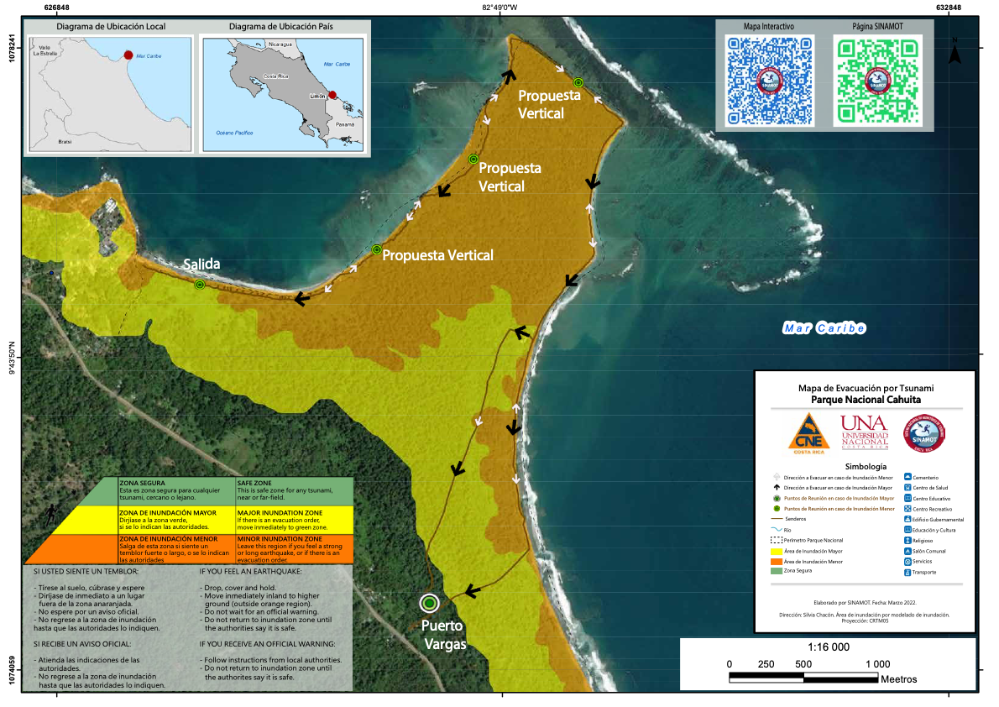
Cahuita National Park
Emblematic Caribbean National Park
Highly visited
From Cahuita point to the National Park entrance: 3 hr walk
Arrival times very short
Mangroves and estuaries: no Highland
Vertical evacuation is needed
Funds needed to build shelters
Community had tsunami evacuation drill
for Caribe Wave 2023

Slide 7
Gandoca-Manzanillo National Park: Manzanillo
Inundation area estimated by fixed height is too large
Bathymetric survey needed to refine
Community and National Park very motivated
Had tsunami evacuation drill for Caribe Wave 2022

Slide 8
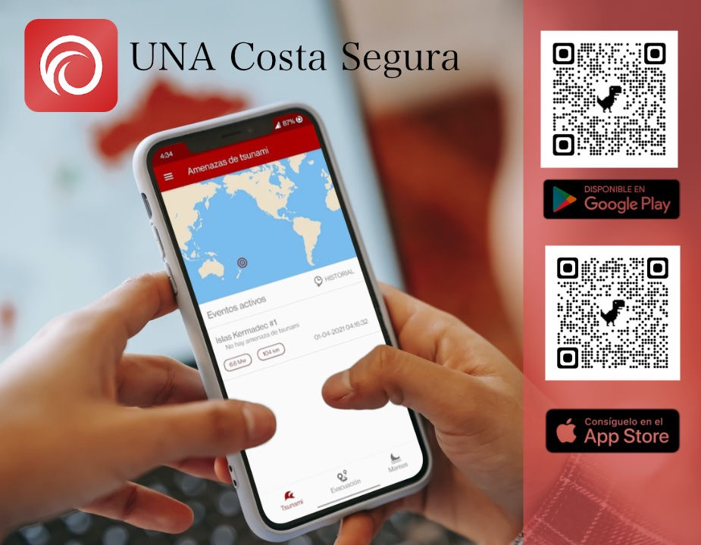
UNA Costa Segura App
Notifications of tsunami threat
Guides through tsunami evacuation routes
Tide prediction

