Slide 1






CARIBE WAVE 2023
Summary Meeting
Dr. Elizabeth Vanacore
Seismologist, Puerto Rico Seismic Network
ICG CARIBE EWS CARIBE WAVE TT Chair
Christa G. von Hillebrandt-Andrade
Manager, ITIC Caribbean Office
ICG CARIBE EWS WG IV Chair
Stephanie Soto and Jelis Sostre
Geologists
ITIC Caribbean Office
April 2023

Slide 2
Objectives
Summary of CARIBE WAVE 23
Evaluation form results

Slide 3
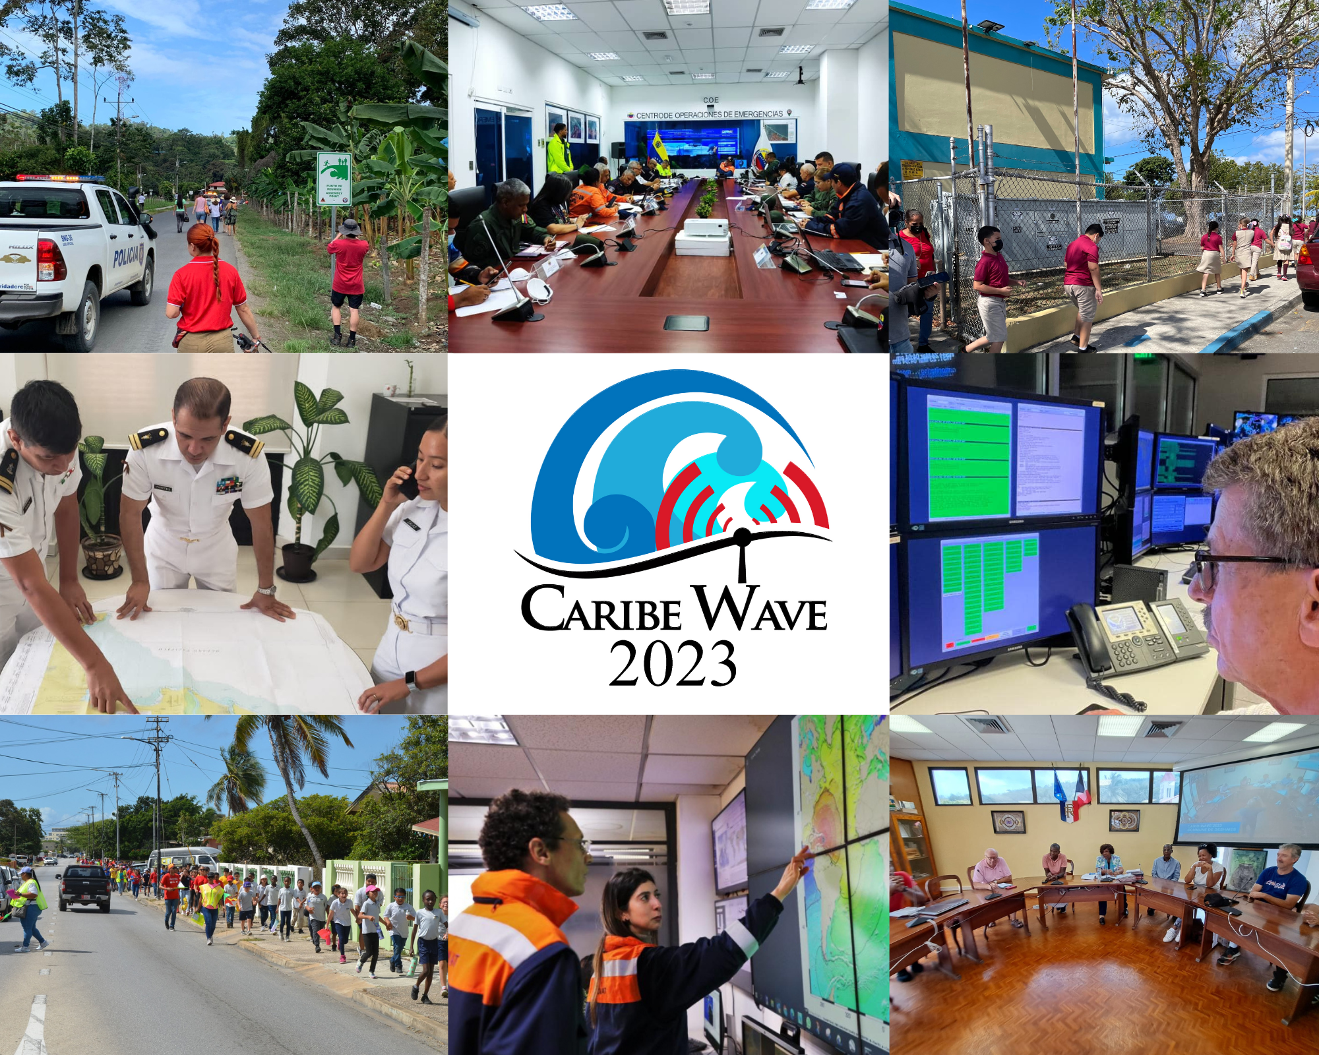
CARIBE WAVE 2023
CARIBE WAVE 23 was held on 23 March 2023. Member States and Territories chose from the two scenarios (Gulf of Honduras and Mount Pelée) and decided if any additional activity would be carried out.
In the Caribbean and Adjacent Regions, 43 Member States and Territories participated with a total of over 430,000 people engaged.
The participation of MS represents a rate of 90% (down from 100% in 2022). Several institutions indicated that is was problem that it was held the same day as World Meteorology Day
b
a
#CARIBEWAVE #TSUNAMIREADY

Slide 4
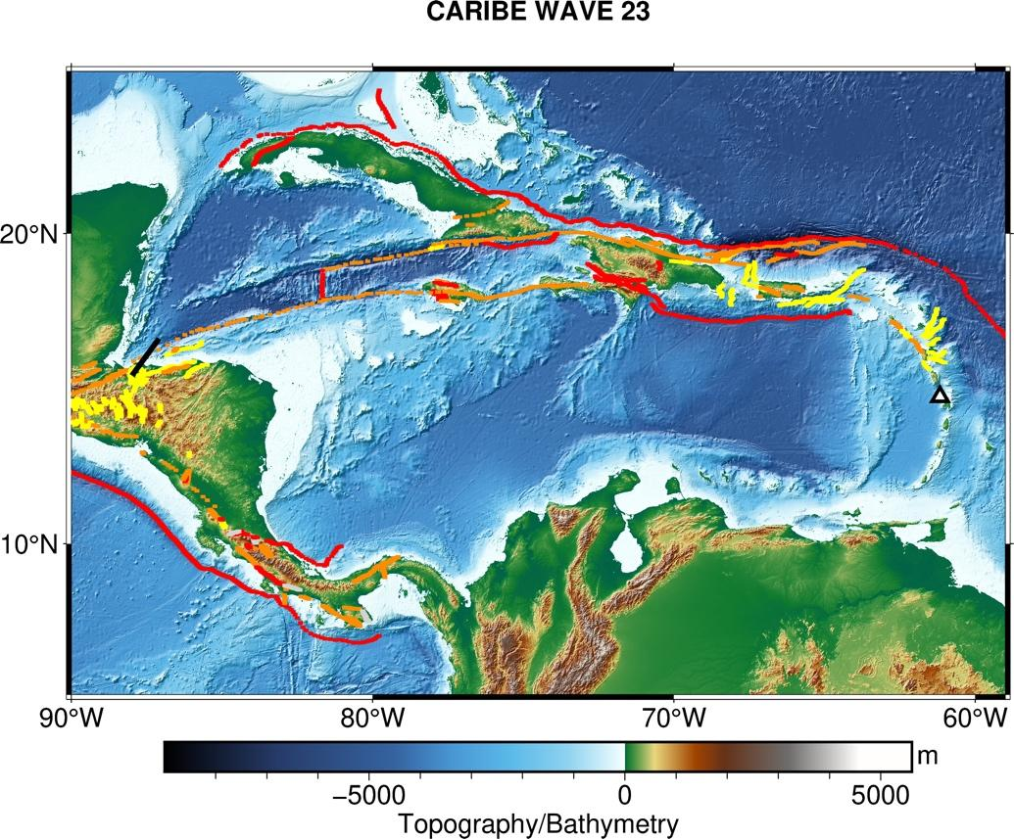
CARIBE WAVE 23 Earthquake and Tsunami Scenarios
Gulf of Honduras
Mount Pelée
Scenario | Origin Time | Mw | Epicenter
Gulf of Honduras | 14:00:00 UTC 23 March 2023 | 7.6 | 16.07⁰N, 87.54⁰W
Mount Pelée |  |  | 14.48⁰N, 61.10⁰W

Slide 5
Timeline
ACTION | TIMELINE
Circular Letter Issued by IOC to MS | ✓ November 2022 (late)
Handbook Draft Circulated among ICG CARIBE EWS, TWFP/NTWC contacts and TT CARIBE WAVE 23 | ✓ December 2022 (late)
Deadline for Comments | ✓ December 2022(late)
Exercise Handbook Available Online | ✓ January 2023 (late)
1st Webinar CW (Overview, PTWC Products) | ✓ 24 January 2023 – English ✓ 25 January 2023 – Spanish ✓ 26 January 2023 – French
2nd Webinar CW (Update, Communication Methods, Registration, Questionnaire, Uploading Pictures/Videos ) | ✓ 21 February 2023 - English ✓ 22 February 2023 – Spanish ✓ 23 February 2023 – French
Countries Indicate Selected Scenario | ✓ 10 March 2023
Exercise | ✓ 23 March 2023
Hot-Wash | ✓ 4 April 2023
Exercise Evaluation Due | ✓ 13 April 2023
Final Draft Caribe Wave 23 Report 24 April 2023

Slide 6
Goals / Metrics
Goals | 2016 Results | 2017 Results | 2018 Results | 2019 Results | 2020 Results | 2021 Results | 2022 Results | 2023 Metrics | 2023 Results
TWFP receive the dummy message | 84% | 95% | 100% | 89% | 97% | 97% | 91% | 100% | 97%
Participation of Member States of ICG/CARIBE-EWS with designated focal warning point | 100% | 100% | 97% | 100% | 92% | 98% | 100% | 100% | 61%
Community involvement (including agencies beyond TWFP) | 73% | 82% | 77% | 66% | 38% | 56% | 43% | 95% | 44%
Number of participants* | 332,812 | 679,985 | 643,403 | 793,353 | 4,622 | 333,518 | 413,281 | +10% | 432,244
Countries who participate submit exercise questionnaire | 100% | 100% | 91% | 82% | 92% | 95% | 100% | 100% | 90%
Members State and territories are satisfied with exercise |  |  |  | 82% | 76% | 96% | 88% | 100% | 97%

Slide 7
Participation
*Number taken from TsunamiZone.org for cases where countries did not report number of participants in the survey.
Country | Participants according to Member States | Participants according to Tsunami Zone
Antigua and Barbuda | 6,020* | 6,020
Aruba | 3,700 | 2,897
Bahamas | 0* | 0
Barbados | 200 | 344
Belize | 2* | 2
Brazil | 15 | 14
Colombia | 97 | 253
Costa Rica | 70 | 54
Cuba | 150 | 0
Curacao | 165* | 165
Dominica | 300 | 4
Dominican Republic | 350 | 165
France (Martinique, Guadeloupe, Guyane, St. Barthelemy, St. Martin) | 175,209* | 175,209
Grenada | 10,769* | 10,769
Guatemala | 25 | 30
Guyana | 6 | 10
Haiti | 150 | 454
Honduras | 0* | 0
Jamaica | 341* | 341
Country |  | Participants according to Member States | Participants according to Tsunami Zone
Mexico |  | 14,500 | 823
Netherlands (Bonaire, Saba, Sint Eustatius) |  | 34 | 34
Nicaragua |  | 90 | 20
Panama |  | 3,000 | 9,354
Saint Kitts and Nevis |  | 2,500 | 2,300
Saint Lucia |  | 300 | 254
Sint Maarten |  | 1 | 75
Saint Vincent and the Grenadines |  | 200 | 101
Trinidad and Tobago |  | 500 | 480
United Kingdom | Anguilla | 500* | 500
 | Bermuda | 233 | 233
 | British Virgin Islands | 3,000 | 14
 | Cayman Islands | 7,225 | 7,329
 | Montserrat | 0* | 0
 | Turks and Caicos | 500* | 500
United States | Puerto Rico | 129,189 | 129,844
 | US Virgin Islands | 17,904 | 17,904
Venezuela |  | 54,999 | 54,999
TOTAL |  | 432,244 | 421,486

Slide 8
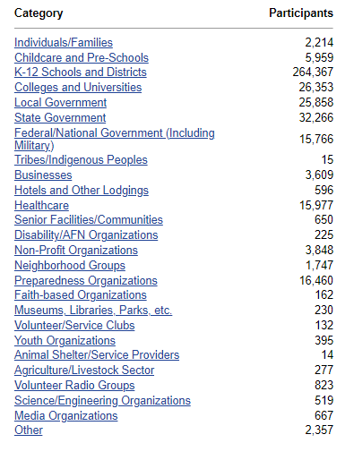
TsunamiZone Participation Categories

Slide 9
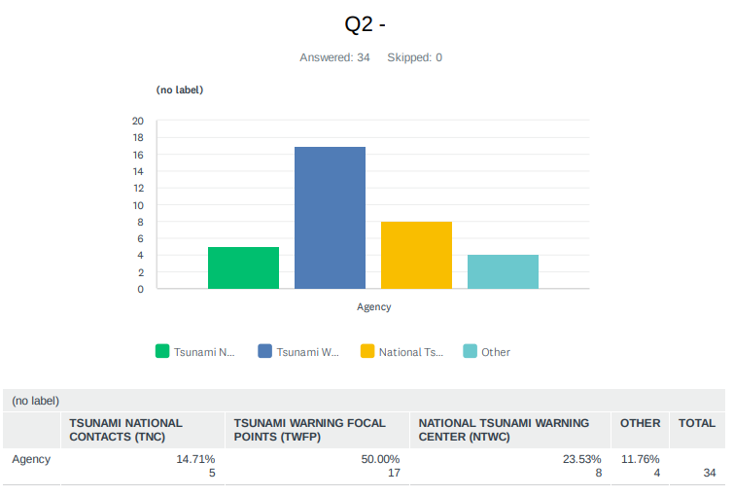
Evaluation Form
The questionnaire contained 45 questions for participating countries to provide feedback on the exercise.
Available from the day of the exercise, March 23 through April 14.
Responses from 90% of MS and territories. A total of 33 surveys were completed from the forty-three of the forty-eight Member States and Territories.

Slide 10
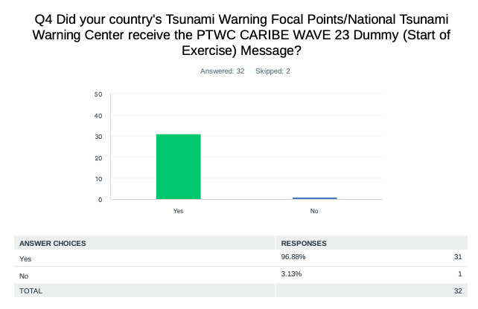
Evaluation Form – Dummy Message
The PTWC issued the “dummy” (start of exercise) message on March 23, 2023, at 1400 UTC and disseminated over all its standard broadcast channels.

Slide 11
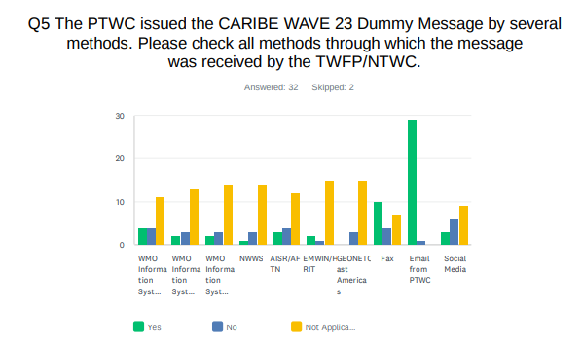
Evaluation Form – Dummy Message
As in past years, the most common methods to receive the Dummy message were the Email and Fax. WMO Information System (GTS) was also a method where several countries received the message.

Slide 12
Evaluation Form – Dummy Message
The time at which the PTWC message was received by the TWFP/NTWC in the different systems.
It is crucial to seek other communication systems to avoid messages delays.

Slide 13
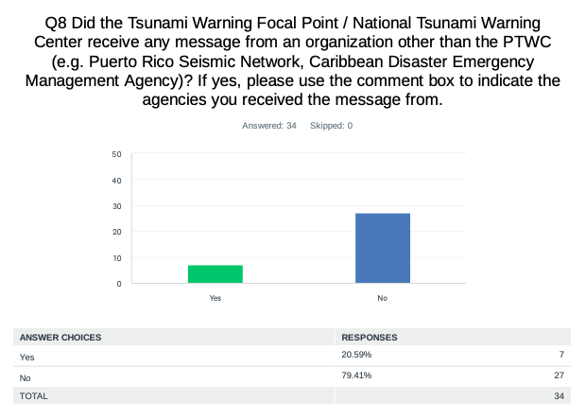
Evaluation Form - Dummy Message
Dominican Republic: Puerto Rico Seismic Network.
Guatemala & Nicaragua: From CATAC.
USA - US Virgin Islands: Puerto Rico Seismic Network - Emergency Management SMS.

Slide 14
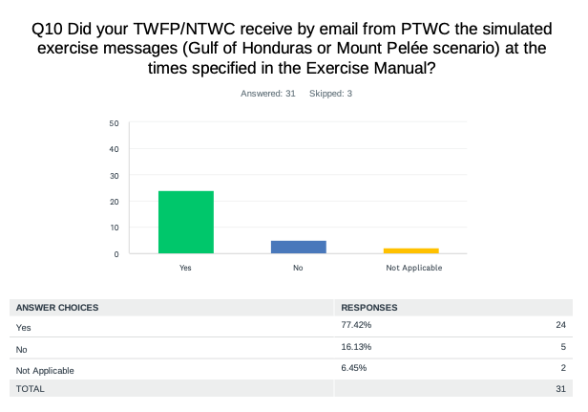
Evaluation Form - Threat Messages
Barbados: The first message which was expected at 1407 UTC was not received until 1416 UTC.
Nicaragua: CaribeWave23 Exercise - CARIBE-EWS Message 2 - Honduras Scenario- Graphical Forecast Products. This message was received twice, at 14:30 and 14:36 UTC.
Panama: Messages from the Gulf of Honduras scenario were received at the specified time.

Slide 15
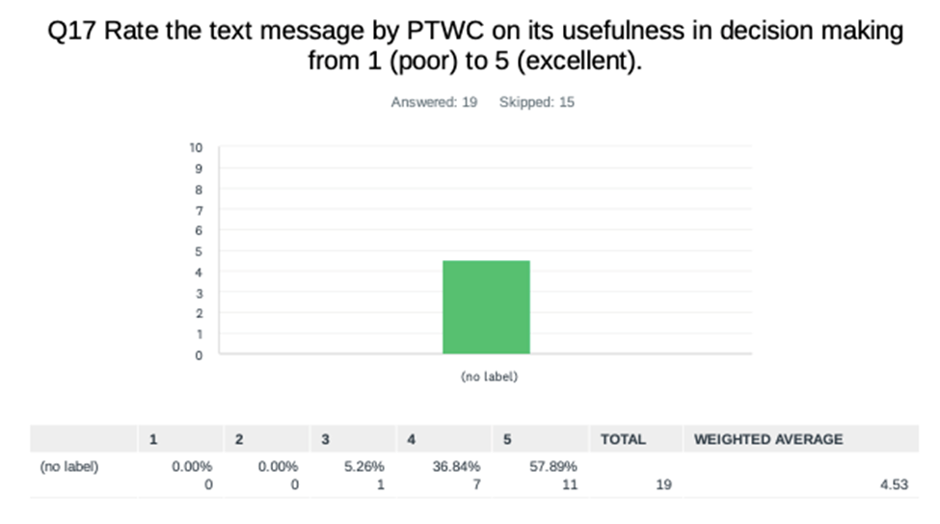
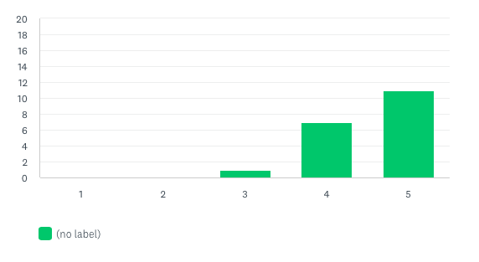
Evaluation Form – Rating of PTWC message

Slide 16
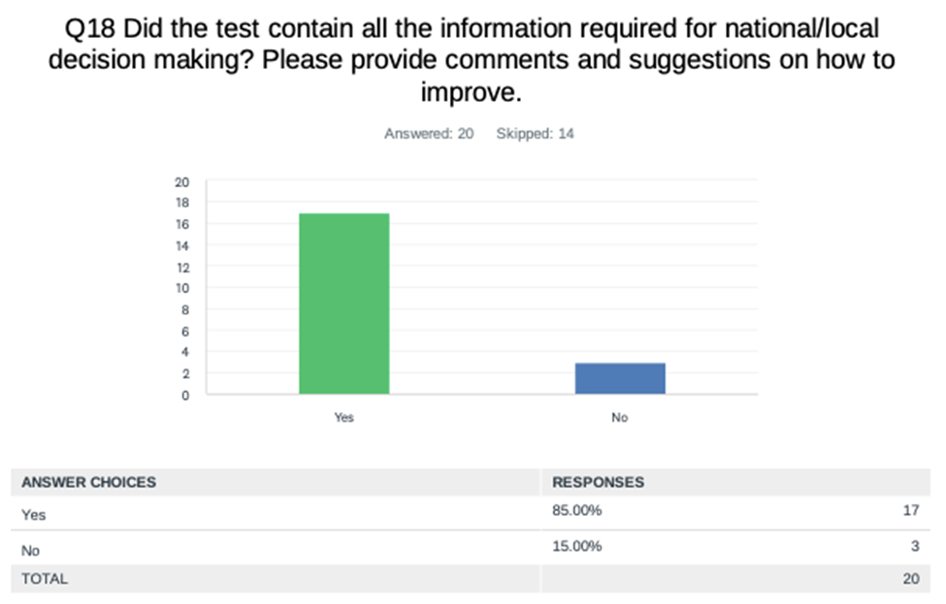

Slide 17
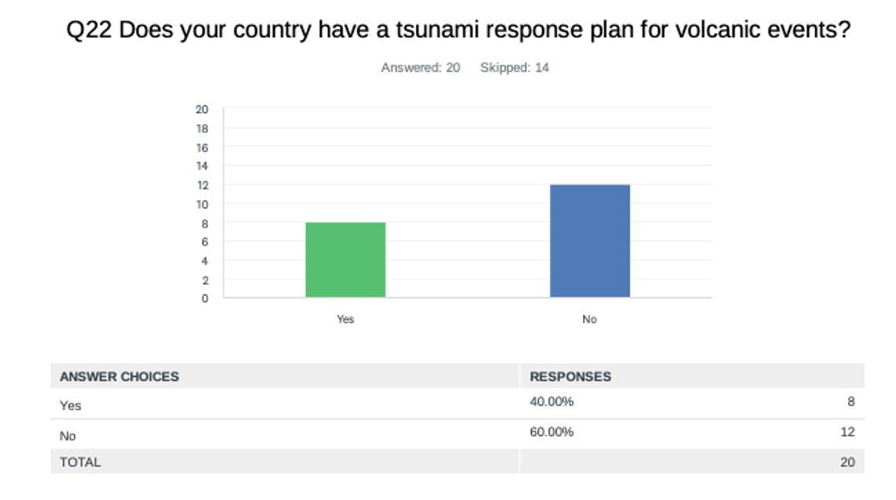
Evaluation Form – Tsunami Response Plan for Volcanic Events

Slide 18
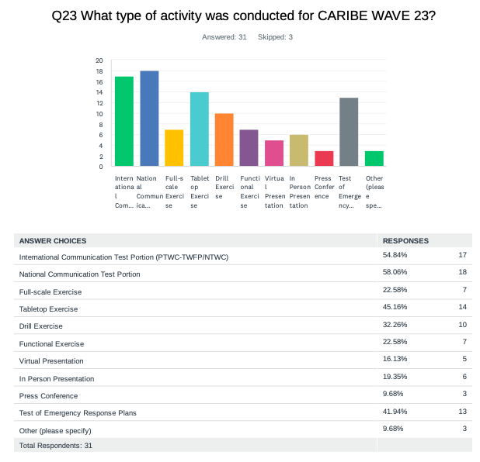
Evaluation Form – Type of Participation

Slide 19
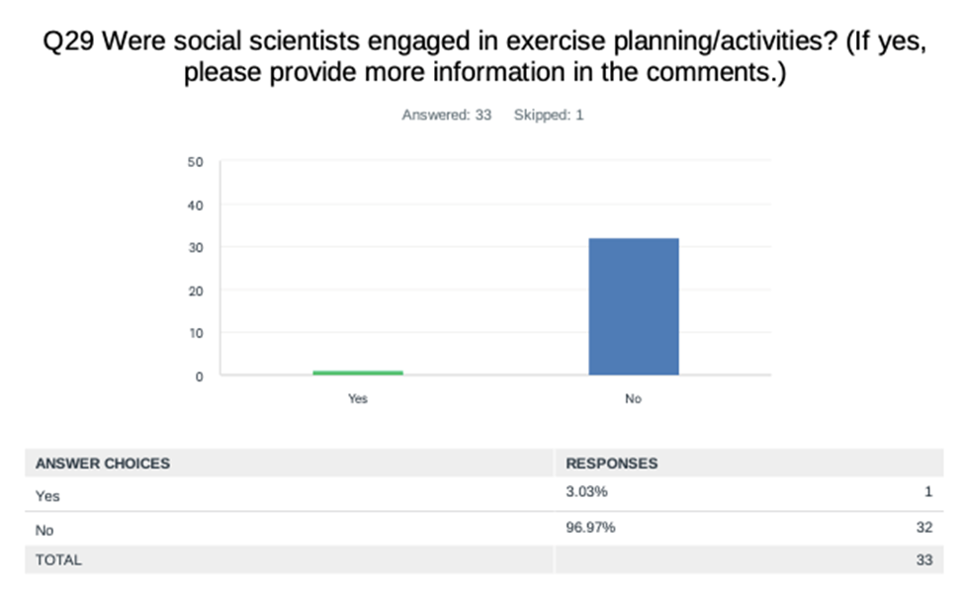
Evaluation Form – Social Scientists Engagement

Slide 20
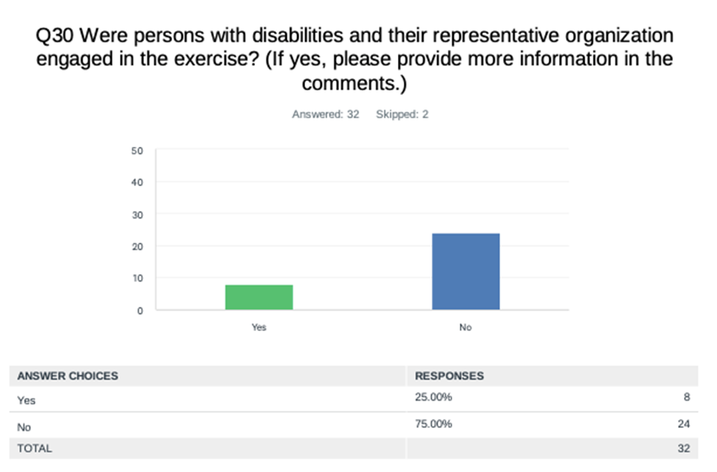
Evaluation Form – People with Disability

Slide 21
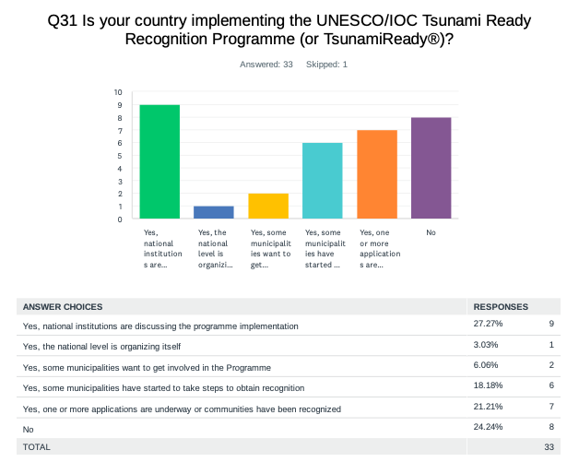
Evaluation Form – Tsunami Ready
According to Member States and Territories, there are about 66 communities recognized for TsunamiReady® or Tsunami Ready.

Slide 22
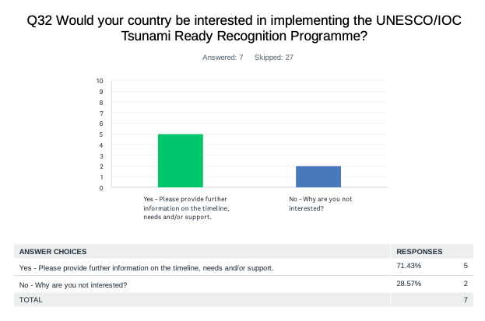
Evaluation Form – Tsunami Ready
The results indicated that 71% of the countries are interested in implementing Tsunami Ready, with 87 as total number of target communities to be recognized (this is a much lower number than previous years).
Countries Interested in Implementing TR
Aruba
Colombia
Cuba
Honduras
Sint Maarten

Slide 23
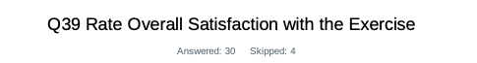
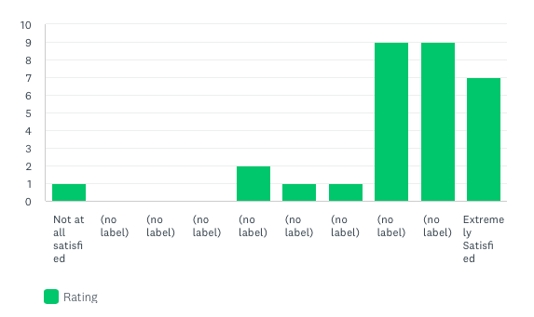
Evaluation Form – Exercise Satisfaction
Netherlands - Bonaire,Saba, Sint Eustatius: More needs to be done to raise awareness /preparedness.
USA - Puerto Rico: This exercise is an amazing opportunity to take under consideration different tsunami scenarios and how our response plans can deal with the challenges. Also provide the opportunity to conduct the PRSN Annual Tsunami Communication Exercise with all the emergency agencies in Puerto Rico and Virgin Islands.

Slide 24
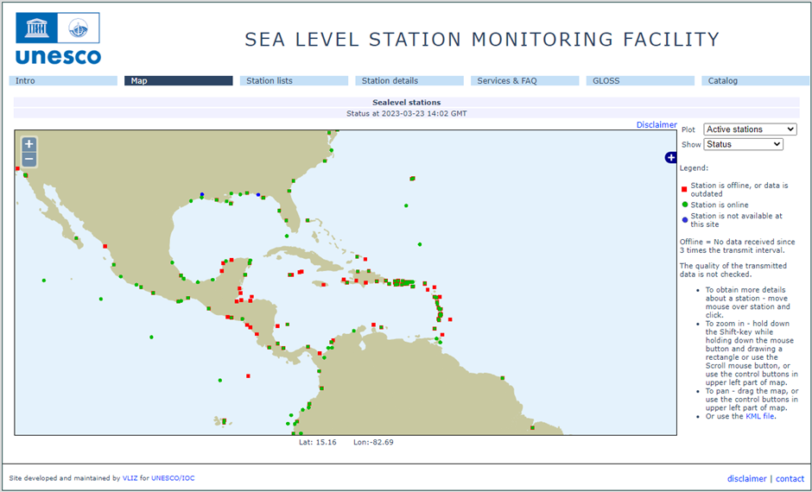
Status of Sea Level Stations during the exercise
Western Muertos Trough scenario
Northern Panama scenario
The PTWC provided simulated forecasted maximum wave heights for 65 CARIBE EWS stations in the simulated bulletins.
Only about 61% of these sea level stations were online on the IOC Sea Level facility during the exercise period.

Slide 25
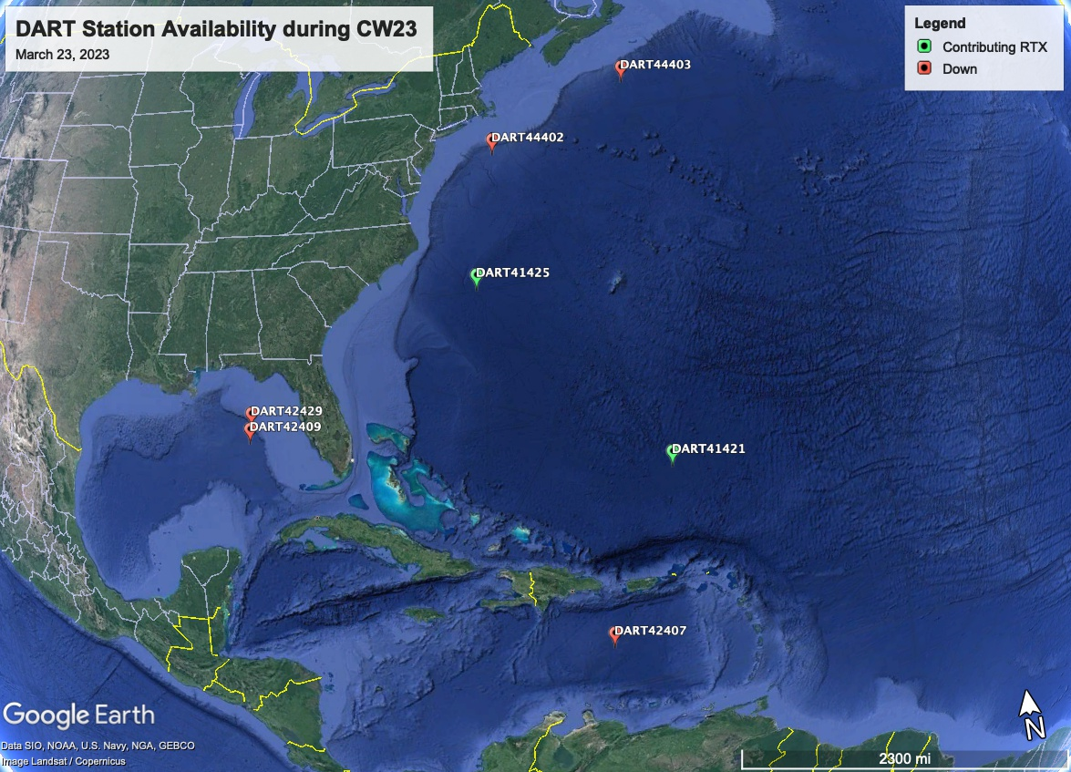
Status of DART’s
Only 2 of the 7 DART stations were streaming data in the Caribbean/Gulf and Atlantic thru the National Buoy Center during the day of the exercise.

Slide 26
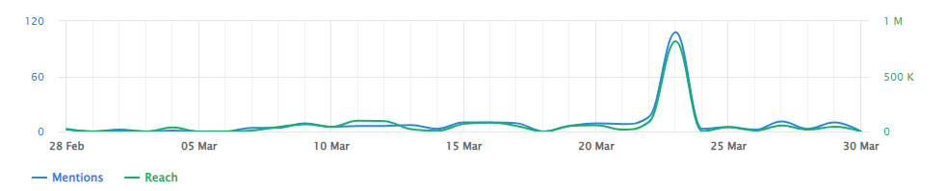
Media Arrangements
The hashtag tracker Brand24 was used to monitor #CaribeWave and #CaribeWave23 from February 28 to March 30.
Social media outlets posts reached over 1.8 million people worldwide.

Slide 27
CARIBE WAVE 23 Task Team
Person | Telephone # | Email
Elizabeth Vanacore, PRSN CARIBE WAVE Chair | 1-787-833-8433 | elizabeth.vanacore@upr.edu
Silvia Chacón-Barrantes CARIBE EWS Chair; SINAMOT Costa Rica | 506-830-96690 | silviach@una.ac.cr
Dan McNamara Chair WG 1 Monitoring and Detection Systems | 303-273-8550 | mcnamara@usgs.gov
Nicolas Arcos Chair WG 2 Hazard Assessment | 1-303-497-3158 | nicolas.arcos@noaa.gov
Emilio Talavera Chair WG 3 Tsunami Related Services | 505-224-92761 ext. 102 | emilio.talavera@gf.ineter.gob.ni
Christa von Hillebrandt-Andrade Chair WG 4 Preparedness, Readiness and Resilience Manager ITIC-CAR | 1-787-249-8307 | christa.vonh@noaa.gov
Silvia Chacón-Barrantes Scientific Experts – Gulf of Honduras Scenario | 506-830-96690 | silviach@una.ac.cr
Valerie Clouard Fabrice Fontaine Scientific Expert – Mount Pelée Scenario | +33 (0)5 61 33 29 07 | valerie.clouard@get.omp.eu frfont@ipgp.fr
Elizabeth Riley Director CDEMA | 246-425-0386 | Elizabeth.Riley@cdema.org
Claudia Herrera Melgar Executive Secretary CEPREDENAC | 502-2390-0200 | iajche@cepredenac.org memendez@cepredenac.org
Major Roselly Pepin Deputy Chief EMIZ Antilles | 596-59-05-81 | roselly.pepin@martinique.pref.gouv.fr
Bernardo Aliaga Technical Secretary UNESCO | 33-1-45683980 | b.aliaga@unesco.org
Charles McCreery Director PTWC | 1-808-689-8207 | charles.mccreery@noaa.gov
David Wald, USGS Scientific Expert – Earthquake Impact Products | 1-303-273-8441 | wald@usgs.gov
Alison Brome Programme Officer, CTIC | 246-243-7626 | a.brome@unesco.org
May consider including representative from Tsunami Zone and a Social Scientist

Slide 28
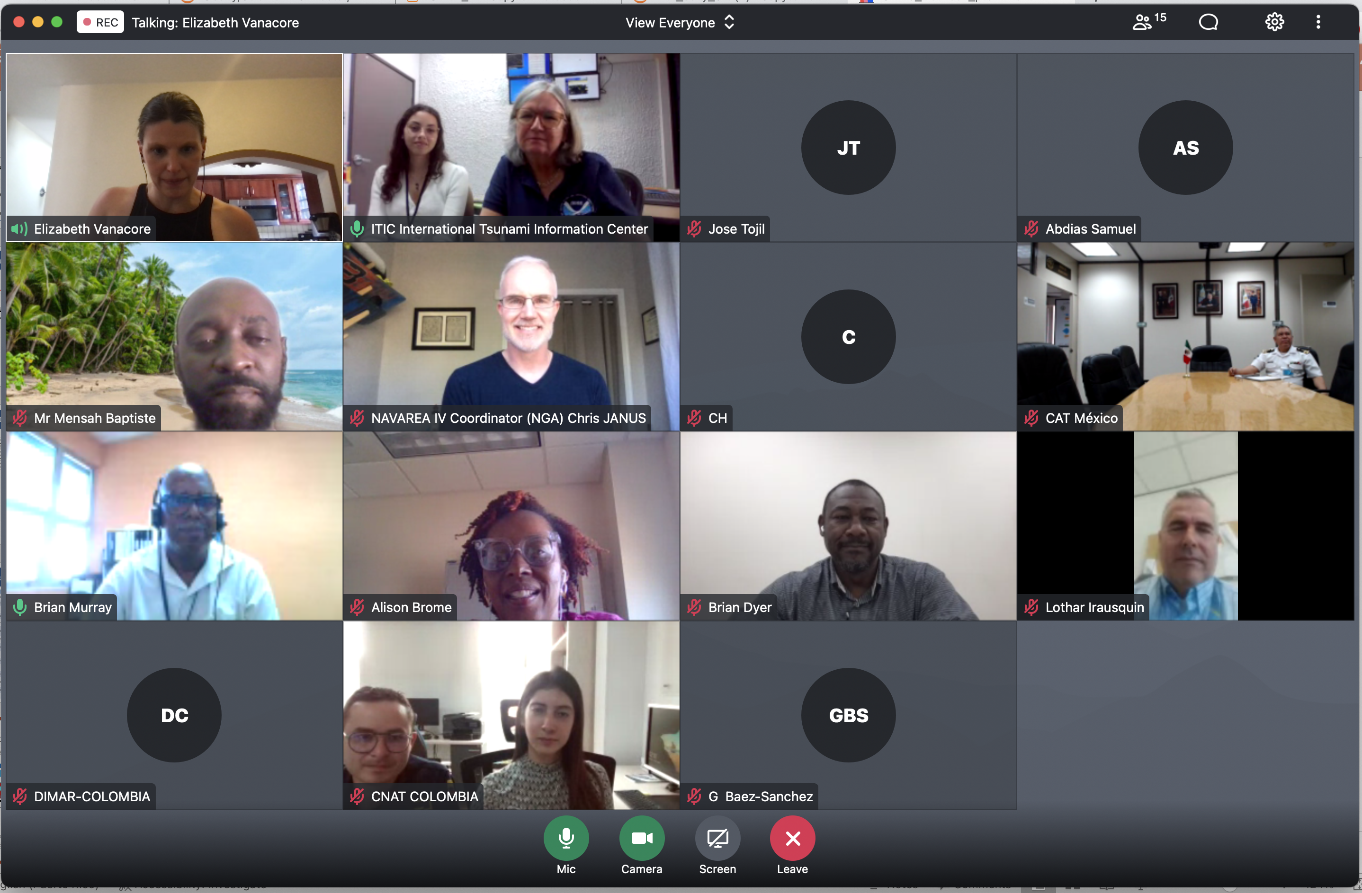
Hot-Wash
After the exercise, the CARIBE WAVE 23 Task Team organized a post-exercise “hot-wash” webinar to permit Member States and Territories discuss and provide feedback on the exercise in an open forum on April 4, 2023.
Some of the Member States feedback were on the successful execution of tsunami evacuations in schools and business. The exercise also helped Emergency Managers identify the need for redundant communication and to adjust their Standard Operating Procedures.
Future CARIBE WAVE exercise scenarios was discussed during the webinar, some countries suggested the use of other volcano generated tsunamis, as well as historical tsunamis such as the Jamaica 1692 Port Royal earthquake, and other earthquake scenarios from the Northwest Caribbean.

Slide 29
Resources
Manual and Guides 86: Multi-Annual Community Tsunami Exercise Programme Guidelines for the Tsunami and Other Coastal Hazards Warning System for the Caribbean and Adjacent Regions.
PTWC Enhanced Products and Staging for the Caribbean and Pacific, English
IOC Manuals “How to plan, conduct and evaluate tsunami exercises” and “Module on Tsunami Exercise” are useful resources.
CARIBE WAVE 2011 through 2023 Handbooks
CARIBE WAVE 2013 through 2022 Final and Media Report
PTWC Communications Plan for the Caribbean
Questions on the exercise can be addressed to the members of the CARIBE WAVE 23 Task Team.

Slide 30
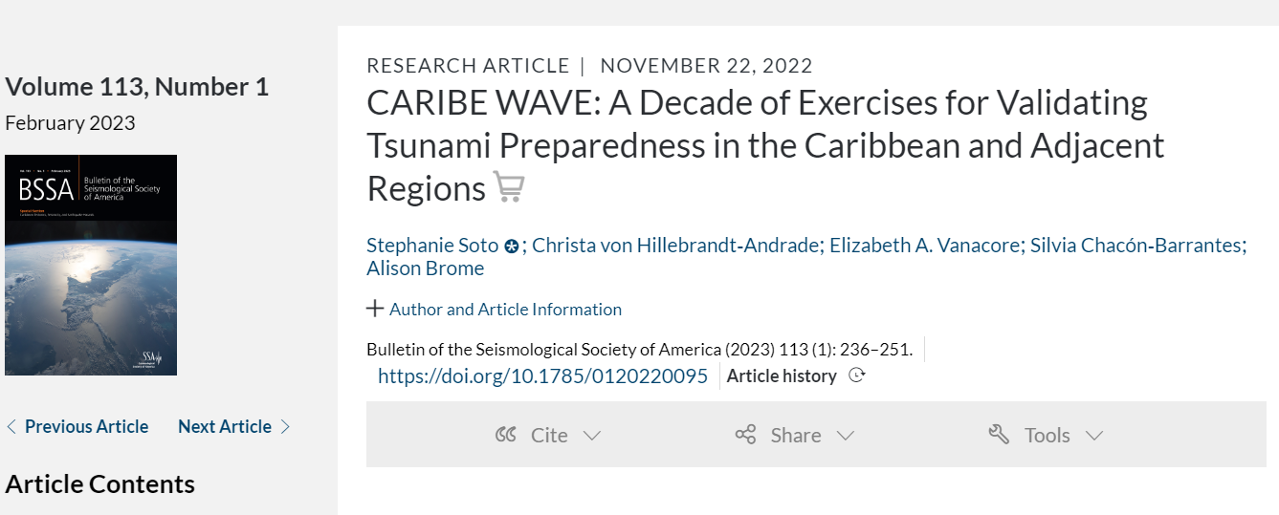
Publication on CARIBE WAVE

Slide 31
Questions, Comments
Thank You!
elizabeth.vanacore@upr.edu
christa.vonh@noaa.gov
From CUBA: CARIBE WAVE Tsunami Exercises are perhaps, without fear of being mistaken, one of the best examples of a systematic effort and activity in order to continuously improve a warning system for the common well-being of all the inhabitants of the Caribbean region, taking into account that it is a relatively small basin where a tsunami could put its precious coastal settlements in great danger.

