Slide 1






CARIBE WAVE 2024
Dr. Elizabeth Vanacore
Seismologist, Puerto Rico Seismic Network
ICG CARIBE-EWS CARIBE WAVE TT Chair
Christa G. von Hillebrandt-Andrade
Manager, ITIC Caribbean Office
ICG CARIBE EWS WG IV Chair
Stephanie Soto Rios
ITIC Caribbean Office
BS Geology
April 24, 2023

Slide 2
Goals for the Intrasessional Meeting
Decide on Scenarios for CARIBE WAVE 24
Decide on the Date and Time
Suggestions for Scenarios Beyond 2024
Multi-Annual Exercise (MG 86) Workshop with CARIBE WAVE TASK TEAM (consider answers to questionnaires with suggestions

Slide 3
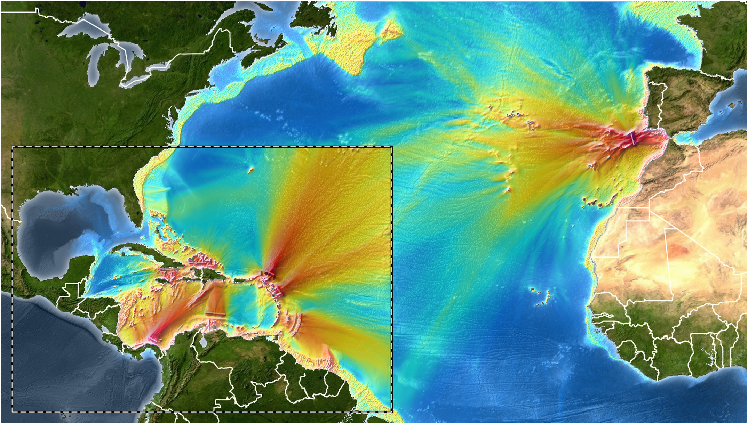
Current Exercise Coverage
Soto et al, 2022

Slide 4
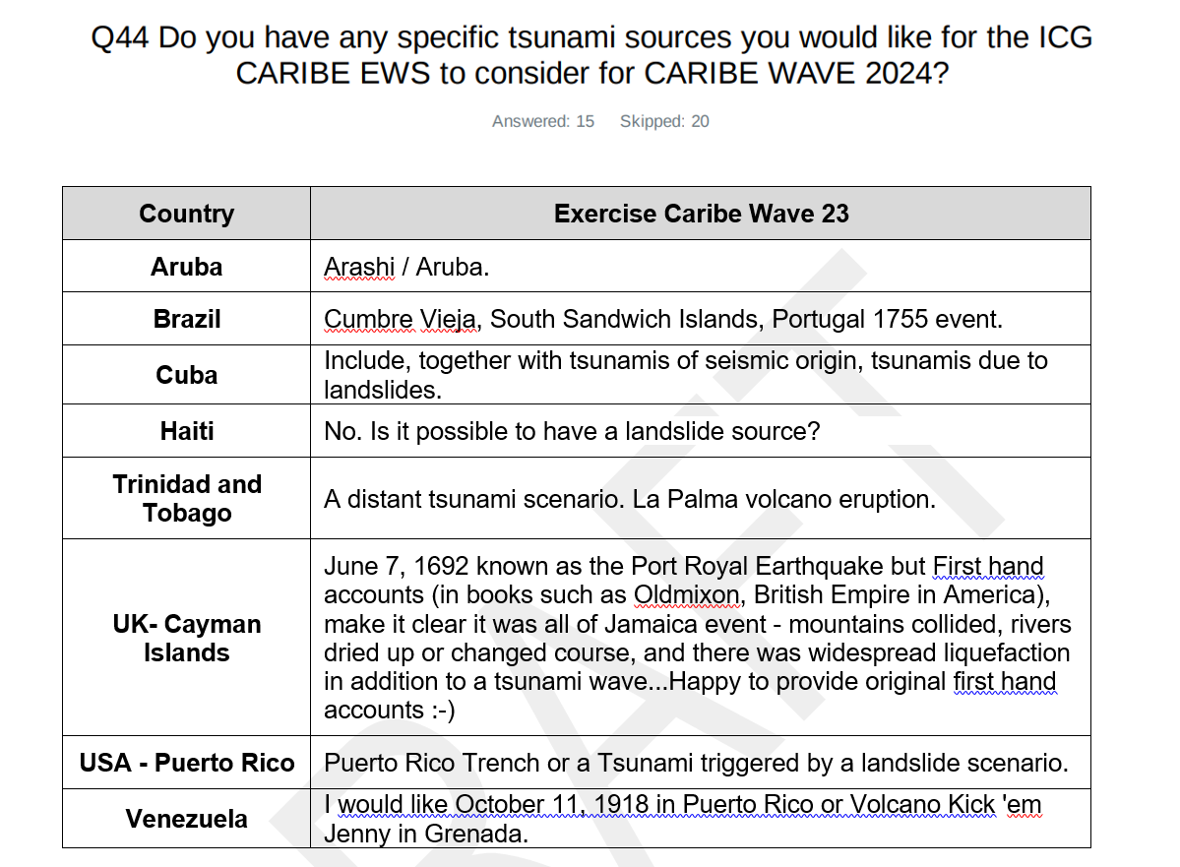
CARIBE WAVE 23 Survey Result

Slide 5
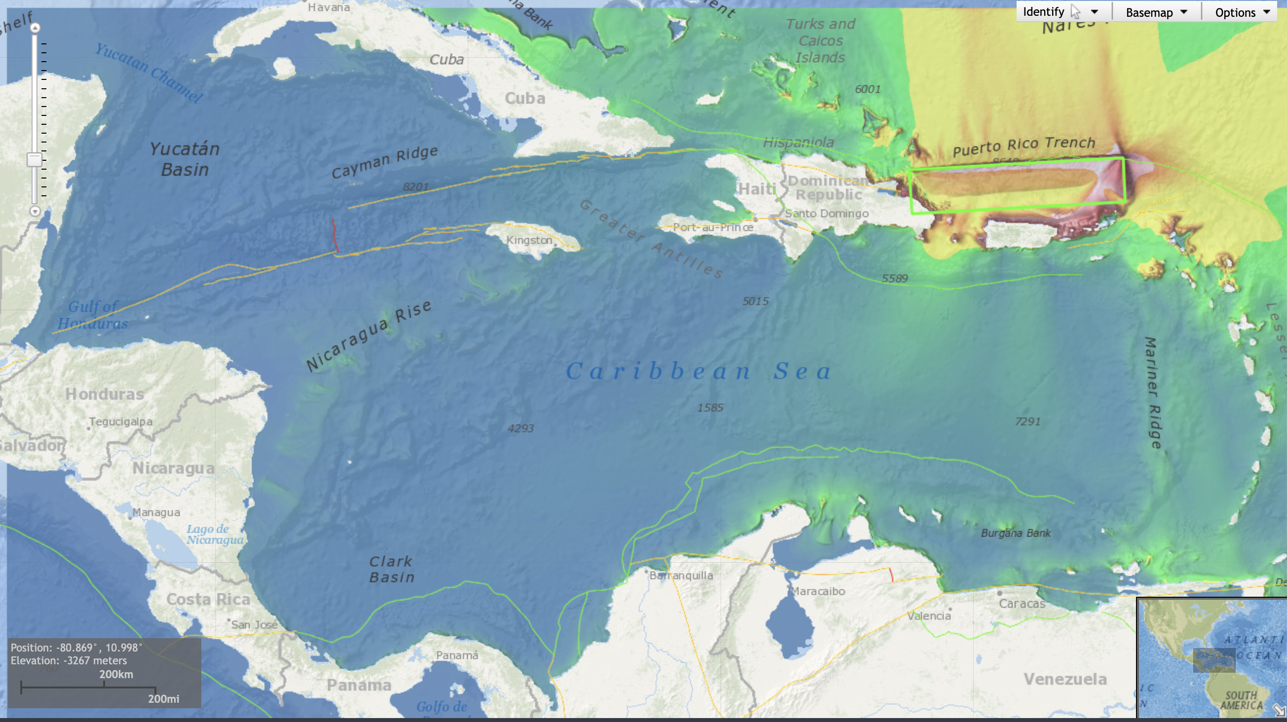
Possible Scenario 1: Puerto Rico Trench
Region: Puerto Rico Trench
Depth (km): 20
Strike (deg): 86
Dip (deg): 20
Rake (deg): 23
Length (km): 500
Width (km): 110
Slip (m): 8
Mw: 8.711311
Generated at Experts Meeting: Dominican Republic 2016

Slide 6
Possible Scenario 2: From Survey Suggestions
Non-Earthquake Sources
Earthquake Sources
Landslide Source (if feasible?)
Volcanic Source (Kick’Em Jenny, La Palma)
Distant source (South Sandwich Islands, Lisbon)
Scenario based on the 1692 Port Royal Jamaica Earthquake
Aruba Scenario (Last Used in 2013)

Slide 7
Date and Time of the Scenario
Keep Thursday at 1400UTC?
  Interest in running a scenario at night/off hours?
Possible Thursday Dates in March: March 7, March 21
  March 14 → National Heroes Day (St Vincent and Grenadines)
  March 23 → World Meteorology Day
  March 28 → Holy Thursday/Easter Week

Slide 8
Multi-Annual Exercise Workshop
ITIC-CAR as part of the USAID/BHA Tsunami Ready have proposed a workshop on MG 86 (Multiannual Exercise) with a hybrid meeting of CARIBE WAVE Task Team
Tentative Date of Meeting: week of June 12 in Barbados
Request CTIC to coordinate with ITIC CAR
Appreciate potential US funding for the workshop

Slide 9
Goals for the Intrasessional Meeting
Decide on Scenarios for CARIBE WAVE 24
Decide on the Date and Time
Members of TT – add social scientist? Tsunami Zone rep?
Suggestions for Scenarios Beyond 2024
Topics for MG 86 Meeting and CW TT Meeting

