Slide 1
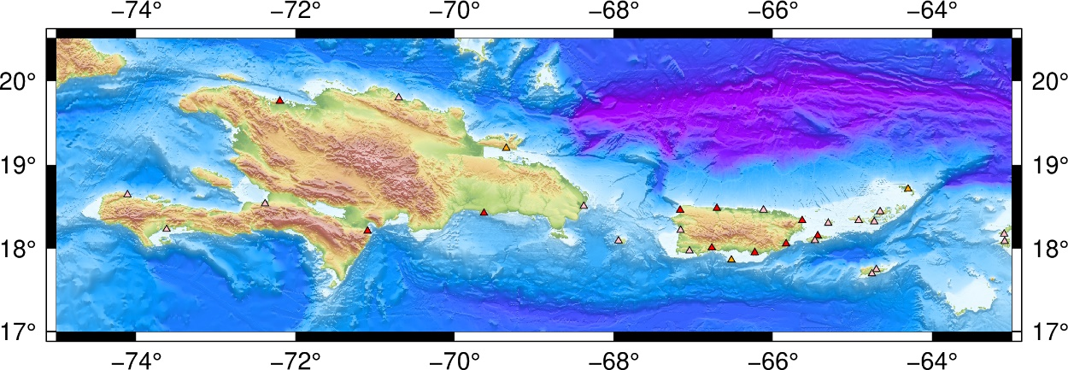
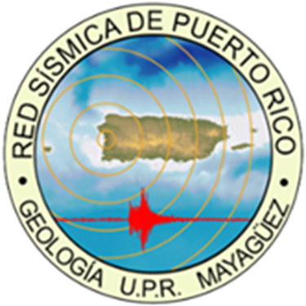
Sea Level Network
The PRSN of the University of Puerto Rico at Mayagüez (UPRM)
operates 7 sea level stations in Puerto Rico and help NOAA/NOS
in the maintenance of 10 more stations.
Support the operations of five regional stations (Tortola, Sto Domingo, Barahona, Haiti and Aruba).
The data are transmitted every 6 minutes on GOES or via EarthWorm export modules each minute for selected stations.
The data can be accessed on the homepage of the PRSN, Tides and Currents site of NOAA, and Tides online site of NOAA and the IOC Sea Level Data Facility.
PRSN operates three tsunami cameras.
Future Plans
Installation of two new Tide Gauges: (1) Samana, DR, (2) Anegada, BVI. Reinstall Isla Caja de Muertos, PR
Incorporation of 1-mins, near real time communications in all PRSN stations (Earthworm)
Install additional tsunami cameras

Slide 2
Seismic Network
The PRSN currently operates 32 seismic stations in Puerto
Rico, the Virgin Islands and the Dominican Republic. PRSMP
operate 120+ accelerometers. Twelve of them use VSAT
(PRSN & USGS)
Stations in Miches and Isla Saona – DR were improved.
A new station was installed in Ceiba PR (strong motion seismometer), two new accelerometers were installed (Villalba and Coamo, PR).
One hundred type-C are being installed in Puerto Rico.
Seismic processing was upgraded to the ANSS/Jiggle.
Future Plans
Installation of four new stations, two of them is the southwestern part of the Island.
Two more accelerometers.
Reinstallation of the seismic station in Aruba.

Slide 3
GPS/GNSS Network
The Puerto Rico Seismic Network operates a GPS Network of
twenty permanent high-rate stations.
All the permanent GPS stations are equipped with either a Trimble NetRs, NetR9 or Alloy GPS receiver and Choke ring antenna,
Twelve stations were upgraded to add RTX capabilities.
Continuous data are simultaneously logged to three sessions with different sampling rate, 15-sec per sample, 1-sec per sample (1 Hz), and 10-samples per second (10 Hz).
Data is available in the EarthScope server or PRSN caster or seedlink.
Future Plans
Installation of four new stations in the southwestern part of the Island, one in Vieques and other in St. Croix.
Implementation of the TEC algorithm in PRSN.
Software upgrades.

Slide 4
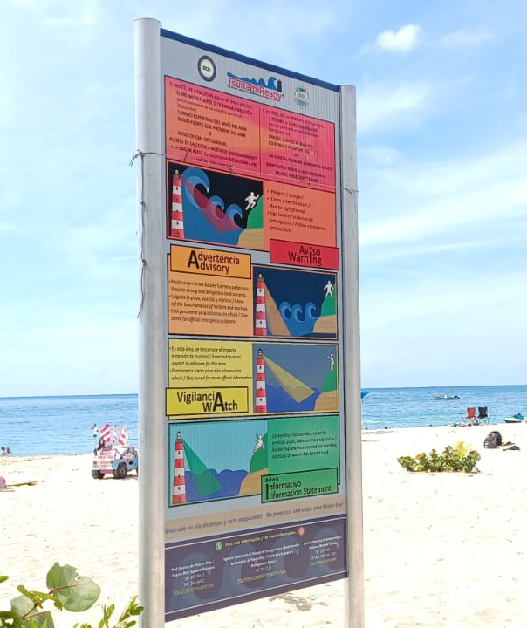
TsunamiReady® / NTHMP.
Forty-six TsunamiReady communities and eighteen TsunamiReady supporters in Puerto Rico
Fifty-eight EMWIN systems installed in Puerto Rico, four of then now equipped with DartCom
hardware
Hundreds of NOAA radios distributed, updated and tested.
Tsunami signage maintenance, thousands installed.
Yearly workshops for emergency personnel, community leaders and EOC officers.
Tsunami vulnerability profiles upgrade to use new census-2020 data.
More the 129,000 participants in the CaribeWave 2023, and more than 450,000 in ShakeOut 2022. Drills and
exercises.
Participation in the WTAD (632mil FB followers).
Future Plans
GPS/GNSS short course in August 2023.
Install four new DartComs.

