Slide 1
4.3.1 Common Alerting Protocol in TEW
CAPS in TEW
4.3 REPORT WORKING GROUP 3
TSUNAMI RELATED SERVICES
Emilio Talavera, INETER/CATAC (Nicaragua, 2018-)
Chair WG3
Heredia, Costa Rica
April 26, 2023

Slide 2

- Research & Development -
Universal ICT system for Disaster Management
April, 2023
Japan Telecommunications Engineering and Consulting Service

Slide 3

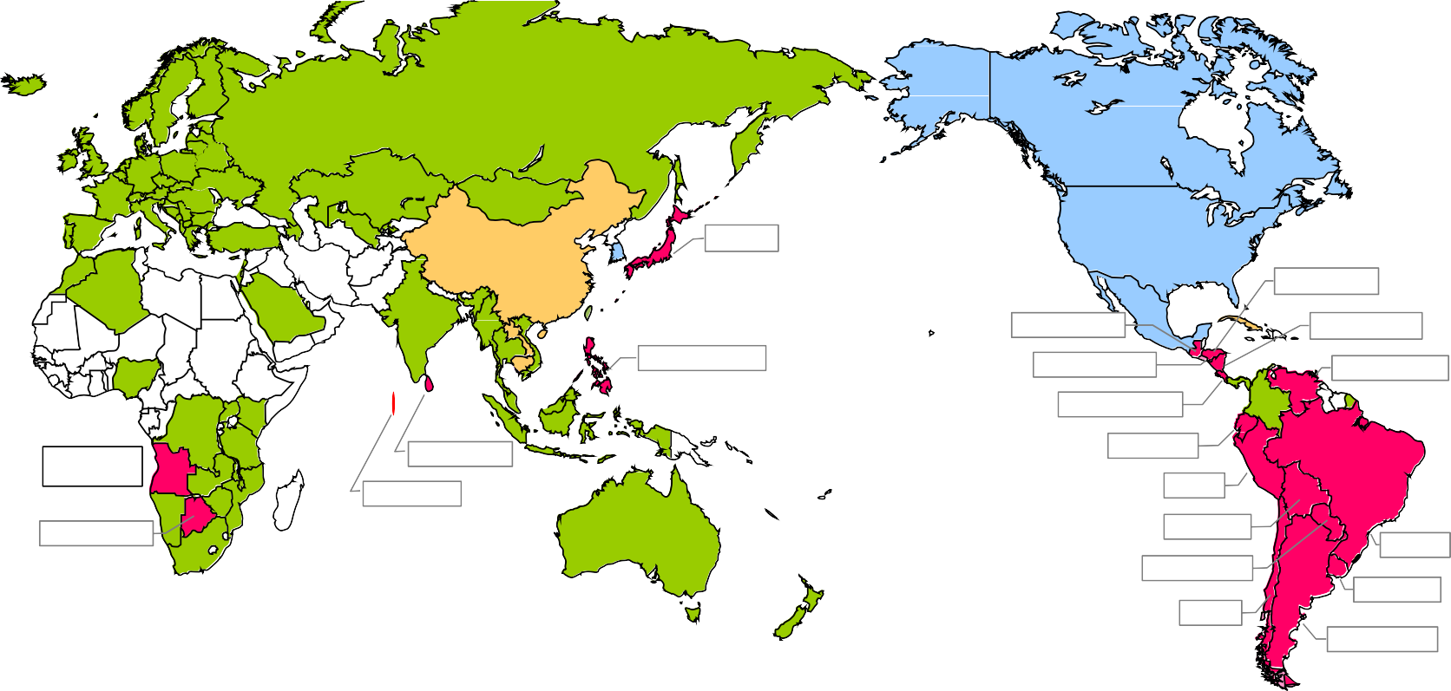
ISDB-T Adopting 20 Countries
Japanese Digital TV Standard
DiBEG Webpage https://www.dibeg.org/world/
Japan
Honduras
Nicaragua
Venezuela
Guatemala
El Salvador
Costa Rica
Ecuador
Peru
Bolivia
Paraguay
Philippines
Angola
Sri Lanka Maldives
Botswana
Brazil
Uruguay
Chile
As of February 2020 Research by DiBEG
ISDB-T adopted ■DVB-T/T2 adopted ■ATSC adopted ■DTMB adopted
Argentina
Many countries expect the introduction of EWBS (Emergency Warning Broadcasting System)
supported by ISDB-T

Slide 4
EWBS Implementation in Latin America with Japan’s Cooperation
Nicaragua
3/2018 Field experiment of EWBS equipment
4/2021 Start of test transmission of EEW (Earthquake Early Warning) information 12/2021 Pilot project for EWBS receivers’ expansion
El Salvador | 10/2018 | Field experiment of EWBS equipment
 | 10/2019 | Demonstration of EWBS receivers
 | 4/2021 | Start of test transmission of EEW (Earthquake Early Warning) information
Costa Rica | 10/2018 | Field experiment of EWBS equipment
 | 3/2019 | Demonstration of EWBS receivers
 | 4/2021 | Start of test transmission of EEW (Earthquake Early Warning) information
Peru 1/2019 |  | Field experiment of EWBS equipment
3/2019 |  | Start of technical support with operation training
11/2019 Large scale demonstration in national evacuation drill on World Tsunami Awareness Day (5th Nov. 2019)
Brazil 12/2019 Field experiment of EWBS equipment Ecuador 3/2021 In-door experiment of EWBS equipment

Slide 5
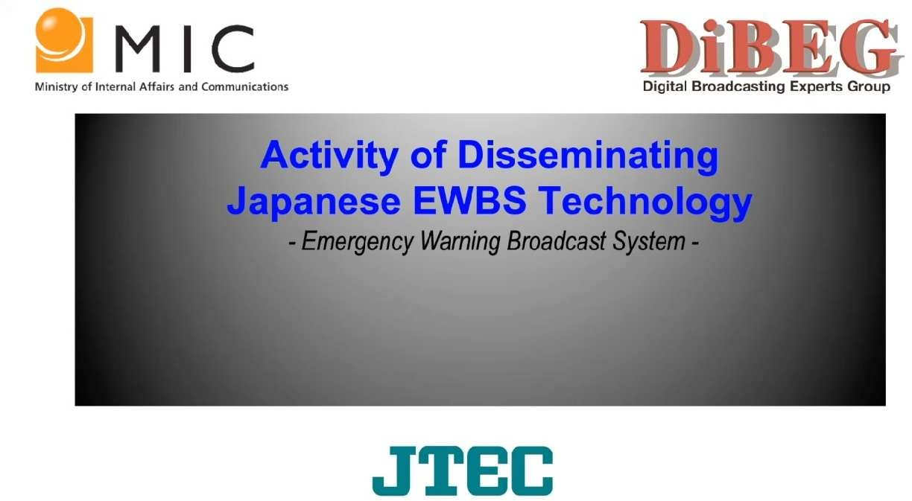
Video (5 minute)
Activity of disseminating EWBS Technology | JTEC

Slide 6
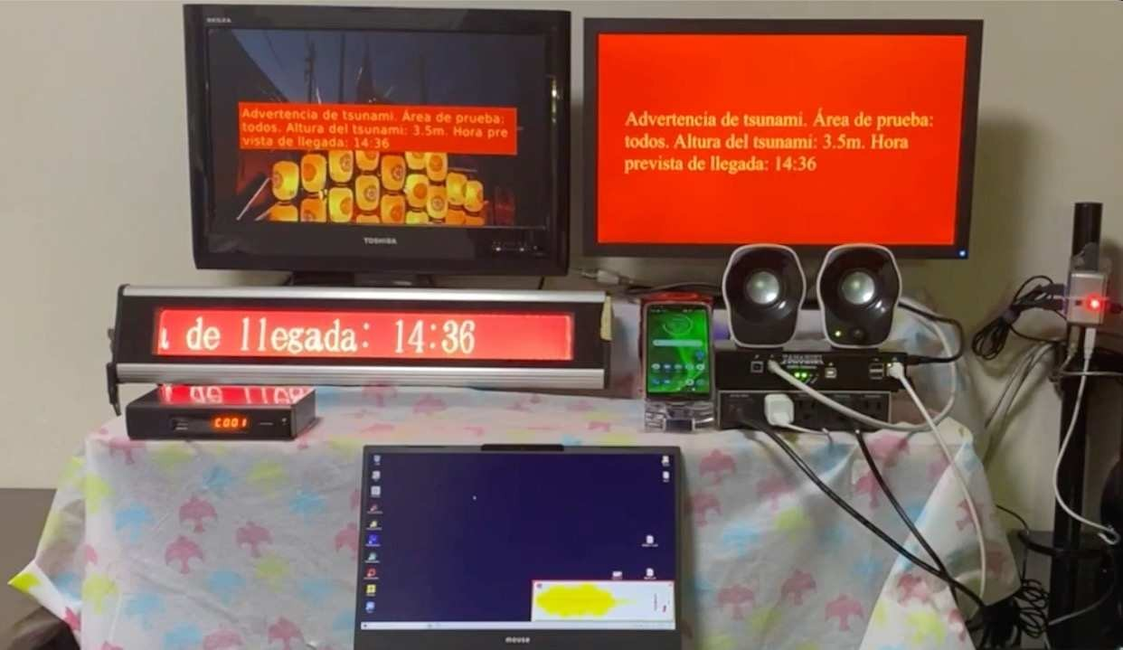
Introductions of various types of EWBS receivers to meet the requirements in Latin America
TV
Siren
Speaker
Display
Mobile Phone
EWBS Gateway
STB
PC

Slide 7
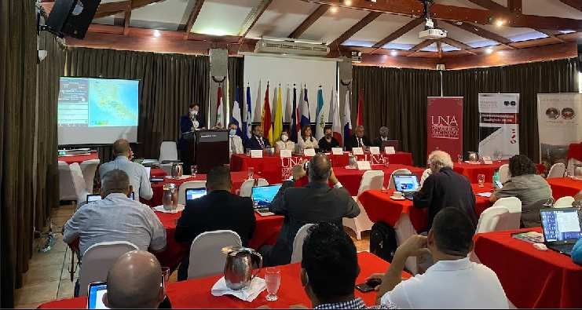
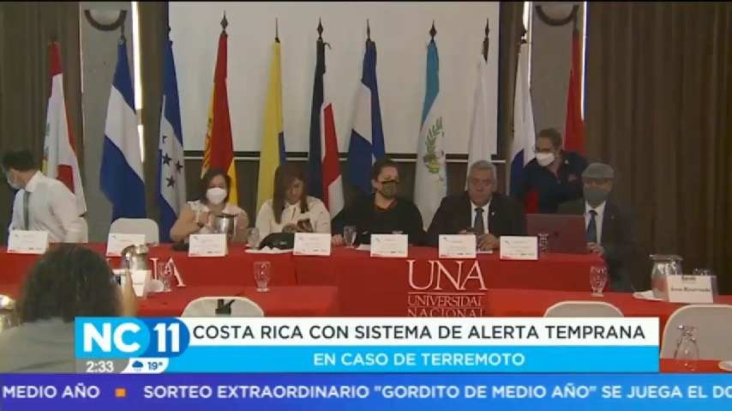
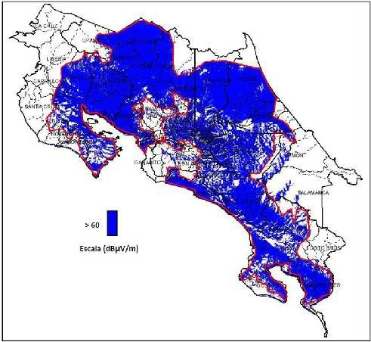
ATTAC Annual Meeting in Costa Rica (4th – 6th Jul. 2022)
News program covered by local broadcaster
TDT Coverage in Costa Rica : 80％
（planed to be expanded up to 95%
Document provided by SINART

Slide 8
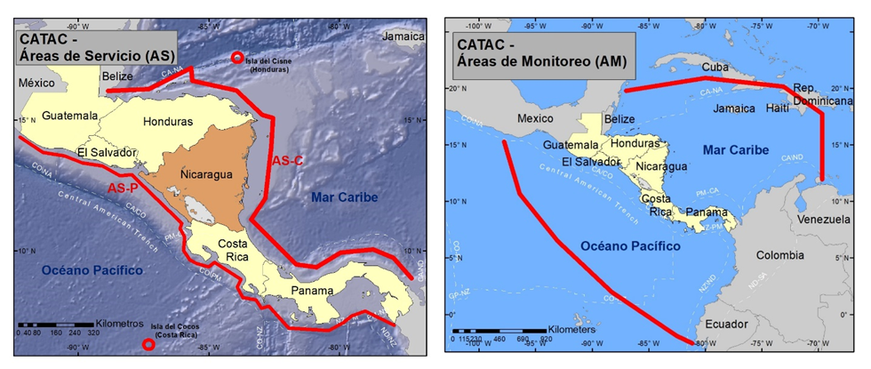
Áreas de servicio y zonas de monitoreo del CATAC
EEW
EWBS

Slide 9


Next Challenges
Towards a comprehensive disaster management ICT system
CAP aggregation & dissemination
Expanded use for radio broadcasting (FM / MW)
“EWBS-CAP Hybrid transmission” utilizing existing broadcasting networks
Emergency information at anytime, anywhere, to anybody

Slide 10
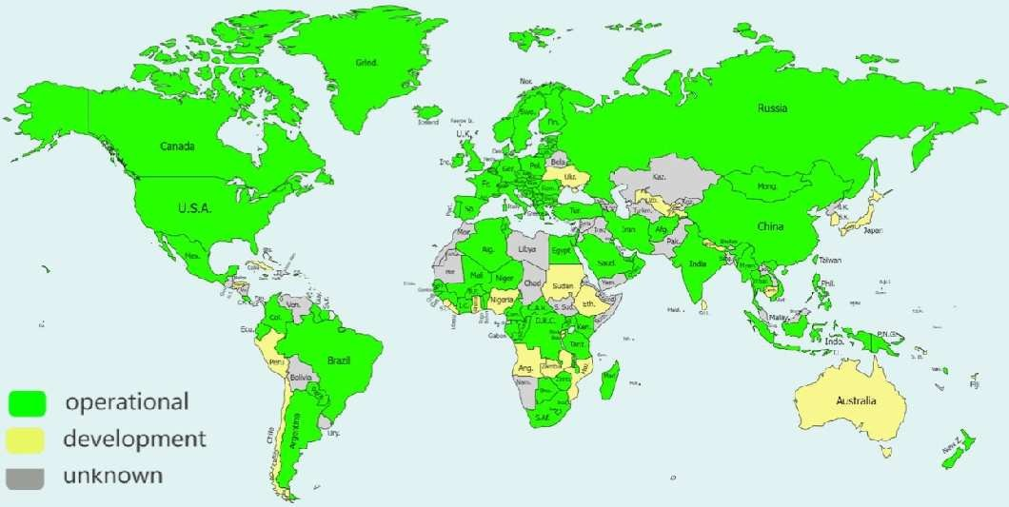

CAP over Broadcasting Radio Waves
Common Alerting Protocol (ITU-T Rec. X.1303 bis)
Specific needs
（understood by JTEC）
CAP Implementation Worldwide
Peru
R&D by themselves
Brazil
Requirement of Next generation Digital Broadcasting System
Switzerland （ATTAC）
Request of R&D to Japan
Philippines
Source：The Global Disaster Preparedness Center (GDPC)
https://preparecenter.org/initiative/common-alerting-protocol-implementation/

Slide 11

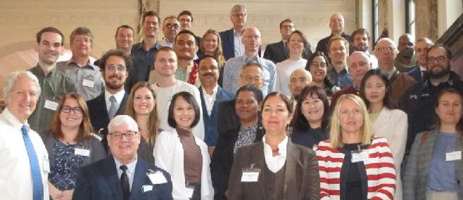
- CAP IMPLEMENTATION WORKSHOP -
https://cap-workshop.s3.amazonaws.com/2022/index.html
2022.9.19-9.21 at Amsterdam,Netherlands,
Data announced by the organizar
Pre-registration : 161 countries, 997 people On-site participation: 45 people
Zoom Participation: Apx.200 people
【Host】
Everbridge 社（緊急時のコミュニケーション管理プラットフォームを提供する民間企業）
Alert-Hub.Org（非営利の災害時緊急警報普及促進団体）
【Co-Host】
  International Association of Emergency Managers (IAEM)（国際危機管理者協会）
  International Federation of Red Cross and Red Crescent Societies (IFRC) （国際赤十字・赤新月社連盟）
  International Telecommunication Union (ITU)（国際電気通信連合）
  World Meteorological Organization (WMO) （世界気象機関）
  OASIS (Organization for the Advancement of Structured Information Standards) （非営利の ICT 標準化団体（米国企業が中心となって設立）

Slide 12
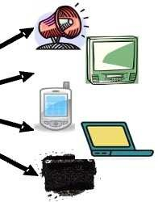
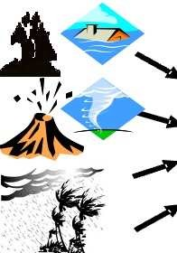


CAP Carries Key Facts
All-Hazards Aggregation
All-Media Dissemination
Alert Flag
CAP
Event ID
Info
Description(Text)
Sender
Area
Geocode
(UBIGEO)
Polygon Area Desc.
(Text)
CAP
CAP
…
CAP
Date
EDXL-DE
EDXL-DE
EDXL-DE
Scope
…..
Category
Response Type
…..
Urgency
OASIS Open Standard
Severity
CAP
CAP (Common Alerting Protocol）
Common XML format for information sharing
EDXL-DE （Emergency Data Exchange Language - Distribution Element）
Common XML schema for information distribution
Certainty
EDXL-DE
…..
Resource Size URL

Slide 13
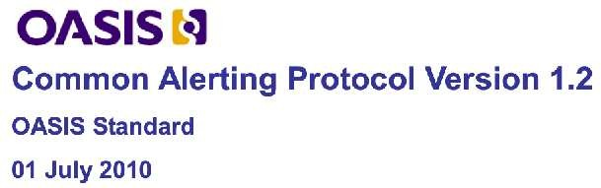
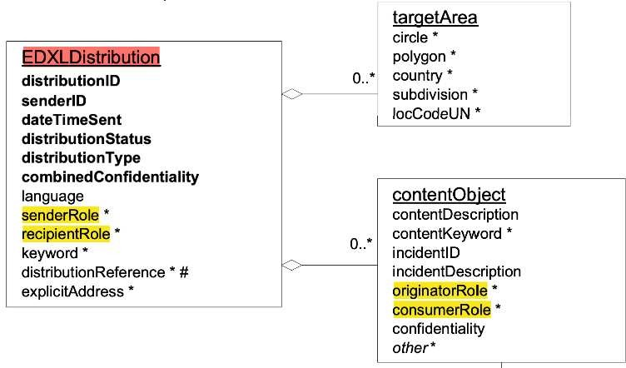
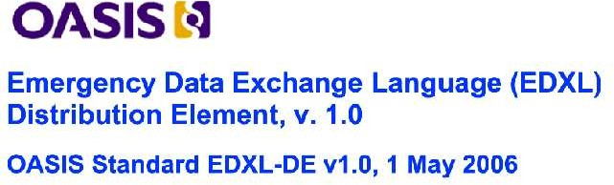
OASIS Open Standard
OASIS (Organization for the Advancement of Structured Information Standards)
A standardization body of “open standards” to support emergency information sharing and data exchange
EDXL-DE Document Object Model

Slide 14
Concept of OASIS Open STANDARD –
4 role model
Originator
Sender
Recipient
Consumer
XML
*Transmission with additional data describing how to open an envelope
Mobile Satellite Internet
XML
Message
Signage Speaker TV Monitor etc.
CAP
EDXL-DE
EDXL-DE
unload
CAP
open
Notification
EDXL-DE
Routing & Transmission
…
XML
Responsible Agency of Aggregation
General citizens
CAP
Hazards management organizations
(Local Government, Broadcasters etc.)
All-Hazards Aggregation
All-Media Dissemination
…
Weather TSUNAMI Earthquake Volcano
Local info.
(Evacuation info.
Lifeline Info. Security info…)
In Japan, “L-Alert” (Commons-EDXL) system is in operation based on concept of OASIS
Commons XML
Originators that issue hazards information
Commons EDXL

Slide 15
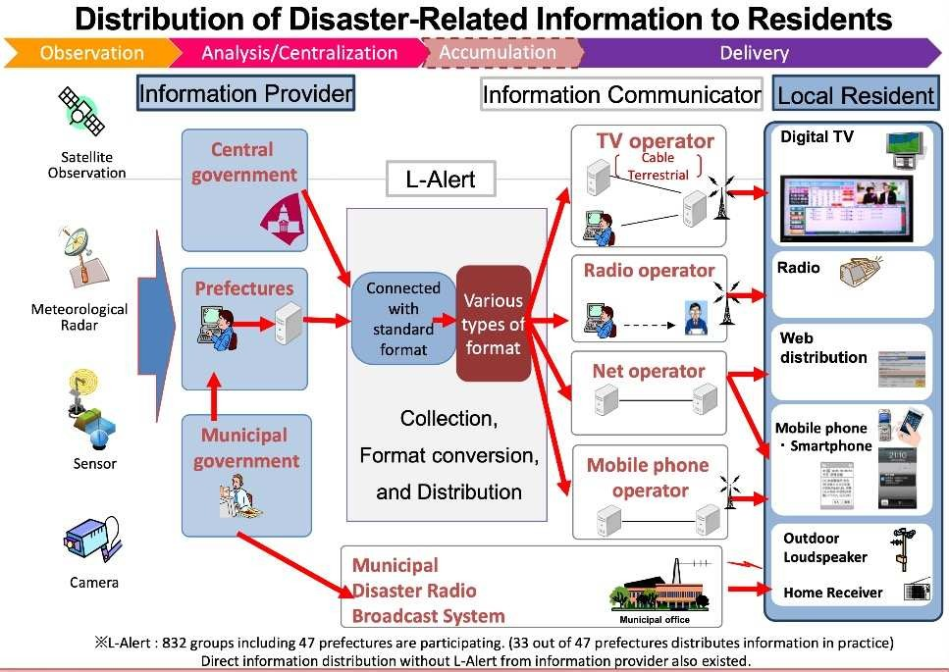
L-Alert system in Japan
Source : NICT (National Institute of Information and Communications Technology)

Slide 16

2 Separate Roles of Broadcasting Radio Wave in OASIS Hazard Delivery
Originator
Sender
Recipient
Consumer
XML
XML
Message
Mobile Satellite Internet Broadcasting
EDXL-DE
unload
CAP
open
Signage Speaker TV Monitor etc.
CAP
EDXL-DE
Notification
EDXL-DE
Routing & Transmission
…
XML
Responsible Agency of Aggregation
Hazards management organizations
(Local Government, Broadcasters etc.)
General citizens
CAP
All-Hazards Aggregation
New Role !
Role 2
Role 1
…
CAP Dissemination
EWBS Dissemination
Weather
TSUNAMI
Local info.
(Evacuation info.
Lifeline Info. Security info…)
Earthquake Volcano
Originators that issue hazards information
Delivery of XML
Data communication function
Delivery of Message
Conventional Broadcasting function

Slide 17



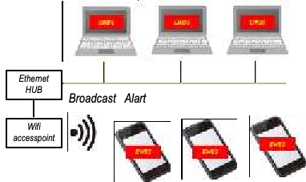

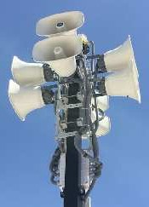







EWBS - CAP Hybrid Transmission
- Draft Proposal for a Universal ICT System for Disaster Management -
Originator
Sender
Recipient
Consumer
XML
Message
EWBS Transmission
by extracted CAP
EWBS
EWBS Dissemination
CAP
EDXL-DE
CAP Transmission
（Direct)
EDXL-DE
XML
EDXL-DE
Role 2
Role 1
CAP Dissemination
XML
CAP
Responsible Agency of Aggregation
Broadcasting Radio Wave
EWBS
Household
All-Hazards Aggregation
EWBS
CAP
…
Public space
CAP
Weather
TSUNAMI
Local info.
(Evacuation info.
Lifeline Info. Security info…)
EWBS
Earthquake Volcano
・・・
Related Parties
/ Equipment
EWBS
Public Display, Speaker…
Originators that issue hazards information
General public

Slide 18

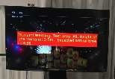








Operation by Broadcasting Standard
Dissemination to General Public
Alert Flag
CAP structure
Event ID
EWBS (Emergency operation)
Info
Description(Text)
Description(Text)
Geocode
(UBIGEO)
Polygon Area Desc.
(Text)
Alert Flag
Geocode
(UBIGEO)
Sender
Area
General receiver
Date
❌ N/A
Scope
EWBS-CAP Hybrid Transmission
IoT Control
-Return-channel
(Monitoring)
-Software update
…..
Category
CAP
Event 1
(24-hour operation)
Response Type
OK
Specially designed receiver
Packing
Event 2
…..
…
CAP
CAP
CAP
Urgency
EDXL-DE
EDXL-DE
EDXL-DE
Loading
Category
Severity
Polygon
Unloading
Certainty
CAP
Unpacking
…..
…..
Delivery only by broadcasting
CAP
Resource Size
URL
EDXL-DE
Operation by CAP open standard
EDXL-DE
Aggregation & dissemination among related parties

Slide 19
Classification of Emergency Information Delivery on Broadcast Radio Waves
 | EWBS | CAP
Recipients | General household Public Space (Public hall, shopping mall etc.） | Disaster management organizations （Municipalities, fire departments, police, media, etc.）
Purpose | Dissemination for General public | Aggregation & Dissemination among related parties
Type | Broadcasting contents／One-way | Data communication ／ Semi-Interactive*
Receivers | TV / STB, Radio etc. for household, Signage, Speaker etc. for public space | Specific display, Emergency radio, Early waring siren system etc.
Information to carry | EWBS signal (Activation flag / Text message / Area-code) | CAP-XML
Technical regulation for receivers’ manufacturing | General receivers that comply to Broadcasting technical standard | Dedicated receivers that comply to CAP open standard (delivery only by Broadcasting)
IoT Control over receivers | N/A | Required “Return channel” , ”Software update”..
Area identification | limited specification by the standard （not flexible operation） | Flexible setting by CAP “Polygon” （flexible operation possible）
* Internet connection to be used for IoT Control

Slide 20
Digital data multiplexing system on FM Radio
Bandwidth assigned for FM Radio Broadcasting
FM Radio Program
to be used for EWBS & CAP
“DARC” system
(Data Radio Channel)
L+R
L-R
Apx. 8kbps
Digital Data
19
38
100
Frequency (kHz)

Slide 21
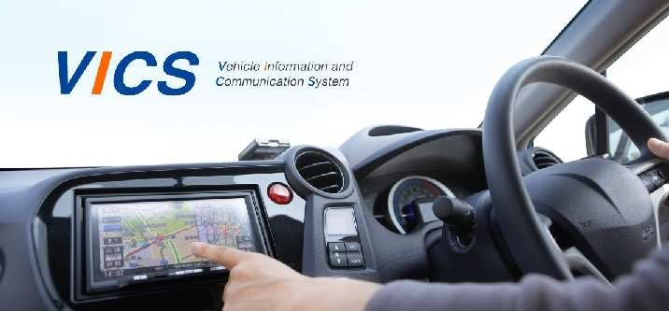
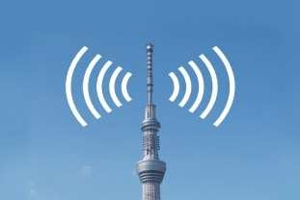
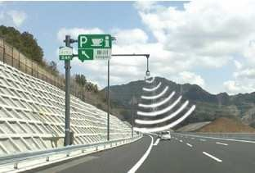




DARC in operation in Japan
VICS (Vehicle Information and Communication System) https://www.vics.or.jp/en/
VICS is an innovative information and communication system, enables you to receive real-time road traffic information about congestion and regulation.
Information is provided through three communication and broadcast media

Slide 22
Conclusion
To develop a clear, flexible and user-friendly national emergency telecommunications plan (NETP) , multi-hazard, multi-phase, multi- technology and multi-stakeholder approach is required.
A standardized emergency messaging format, the Common Alerting Protocol (CAP), is considered as an essential aggregation part of the NETP.
Existing broadcasting radio wave is an inclusive and sustainable option to introduce the NETP as a robust and reliable media for massive dissemination.
EWBS-CAP hybrid transmission using broadcasting radio wave is a simple solution for following both purposes,
  CAP information sharing among stakeholders
  EWBS direct message delivery to general citizens

Slide 23

ありがとうございます
Thank you !
sakaguchi @ jtec.or.jp
https://www.jtec.or.jp/english/activities/ewbs.html
Japan Telecommunications Engineering and Consulting Service

