Slide 1


TSUNAMI READY PROGRAM FOR ST. VINCENT AND THE GRENADINES

Slide 2
OUR MISSION STATEMENT
To coordinate the use of all available resources (local, regional,
and international) to ensure that all the people of St. Vincent
and the Grenadines are better able to mitigate against disasters,
prepare for disasters, respond to disasters and recover from the
impact of disasters in the shortest possible time.

Slide 3
The Tsunami Ready Program
The UNESCO IOC CARIBE EWS Tsunami Ready Pilot Programme - supported by
the Caribbean Tsunami Warning Programme of The National Oceanic and
Atmospheric Administration (NOAA) with funding from USAID/OFDA.
BENEFITS OF THE TSUNAMI READY PROGRAM
Public Education on the science, signs and impact of Tsunami in context of
the national response.
Development of Tsunami EARLY WARNING SYSTEM (EWS)
Creation of Resource Material, Evacuation Maps and Hazard alert signage.
Revitalization of community emergency response mechanisms for
St. Vincent and The Grenadines.

Slide 4
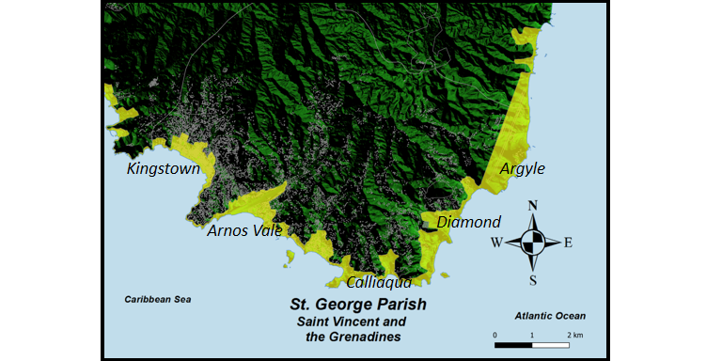
VULNERABILITY OF ST.GEORGE

Slide 5
WHY ST. GEORGE AND UNION ISLAND
Vulnerability due to:
Active tectonic plates (we border on the Caribbean plate)
The presence of the “Kick ‘em Jenny” volcano underwater between SVG and Grenada.
Increased activity of “Kick ‘em Jenny”
Most of our settlements are developed along the coast.
Most of the Grenadine islands are low-lying.

Slide 6
With the majority of our economic activity/assets
concentrated in St. George parish, the importance
of preparation and protection of this area cannot be slighted.
The scope of the program includes the coastal communities of:
Kingstown,
Arnos Vale (including Sion Hill Bay), Indian Bay
Calliaqua & Villa
Ratho Mill & Prospect
Brighton & Diamond
Stubbs & Argyle
Union Island (Tsunami Ready)

Slide 7
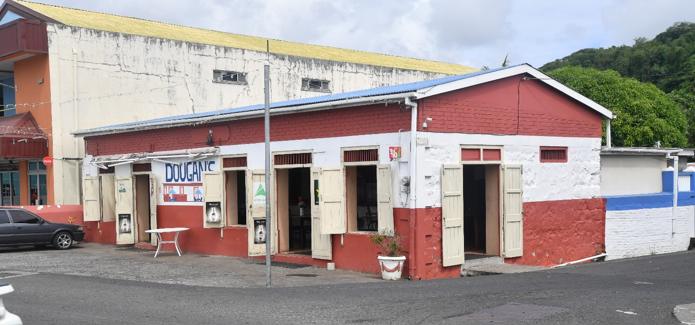
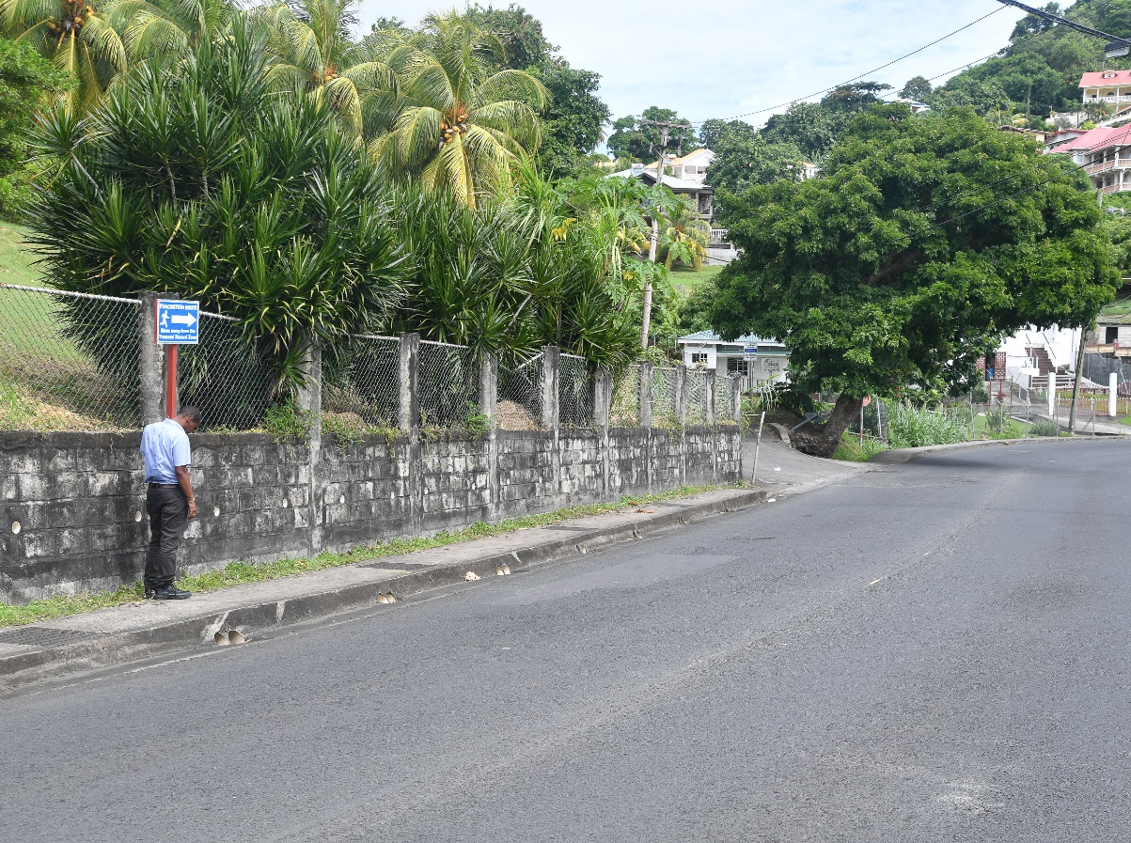
Creation of Resource Material, Evacuation Maps and Hazard alert signage.

Slide 8
Population must also be guided by natural signs.
FEEL
If you
the earth move
SEE
If you
the water recede
HEAR
If you
the rumbling of the ocean
RUN!

Slide 9
Institutional Mechanisms for Tsunami Warnings
National Tsunami Warning Focal Point (TWFP) - NEMO responsible for establishing & issuing all Tsunami Alerts for SVG
Tsunami National Contact – Ms. Michelle Forbes (Director)
National Tsunami Warning Centre (NTWC) - SVG Meteorological Services
Call out tree (next slide)
Tsunami Alert levels
We have streamlined Tsunami ready activities under the National DRR Programme
Guided by the CDM framework and the CWP

Slide 10
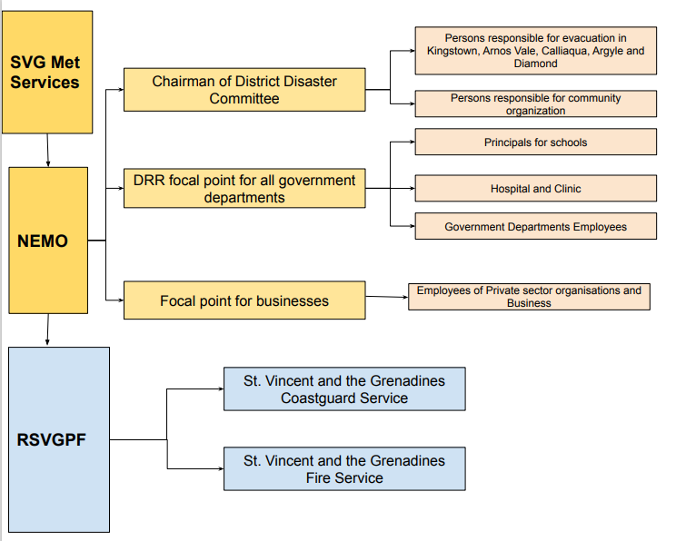
Tsunami Callout Tree

Slide 11

PTWC
Tsunami Threat/Info message
NEMO
Alert Level message
ORGANIZATION
Focal Point
A1
Raise Alarm
Evacuation process
Assembly point
If a tsunami warning is issued by NEMO
the following will occur:
Account for all members

Slide 12


National EWS COMMS Media
VHF radios
Email
Radio & TV
Telephone
CAP.CAP
END OF THREAT
Threat has passed
NEMO ISSUES END OF THREAT MESSAGE
ALL CLEAR ISSUED BY PRIME MINISTER
Safe to return to lower elevations
ALL
CLEAR
Community EWS
Community WhatsApp Groups
Church bells
Megaphones
Town criers

Slide 13
SIGNAGE EXAMPLES

Slide 14
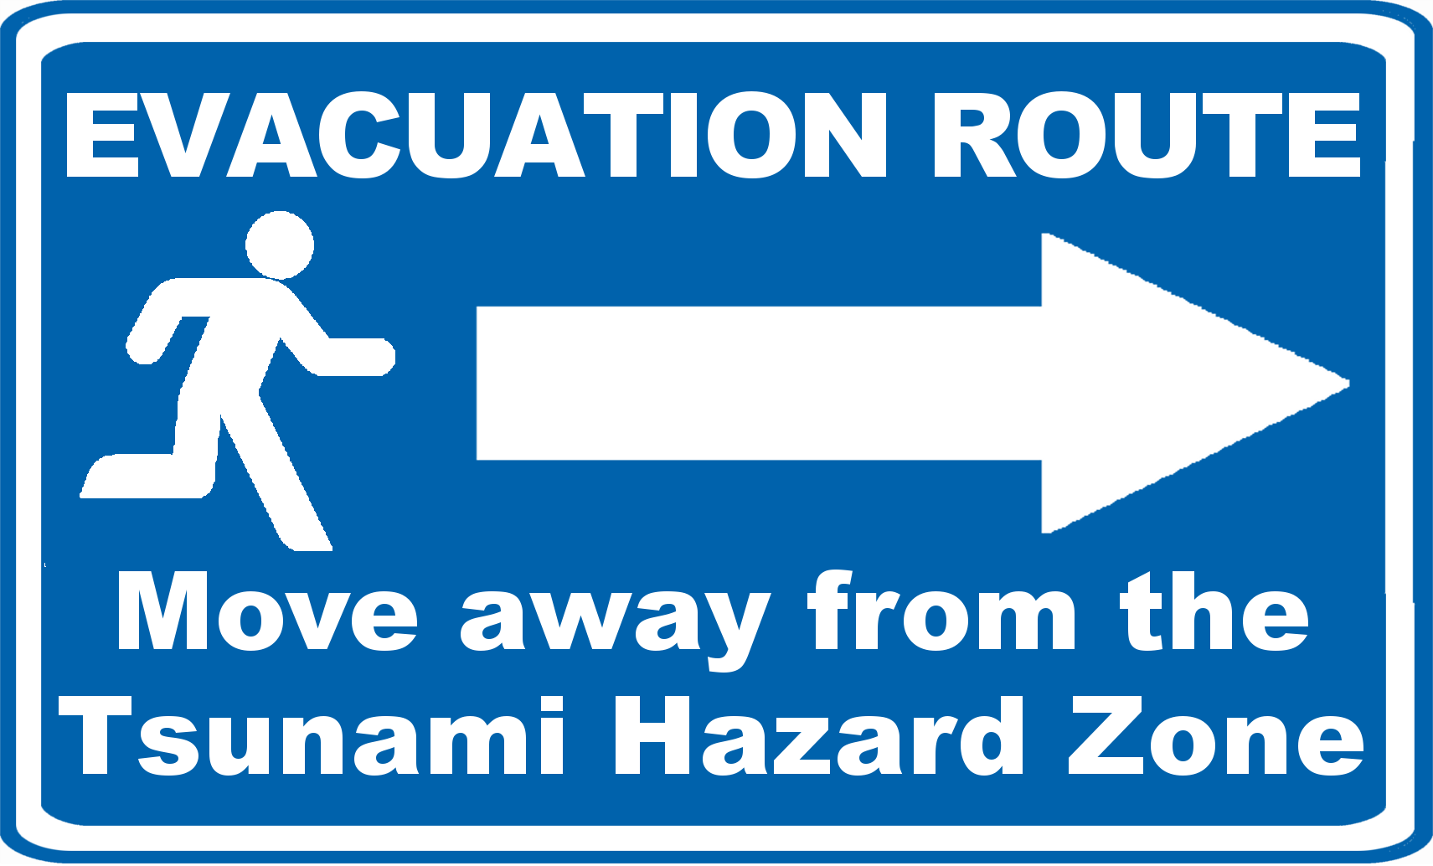

Slide 15
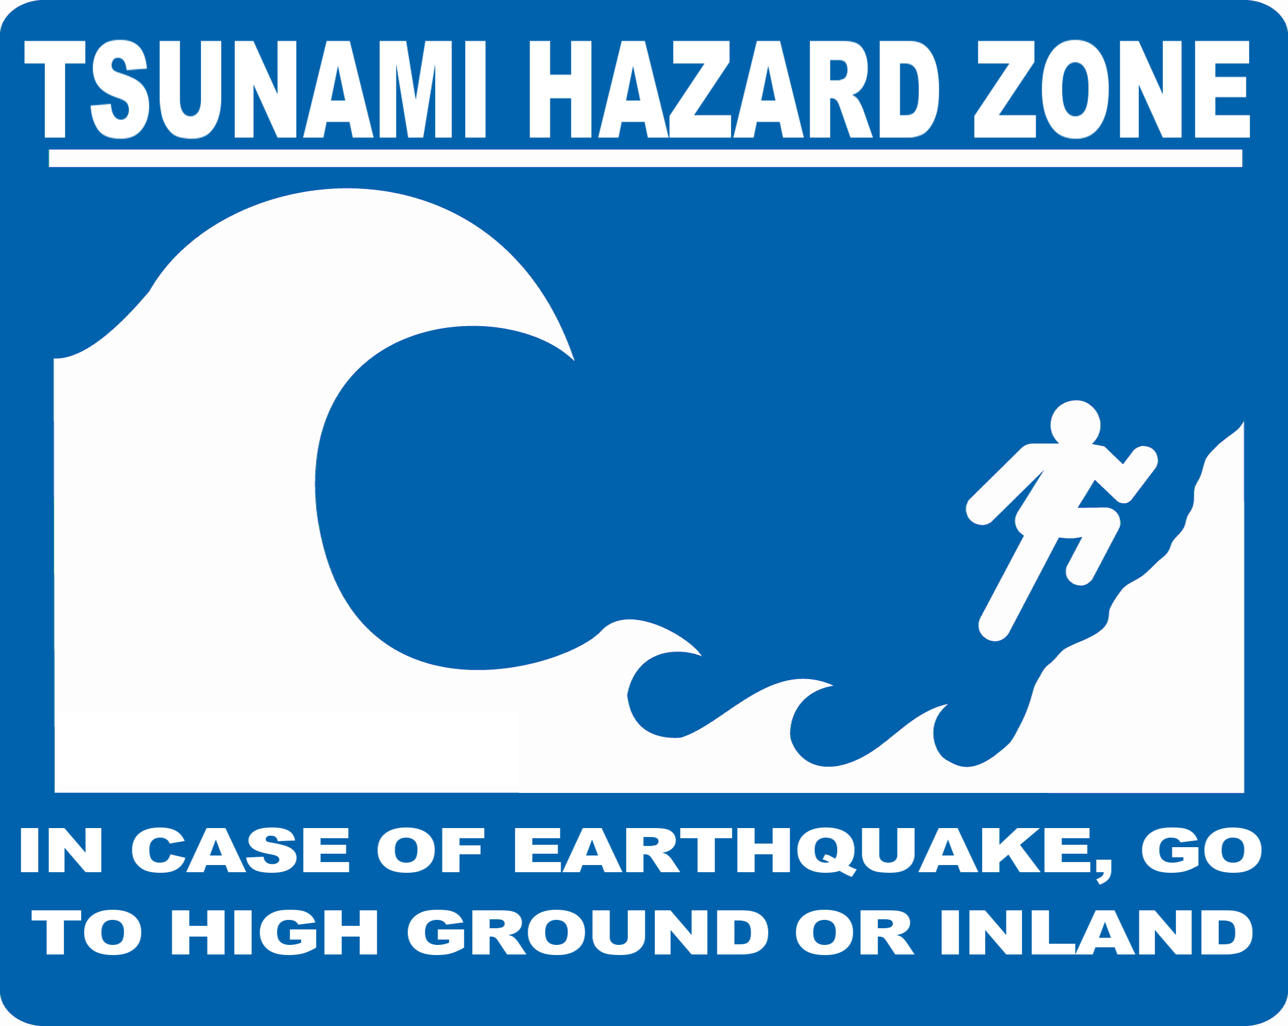

Slide 16


Slide 17
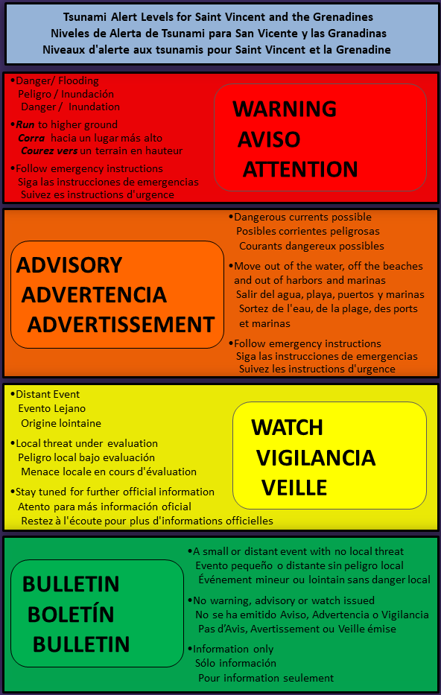

Slide 18
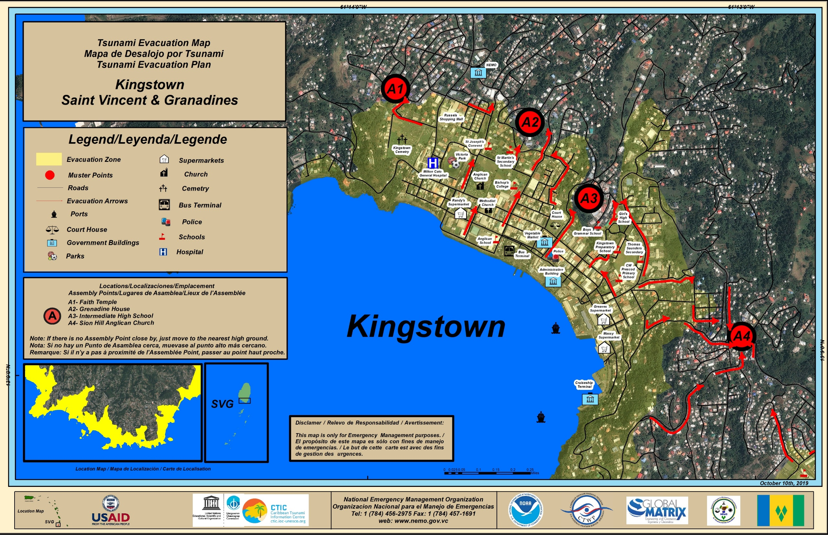

Slide 19
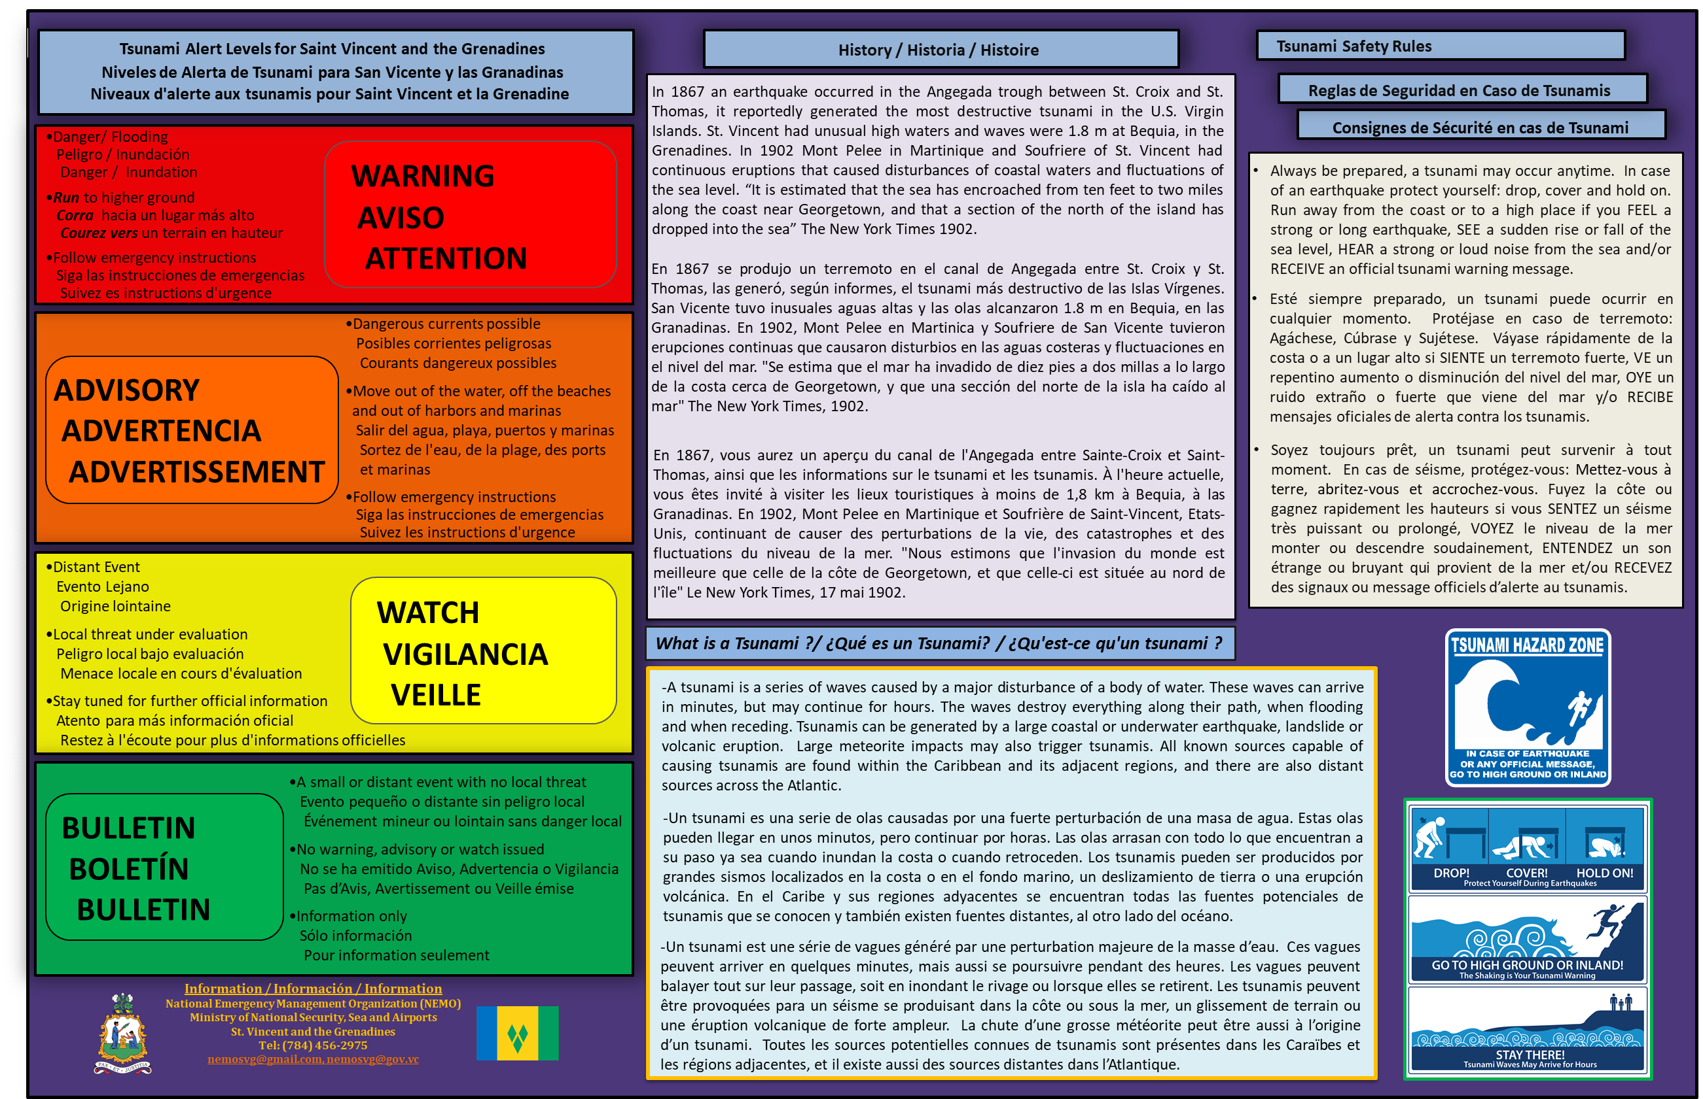

Slide 20


Slide 21
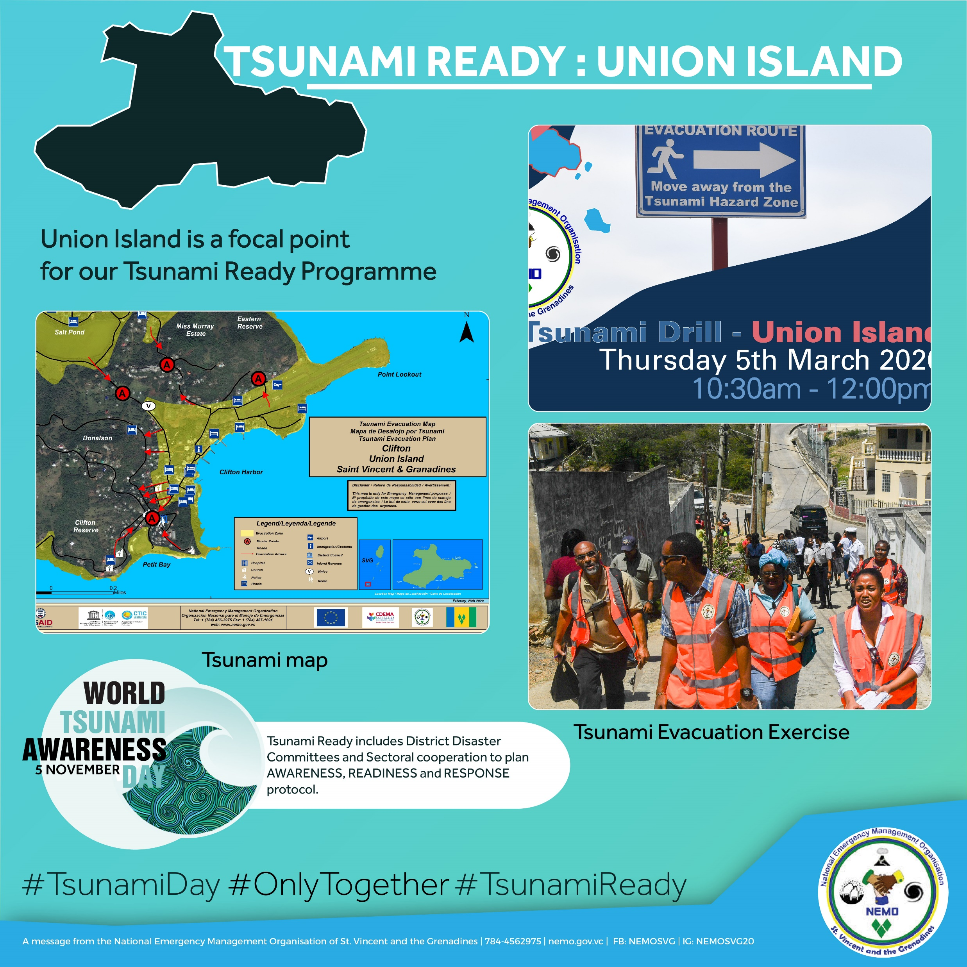

Slide 22
Challenges to the Programme
Finances – Expensive (approximately EC $100 000)
Data
  Increase situational Awareness
  Support the public education
  Support response and preparedness
Political will – leaders of society, greater representation at the cabinet level.
Community Buy-in
Risk Perception
  Probability of occurrence perceived as low
  Public Education Low

Slide 23
THANK YOU FOR YOUR ATTENTIVENESS
ANY QUESTIONS?

