Slide 1


ICG/CARIBE EWS XVI
COSTA RICA
25-28 April 2023
3.1 Report of the Caribbean Tsunami Information Centre (CTIC)
April 2022 – March 2023
Alison Brome
Programme Officer, CTIC

Slide 2
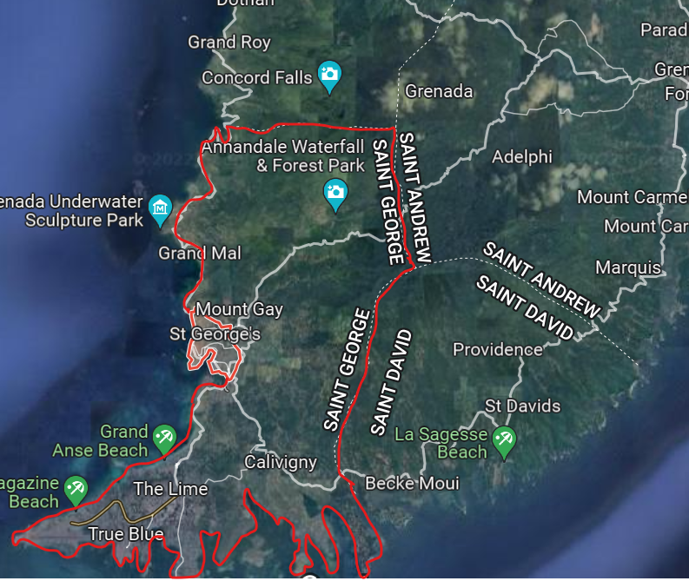
UNESCO/IOC CARIBE EWS Project, Grenada
Project Name: Strengthening Capacities for Tsunami Early Warning in Grenada
Donor: Government of Australia, Port of Spain Direct Aid Program & UNESCO/IOC
Funding: USD $57,000
Project Scope: Public Awareness and Education for Saint George Parish, Tsunami Ready nomination for select communities in St. George’s City
Challenged by senior personnel (NDO) and political changes in country
Draft Inundation and Evacuation Maps under review, public consultation initiated, project completion by December 2023

Slide 3
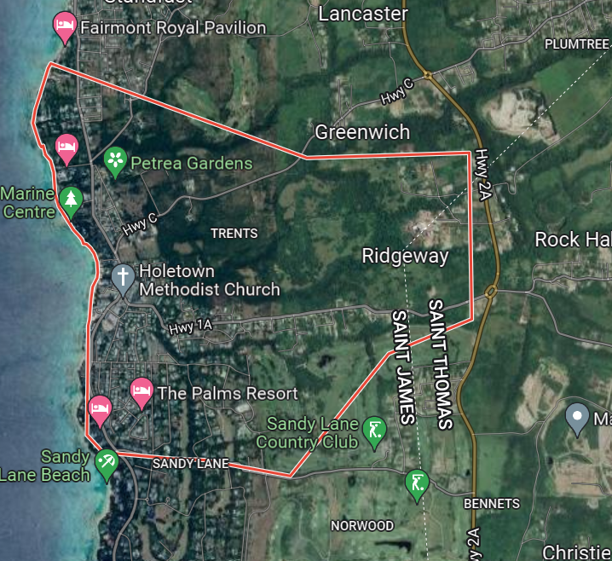
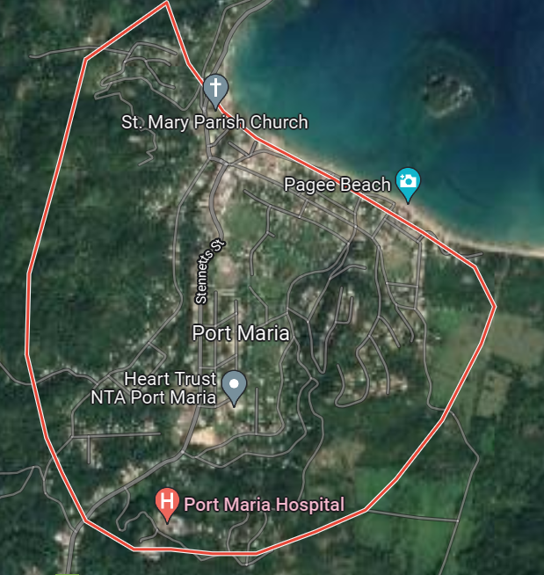
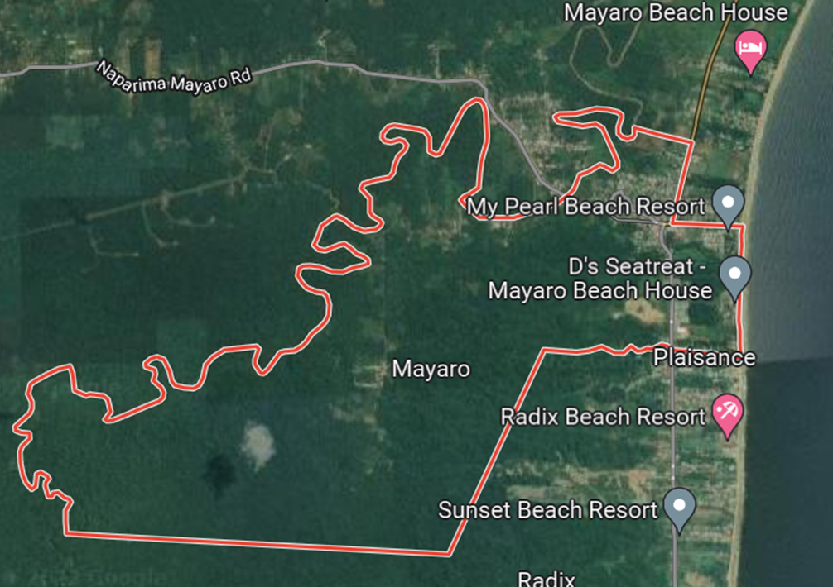
UNESCO/IOC CARIBE EWS NORAD Project Communities
Porters to Holders Hill, St. James, Barbados
Port Maria, St. Mary, Jamaica
Mayora Village, Mayaro–Rio Claro County, Trinidad and Tobago
Project Name: Towards a Safer Ocean in the Caribbean through Tsunami Ready Communities
Donor: Norwegian Agency for Development Cooperation (NORAD)
Funding: NORAD: 170,000, UNESCO: 30,000
Duration: January – September 2022, extended to July 2023
Capitalize on best practices and enhancing national capacity in Tsunami Ready Strategy
National Consultants, PAE ongoing, draft inundation and evacuation mapping completed for Barbados, delays in establishing partnership agreement with GOB but nearing finalization, additional project reorganisation initiated

Slide 4
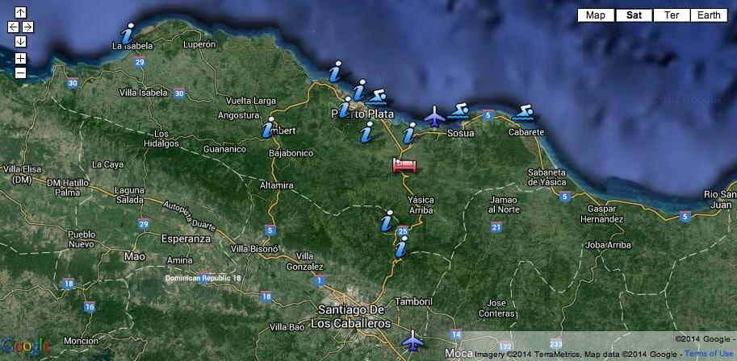
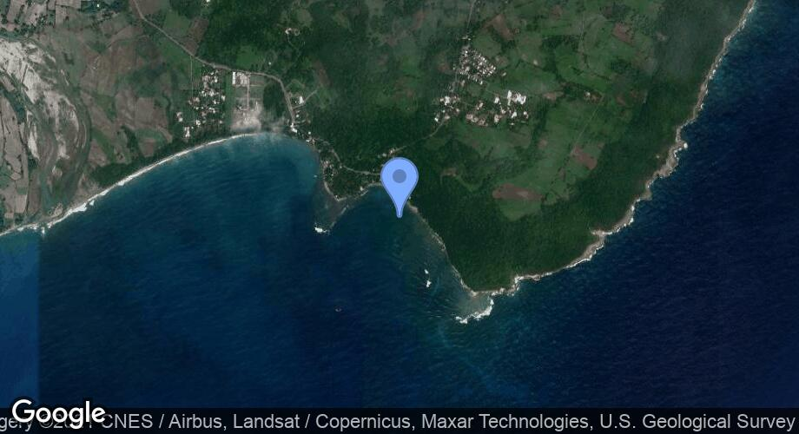
UNESCO/IOC CARIBE EWS Project, Dominican Republic
Puerto Plata and Sabana Grande de Palenque, Dominican Republic
Puerto Plata
Sabana Grande de Palenque
Tsunami Ready programme advanced in both communities through previous project funding
UNESCO/IOC in discussion with national and community authorities to finalise requirements including mapping, re-installation of signage etc.
Letter of support received from Municipality of Palenque

Slide 5
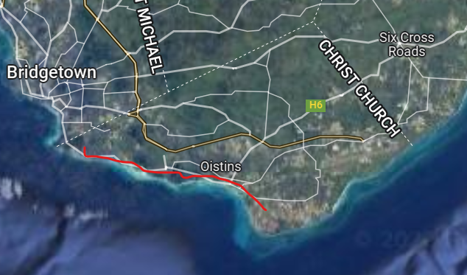
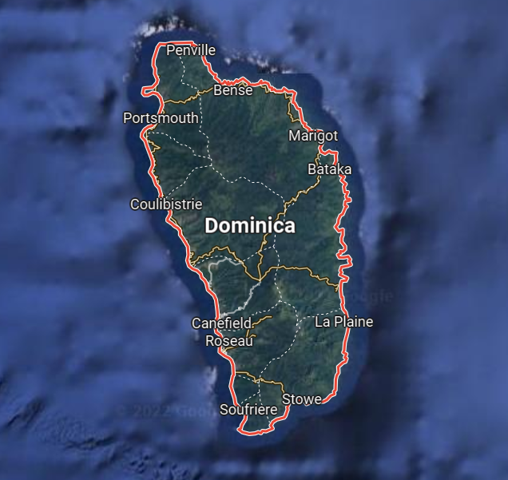
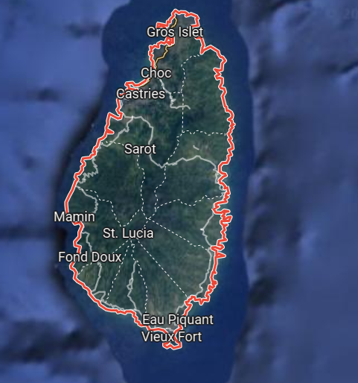
ITIC-CAR USAID/BHA Project Communities
Lead Implementing Agency: ITIC CAR
Christ Church West, Christ Church, Barbados
Dominica
Laborie, Saint Lucia
Garrison
Rendevous
Barbados – mapping finalized, national plan revision ongoing, signage installation under discussion, Exercise CARIBE WAVE 2023
Dominica – draft national protocol & evacuation map for Calibishie available, process impacted by personnel changes at NDO
Saint Lucia – Mapping & National SOPs under development, PAE ongoing, CARIBE WAVE 23 Exercise, Expression of interest letter submitted

Slide 6
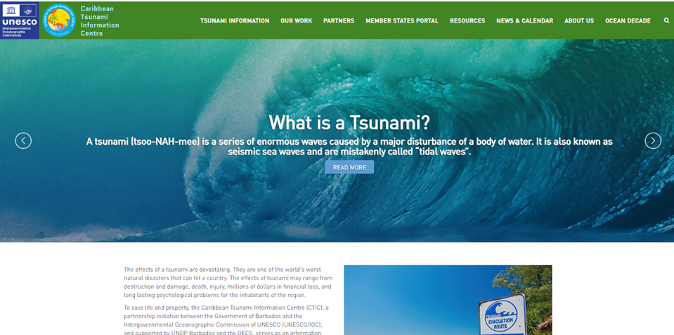
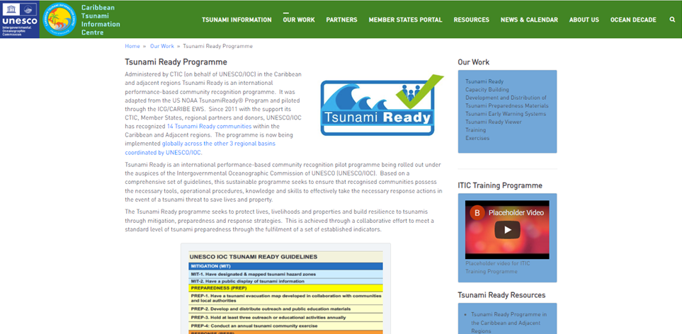
CTIC Activities 2022 – 2023 cont’d
ICG/CARIBE EWS WG 4:
Meetings, review & development of documents and resources
CTIC WEBSITE:
Phase 1 completed, deployment under consideration as part of
IOC comprehensive website management strategy
TSUNAMI READY TASK TEAM:
Meetings, review & development of documents and resources
Review, update and digitizing of Tsunami Ready evaluation survey for administration to Tsunami Ready communities recognized since 2019
CARIBE WAVE 2023:
Exercise Handbook review, registration, promotion, webinars,
exercise, evaluation

Slide 7
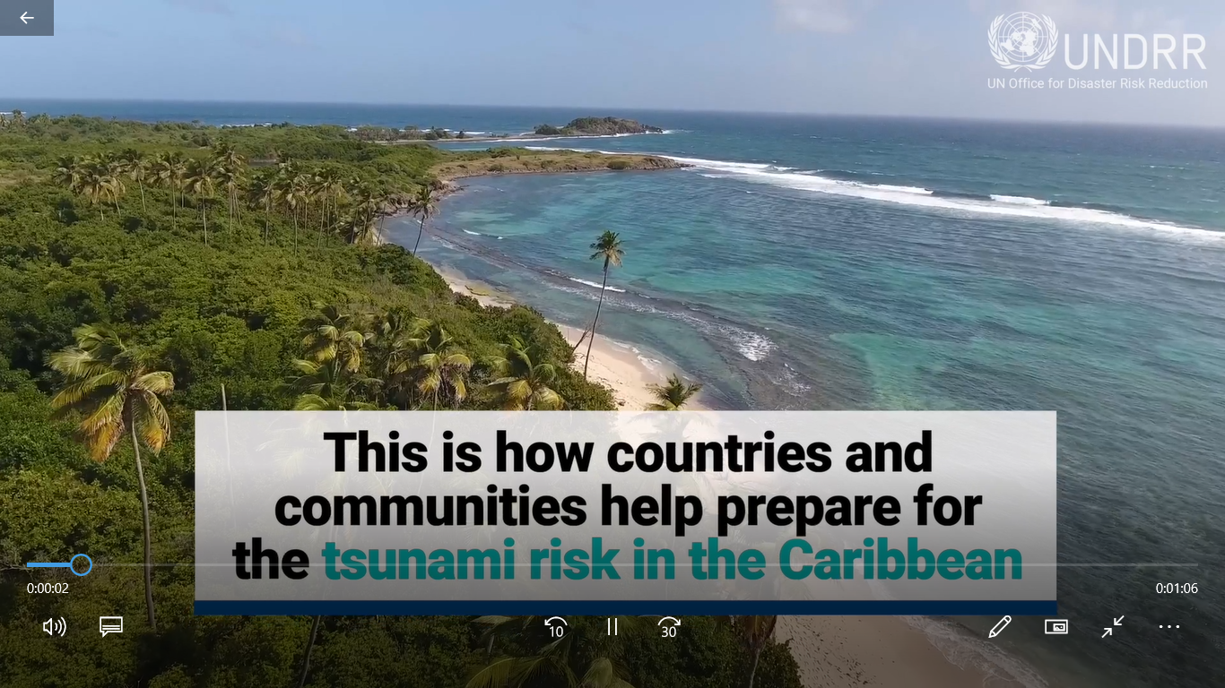
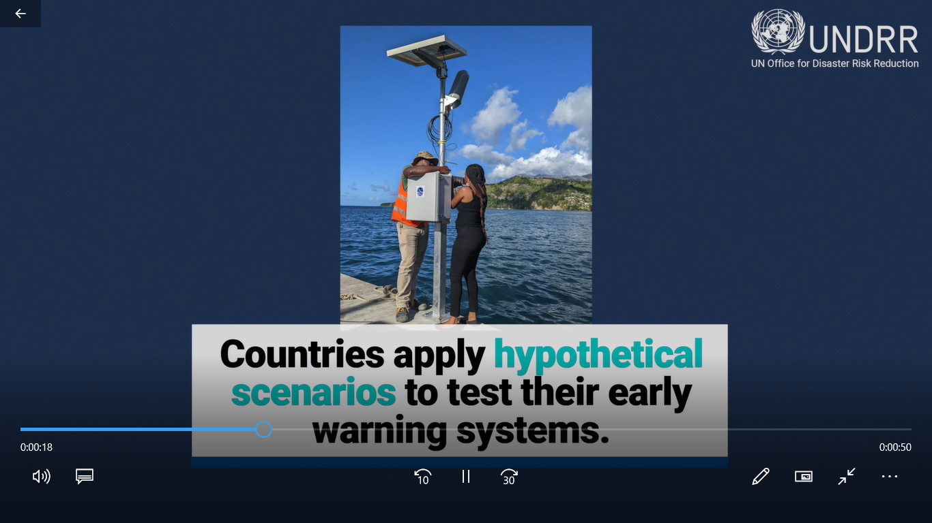
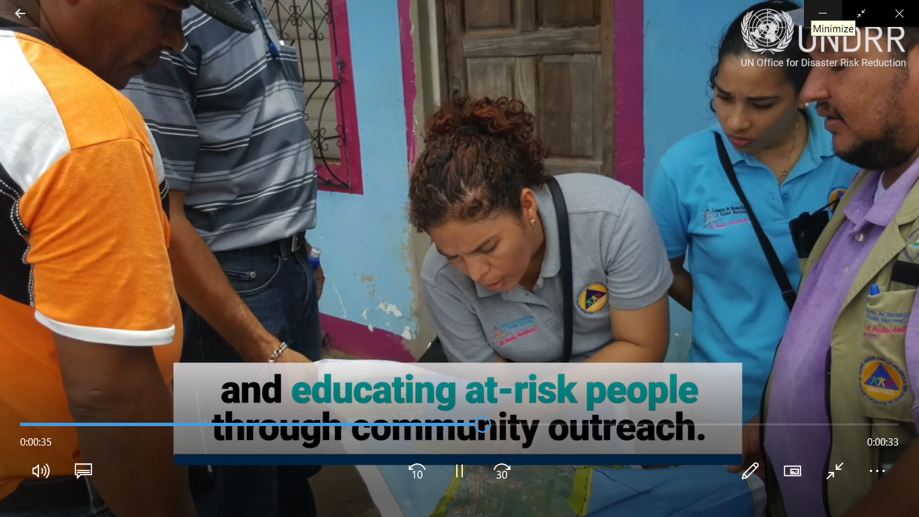
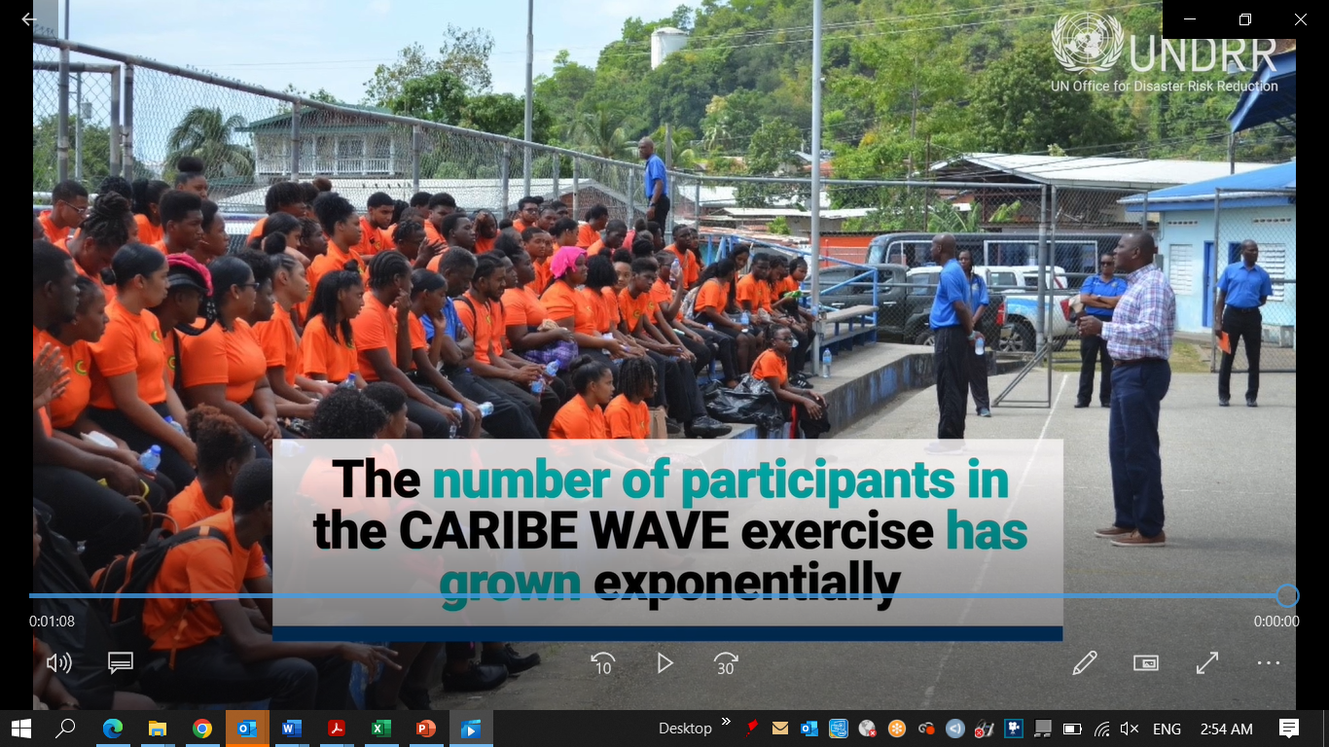
CTIC Activities 2022 – 2023 cont’d
WTAD:
2022 - Supported UNDRR-led development of 1 video re: CARIBE WAVE & Tsunami Ready in support of MHEWS
OCEAN LITERACY:
Dissemination of PAE materials to Member States (including Request form, development of PAE resources and promotion

Slide 8
Follow-Up Actions:
Advise countries currently implementing Tsunami Ready to follow Manuals and Guides 74 Standard guidelines for the Tsunami Ready Recognition Programme
Continue collaboration to mobilize funding and in-kind support
Instructs CTIC to identify actions arising from Caribe Wave Exercise 2021 and coordinate with corresponding Working Groups and Task Teams follow up actions
Requests the Caribbean Tsunami Information Center (CTIC) to develop specific public awareness materials for local tsunami events
Communicate with Member States to identify those interested in Tsunami Ready
Continue collaboration to mobilize funding and in-kind support - ongoing
Instructs CTIC to identify actions arising from Caribe Wave Exercise 2021 and coordinate with corresponding Working Groups and Task Teams follow up actions - outstanding
Requests the Caribbean Tsunami Information Center (CTIC) to develop specific public awareness materials for local tsunami events – initiated through Barbados Community College
Communicate with Member States to identify those interested in Tsunami Ready – ongoing with TT TR

Slide 9
Follow-up Actions:
Advise countries currently implementing Tsunami Ready to follow Manuals and Guides 74 Standard guidelines for the Tsunami Ready Recognition Programme
Continue collaboration to mobilize funding and in-kind support
Instructs CTIC to identify actions arising from Caribe Wave Exercise 2021 and coordinate with corresponding Working Groups and Task Teams follow up actions
Requests the Caribbean Tsunami Information Center (CTIC) to develop specific public awareness materials for local tsunami events
Communicate with Member States to identify those interested in Tsunami Ready
Recommends deeper cooperation between CTIC, CTWP, ITIC, ICG/CARIBE-EWS WG4, the Task Team on Tsunami Ready, and partners including UNDRR and the Regional Early Warning System Consortium (REWSC) to support Member State preparedness and resilience - ongoing
Further Recommends that the CTIC continues to pursue the formalization of agreements to provide a sustainable framework for technical cooperation - ongoing
Requests CTIC in association with the Tsunami Ready Task Team to administer the Tsunami Ready evaluation survey for Tsunami Ready communities recognized since 2019 – survey under review for digitizing by TR TT
Further requests CTIC in association with the Tsunami Ready Task Team and Member States determine the target number of communities in the CARIBE-EWS for Tsunami Ready recognition by 2030 - ongoing

Slide 10
CTIC Considerations and Challenges
Renewal of IOC MOU with Government of Barbados in process due 11 June 2023
Financial and human resource constraints, implications for achievements
Maximisation of opportunities for enhanced technical collaboration and resource mobilization
COVID-19 pandemic and other hazards impacts on priorities + human and financial resources of national Disaster Risk Management Organisations, donors, international and regional organisations to support CARIBE EWS
Need for sustained preparedness activities for tsunamis & deepening existing mechanisms and exploration of new opportunities to facilitate the integration of impacts and risks associated with other coastal hazards within CARIBE EWS
Limited avenues distribution of hard copy education and outreach materials

Slide 11
Key Recommendations to ICG/CARIBE EWS XVI
Notes the significant actions of the CTIC to mitigate the impacts of tsunamis and other coastal hazards in the Caribbean and Adjacent Regions during the April 2022 to March 2023 period, and the associated report.
Notes with appreciation the strong cooperation between the CTIC and ICG/CARIBE EWS Working Group IV particularly in relation to the implementation of the Tsunami Ready Programme, the dissemination and development of outreach and educational resources, support to Ocean Decade initiatives and the achievement of indicators; including the work of the Western Tropical Atlantic Decade Safe Ocean Working Group.
Acknowledges the good collaboration between the CTIC and the CARIBE WAVE Task Team in planning, promoting, executing and evaluating the annual CARIBE WAVE Exercise.
Recommends deeper cooperation between CTIC, ICG/CARIBE WG 4, CARIBE WAVE Task Team, Tsunami Ready Task Team, and partners including UNDRR to support Member State preparedness and resilience.

Slide 12
Key Recommendations to ICG/CARIBE EWS XVI
Encourages Member States to commemorate the World Tsunami Awareness Day (WTAD) on November 5, and share their activities.
Recommends for CTIC to work on WTAD 2023 with the UNDRR, UNESCO/IOC, ICG/CARIBE EWS WG 4 and Member States to coordinate a CARIBE-EWS activity.
Recognises the current work of the CTIC on the review and development of framework and partnership agreements with regional organisations in particular.
Recommends that the CTIC continues to pursue the formalization of agreements to provide a sustainable framework for technical cooperation.
Urges ICG/CARIBE EWS Member States to make contributions to the IOC Special Account and provide human resources under various arrangements to support the work of the CTIC.
Recommends that CTIC continues to work with the IOC Secretariat, CARIBE EWS Member States and partners to develop a strategic plan to guide the resource mobilization efforts of the CTIC

Slide 13
Thank You
a.brome@unesco.org

