Slide 1
CoastPredict: observing and predicting the global coastal ocean
Co-chairs:
Nadia Pinardi, University of Bologna
Villy Kourafalou, University of Miami
Joaquín Tintoré, SOCIB and IMEDEA (CSIC-UIB)
and
E.Heslop, GOOS Unesco-IOC
This programme is endorsed by the UN Decade of Ocean Science
Notes:
By 2050, it’s estimated that more than one billion people will live in the world’s low-lying coastal zones.
Rich in resources and opportunities for trade and recreation, the coastal ocean is susceptible to many natural and man-induced risks and hazards. Coastal resilience is the capacity of the socioeconomic and natural systems to cope with coastal risks and hazards by adapting whilst maintaining the coastal system essential functions.
A Un Decade endorsed program, CoastPredict, is planning to advance the science for coastal resilience.

Slide 2

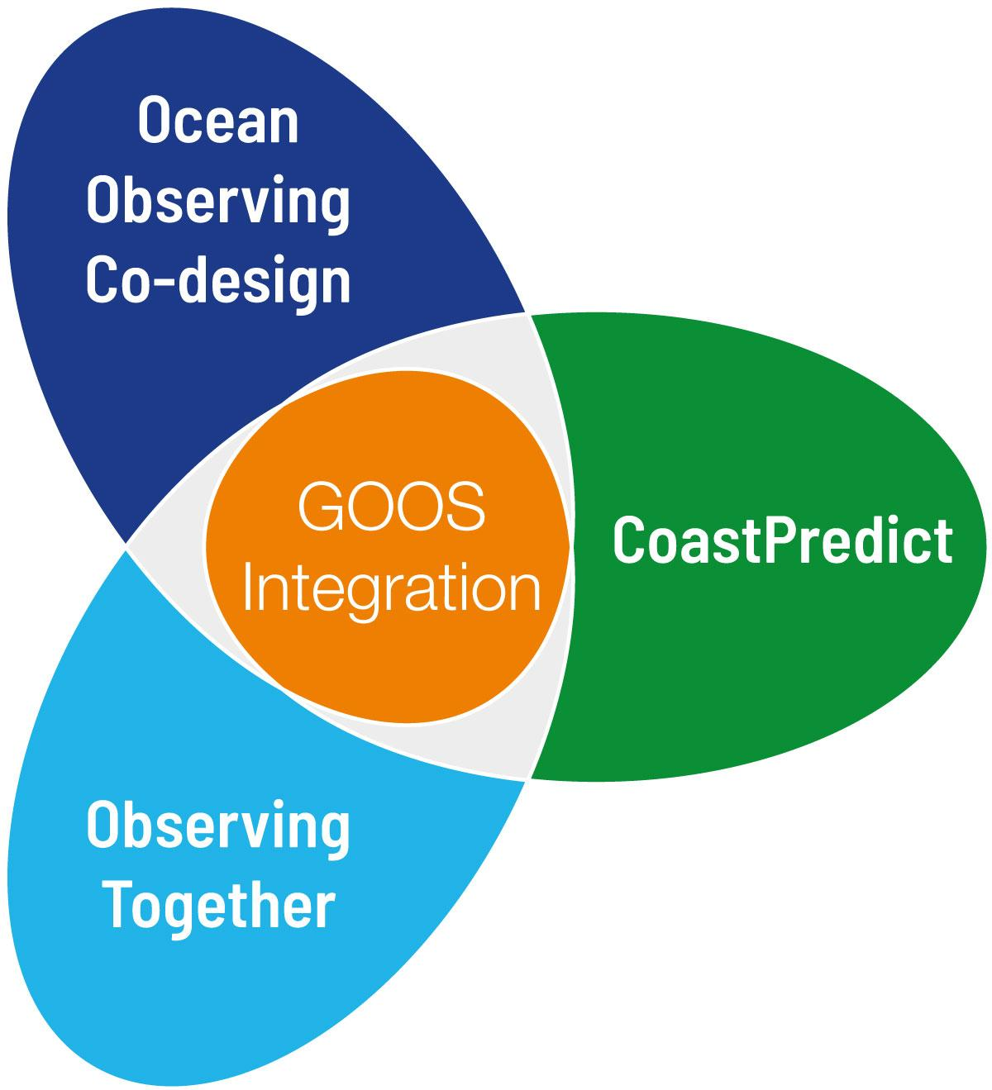
High level objectives
1) A predicted global coastal ocean;
2) The upgrade to a fit-for-purpose oceanographic information infrastructure;
3) Co-design and implementation of an integrated coastal ocean observing and forecasting system adhering to best practices and standards, designed as a global framework and implemented locally.

Slide 3
AIMS
Transform the science of observing and predicting the global coastal ocean;
Develop an integrated coastal and open ocean observing and modelling system;
Provide improved, multidisciplinary, and extended range predictive capability for the coastal zone to respond to societal needs;
Upgrade the infrastructure for exchange of data with standard protocols.
“Focusing on the many common worldwide features of the coastal ocean”

Slide 4
Expected outcomes
1.
2.
3.
Integrated knowledge of global coastal ocean from events to climate.
Design and implementation of an integrated river / estuarine / coastal / open ocean observing and modelling multidisciplinary system.
Improved coastal marine forecasting and extended range predictive capabilities for the coastal zone.
4.
5.
6.
Development of methods for trusted data / information exchange and interoperability across the value chain.
Innovative and sustainable
applications for coastal solutions/
services that directly benefit local populations including well-being and human health.
Increased equitable education and capacity for observing and forecasting in the global coastal ocean.

Slide 5
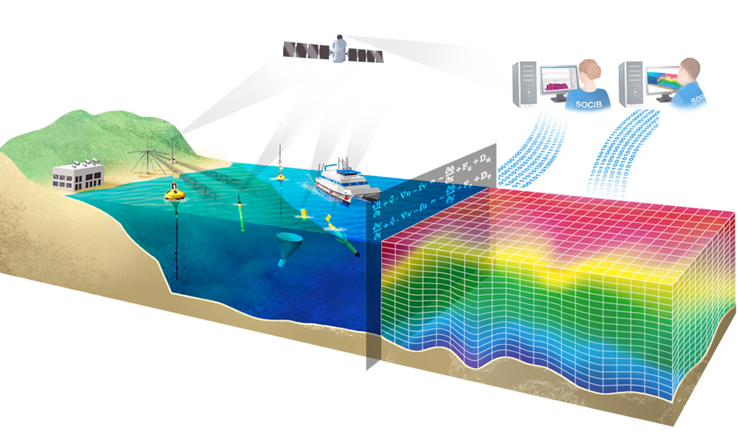
New integrated observing approach
Comprehensive and efficient observing systems:
From inland to offshore
Relocatable
Multi-sensor, “smart” sensors
Delivering data: open and free access to users
3 projects &, 4 affiliated projects endorsed.

Slide 6
The CoastPredict development plan
Global Coast
experiment
Revolutionarizing
the global
coastal ocean
observing
& predicting
New Global Coastal
Ocean concepts & standards, networks
for a Coastal resilience-ready
community
FA1, FA2,
FA3, FA4,
FA5, FA6
15~20 world coastal areas
as demonstration regions/sites for
new technologies & integration (obs & mod) providing SOLUTIONS and having REAL IMPACT on coastal resilience
Notes:
Focus Area 1: Integrated observing and modelling for short term coastal forecasting and early warnings
Focus Area 2: Earth system observing and modelling for coastal climate monitoring and downscaling
Focus Area 3: Solutions for integrated coastal management
Focus Area 4: Coastal ocean and human health
Focus Area 5: International open and free access to coastal information
Focus Area 6: Equitable coastal ocean capacity

Slide 7
Global Coast Basic principles
Coastal observation and prediction products/information
Digital Platform for on-demand resources & data analytics & user-oriented transformation
End-user tailored products and decision support systems for coastal resilience
Training and outreach
Global Coast Platforms
Contributing to the whole Coastal Ocean Value Chain

Slide 8

Get involved !
© SOCIB
… start the conversation about how you can help us and what your contribution will enable us to achieve together.
Thank you!
www.coastpredict.org
info@coastpredict.org
Notes:
Thank you all for the attention

