Slide 1
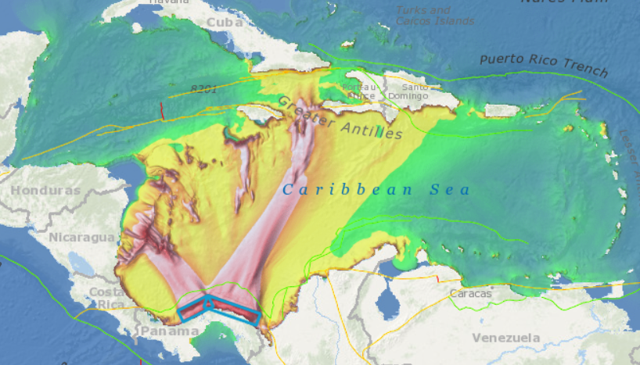
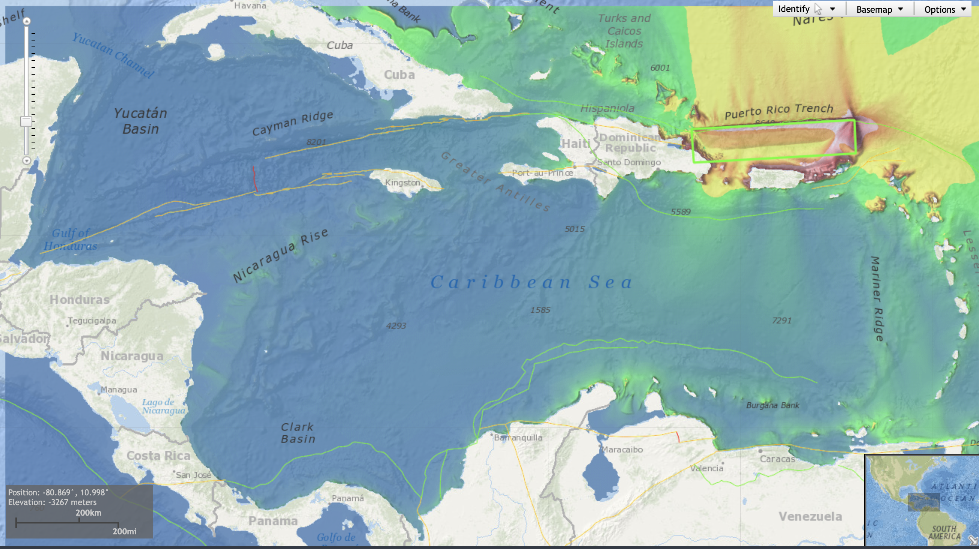
Intrasessional Working Group on CARIBE WAVE 24
Decides that CARIBE WAVE 24 will consist of 2 scenarios that include 1) a tsunamigenic earthquake along the Puerto Rico Trench, 2) the 1882 north Panama Deformed Belt scenario,
Name: 1882a
Basin: Caribbean Sea
Region: NPDBt
Depth (km): 22.5
Strike (deg): 109
Dip (deg): 30
Rake (deg): 110
Length (km): 274
Width (km): 70
Slip (m): 6
Mw: 8.340045
Region: Puerto Rico Trench
Depth (km): 20
Strike (deg): 86
Dip (deg): 20
Rake (deg): 23
Length (km): 500
Width (km): 110
Slip (m): 8
Mw: 8.711311
Generated at Experts Meeting: Dominican Republic 2016
Name: 1882b
Basin: Caribbean Sea
Region: NPDB
Depth (km): 22.5
Strike (deg): 63
Dip (deg): 30
Rake (deg): 65
Length (km): 166
Width (km): 70
Slip (m): 6
Mw: 8.19495

Slide 2
Intrasessional Working Group on CARIBE WAVE 24
Suggests that the CARIBE WAVE 25 exercise consist of 2 scenarios that include 1) 1692 Jamaica scenario, and 2) the 1755 Lisbon scenario,
Suggests that the CARIBE WAVE 24 exercise will take place on Thursday, March 21, 2024, commencing at 15:00 UTC with one dummy message, and the 1st message for the scenarios shortly after according to PTWC simulated procedures for the corresponding scenarios,
Recommends following a similar timetable and benchmarks on CARIBE WAVE 23 and that preparatory webinars follow the same or similar process as used in previous exercises,
Further recommends that the registration process remains at www.tsunami zone.org

Slide 3
Intrasessional Working Group on CARIBE WAVE 24
Acknowledging the CARIBE WAVE TT uses CATSAM TO decide future scenarios,
Recommends that Task Team CARIBE WAVE to assist WG2(1) in prioritizing of scenarios to be included in CATSAM.
Recommends that flexibility be given to Member States for running of CARIBE WAVE 23, if the agreed date is not feasible, and that information on conducting the exercise on alternative dates be shared in the Exercise Manual.
Recommends TT CARIBE WAVE to explore the possibility of gradually increasing the level of difficulty for future CARIBE WAVE Exercises (e.g. hours, weekends, holidays), based on preparedness of Member States (e.g. number of TR communities).
Recommends Member States to combine CARIBE WAVE scenarios with multi-hazard events, in the context of CARIBE WAVE Exercises.

Slide 4
Intrasessional Working Group on CARIBE WAVE 24
Recommends that Task Team CARIBE WAVE review and update the CARIBE WAVE Post-Exercise Questionnaire.
Suggests that TT CARIBE WAVE explore opportunities to further involve tourists and tourism organizations in CARIBE WAVE Exercises, with the aim to develop guidelines/resources on involvement of tourists in CARIBE WAVE Exercises.
Recommends that the TT CARIBE WAVE hold a meeting in 2023 to discuss the CARIBE WAVE questionnaires, and opportunities for integrating gradual flexibility in CARIBE WAVE Exercises.

