Slide 1

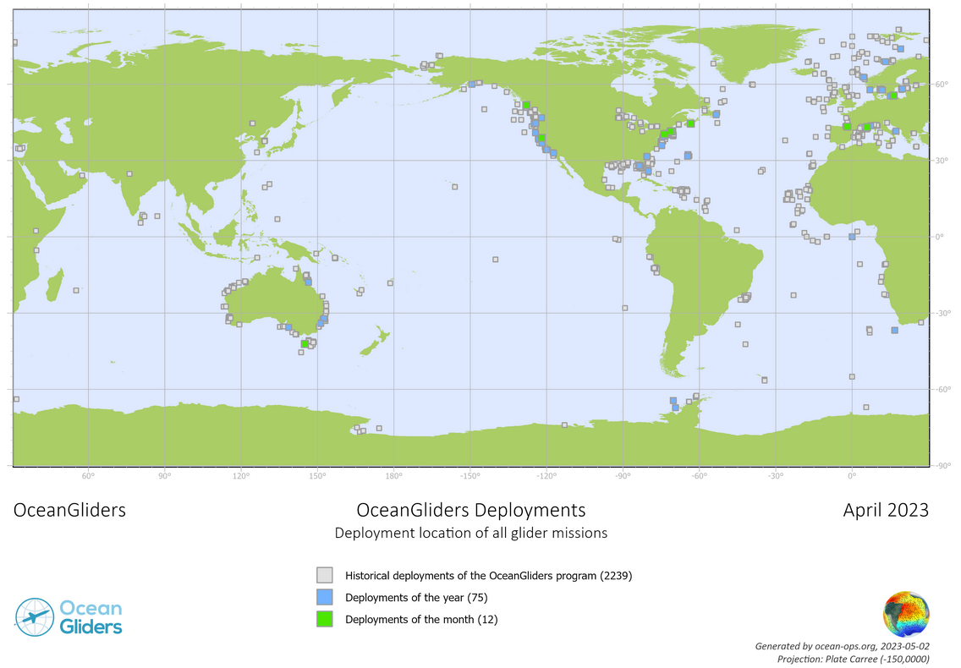
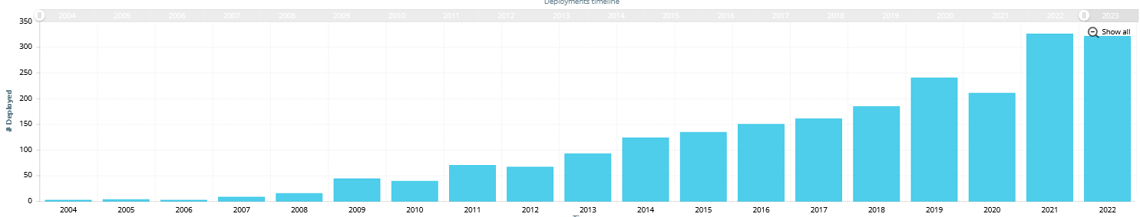
Current Status :
Growing international involvement in the OceanGliders program (+2 countries in 2023, Belgium and Mexico)
320 deployments registered in 2021 and 2022. 2023 is on a similar pace.
Continuous development of OceanOPS capacity to monitor the program (Maps, KPIs, automatic metadata harvesting)
OG1.0 and BUFR format for glider released !!!
Paper on community best practices should be finalized in 2023.
US communtity met late 2022. An organisation committee is preparing for the next international meeting in June 2024.
Open call for new task teams to extend scope of the program and renew existing task teams
number of OceanGliders missions per year since 2004

Slide 2
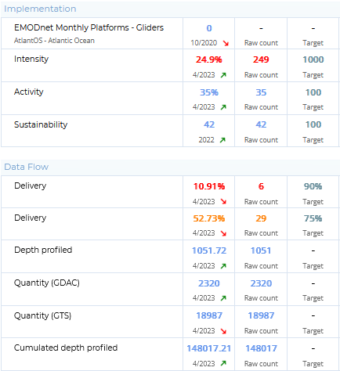
Developments and Achievements
Main achievements in 2022-2023:
OG1.0 and BUFR format for gliders finalized
Good progress in terms of implementation and moderate progress in terms of data flow.
Strong representation of OceanGliders during UG2 meeting (sept 2022)
Main activities in 2022-2023
Automation of metadata harvesting (VOTO, Alseamar), to be further developed
New programs entering linked to OceanGliders
Renewal of the OceanGliders steering committee (Jan 2023) and call for new task teams in progress

Slide 3
How did OceanGliders ST tackle last year challenges and concerns?
OceanGliders Program coordination:
Need to develop clearer targets for the OceanGliders program, maybe at the TT level ?
  Call for new and updated task team being processed, target by TT being part of the process review.
Meeting is needed to share new scientific results and continue to build the OceanGliders community.
  Next community meeting planned for June 2024. « Save the date » being release June 2023.
More regular OceanGliders steering team meetings and exec meetings

Slide 4
How did OceanGliders ST tackle last year challenges and concerns?
Data management :
Evolve toward a more unified data management system
  The format (being released officially later this month) should be a huge step to harmonize data management procedures.
Engage closer cooperation with IOOS GDAC (US), European glider RI and OceanGliders Canada.
  Strong participation to the European Glider Research Infrastructure data management road map.
  Develop M2M communication with Alseamar (glider manufacturer) and VOTO (ERDDAP)

Slide 5
How did OceanGliders ST tackle last year challenges and concerns?
Best practices :
Finalize OceanGliders best practices documents (stand by since 6 months).
  Work in progress, Pierre Testor and Victor Turpin engage in finalization
Continue the production of Standard Operational Practices
  Nacent progresses in the RTQC SOP.
Metadata management
Engage the community in the use of OceanOPS system
  Request WMO ID for gliders being centralized in OceanOPS and used by the OceanGliders community
  C-IOOS upload metadata autonomously on OceanOPS.
  CIOOS developed a Glider DAC

Slide 6
OceanGliders next challenges?
Data and metadata management :
Implement OG1.0 and BUFR format
Centralize all OG data sets into one single entry point
Elaborate a delayed mode data management strategy for the program
Promote the use of OceanOPS to manage metadata
Best practices :
Finalize OceanGliders best practices documents.
Promote the use of the OceanGliders Github repository
Monitoring
Develop operational monitoring of key OceanGliders national programs through automated data and metadata flow
Support to develop monitoring tools at OceanOPS is needed

Slide 7
Priorities for 2023-2024
Organize community meeting in 2024
Creation of new task team and renew engagement of existing task teams
Build upon the release of OG1.0 and BUFR format
Engage in the delayed mode data management with the OceanGliders data management task team.
Develop more monitoring tools for the program

Slide 8
Asks from OCG
Support cross-network collaboration (workshops, meetings, data flows)
Help to coordinate response to Ocean Decade actvities
Promotion to regular from emerging network
Support opportunities for funding of Ocean OPS

