Slide 1
Meeting stakeholder needs and making every observation count
Co-chairs: Molly Powers (Pacific Community)
Alvaro Scardilli (Naval Hydrographic Service, Argentina)
This programme is endorsed by the UN Decade of Ocean Science

Slide 2
GUIDING PRINCIPLES FOR PROJECTS:
Aim is sustained ocean observations, i.e. not one-off research project observations;
Engagement with GOOS components (networks, systems, etc);
Adherence to using and / or contributing to creating community adopted best practices;
Adherence to FAIR [findable, accessible, interoperable, and reusable] data principles;
Willingness to share experience and lessons learnt across Observing Together;
Willingness to engage in co-design activities to improve observing system fit for purpose and to optimise the observations to inform stakeholder decision-making

Slide 4
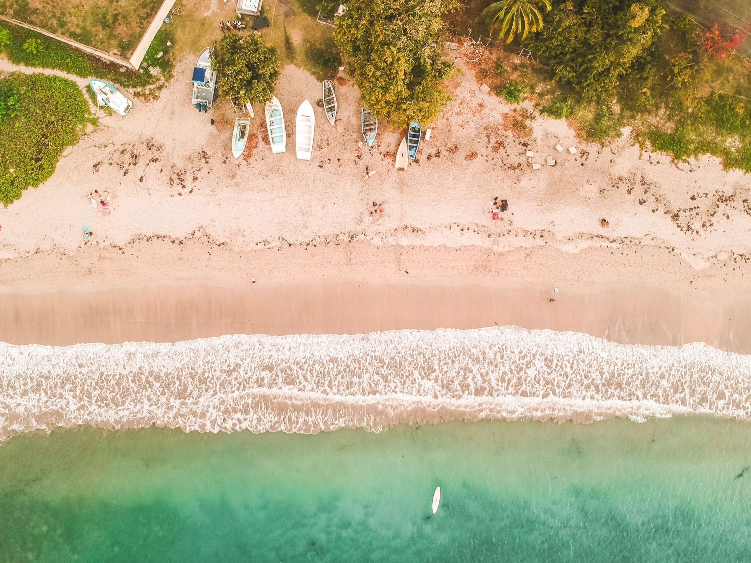
NATIONAL OBSERVING SYSTEMS DEVELOPMENT
Enhancing ocean observing system within the Republic of Mauritius
Enhancement of hydrographic and oceanographic observations in the Kingdom of Morocco
enhancement of ocean knowledge and forecasting by developing and enhancing national system
contribute to the regional programmes of African / Indian Ocean regions
strengthen capacity in terms of platforms and network development
develop modelling capabilities
benefit from and adhere to best practices
Photo by Guillaume Baudusseau on Unsplash
Notes:
Projects are falling into three categories - the first we highlight here is national observing systems development
2 projects - Morocco and Mauritius - these have similar aims and needs and we look in more detail at them in next slides

Slide 5
Enhancing ocean observing system Republic of Mauritius
Request for opportunities through GOOS to increase observing system in Mauritius
Request for regional collaboration
Develop infrastructure to share data
Early warning system needs enhancement of observations but government funding not available
Particular capacity development needs around: > Early warning system upgrade (storm surge & wave model) and training to build modelling capacity, incl. development of operational oil fate & transport modelling system
> Specific areas for capacity development & training: Wave modeling / Coastal hydrodynamics / GIS / Climate Change coastal adaptation / Oil spill modelling / Disaster management for coastal community
Existing activity:
Instrumentation: Drifters (NOAA) and Argo (from Meteo France) deployed. Wave riders - 2 to be deployed / one Mauritius and one in Rodrigues. New tide gauges being deployed (Uni Hawaii). Coastal radar deployment(waves and coastal erosion)
Notes:
MOLLY END HERE

Slide 6
Enhancing ocean observations Morocco
Strengthen capacity of observing platforms
Strengthen capacity for tsunami early warning
Support to align with standards and best practices for networks e.g. GLOSS
Data management & transfer
Capacity development (priority: modelling - workshop suggested)
Connection to regional initiatives to share success and contribute regionally (Africa, Mediterranean)
Visibility
Existing activity:
> Season oceanographic survey cruises - Atlantic Ocean and the Mediterranean Sea in order to study the variability and evolution of the ocean through hydrological and current measurements.
> Tide gauges in ports through tidal observatory project - part of national coordination: hydrography, oceanography & mapping
> HF radar network, buoys, automatic weather (National Weather Service / National Port Authority)
> High resolution hydrographic surveys

Slide 7
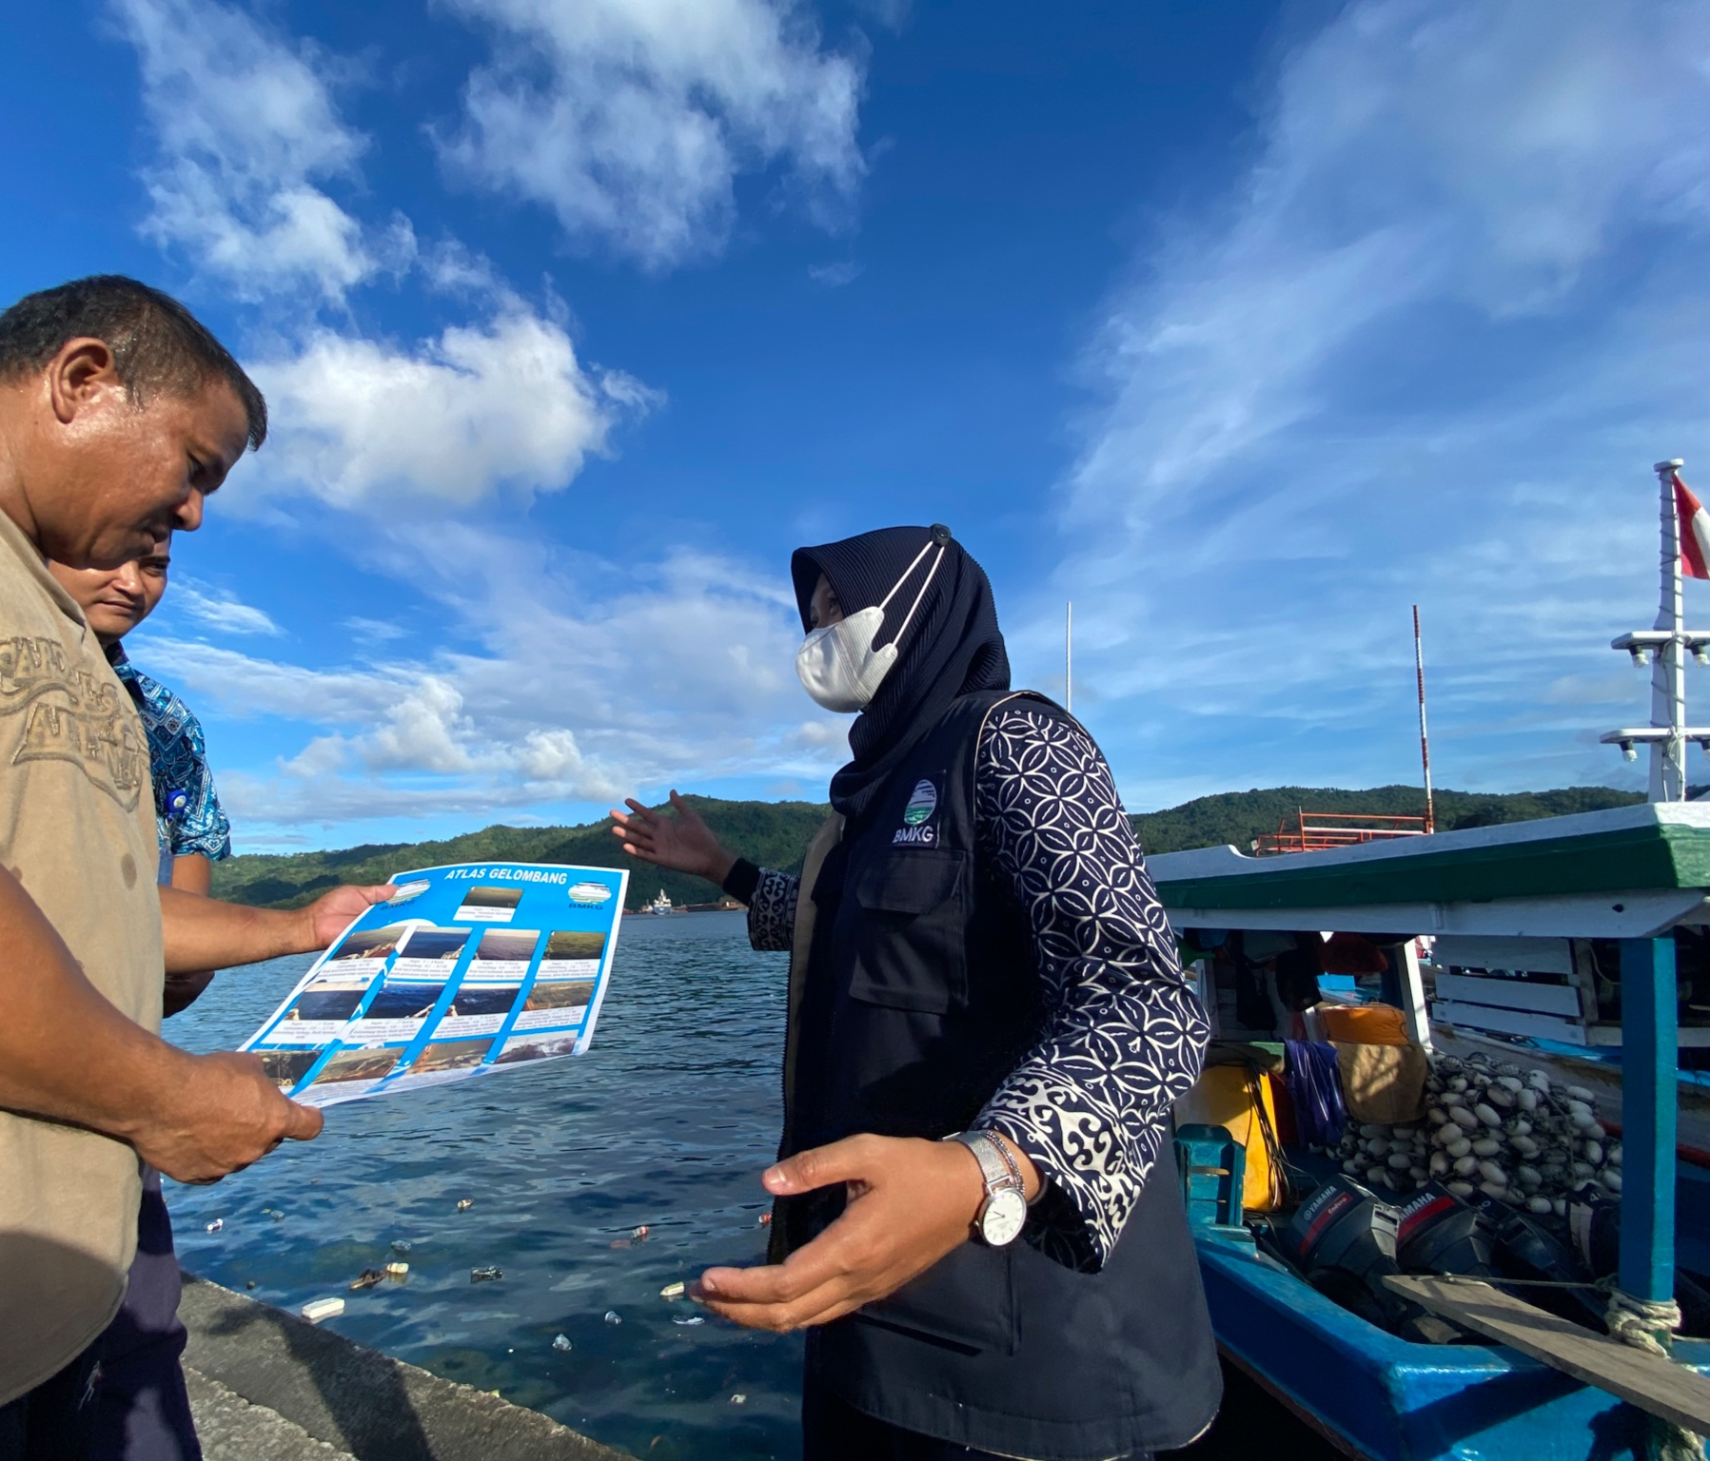
END-USER ENGAGEMENT
Fisherman Weather Field School (BMKG Indonesia)
educating fishing communities to improve knowledge about weather climate literacy and climate change and their use for fishermen and coastal communities
reduce accidents / risk due to extreme weather
increase business certainty and sustainability by optimising fishing & aquaculture activities
increase awareness of in-situ equipment vital role, to reduce vandalism
POTENTIAL TO REPLICATE THIS IN OTHER COUNTRIES / REGIONS?
Photo © BMKGSekolah Lapang Cuaca Nelayan (SLCN)

Slide 8
END-USER ENGAGEMENT
AtlantOS-Connect
integrate user communities to understand their needs
enhance data accessibility to increase the value and responsiveness of the ocean observing system to critical users
diversify membership of the AtlantOS Steering Committee
develop and communicate studies of the societal and economic value of Atlantic Ocean observing to user communities

Slide 9
NEW OBSERVERS
Sailing 4 Science (NTNU Norway)
focus on remote, understudied coastal ocean often coinciding with SIDS or low income communities, where capacity building must be carefully co-designed
deploy frugal, cost-effective observation tools
Big capacity development focus e.g. Ghana Dec 2022 / Tanzania Jan 2023
POTENTIAL TO INTERACT WITH GRAs WHEN EXPEDITIONS ARE HAPPENING TO TARGET PRIORITY OBSERVATIONS?
Notes:
The co-created, crowd-sourced data is valuable in itself but the collection process will be important ocean literacy and awareness activities additionally.

Slide 10
More info on
Observing Together webpage
goosocean.org

Slide 11
PROJECTS ENDORSED BY THE OCEAN DECADE
NEW OBSERVING SYSTEMS:
MarocNatCom
Enhancement of oceanic knowledge by developing a Moroccan national observations network
Mauritius Meteorological Services
Enhancement of the ocean observing system within the Republic of Mauritius
END-USER ENGAGEMENT:
Agency for Meteorology, Climatology and Geophysics of the Republic of Indonesia [BMKG]
Ocean Literacy: Fisherman Weather Field School - Sekolah Lapang Cuaca Nelayan [SLCN]
AtlantOS-Connect
Focus on user community engagement with observing networks
NEW OBSERVERS:
Norway NTNU
Sailing4Science: expand capacity for through citizen science, with emphasis on remote under-observed areas
Notes:
This slide gives an overview of the projects involved grouped under natural groupings that we plan to leverage to streamline how we support these projects and create opportunities for knowledge sharing and synergy between projects

