Slide 1
Belen Jimenez
South and West Pacific Regional Data Center E-mail: pacific@seabed2030.org
https://seabed2030.org
OGC-14 Meeting, 08 June 2023

Slide 2
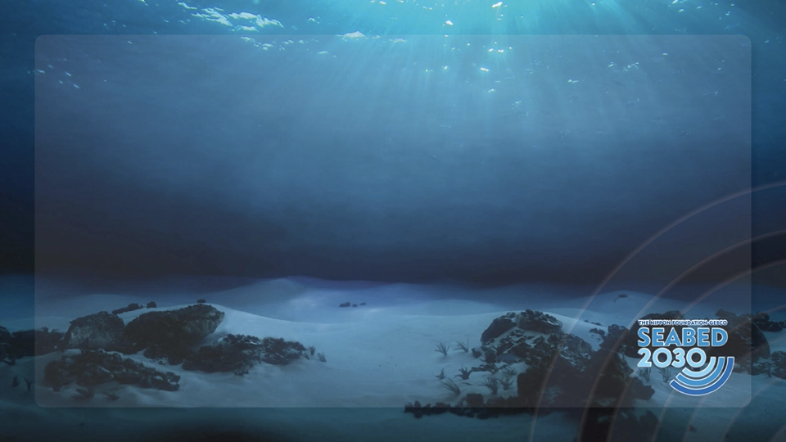
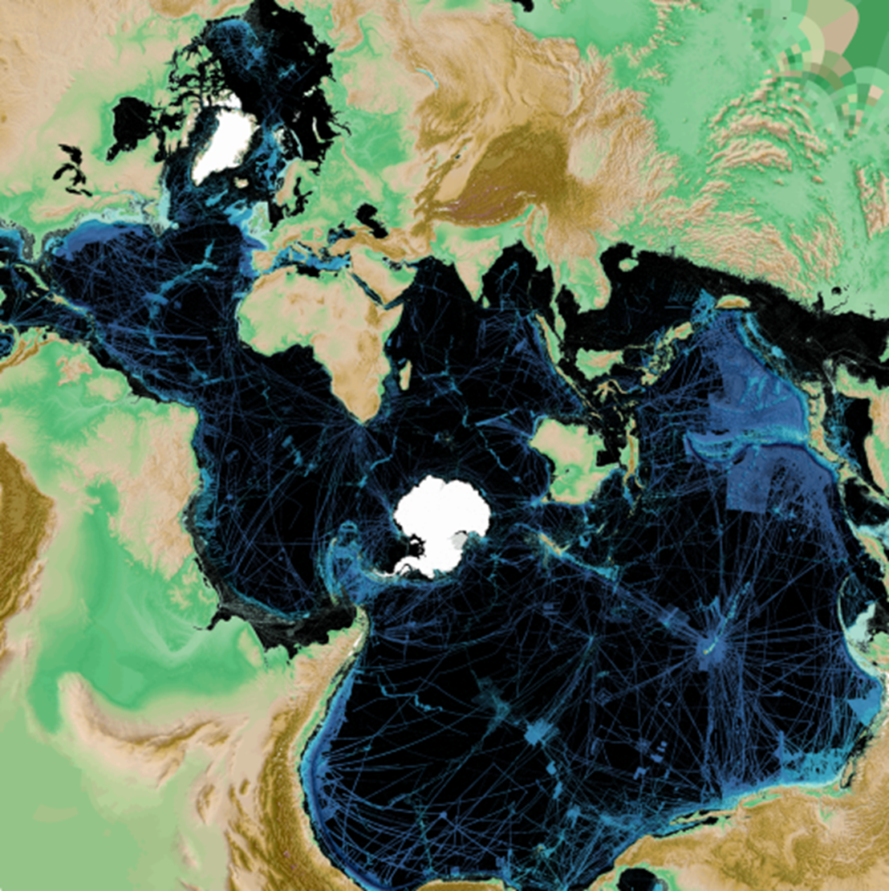
It really is …..
Our One Ocean!
Seabed 2030 Vision:
100% of our Ocean Floor mapped by 2030
Notes:
There is no mi

Slide 3
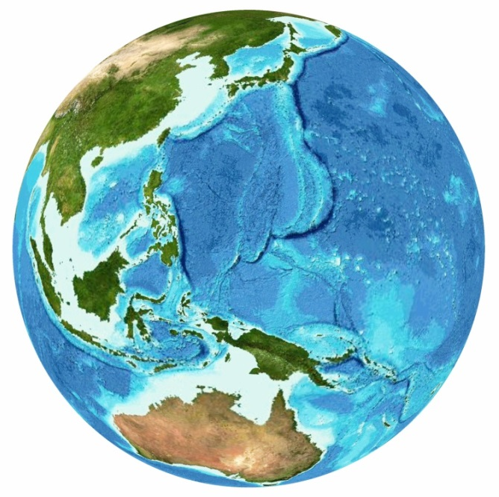
GEBCO + Nippon Foundation → Seabed 2030
General Bathymetric Chart of the Oceans -
Authoritative, publicly-available
https://www.gebco.net/
https://seabed2030.org/

Slide 4
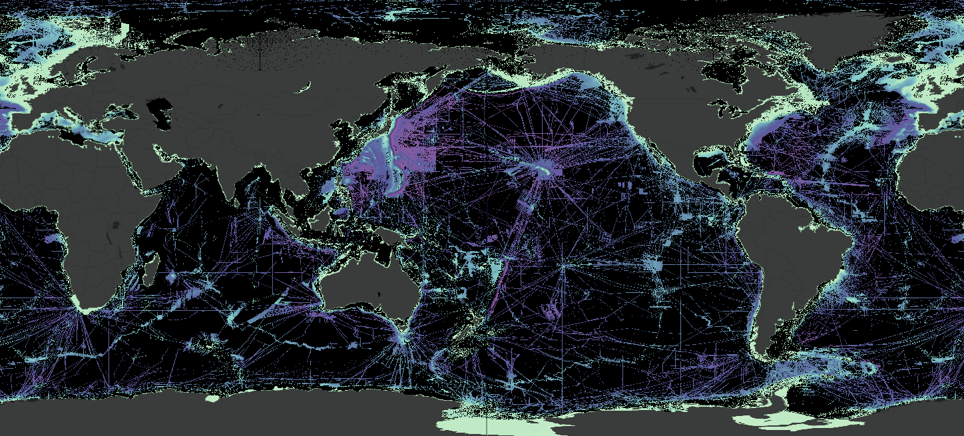
Global progress
24.9%

Slide 5
How can you get involved?
Data IN
GEBCO
A + B + C = 100%
Data NOT in GEBCO
Not Mapped
Talk about Seabed 2030
Contribute Data
Collect Data in Transit
Crowdsourced Bathymetry
Fill in the Gaps

Slide 6
Thank you

