Slide 1
Ship Observations Team
OCG-14 Hybrid Meeting
6-8 June 2023
Cape Town, South Africa
Joel Cabrie, VOS Panel Chair (acting)
Tamaryn Morris, SOOP Implementation Panel co-Chair
On behalf of:
Darin Figurskey (outgoing SOT Chair), Huai-Min Zhang (incoming SOT Chair), Elizabeth Kent (SOT vice-Chair), Rudolph Krockauer (ASAP Chair), Francis Bringas (SOOP co-Chair), Justine Parks (SOOP co-Chair), Martin Kramp (Technical Coordinator)

Slide 2
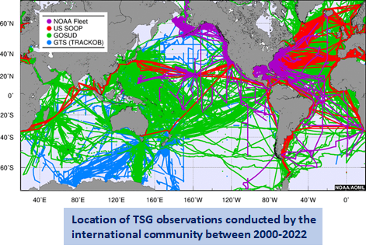
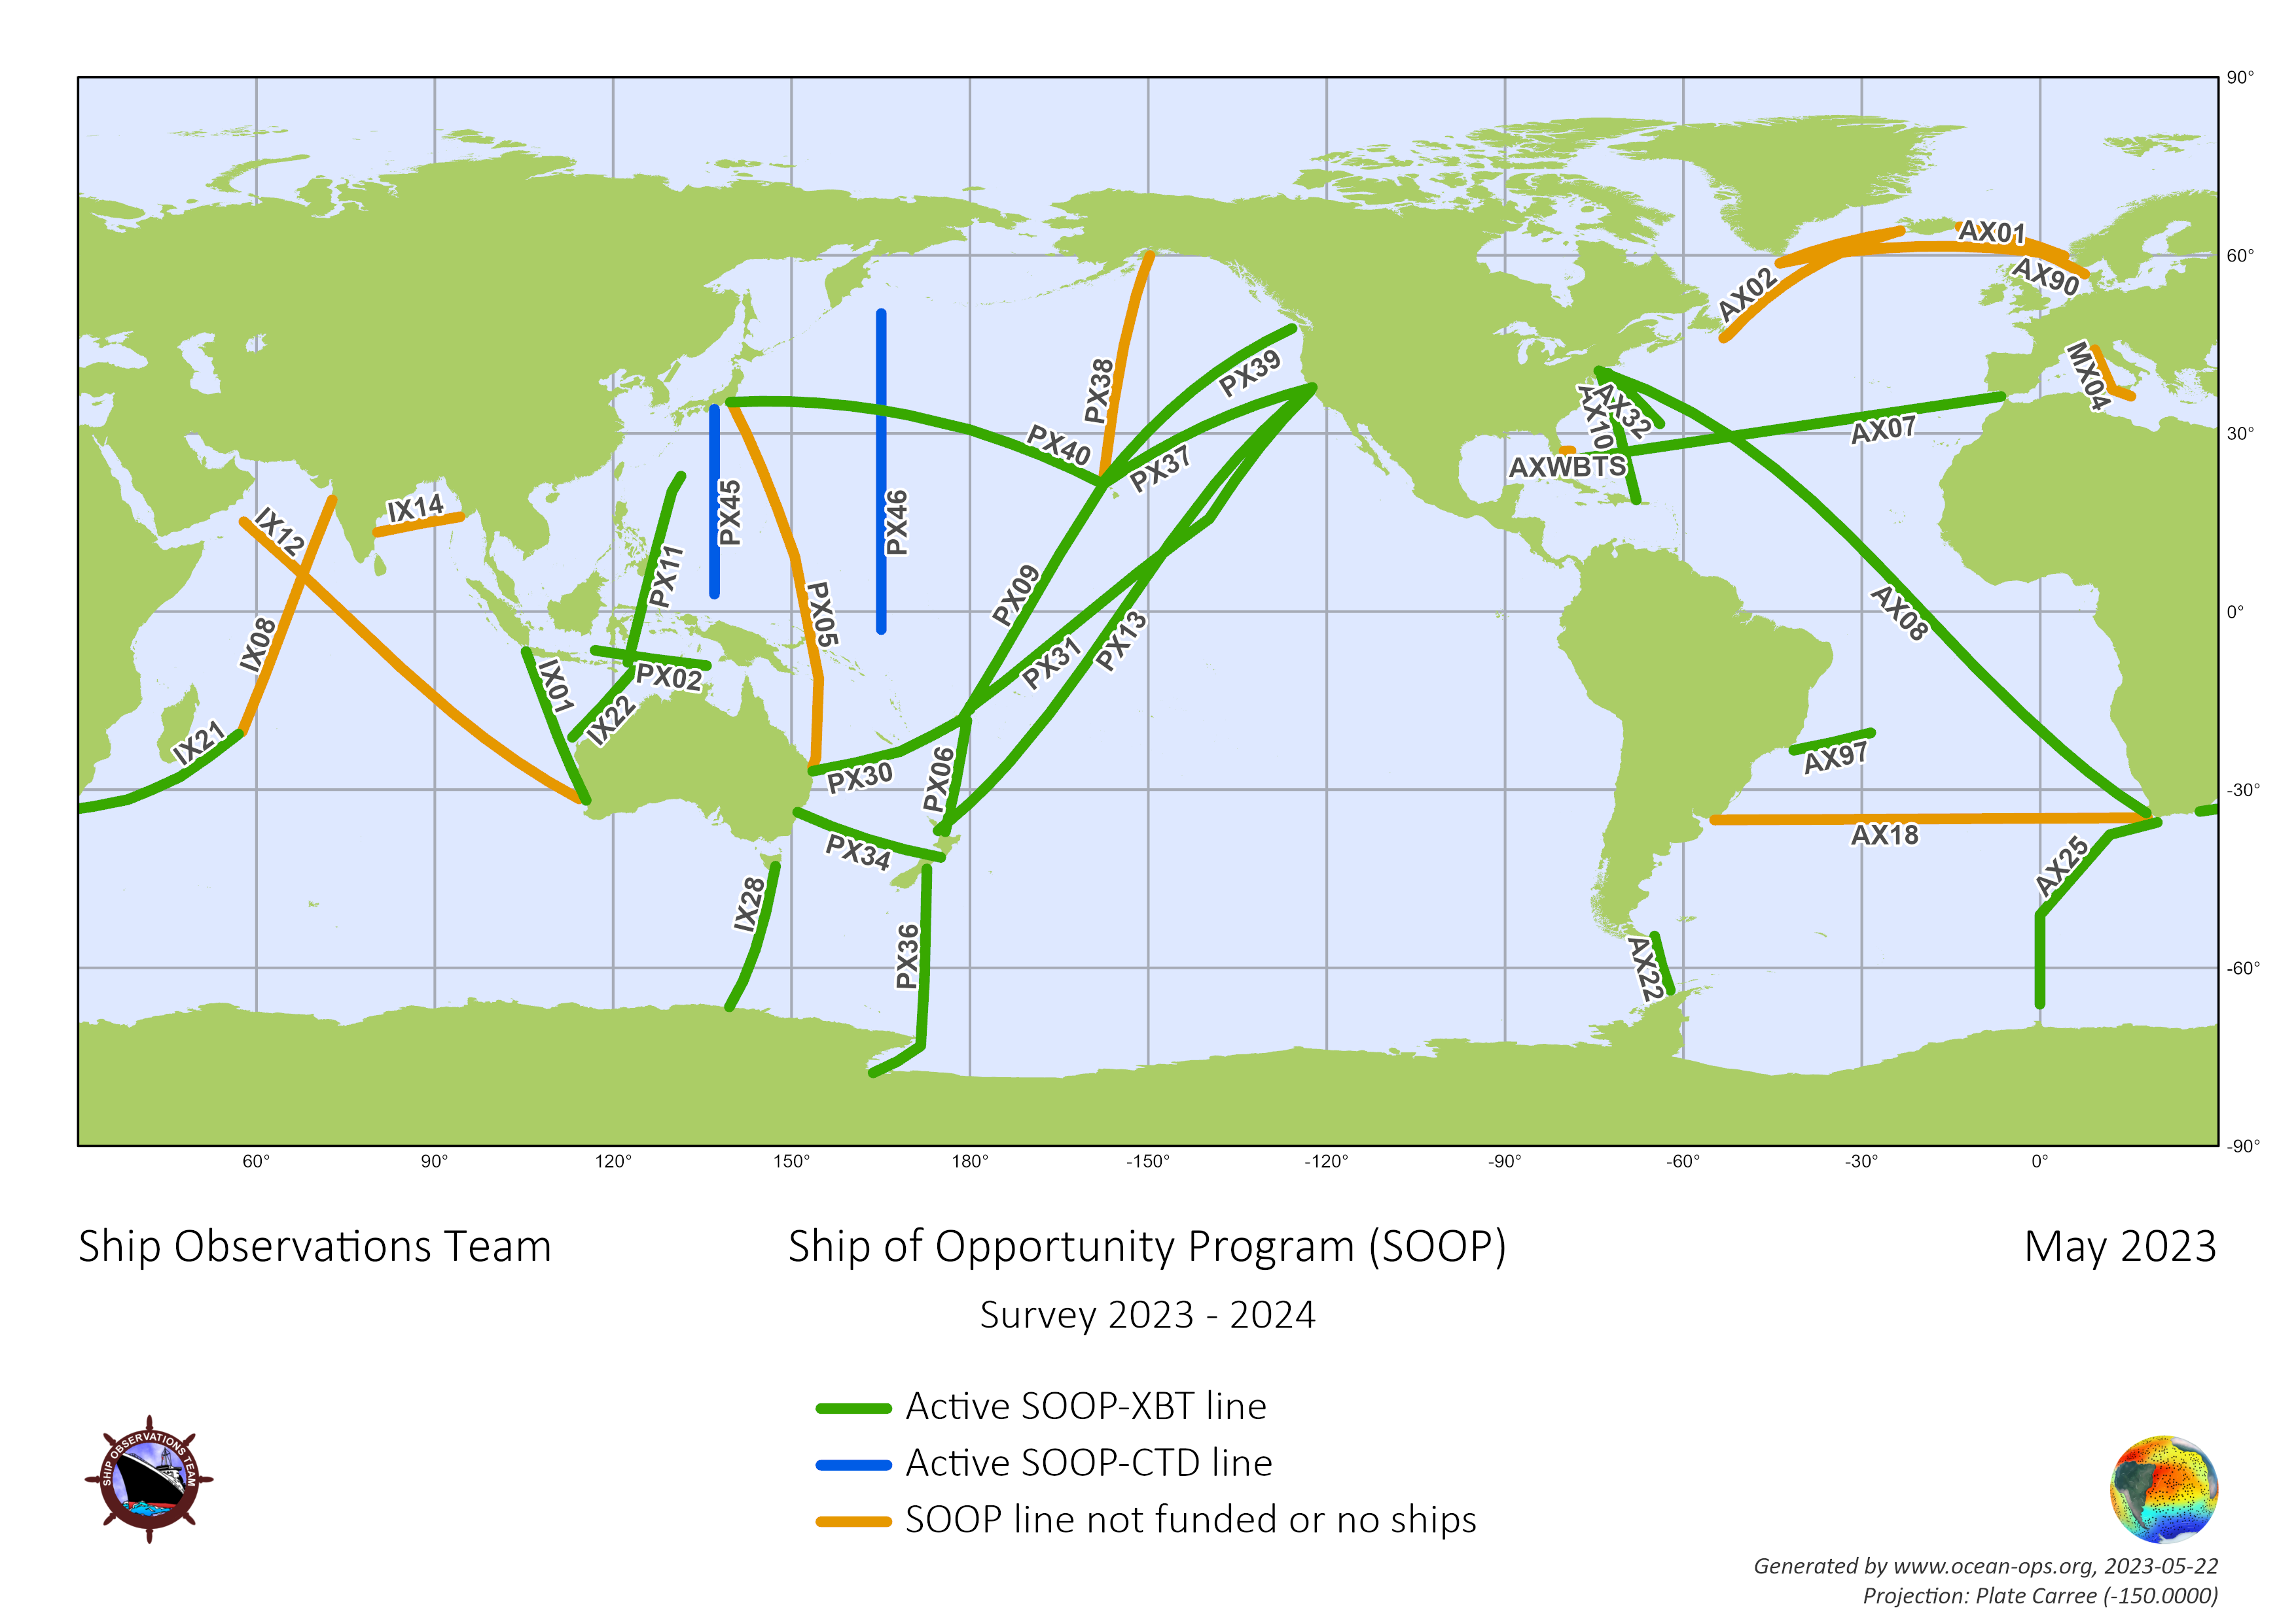
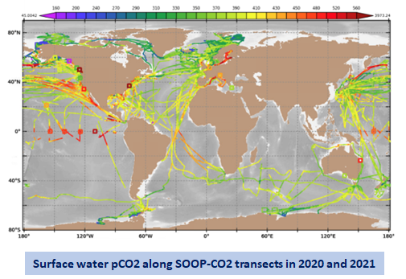
SOOP
(XBT, TSG, PCO₂, CPR, Ferrybox communities)
75% of recommended transects are active, plus 6 additional transects
PX45/46 per regular CTD casts, PX36 re-established
10,500 XBT profiles, 1,000,000 pCO2 and 5,000,000 TSG obs. per year
82 Ships during the last 2 years
90% of XBT profiles submitted to GTS in near real time after auto-QC
Active development of new technologies and data management techniques
Active participation in science and data projects including XBT Science Team, IQuOD, GTSPP, and GOSUD
Notes:
CTD – blue lines – Japan. Needed to capture these lines and not lose them from the OceanOps datasets. Third party vessels that now do CTDs – like vessels of opportunity. TSG, PCO2, CPR not as well established as XBT. This intersessional period will focus on this.

Slide 3
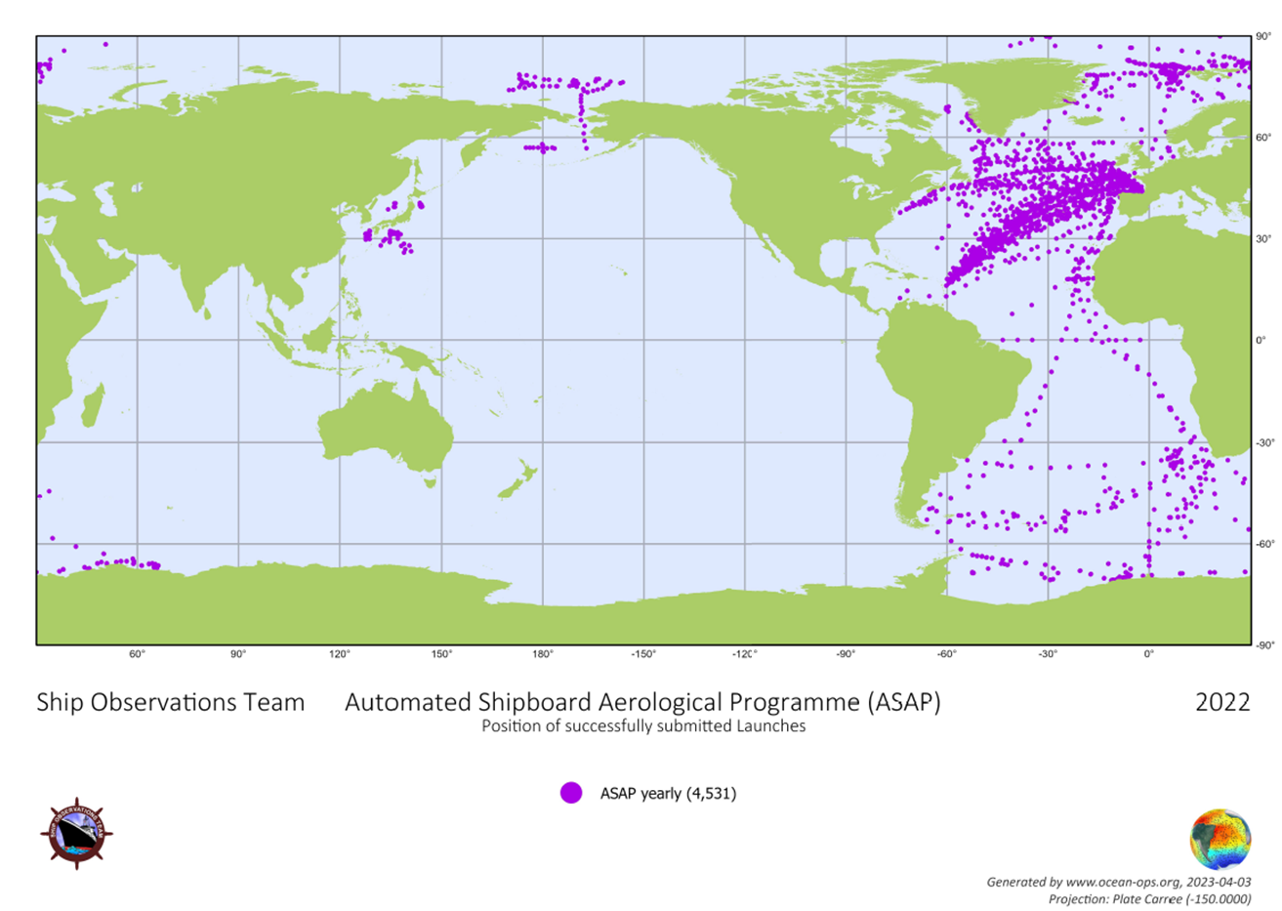
ASAP
Status (March, 2023)
European ASAP fleet: 17 active (+ 1 inactive) ships (13 merchant ships + 4 governmental ships), focusing on the North Atlantic.
Regular daily soundings in Polar regions and in transit from German research ship Polarstern.
Irregular soundings from other research ships.
Foci for 2023
Extend sounding data by implementing ascents + descents.
Sustain good data quality.
European ASAP: Prepare next Programme phase 2024-2028.
Promote ASAP activities in observing community to achieve better coverage at global scale.
Migrate last remaining stations to BUFR and SOT-IDs
Recent achievements
ASAP independent panel within SOT since SOT-11
4531 successful ASAP launches with data submission to the GTS in the year 2022 (mainly in the North Atlantic and Arctic).
E-ASAP: 3681,
RV Polarstern: 389,
RVs from Japan, Korea, South Africa: 461

Slide 4
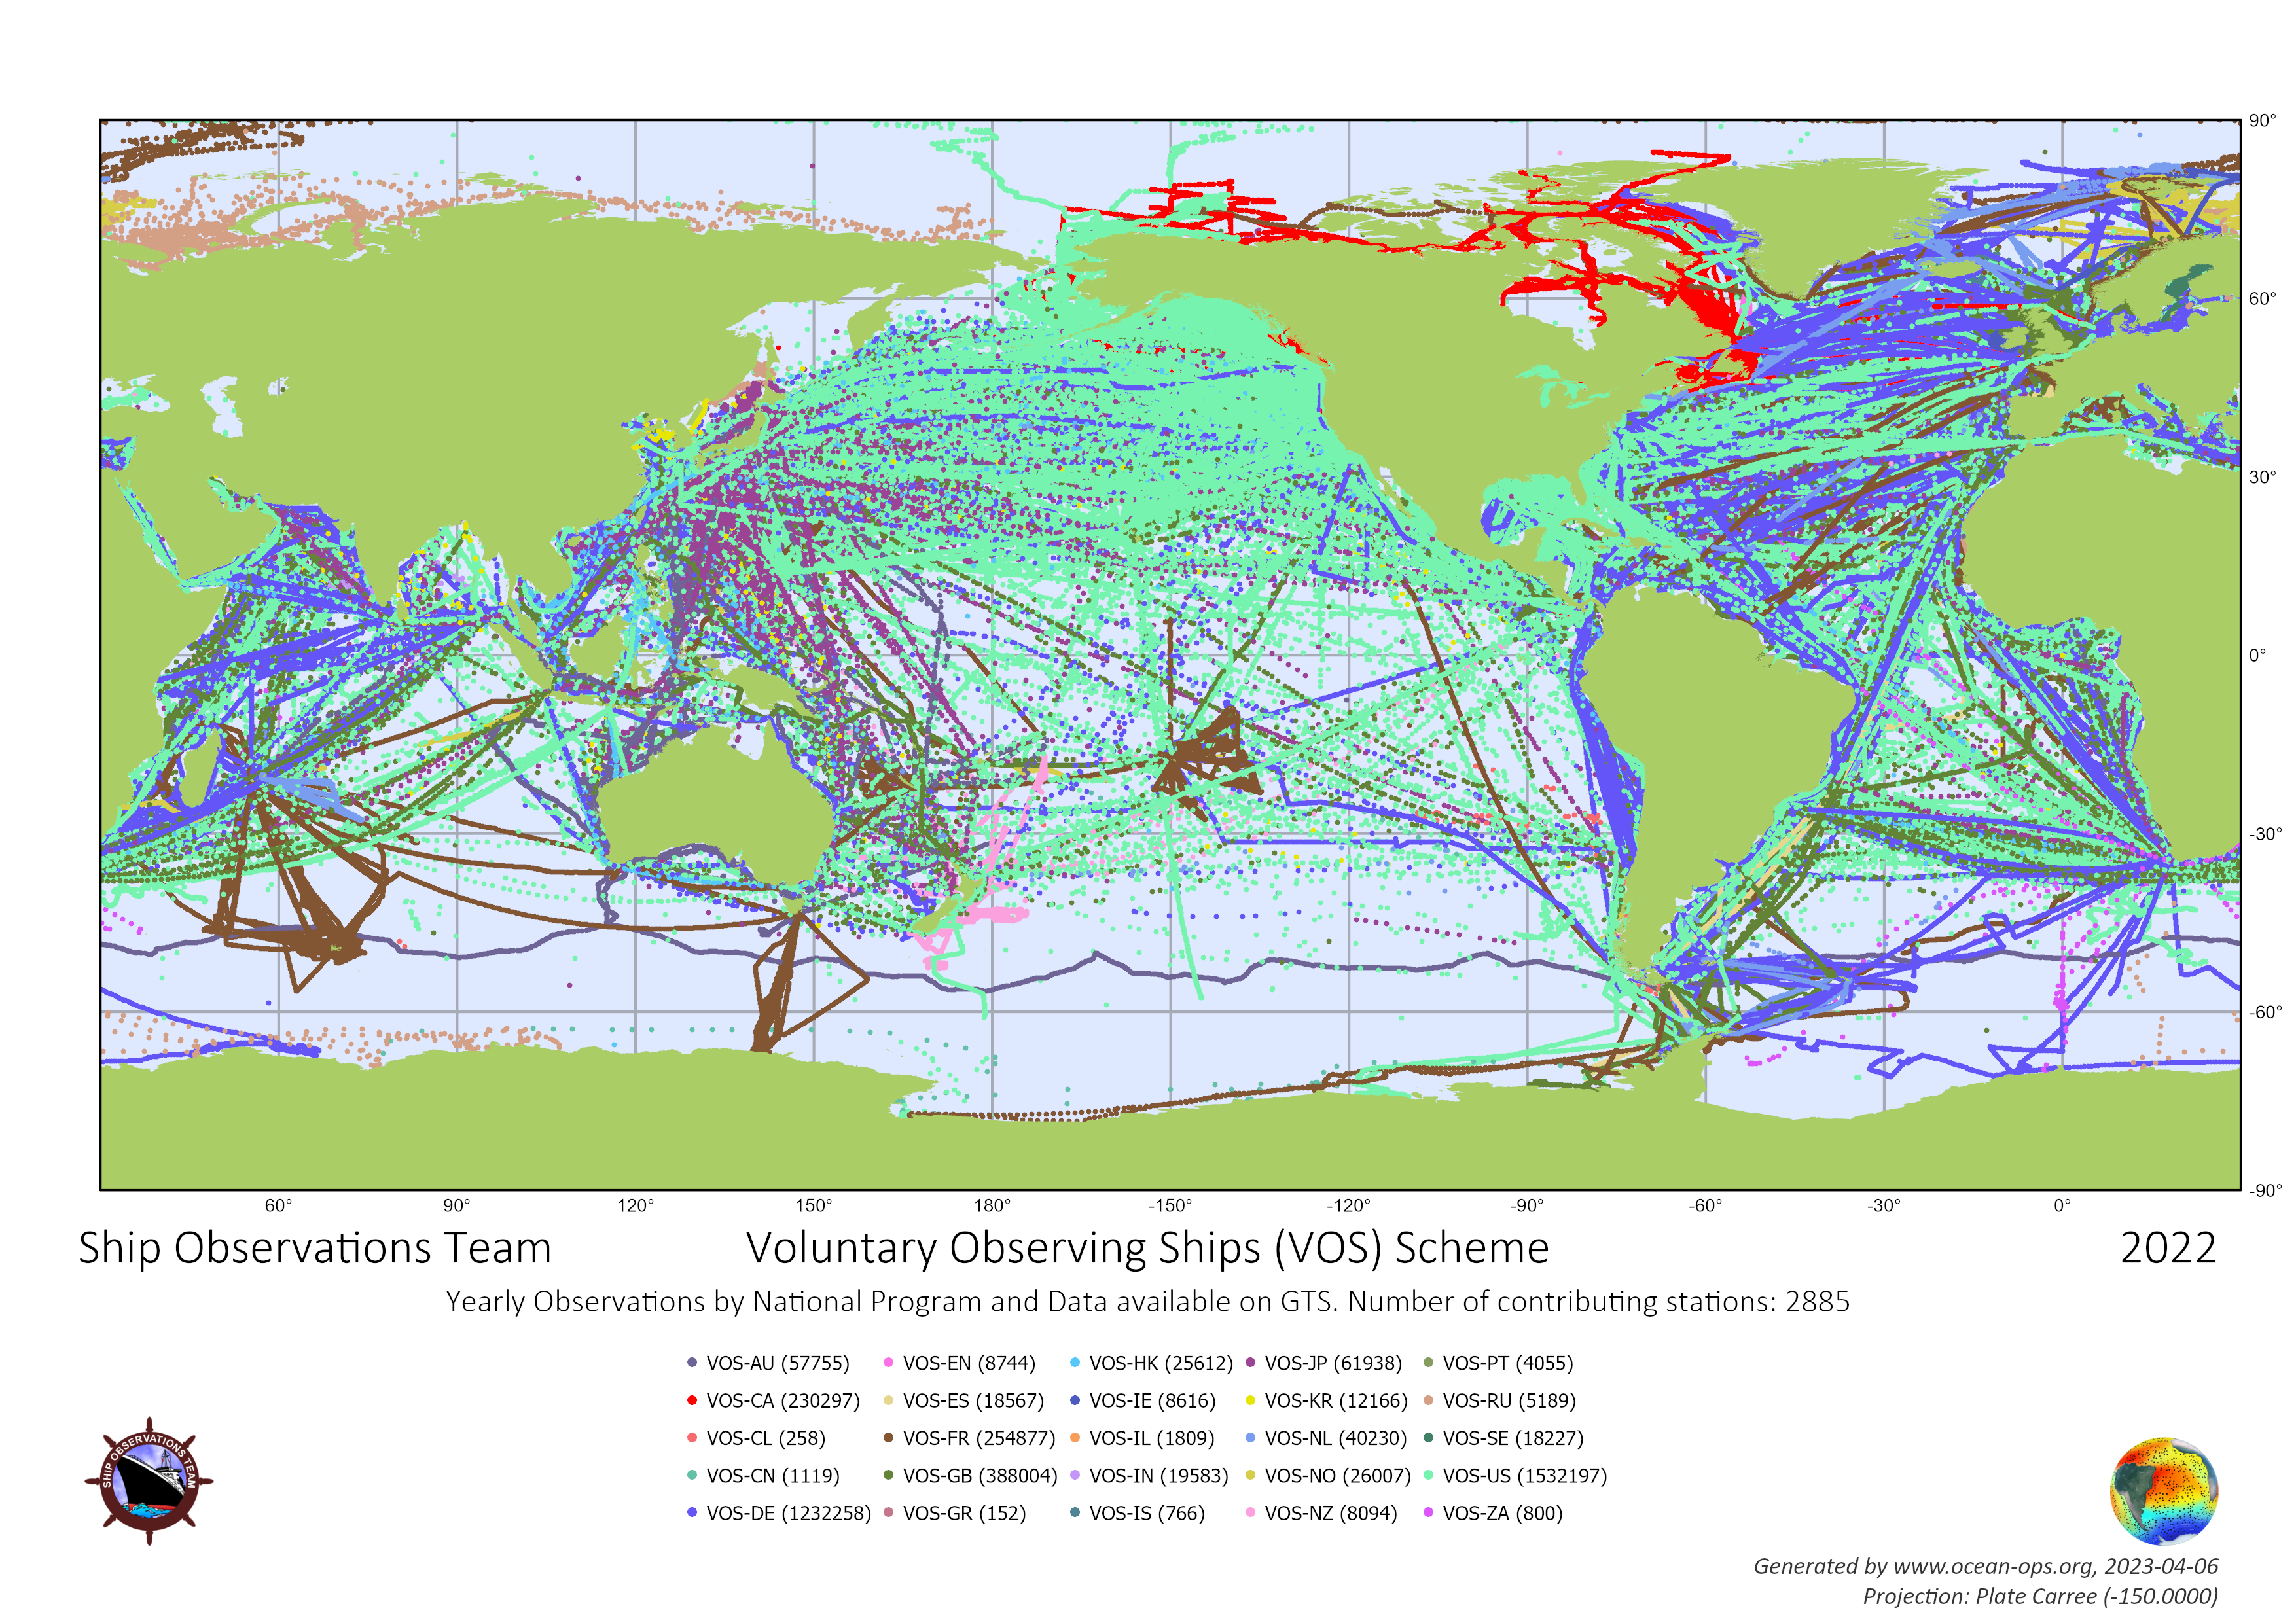
VOS
3.96 million real-time observations sent to GTS in 2022
25 national VOS programs
2885 active vessels (<5%)
26% of the fleet has now been automated, increasing the number of observations
Averaging 300,000 observations per month from 1600-1700 ships
Only 13 VOS programs provided delayed-mode data to VOS GDACs
1.25 million IMMT observations
15 of the 25 registered VOS nations provide PMO services, with 60 PMOs registered globally

Slide 5
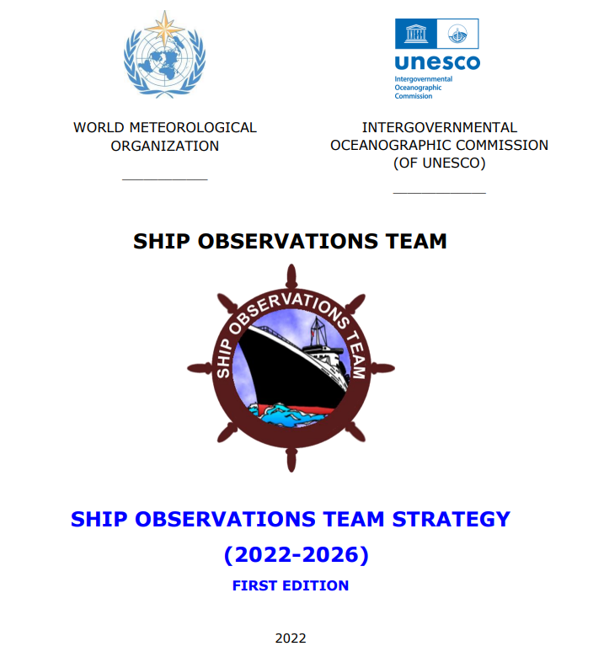
Developments and Achievements
Finalized the SOT Strategy.
In September 2022, made the official transition from WMO Pub47 format metadata hosted at the ESURFMAR VOS Metadata database, to the new SOT WIGOS Metadata format, hosted at OceanOps.
Nearly complete with Capacity Development initiative: VOS sensors for three developing VOS programs.
SOT-12 in Melbourne, May 15 – 18.
Report in progress, including minor updates to SOT ToRs.
XBT science workshop in Melbourne, May 11 – 12.
Participation in reinvigorated GOSUD steering committee.
Posters at the GCOS/EUMETSAT 2nd Climate Observation Conference.
Increased use of OceanOPS website.
ISO standards review for specifications for shipboard meteorological instruments.
Automation of national annual reports through the OceanOps system – an example for other networks
Welcome back Champika!

Slide 6
Challenges and Concerns
Turbowin future updates (partner board driven)
Leadership changes and absences.
Observations in EEZs
Including Iridium communications in Indian EEZ (e.g. missing XBT data, VOS data).
Continue discussions with IHO around bathymetry data acquisition in EEZs
Global representation in task teams and leadership.
WMO-IOC coordination of SOOP-led initiatives.
Support for indemnification issue for ship riders.
ASAP expansion.
Transition to BUFR format and termination of TAC.

Slide 7
Future Plans and Opportunities
New leadership - Darin Figuresky is leaving and Huai-Min Zhang is replacing him as SOT Chair
SOT IDs and metadata for SOOP beyond XBT network
Third party progress (incl. the racing yacht community), in terms of vessel recruitment and data coverage, particularly with guidance documents.
PMO regional workshop, end of 2023.
Continuing to work with the Schmidt Ocean Institute on ASAP expansion – new research ship build.
Continuing to improve / simplify national reporting.
Maintaining collaboration with DBCP and Argo by providing deployment opportunities where possible.
Continuing Best Practice development - Ship recruitment, CPR, TSG and PCO₂
Notes:
Third party data can also be a challenge given data quality, sensor calibrations and metadata standards.

Slide 8
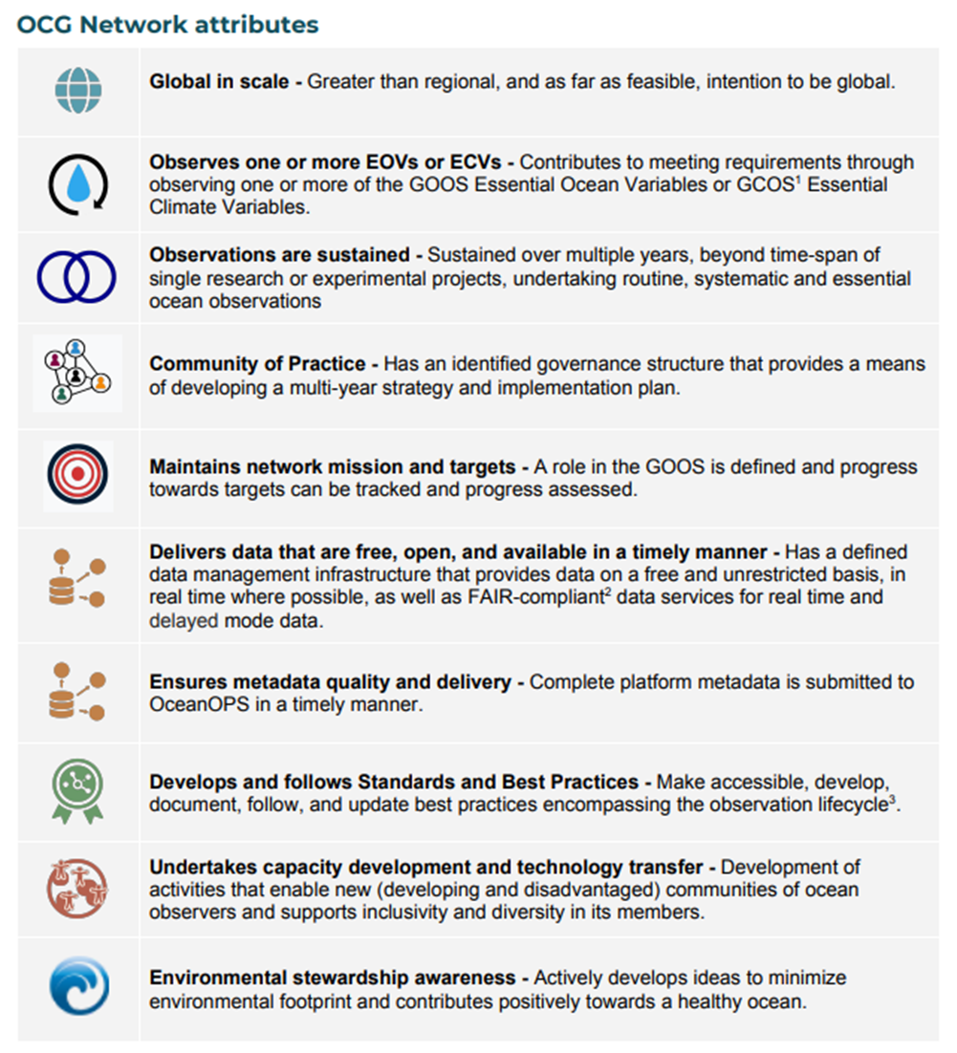
Attribute Report out

Slide 9
Asks from OCG
Promote WMO functional connections.
Continue support for OceanOPS.
Continue advocacy for furthering solution spaces, particularly for SOOP networks, as suggested by the GOOS Ocean Observations in Areas under National Jurisdiction (OONJ) Workshop.
Promotion of SOT activities (VOS, ASAP, SOOP) in shipping fora where and when the IOC and / or WMO secretariat are invited.

Slide 10
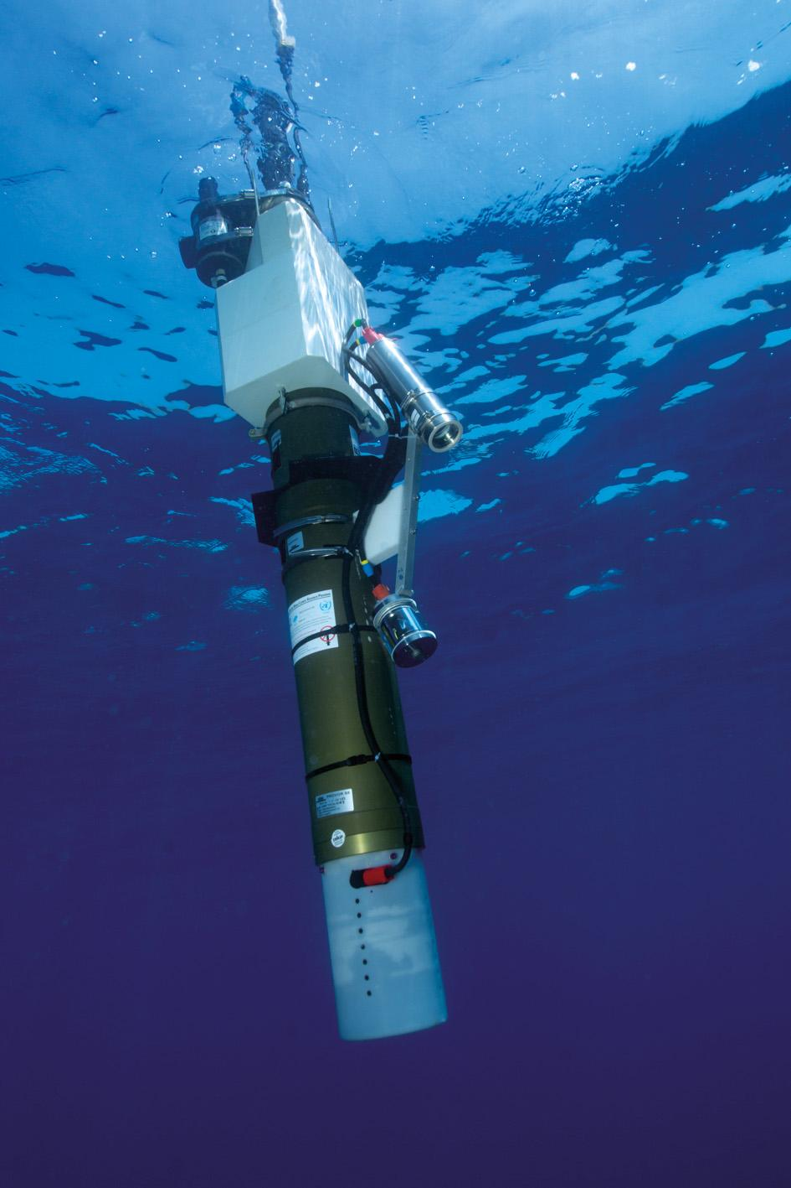
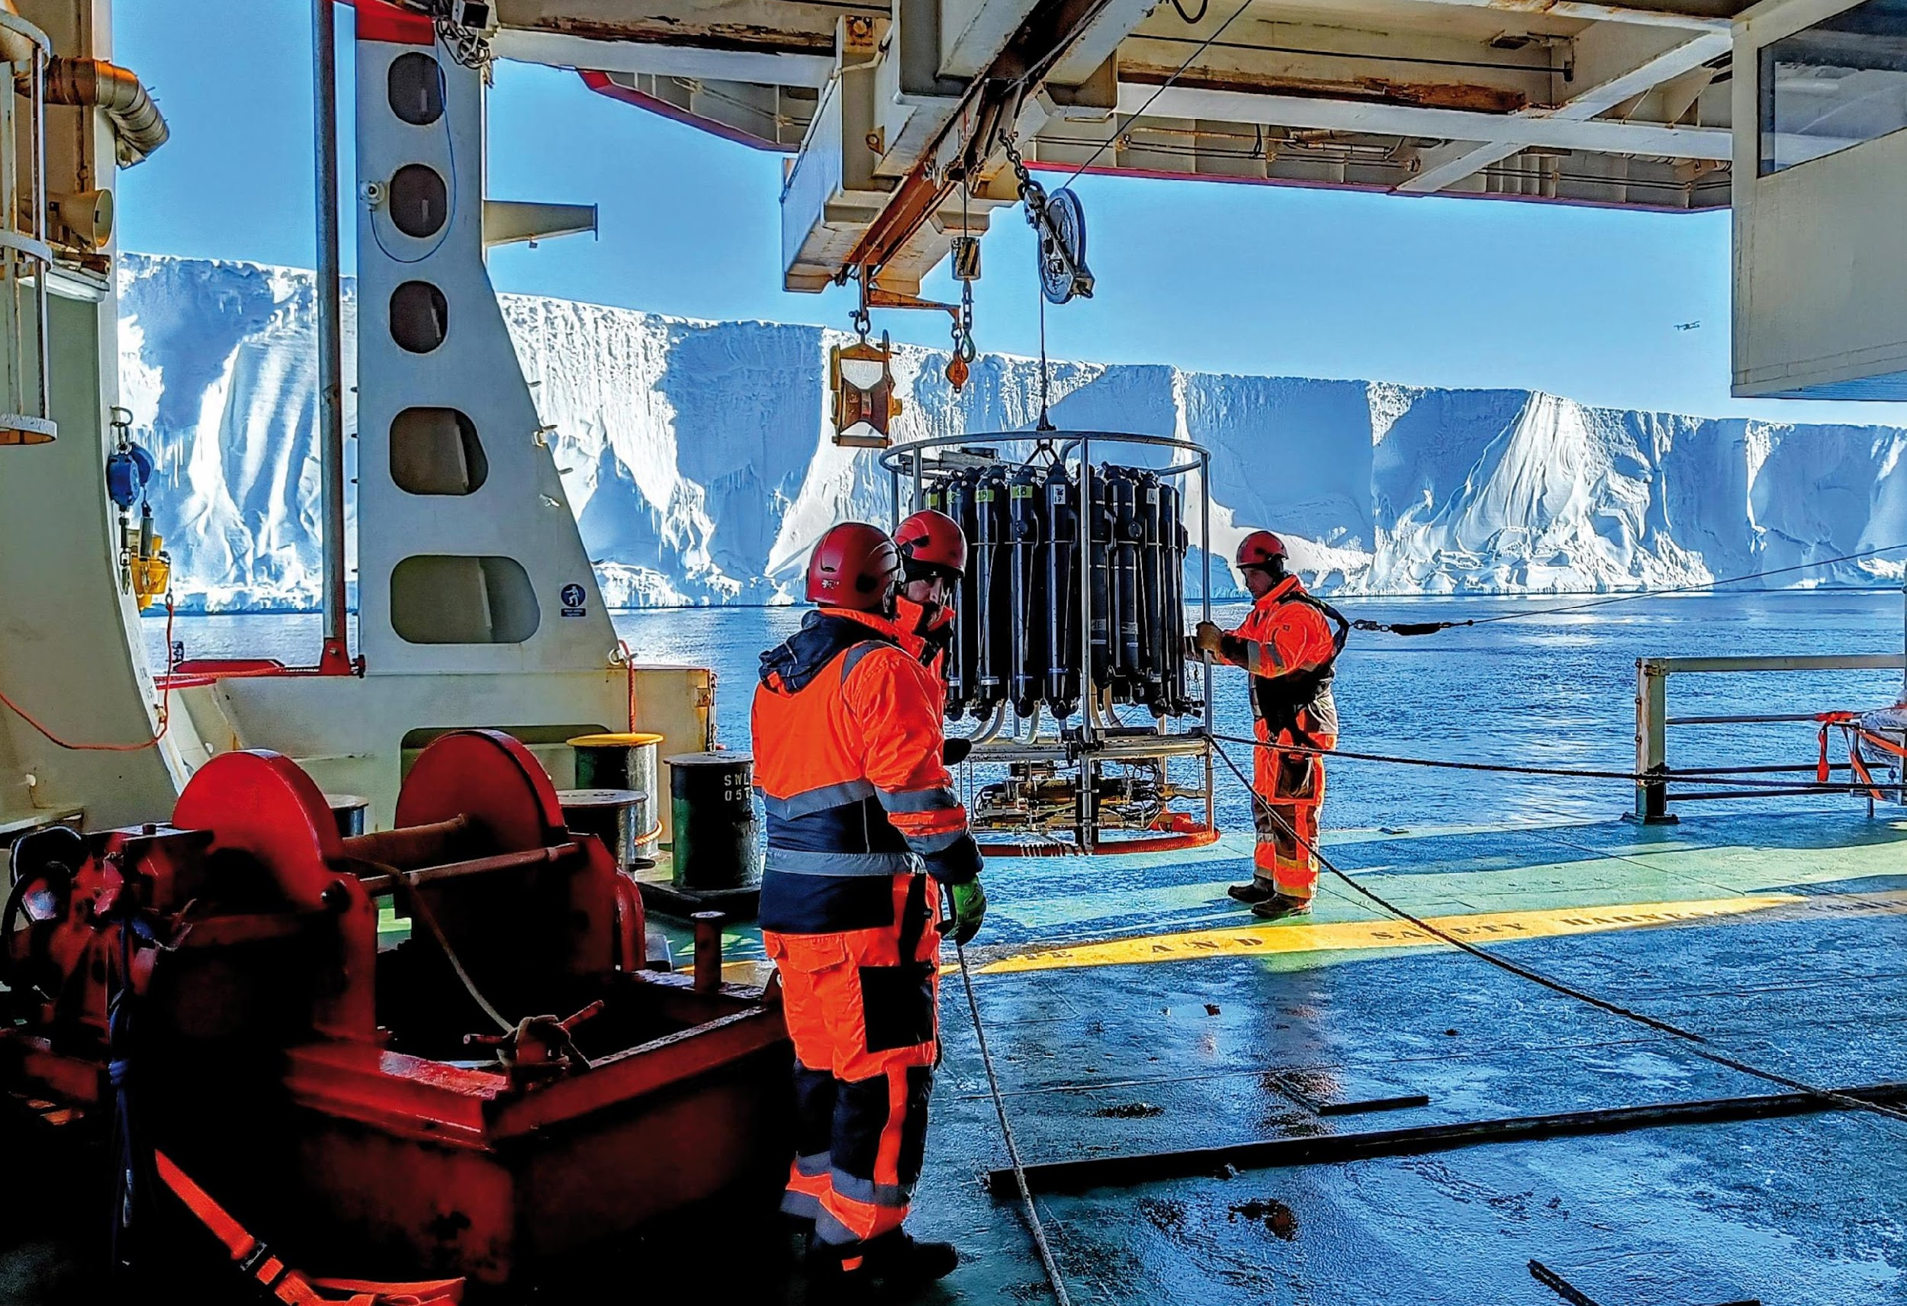
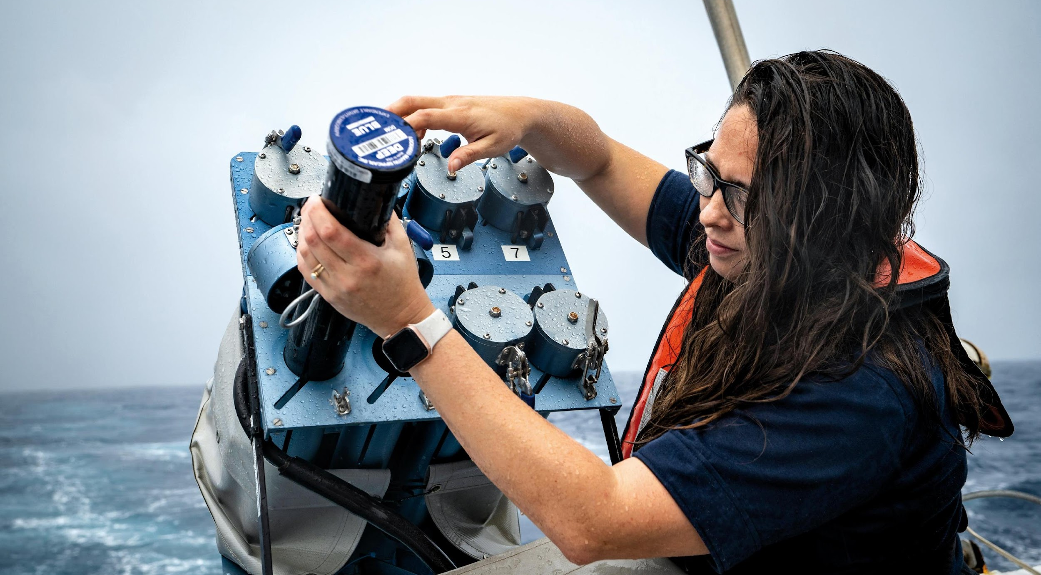
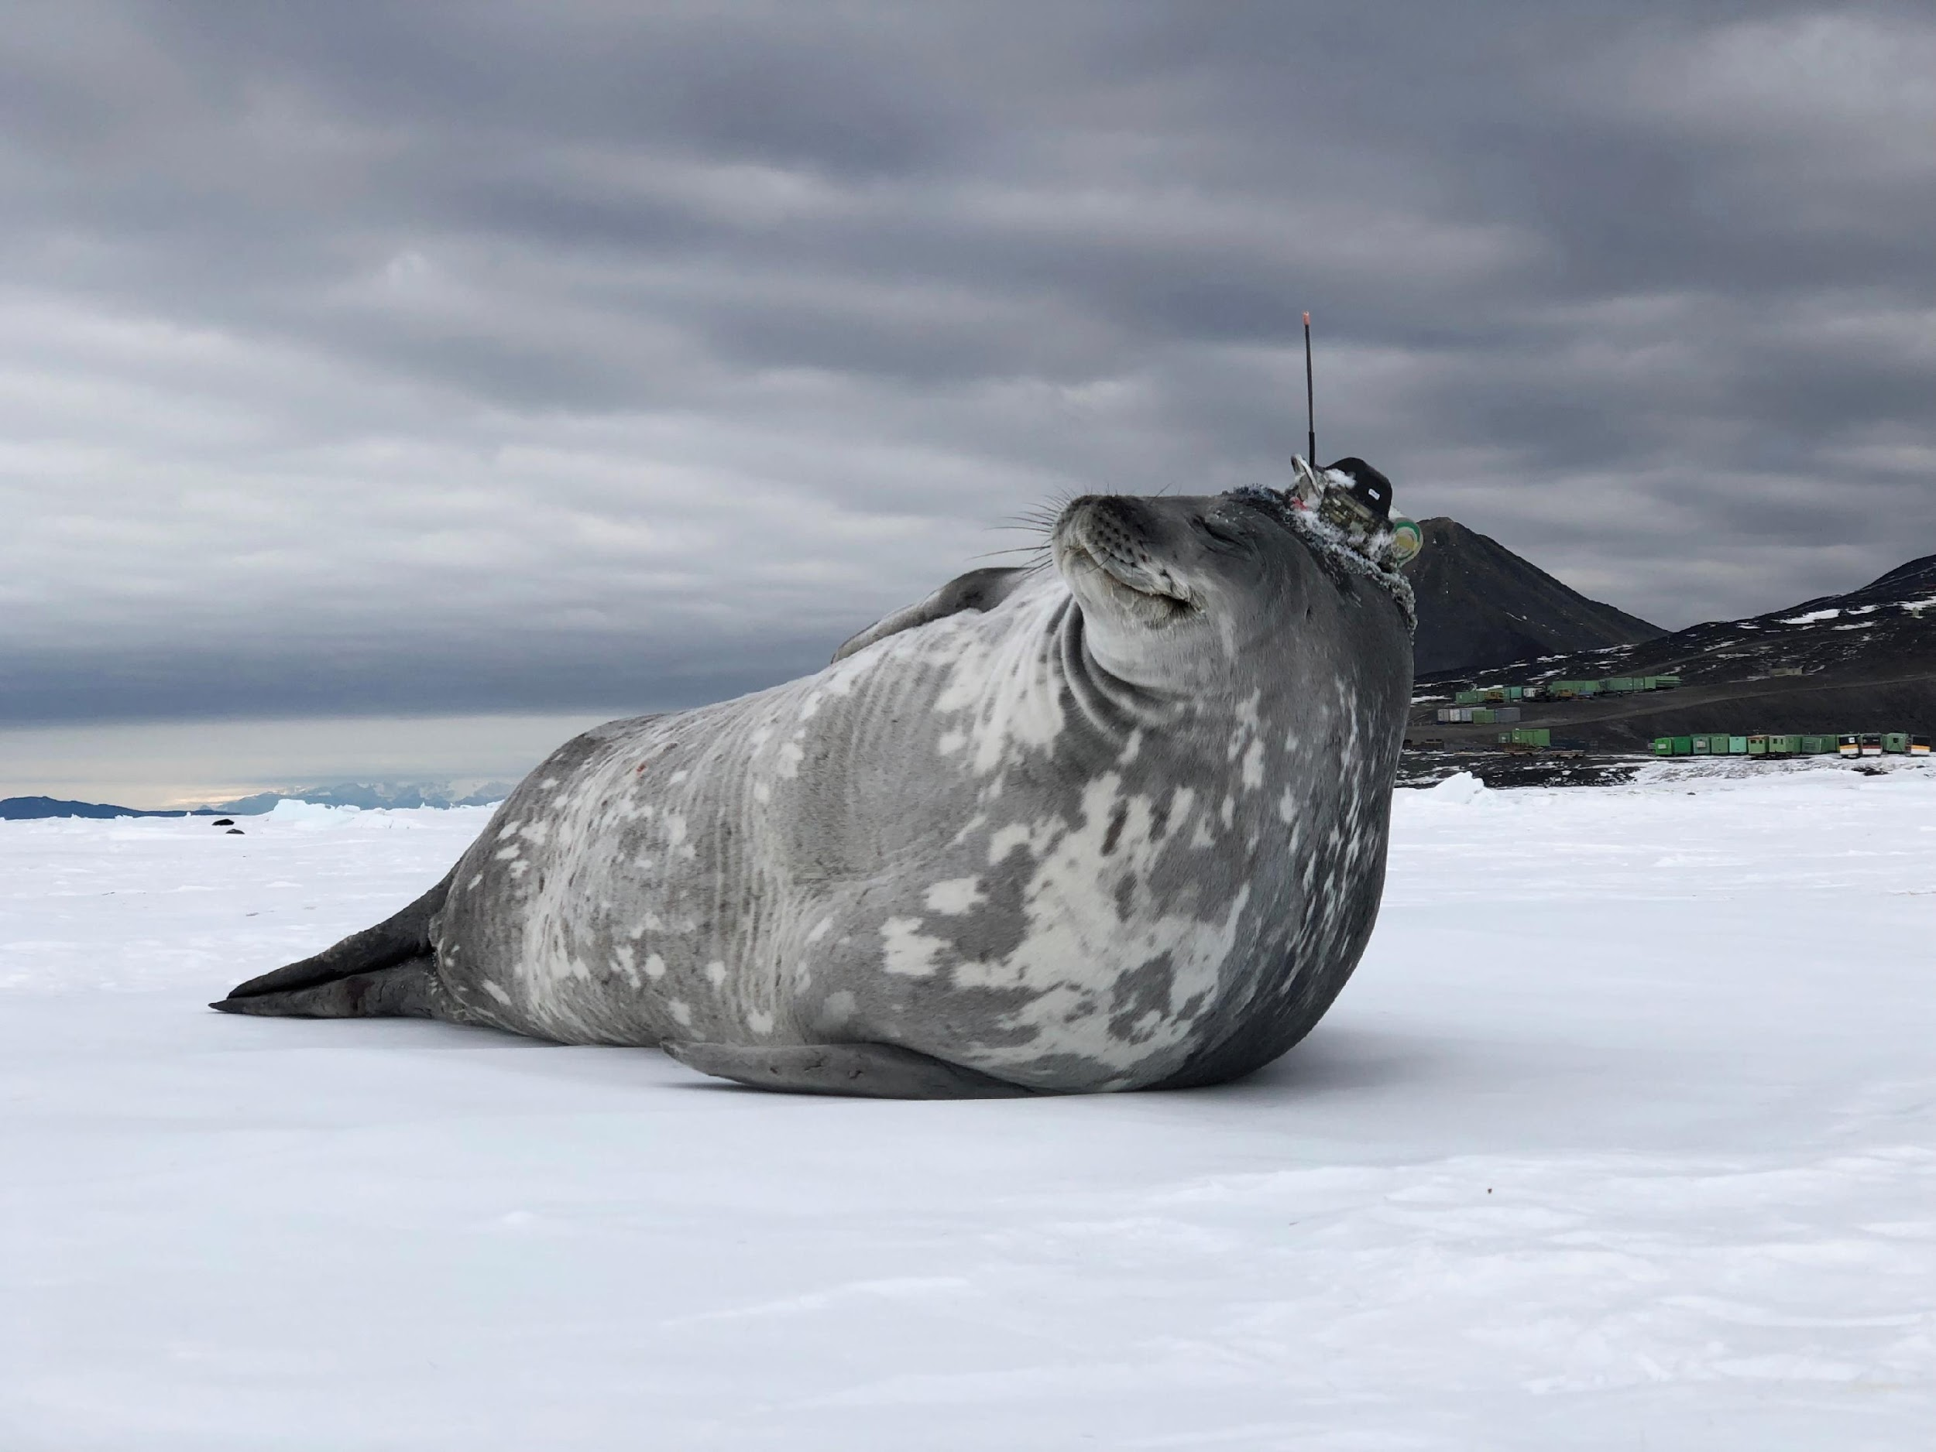
Thank you
goosocean.org

