Slide 1



Project CoastWAVE IOC EU ECHO NEAMTWS
Strengthening the Resilience of Coastal Communities in the North East Atlantic, Mediterranean Region to the Impact of Tsunamis and Other Sea Level-Related Coastal Hazards Project
Project Meeting (Cyprus)
30/05/2023
Cyprus Geological Survey Department (Tsunami National Contact)
Representing the NEAMTWS Cyprus National Committee

Slide 2
Local Partners
Preliminary information concerning key national stakeholders and partners that you envisage for this project:
Members and the observers of NEAMTWS Cyprus National Committee:
1. Cyprus Geological Survey Department (GSD), the designated Tsunami National Contact, the technical advisor of the state for all geo-matters. It owns and operates the national seismic network. (Sylvana Pilidou, Iordanis Dimitriadis)
2. Cyprus Civil Defence (CD), the designated Tsunami Warning Focal Point, the national civil protection entity of the country. (Nikolas Paris)
3. Cyprus Department of Lands and Surveys (DLS), the national agency and state advisor for cartographic, geodetic and hydrographic issues. It operates the national GNSS and sea-level networks. (Giorgos Kokosis)
4. Oceanography Centre of the University of Cyprus (UCY), the leading university and the most active research institution in Cyprus. Was involved in NEAMTWS activities in the last 15 years and was a partner in various tsunami-related projects. (Georgios Georgiou)
5. The Cyprus Marine and Maritime Institute. (Nicholas Flourentzou)
Other partners and stakeholders:
6. Cyprus University of Technology (CUT), one of the biggest universities in Cyprus, achieved international research excellence. (Nicholas Kyriakides)
7. Frederick Research Centre (FRC), one of the leading research centres in Cyprus, with experience in implementing safety, risk and post-disaster management projects. (Dr. Petros Christou)
8. Larnaca Municipality

Slide 3

Current Progress - Cyprus
1. Identify Partners in Cyprus – DONE
2. Shortlist Suitable Municipalities/Communities and make final choice – DONE
3. Basic Activities Plan – DONE
4. Submit Cyprus Technical Proposal – DONE & ACCEPTED
5. Collaboration agreement with Larnaca Municipality – DONE & ACCEPTED
6. Submit Cyprus Financial Proposal – DONE & APPROVED
7. GSD signs Contract with UNESCO – DONE
8. National Tsunami Ready Board Establishment – DONE
9. GSD signs contracts with local partners – DONE
10. Implementation of Activities 4 & 5 (Risk Perception) –DONE (GSD -> FRC)
11. Implementation of Activity 7 (SOPs) – TENDER PROCESS, att. SOP workshop, Discussing options with potential consultant (GSD -> CCD)
12. Implementation of Activity 8 (Inundation & Evacuation Maps) – STARTED Awarded Consultancy in December 2022, through tendering procedure (GSD) -- topo & bathy data from DSL
13. Implementation of Activities 9 to 11 – STARTED

Slide 4
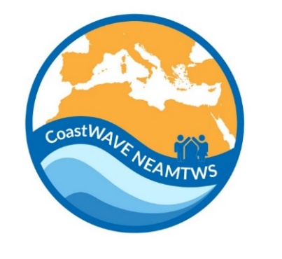
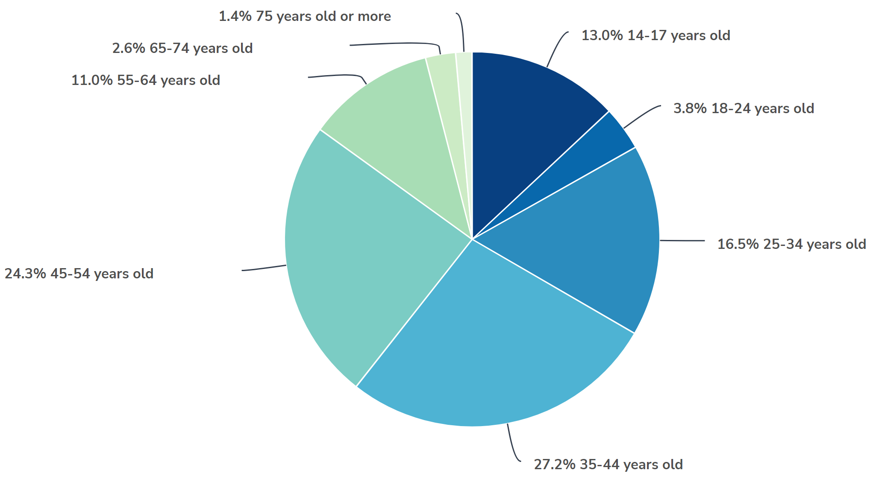

Activities 4 & 5
Public Awareness
Tsunami Modelling
Evacuation Routes
SOPs
Public Education
Public Training
Infrastructure
Population: 51500
Sample: 345
Female: 183
Μale: 157
Notes:
Due to the use of a wrong link lot of answers were overwritten

Slide 5
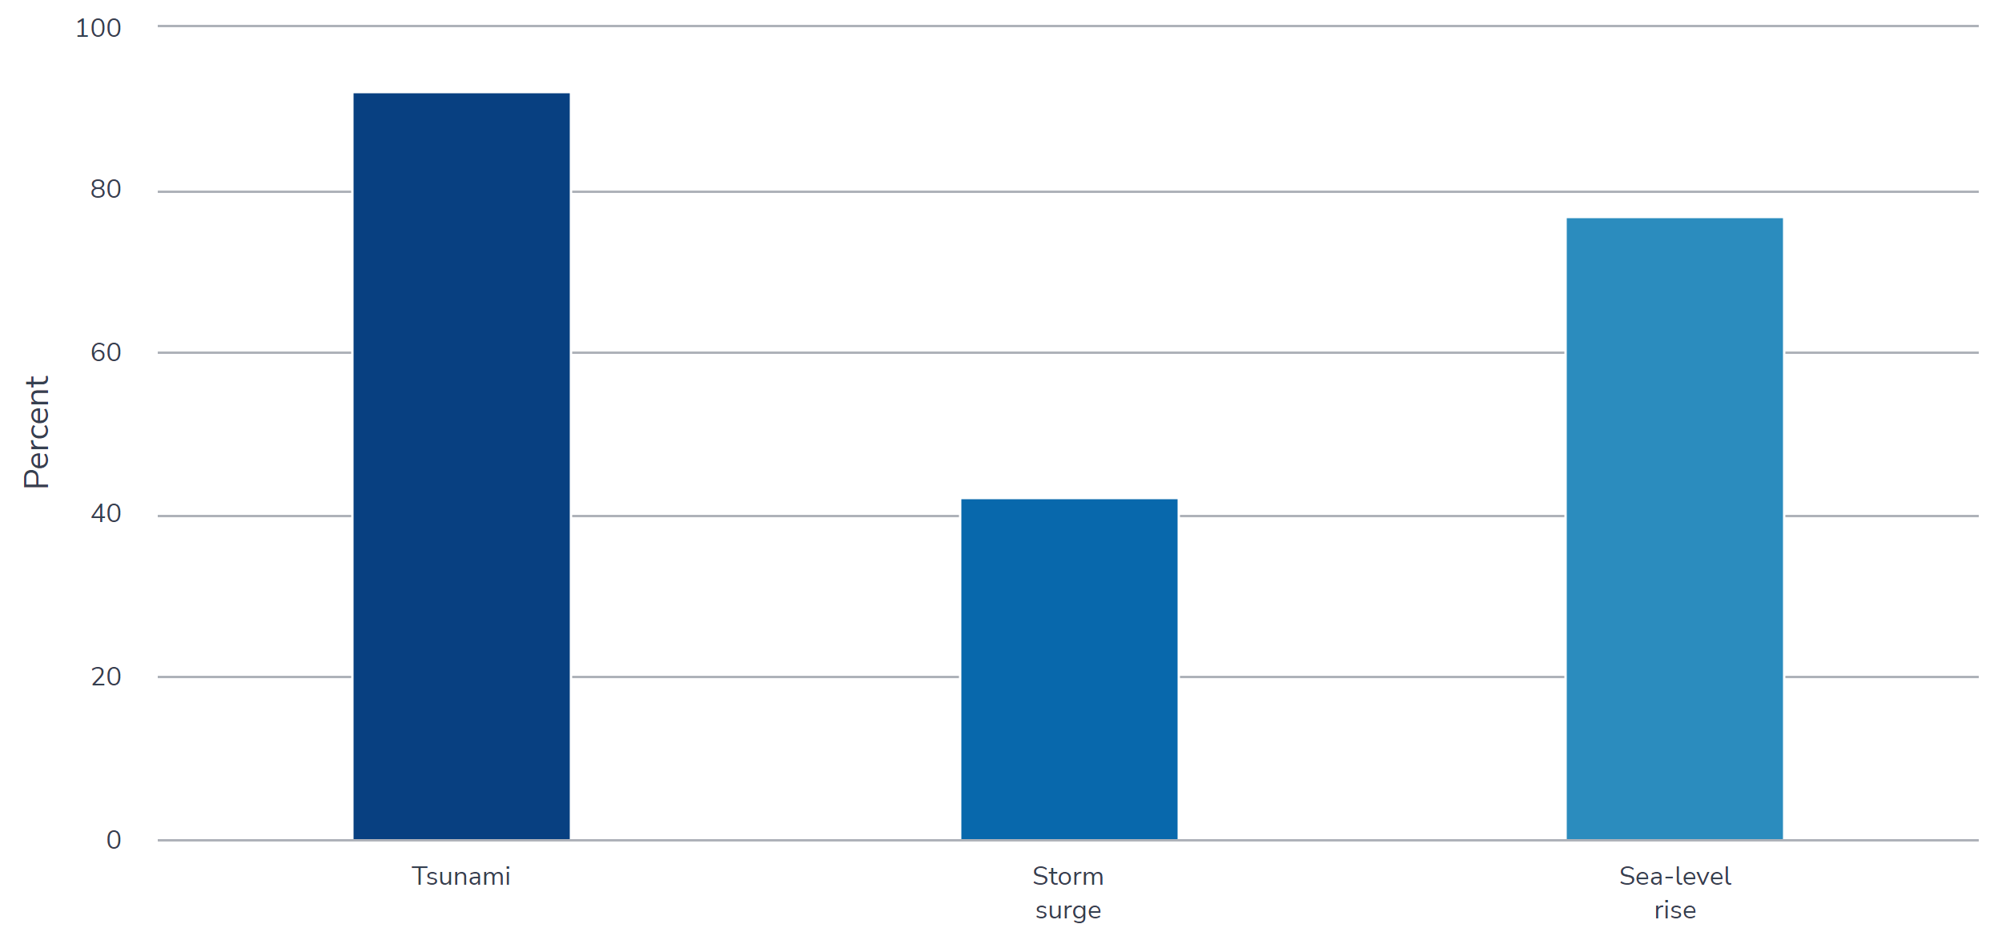
Awareness/Knowledge
Public Awareness
Tsunami Modelling
Evacuation Routes
SOPs
Public Education
Public Training
Infrastructure
92.4%
76.8%
42.4%

Slide 6
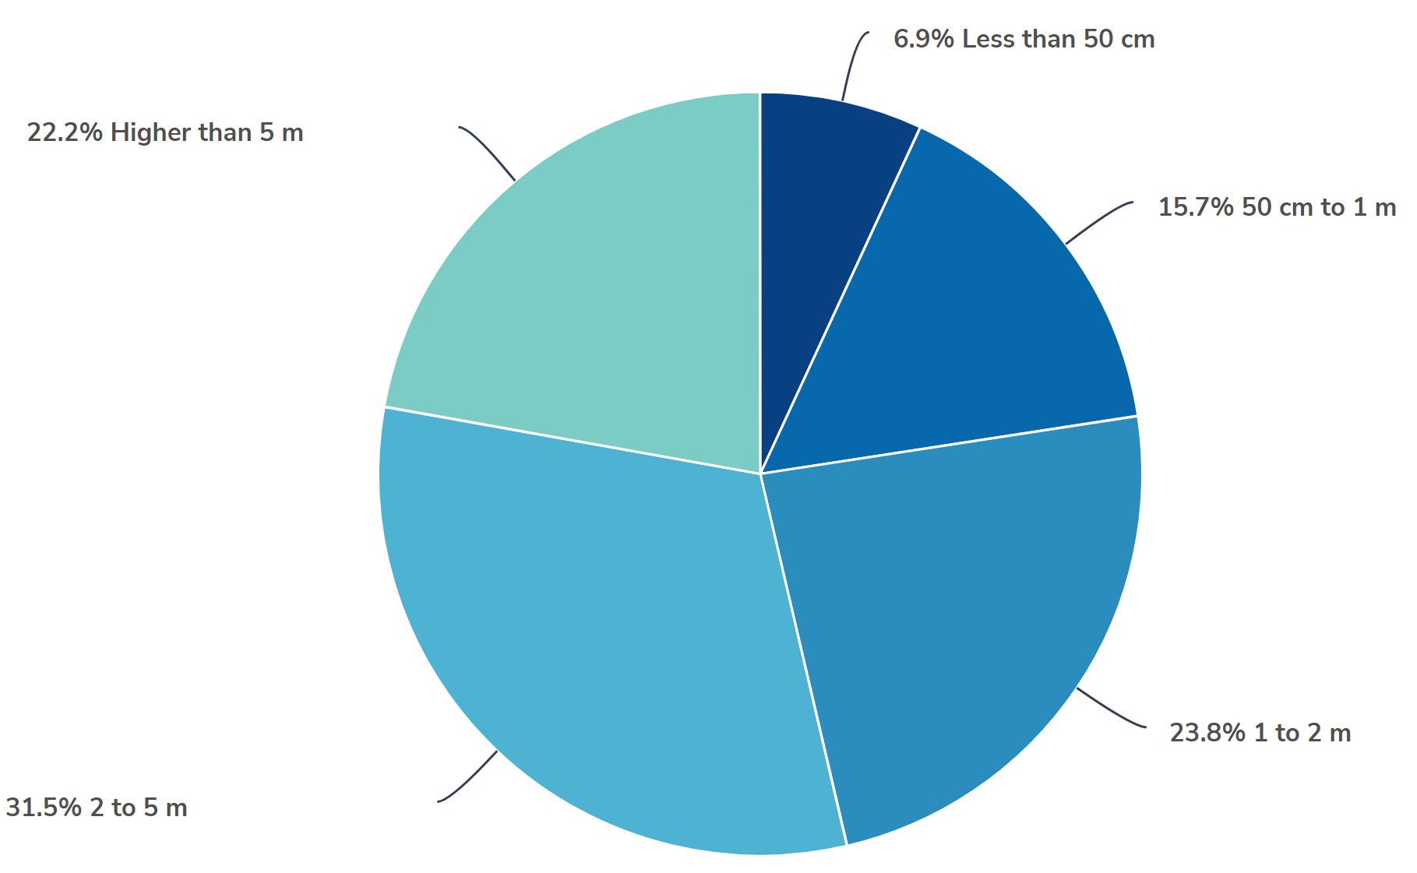
Awareness/Knowledge
Public Awareness
Tsunami Modelling
Evacuation Routes
SOPs
Public Education
Public Training
Infrastructure
Respondents’ expected height of a possible tsunami event.

Slide 7
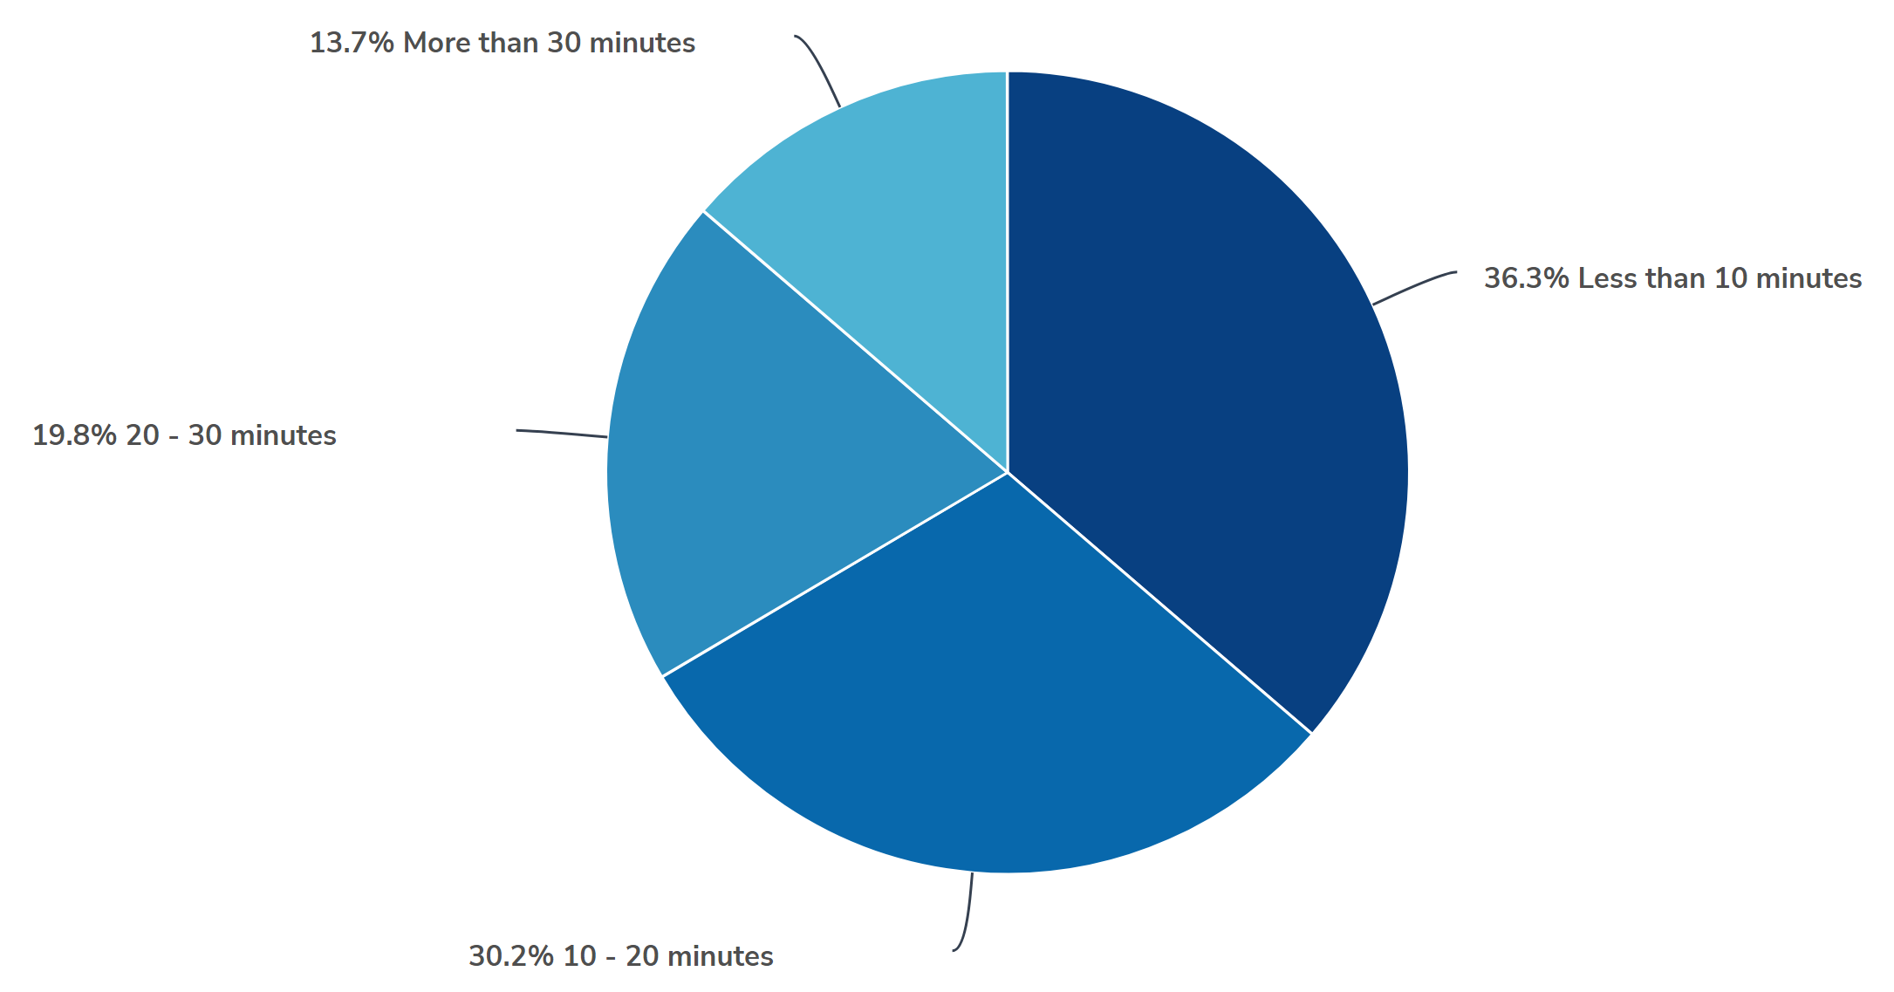
Awareness/Knowledge
Public Awareness
Tsunami Modelling
Evacuation Routes
SOPs
Public Education
Public Training
Infrastructure
Respondents’ expected height of a possible tsunami event.

Slide 8
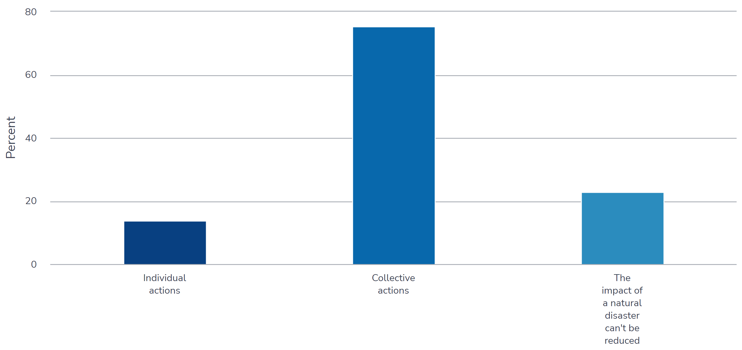
Assessment, Preparedness and Response
Public Awareness
Tsunami Modelling
Evacuation Routes
SOPs
Public Education
Public Training
Infrastructure
(75.6%)
(23.1%)
Actions for Reducing Impact of Sea-level Related Disasters.
Notes:
(75.6%) recognized the importance of collective actions in reducing or avoiding the impact of sea level related disasters
(23.1%) still believe that the impact of a natural disaster cannot be reduced.

Slide 9
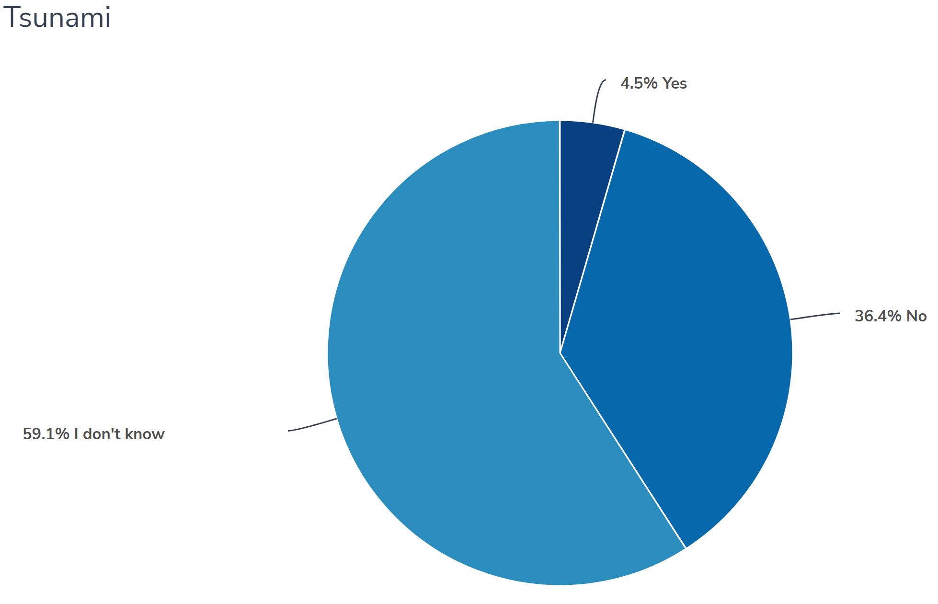
Assessment, Preparedness and Response
Public Awareness
Tsunami Modelling
Evacuation Routes
SOPs
Public Education
Public Training
Infrastructure
Awareness of Existence of Municipality Evacuation or Resettlement Plans
Notes:
They do not know such plan or an undertaken for a such disaster..

Slide 10
Activity 8
(GSD/NTRB) Development of NTRB-approved inundation maps for Larnaca.
WORKSHOP----27/06/23
(GSD/NTRB) Mapping and designation of tsunami hazard zones for Larnaca
WORKSHOP-----28/06/23
(GSD/NTRB) Development of NTRB-approved tsunami evacuation maps for Larnaca.
WORKSHOP-----SEPTEMBER 2023
- (GSD/NTRB) Final design of information signs for tsunami awareness and evacuation of Larnaca.
NOVEMBER 2023
Public Awareness
Tsunami Modelling
Evacuation Routes
SOPs
Public Education
Public Training
Infrastructure

Slide 11
SOPs
02.06.23
(CD) Workshop with identified SOP stakeholders prior to SOP drafting.
06-07.11.23
(CD) Tabletop Exercise national to community level tsunami exercise.
Dec. 2023
Jan.
2024
(CD) Organization
National to community level tsunami awareness and SOPs workshop.
(CD) Development:
During the NEAMTWS Exercise
Feb. 2024
(CD) Organization
National to community level tsunami awareness and SOPs workshop.
Generic national and local tsunami protocol and SOPs.
??????
Public Awareness
Tsunami Modelling
Evacuation Routes
SOPs
Public Education
Public Training
Infrastructure

Slide 12
Activity 9
Mar. 2023
(CUT) Data Collection People at risk in the tsunami hazard zone, economic, infrastructural, political.
Dec. 2023
(CD) Development of National and local tsunami awareness material for the general public.
Dec. 2023
(CD) Development:
Generic national and local tsunami protocol and SOPs
Dec. 2023
Jan 2024
(CD) Development:
Generic national and local tsunami protocol and SOPs
(NTRB) Preparation of information signs for tsunami awareness and evacuation information of Larnaca/ sign posts for evacuation directions for Larnaca.
Public Awareness
Tsunami Modelling
Evacuation Routes
SOPs
Public Education
Public Training
Infrastructure
Notes:
Exercise should be at a community level not in national level…

Slide 13
Activity 11
Sep. 2023
(CMMI) Supply and installation of IDSL(s) in Larnaca (funded and coordinated by UNESCO).
Sep. 2023
(CMMI/GSD) Supply and installation of siren(s) and /or other alerting equipment in Larnaca (funded and coordinated by UNESCO).
Feb.2024
(CD) Integrate tsunami detection and alerting systems into national sea level hazard warning systems.
Public Awareness
Tsunami Modelling
Evacuation Routes
SOPs
Public Education
Public Training
Infrastructure
Notes:
They cannot give a qoutation without a preparation related to the number of sirens.

Slide 14
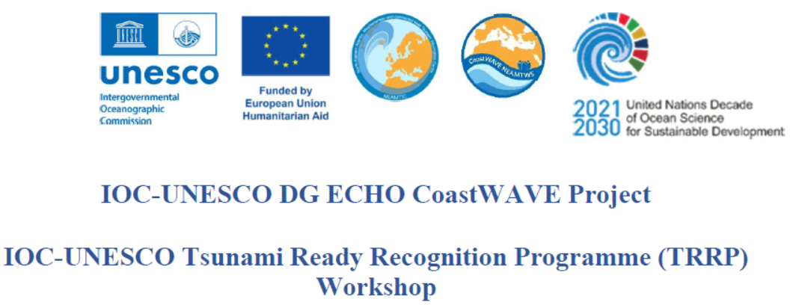
Notes:
Sops –discussed
Tsunami ready board

