Slide 1
CoastWAVE Quarterly Meeting: Marsaxlokk, Malta
Prof. Pauline Galea
Blanca Mendiguren
Department of Geosciences
University of Malta

Slide 2
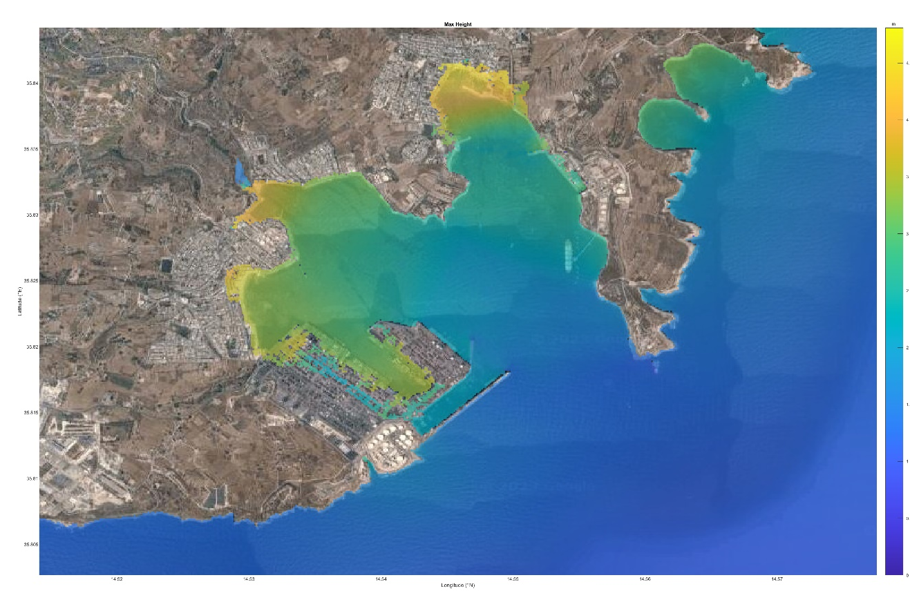
Quarterly summary
Modelling scenarios:
365 AD Crete earthquake
Mw: 8.5
Extreme tsunami evacuation zone
4
3
2
1
0
Tsunami-HySEA: developed by EDANYA Group (https://edanya.uma.es) from the Universidad de Málaga (UMA)

Slide 3
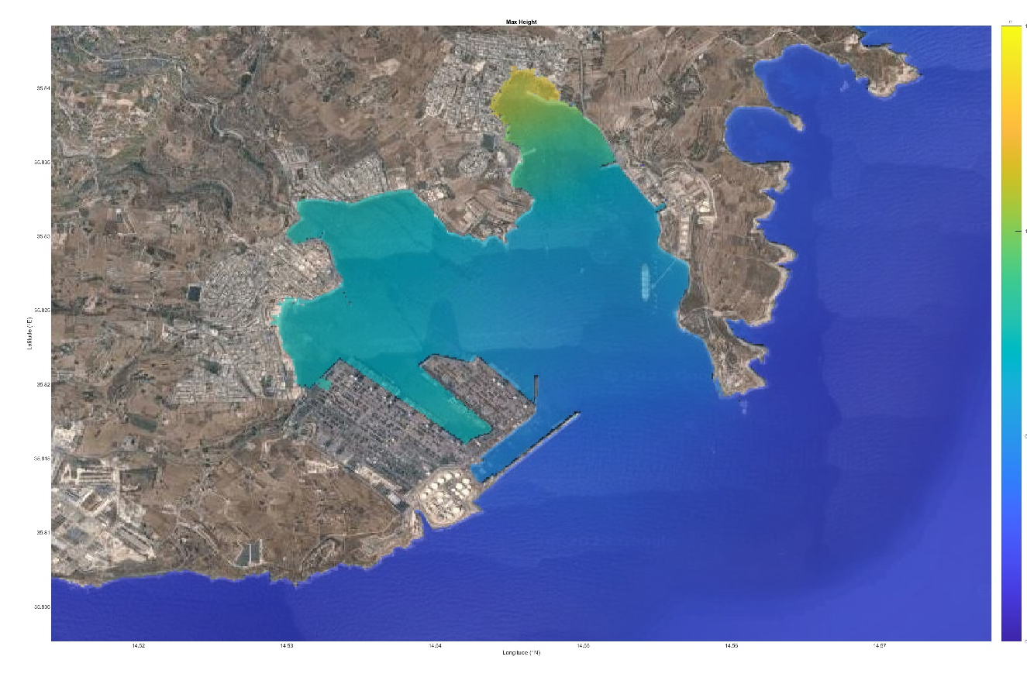
Quarterly summary
Modelling scenarios:
365 AD Crete earthquake
1908 Messina earthquake
Mw: 7.1
Tsunami evacuation zone
1.5
1
0.5
0
Tsunami-HySEA: developed by EDANYA Group (https://edanya.uma.es) from the Universidad de Málaga (UMA)

Slide 4
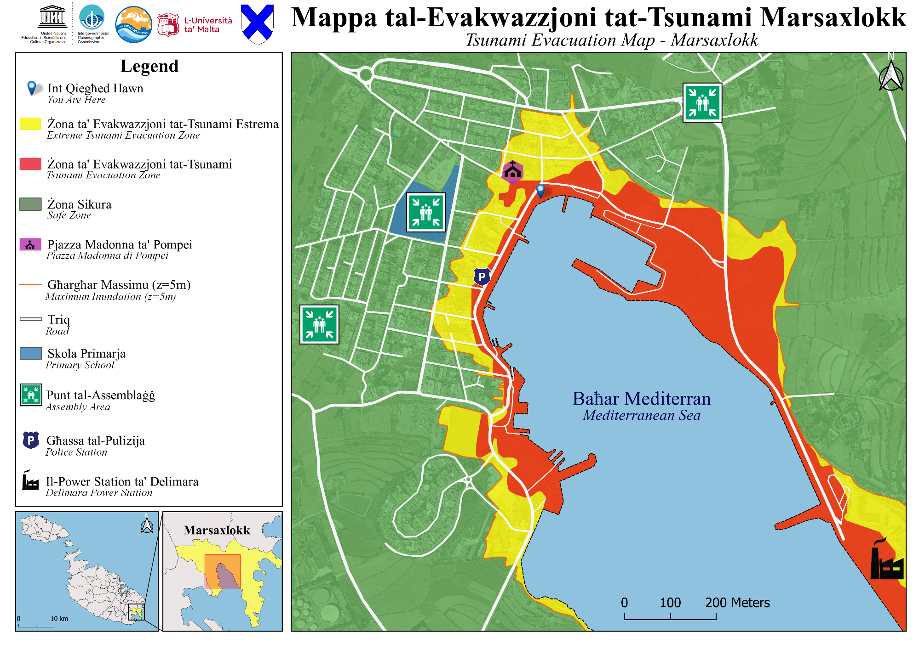
Quarterly summary

Slide 5
Quarterly summary
Resources identified:
Economic: Central Government of Malta will provide funds.
Infrastructural:
CPD Operations Centre plus On-Site Coordination Centre can be deployed.
Relocation of civilians: Social housing, pre-fabricated containers, and disused hangars.
Political:
Firefighters, Police officers, Army and Transport Malta.
Medical Assessment Units at Mater Dei Hospital is prepared for Major Incidents and mass casualties.
Transport for rescue: Army Police CPD (heavy plant and helicopters) and NGOs (rescue boats, jet skis and buses).
Social:
Collaboration with NGOs (Red Cross, St John Rescue Corps and The Emergency Fire & Rescue Unit).

Slide 6
Quarterly summary
National Workshop on Tsunami Preparedness:
Discussion meeting held on 5th May with CPD and M’Xlokk LC.
Agreed on date and venue: 11th July 2023 – Salini Resort
Intended for:
Mayors of Coastal Local Councils
Civil Protection Department
Transport Malta Authority
Mater Dei Hospital Emergency Department
Local Enforcement System Agency
Enemalta
Enemed
Malta Police Force
Armed Forces of Malta
NGO’s
Under the auspices of the Ministry for Home Affairs, Law Enforcement and National Security
Agenda in progress

Slide 7
Poster presentation at IUGG
Session JS09 “Early Warning Systems for Geohazards”
Accepted poster on “Building resilience in coastal communities: a comprehensive approach to making Malta Tsunami-Ready”

Slide 8
ASSESSMENT

Slide 9
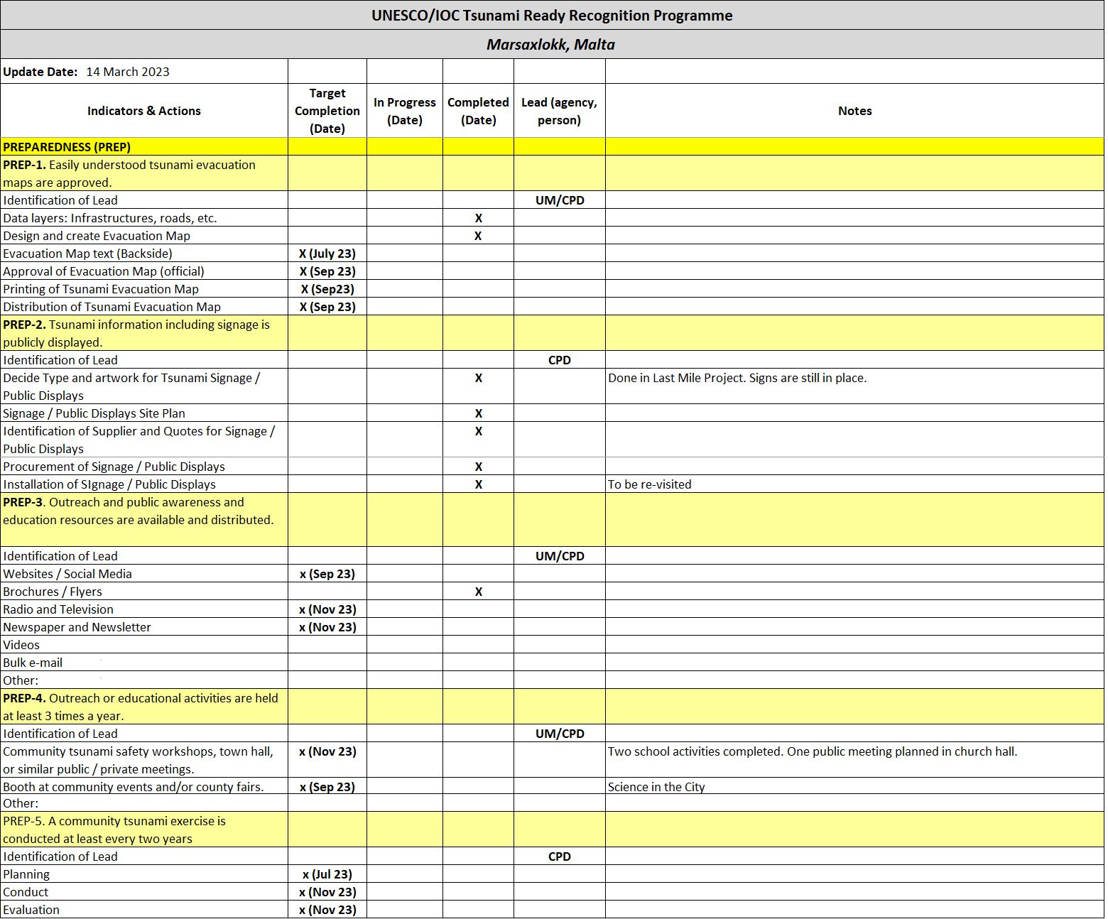
PREPAREDNESS

Slide 10
PREPAREDNESS

Slide 11
RESPONSE

Slide 12
RESPONSE

