Slide 1
Observations Coordination Group
14th Meeting
OCG-14 Meeting, June 5-8, 2023
Breakwater Lodge, Cape Town, South Africa
Notes:
Ann

Slide 2
OCG-14 Etiquette
Keep your microphone muted unless you are speaking and try to use video.
For question or comment, please use the chat box or indicate by raising your hand in order to be called upon by the moderator.
Please be succinct in both your questions and answers.
The sessions will be recorded for the purpose of writing the report, and the recordings deleted afterwards.
Attendees who are joining as observers please edit their names and note OBS_ in front of their name.
Notes:
Ann

Slide 3
OCG-14 Format
Meeting time: Tuesday June 6th - Thursday 8th - 8 - 17 pm GMT+1
Annotated Agenda at the bottom of the timetable outlines questions and intended outcomes for each session
Agenda topic, presenter and materials are linked in the Agenda and on the OCG-14 website
OCG-14 Actions will be recorded and reviewed daily
OCG-14 Workshops
Low cost technologies - June 2
Boundary Currents Workshop - June 5
Outreach activity - June 9
Notes:
Ann

Slide 4
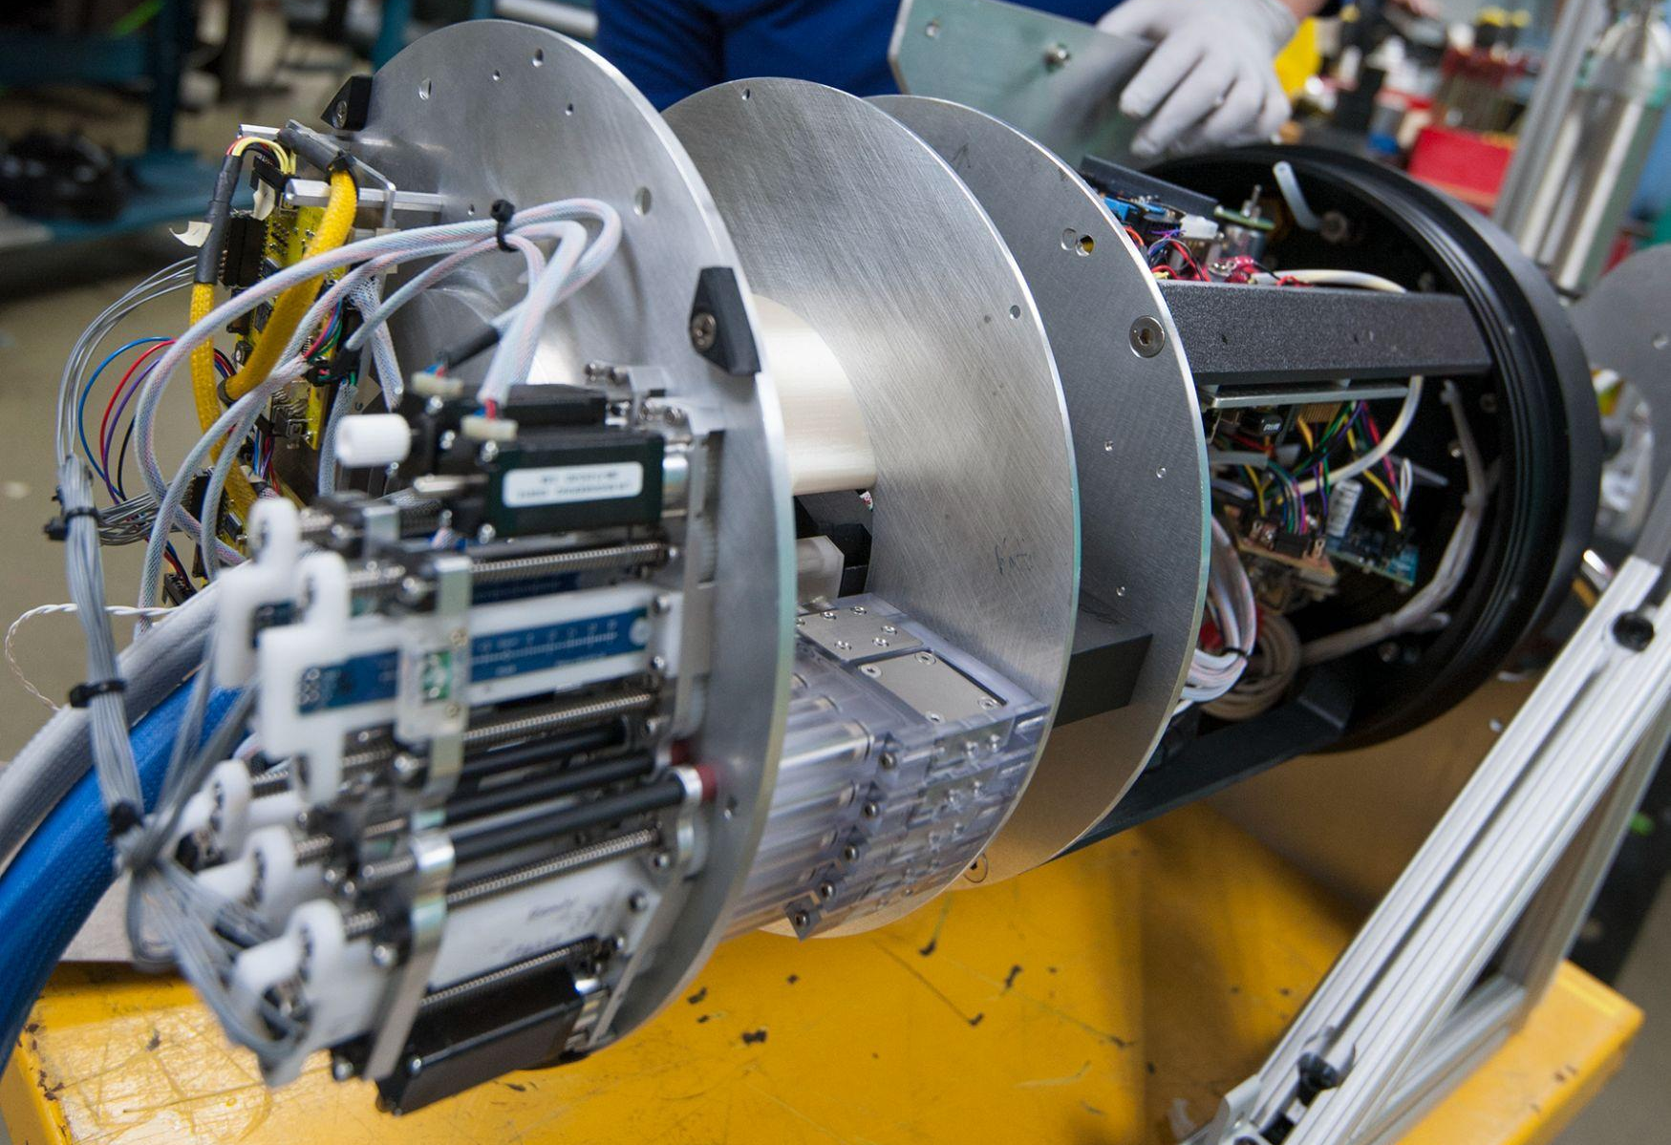
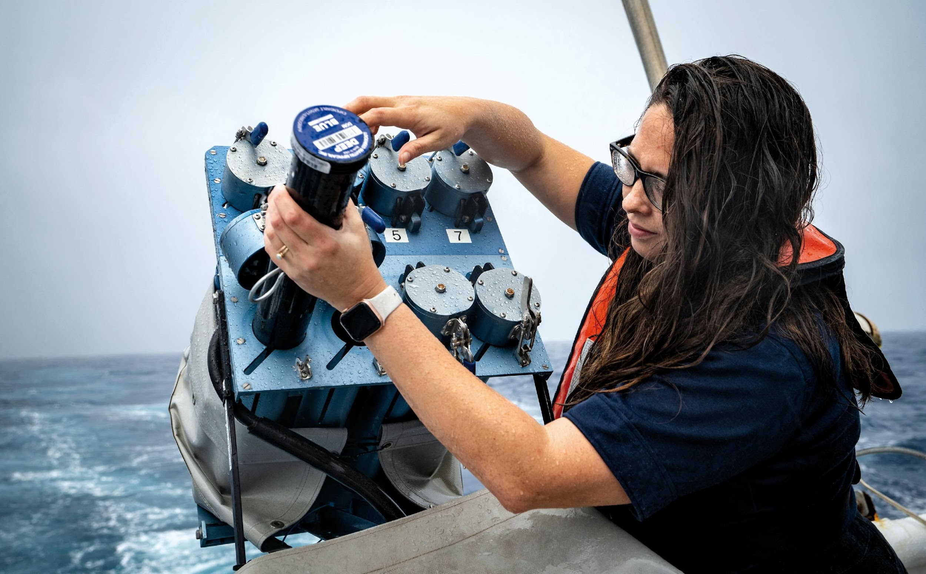
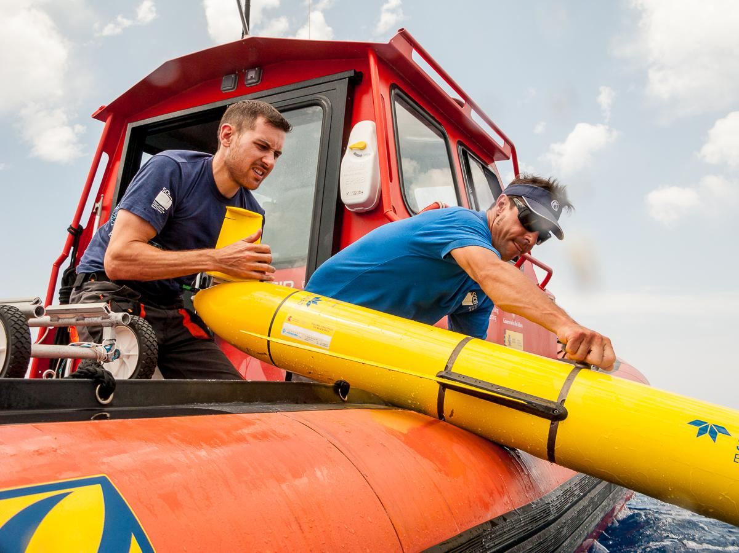
PLEASE NOTE!
Mailing list: There will be yearly check ins with the networks to ensure members are still active and emails are received.
Membership: Update as it changes.
For any changed, contact Ann-Christine Zinkann [ann-christine.zinkann@noaa.gov]
Notes:
Ann

Slide 5
Dr. Ashley Johnson
Director,
Department of Forestry, Fisheries and Environment
Notes:
Status of the Observing system: recovering from COVID gaps, particularly moorings
Remaining gaps: Indian Ocean (RAMA, Argo, Drifters) - US committed $2.5M resources to replace all of the RAMA moorings
New capabilities coming online: BGC-Argo, more gliders, etc.

Slide 6
Observations Coordination Group
David Legler (OCG Chair) and the OCG Executive Committee
OCG-14 Meeting, June 5-8, 2023
Notes:
Status of the Observing system: recovering from COVID gaps, particularly moorings
Remaining gaps: Indian Ocean (RAMA, Argo, Drifters) - US committed $2.5M resources to replace all of the RAMA moorings
New capabilities coming online: BGC-Argo, more gliders, etc.

Slide 7
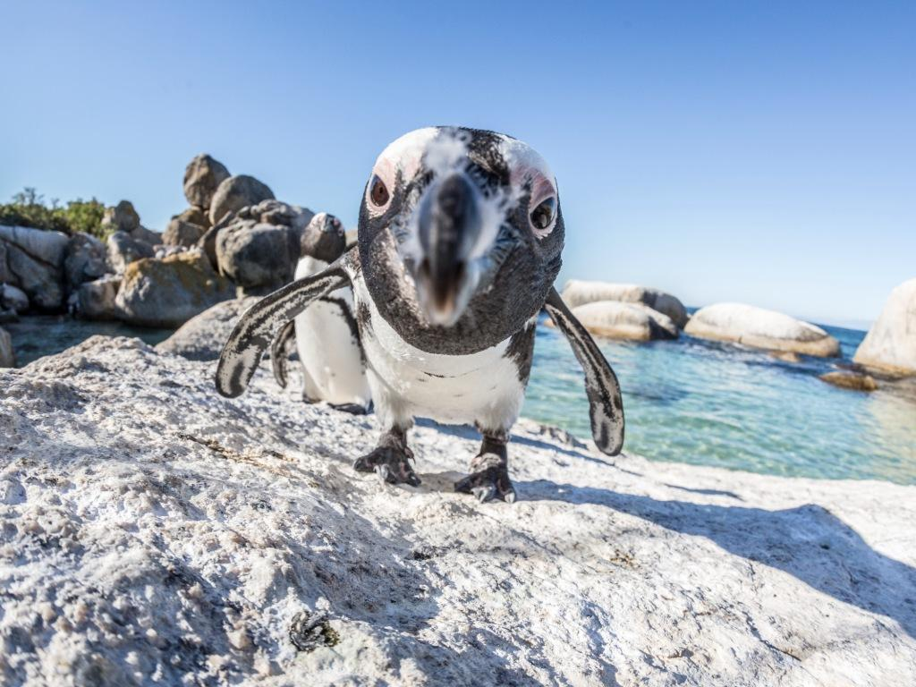
Welcome
To
Cape Town!
Notes:
Congratulations on making it through this year. Largely recovered, except ship-based activities where we WILL see a COVID gap in our records.
Despite the limitations from COVID, the community has responded and demonstrated dedication to ocean observing
OCG too
UN Decade (Wed)
Work and collaboration with UN Decade Programmes as they initiate
Time consuming endeavour. UN Decade activities are a pathway to change. Opportunity for more engagement (eventually resourcing???)
Things are becoming more clear, still need to be vigilant for duplication, efficiency, opportunity and developing and implementing the system.
How best for OCG to support networks with this?
EH Notes
What do we need this to do at the start of the meeting
Lay out some excitement about the agenda and aims
Show progress and good work across the year, responding to circumstances, focus on foci and actions from last year, acknowledge people's work, commitment, progress, ideas of exec (Vice Chairs) and networks - real successes we ahev had - we should be very clear on this - OCG, the networks gains recognition for efforts - in turn support our work to develop observing system
Other work to make OCG meaningful for OO - WMO IP etc
Challenges ahead
How our discussions this week will help guide OCG

Slide 8
Recap since OCG-13
A year of challenges, ingenuity, determination (and a few new worries)
Observations Coordination Group/GOOS continues its central role in developing an efficient, coordinated, and useful ocean observing system
Recognition of OCG as a central pillar of GOOS and significant strategic importance
Authoritative and public GOOS voice with the Report card strengthens, plus public ‘news’ items are often linked to “OCG” and networks
UN Decade opening up new connections and opportunities
Notes:
Congratulations on making it through this year. Largely recovered, except ship-based activities where we WILL see a COVID gap in our records.
Despite the limitations from COVID, the community has responded and demonstrated dedication to ocean observing
OCG too
UN Decade (Wed)
Work and collaboration with UN Decade Programmes as they initiate
Time consuming endeavour. UN Decade activities are a pathway to change. Opportunity for more engagement (eventually resourcing???)
Things are becoming more clear, still need to be vigilant for duplication, efficiency, opportunity and developing and implementing the system.
How best for OCG to support networks with this?
EH Notes
What do we need this to do at the start of the meeting
Lay out some excitement about the agenda and aims
Show progress and good work across the year, responding to circumstances, focus on foci and actions from last year, acknowledge people's work, commitment, progress, ideas of exec (Vice Chairs) and networks - real successes we ahev had - we should be very clear on this - OCG, the networks gains recognition for efforts - in turn support our work to develop observing system
Other work to make OCG meaningful for OO - WMO IP etc
Challenges ahead
How our discussions this week will help guide OCG

Slide 9
Aims of OCG-14
OCG strives to enhance engagement with the Networks and focussing tasks on network needs and priorities
Setting priority actions for the next year!
How we work with requirement setting; WMO Rolling Review of Requirements, OOPC, BGC Panel, etc.
New networks (horizon scan, and refining OCG Network Attributes )
Implementation strategy for Data and Metadata
Share synthesis of GOOS-MTS dialogues and discuss next steps
OCG, network and GOOS development within the UN Ocean Decade - the best way to be engaged
Priorities for developing system-wide capabilities across OCG networks
Notes:
Congratulations on making it through this year. Largely recovered, except ship-based activities where we WILL see a COVID gap in our records.
Despite the limitations from COVID, the community has responded and demonstrated dedication to ocean observing
OCG too
UN Decade (Wed)
Work and collaboration with UN Decade Programmes as they initiate
Time consuming endeavour. UN Decade activities are a pathway to change. Opportunity for more engagement (eventually resourcing???)
Things are becoming more clear, still need to be vigilant for duplication, efficiency, opportunity and developing and implementing the system.
How best for OCG to support networks with this?
EH Notes
What do we need this to do at the start of the meeting
Lay out some excitement about the agenda and aims
Show progress and good work across the year, responding to circumstances, focus on foci and actions from last year, acknowledge people's work, commitment, progress, ideas of exec (Vice Chairs) and networks - real successes we ahev had - we should be very clear on this - OCG, the networks gains recognition for efforts - in turn support our work to develop observing system
Other work to make OCG meaningful for OO - WMO IP etc
Challenges ahead
How our discussions this week will help guide OCG

Slide 10
Highlights and Accomplishments
OCG led engagement with WMO in their RRR process. GOOS, ETOOFS, OOPC, and potentially BGC Panel will now have stronger role in RRR and WMO Statements of Guidance
GOOS request to be considered in WMO GBON (approved by GOOS SC)
3 Emerging networks transitioning to mature status; engaged several new potential networks
OCG Data implementation strategy under review with OCG networks
Progress on metadata standards across networks [OceanOPS]
Notes:
3 Emerging networks transitioning to mature status [AniBOS, OceanGliders, HF Radar]
Potential new networks interacting with OCG [Smart Cables, Ship based ocean time series, USV OASIS, Marine Debris]

Slide 11
Continued!
6 Best practices endorsed, 3+ in process
Report Card - moving cross GOOS [OCG/OceanOPS leading]
Published the OONJ Workshop Report (GOOS Report No. 246)
Continued capacity development Webinar Series & in-person workshop in June
OceanOPS strategic plan on track
3 OCG Roundtables
Notes:
3 Emerging networks transitioning to mature status [AniBOS, OceanGliders, HF Radar]
Potential new networks interacting with OCG [Smart Cables, Ship based ocean time series, USV OASIS, Marine Debris]

Slide 12
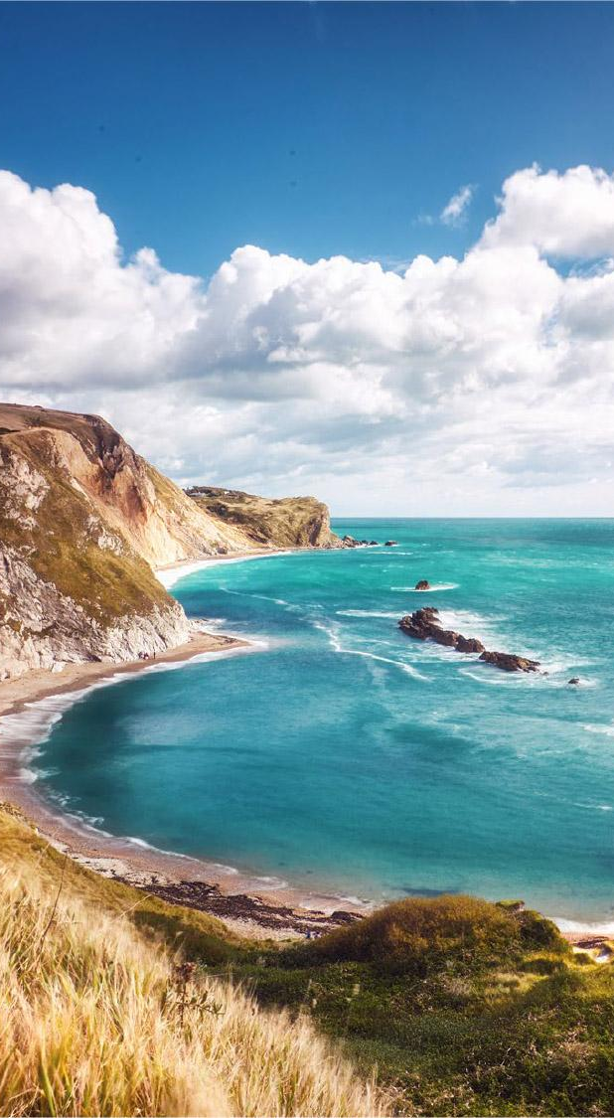
Major Challenges
Continued erosion of resourcing of many ocean observations
No guide or process to prioritize observing activities. How do we coordinate/prioritize? (with Panels and others)
There needs to be more dialogue and coordination around a shared organizational vision of how to effectively implement the FOO (eg Contrast OCG emphasis on networks vice EOVs) and
Developing an integrated, interoperable and highly functional data management framework providing metadata and data.
Engaging and guiding private sector interests and resources (Challenge and Opportunity).
Integration of emerging networks and clear guidelines
Notes:
EH: GOOD CHALLENGES
Emerging networks…. Which(from BGC and BIOECO and GRAs) are ready to join OCG… (resource limitations within OCG and OceanOPS)...?

Slide 13
Opportunities
Implementation of OCG data strategy…what are our priorities?
Developing of metrics (measures) to track and clarify OCG network maturity
Lower barriers and increase industry partnership via GOOS/MTS Dialogues
Consideration of ocean networks in WMO GBON
Observing technology development, assessment, and infusion across networks (System Evolution)
Improving engagement and feedback (e.g. UN Decade activities)
Effective interaction between GOOS panels

Slide 14
This Week and the Way Ahead
Celebrate successes!
Core business surrounding our foci remains critical
Enhance engagement with the Networks
Significant opportunities for OCG and its networks!
Clear cross network dialogue on new opportunities, and our OCG foci priorities, also in identifying barriers to implementation
Help in communicating with/engaging with other groups in these communities
OCG, networks and the Ocean Decade - efficiently expanding the ocean observing system
Meeting in person or virtual in 2024?? Where? Volunteers?

Slide 15
Potential actions
Adoption of the OCG data strategy development, network reporting (eg via report card), & Best Practices
Networks, panels, and UND actions to work with modelers to catalyze studies for WMO Impacts Workshop in 2024. Do we need a complementary workshop to fill in gaps?
We need a process across GOOS to assess readiness and prioritize observing actions (e.g., new networks, invest in advancing TRLs).
Establish a Task Team to refine metrics of readiness and maturity of networks
Notes:
MOU between GOOS and MBON and OBIS need to be renewed, Panel would like to propose the MOU that GOOS Exec can implement
The BioEco Panel co-chairs are currently discussing potential attendance at the GRA Forum (date still being decided but likley to be early 2024) to discuss emerging BioEco networks and to further facilitate uptake of BioEco EOVs into the GRAs.
https://obis.org/2016/12/15/goosgeobonobis/

Slide 16
Potential actions
Work closely with regional organizations, national governments, and local communities to develop integrated observing strategy, for example OCG, Bio-Eco Co-Chairs could attend GRA meetings.
Develop a strategy to engage the private sector/industry (following GOOS/MTS Industry Dialogues)
Notes:
MOU between GOOS and MBON and OBIS need to be renewed, Panel would like to propose the MOU that GOOS Exec can implement
The BioEco Panel co-chairs are currently discussing potential attendance at the GRA Forum (date still being decided but likley to be early 2024) to discuss emerging BioEco networks and to further facilitate uptake of BioEco EOVs into the GRAs.
https://obis.org/2016/12/15/goosgeobonobis/

Slide 17
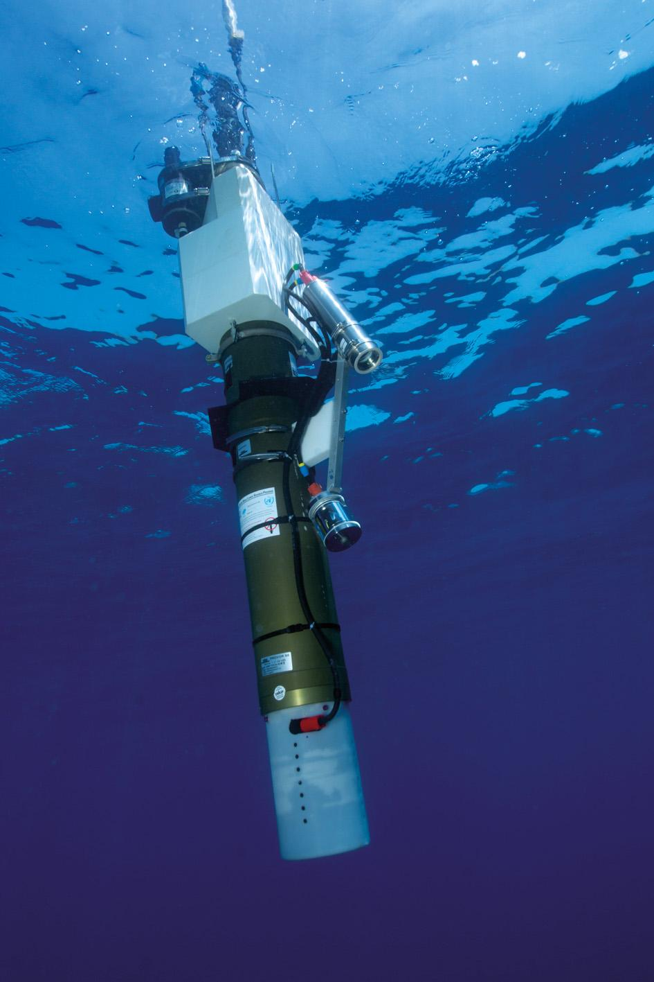
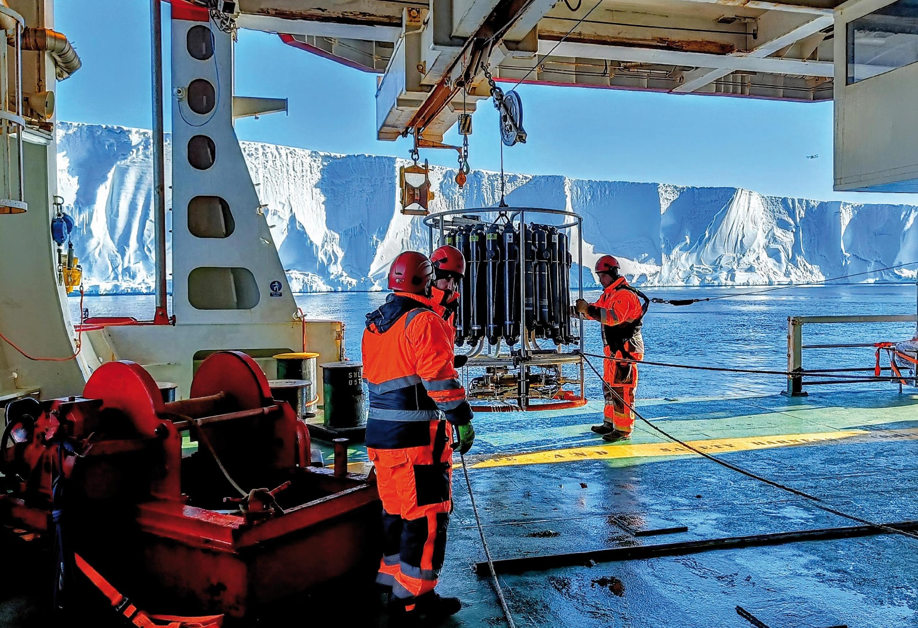
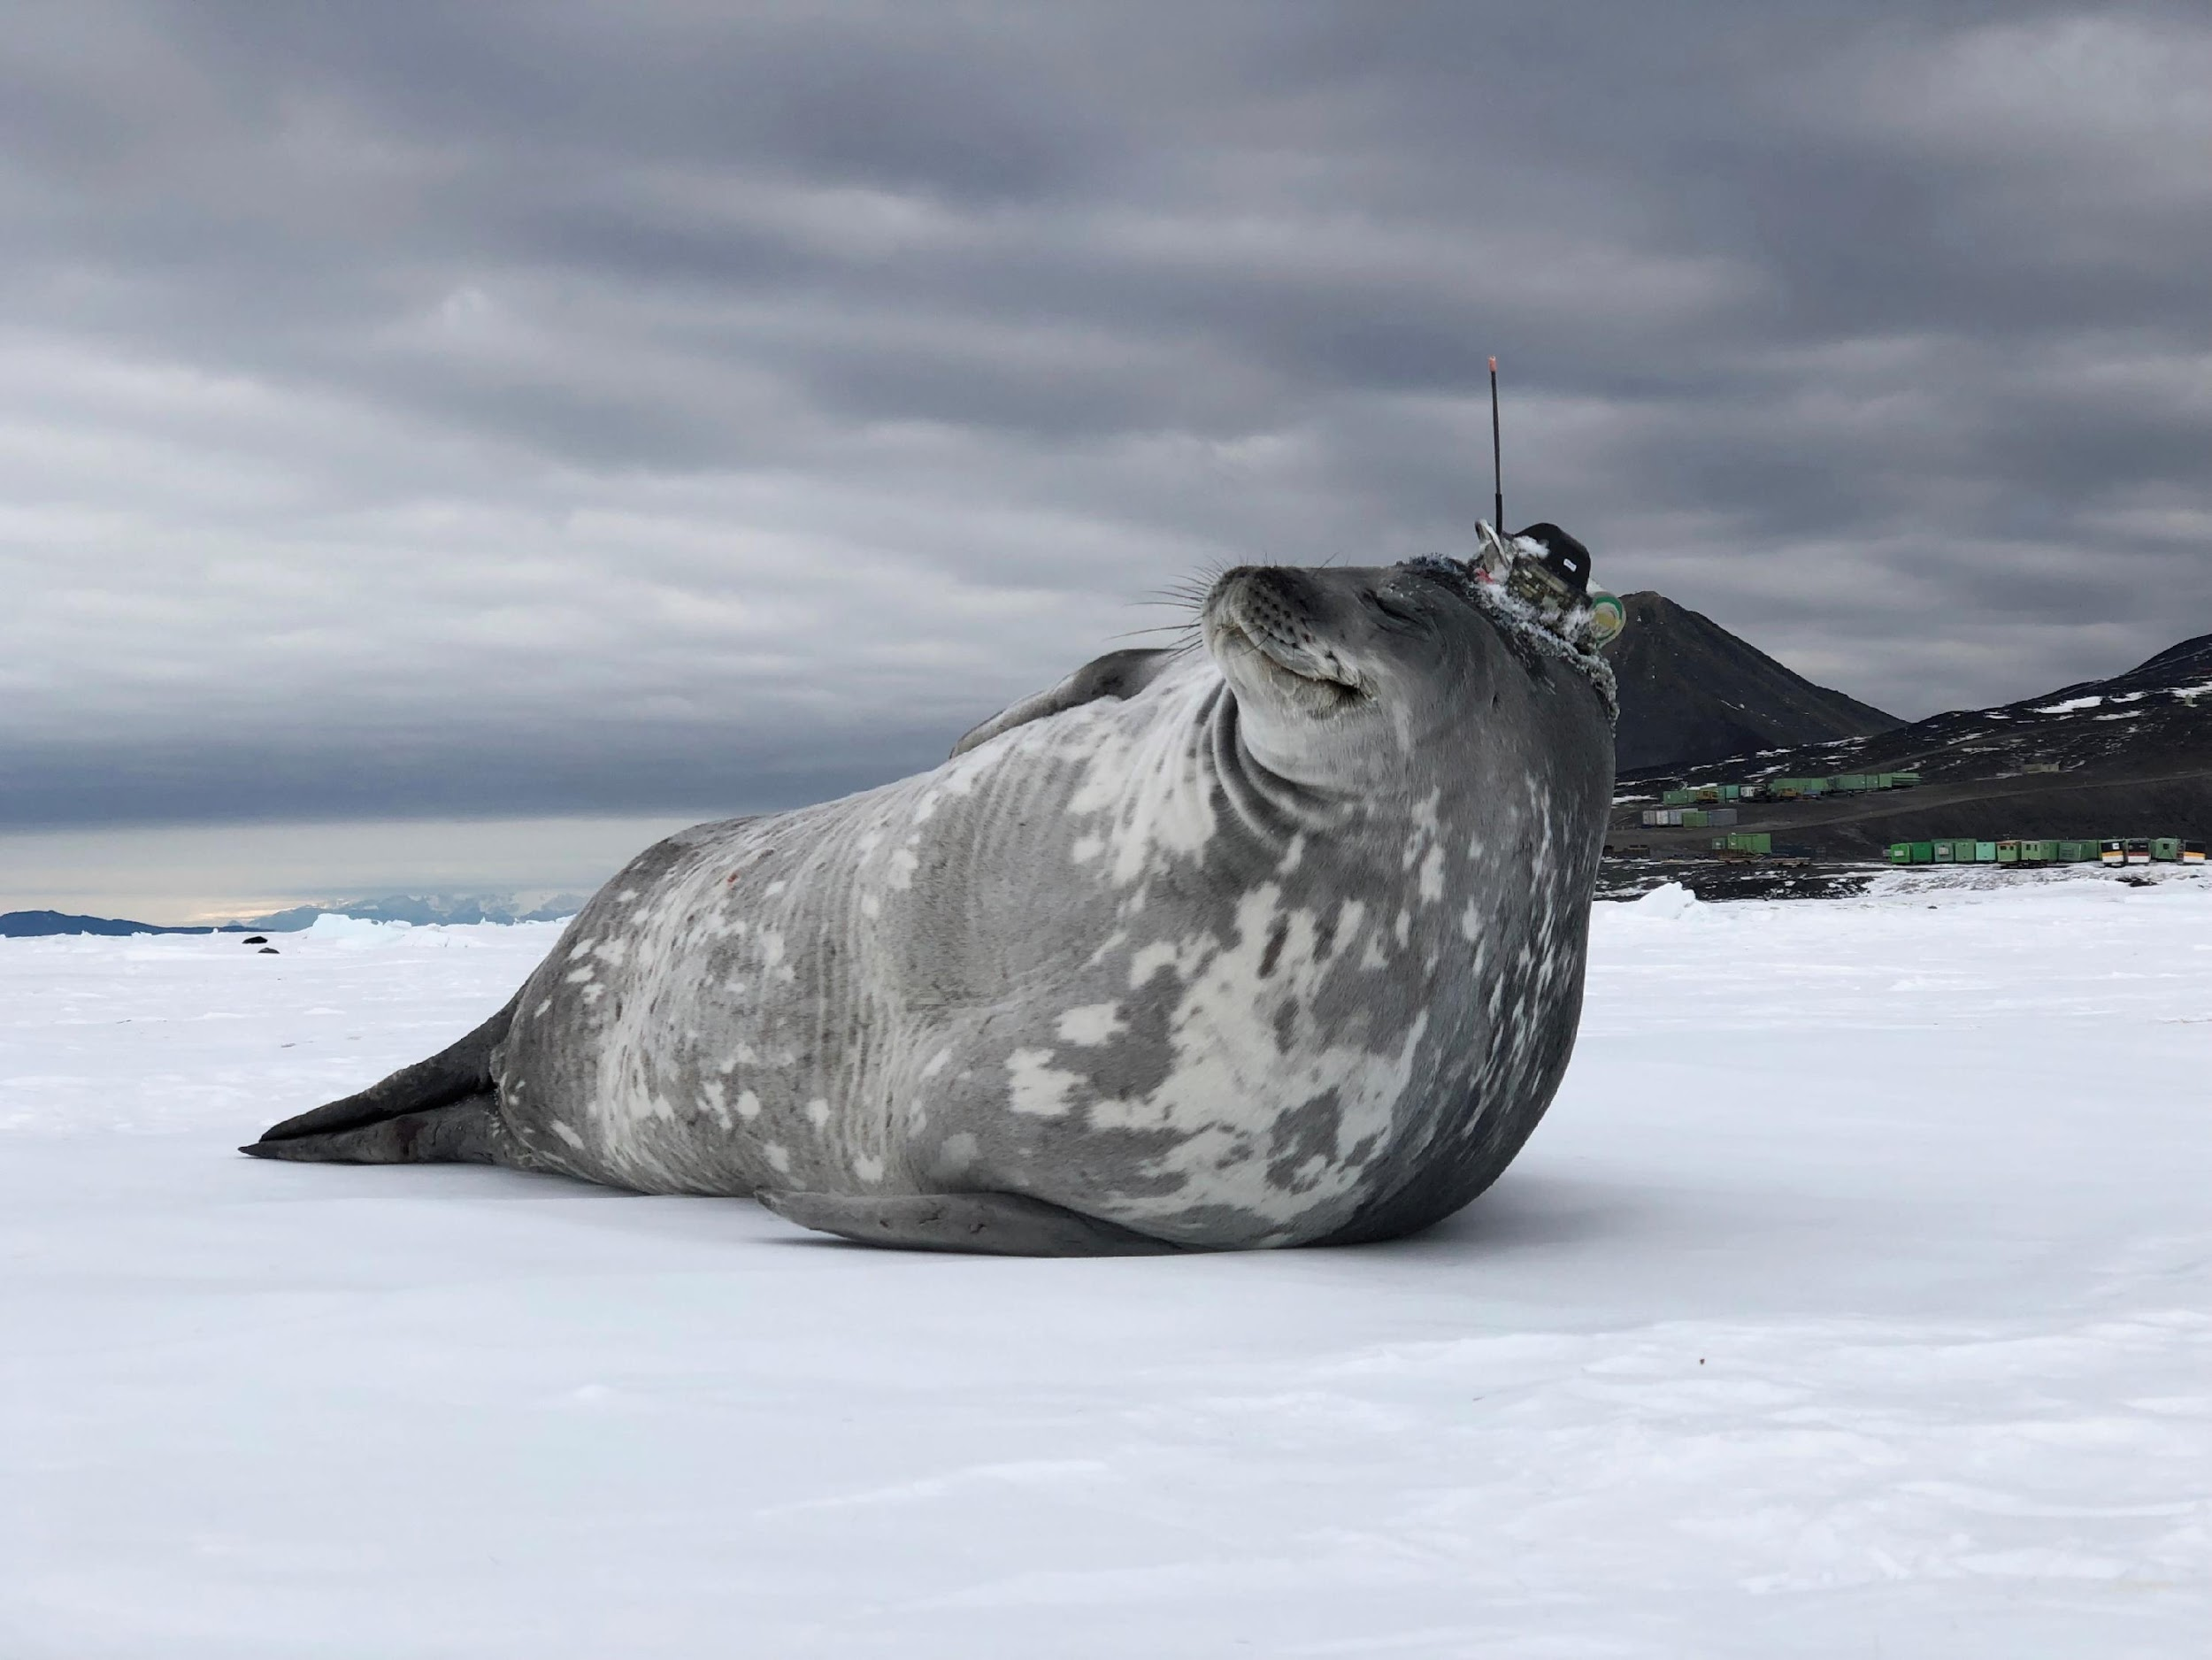
Thank you
goosocean.org

