Slide 1
GOOS Report Out & Perspectives
Emma Heslop
Act. Director GOOS Office, IOC/UNESCO
OCG-14

Slide 2
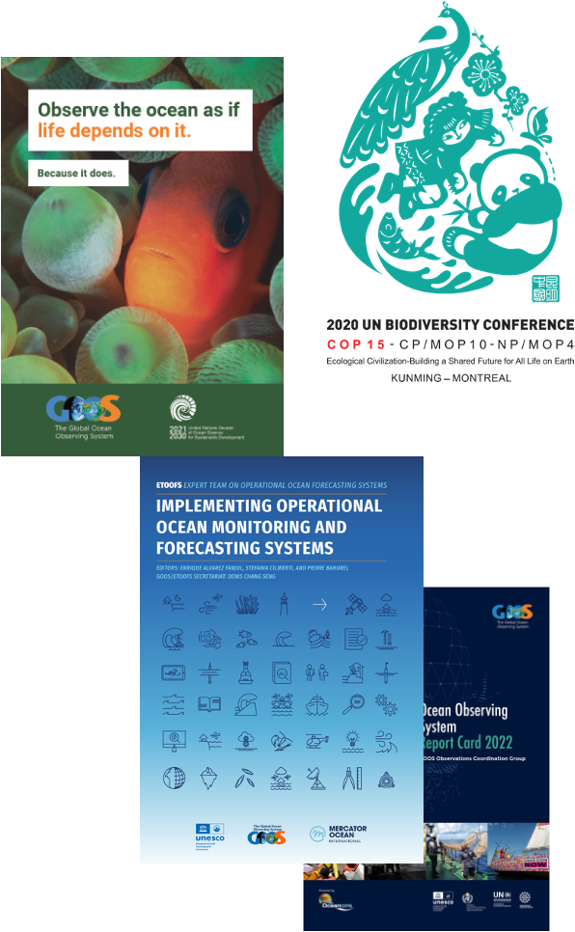
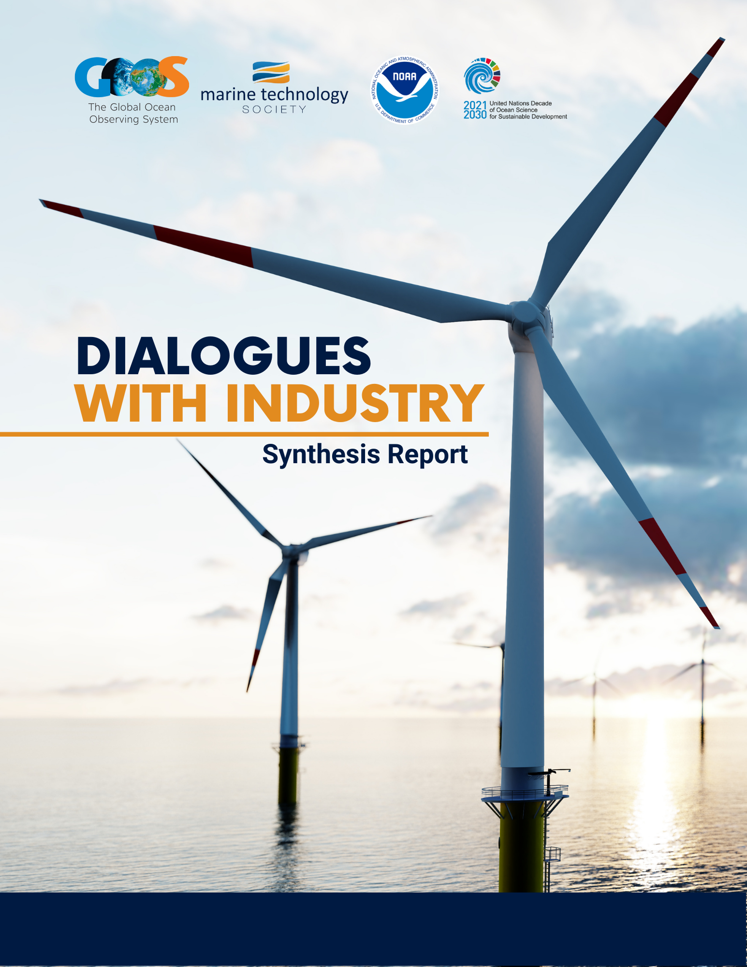
Focus and successes
Comms and advocacy across the UN focus – building understanding need for ocean observing and GOOS (more later)
Regional rejuvenation - Pacific Islands, Caribbean, Africa, Arctic
Dialogues with Industry (GOOS & MTS & NOAA) (hear at OCG-14 – initiated from OCG conversations – connection networks?
GOOS National Focal Points – also being re-activated and moving forward - national allies for networks?
WMO RRR important engagement for GOOS Office, OCG/OceanOPS, OOPC, BG Panel, and ETOOFS – GBON technical specifications SSS and SSP – SOFF opportunity for SIDS and developing countries – ocean greater visibility
Increased partnership – WMO, IODE, MSP, OSS, UNEP, Member States and across UN
UNESCO - Sorbonne hosting agreement for BGC Argo new OceanOPS team member (Orens)
Guide Operational Ocean Forecasting System
EOV Paper almost complete
BioEco portal (visualisation/metadata) launched
Notes:
Change
Comms
Advocacy
NFP
Relationships
Thought Leadership

Slide 3
GOOS Steering Committee April 2023
Notes:
Really great progress all SOs

Slide 4
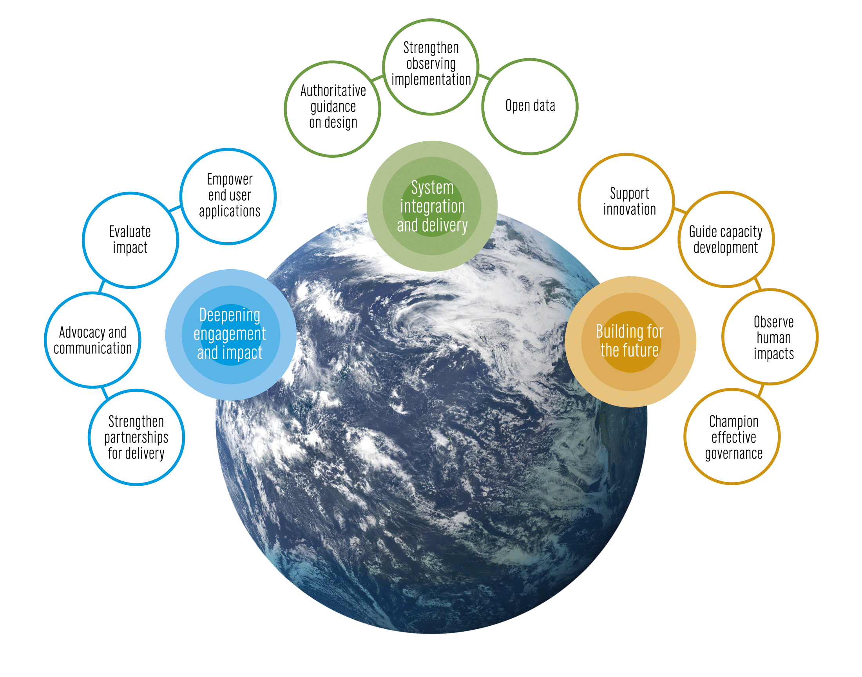
Focus, Focus, Focus
First time reporting out against the 11 Strategic Objectives – OCG took lead on Objective 6 strengthening the observing implementation
Continue advocating for sustained, coordinated ocean observations, visible at international fora
Regional coordination (PI-GOOS, IOCARIBE GOOS, GOOS Africa, Arctic TT)
UN Ocean Decade continues to an important opportunity, Co-Design Programme is working across several objectives
Evolving GOOS Governance - key action for 2023
Strengthening GOOS core support highlighted as vital, including support for needed data and metadata integration work across GOOS

Slide 5
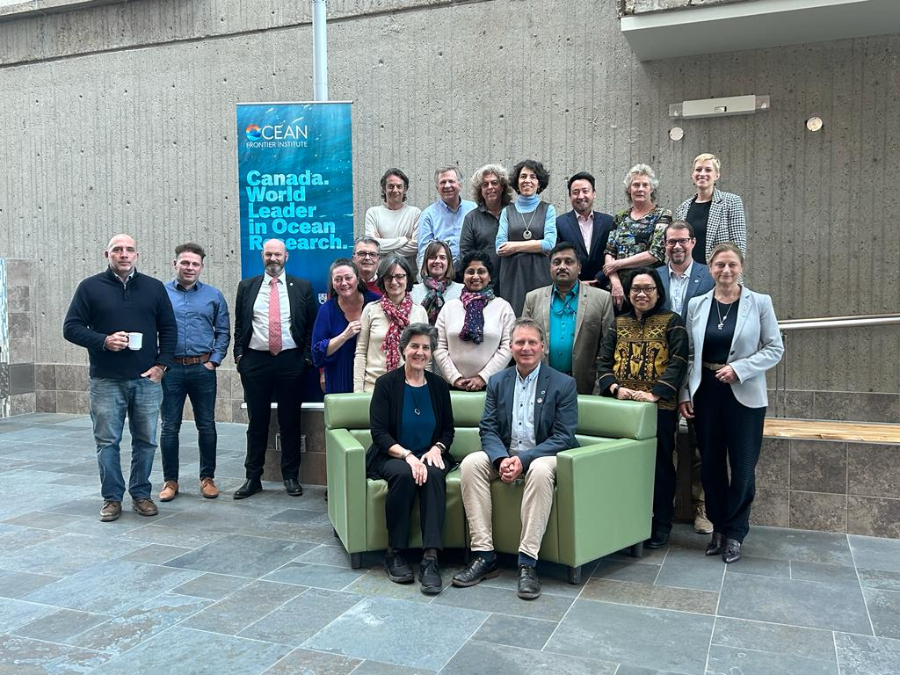
New
Adopted
Updated ToRs for GOOS National Focal Points
New EOV – Bottom Pressure
Canadian Integrated Ocean Observing System (CIOOS) proposal to be a new GRA - adopted
Arctic ocean observing TT – with some modifications
New GOOS Projects - SMARTCables starting to work with OCG – pathway an emerging network, Integrated Marine Debris Observing System (IMDOS) also starting to engage with OCG – pathway unknown as yet

Slide 6
IOC Assembly
Notes:
Ocean Observing has made great progress… BUT not sufficient for societies current and future needs but
Right now, we are driving into our future in darkness. And GOOS aims to turn on the headlights.

Slide 7
IOC Assembly June 2023
GOOS Work Plan: Adopt the Work Plan - summary based on SO reports and SC priorities – support structure ask GOOS needs to double in size 2026
EEZ: Report on GOOS Network Survey and member states feedback
GCOS IP and Joint WMO-IOC-UNEP-ISC Review for GCOS: Summary GCOS IP and Review
JCB: Summary progress – review

Slide 8
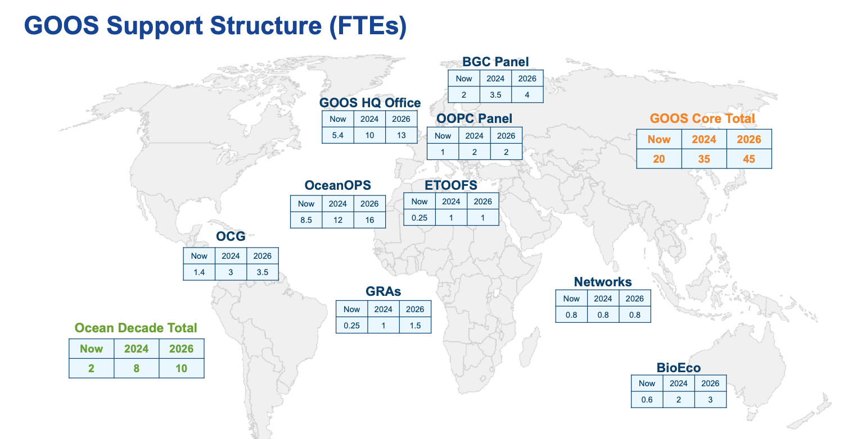
IOC Assembly June 2023
Item: 4.8.1 - IOC/A-32/4.8.1.Doc(1)
Global Ocean Observing System (GOOS) Implementation plan (2024–2025) – Summary - here

Slide 9
EEZ Issues - networks
Item: 4.8.2 - IOC/A-32/4.8.2.Doc(1)
Summary Report on the Consultation on Ocean Observations in Areas under National Jurisdiction – here
Plus IOC/INF-1431 for more details - Details on the results from the 2023 survey to global ocean observing networks on ocean observations in areas under national jurisdiction
64 anonymous response – 35 (55%) indicated that their operations had been impacted – 80% Argo, 71% Go-SHIP, AniBOS and OceanGlider 66%, OceanSITES 60%
76% (27/35) experienced - marine scientific research (MSR) process is incompatible with the operational reality sustained ocean observing
68% experienced - advance notice is incompatible with operation for some platforms
34% MSR clearance is often impossible to obtain in zones where EEZs are disputed
14% experienced - no national procedure for MSR clearance - new technology
Argo many missions, % impacted 5% to 100%. DBCP many missions (70) with a relatively high % impacted (50%). GO-SHIP small number of missions % impacted high (40-80%). AniBOS moderate missions (35) low % impacted (2.8%).

Slide 10
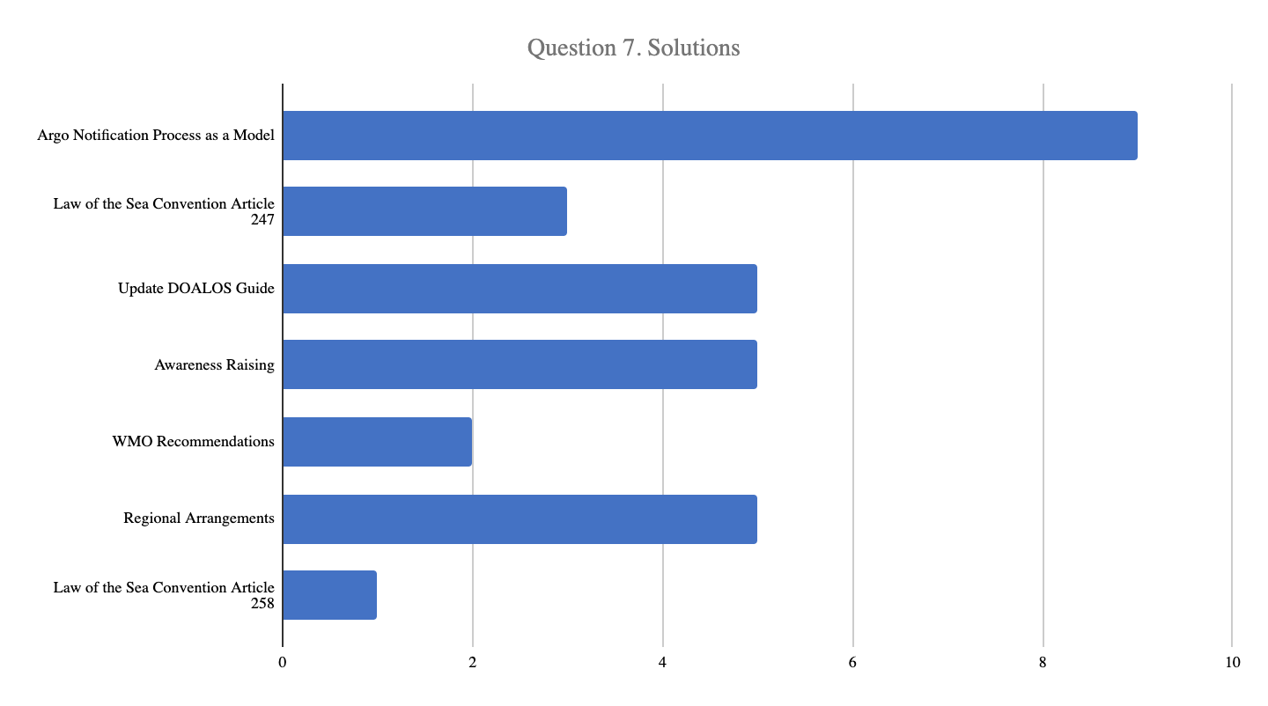
EEZ Issues – Member States
Item: 4.8.2 - IOC/A-32/4.8.2.Doc(1)
Summary Report on the Consultation on Ocean Observations in Areas under National Jurisdiction – here
15 (now 17) responses - big variation in level of activity in other nations water and in their waters 0 – 100.
Generally satisfied with clearance process – many report they give clearance more rapidly than 6 months 2-4 months. Issues encountered are the same as the networks in general, with addition surface CO2 VOS
Four of the 7 solution spaces seen as most promicing/worth exploring
IOC Asembly Decison: foem an ad-hoc Working Group of volunteer member states to explore the issues and report bexk recommendations
Des

Slide 11
Ocean Decade
Notes:
Really great progress all SOs

Slide 12
Co-Design Exemplars
*Each exemplar is at different levels of maturity
The Ocean Carbon Cycle
Improving carbon data to inform climate targets, such as net zero
Tropical Cyclones
Advancing tropical cyclone forecasting to save lives & property
Storm Surge Improving predictions to minimise impacts on vulnerable communities & natural resources
Marine Life
Conserving marine biodiversity and supporting sustainable use of resources
Boundary Currents
Understanding key current systems that significantly influence productivity, weather and climate
Marine Heatwaves Monitoring marine heatwave impacts on biodiversity and economies
Notes:
In general each exemplar will follow a similar development path. From the basics of initiating communications and a co-design process (engaging users, describing the value chain, etc) to full-scale globalizaiton of their intended activities.
Different exemplar areas are at different readiness levels - some will mature to implementation within a year, others will need longer to determine the design and the value - often down to the maturity of the sector and the service - e.g. tropical cyclone forecasts are well connected to users - we are increasing the accuracy, but for carbon, and marine resource management the services do not yet exist.
They all share in common the common purpose of developing tools/diagnostics, and best practices and demonstrating their effectiveness through pilot projects that, if successful, could then be scaled to a more permanent and global scale system.
NEXT SLIDE
======================================
- requiring alignment and investment - to deliver design for obs & recommendations for models and services (connected chain)
Work out scaling too…..
GOOS synthesises recommendations
Linked to observing projects - programme/GOOS
At same time programme is developing over the next 1-4 years
tracking and reporting capability
Developing infrastructure - DCCs, DCOs, GOOS, WMO connecting to other processes (RRR), and UN Policy, GCOS
Develop knowledge for best practice - deliver this for more exemplars - global and regional scale
Work on cultural change…
Where will we be at 5 years?
X exemplars?
System lifted in key areas
Ability to now test the system for needs - WNO others,
New exemplars - perhaps even regional/ local to lift the system
Expanded testing facility with ability to access for GOOS Projects,
Links between prediction and observing firmly established, assessment of value routinely undertaken
AT 5 years - ASSESS - what need to do to move from exemplars to systemic - size of any core facility/management… is it even needed

Slide 13
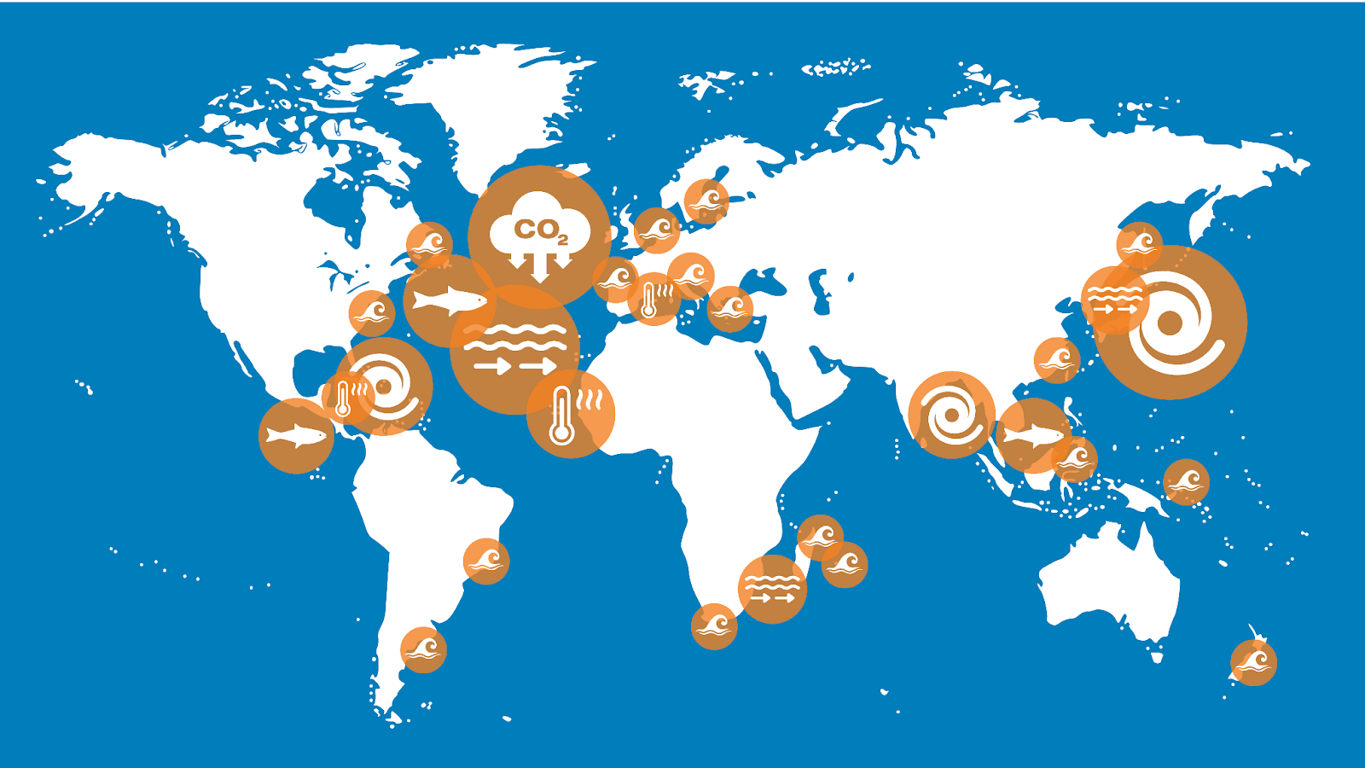
June - Boundary Currents Workshop
July – CoastPredict/EuroSea – connections modelling-observing
Sept 18-20 – Co-Design/EuroSea legacy meeting Paris
Sept 21-23 – DCC China host workshop to discuss tropical storms, MHW pilots
Oct onwards – NSF funder workshops

Slide 14
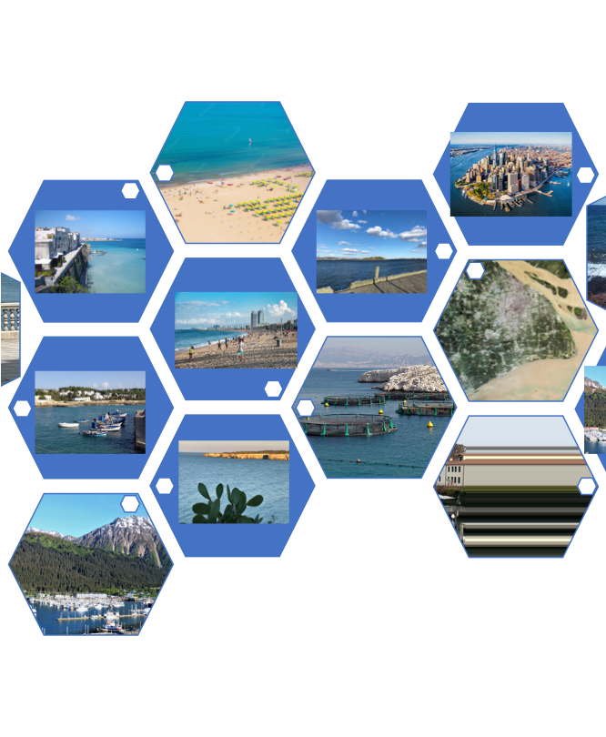
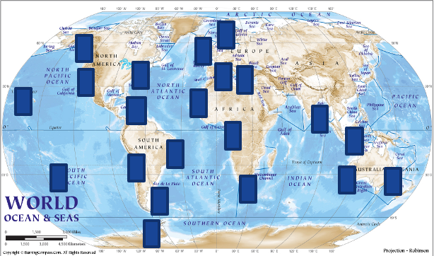
Global Coast
Area with different coastal features, societal needs, and level of development - same backbone
Global Coast - 4-6 sites, variety of coastal features, societal needs, existing infrastructure
Developing services, advancing science/capability, testing new tech
Common data and best practice backbone
Notes:
Revolutionising Global Coastal Ocean observation and forecasting and offering open and free access to coastal information

Slide 15
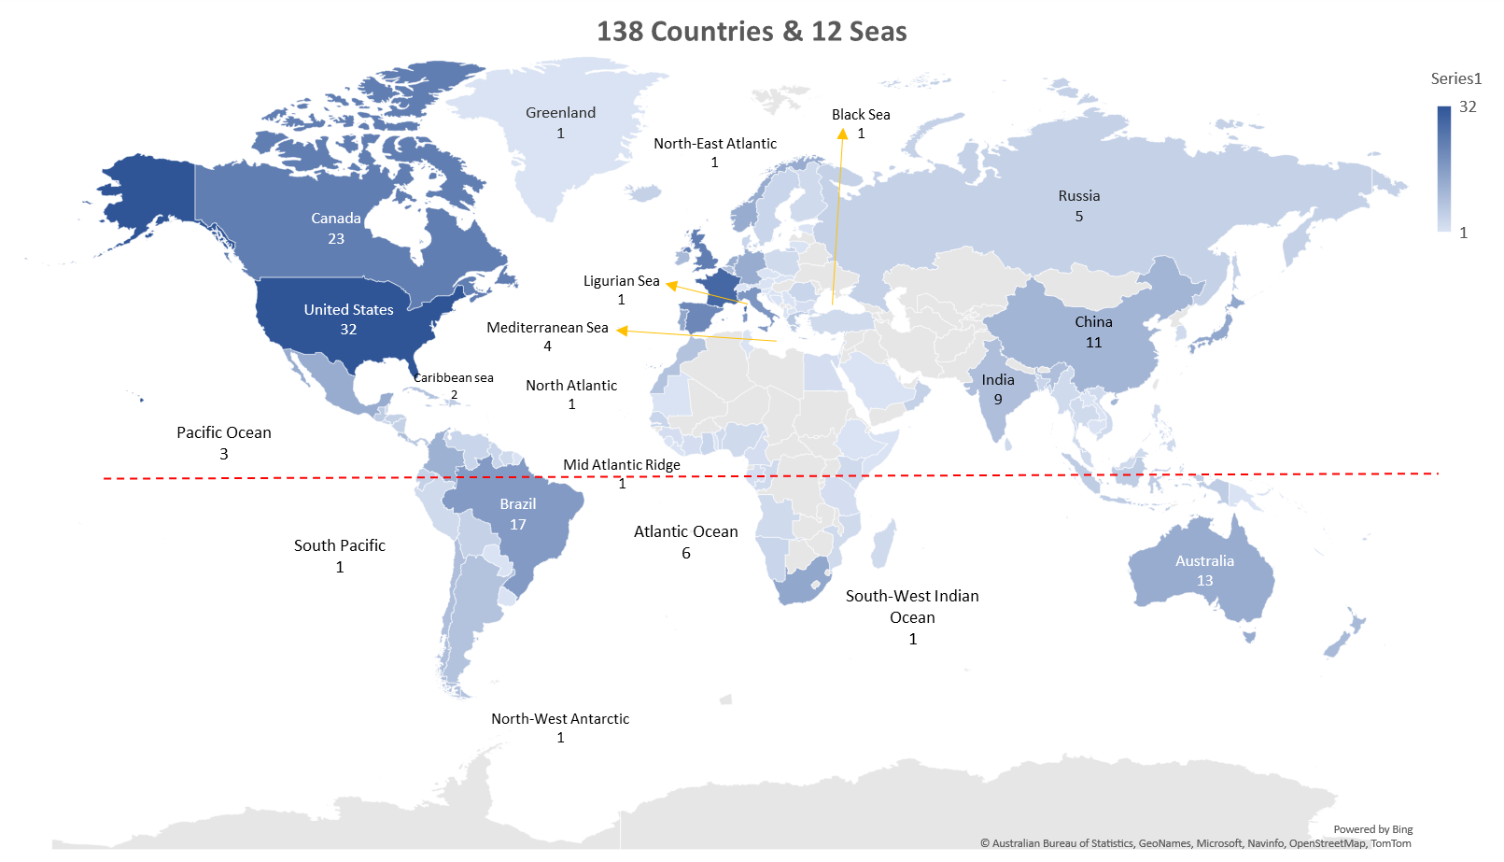
Decade Coordination Office – Ocean Observing
DCO Leader starts 01 July (funded by the Ocean Decade) - Terry McConnell (Fugro/Ocean Decade), assisted by Yaeji
10 Programmes and many, many projects
Focus work collaboration, fundraising, support, GOOS Connections/legacy (include OCG/networks/data), Vision 2030 Paper
Map implementation areas - how nations could use these towards aligned infrastructure asks
Notes:
One person to fundraise?
Make the case for changes in funding to sustained and for ‘infrastructure’, should go alongside this, also make the case for culture change around recognition for collaboration and BP, make the case for vital public infrastructure

Slide 16
The Ocean Decade presents an opportunity to lift all components of the digital ecosystem
END-USER APPLICATIONS…
OBSERVATIONS
& DATA COLLECTION
ANALYTICS, MODELLING & PREDICTION
Ocean Observing
DATA MANAGEMENT & SHARING
Ocean Data Sharing
Notes:
The goal of the Decade is to develop sustainable solutions to meet the 10 Decade Challenges.
Solutions involve delivering knowledged and information to ddecidion smakers/policy makers at the right time.
For these solutions to work, we need the necessary infrastructure behind to support the data and information colectiong, management, sharing and utilization; it to make it happen.
The four key components of a digital ecosystem required for an end-user application are as follows
With every endorsed Ocean Decade programme and project, we aim to develop such solutions, and we need to make sur eis that we don’t end up with multiple such icebergs floating around
This is important enough that we need a focused coordinated approach from observations (upstream) all the way along the value chain to the end-user and decision maker (downstream). We are doing this by implementing these 3 coordination offices – DCOs for Ocean Observing (hosted by GOOS), Ocean Data Sharing (hosted by IODE) and Ocean Prediction (hosted by Mercator). These are responsible for coordinating the work of relevant decade endorsed programmes and projects, as well as supporting with comms and resource mobilisation.
For GOOS - opportunity to lift ocean observing For IODE - opportunity to play a central role in establishing a globally distributed digital ecosystem for data sharing, extending the work they are doing on OceanInfoHub

Slide 17
Looking ahead
Notes:
Really great progress all SOs

Slide 18
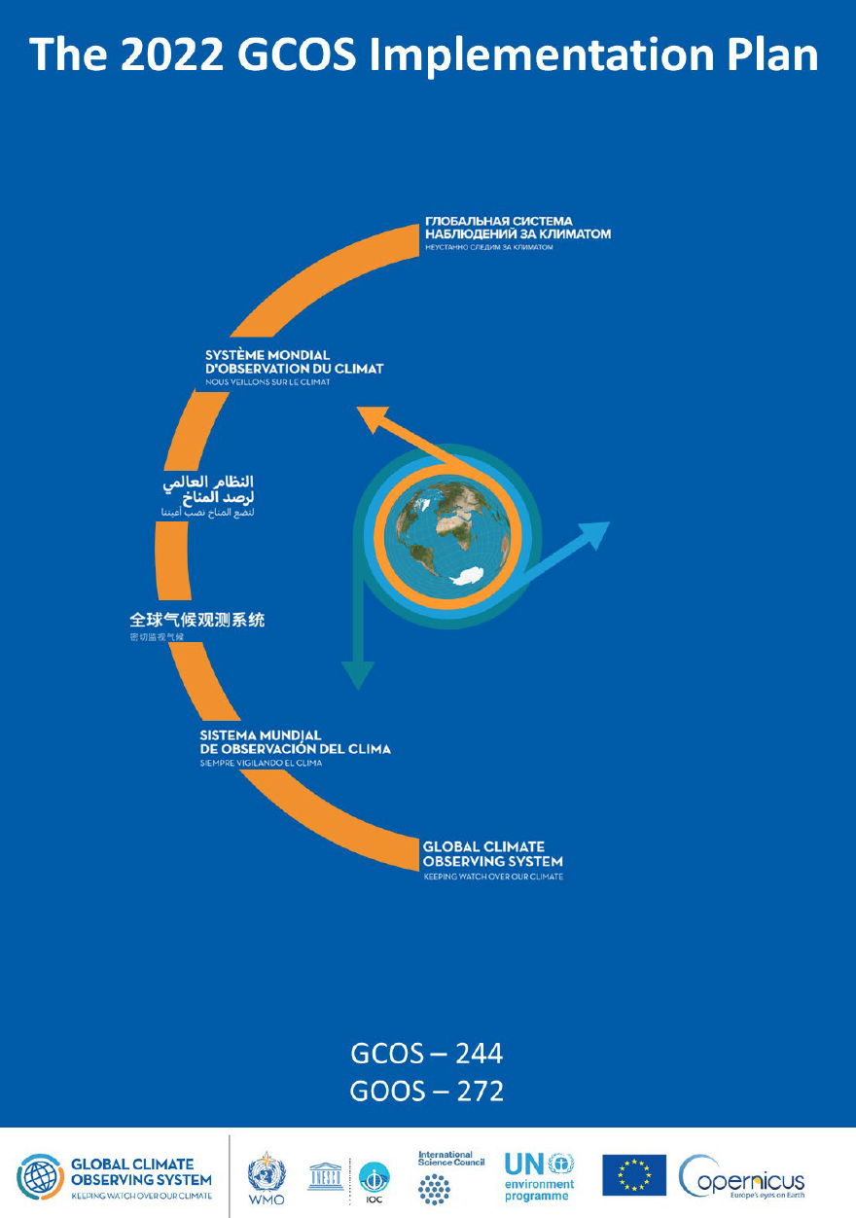
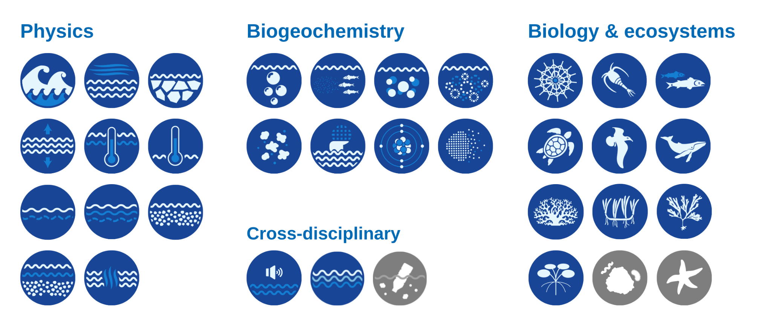
Requirements
GOOS, OCG, OOPC, BGC Panel (and ETOOFS) engage in the WMO RRR process – ocean applications climate, BGC cycles, mesoscale forecasting
Co-Design Programme working on design/requirements for application areas – similar & different to WMO RRR
GCOS Implementation Plan – specific actions – OOPC coordinate across GOOS Expert Panels
GOOS Expert Panels – how use the EOVs specification sheets – not sufficient for design
TPOS2020, CoastPredict, DOOS, OASIS…?
Ocean Decade Vision 2030 Process – 2030 Goals for ocean observing(!?!)
Notes:
One person to fundraise?
Make the case for changes in funding to sustained and for ‘infrastructure’, should go alongside this, also make the case for culture change around recognition for collaboration and BP, make the case for vital public infrastructure

Slide 19
How OCG respond?
2-day Workshop before OCG meeting to discuss across requirements?
Identify cross network response – existing that can be adapted / where need new/investment?
Invite GOOS Panels, GCOS, others
Limit what consider as requirements – major initiatives driven by end user needs, as well as science
Trial next year?
1-day update in intervening years?
Notes:
One person to fundraise?
Make the case for changes in funding to sustained and for ‘infrastructure’, should go alongside this, also make the case for culture change around recognition for collaboration and BP, make the case for vital public infrastructure

Slide 20
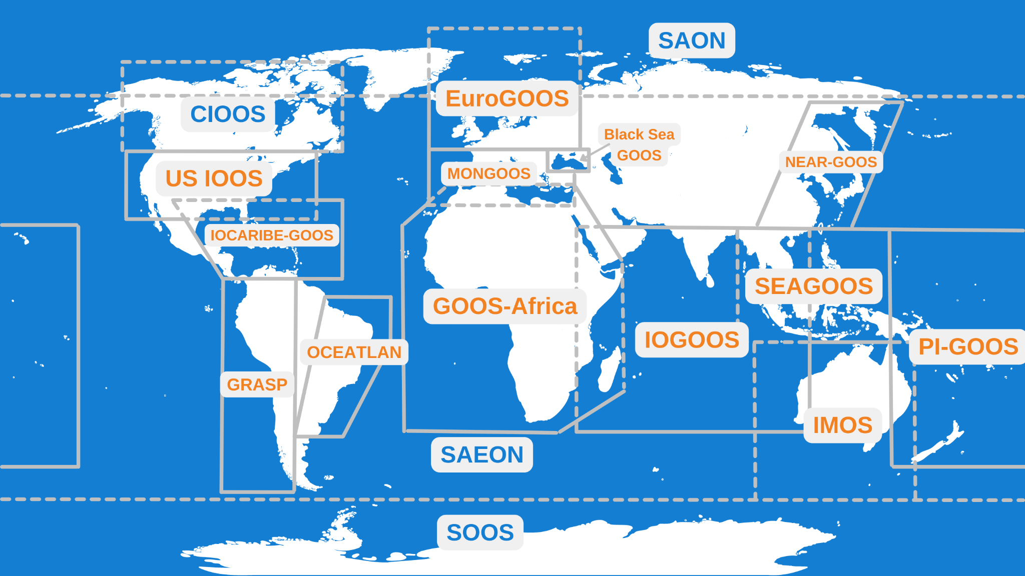
OCG links with GRAs and GOOS NFP
GRAs
13 GRAs – soon to be 14 - rejuvenation in PI-GOOS, IOCARIBE-GOOS, GOOS Africa, & new CIOOS, and 130 countries contribute
Network engagement in regions for planning/capacity?
Alignment for OCG Data Implementation Strategy?
GOOS National Focal Points
Now 65 NFP
Natural national allies for networks?
Notes:
One person to fundraise?
Make the case for changes in funding to sustained and for ‘infrastructure’, should go alongside this, also make the case for culture change around recognition for collaboration and BP, make the case for vital public infrastructure

Slide 21
OCG
Topics
Squeeze on resource – defence in visibility and change of narrative to essential – comms and advocacy, Member States, NFP, GRAs, sponsors, partners – amplify the messages – sustained observations are indispensable
Data and metadata – must flow
Best practices – must underpin
Design to services – links to modelling community and users vital
Private sector role - public-private partnership - concrete outcomes and transformation
OCG work remains critical, networks are the core of sustained operational observing system, continue to strengthen and evolve

Slide 22
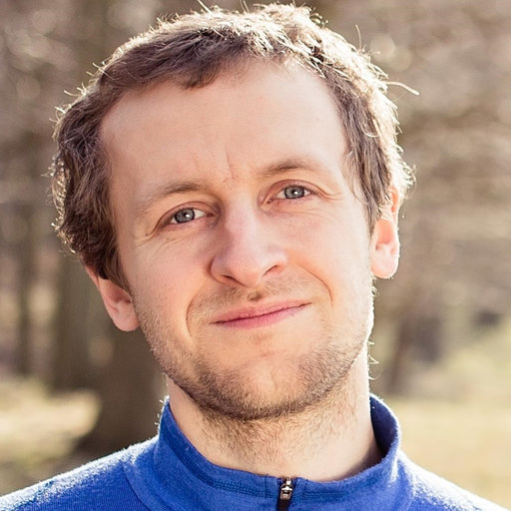
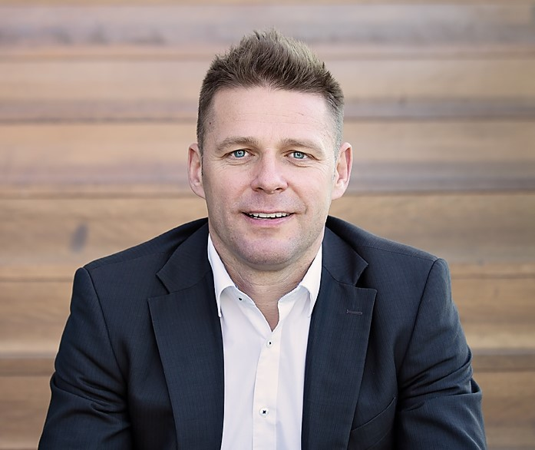
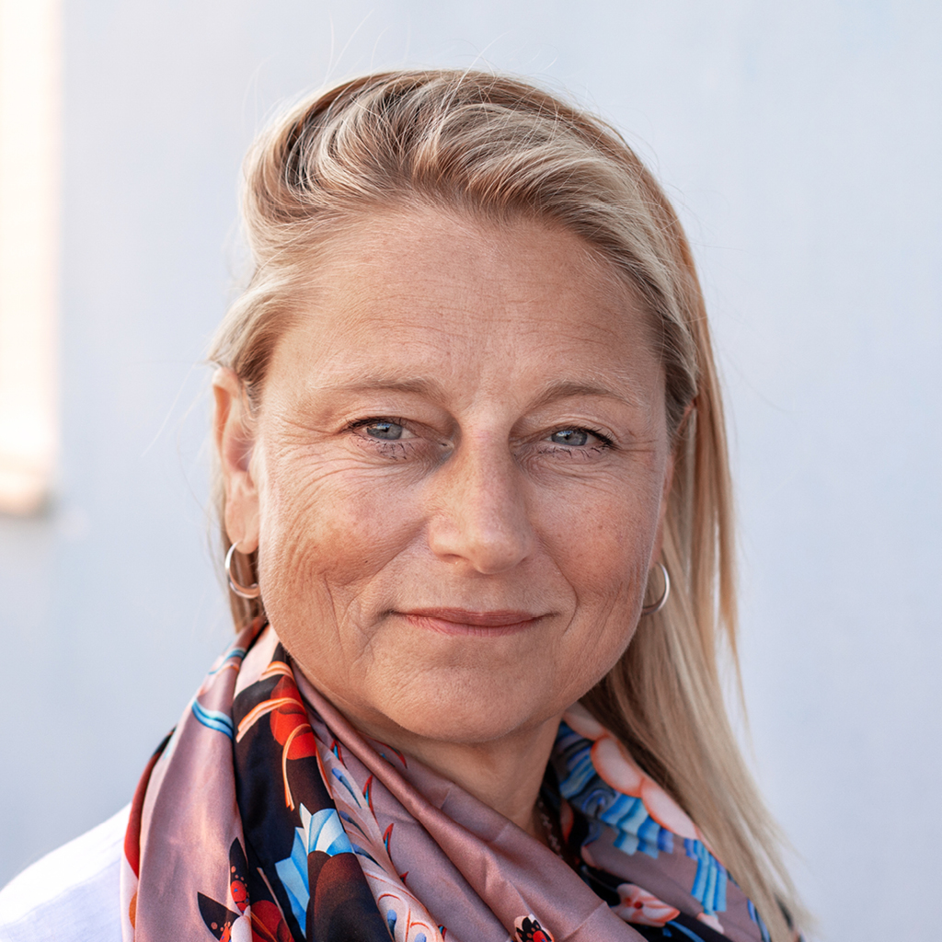
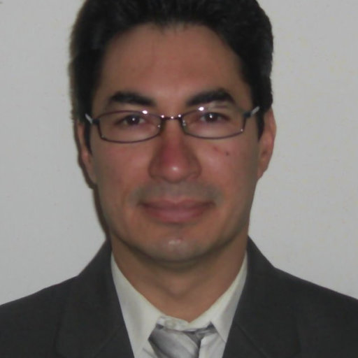
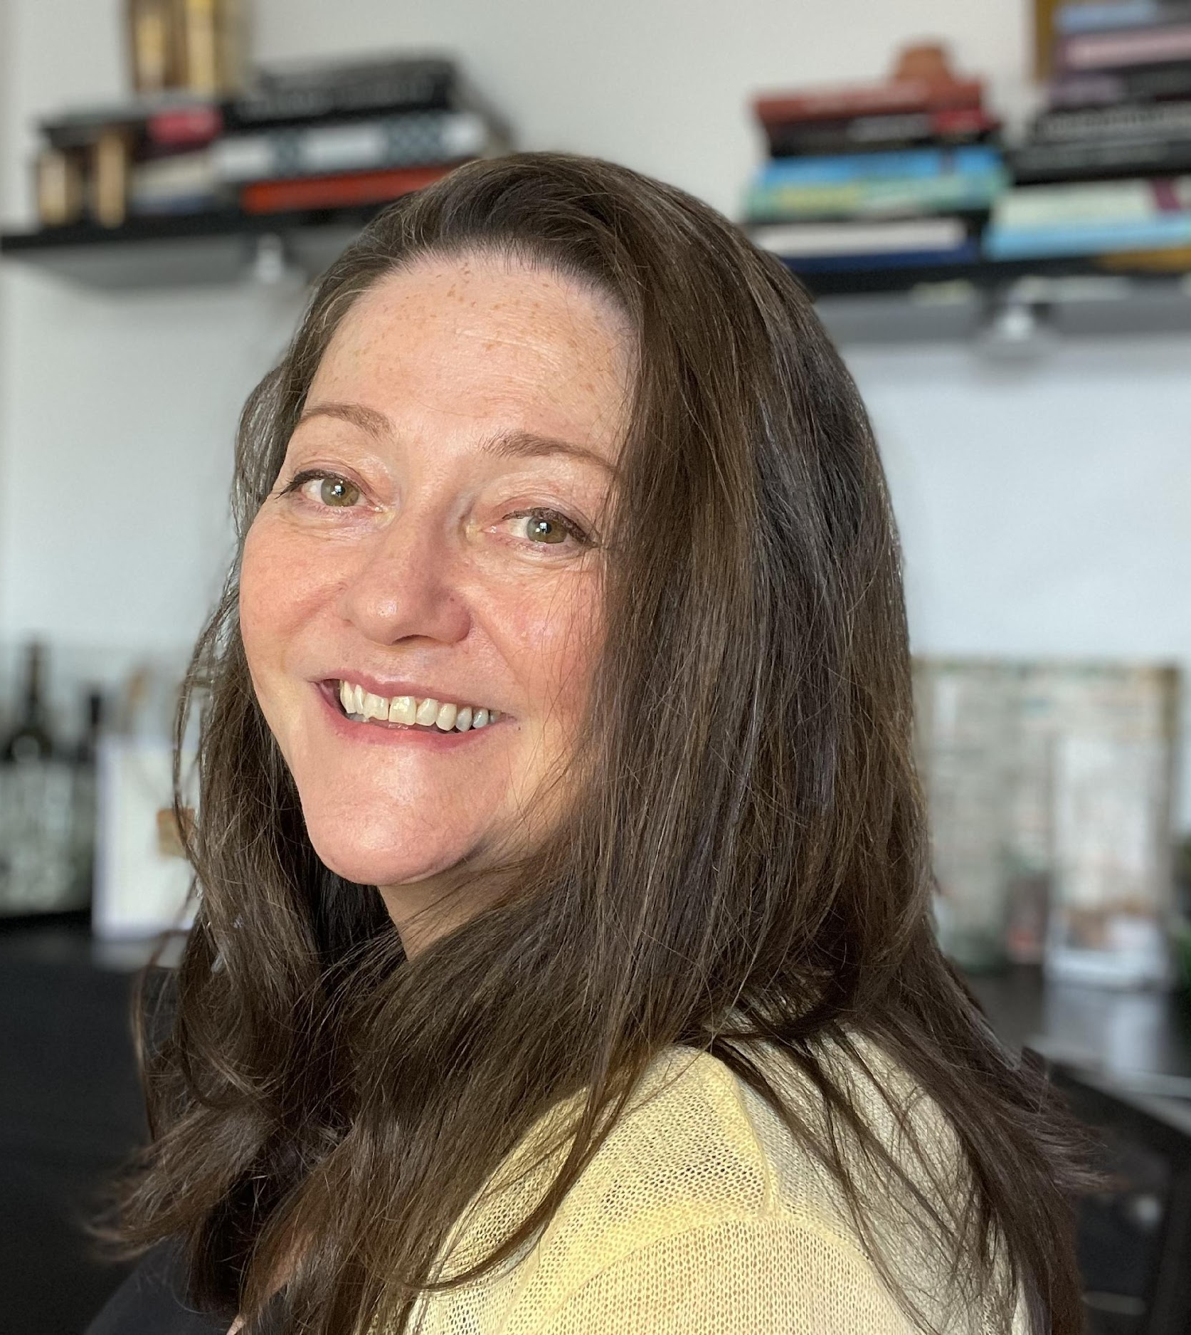
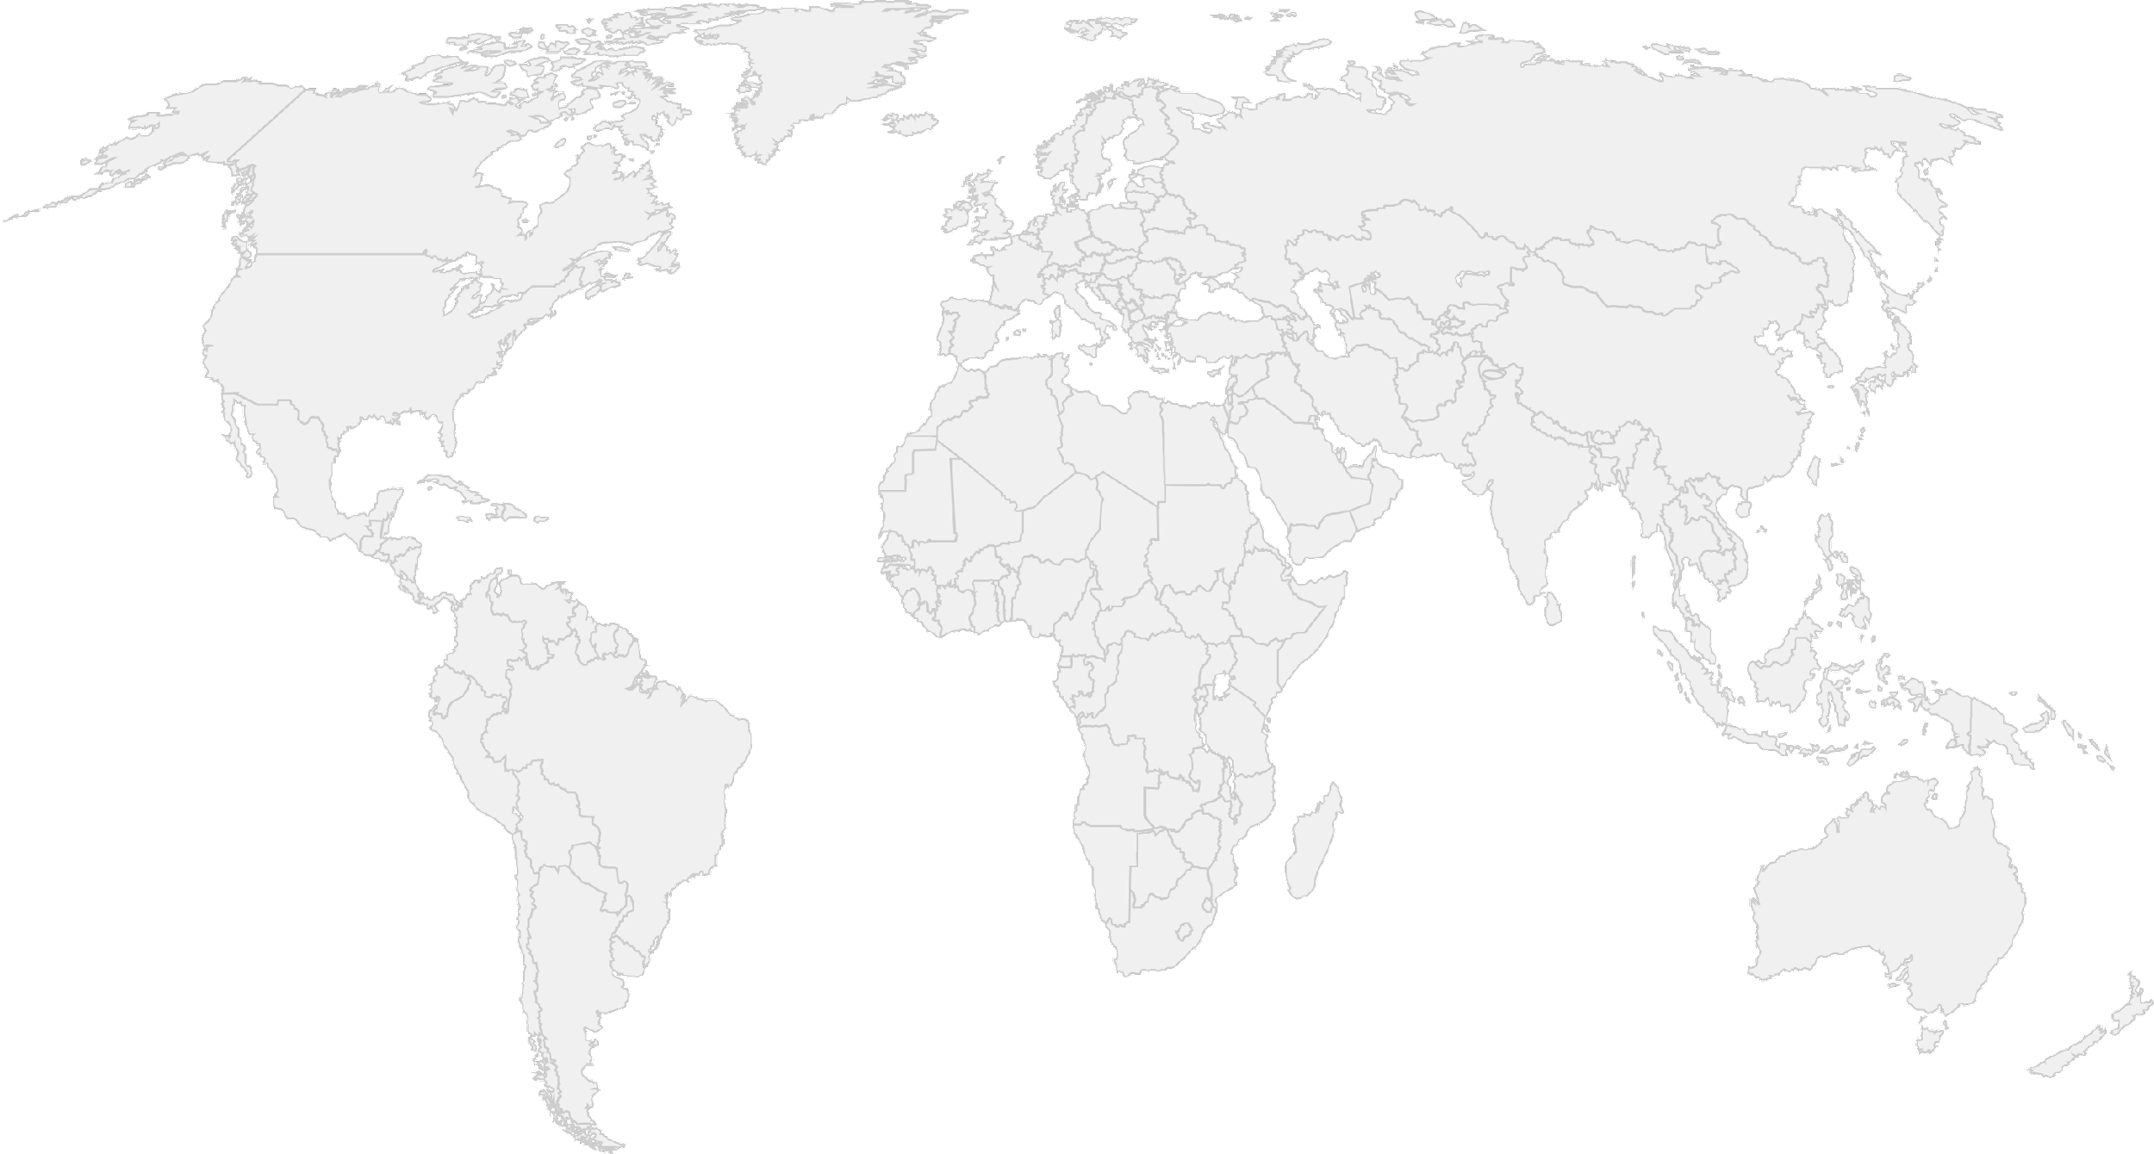
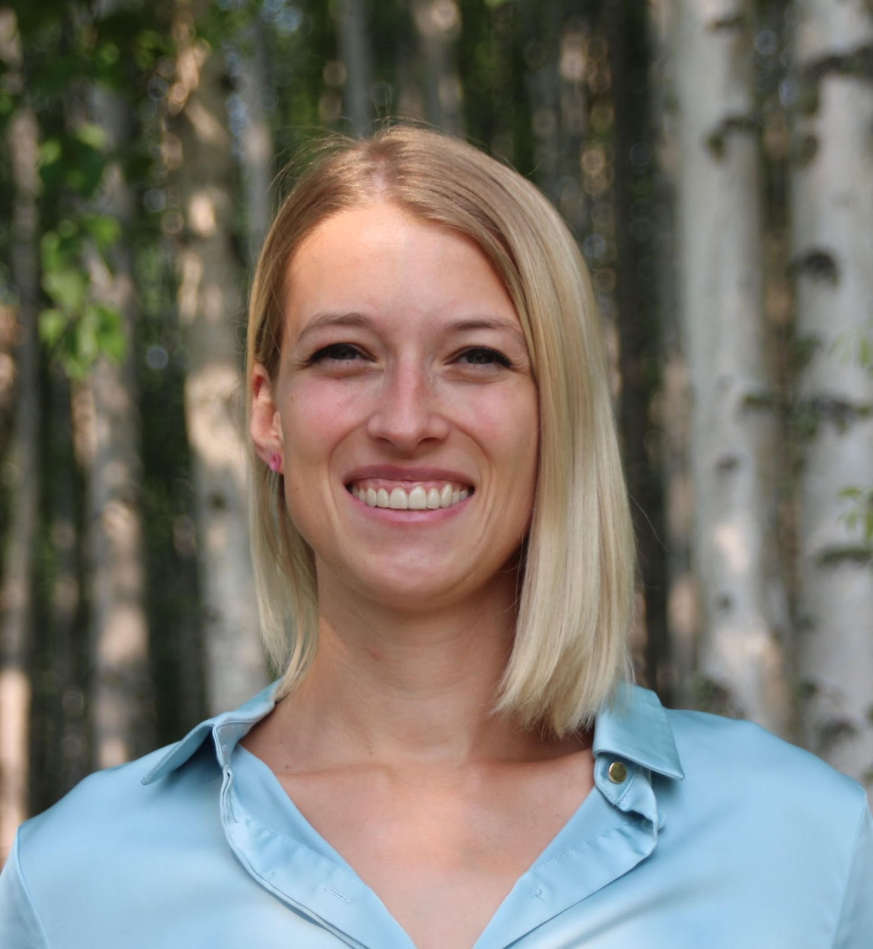
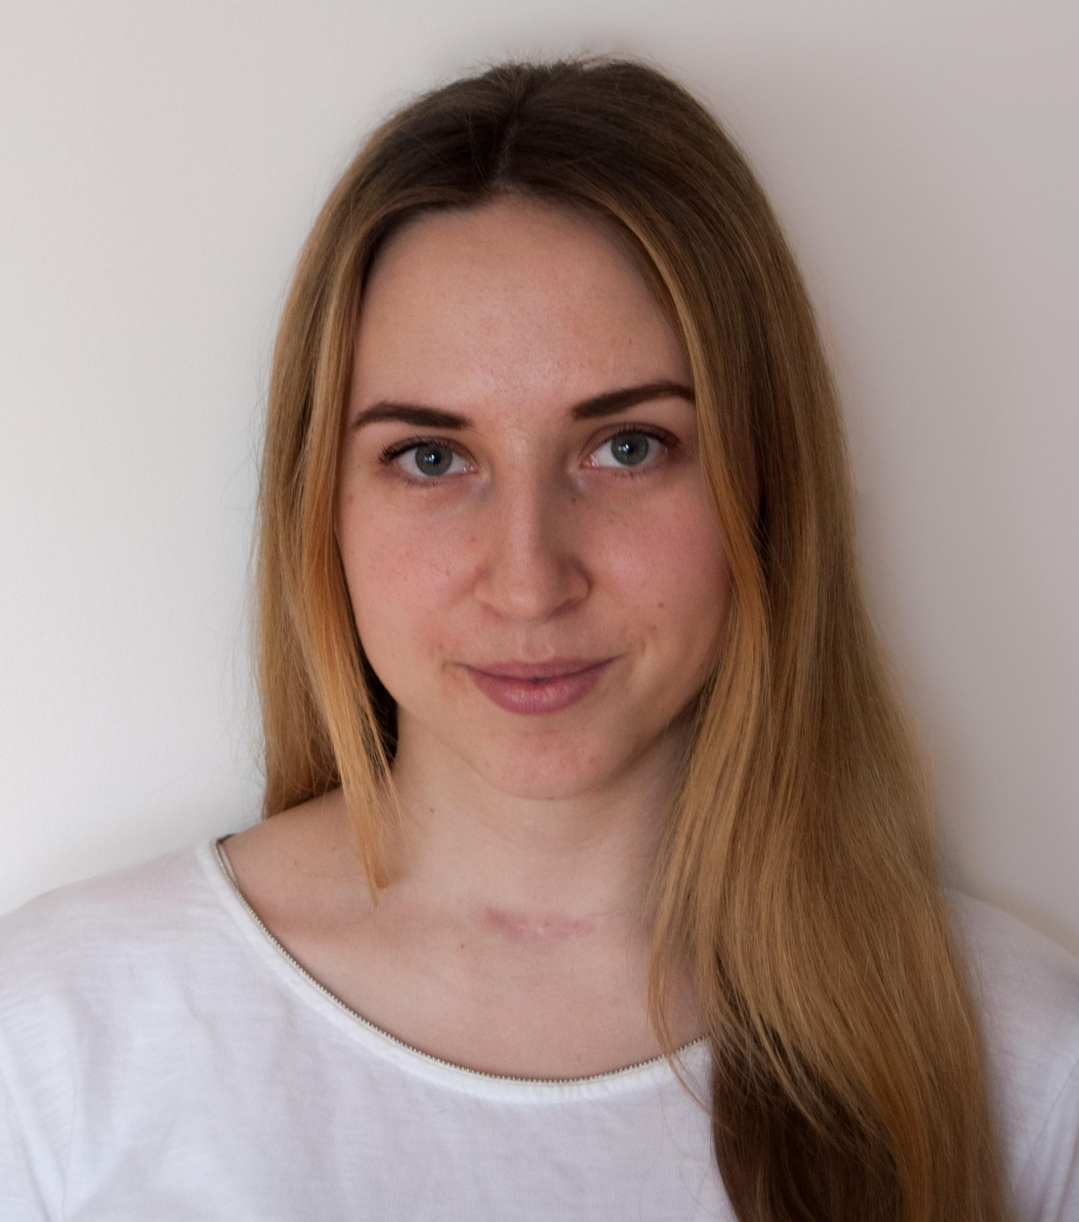
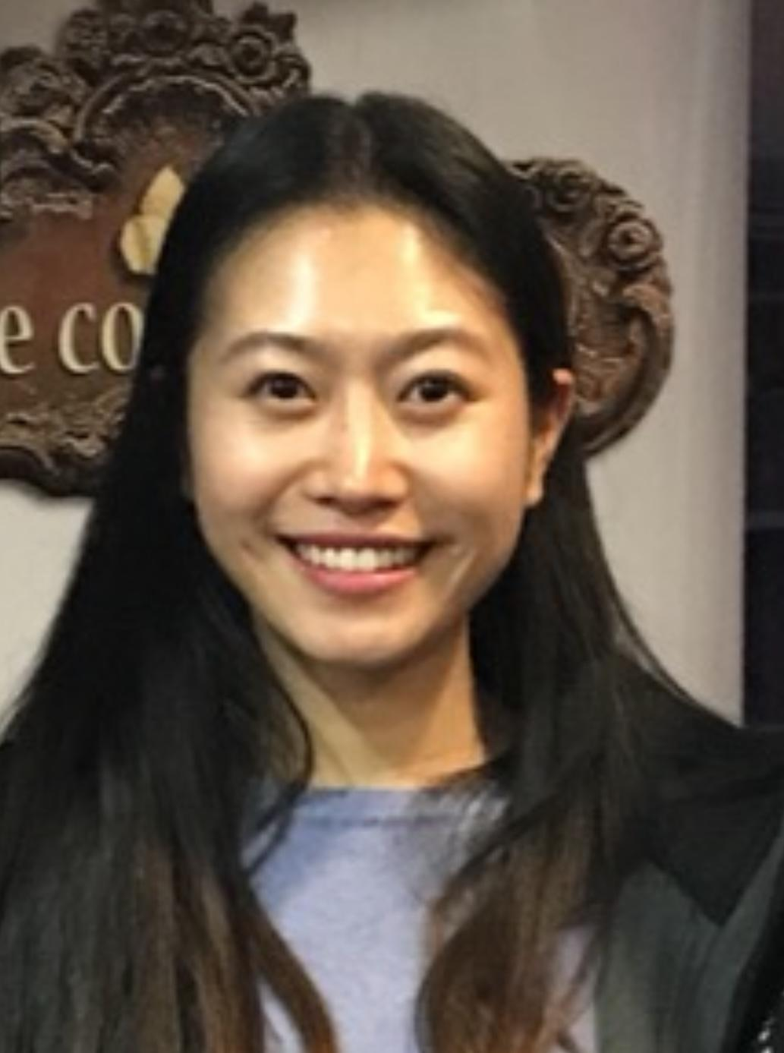
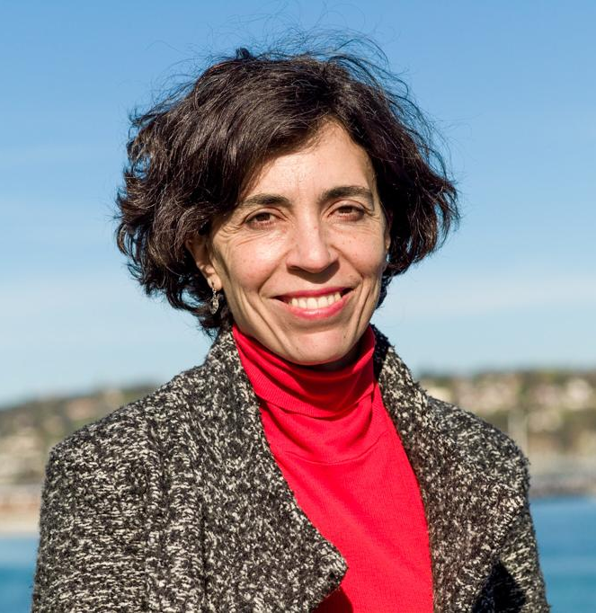
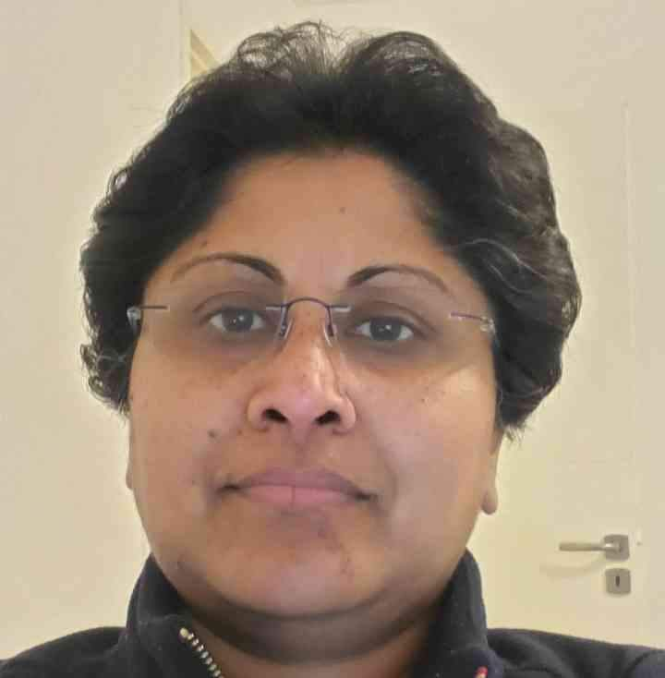
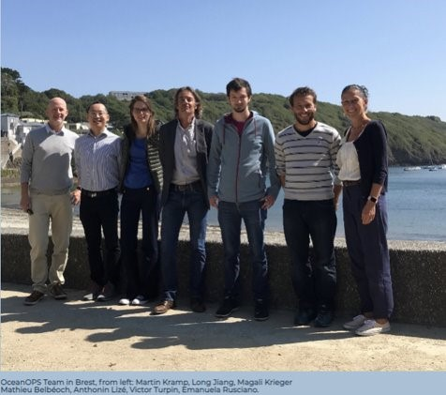
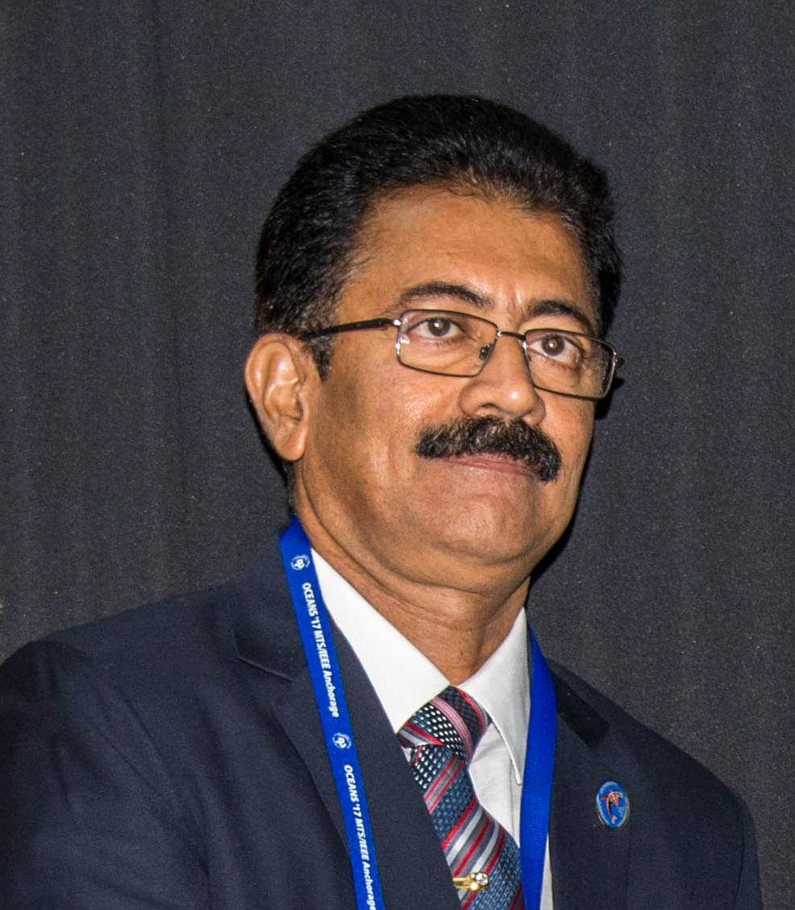
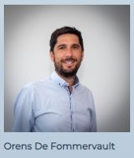
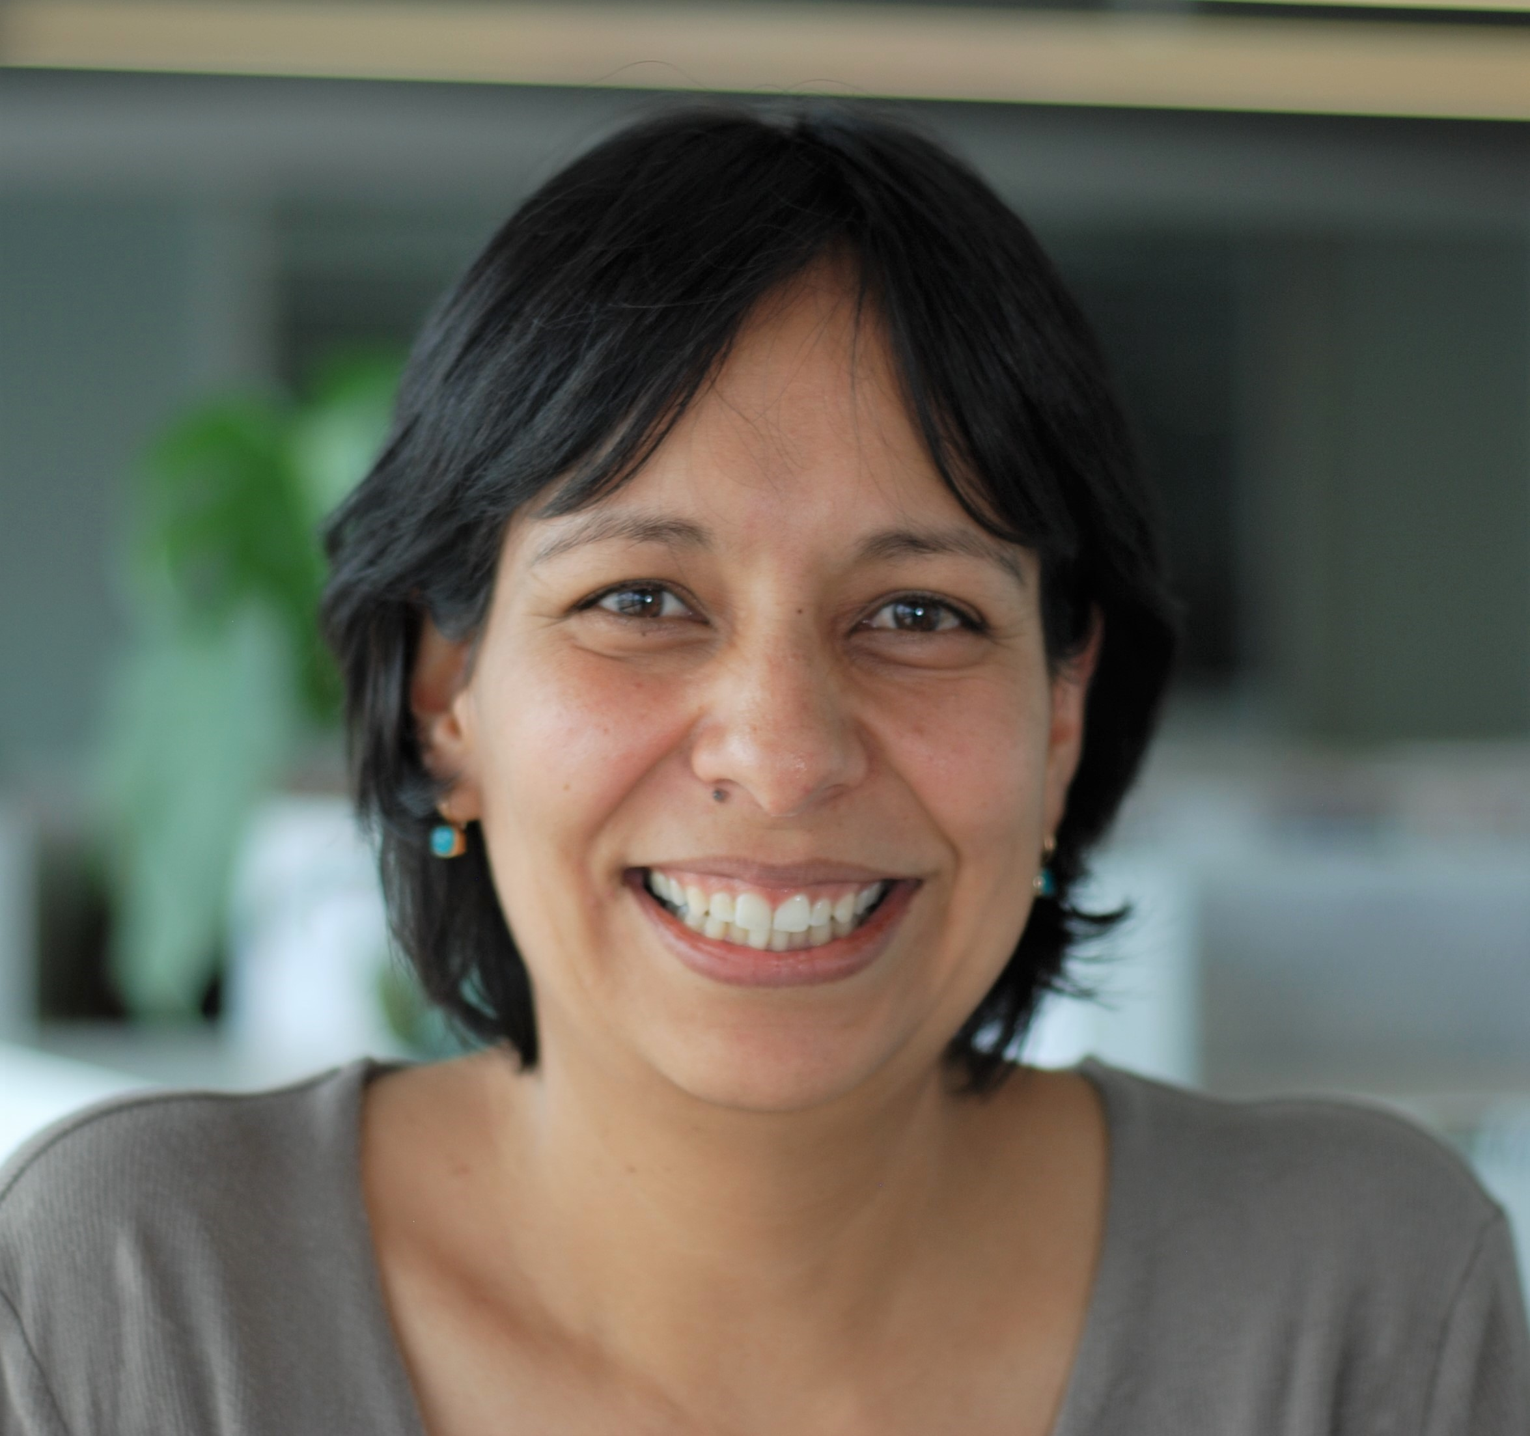
GOOS Office Team
Artur Palacz and Maciej Telszewski
IOCCP, Sopot, Poland
BGC Panel
Ann-Christine Zinkann,
NOAA, US
OCG, Co-Design, GOOS Projects
Laura Stukonyte,
Barcelona, Spain
GOOS Communication,
Emma Heslop, Denis Chang Seng, Forest Collins
Yu Ting, and Yaeji Baek
GOOS HQ in Paris, France
GOOS, ETOOFS, GRAs, OCG, DCO
Belen Martin Miguez, and Champika Gallage
WMO headquarter in Geneva, Switzerland
OOPC and OCG
R Venkatesan, GOOS consultant, India. NFP
OceanOPS team in Brest, France
From left: Martin Kramp, Long Jiang, Magali Krieger, Mathieu Belbeoch, Anthonin Lize, Victor Turpin, Emanuela Rusciano
Ana Lara-Lopez
BioEco, Hobart, Australia
BioEco Paneel
Notes:
21 people - supporting the work of GOOS

Slide 23
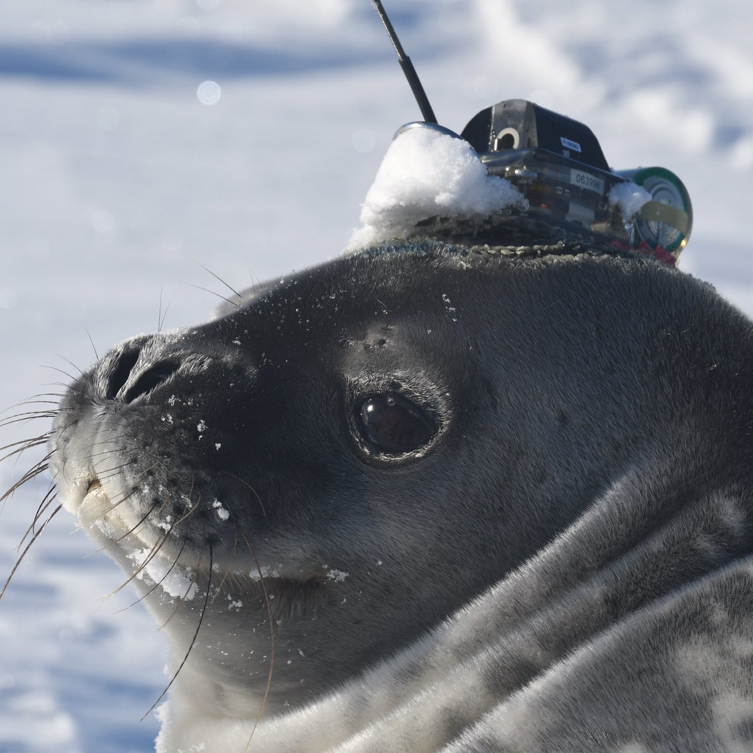
Thank you
goosocean.org

Slide 24
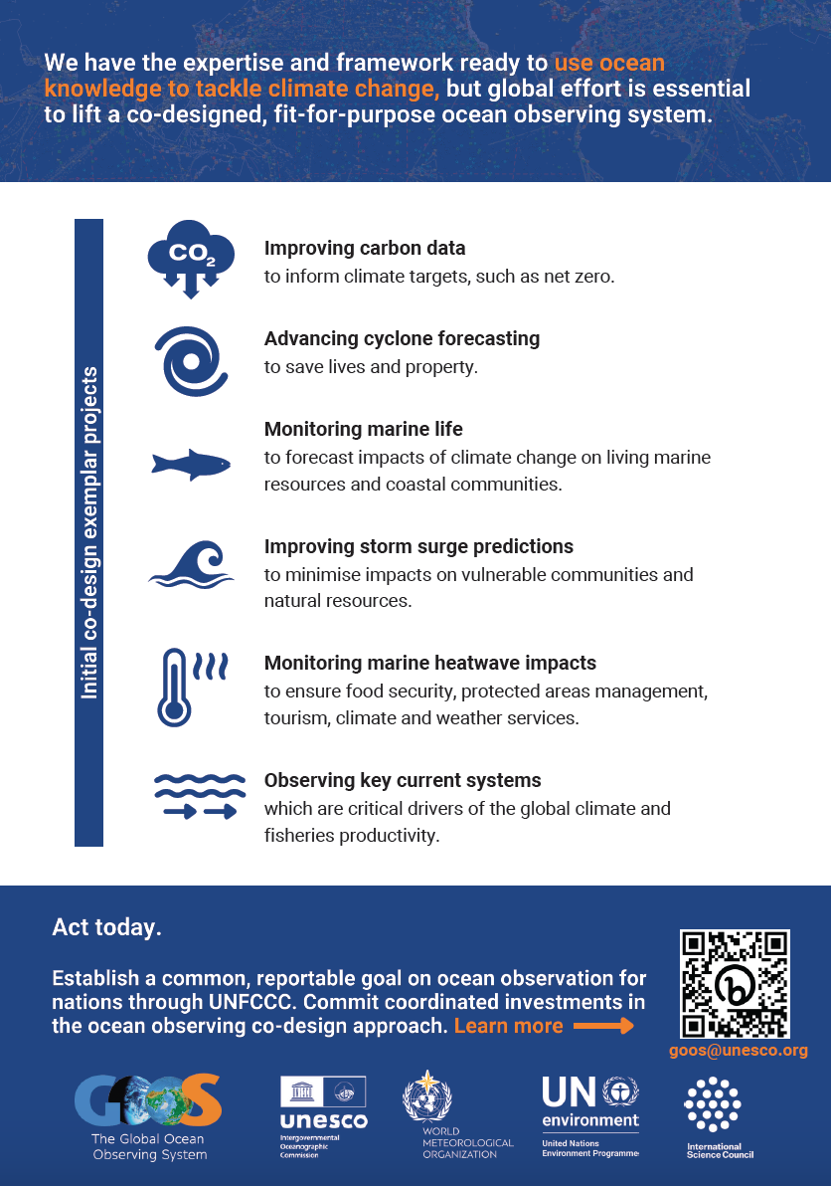
GOOS priorities for lifting the observing system?
Why?
Impact - inspiring ambition that can be measured
Implementation Roadmap articulates areas in IMPACT Section
Co-Design & CoastPredict focus on many of them
GG+A work and other interaction with funders shows that we need powerful messaging about impact/benefit for society
Co-Design set 6 areas - we are using these by default in messaging for COP etc. give tangible impact
We are asked by G7, EC, others priority areas for investment/action
Galvanise collaboration between nations - NFP, GRAs
Alignment in funding for impact
Foci for big ask projects, brings coordination funding at the same time
Focuses GOOS work with tangible impact
Integrate needs GCOS climate / RRR / GHG etc
Notes:
Priority areas to focus effort to lift ocean observing system capacity - creating & measuring impact
Limited in number 5 or 6?
Set for limited duration 3-4 years duration
Strongly linked to societal need
Could GOOS SC agree such areas and set with input Panels, GCOS etc.
Take from the Implementation Roadmap and review/synthesise

Slide 25
Strengthening and integration
GOOS
Core Team - strengthen and integrate
Transparency in processes
Identify GOOS unique core value/work
IP implementation / Monday
System - Goal 2 (SO5, 6, 7, 3)
EOVs
Data/metadata flow
Best Practices
Regional and national (GRAs / NFPs)
Integration - obs-modelling-services
Fit for purpose - connection users
Notes:
Squeeze on resources (missing 1 FTE for 6 months in 2022, 4 months 2023) - ambition of GOOS will require more staff at HQ or supporting HQ work
Strengthen mechanisms to bring recommendations to SC from TT and Projects - set priorities and seek support (new work needs to be supported)
Strengthen IP implementation Monday - GOOS Exec update and assess every quarter year
Ask GOOS Office to develop a structure assessment & human resources needs end 2023 (IOC funding clear) – assess core structure support (Panels, OceanOPS, OBIS BioEco work, and GOOS Projects, Partners, Fundraising, NFP) related to the objectives, and including visibility of the real in-kind resources (panels in kind support % people's time, NFP time….) current and future needs to support GOOS workplan ahead

