Slide 1
European observation networks assessment in the EuroSea Project
J. Karstensen GEOMAR & G. Petihakis HCMR & help of: V. Fernandez EuroGOOS
co-lead: WP3 Network Integration & Improvement
OCG-14 meeting 6. June 2023, hybrid/Cape Town

Slide 2

EuroSea: Improving and Integrating European Ocean Observing and Forecasting Systems for sustainable use of the Oceans
EU Project: 2019 – 2023; 16 countries/55 partners; 12.3 Mio. Euro Budget
Improve the European ocean observing system
Integration into
global context
Deliver ocean
observations & forecasts
Knowledge about ocean climate, marine ecosystems & their vulnerability to human impacts
Demonstrate the importance of the ocean
Significance for an economically viable
& healthy society

Slide 3
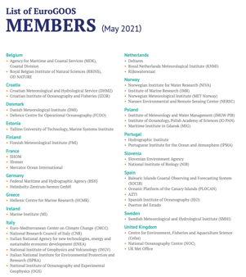

Some facts about the European Landscape
European Global Ocean Observing System:
EuroGOOS – GOOS RA
EuroGOOS coordination funding
  Legal structure: AISBL - > 3rd party projects
  Fees (currently: 46 members; 19 countries)
+ EU Research infrastructurs e.g. EuroARGO, EMSO, ...
+ EU Data integrators (SeaDatanet, EMODnet, CMS)
Core for all of this:
National systems – Variety of actors, structures, technologies, funding

Slide 4
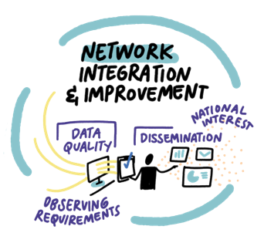























WP3: Network Integration & Improvement
48
23
Months
Partners
203
mm
10
Tasks
20 Milestones -- 19 Deliverables
2.2
M €
Budget

Slide 5













WP3: Network Integration & Improvement
Objectives
 | EuroGOOS | OCG networks
HF Radar
Glider
Fixed Platforms
Autonomous Surface vehicle
Profiling floats
Ships
Tide gauges
Data issues | EuroGOOS DATAMEQ WG
OMICS | EuroGOOS BIOWG | e.g. GOOS BioEco/MBON
EuroSea WP3 Overall:
Improve integration of nations observing for “optimal” use in European (EuroGOOS)
and in global (GOOS) initiatives
Not established yet
Structure along coordination groups:
  Observational networks (7)
  Data flow and integration
  Augmented/OMICS observations
  European Vision of Ocean observing Integration
+ ...
Notes:
EuroGOOS Biological Observations Working Group (BIOWG)
EuroGOOS Data Management, Exchange, and Quality Working Group (DATAMEQ WG)

Slide 6
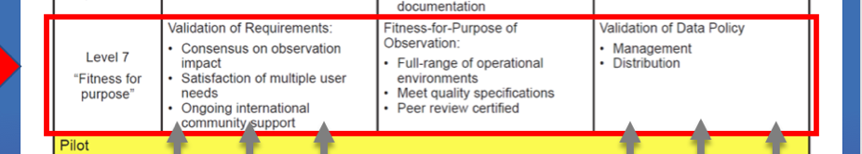
How to “measure” Integration & Improvement?
Maturity of Coordination Network
WP3 Benchmarks:
  Coordinates a defined community
  Open to all operators/interest groups
  Long term (>10 years) sustained coordination-needs identified
  Best Practices strategy
  Internal coordination guided by expertise/supported technical coordinator
  FAIR data policy
  Specification and governance structure documented (ToR)
(FOO; Lindstroem et al. 2012)

Slide 7







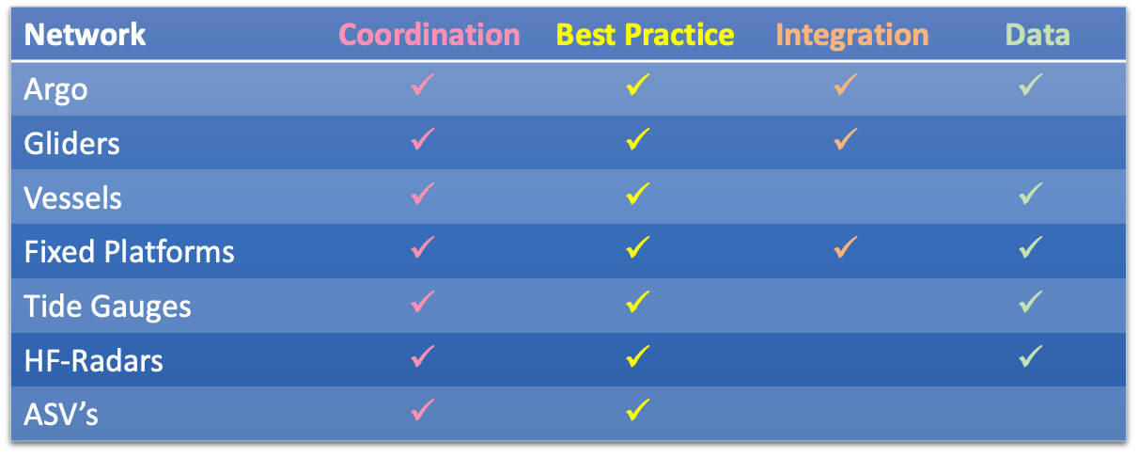







Observation network major targets
Interoperability
EOOS
Coordination
Connection with Global
Coordination
Coordination
Cost
Assesment
Harmonisation Metadata Stds
Biogeochemical
(BGC)
Best Practices
Best Practices & QC Procedures
Deep - below 2000m
(DEEP)
Evaluate assess technologies
Coordination
Develop
Tools for QC
Products
Network
Definition
Recomendations
Data Flow
ToRs
Best Practices
Best Practices/SOPs
Coordination
Coordination
EU level – EuroGOOS/ROOS
Improvements/Best Practices
Auto QC
Processing Techniques
NRT Data MGT
Best Practices
Operations & Data
Integration GOOS

Slide 8
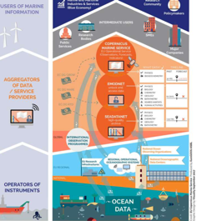
Thematic network major targets
Task 3.8 Augmented Observatories
Shape International Standards
Develop, Implement, Disseminate
Aligned to GOOS EOVs
SOPs & Best Practices
Coordination via related observational
Task 3.9 Ocean Integration
Develop a strategic European Vision of Ocean Integration
Task 3.10 Interface with in Situ data integrators
Assess via examples of Integration
Ingestion of (meta)data
at national/PI level
CMEMS
EMODnet
SeaDataNet

Slide 9
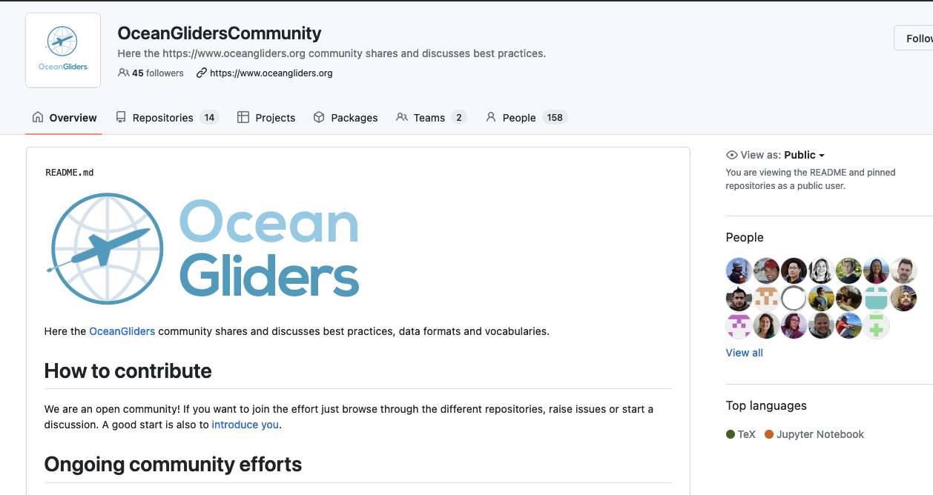
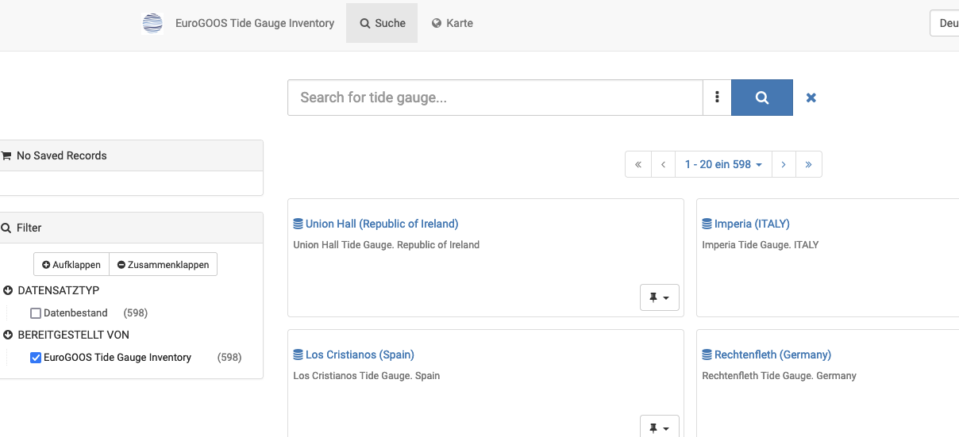
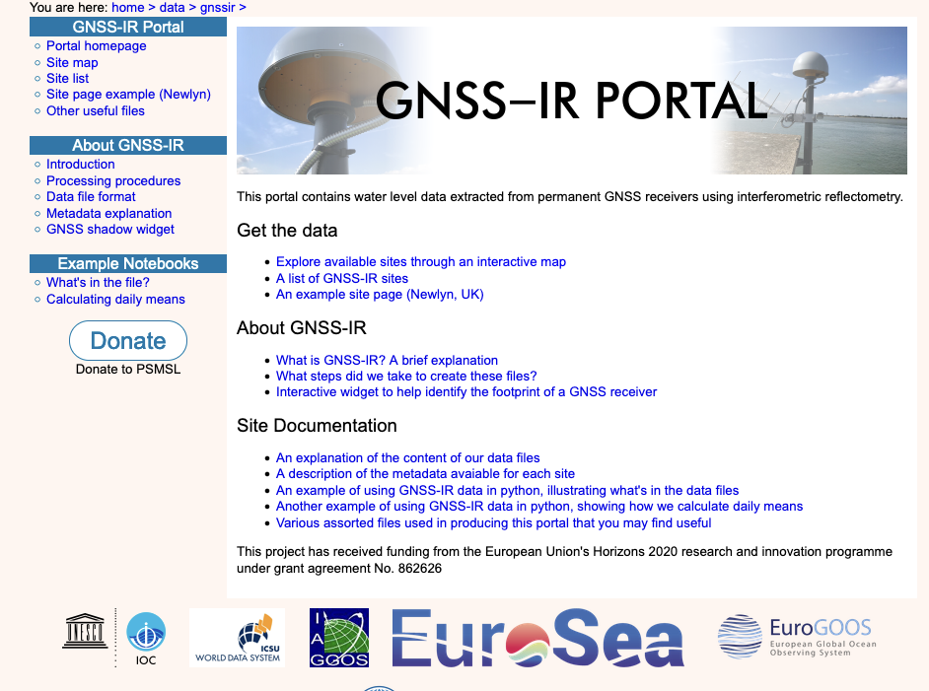
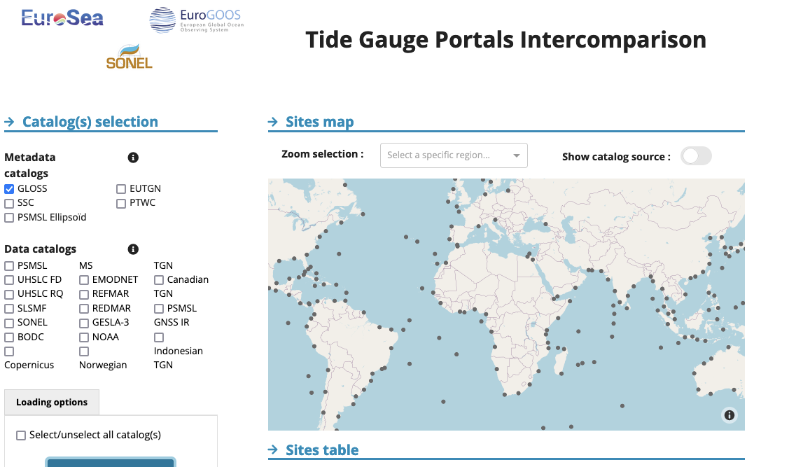
Some examples for activities WP3
EuroGOOS glider TT
  Aim: First collection of Best Practices
  Engagement with OCG-OceanGliders, IOC-OBPS & EU glider Research Infrastructure GROOM II
  Critical elements for success:
    Funding (staff & virtual meeting)
    Champion (S. Thomsen, LOCEAN, France)
EuroGOOS Tide Gauge TT
  Aim: streamline databases & strengthening EU sea-level community
  Engagement GLOSS & nations
  Critical elements for success:
    Funding (staff &website/code developer)
Three new data portals:
Metadata inventory tool (eutgn.marine.ie)
GNSS-IR data portal (psmsl.org/data/gnssir)
gaps/dublicate analysis:( www.sonel.org/tgcat

Slide 10
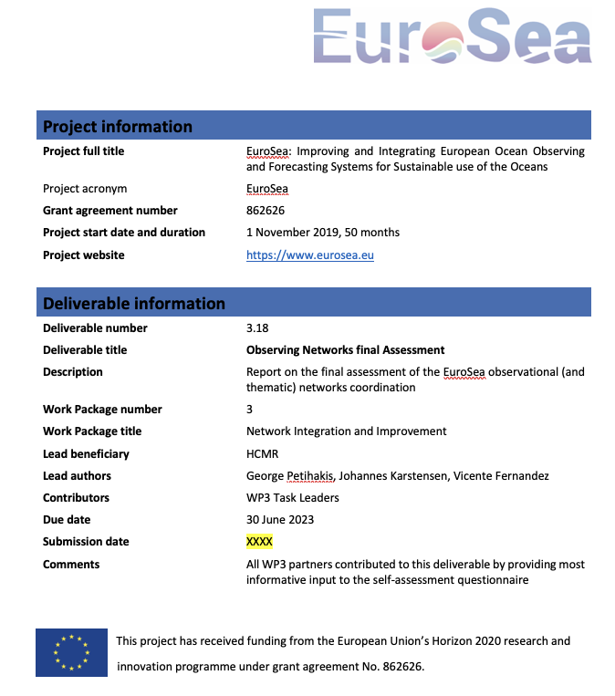
WP3 synthesis of improvement
D3.2 (initial 2019)/D3.18 (Final 2023) Assessment of the EuroSea observational and thematic networks coordination
Internal organization
(ToR, Website, Institutions, Governance, Representative, link to global networks)
Network Performance & Targets
(Best Practices, Data QC & QA strategies, Metadata & data access)
Visibility of the network
(Metadata delivery, BP accessibility, Key performance indicators, GTS, Data policy)
Coverage and Facilities
(Driver operations, Driver observing, Dialogue with othernetworks)
Future aspirations
(Network in 2030, Challenges & opportunities)
https://eurosea.eu/download/outputs_and_reports/deliverables/EuroSea-D3.2-Observing-Networks-Initial-Assessment.pdf

Slide 11
WP3 brief summary with reflections on OCG
Primary objective of networks is providing a home & coordination of communities
Augmented observatories show great progress (OMICS) but not well integrated in observation groups
Coordination & building communities requires funding:
  Staff & meetings, Manager
  Websites / data tool, shared document (Best Practice) & Software development and maintenance
  How much? cost items needed
Network KPIs to help individual network to develop – guidelines are needed!
Better integrate European coordination groups into OCG networks e.g. EuroGOOS TT representative
The success of the coordination goes back to the Nations:
  Are the “contact points” in a position to represent the landscape (hydrographic offices, science)?
  How to get volunteers on board and also keep their interest and engagement?
  Reward volunteers efforts & work (e.g. certificates, statistics, cool stories, ...)
  Integrate data/metadata management with the Nations NODC as the key component
  Agreements/directives with legal/financial consequence are a success e.g. MSFD
  (maybe the outcome of EU DG MARE “consultation on Ocean Observation”)

