Slide 1
Impact studies in Synobs/OS-Eval Team
OCG-14 Hybrid Meeting
6-8 June 2023
Cape Town, South Africa
Yosuke Fujii, Elisabeth Rémy

Slide 2
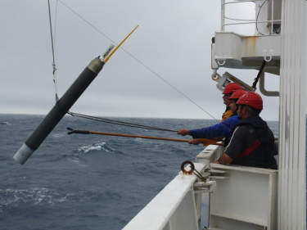
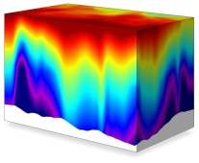
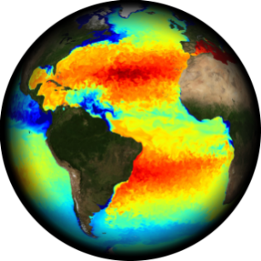
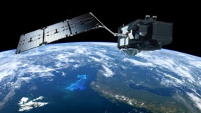
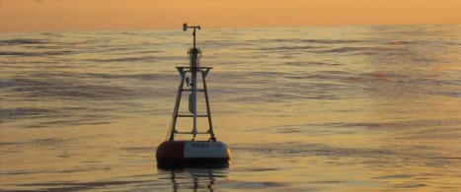
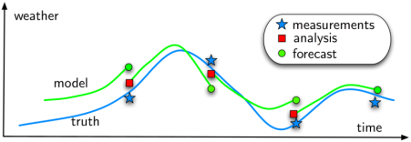
Ocean monitoring and forecasting systems
Strengthening the link between the ocean observing community and the monitoring and forecasting centers is crucial to give feedback on the use, impact and expected evolution from ocean monitoring and forecasting centers.
Historically, ocean modeling/data assimilation and observing communities has less interactions than in atmosphere, especially for in situ networks (except Argo).
Ocean observing systems
Data integration into model
(physics and BGC)
Provision of Ocean, ice and BGC analysis and forecasts
Feedback from ocean monitoring centers to observing networks.

Slide 3
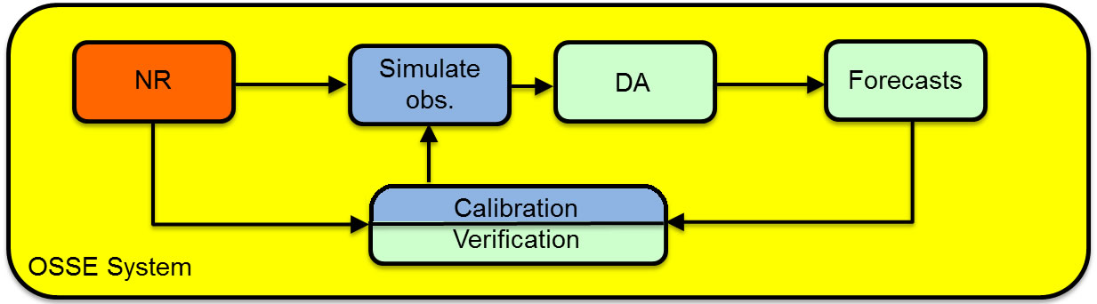
Observation impact assessment by forecasting centers
Observation impact studies are performed to:
verify that observation information is « optimally » used in the analysis step and improve the assimilation components,
quantify the impact of the observation network in ocean analyses and forecasts,
demonstrate the value of an observation network for ocean analyses and forecasts,
test future observing system design from an integrated system perspective involving satellite and in-situ observations and numerical models.
OSEs (Observing System Evaluations) => assessing the impact of existing data sets on a (by withholding observations). Other approaches (e.g. DFS) are also used.
OSSEs (Observing System Simulation Experiments) => help designing new observing systems and to perform preparatory data assimilation work.

Slide 4

OSE by the OceanPredict OSEval Task Team
OceanObs’19 Community White Paper on OS-Eval
Review papers:
Fujii et al. (2019). Review of Observing System Evaluation studies in Ocean Predict centers. https://doi.org/10.3389/fmars.2019.00417 (OceanObs'19 Community White Paper)
Oke et al. (2015a,b). J. of Oper. Oceanogr. (In the GODAE OceanView Special Issue.)
Ocean Predict OSEval Task Team:
https://oceanpredict.org/science/task-team-activities/observing-system-evaluation/#section-introduction

Slide 5
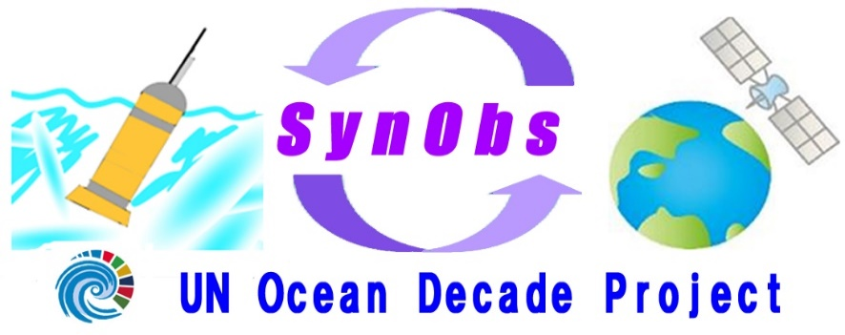
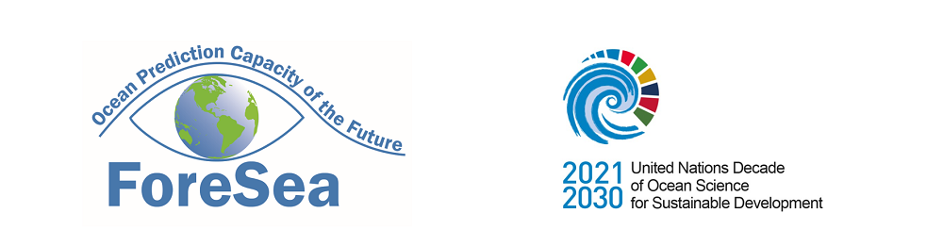
Synergistic Observing Network for Ocean Prediction
Led by OceanPedict OS-Eval TT
Objective
  SynObs will seek the way to extract maximum benefits from the combination among various observation platforms, typically between satellite and in situ observation data, in ocean predictions.
Strategy
  SynObs aims to identify the optimal combination of different ocean observation platforms through observing system design/evaluation, and to develop assimilation methods with which we can draw synergistic effects.
SynObs
Contact
SynObs Co-Chairs: Y. Fujii (JMA/MRI), Elisabeth Remy (Moi)
E-Mail: synobs@mri-jma.go.jp
https://oceanpredict.org/un-decade-of-ocean-science/synobs-2/
Mailing List
SynObsML@googlegroups.com
Please mail to synobs@mri-jma.go.jp for joining
Notes:
The full name of SynObs is Synergistic Observing Network for Ocean Prediction.
The objective of SynObs is to seek the way to extract maximum benefits from the combination among various observation platforms, typically between satellite and in-situ observation data, and also between the open ocean and coastal seas in ocean predictions.
The strategy of SynObs is to identify the optimal combination of different ocean observation platforms through observing system design/evaluation, and to develop assimilation methods with which we can draw synergistic effects.
You can contact to SynObs through this mail address or you can check the webpage.
You can also join the mailing list if you request by mail.

Slide 6

SynObs: A common comprehensive project
SynObs
ForeSea
Ocean Observing Co-Design
CoastPredict
Decade
Programmes
COSS-TT
MEAP-TT
DA-TT
OS-Eval TT
SynObs
aims to generate transformative collaboration among the three UN Decade Programmes.
Decade Project
Notes:
You know, SynObs is suggested as a common comprehensive project among the three UN Decade programmes, ForeSea, CoastPredict, and Ocean Observing Co-Design.
You know, ForeSea is proposed by OceanPredict in order to enhance the ocean prediction value chain.
CoastPredict is also proposed to promote use of coastal predictions for societal benefits.
These programmes need to collaborate with observational communities to construct the observing systems which are effective for predictions.
Meanwhile, Ocean Observing Co-Design is proposed by GOOS to make the ocean observing network optimal for various purposes.
So, SynObs is proposed as a UN Decade Project under the collaboration of OceanPredict task teams in order to generate transformative collaboration among the three UN Decade Programmes.

Slide 7

Outline of SynObs Activity Plan
1. Collaboration for evaluation and design
Collaboration on a Multi-System OSE and OSSE (SynObs flagship OSEs/OSSEs)
Establish a best practice based on the collaboration above.
2. Supporting DA scheme development
Share the information on the development of DA schemes
Planning of observation campaigns for DA scheme development
3. Providing information from ocean prediction systems in real time
Explore the methods to evaluate observing system status in real-time
4. OS-Eval showcase and reporting
Introduce OS-Eval examples to demonstrate its potential (Frontier Marine Science Special issue, Ocean Science Meeting 2024 Session, Showcase webpage, etc.)
Contribute to reports on observation requirements and design
Notes:
Then, this slide show the outline of the SynObs activity.
SynObs promotes collaboration for evaluation and design of the ocean observation network.
For than, we are currently planning Multisystem OSE and OSSE or SynObs flagship OSE.
Many global and regional systems participates in this project.
And we plan to use the GEOS/NASA high-resolution coupled simulation as the Nature Run.
We plan to establish a best practice of observing system evaluation through this collaboration.
SynObs also aims to support DA scheme development for better use of observation data.
We promote to share the information on the development and we are considering the possibility to plan an observation campaign to support the development.
And we aim to provide information from ocean prediction systems in real time.
We explore the methods to evaluate observing system status in real time.
Finally, we plan to create OS-Eval showcase and reports.
We try to introduce OS-Eval examples to demonstrate its effectiveness.
So we are currently planning Frontier Marine Science special issue and having a session in ocean Science meeting next year.
We also aim to contribute to the community reports on obserevation requirements and design.

Slide 8
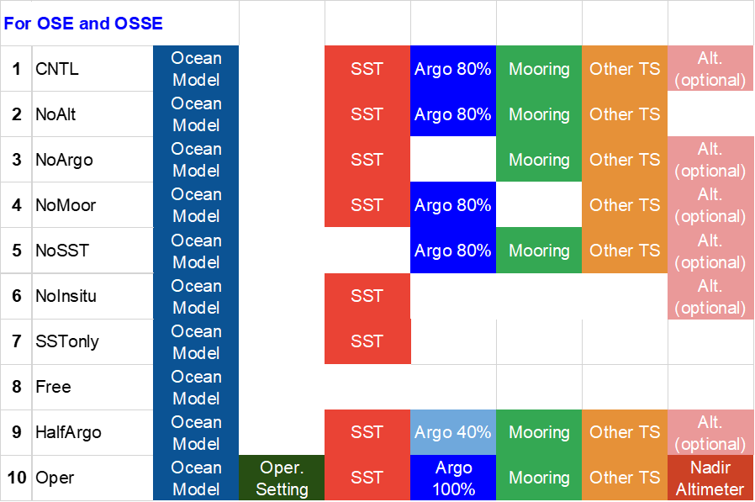
Plan of SynObs Flagship OSEs/OSSEs
OSEs requested in the OP OSEs and S2S OSEs
SynObs plans to implement OSEs/OSSEs using various ocean prediction systems with a common setting.
Why?
In order to remove system dependency by averaging the results with various systems
Systems participating in the OP OSEs
Ocean Prediction OSEs
Reanalysis: Jan. 2020-Dec. 2020 (Dec. 2022)
10-day predictions: Started from every pentad
S2S OSEs (with lower resolution systems)
Reanalysis: 2003-2022 + monthly/seasonal prediction
Ocean Prediction OSSEs
Results will be shared through a public database.
We would like to ask GOOS and Co-Design community to support for diagnosing the results.

Slide 9
Lessons learnt from past experiences
Observing systems are multi-purpose. Evaluating all aspects of the potential benefits of an observing system cannot be done with a single experimental design (dependency of the results to the region, model resolution, time scale considered…).
OSE/OSSE are based on assumptions and approximations that need to be taken into account when interpreting the results. Results are highly system dependent.
Coordinating multi system OSE/OSSE is very difficult.
The need of observation for validation should also be highlighted.
OSSEs require dedicated infrastructures. It is essential to strengthen the capabilities of operational centres to assess the impact of present and future observations to guide observing system agencies but also to improve the use of observations in models.

Slide 10
Recommendations for future assessment and design studies
Agree on standards and best practices on the way to perform OSEs (e.g. data denials, DFS/IC, FSOI, SRF) and OSSEs (e.g. NR and AR choices, calibration with OSSEs).
Agree on observing network design options to test and define metrics for observing system evaluation taking into account user & application needs
  Need of coordination between modelling/data assimilation experts and observation/network experts for a proper design and interpretation of OSSEs, especially to extract compelling messages on the ability of the ocean observing system to resolve processes having different temporal and spatial scales.
Results are highly system dependent: Improve their robustness by moderating system-dependency with multi-system evaluation and regular re-assessment of the observation impact to follow the system evolutions.
Find an efficient and sustainable way for routine observation impact assessment and to inform on observation impact status.

Slide 11
Backup

Slide 12
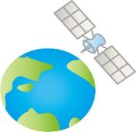
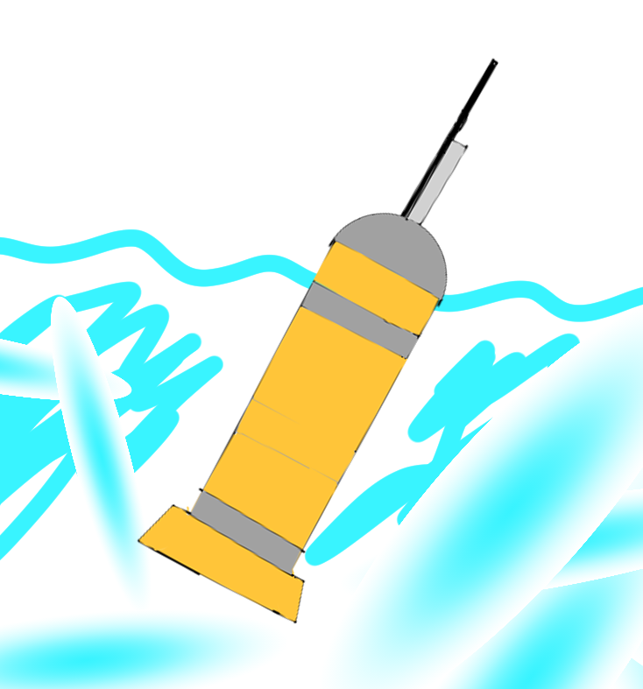
Synergistic Observing Network for Ocean Prediction (SynObs)
UN Ocean Decade Project Under ForeSea
(Led by OceanPredict OS-Eval TT)
Officially Endorsed at June 8th
Objective
SynObs will seek the way to extract maximum benefits from the combination among various observation platforms, typically between satellite and in situ observation data, in ocean/coastal predictions.
Strategy
SynObs aims to identify the optimal combination of different ocean observation platforms through observing system design/evaluation, and to develop assimilation methods for maximum synergy among different observations.
Scope
Targets of SynObs include open-ocean (global, tropical, mid-latitude, polar areas), coastal, and biogeochemical (BGC) observing systems
Synergy
Notes:
Then, SynObs, that is, Synergistic Observing Network for Ocean Prediction, is a UN Decade project proposed by the OceanPredict OS-Eval TT.
The objective of SynObs is to seek the way to extract maximum benefits from the combination among various observation platforms, typically between satellite and in situ observation data, or between coastal and open ocean platforms, in ocean and coastal predictions.
On the strategy, SynObs aims to identify the optimal combination of different ocean observation platforms through observing system evaluation and design, and to develop assimilation methods with which we can draw synergistic effects from the combination.
Our targets include open-oceans, such as the global ocean, tropical ocean, mid-latitude, and polar areas, and coastal and biogeochemical observing systems.

Slide 13

Expected Activities in SynObs
1. Collaboration for evaluation and design
Flagship (Core) multi-system OSE
Several Extensions (S2S OSE, OSSE, etc.) of the flagship OSE
Facilitating communication for OS-Eval collaborations
2. Supporting DA scheme development
Support information sharing activities (e.g., DA-TT seminars, workshops, etc.)
Facilitate Discussions on the development of DA technology and models.
Observation campaigns for the development
3. Providing information from ocean prediction systems on regular basis
Regular reporting on information of QC, innovations, increments, etc.
Explore the methods to evaluate observing system status in real-time operation
4. OS-Eval showcase and reporting
Collect OS-Eval examples and introduce them (Showcase)
Contribute to a report on observation requirements and design
Notes:
This is the brief summary of the SynObs activity plan shown in the previous meeting.
We planned the showcase and report, clollboative evaluation, providing real-time information, and supporting DA development.
Today, I would like to discuss about the Flagship or Core multi-system OSEs
and its several extensions.

Slide 14
Expectations/Requests of OSE/OSSE to SynObs
SynObs proposal defined 7 targeted combinations
Altimetry and satellite surface velocity with Argo
Tropical buoy array, Argo, and Altimetry
Satellite SSS and in-situ observations
Satellite SST/radiometer observations and near surface observations
Satellite ocean color and BGC Argo
Sea ice concentration and thickness
Coastal ocean and Open Ocean Observations
SWOT: OSSE and post-launch OSE (launch targeted for November 2022) .
Ocean Observing Co-Design expects SynObs to conduct OSE/OSSEs for some of their exemplars (Marine Heatwaves, Boundary Currents, Tropical Cyclones, Storm Surge, Carbon Cycle, Biodiversity).
TPOS-SAC requested OSE/OSSE for new TPOS, and ECMWF, NCEP, and JMA started to discuss on a collaborative OSE for S2S forecasts.
Argo Science Team aims to enhance the communication with modeling communities.
Multi-system OSE for salinity drifts are currently on-going (Suggested by P. Oke.)

