Slide 1


OCG Network Metrics
Yu Ting, IOC/OOS, GOOS
OCG-14, Cape Town, South Africa, June 5-8, 2023

Slide 2









OCG Networks – mature and emerging
The Observation Coordination Group (OCG) works to efficiently operate, maintain, coordinate and integrate a comprehensive in-situ global ocean observing system
13 OCG Networks:
  Ship based meteorological – SOT
  Ship based oceanographic – SOT
  Repeated transects - GO-SHIP
  Sea level gauges - GLOSS
  Time series sites - OceanSITES
  Moored buoys – DBCP
  Tsunami buoys - DBCP
  HF radars
  Drifting buoys – DBCP
  Profiling floats – Argo
  Deep & biogeochemistry floats – Argo
  OceanGliders
  Animal borne sensors - AniBOS
Emerging networks:
Fishing Vessel Ocean Observing Network
USV OASIS
Smart Cables
Ship based Ecological Time Series
Integrated Marine Debris Observing System
Note: Network description taken from the Report Card 2022, link www.ocean-ops.org/reportcard2022

Slide 3


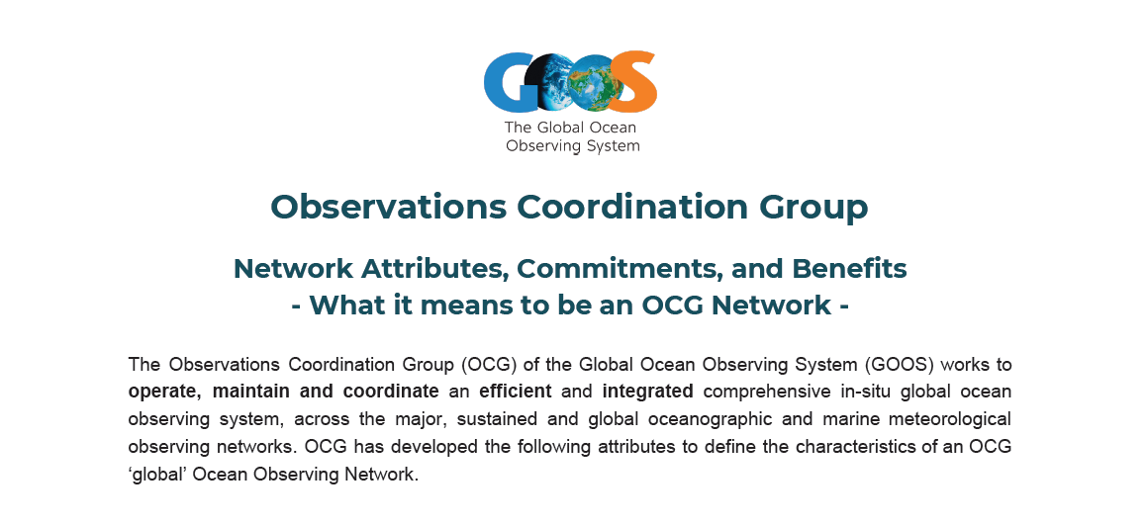

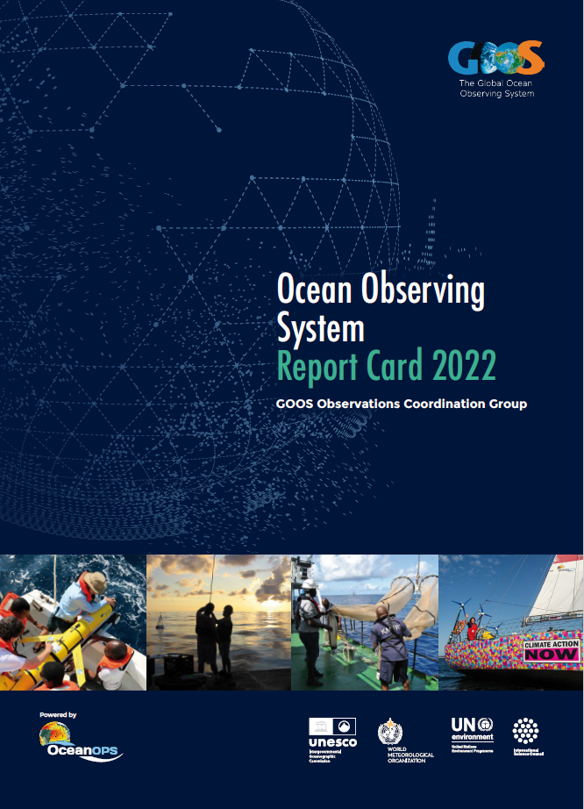
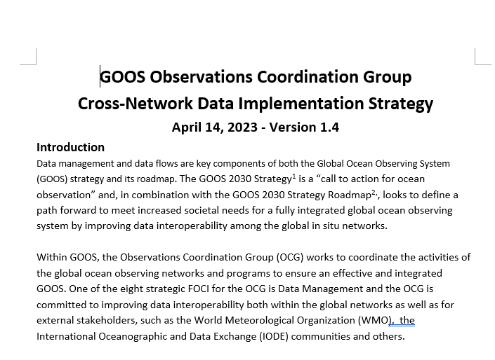
OCG 3 tiered management-- inspirations
OCG Network Attributes
Framework for Ocean Observing
Report Cards
OCG Cross-Network Data Implementation Strategy (draft)
Concepts of new, incremental stages
Global coverage, EOVs and ECVs, standards and BP, CB, ES, …
GOOS Report No. 266 https://oceanexpert.org/document/24002
Maturity of system/ networks/ elements, page 8, 10 and 11, (http://www.ioccp.org/images/D2backgroundDoc/Framework%20for%20Ocean%20Observing.pdf )
Data and Metadata
Implementation status
Report Card 2022, link: www.ocean-ops.org/reportcard2022
Data and metadata
Best practice
https://oceanexpert.org/downloadFile/53282
Concept of new, engagement to GOOS
…

Slide 4
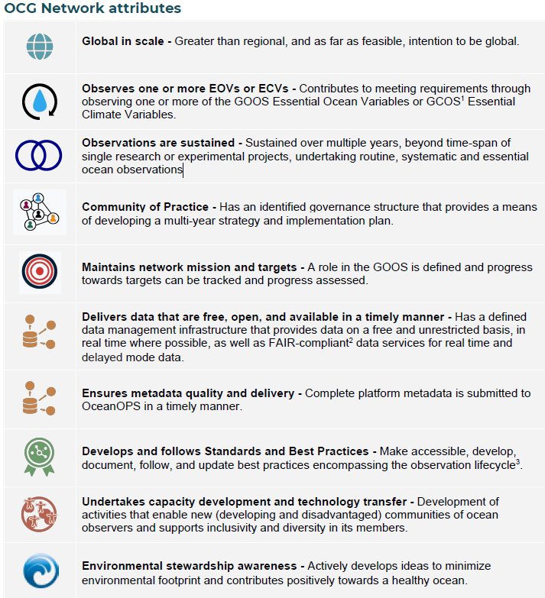
GOOS Report No. 266

Slide 5
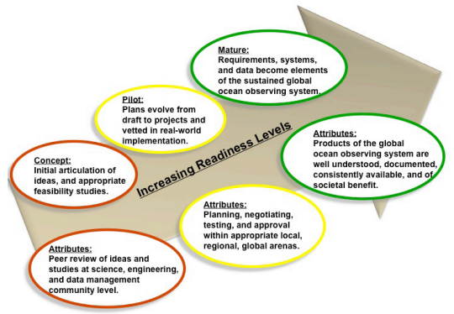
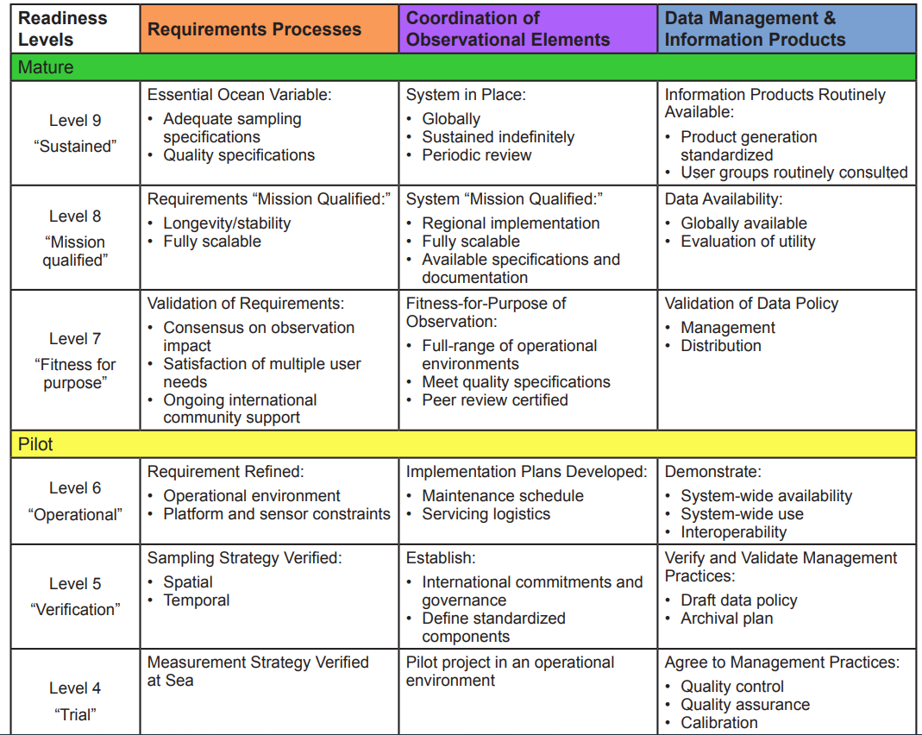
Framework for Ocean Observing
FRAMEWORK PROCESSES BY READINESS LEVELS
Figure 5. The Concept of Readiness Levels. How ocean observing activities will be assessed for inclusion in the Framework for Ocean Observing. The scale and scope of activities at each readiness level will vary according to the needs of a particular EOV.

Slide 6
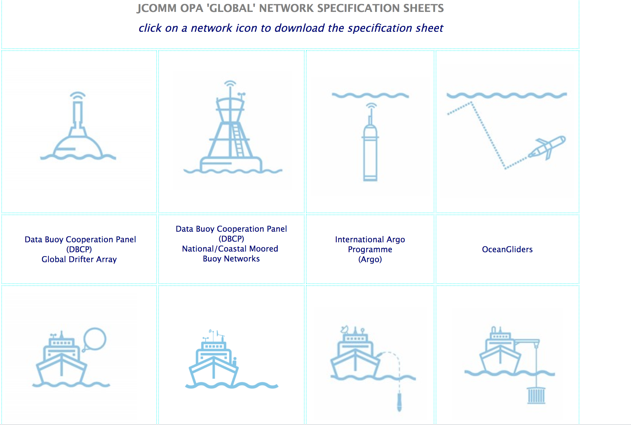

From emerging to mature
Mature and/or Operational
Developing and/or Pre-operational
Emerging
Readiness/
maturity
Global coverage
Governance
Data and metadata
Standards and Best Practices
Capacity building
Engagement (to GOOS)

Slide 7
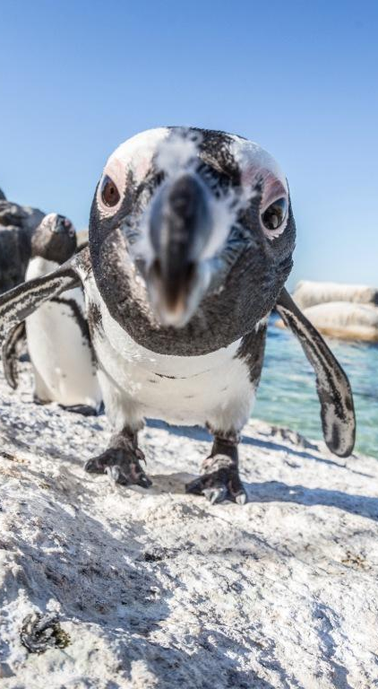
Intended Uses
What are the intended uses of these metrics?
  - Mapping of all global ocean observing systems and their maturity levels (sponsors, stakeholders)
  - Strict rules to guide development, recognition, branding, inclusion in GOOS? (networks, GOOS)
  - GOOS reporting and comms structured around these tiers of maturity? (networks, GOOS)
Who will track these and at what cost?
How strict will this process be? why?

Slide 8

Action proposed
To establish a Task Team with network volunteers for the intersessional period:
  - to work on the details of these metrics
  - using the FOO, attributes and current base doc (clean up, simplify and assess fit for purpose)
  - discuss and identify target audiences/uses
  - submit for review at OCG-15 (2024)
Membership: OCG Exec, volunteers from the networks.
For sign-up/nomination, please contact YU Ting [t.yu@unesco.org]

Slide 9
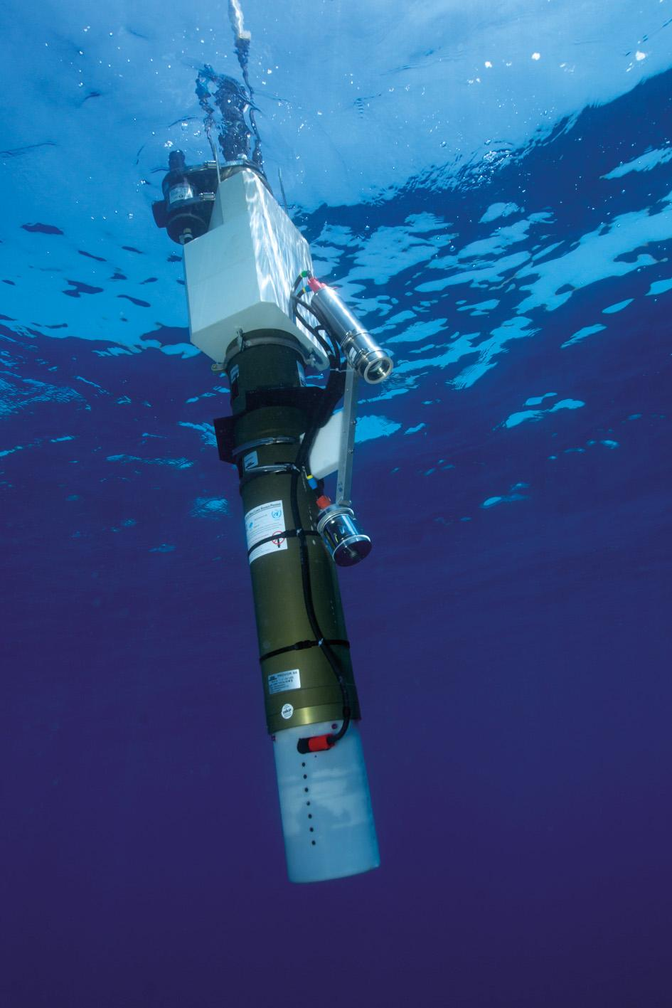


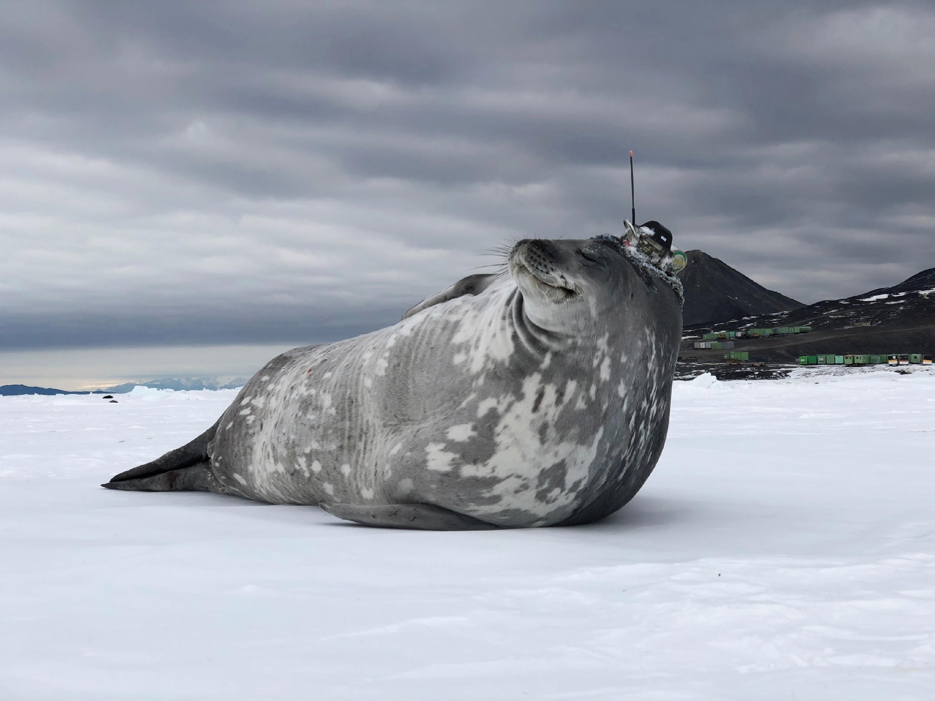
Thank you
goosocean.org

Slide 10
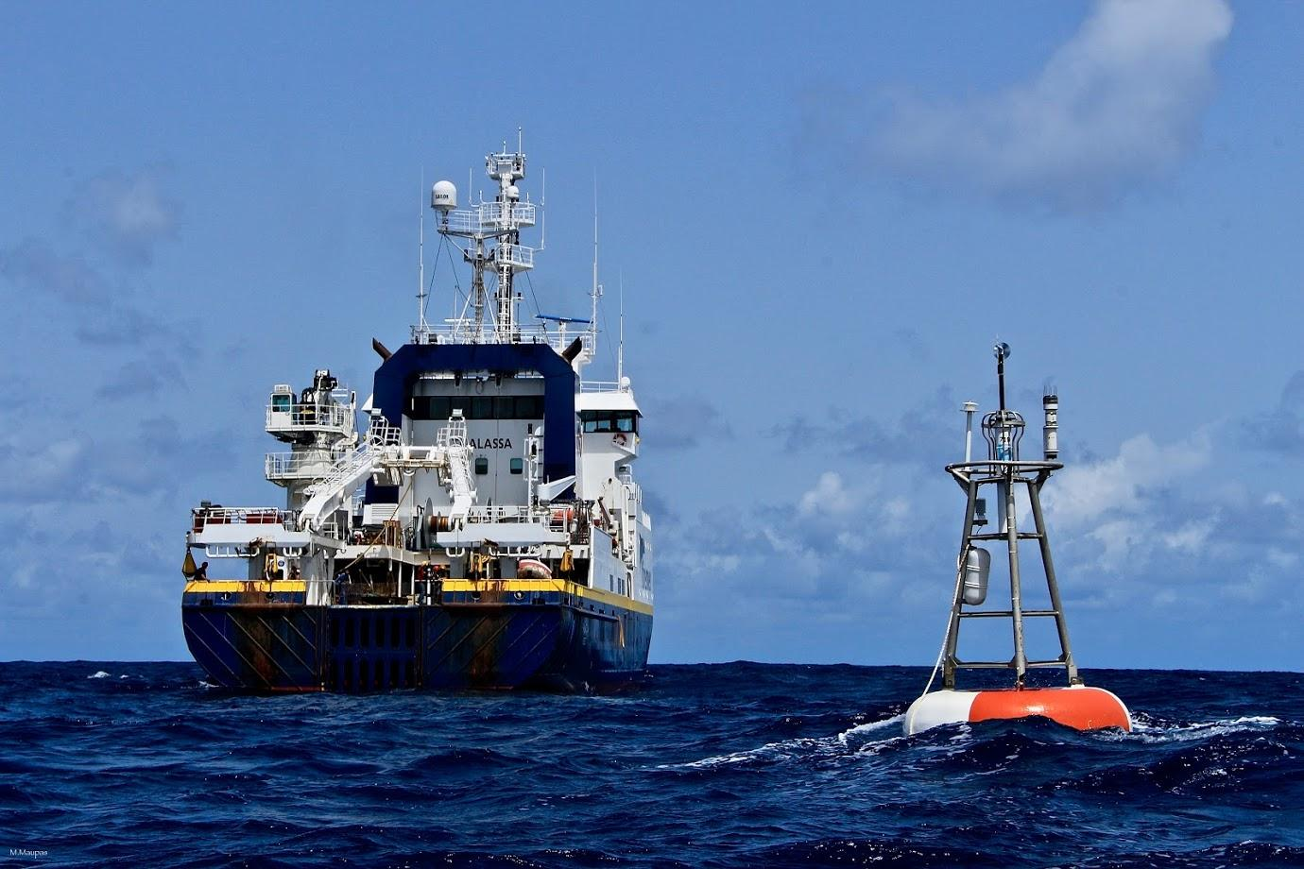
Brainstorming

