Slide 1
Ship-based Ecological Time Series
OCG-14 Hybrid Meeting
6-8 June 2023
Cape Town, South Africa
Heather Benway, Lead PI, Marine Ecological Time Series Research Coordination Network & Executive Officer, Ocean Carbon & Biogeochemistry (OCB) Project Office

Slide 2
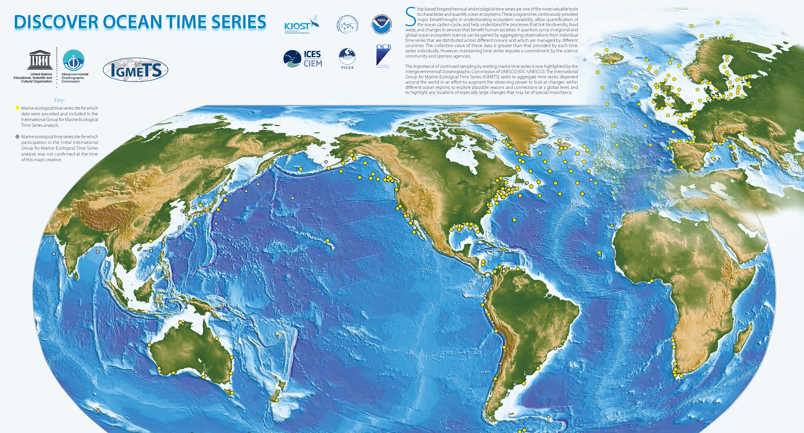
Network Overview
Please feel free to include a map or graphic showing the status of the network together with some comments/statistics
Use/update of the networks summary slide already provided

Slide 3
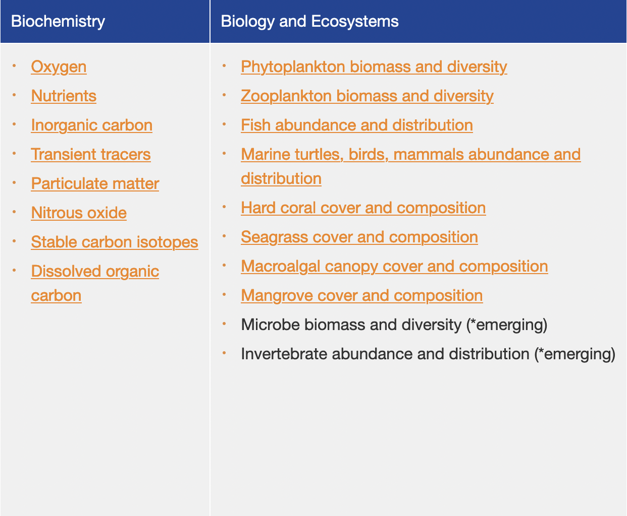
Network Overview
Please feel free to include a map or graphic showing the status of the network together with some comments/statistics
Use/update of the networks summary slide already provided

Slide 4
Network Overview
Please feel free to include a map or graphic showing the status of the network together with some comments/statistics
Use/update of the networks summary slide already provided

Slide 5
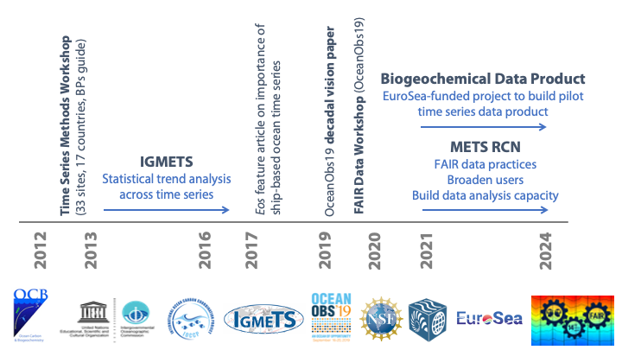
Developments and Achievements
FAIR Data BPs Recommendations
Methods BPs in OBPS

Slide 6
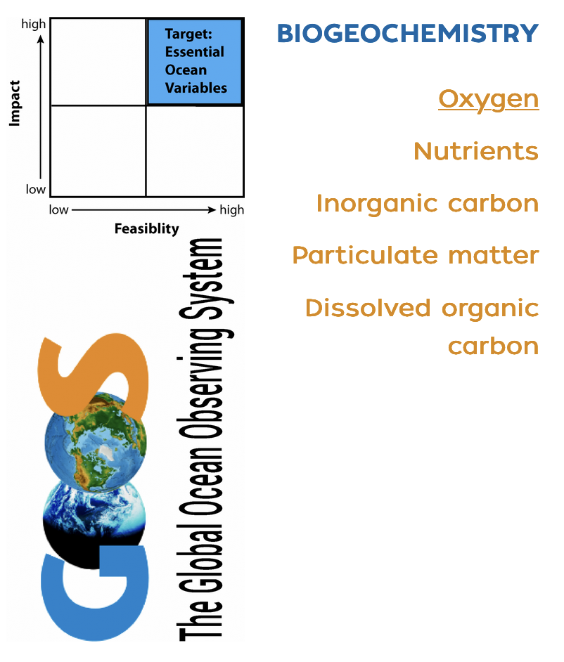
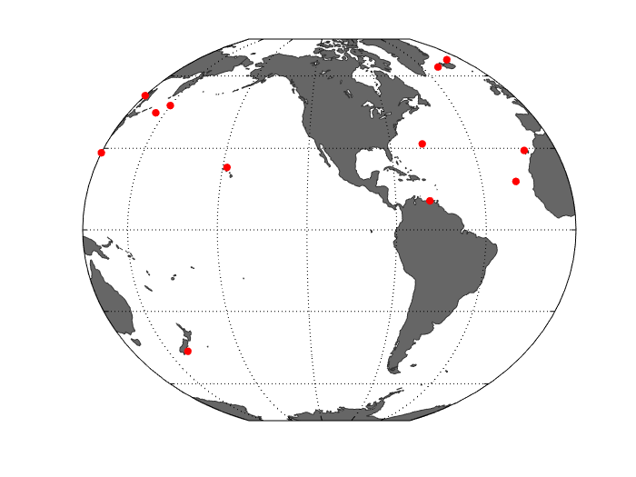
Developments and Achievements
Biogeochemical Time Series Data Synthesis Product
Nico Lange, Angelique White, Björn Fiedler, Frank Muller-Karger, Kim Currie, Laurent Coppola, Marta Álvarez, Masahide Wakita, Melchor Gonzales, Sólveig Rósa Ólafsdóttir, Arne Körtzinger, Benjamin Pfeil, Toste Tanhua
Iceland TS
Irminger TS
DYFAMED
K2
KNOT
RADIALES
ESTOC
HOT
CVOO
CARIACO
Munida
https://www2.whoi.edu/site/mets-rcn/ts-data-product/

Slide 7
Developments and Achievements
Biogeochemical Time Series Data Synthesis Product
Mapping & Metadata
moles_of_dissolved_inorganic_carbon_per_unit_mass_in_seawater
phosphate
TA
ALKALIN
TCO₂
PHSPHT
ALKALI
TCARBN
PO₄
LON
LONX
DIC
LONGITUDE
PH_SWS
longitude
LONG
pH
NO₃
Organic-P
PH_TOT
pH_NBS
POP
NITRAT
PP
NO₃+NO₂
nitrate
https://www2.whoi.edu/site/mets-rcn/ts-data-product/

Slide 8
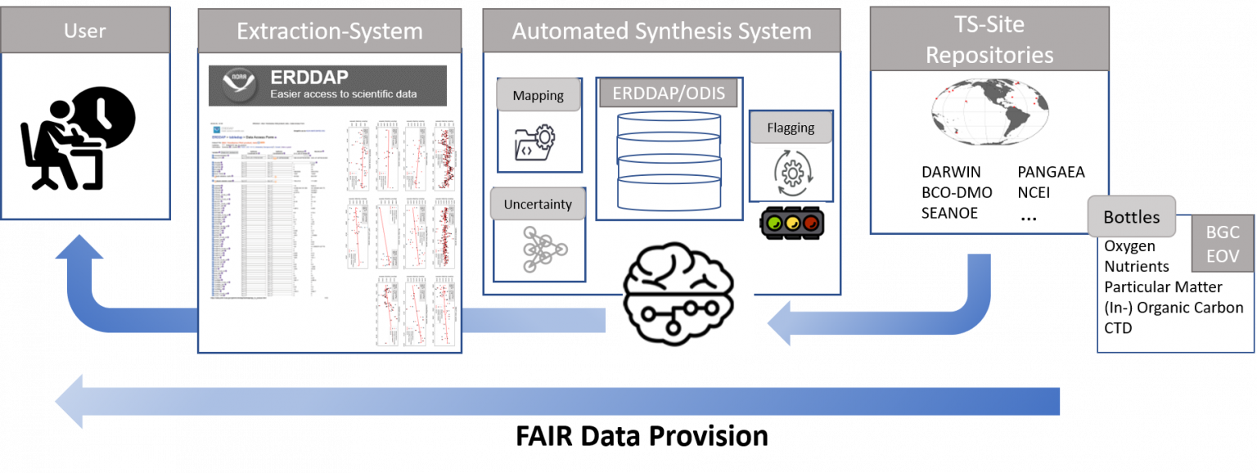
Developments and Achievements
Biogeochemical Time Series Data Synthesis Product
Vision = increased discoverability for ocean time series data
Schema.org

Slide 9
Developments and Achievements
Mapping to & amending the CF vocabulary
Hawai’i Ocean Time-series (HOT)
New terms
Chlorophyll & pigments
Particulates (C, N, P, Si)
Sinking mass fluxes
N₂O
δ¹⁵N and δ¹³C

Slide 10
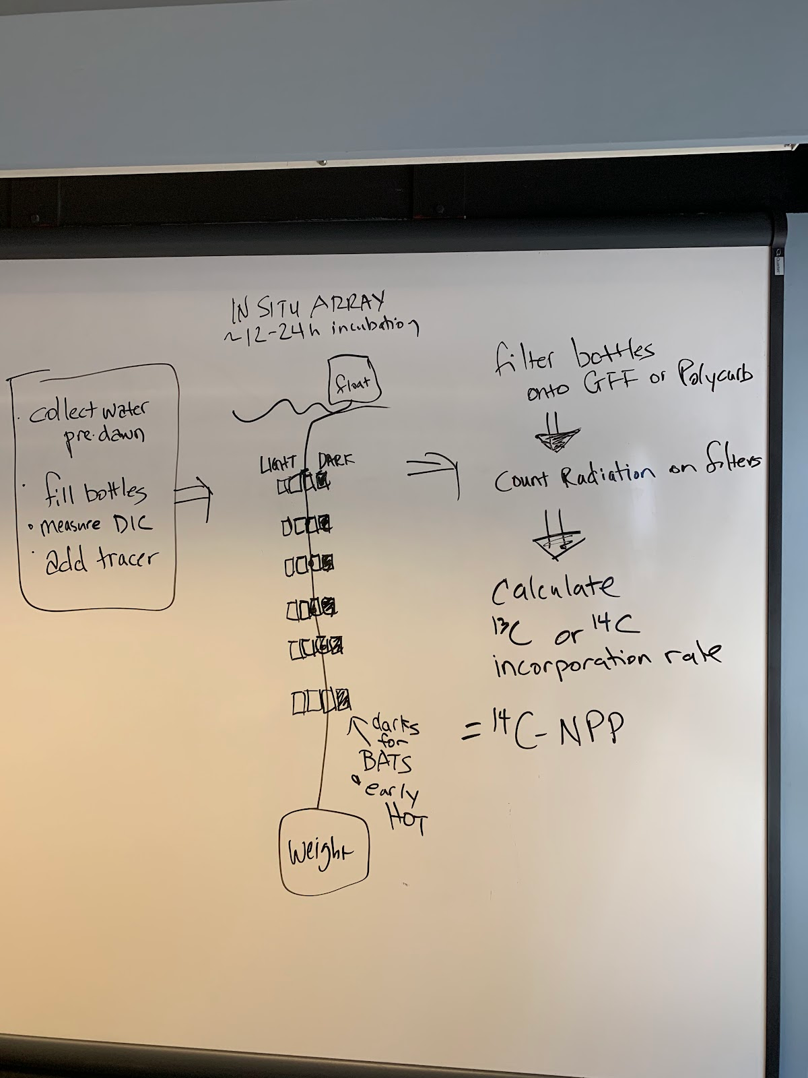
Developments and Achievements
April 2023 METS RCN Hackfest – Bio Use Case Development
HOT sampling/analytical workflows and metadata reporting requirements
Mesozooplankton biomass
Primary Productivity

Slide 11
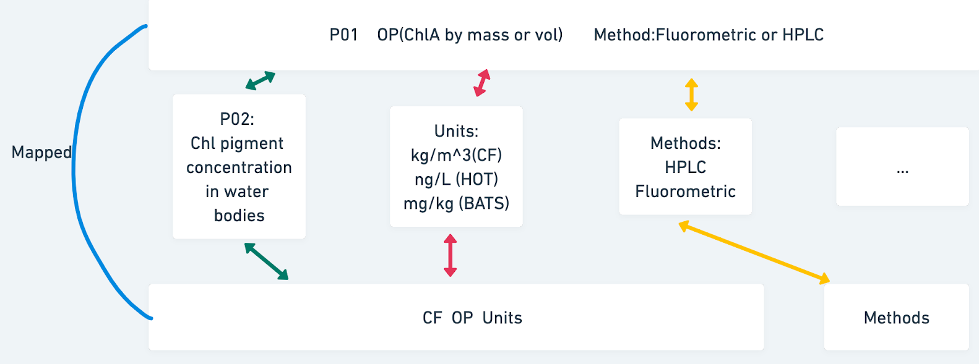
Developments and Achievements
April 2023 METS RCN Hackfest
Mapping exercises
Chlorophyll (HPLC, fluorometric)

Slide 12
Future Plans and Opportunities
International Workshop: FAIR Data Practices for Ship-based Ocean Time Series
January 9-12, 2024 (BIOS, Bermuda)
Convene globally distributed ship-based ocean time series representatives who are interested and committed to FAIR data practices with data managers and experts in semantic web technologies to:
Share and vet newly drafted biogeochemical and biological use cases for adoption by the broader METS community
Work with participating time series representatives to implement these use cases for their time series programs
Co-develop best practices for responsible use of ocean time series datasets (as a contribution to OBPS)
Update recommendations on sampling and analytical protocols from the 2012 Methods Workshop
Explore mechanisms for engaging broader stakeholders (managers, educators, etc.) in the use of ocean time series data sets (pilot regional stakeholder networks)
Start planning an Ocean HackWeek for ocean time series data
Registration will open in Fall 2023 - https://www2.whoi.edu/site/mets-rcn/

