Slide 1
Standards and Best Practices
Juliet Hermes - SAEON
OCG-14 Meeting, June 5-8, 2023
Breakwater Lodge, Cape Town, South Africa

Slide 2
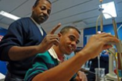
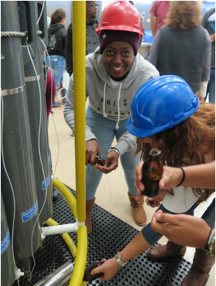
Standards and Best Practices
GOALS
Ensure network endorsed best practices are findable and utilized
Provide network Best Practices for all EOVs that the network observes, for each stage of the observation life cycle, and have recorded in metadata
Ensure harmonization across networks and support joint capacity development
HIGHLIGHTS
Thanks to networks there has been more emphasis on this and people are reaching out for assistance. OBPS document on writing a best practice has been valuable
7 endorsed, 3 waiting.
GOOS webpage with a link to apply for endorsement

Slide 3
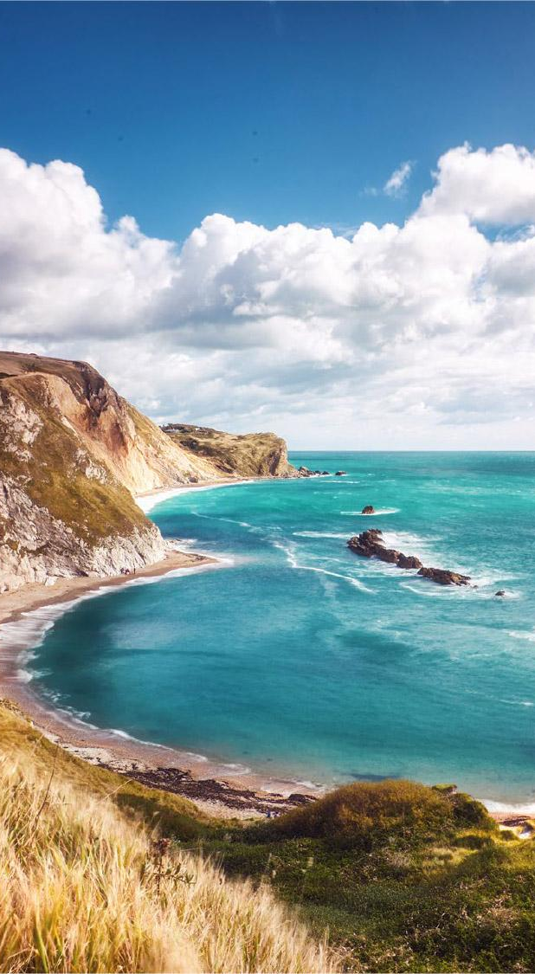
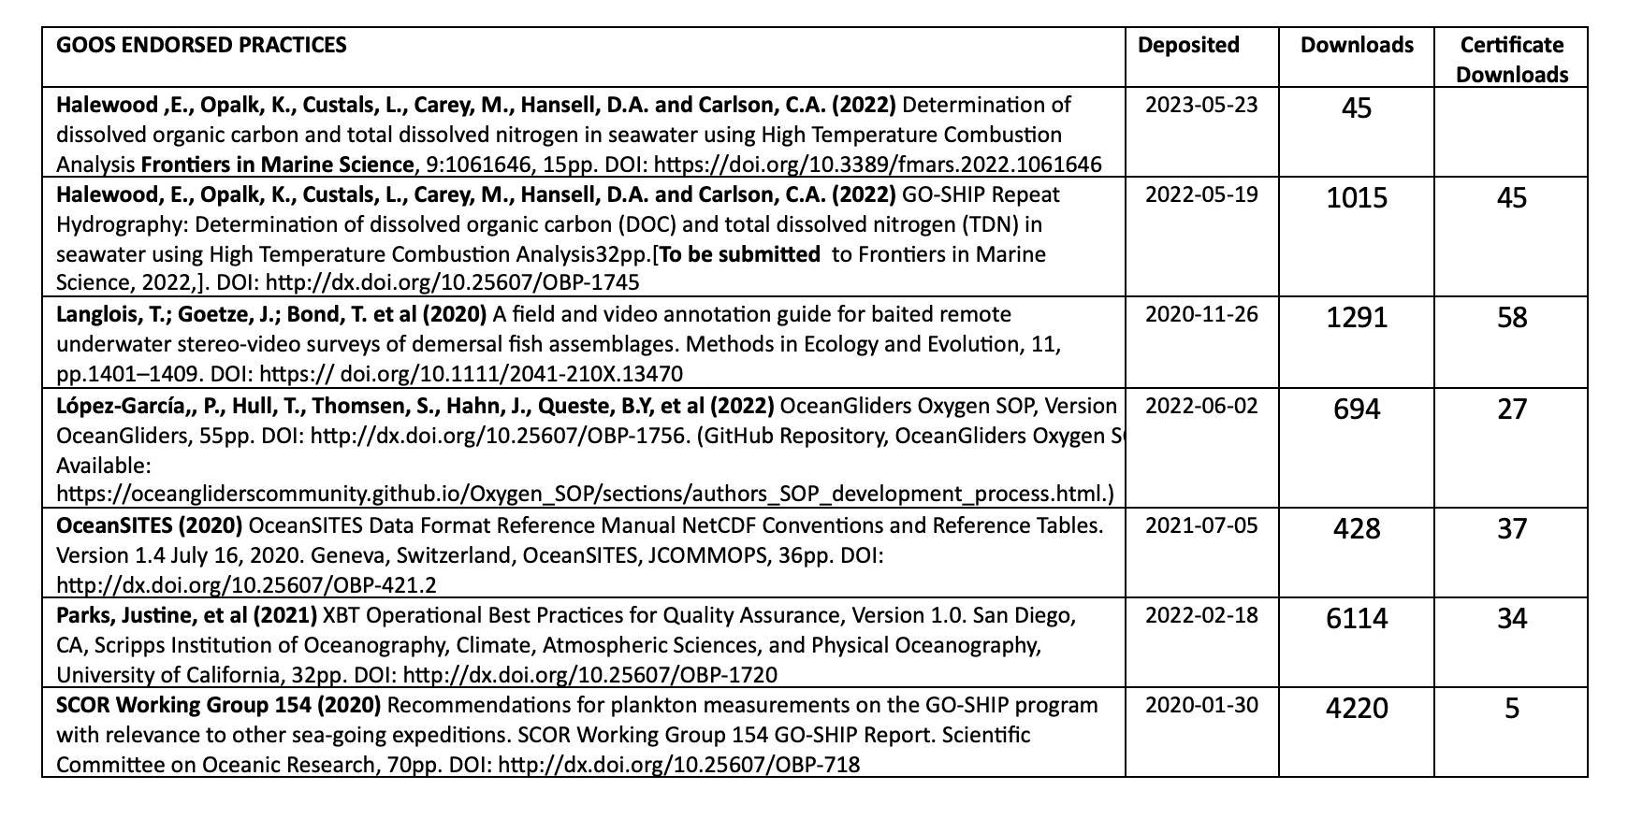
GOOS Endorsed

Slide 4
Next Steps
OTHER ACHIEVEMENTS
Represent GOOS OCG on OBPS, part of a TT focused on BP for under resourced countries, part of the OASIS SCOR WG supporting BP
Ocean Practices for the Ocean Decade, endorsed program
‘Endorsed’ search field on OBPS now live
Editor on Frontiers research topic best practices
NEXT STEPS
Work with BioEco panel further
Explore BP/standards with industry
Look at regional best practices in a global context

Slide 5
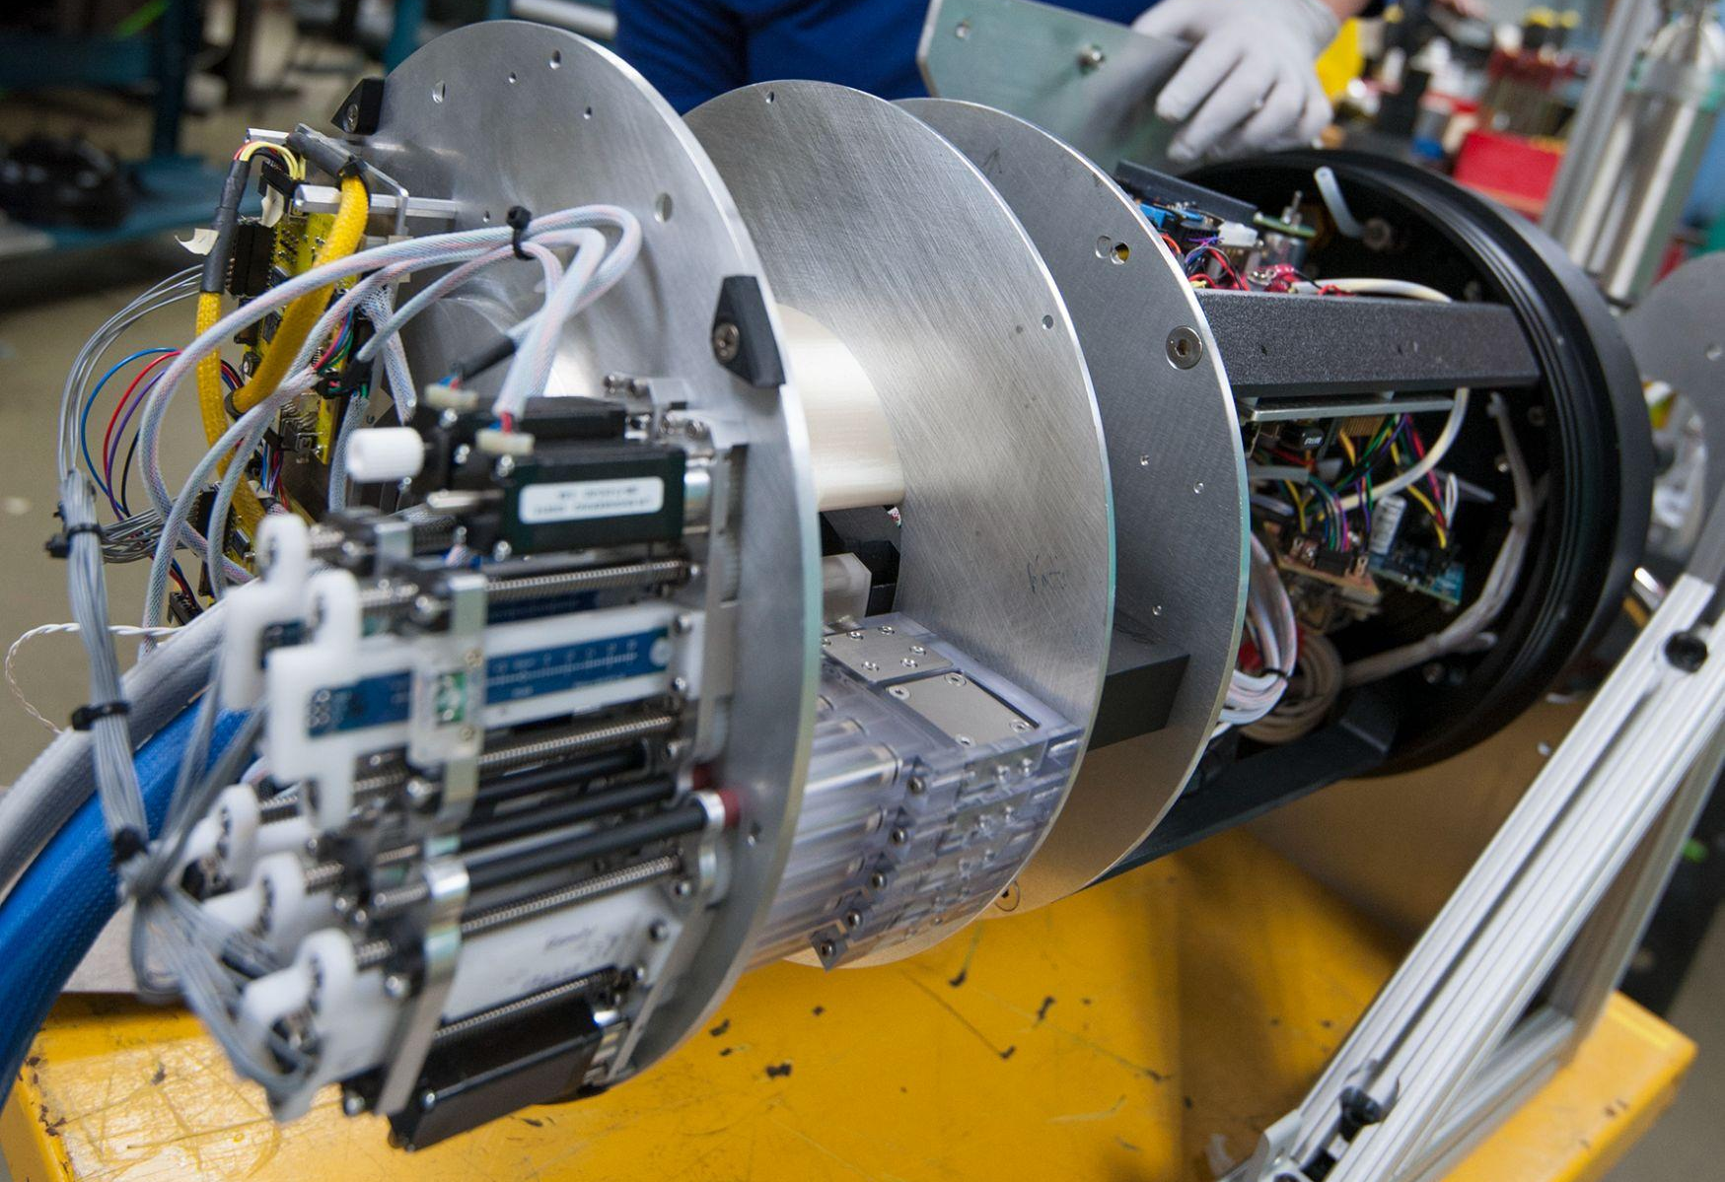
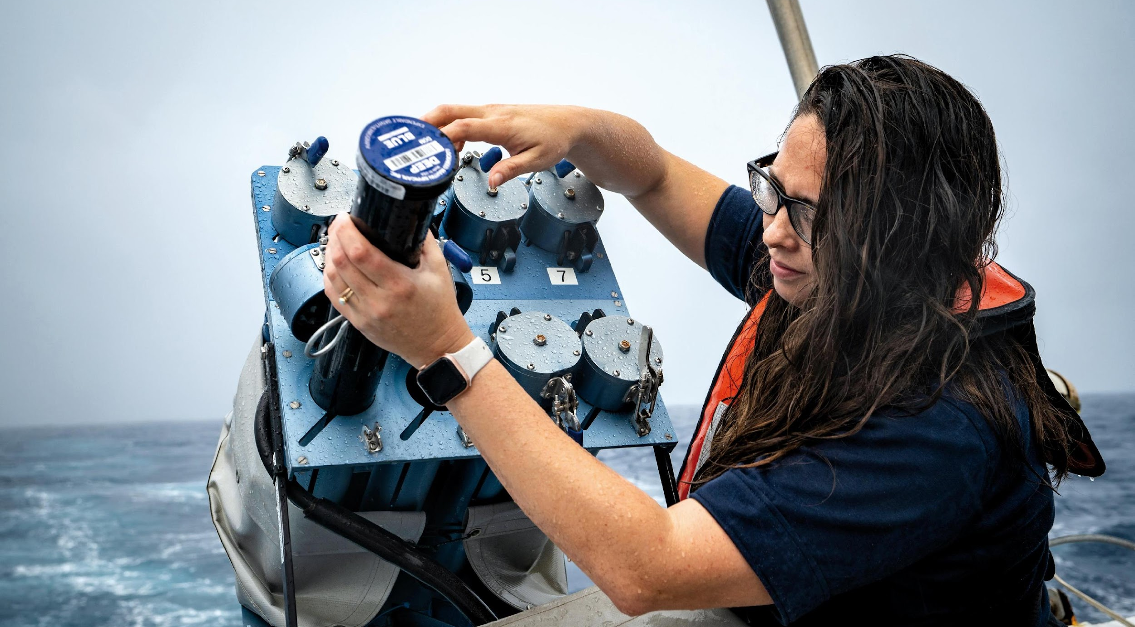
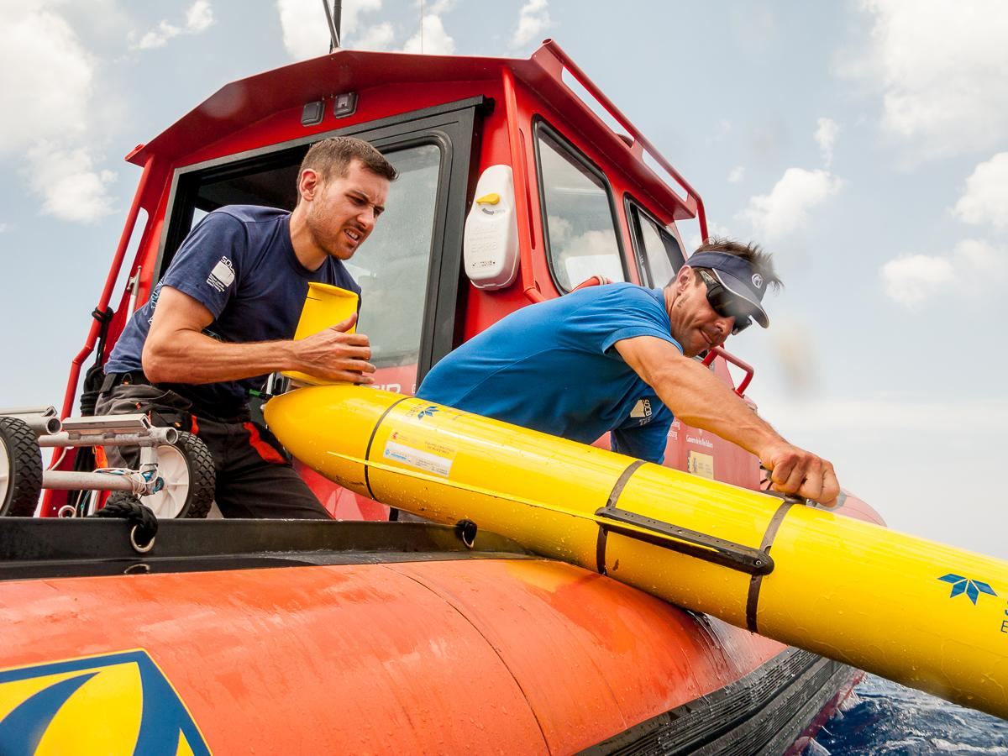
Asks
CONSTRAINTS - Capacity
Additional people resources are key to future progress of executing GOOS core business of developing agreements on and documenting Best Practices
ASKS FROM THE NETWORKS
Please continue to drive this within your networks, through dedicated people and working groups, are you using OBPS?
Inform your constituents of your BP
What are potential opportunities to raise awareness of OBPS
How has the process for endorsement been for you?
What are the major obstacles to creating/converging your best practices?
Can you share any photos of best practices in action or any best practices stories

