Slide 1
Communications
GOOS & OCG
Laura Stukonytė, GOOS Junior Communications Consultant
Emma Heslop Act. Director GOOS Office
OCG-14

Slide 2
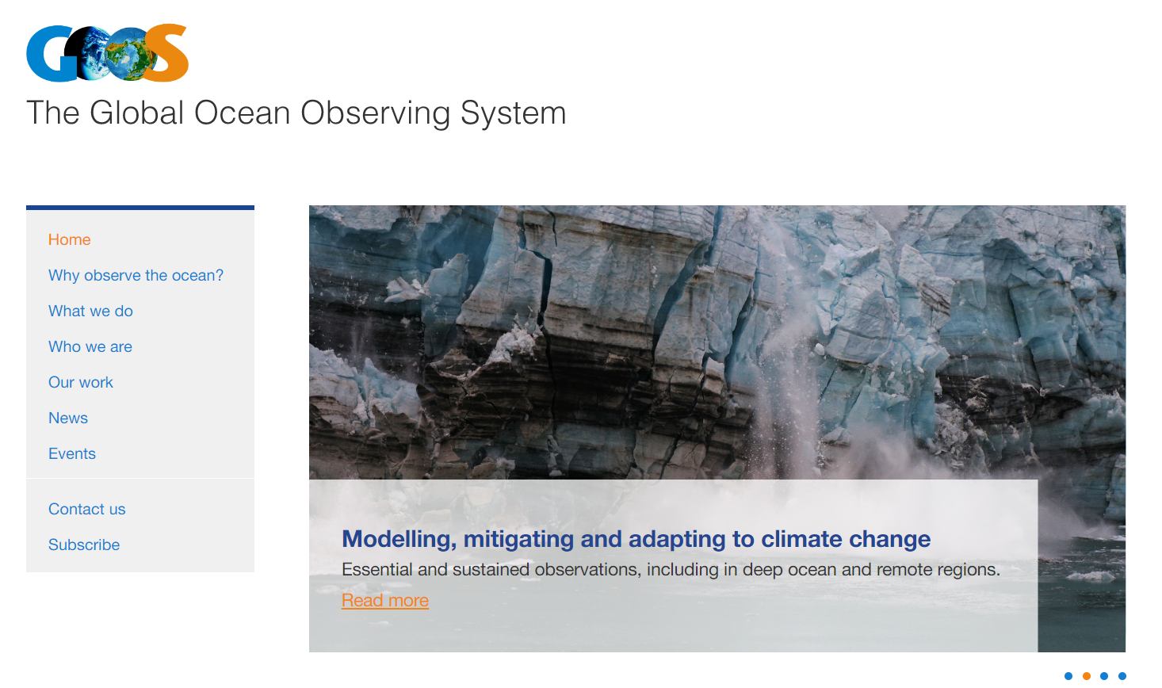
Evolving GOOS communications
2020: Renewed website
2021 October: Consultant hired
2021 October: Strategy and plan developed by Wolf&Player
2022 August - onwards: Implementation
GOOS communications have reached a level of stability: regular news and feature stories, planned campaigns, social media activity and a growing audience
Notes:
GOOS Communications Plan has been developed by Wolf&Player, many of its recommendations are being implemented / are planned to be implemented in the next biennium
GOOS communications have reached stability: regular news and feature stories, planned campaigns, social media activity and a growing audience

Slide 3
Key audience groups
Produce / enable production of data
Consume / leverage data
Strengthen the ocean observing community
Demonstrate the value of global coordination
Make the business case for sustained ocean observing
Show how critical ocean observing is to the success of the Ocean Decade
Source: GOOS Communications Plan by Wolf&Player
Notes:
We can divide our audience into two main groups - the producers or enablers of ocean data, and those who consume or leverage the data. And through our communications, we then want to strengthen and champion the first group, mainly the ocean observing community, and make the business case for sustained ocean observing to the second group. An overarching objective is to demonstrate the value of global coordination, or the work of GOOS, as well as show how critical ocean observing is to the success of the Ocean Decade.

Slide 4
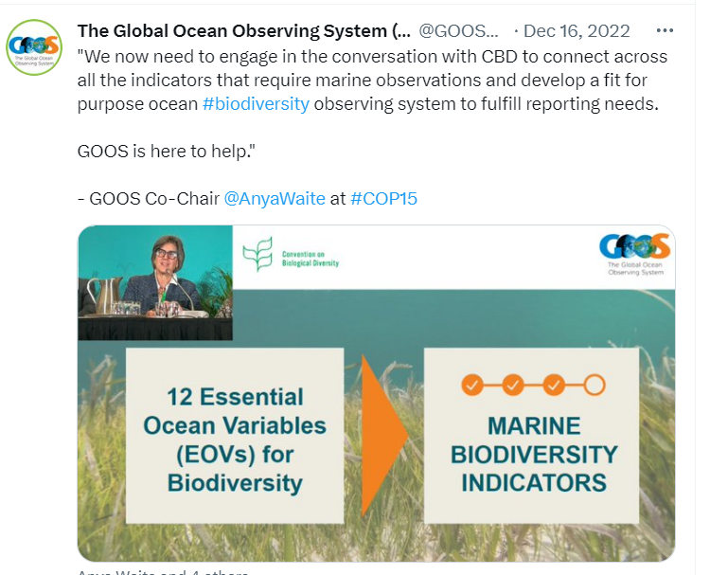
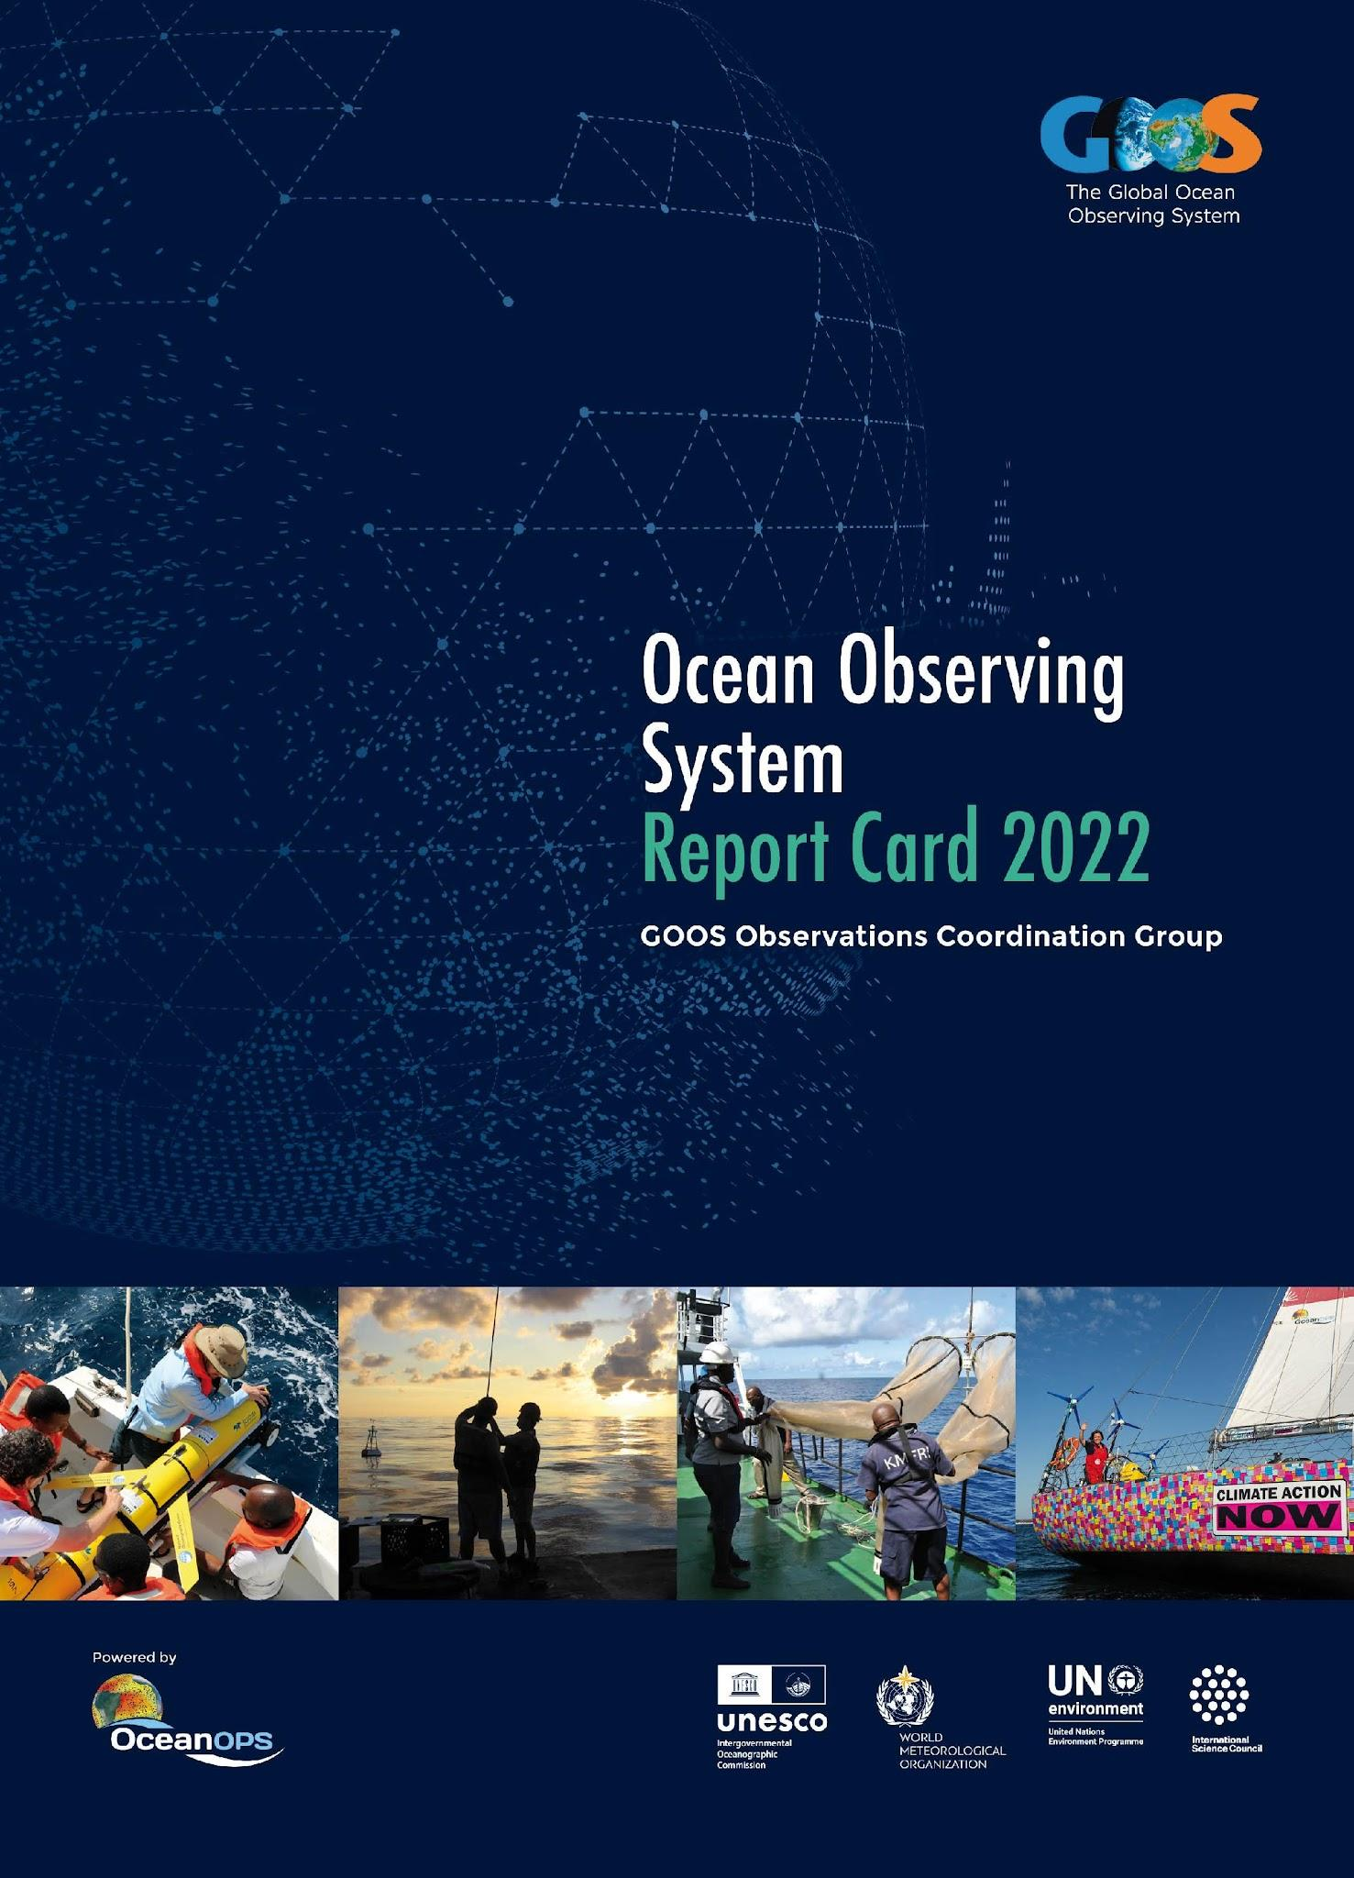
Reaching our audiences
TARGET AUDIENCE
Ocean observing community | Beneficiaries of ocean data
GOOS website
Feature stories
News articles from across GOOS | GOOS-OceanOPS Annual Report Card
Social media | Advocacy / UN
Mailing
Notes:
Feature stories: with ocean observers as champions & highlighting the value of sustained, coordinated ocean observing
News articles from across GOOS: to inform the community about recent events and advancements (e.g. GCOS conference, GOOS BioEco portal, Ocean Best Practices…)
Social media: Posts with latest news from GOOS and partner organizations (Twitter, Facebook, LinkedIn), live tweeting from key conferences
Mailing: Bi-monthly GOOS Updates and irregular GOOS Notes with announcements and events (~1850 subscribers)
Report card: Demonstrating how an integrated observing system adds value to society across the three GOOS Delivery areas: climate, operational services, and ocean health
UN Advocacy: Clear messaging on need for ocean observations (& frameworks/system) and how we help/solve - panels and presentations and flyers with GOOS, IOC, Ocean Decade - e.g. UN Ocean Conference, COP27, COP15, UN ICP

Slide 5
GOOS website: Recent OCG updates
The OCG section on the GOOS webpage was updated, with some additional content still pending.
Updates:
OCG Foci subpages with descriptions, leads and contacts
OCG team page
Updated network pages (+ new pages for Tsunami Buoys, ASAP, VOS and SOOP)
To be discussed: is there a need to update the network specification sheets? Are they used?

Slide 6
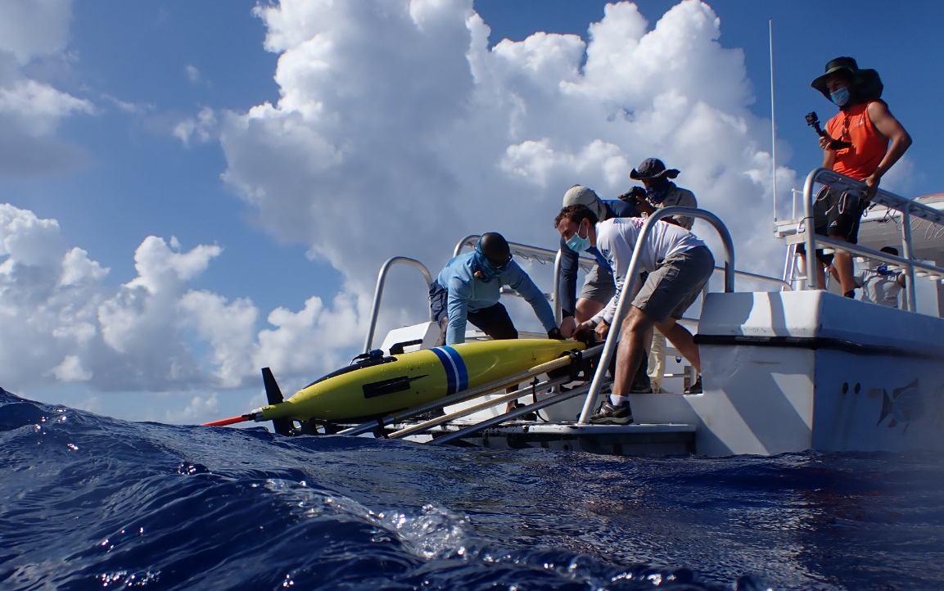
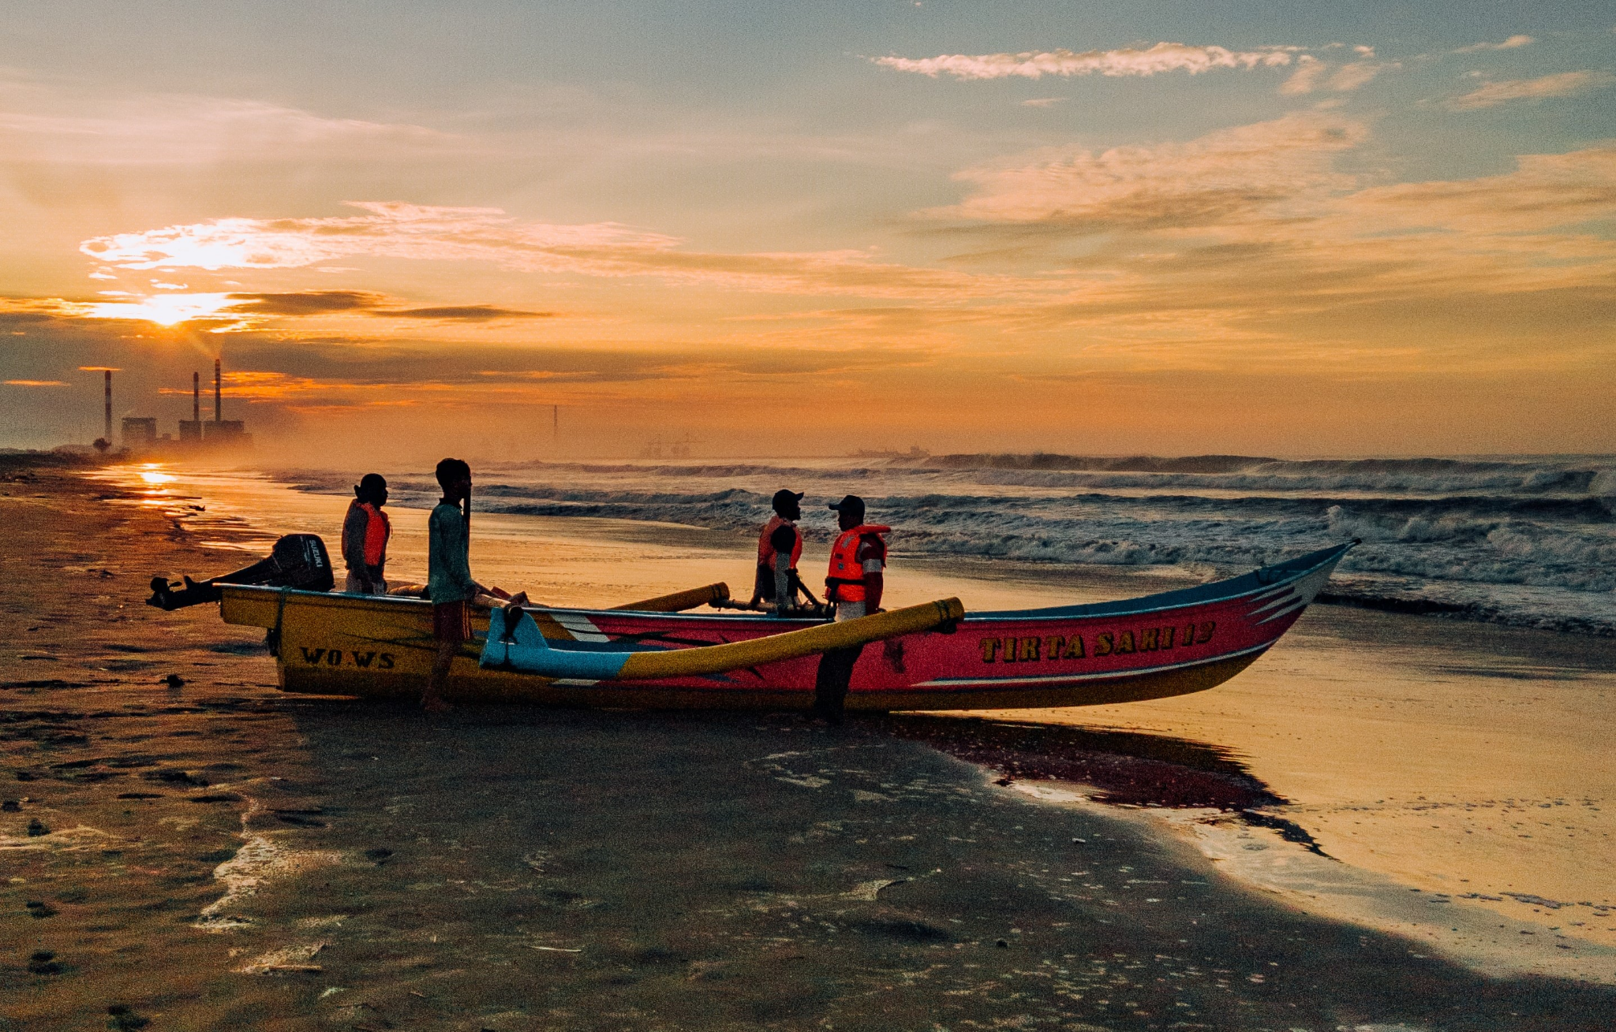
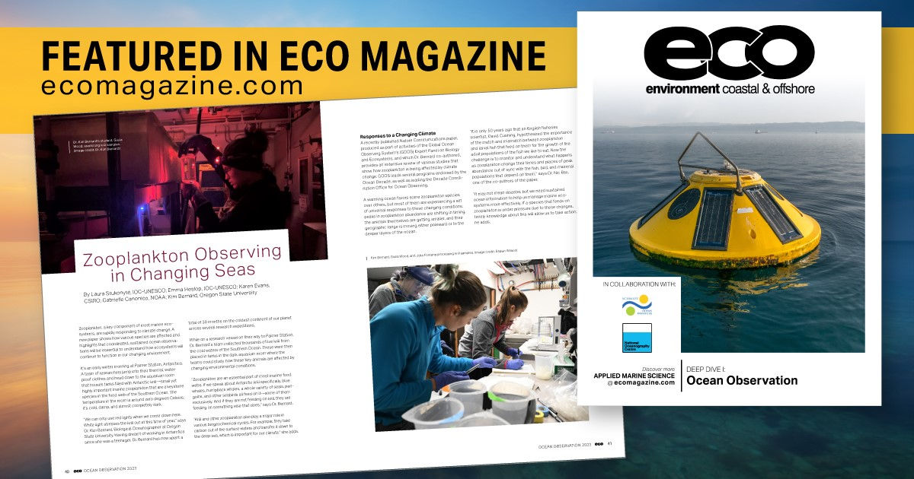
Feature stories
7 feature stories since 2022, all picked up by external media (e.g. ECO Magazine, CBS news, Nautilus, Mongabay, Ocean Science & Technology News)
Featuring OCG networks:
A new wave of elephant seals becomes animal oceanographers (AniBOS)
When a cruise through the Mediterranean Sea is not exactly a holiday (MedSHIP/GO-SHIP)
Tropical cyclones: Why we must observe the ocean to better protect people on land (Ocean gliders)
New ocean observing technologies to maximize the potential of Tsunami Warning Systems (GLOSS, Tsunami Buoys)
To be discussed: Do you find the stories effective? Are networks willing to collaborate on these more often in the future?
Notes:
Mention themes!

Slide 7
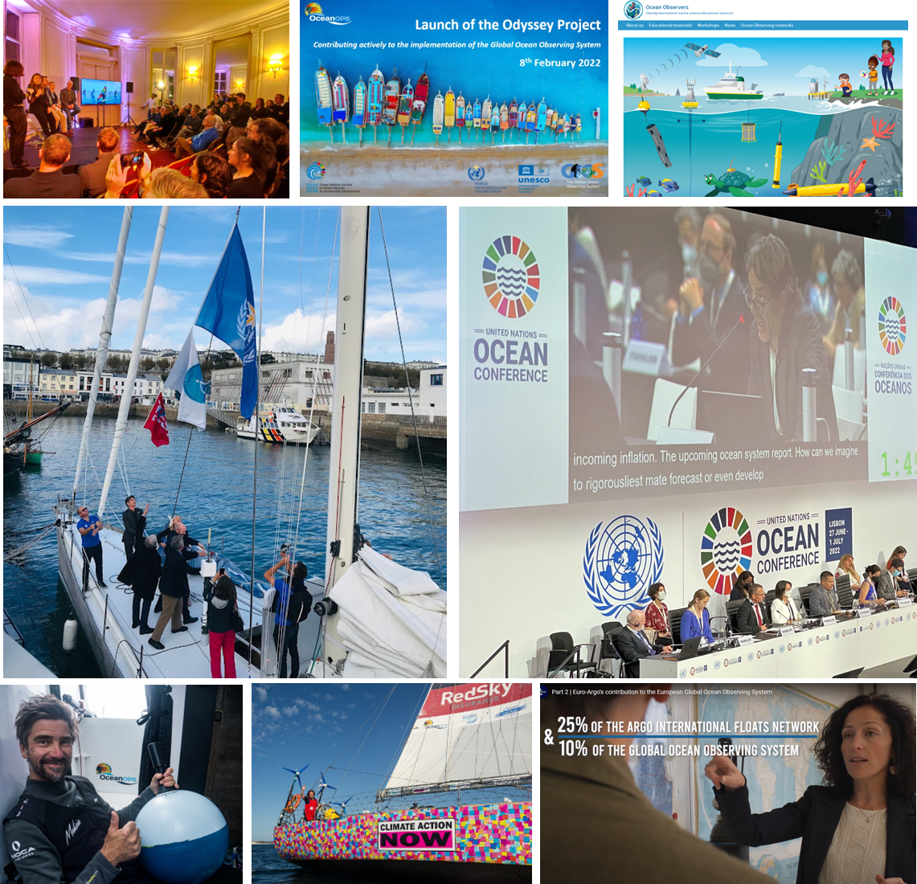
OceanOPS communications
Cooperation with civil society (operational and promotional goals) - relative access to mass medias. Promoted with IOC, WMO and GOOS office.
Project Odyssey launch meeting aside OneOcean summit. Contribution of diving, surfing, fishing ,sailing, shipping, etc to the GOOS.
Iris sailing charter departure ceremony with IOC, GOOS and WMO delegates and French elected officials. 95 Argo floats deployed in Atlantic (for US, CA, EU).
Several outreach & comm activities (PR, news, tweets) focusing on the engagement of skippers (e.g. The Ocean Race).
Contribution to educational and awareness campaigns with European partners.
Notes:
OceanOPS is the GOOS operations monitoring and support centre

Slide 8
Report Card 2022-2023
Report Card 2022 published Sept 2022, 6th edition and first truly cross-GOOS
>2,000 visitors from >100 countries consulted the new interactive web version since publication.
Report Card 2023 planning: New topical stories to illustrate cross-network/cross-GOOS integration:
Marine heat waves
Safety at Sea
Seagrass
Community collaboration & capacity development stories
Cyclone forecasts Co-Design exemplar
Release Fall 2023
Notes:
Focuses on how an integrated ocean observing system adds value to society across the three GOOS Delivery areas: climate, operational services, and ocean health Promoted through a web release, video (effective), social media, mailed to key stakeholders

Slide 9
Opportunities through GOOS
Future story opportunities - suggest your ideas for engaging feature stories: - With an interesting human angle: experiences from the field, excitement, impact stories - Newsworthy stories: findings of societal importance - Featuring ocean observers as champions (1-2 stories from the network can be developed every 2 months)
Social media: Tag @GOOSOcean in your tweets or share your social media posts with us so we can share them through GOOS
GOOS Mailing: A relevant event coming up? Send your announcement to Laura for dissemination through the GOOS mailing list (>1800 subscribers)
GOOS Website: OCG team and networks are welcome to get in touch with Laura with requests for updates on OCG and network pages
l.stukonyte@unesco.org

Slide 10
How do we produce stories together?
Proposed process:
1
2
3
Bi-monthly call for story ideas
Story development
Dissemination
under different themes (e.g. climate/biodiversity/hazard warnings); sent out to OCG network leads by GOOS
from interviews, then elaborated with network representatives - GOOS leads in writing (time frame - 1 month)
through GOOS and IOC websites, social media and newsletters; sent out to media contacts and the originators of the story

Slide 11
Together we can make the value of sustained and coordinated ocean observing more visible and better understood.

Slide 12
Questions to discuss:
Feature stories: Do you find these effective? Are networks willing to collaborate on more stories in the future through the proposed process?
Network specification sheets: Is there a need to update? Are they used?
General communications: What are potential messages to work on increasing OCG visibility and utility?
Is a standard OCG slide deck needed?

