Slide 1
The Ocean Decade Research Programme of the Maritime Acoustic Environment
Heather Spence (Co-chair), Kyle Becker (Co- Chair), Grace Smarsh (Exec. Sec.)
Interagency Working Group of Ocean Sound and Marine Life (USA)
OCG-14, June 8, 2023
Notes:
Stock photo from unsplash

Slide 2
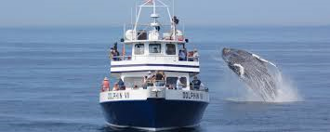
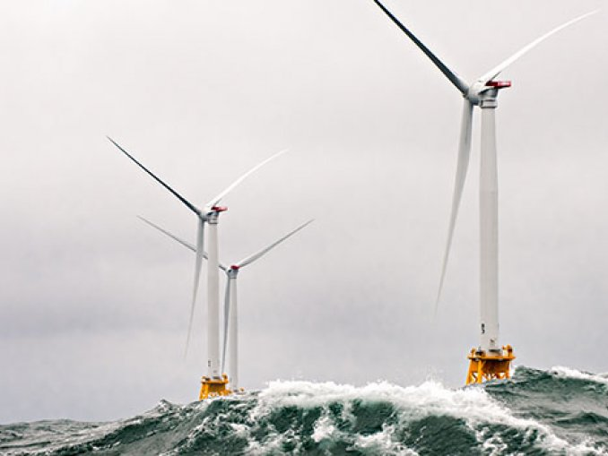
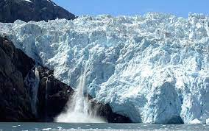
Ocean Sound”
The Acoustic Environment: collectively, the combination of all sounds
within a given area modified by interactions with the environment (National Park Service)
“ The Science of
Acoustic Environment → Listen and Assess → Biological and Physical Environment
(Signal) (Information)
Acoustic Environment ← Model and Predict ← Biological and Physical Environment
(Decision Space) (Scenario)
Notes:
How will our research program work.
To date many ocean acoustics studies have been focused mainly on the Noise, and less on the acoustic environment.
In a recent conversation with Gordon Hempton of Quiet Parks International he recommends listening to the quiet.
This is consistent with the idea of Natural Quiet and listening to the sounds of biology and natural processes that give clues about place and time.
Clues about ecosystems and habitats and how marine life interacts with their acoustic environment.
The research program aims at understanding and characterizing Natural Quiet in order to better understand the impacts and consequences of human introduced sound and noise.
To do this, we first need to make undersea soundscapes more accessible to everyone. This will not only bring more awareness to the fascinating world of ocean sound but also create a demand signal for preserving and even restoring natural quiet in the oceans.
We will do this through partnering with the Ocean Corps for Ocean Science to include sound in their ocean science curriculum, and by supporting the development of less expensive instruments and user-friendly web-based interfaces to allow for citizen science.
We will also support research aimed at discovering and extracting the information contained in sound data to learn about both the sources and the environment.
Our goal is to turn acoustic signals into information that can be used to make assessments or predictions about the environment.
From this we can develop tools to aid decision makers in their choices for Sustainable Development and uses of the oceans.

Slide 3
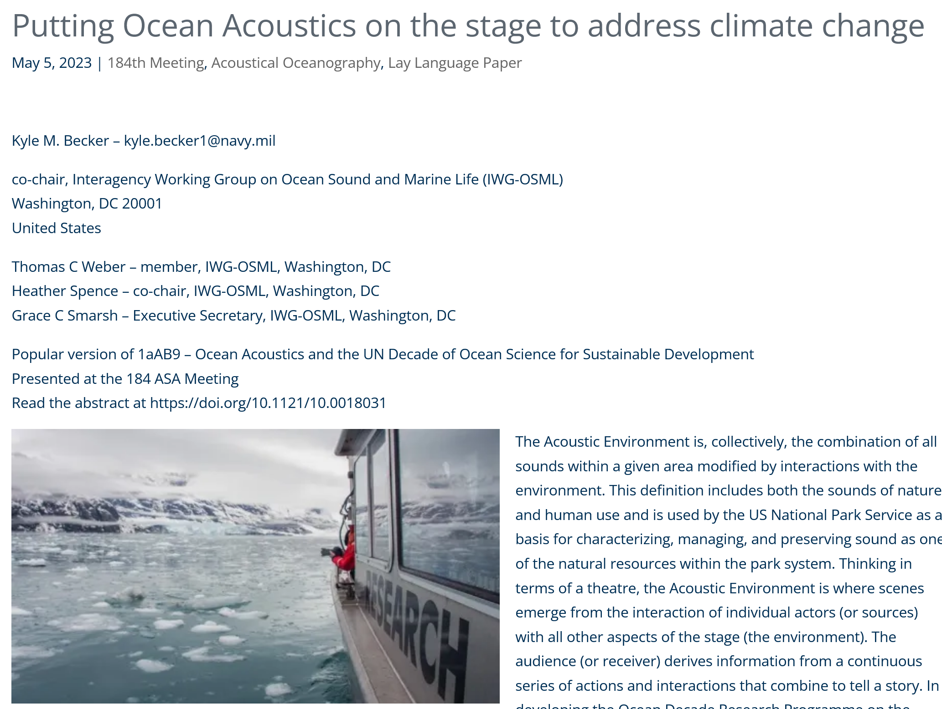
Recent Outreach

Slide 4
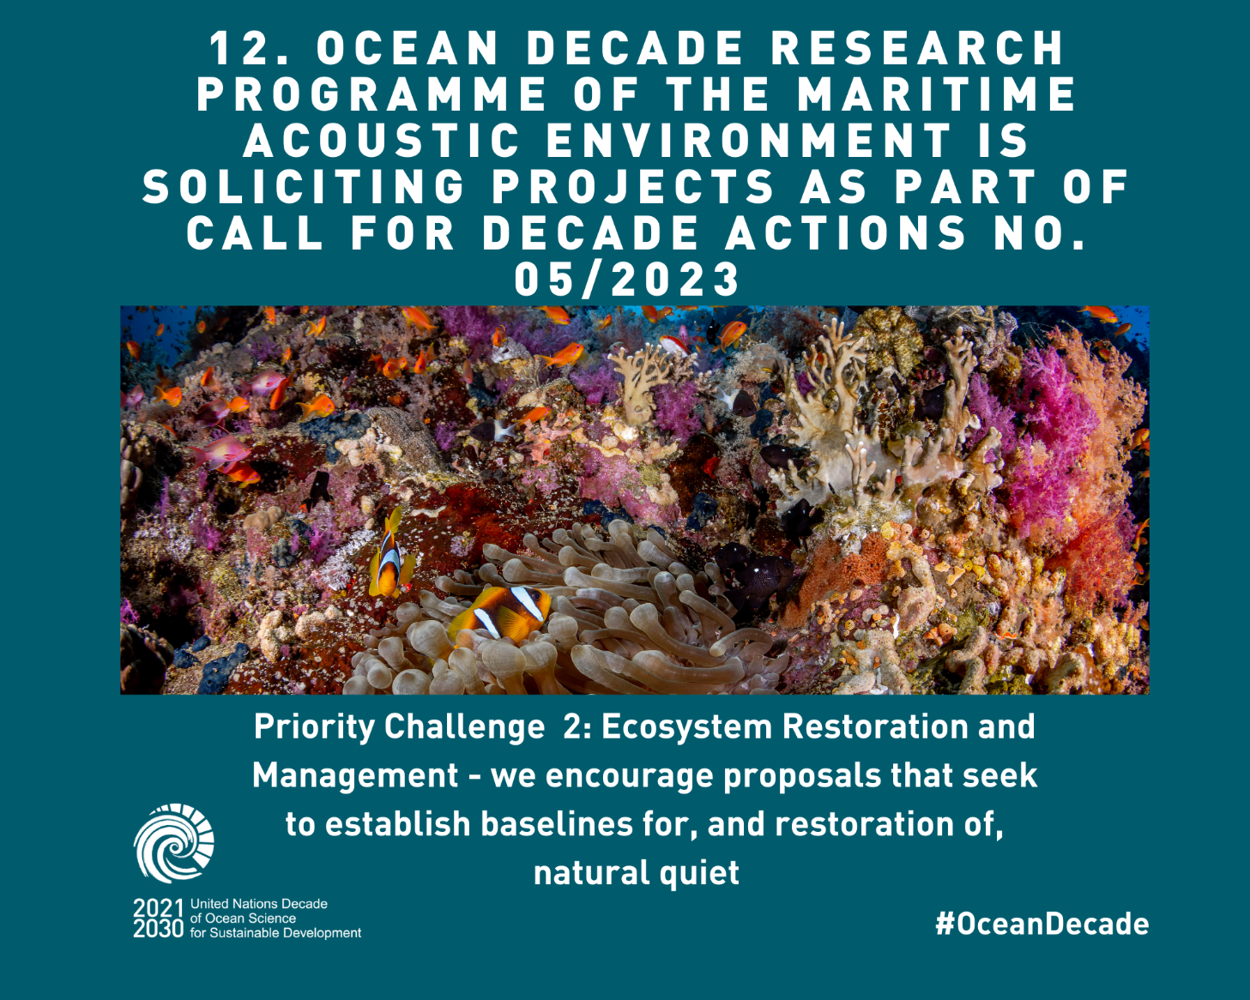
Action Solicitation
Call for "Ocean-Shot" Concepts-
Transformative Research for the
Decade
“Ocean-Shots”, defined as an ambitious, transformational research concept that draws inspiration and expertise from multiple disciplines and fundamentally advances ocean
science for sustainable development.
Apply today using our online form, or email oceandecadeus@nas.edu with questions.
OD-MAE

Slide 5
The OD-MAE program supports collecting information from the ocean to further analyze, interpret, assess, predict, and share to meet OD Challenges, Outcomes, and Goals
Opportunities:
Partners: Underwater acoustics is interdisciplinary, and can provide complementary/additional information
Capacity building: can new technology incorporate acoustic monitoring components in observation systems?
Support: Tends to be an underrepresented field in ocean science

Slide 6
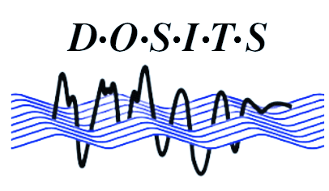
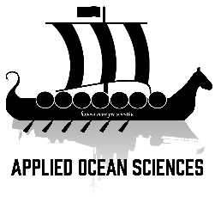
Welcoming additional partners!
“ The Science of
Ocean Sound”
Contact: Kyle.becker1@navy.mil

