Slide 1
Revolutionising Global Coastal Ocean observing and forecasting
Nadia Pinardi, University of Bologna
Villy Kourafalou, University of Miami
Joaquín Tintoré, Balearic Islands Coastal Observing & Forecasting System
Emma Heslop, GOOS, IOC/UNESCO
This programme is endorsed by the UN Decade of Ocean Science
Notes:
This is a general overview of the progress of work by the CoastPredict Programme in the past 4 months.

Slide 2
Work in the past year:
DCC on Coastal Resilience Strategy and workshop
CoastPredict projects, FLAME and PredictOntime Workshops
Preparing the Global Coast Experiment
Notes:
First we have defined the CoastPredict Focus Areas that breakdown the work in 6 concentration areas. Second UNIBO has submitted in February 2022 a proposal for a Decade Collaborative Center on Coastal Resilience in a chaning climate. I conclude with requests for discussion to the GOOS SC

Slide 3
DCC-CR Strategic Objectives
Decade Collaborative Center for Coastal Resilience:
Strategic Objectives
Improve Science Information for all
Enhance Stakeholder engagement
Timeframe:
2023-2027
Cross-cutting activity: Cities with the Ocean
Promote Equitable Education
Uphold Environmental Justice for Coastal Communities

Slide 4
Activities Sep 2022 – Feb 2023
Initial activity
Workshop on 'Integrated Coastal Management and Marine Spatial Planning in support of Coastal Resilience'
First workshop organized
50 people joined the meeting in person
~100 people connected remotely
Presentations available on the website

Slide 5
CoastPredict : ENDORSED PROJECTS
Focus Area 1
Integrated observing and modelling for short term coastal forecasting and early warnings
CORE PROJECT: PredictOnTime will develop systems to observe and predict natural extreme events in the global coastal ocean (Italy) AFFILIATED PROJECTS:
Integrating Coastal Hazards Early Warning Systems in the Tropical Americas and Caribbean (IOC-Caribe)
AI ensemble engine for coastal hazard predictions (The Netherlands)
Focus Area 4
Coastal ocean and human health
AFFILIATED PROJECTS:
SUSTAIN: PH ocean observing and coastal resource management (Philippines)
Coastal Pollution ToolBox (DE)
Focus Area 2
Earth system observing and modelling for coastal climate monitoring and downscaling
CORE PROJECT: FLAME Future Coastal Ocean Climates - innovative, high-resolution, downscaled projects for coastal ocean climates and impacts (UK)
AFFILIATED PROJECTS:
> European Knowledge Hub on Sea Level Rise (BE)
20 world ocean areas
where
projects
will be piloted
Focus Area 5
International open and free access to coastal information
CORE PROJECT: CORIS - Coastal Ocean Resource Environment - sustainable delivery of high-quality environmental data and information, products to research, industry and government (ES)
Focus Area 3
Solutions for integrated coastal management
AFFILIATED PROJECTS
> MANCOGA: Mangroves as Nature-based Solutions to Coastal Hazards in Eastern Ghana endorsed & funded by Meerwissen (Ghana)
Focus Area 6
Equitable coastal ocean capacity

Slide 6
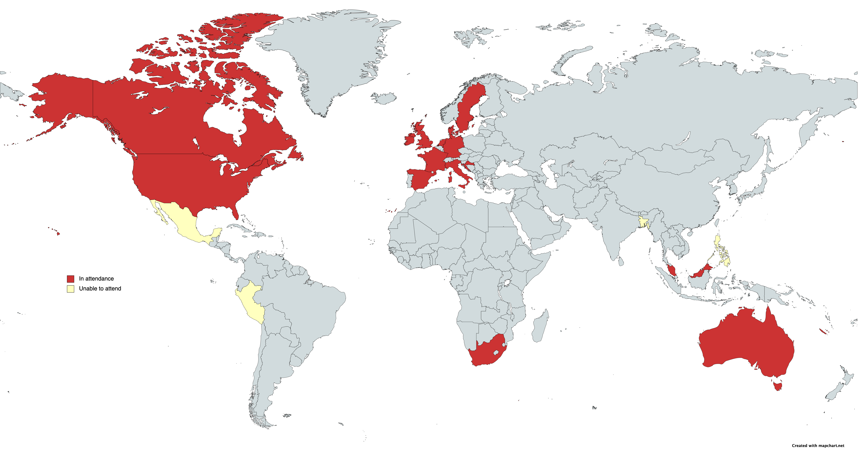
FLAME Workshop (Feb. 21-23, 2023) participants and regions of focus
In attendance
Unable to attend
TIMELY!!!!
IPCC Coastal Climate Modelling Framework being prepared

Slide 7
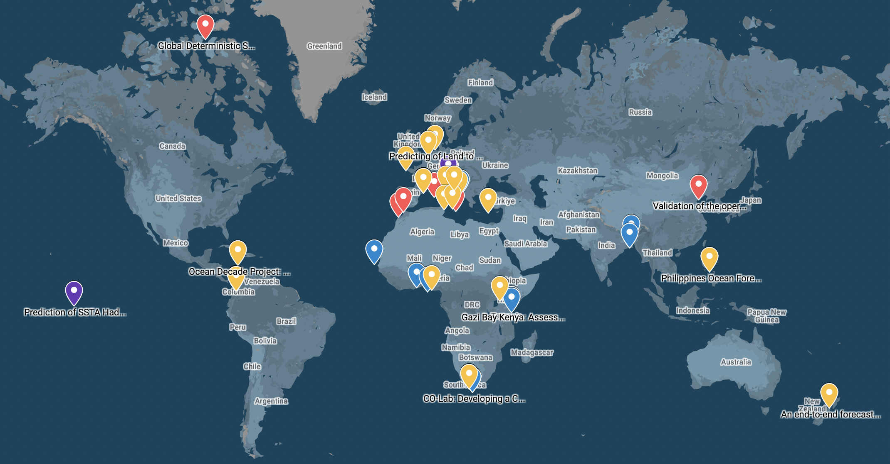
PredictOnTime Workshop (May 11-13, 2023) and regions of Focus
TIMELY!!!!
Relocatable coastal integrated system needed from many communities

Slide 8
THE COASTPREDICT DEVELOPMENT STRATEGY: THE BUTTERFLY APPROACH

Slide 9
“Global Coast”: the global coastal ocean experiment
GOAL
GLOBAL COAST will implement the CoastPredict projects and guidance principles in a range of contrasting global coastal oceans to demonstrate the value of an integrated and fit-for-purpose coastal observing and prediction system that delivers innovative products and services for coastal resilience in collaboration with local stakeholders.
In other words: the Global Coast initiative coordinates the planning of demonstration test sites where FAs technologies and methods will be implemented following a general strategy

Slide 10
The Global Coast Experiment infrastructure in the global framework
Global Coast infrastructure
GDACs
NODCs
WIS2
Global Coast infrastructure (internet+cloud)
DTPS1
DTSP-2
DTSP-n

Slide 11
Global Coast Digital Infrastructure: DTSP components
Global Coast infrastructure (internet+cloud)
DTPS1
DTSP-2
DTSP-n
MAIN TARGET:
Coastal observations and prediction products/information
MAIN TARGET: On-demand models, data analytics and user-oriented transformation
DEMO:
End-user tailored products and decision support systems for coastal resilience
MAIN TARGET:
Training and outreach
material
DTSP contents

Slide 12
The Global Coast Experiment survey will be sent out July 2023 Get in touch!
© SOCIB
www.coastpredict.org
info@coastpredict.org

