Slide 1
Transforming Ocean Observing through Co-Design
David Legler | Director, Global Ocean Monitoring & Observing, National Oceanic & Atmospheric Administration
Sabrina Speich | Professor, Physical Oceanography & Climate Sciences, Institut Pierre-Simon Laplace
Emma Heslop | Acting Director, Global Ocean Observing System,IOC-UNESCO
Andrea McCurdy | COL / NASA

Slide 2
THE OCEAN
Provides 50% of our planet’s oxygen
Absorbs 25% of anthropogenic carbon every year
Provides food security for 3 billion people
Absorbs heat, drives extreme weather and controls climate
…if we don’t have the ocean observations underpinning our decisions, we might as well be guessing at solutions
Notes:
71% of our planet is covered by the ocean.
The ocean…..
Ocean observation underpin a wide range of applications
There are multiple and urgent drivers of the Co-Design plan of action.
The world has, finally….with help from GOOS, recognized the importance of the ocean!
Public and private sector are demanding specific and actionable ocean information… About carbon, about life in the ocean, food security, and extreme events.
We know there is a paucity of information.
We have the tools and capabilities to address this gap. We need resources and We need better integration of observing and modeling and products to provide INFORMATION (regardless of the platform from which it originates).
Now there is an urgency to get on with it and bring users into the enterprise more centrally. This need gives us a new opportunity to engage information USERS to allow GOOS to be much more responsive to their needs to ensure the observing system of the future will be fit for purpose and provides a measurable return on investment .

Slide 3
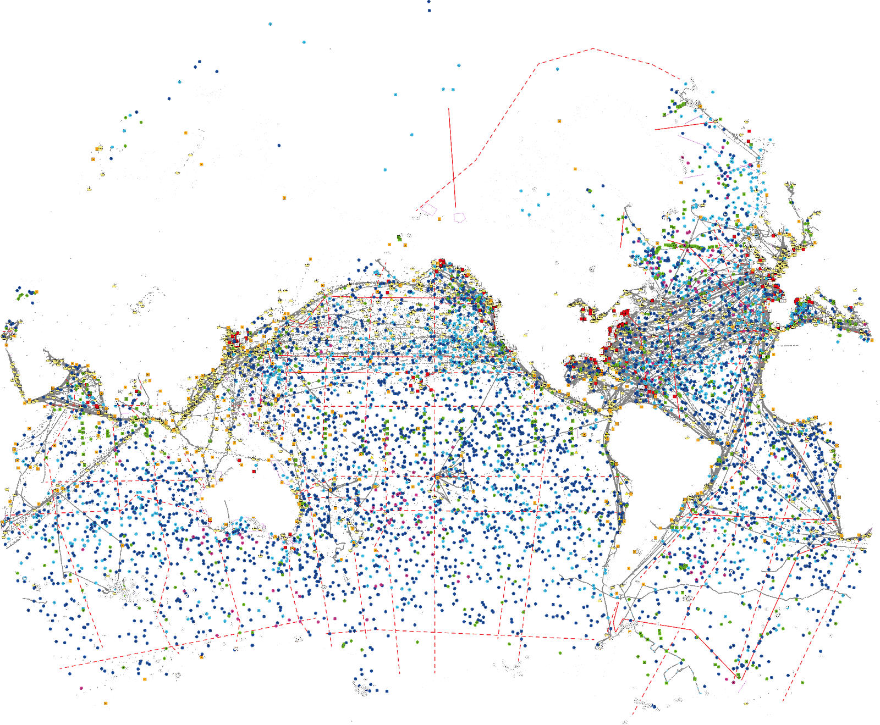
Sufficient to address accelerating climate impacts and societal needs?

Slide 4
THE CHANGE
Increase Global Capacity
Bridge and engage across observing - modeling/forecasting- policy and other users
Establish clear priorities
for investment in ocean observing
Accessible and impactful ocean information to effectively meet global challenges
Notes:
We need more information on the ocean to meet challenges such as climate change mitigation and adaptation, improving ocean, coastal and weather prediction, food security, and human health and safety.
For this we need to establish clear priorities for how we invest in ocean observing for the future and better integrate observations and models to produce useful ocean knowledge
This demands a step change in how we design our global ocean observing system: integrating across the value chain of observing, modeling, and user engagement.
We have the tools and capabilities but we’re not connecting well along the value chain and connecting users
Programmes big ambition is to transform the quantity, fit for purpose, and availability of ocean information - through CO-DESIGN - in the Decade…
The Ocean Observing Co-Design Program will connect observing to modeling and user engagement, and usher in an era of co-design to better prioritize investments, improve integration, and overall increase the capacity of the global ocean observing enterprise to address ocean information needs.
NEXT SLIDE
Transformation through co-design...

Slide 5
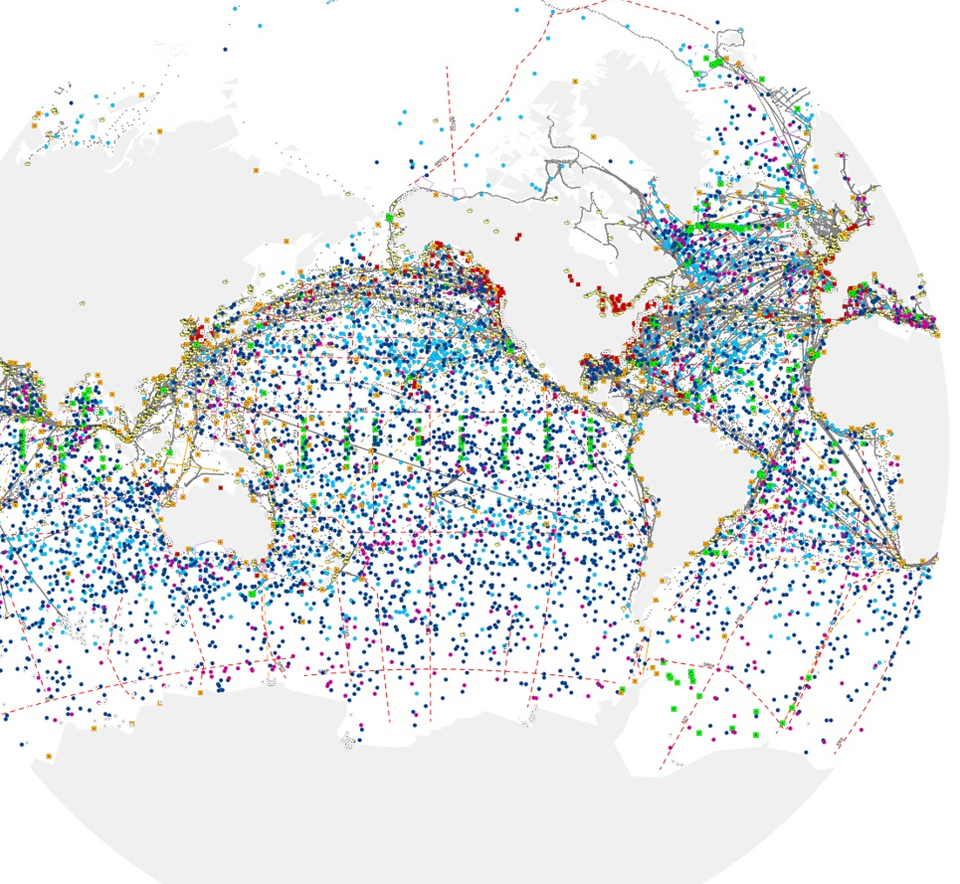
The Programme will evolve the ocean observing system so that it is co-designed with end-users and responds to their needs
Notes:
David-------------------------------------
Our vision is to evolve and transform the Global Ocean Observing System to better address the Decade Challenges through observing Co-Design processes (Here co-design is understood as a continuous process, a collaborative and iterative effort among all stakeholders). By actively engaging user perspectives and knowledge, we will transform and augment the current ocean observing system to be more RESPONSIVE TO USER NEEDS, AND provide COMMUNITIES with INFORMATION they can act on. Such a system will more naturally attract resources, better address needs, allow us to increase capacity, and become more unified through regular best practices and processes to set priorities,,,,,, and ultimately better observe the global oceans…enabling a wide range of activities throughout the UN Decade.
Next Slide
===================
Make clear that user-focused obs is not how we have been operating but science driven
An ocean observing co-design process provides a fit-for-purpose and responsive observing system that interconnects experts and stakeholders to ensure sharing of knowledge across disciplines, integration along the value chain, co-construction of solutions and innovative concepts, and the targeted production of products and services useful to stakeholders. Here co-design is understood as a continuous process, a collaborative and iterative effort among all stakeholders.

Slide 6
TANGIBLE OUTCOMES
Link along value chain and users
Design for observing and forecasting
Economic value assessment
Blueprint for services if they don’t exist
Ongoing tracking of implementation
Notes:
SABRINA
COuld also mention ECOP participation

Slide 7
THE EXEMPLARS
The Ocean Carbon Cycle
Improving carbon data to inform climate targets, such as net zero
Tropical Cyclones
Advancing tropical cyclone forecasting to save lives & property
Storm Surge Improving storm surge predictions to minimise impacts on vulnerable communities & natural resources
Marine Life
Sustaining development and conservation of living marine resources
Boundary Currents
Observing key current systems
Marine Heatwaves Monitoring marine heatwave impacts on biodiversity and economies
Notes:
<<<<<<<<<<<<<SHOW EXCITEMENT>>>>>>>>>>>>>>
Delighted today to give a preview of the progress in developing the co-design programme and the first key projects that will launch the process and the change.
These exemplars are at the intersection of critical needs, engaged user communities, opportunities to innovate our observing approaches, and engaging new communities and voices.
Because of their importance, because of the opportunities, there is a lot of energy and enthusiasm behind each of the exemplars which you’ll hear about next.
It’s my pleasure to introduce Tammy Morris, Senior Scientist/Marine Coordinator from the S African Weather Service who will begin our roundtable of Exemplar summaries
NEXT SLIDE
====================================
Exemplar projects do 3 things: help lift the system, embed new co-design practices, the programme then develop process and infrastructure for wide spread co-design
Each exemplar will
Address key gaps in an integrated value chain across observing – modelling - services – users
Engage key user stakeholders to understand their needs
Integrate along the chain from observers to users to assure deliver
Assess value of investment on ocean observation
Support the development of co-design best practice

Slide 8
Take the next step
Contact:
Ann-Christine Zinkann - ann-christine.zinkann@noaa.gov
Notes:
David
We’ve done a lot of work in planning our actions going forward. Let us know if there is a particular exemplar project that interests you. We would love to participate in focussed one-one calls about Exemplar projects that interest you.
We have exemplar leads
Thank you for participating in today’s call. I look forward to the discussion. S
Turn back it over to Emma to moderate the discussion.

