Slide 1
Decade Update & DCO
Emma Heslop, Act. Director GOOS Office, IOC/UNESCO
Alison Clausen, Deputy Lead, IOC Decade Coordination Unit
GOOS 12th Steering Committee meeting 25 - 27 April 2023

Slide 2
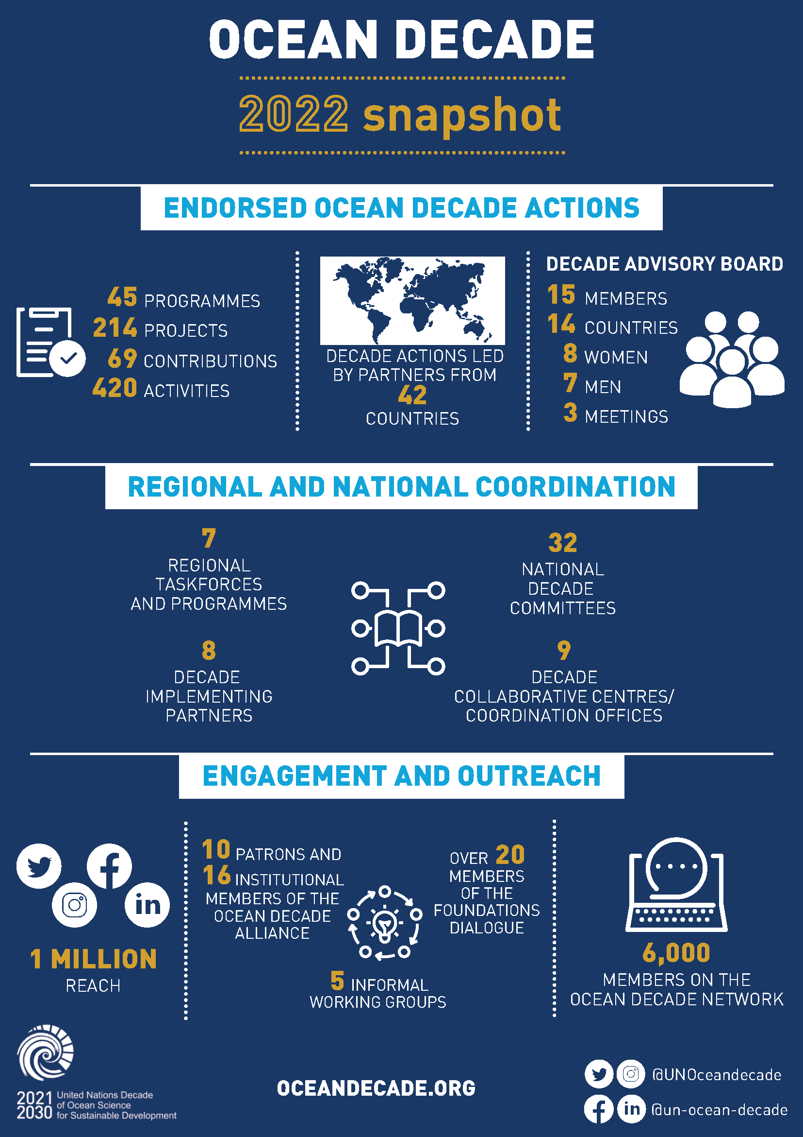
2022 Highlights
The Science We Need for Ocean We Want
Join a shared, global effort that builds on decades of achievements in ocean science.

Slide 3
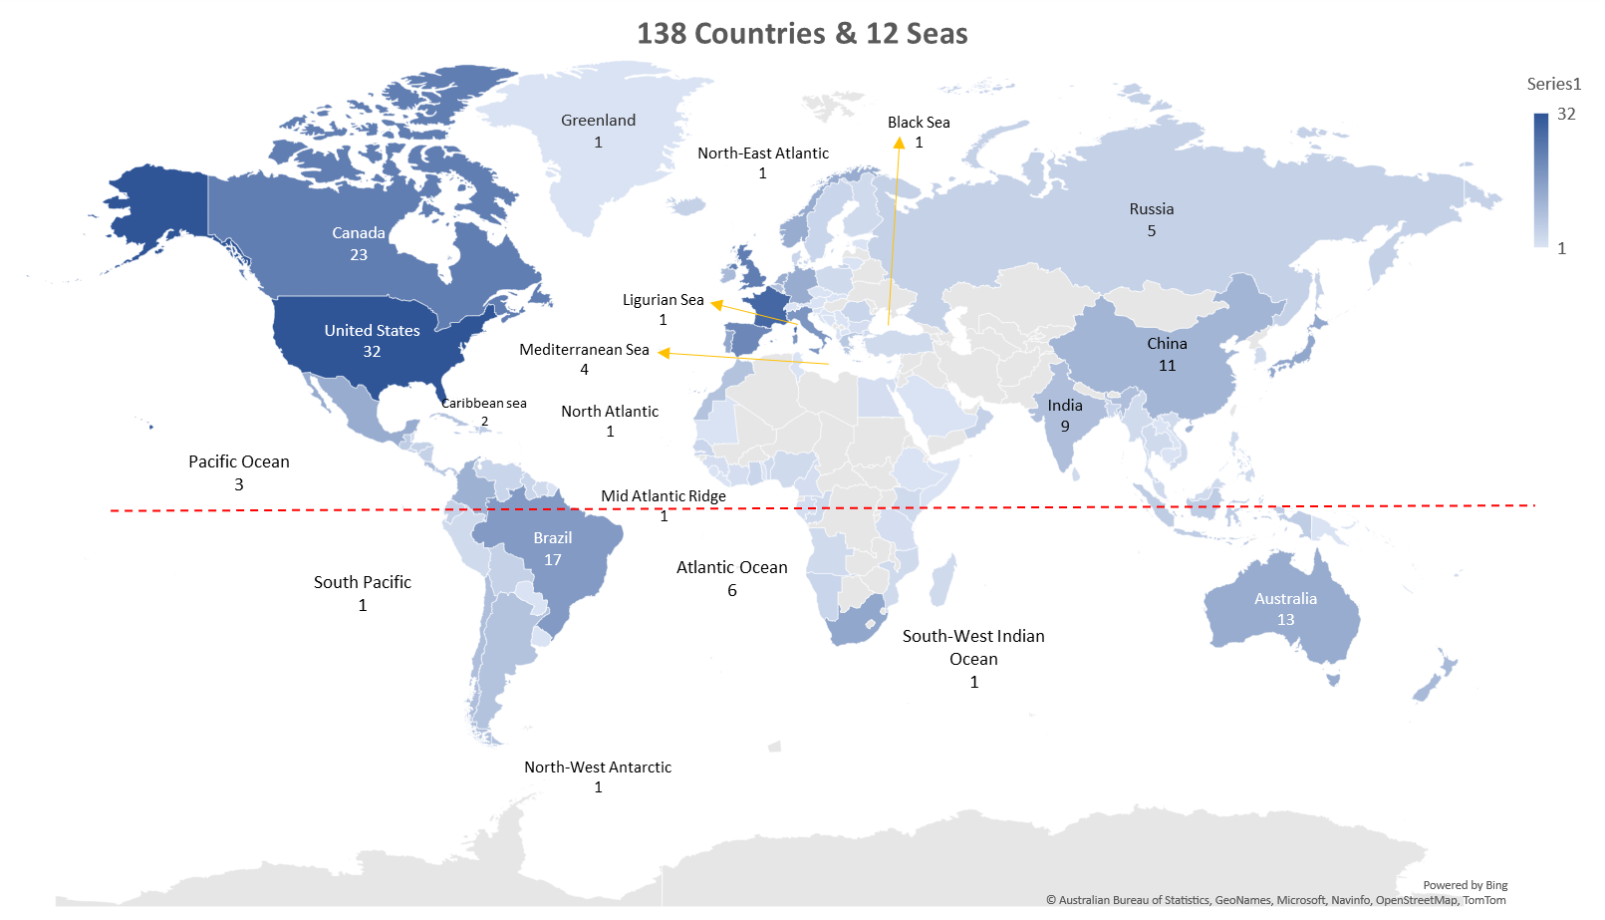
DCO Ocean Observing
DCO (Decade Collaboration Office)
TORs approved GOOS SC / IOC Executive Council 2022
10 Programmes under DCO Ocean Observations
Yaeji developed basic analysis - mapped locations, etc
One initial call - agreed to work on refining the mapping
Decade Coordination Unit supporting DCO
DCU provided 100K$ for the first year DCO lead
4 applicants for role - 2 short interviews this week
30
Equator
*Global level coverage: 24
*European level coverage: 3

Slide 4
Ocean Decade Vision 2030
To remain relevant, the Decade needs to ensure that:
The Ocean Decade Challenges remain relevant.
Decade Actions are tailored to fulfil the most pressing gaps in science, knowledge and solutions.
Set a strategic ambition for each Challenge to answer the question: “What does success look like for this Challenge at the end of the Decade [or sooner]?” and set out process to measure progress to meet that ambition
Identification of residual gaps so that priority Decade Actions can be solicited to fill critical gaps.
Challenges to be refined, modified and eventually removed as they are fulfilled, and/or new Challenges adopted to respond to emerging issues.
Priority datasets to unlock or generate
Capacity development & exchange needs
Technology and innovation solutions
Strategic ambition
Indicators to measure progress against each element
Partnerships & resources
Infrastructure to faciliate data or knowledge generation
Knowledge to generate and/or share

Slide 5
Ocean Decade Vision 2030
WG ODC 1
Lead Partner ODC 1
WG ODC 2
Lead Partner ODC 2
WG ODC 3
Lead Partner ODC 3
1. Articulating priority user needs for sustainable development solutions
2. Analysis of existing and missing datasets, knowledge, solutions & enabling environment elements to meet priority user needs
3. Identifcation and progressive refinement and consolidation of elements of strategic ambition taking into account datasets, knowledge, solutions and enabling environment, including consideration of means of measurement
Strategic ambition of Ocean Decade Challenge comprising:
- Datsets
- Knowledge, solutions, infrastructure
- Enabling environment
- Indicators to track progress
WG ODC 4
Lead Partner ODC 4
Decade Coordination Unit
Co-Chairs’
Working Group
WG ODC 5
Lead Partner ODC 5
WG ODC 6
Lead Partner ODC 6
WG ODC 7
Lead Partner ODC 7
WG ODC 8
Lead Partner ODC 8
WG ODC 9
Lead Partner ODC 9
WG ODC 10
Lead Partner ODC 10
The process…
The players…

Slide 6
Ocean Decade Vision 2030
1. Identify wide range of potential priority user needs for Challenge via WG discussions, literature review and targeted consultations
Outcome 1: 'Long list' of potential user needs and related early ideas on elements of strategic ambition
2. Discussion between Co-Chairs of initial outcomes to optimise synergies and reduce overlap / duplication
Outcome 2: Presentation of initial consolidated findings to IOC GBs and Decade Advisory Board
3. Further consultation, analysis of feedback received & refinement by WGs to develop short list of user needs & potential related elements of strategic ambition
Outcome 3: 'Short list' of potential elements of strategic ambition for each Ocean Decade Challenge
4. Discussions between Co-Chairs to refine, find synergies & avoid duplication
Outcome 4: Presentation of consolidated findings to Decade Advisory Board
5. Final proposal for strategic ambition & documentation in draft White Paper
Outcome 5: Open review of White Papers and final presentation to Decade Advisorty Board
6. Finalisation of White Papers & preparation of Synethis Report
Outcome 6: Presentation to Second International Ocean Decade Conference

Slide 7
2024 Ocean Decade Conference
Barcelona, Spain: 10 - 12 April 2024
Convene Actions and Partners to celebrate achievements, take stock and set collective vision
Results of Vision 2030 will be workshopped and ‘validated’
3-day conference, complemented by partner-led satellite events

Slide 8
For SC to discuss
Response to Decade Vision 2030 request?
It is a huge task to do well, little value in doing it badly, not sure GOOS has the capacity to respond & not sure it is our priority
Proposal 1: put out an open call for members to work on this committee? DCO lead supports this group
Proposal 2: Deliver the assessment via 3 GOOS delivery area, use GCOS report, WMO RRR, BioEco? Ask DCO lead to collate this
Proposal 3: Say no (Decade asks another group to do this).

