Slide 1
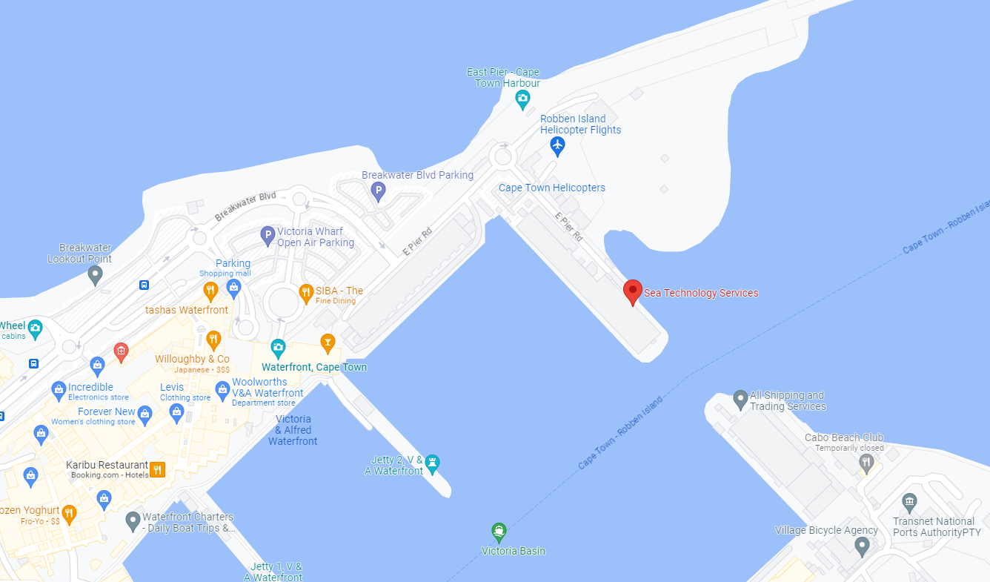
OUTREACH EVENT - Friday, START 9:00 am
Please join our Outreach event at the Pieter Stoker Center
Please arrive at 8:45
Join us in presenting the ocean observing platforms to school kids!
Notes:
MOU between GOOS and MBON and OBIS need to be renewed, Panel would like to propose the MOU that GOOS Exec can implement
The BioEco Panel co-chairs are currently discussing potential attendance at the GRA Forum (date still being decided but likley to be early 2024) to discuss emerging BioEco networks and to further facilitate uptake of BioEco EOVs into the GRAs.
https://obis.org/2016/12/15/goosgeobonobis/

Slide 2
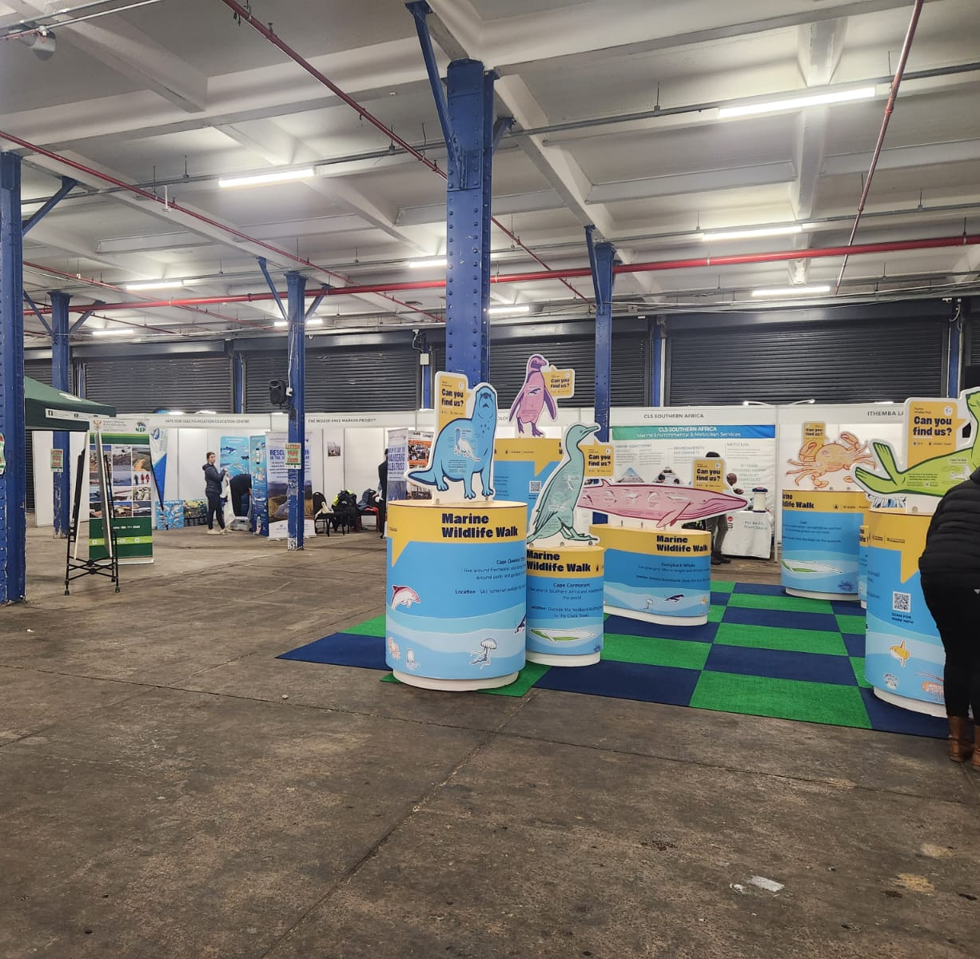
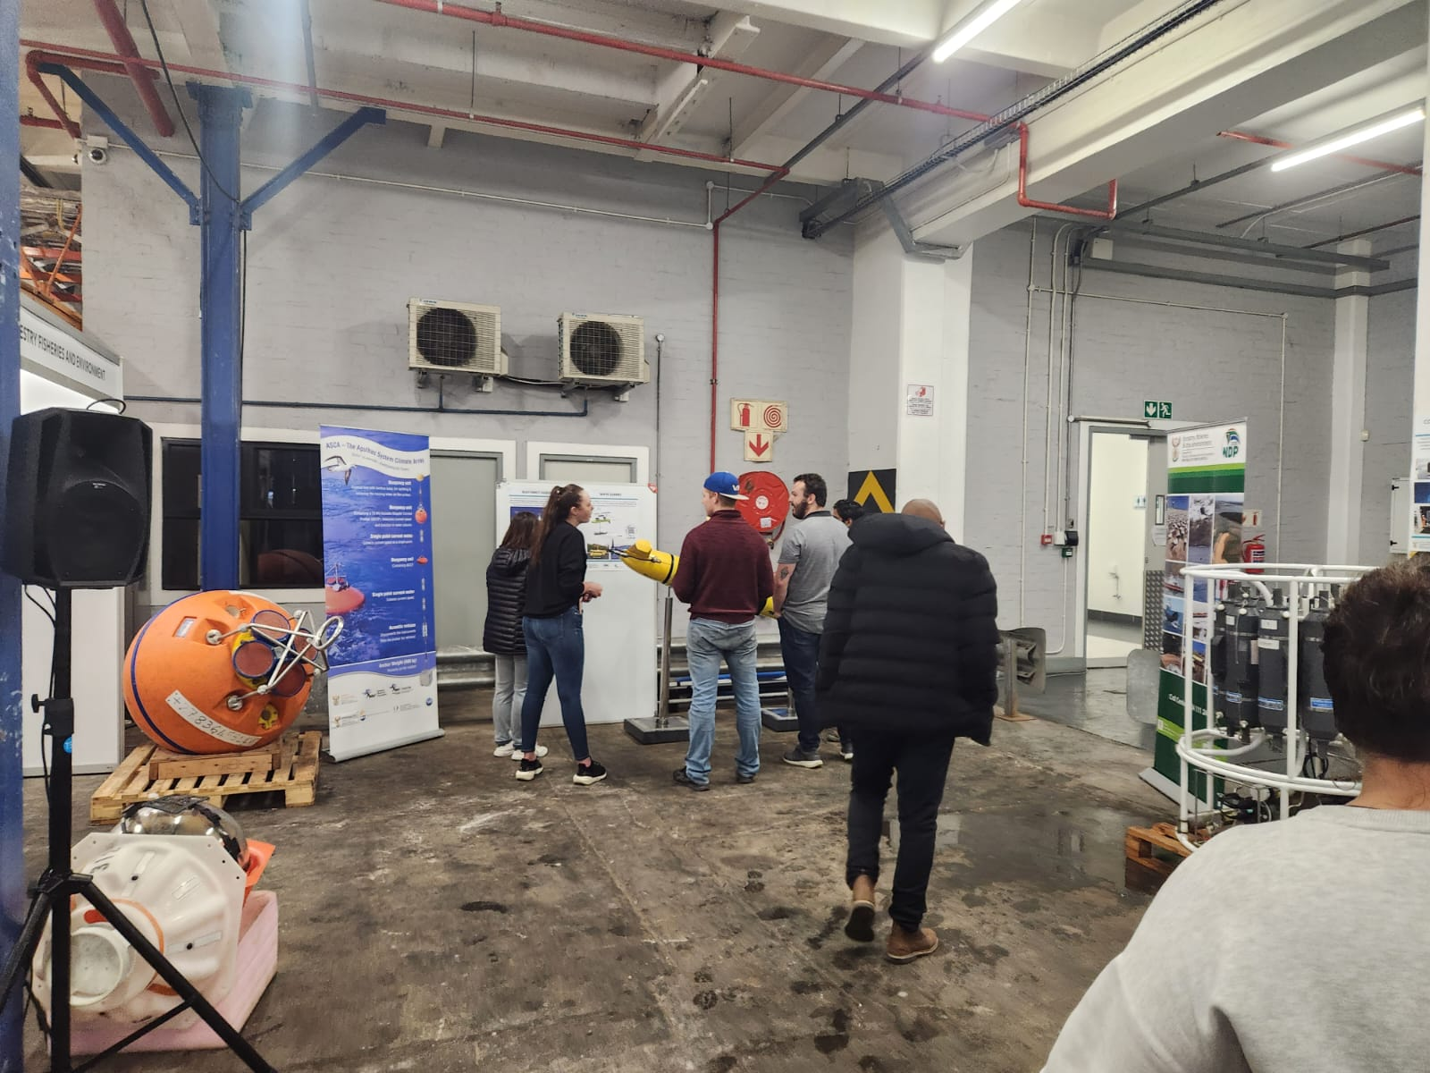
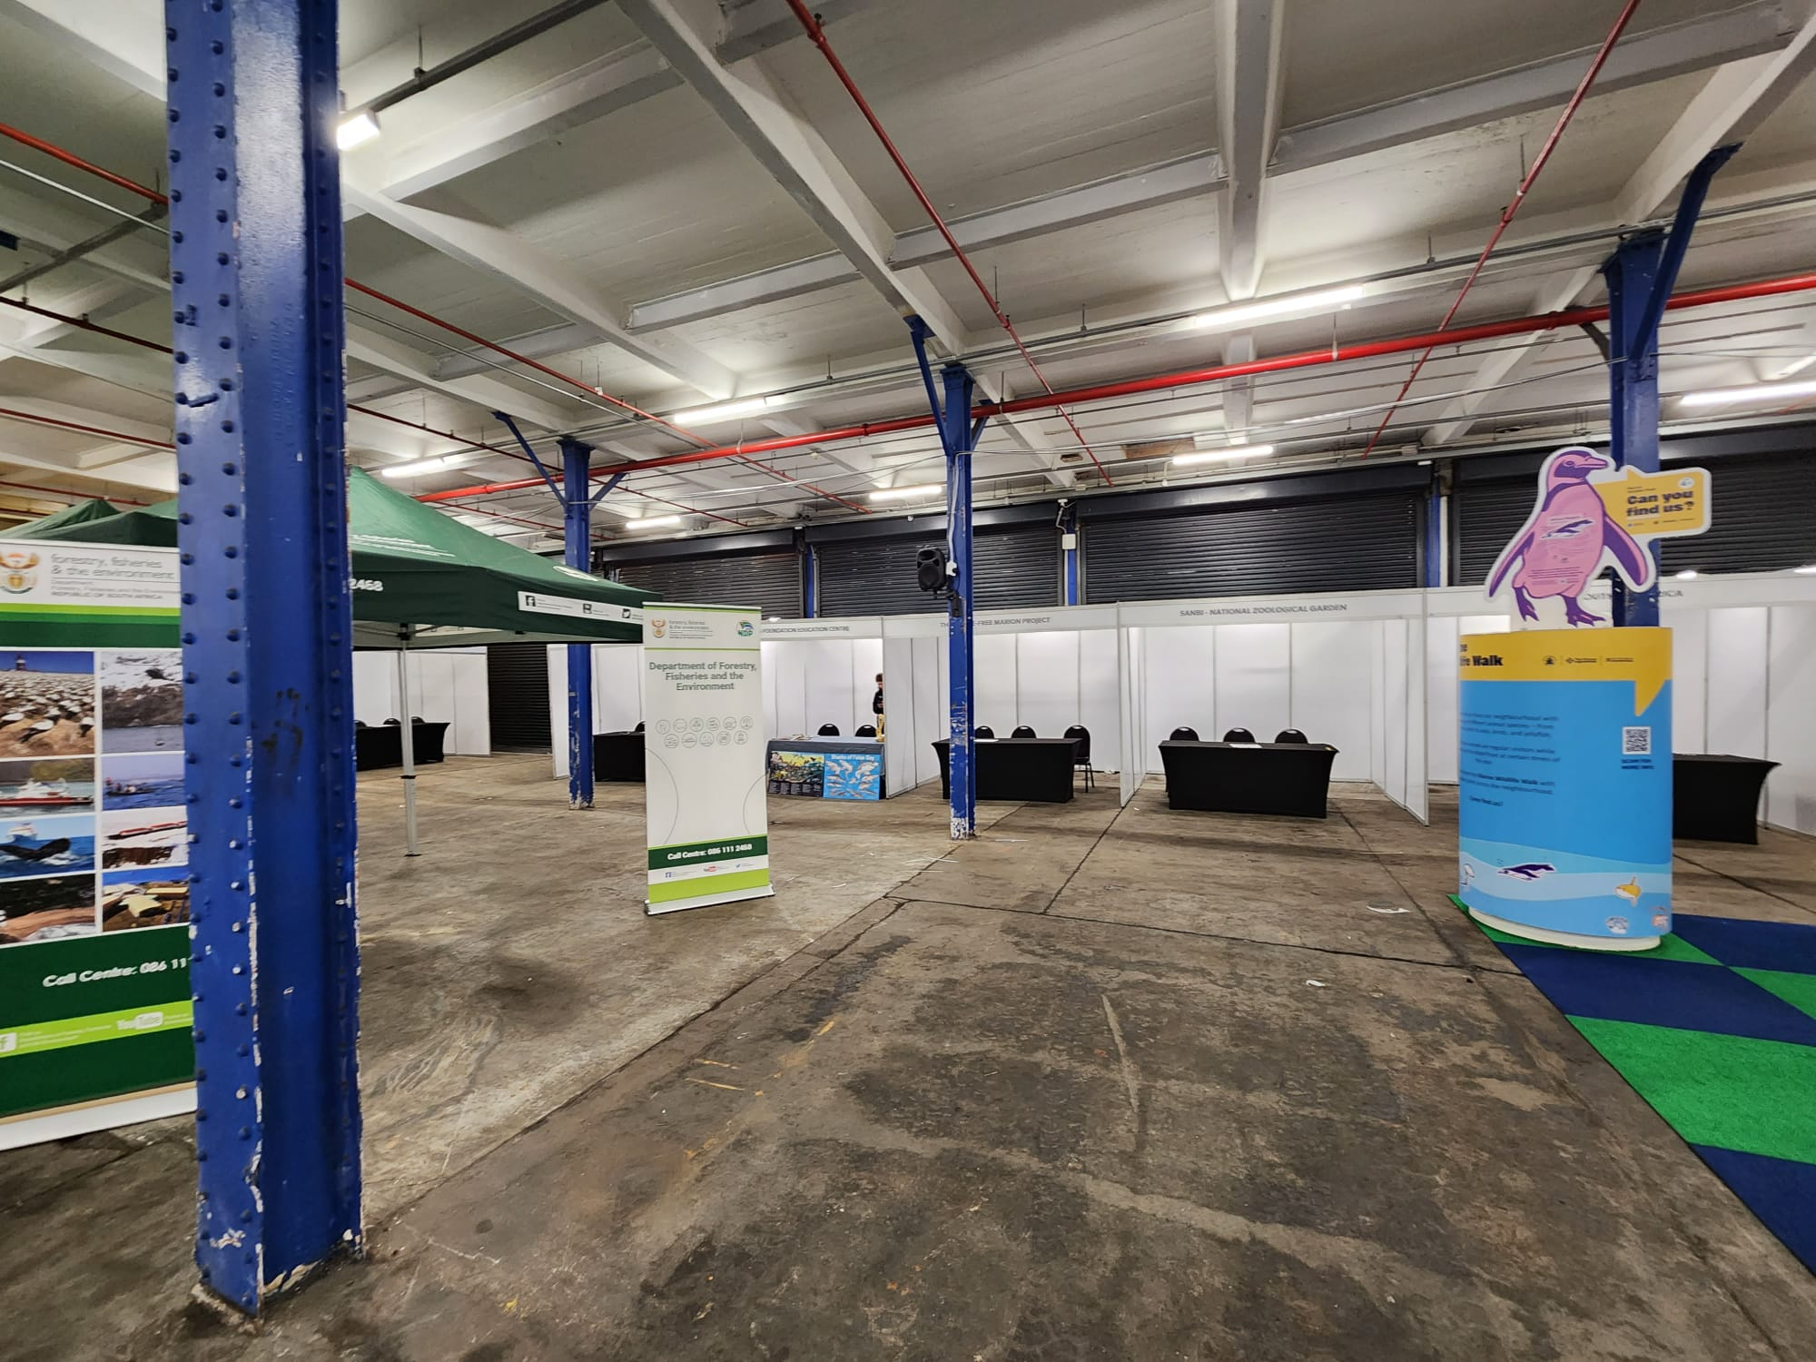
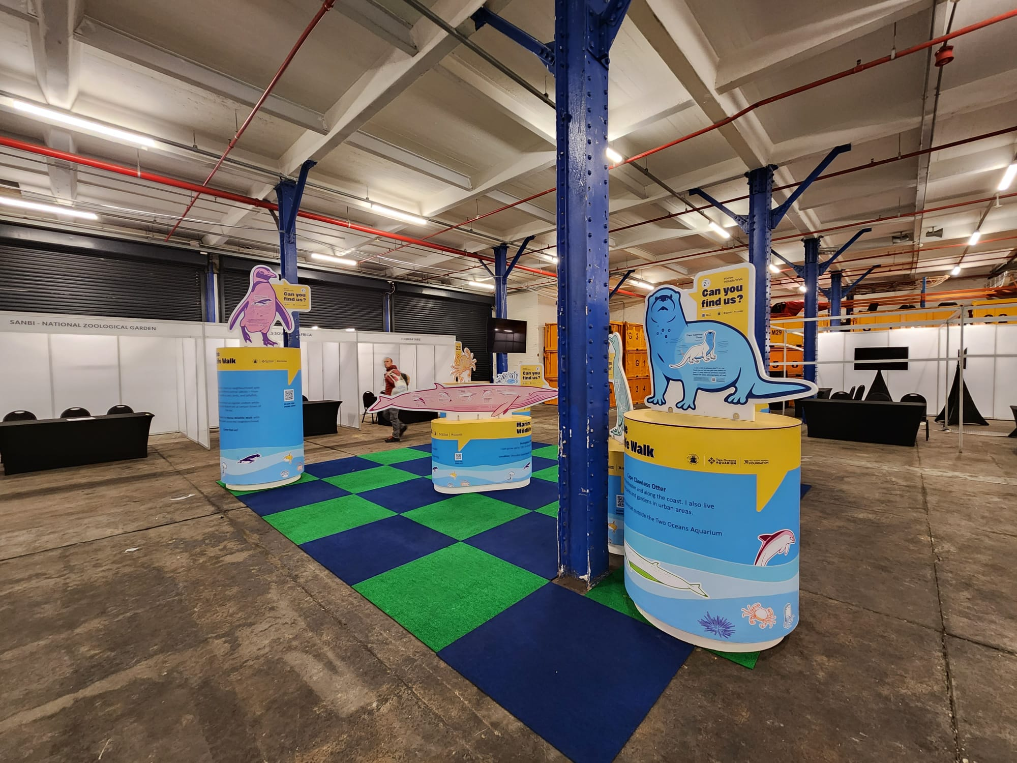
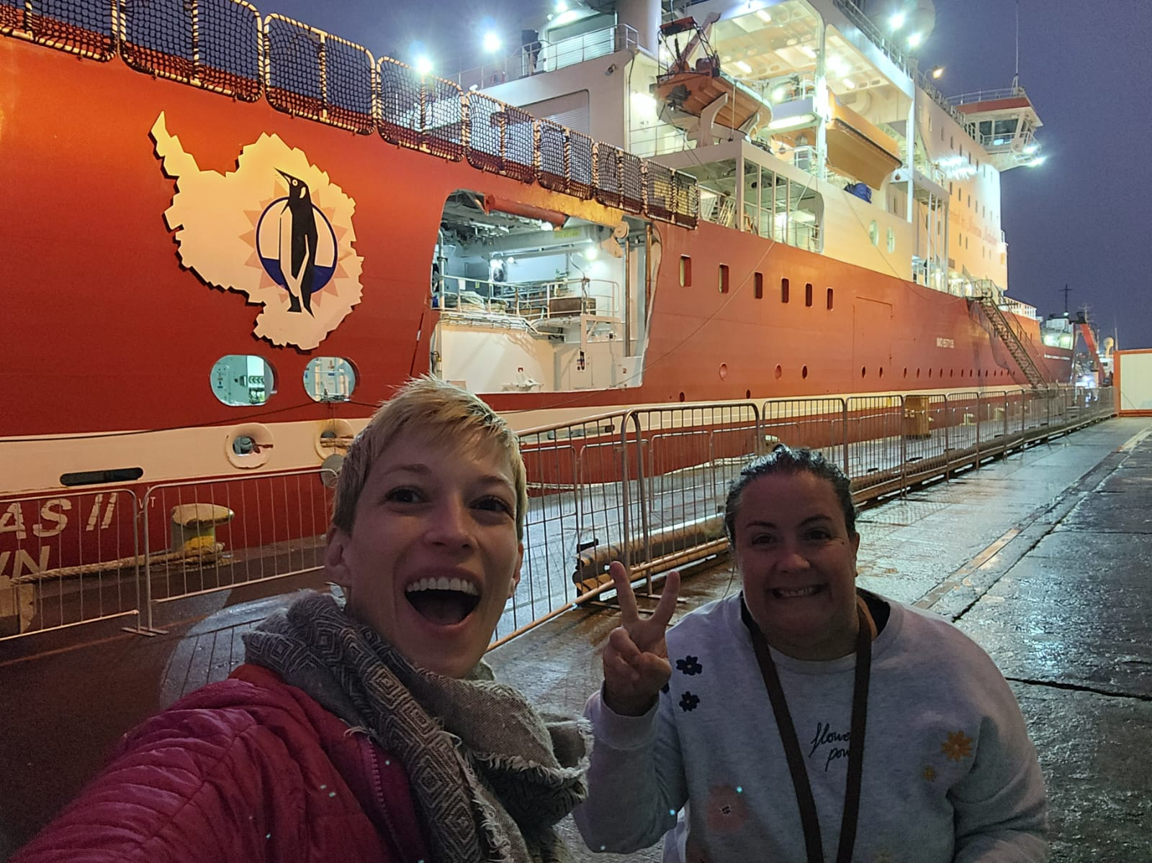
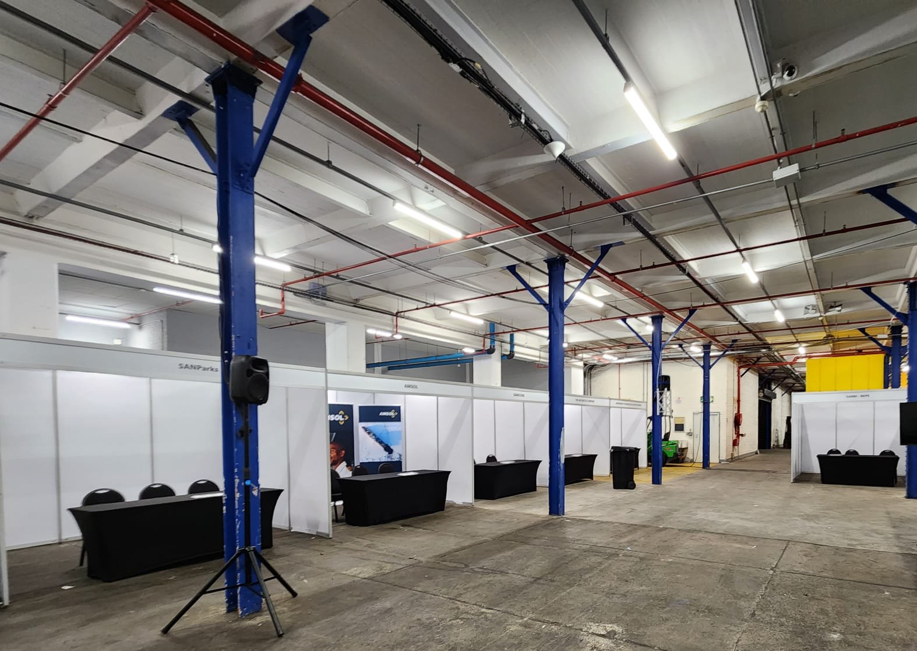

Slide 3
Observations Coordination Group
14th Meeting
OCG-14 Meeting, June 5-8, 2023
Breakwater Lodge, Cape Town, South Africa
Notes:
Ann

Slide 4
RECAP OF THIS WEEK
……………………………
Notes:
Congratulations on making it through this year. Largely recovered, except ship-based activities where we WILL see a COVID gap in our records.
Despite the limitations from COVID, the community has responded and demonstrated dedication to ocean observing
OCG too
UN Decade (Wed)
Work and collaboration with UN Decade Programmes as they initiate
Time consuming endeavour. UN Decade activities are a pathway to change. Opportunity for more engagement (eventually resourcing???)
Things are becoming more clear, still need to be vigilant for duplication, efficiency, opportunity and developing and implementing the system.
How best for OCG to support networks with this?
EH Notes
What do we need this to do at the start of the meeting
Lay out some excitement about the agenda and aims
Show progress and good work across the year, responding to circumstances, focus on foci and actions from last year, acknowledge people's work, commitment, progress, ideas of exec (Vice Chairs) and networks - real successes we ahev had - we should be very clear on this - OCG, the networks gains recognition for efforts - in turn support our work to develop observing system
Other work to make OCG meaningful for OO - WMO IP etc
Challenges ahead
How our discussions this week will help guide OCG

Slide 5
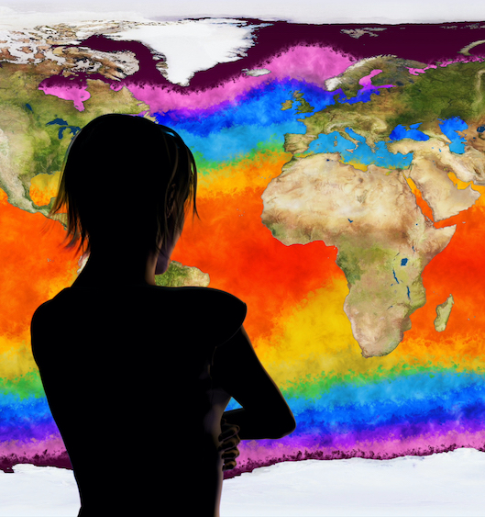
OCG-14
ACTIONS
Notes:
Congratulations on making it through this year. Largely recovered, except ship-based activities where we WILL see a COVID gap in our records.
Despite the limitations from COVID, the community has responded and demonstrated dedication to ocean observing
OCG too
UN Decade (Wed)
Work and collaboration with UN Decade Programmes as they initiate
Time consuming endeavour. UN Decade activities are a pathway to change. Opportunity for more engagement (eventually resourcing???)
Things are becoming more clear, still need to be vigilant for duplication, efficiency, opportunity and developing and implementing the system.
How best for OCG to support networks with this?
EH Notes
What do we need this to do at the start of the meeting
Lay out some excitement about the agenda and aims
Show progress and good work across the year, responding to circumstances, focus on foci and actions from last year, acknowledge people's work, commitment, progress, ideas of exec (Vice Chairs) and networks - real successes we ahev had - we should be very clear on this - OCG, the networks gains recognition for efforts - in turn support our work to develop observing system
Other work to make OCG meaningful for OO - WMO IP etc
Challenges ahead
How our discussions this week will help guide OCG

Slide 6
OUTREACH EVENT
Work c
Notes:
MOU between GOOS and MBON and OBIS need to be renewed, Panel would like to propose the MOU that GOOS Exec can implement
The BioEco Panel co-chairs are currently discussing potential attendance at the GRA Forum (date still being decided but likley to be early 2024) to discuss emerging BioEco networks and to further facilitate uptake of BioEco EOVs into the GRAs.
https://obis.org/2016/12/15/goosgeobonobis/

Slide 7
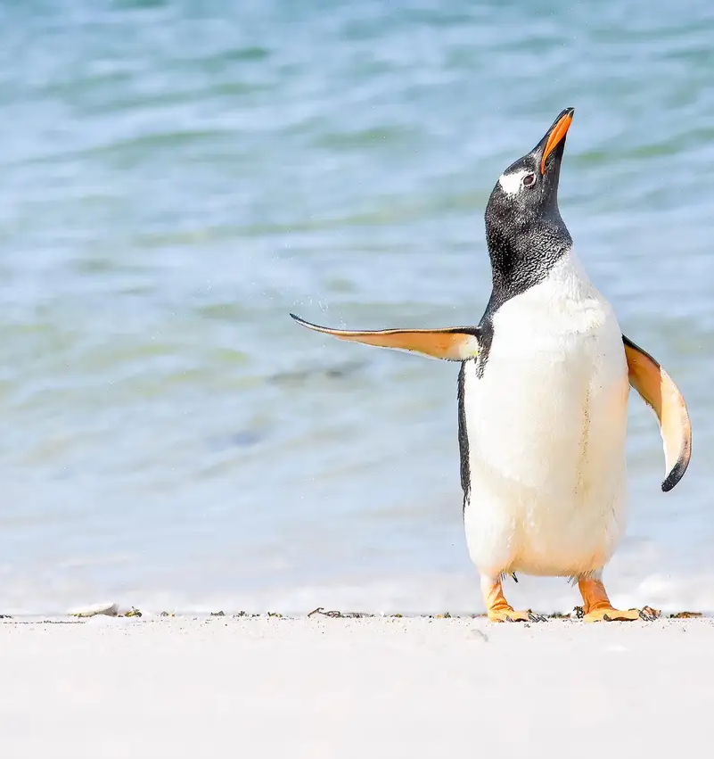
HAVE A SAFE TRIP HOME!
Notes:
Congratulations on making it through this year. Largely recovered, except ship-based activities where we WILL see a COVID gap in our records.
Despite the limitations from COVID, the community has responded and demonstrated dedication to ocean observing
OCG too
UN Decade (Wed)
Work and collaboration with UN Decade Programmes as they initiate
Time consuming endeavour. UN Decade activities are a pathway to change. Opportunity for more engagement (eventually resourcing???)
Things are becoming more clear, still need to be vigilant for duplication, efficiency, opportunity and developing and implementing the system.
How best for OCG to support networks with this?
EH Notes
What do we need this to do at the start of the meeting
Lay out some excitement about the agenda and aims
Show progress and good work across the year, responding to circumstances, focus on foci and actions from last year, acknowledge people's work, commitment, progress, ideas of exec (Vice Chairs) and networks - real successes we ahev had - we should be very clear on this - OCG, the networks gains recognition for efforts - in turn support our work to develop observing system
Other work to make OCG meaningful for OO - WMO IP etc
Challenges ahead
How our discussions this week will help guide OCG

