Slide 1

PTWS WG3
Working Group Report
ICG/PTWS-XXX, September 2023
Chair: Ashleigh Fromont (NZ,
Vice Chair: Laura Kong, ITIC
Written Report also available

Slide 2
Terms of Reference
ICG/PTWS-XXIX in December 2021 decided to continue PTWS Working Group 3 (Disaster
Risk Management and Preparedness).
The Terms of Reference of Working Group 3 Disaster Risk Management and Preparedness were agreed as follows:
Facilitate in collaboration with TOWS Task Team on Disaster Management and Preparedness and organizations such as UNISDR, the exchange of experiences and information on risk reduction and preparedness actions, and matters related to disaster management.
Promote preparedness in coastal communities through education and awareness products and campaigns.
Facilitate SOP training across regions to strengthen emergency response capabilities of Member States and their Disaster Management Offices.
Facilitate and monitor Tsunami Ready campaigns and outcomes, and report results to the ICG/PTWS and the TOWS-WG.
Develop and promote best practice preparedness material, programs and assessment tools.
Develop and Promote tsunami risk reduction theory and practice
Support the ITIC of the ICG
Notes:
.

Slide 3

1. Collaboration Activities
At the TOWS-WG-XVI meeting in March 2023, the WG welcomed recommendation ICG/PTWS-XXIX.4 regarding the request from the PTWS for WG3 to ‘explore in cooperation with TOWS-TT DMP ways to recognize communities that choose not to implement the UNESCO/IOC TR programme’
Actions for TOWS-TT-DMP for the next period include:
    Guidelines for mainstreaming tsunami DRR for coastal urban development planning
    Guidelines for critical infrastructure from impacts
    Update the Tsunami Hotel Guide developed by NEAMTWS

Slide 4

1. Collaboration Activities
The Director of ITIC has been recently appointed as the Chairperson of the Tsunami Ready Coalition for a two-year period.
The IOC Tsunami Ready Guideline (MG74) which the working group participated in the development of, was published in April 2022.

Slide 5
2. Promote preparedness
World Tsunami Awareness Day
The theme for World Tsunami Awareness Day 2022 was Sendai Target g: “Substantially increasing the availability of and access to multi-hazard early warning systems and disaster risk information and assessments to the people by 2030.”
Pacific activities included an UNDRR - UNESCO IOC video on the Tsunami in Tonga; and SPC DRR Senior Advisor participation to the global ‘Early Warning Early Action Before Every Tsunami Webinar’ on 4 November 2022 in Bangkok

Slide 6
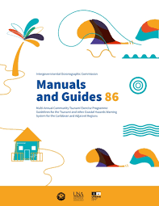
2. Promote preparedness
Wave Exercises
The tenth Exercise Pacific Wave was carried out from September through to November 2022.
MG86 has been published and translated into French and Spanish.

Slide 7
2. Promote preparedness
Awareness Resources
The ITIC continued to update its global and regional awareness products, and to create new ones (further reported in the ITIC report)
Updates to 2022 were done for the Global Tsunami Sources, Significant Earthquakes, and Volcanic Eruptions. Printed copies of some maps are available on request to all Member States
Undertaking further identification of existing awareness products would be beneficial.

Slide 8

3. Training
ITIC have conducted a number of in person trainings from November to February 2023
This includes several regarding Tsunami Ready Implementation, in Micronesia, Fiji, Marshall Islands, and Palau, as well as tsunami warning and evacuation SOPs
Further Tsunami Ready implementation training is planned for Kiribati, Samoa, Solomon Islands and Vanuatu.

Slide 9

3. Training
ITIC is supporting the IOC Ocean Teacher Global Academy (OTGA) as a designated Specialized Training Center for Tsunamis. ITIC and the Indian Tsunami Information Centre are working together to support Tsunami Ready training for the topics of:
Tsunami Awareness (2023 Q4)
Tsunami Ready (2023 Q4)
Tsunami Early Warning Systems (2024)
TEMPP (2024 - 2025)
Tsunami TWC and TER SOPs (2024)
NTWC Competencies (2024-25)

Slide 10
4. Tsunami Ready Progress
Tsunami Ready will be discussed further in Agenda Item 4.2
17 pacific communities in 6 countries (Honduras, El Salvador, Costa Rica, Guatemala, Panama and Samoa) have official recognition.
Tsunami Ready Recognition for communities is further planned or underway in at least 9 countries.
5 further member states have expressed interest to ITIC in implementing Tsunami Ready, and most countries have already achieved some indicators.

Slide 11
5. Best practice preparedness
. TSUCAT (introduced in 2017) has a new version, v4.3, made available in Quarter 1 of 2023
The major addition is the addition of options to include community tsunami exercise injects that are based on the PTWC messages.
In 2022, the U.S. compiled tsunami maritime guidance and practices for hazard planning and preparedness for Maritime Communities

Slide 12
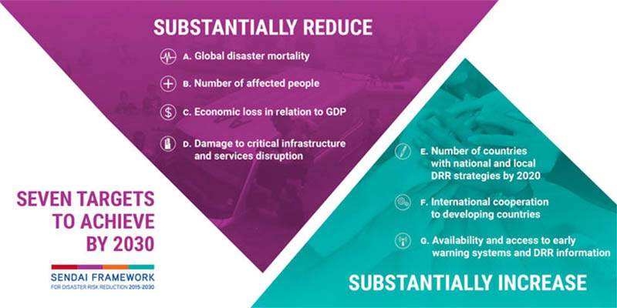
6. Tsunami risk reduction theory
WG3 notes that a MidTerm Review of the implementation of the Sendai Framework for Disaster Risk Reduction 2015-2030 has taken place.
Recommendations are designed to accelerate implementation of the framework by 2030

Slide 13
Thank you
ICG/PTWS-XXX, September 2023
Chair: Ashleigh Fromont (NZ,
Vice Chair: Laura Kong, ITIC
Written Report also available

