Slide 1

PTWS WG2 TT on the
Minimum Competency Levels for
National Tsunami
Warning Centre (NTWC)
Operations Staff
ICG/PTWS-XXX, September 2023
TT Co-chairs: Laura Kong, ITIC
‘Ofa Fa‘anunu, Tonga

Slide 2
NTWC Competency Development - History
PTWS-XXVII (2017, Tahiti) – Identified need
  WG-SWP-IV (2016, Honiara). Develop competency guidelines for tsu operational personnel
  Tonga - needs assistance to review its national tsunami warning procedures,… and establish minimum warning competency levels.
  => WG 3 (Training) - on-going need for warning & response training in SW Pacific, including introduction of competency based training. Funding required to advance.
  Action: WG 2 est by mid-2018 (PTWS-XXIX, 2019), minimum competency level for NTWC operations, by identifying a) what competencies required and b) what training schemes in existence & what guidelines & principles can be adapted for this purpose. WG2 rpt to SC
  Action: PICT WG ToR: 2. Develop competency guidelines for tsunami warning personnel for PICTs and report outcomes to PICT WG and WG2
  PTWS-XXVII.1. Appendix 2. Budget & Programme, 2017-2019
Activity | Approx. co- investment by MS and UNESCO | Extra-Budgetary resources required | Year of expenditure | Status
WG2 Development of Tsunami Warning Centre Competency Training Program Workshop |  | US$25K | 2017 | Not done, no funding. Instead done by email.
WG2 NTWC Training (five countries not conducting TEMPP/Tsunami Ready) |  | 5x US$25K = US$300K | 2017 2018 2019 | Not done, no funding. Tonga Pilot (2019). Competency course development (ITIC 2024 pilot)

Slide 3
NTWC Competency Development – History ICG/PTWS-XXIII established WG 2 Task Team (TT) on Minimum Competency Levels for National Tsunami Warning Centre (NTWC) Operations Staff
Est. TT, PTWS-XXVIII (2019). Chairs: Ms Lara Bland (NZ), Mr Ofa Fa’anunu (Tonga).
  Build from draft Framework developed by small group after 2018 PTWS WG mtg in Hawaii.
  CONTENT - competency framework proposed is multi-tier system with different levels of knowledge and skills required depending on the roles.
  2019 draft was incomplete – required further work to finish
  October 2019 – Draft Competencies Pilot by ITIC at request of Tonga Met
Cont. TT, PTWS-XXIX (2021, virtual). Chairs: Mr Ofa Fa’anunu (Tonga), Dr Laura Kong (ITIC)
  Draft PTWS NTWC Minimum Competency Framework shared with Global TOWS WG Inter-ICG TT on Tsunami Watch Operations and Disaster Management and Preparedness (2022, 2023)
  Complete Draft Framework (May – July 2023)
  Final TT Report (Sept 2023): Minimum Competencies, Framework, Training, Existing schemas
PTWS-XXX (2023) – Member States approve Framework
  WG 2 recommends approval of PTWS NTWC Minimum Competency Framework
  ITIC proposes to pilot Competency Training in 2024

Slide 4

PTWS WG2 Task Team: Minimum Competency Levels for
National Tsunami Warning Centre (NTWC) Operations Staff
ICG/PTWS-XXIX.1 (2021)
This expert Task Team will establish and document the minimum competency levels for NTWC operations staff and develop a framework for the competencies and training requirements of the roles of a NTWC.
Establish the minimum competency levels required for NTWC operations staff.
Establish a framework for the required competencies required by the roles of a NTWC.
Establish what training is required to ensure NTWC staff meeting minimum competency levels.
Investigate and document what schemes are currently in existence and what guidelines and principles can be adapted for this purpose.
The Task Team will be composed of Wilfried Strauch (Nicaragua), Ofa Fa'anunu (Tonga), Yuelong Miao (Australia), Chip McCreery (USA), Lara Bland (NZ), Laura Kong (USA), and Ken Gledhill (NZ). Co-Chairs are Mr Ofa Fa’anunu (Tonga, second term) and Dr Laura Kong (United States, first term)
=> Draft document, “NTWC Competency Framework”, produced at ICG/PTWS-XXVIX (2019) => Complete draft presented at ICG/PTWS-XXX (Sept 2023 for approval)

Slide 5
PTWS Pacific Island Countries and Territories (PICT) Working Group Task Team on Capacity Development
ICG/PTWS-XXVIII.1 (2019)
Continue the development of competency framework for National Tsunami Warning Centres personnel and pilot it in Australia, Vanuatu, Fiji, Samoa and Tonga and report progress and lessons learnt to ICG/PTWS WG 1, 2 and 3.
Continue to monitor and coordinate the Pilot Tsunami Ready Programme and TEMPP in Samoa, Tonga, Fiji, Cook Islands, Solomon Islands and Vanuatu and review the Tsunami Ready Checklist for schools and communities in PICT.
Continue to develop the guideline for National Tsunami Warning Centres in responding to local tsunami and report to WG 1, 2 and 3.
Develop an online survey of warning and mitigation capabilities in the Pacific Island Countries and Territories (Member countries and IOC).
The Task Team Members: Australia, New Caledonia (Co-Chair), Tonga (Co-Chair), Samoa, Vanuatu, New Zealand, Solomon Islands, Fiji, PNG, ITIC, SPREP, SPC, IOC, PTWC. Chair Mr Ofa Fa’anunu (Tonga, third term) .

Slide 6
Competencies - Summary
(Tier 2: Comprehensive, Expert, Tier 1: Basic)
Core science KNOWLEDGE: Basic tsunami science / earthquake source knowledge
Advanced science KNOWLEDGE : Advanced tsunami science / earthquake source knowledge, tsunami forecast modelling
Core OPERATIONAL competency
  Understand & use TSP text / graphical products, core set of decision support tools. Perform all core NTWC SOPs
  Identify potential regional, distant, and local source tsunami threats
Advance OPERATIONAL competency
  Understand and produce tsunami threat maps
  Explain relationship of tsunami warning products to evacuation maps and routes
  Use a comprehensive set of decision support tools
  Advanced practical seismology (locate / characterise EQs), sea-level observations: measure & interpret records
Core AGENCY competencies
  Provide national threat and impact assessment. Liaise with NDMO and response agencies. Monitor public enquiries, and provide guidance. Conduct Post-event activities (e.g., post-tsunami surveys).

Slide 7
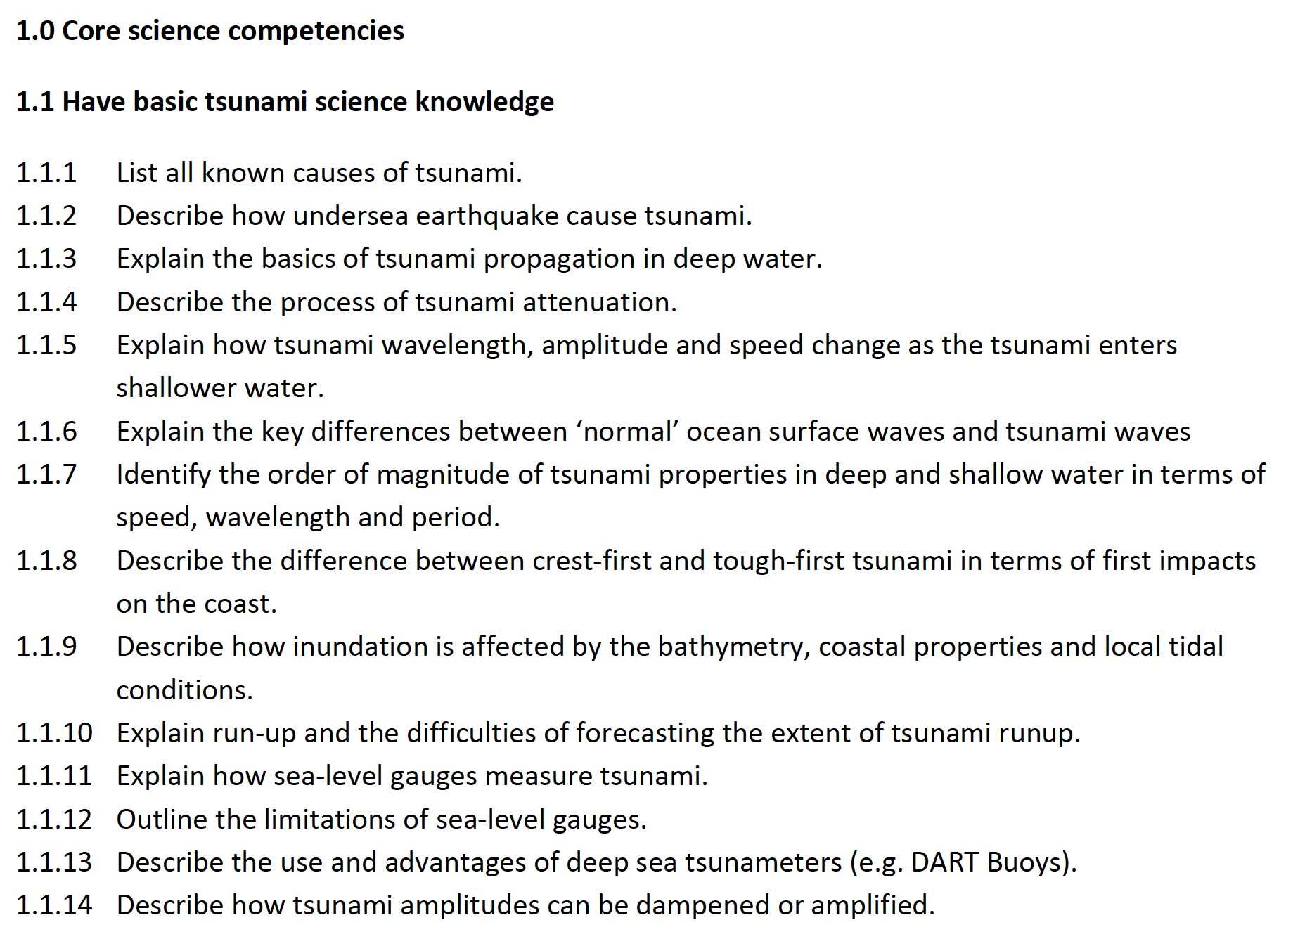
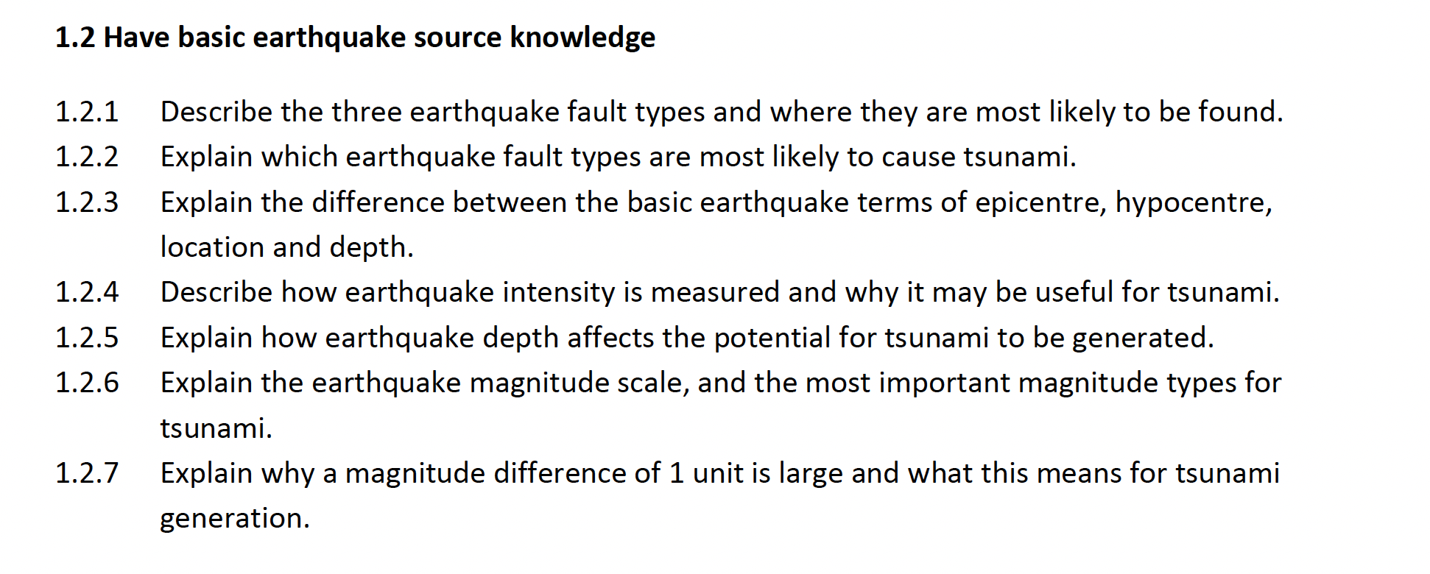
Competencies - Details

Slide 8
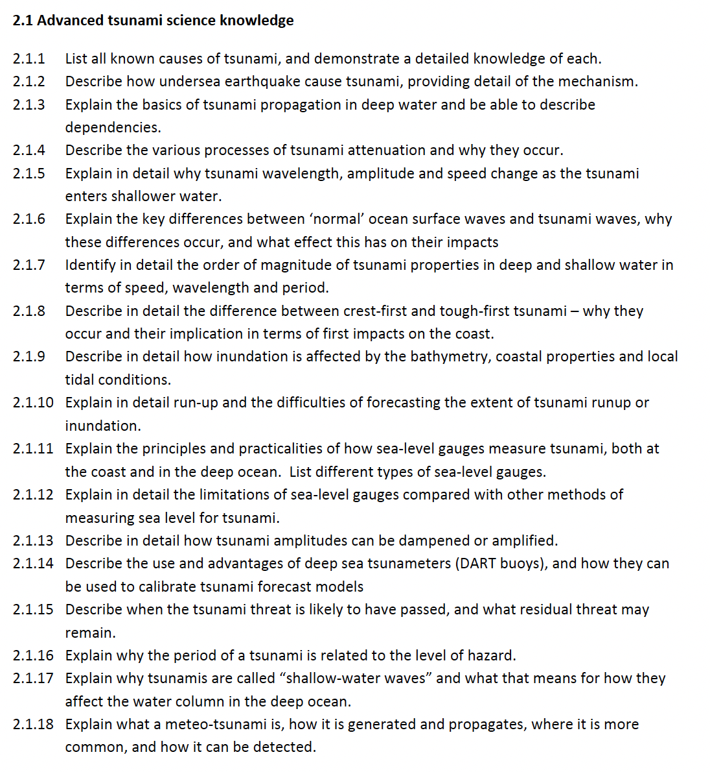
Competencies - Details

Slide 9
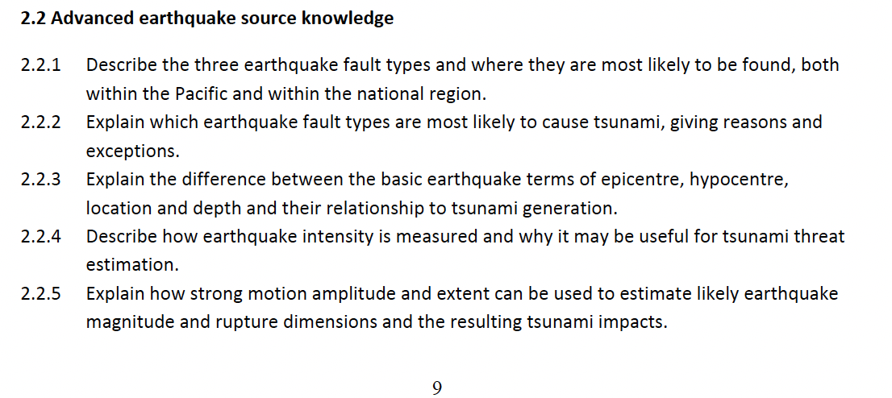
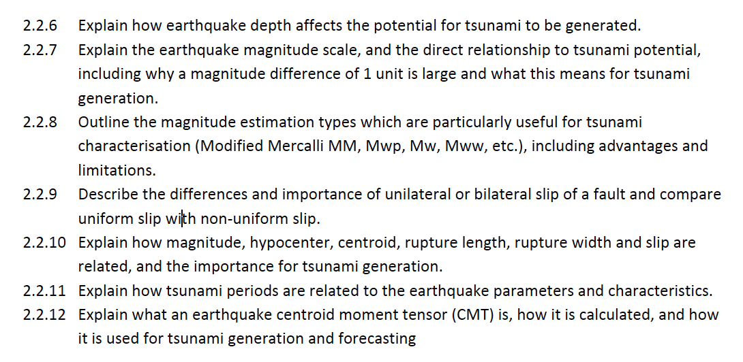
Competencies - Details

Slide 10
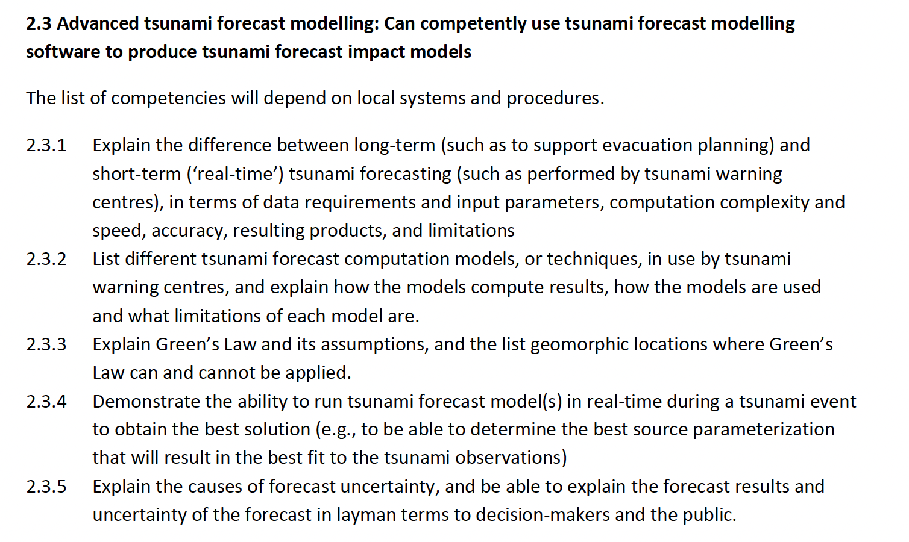
Competencies - Details

Slide 11
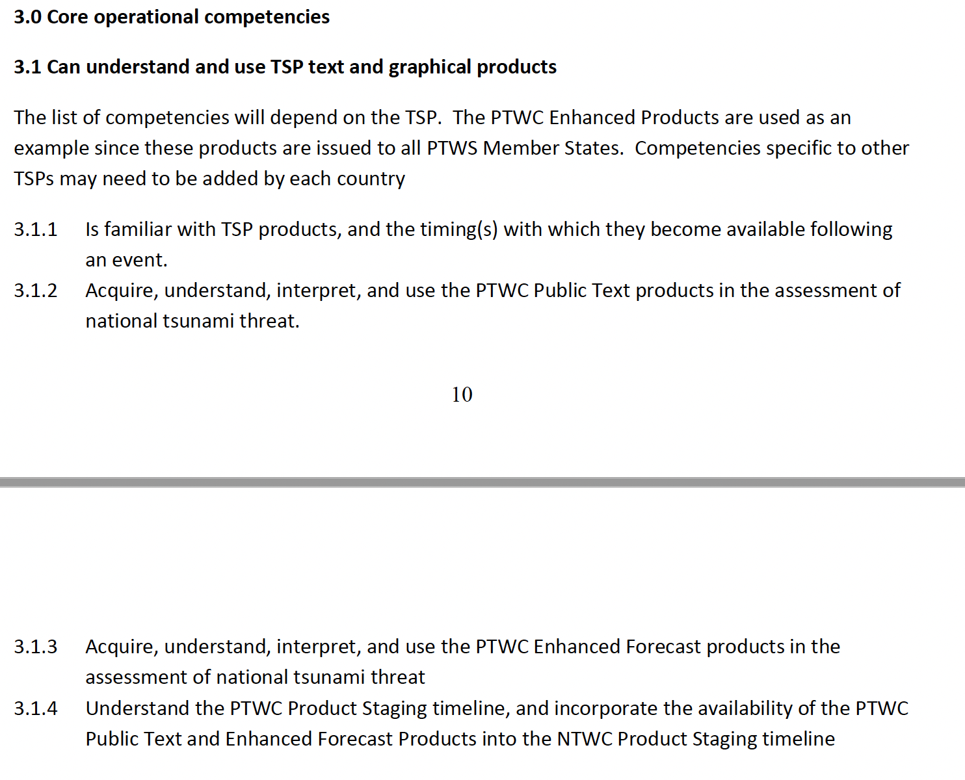

Slide 12
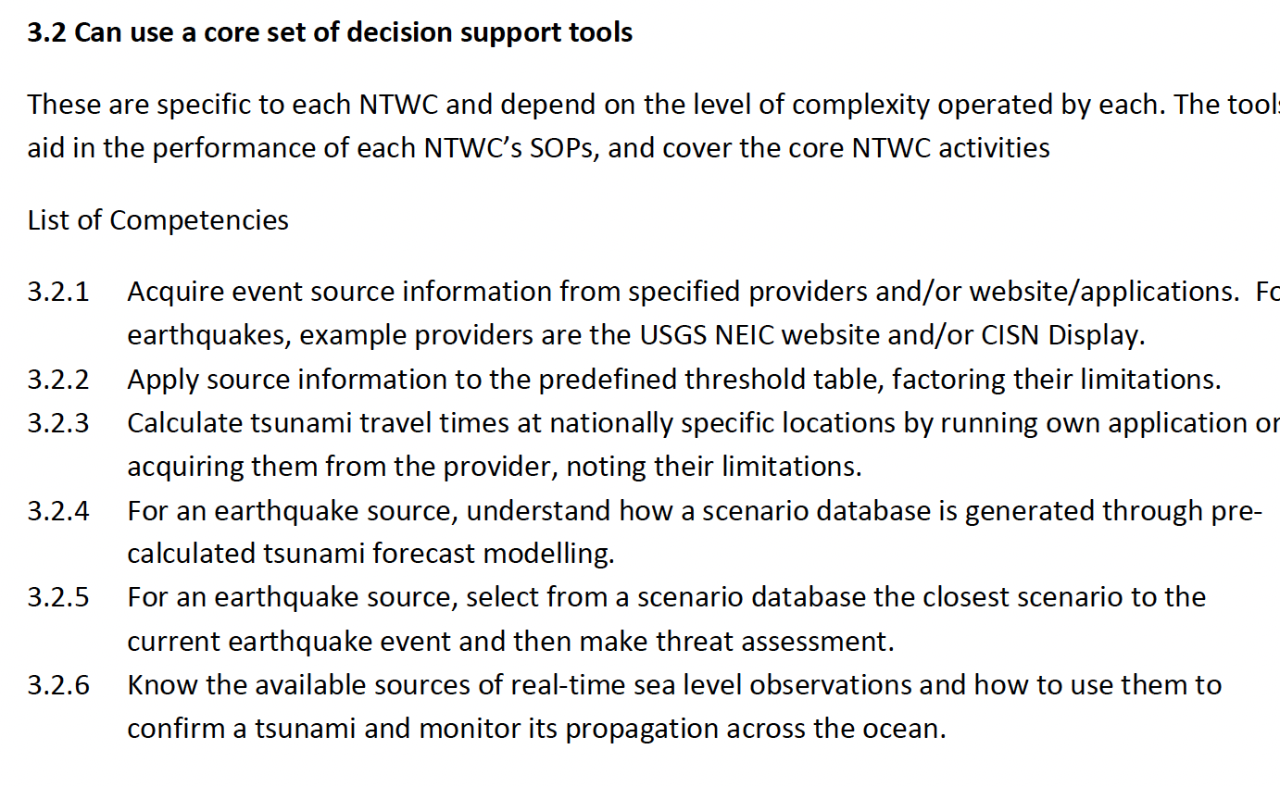

Slide 13
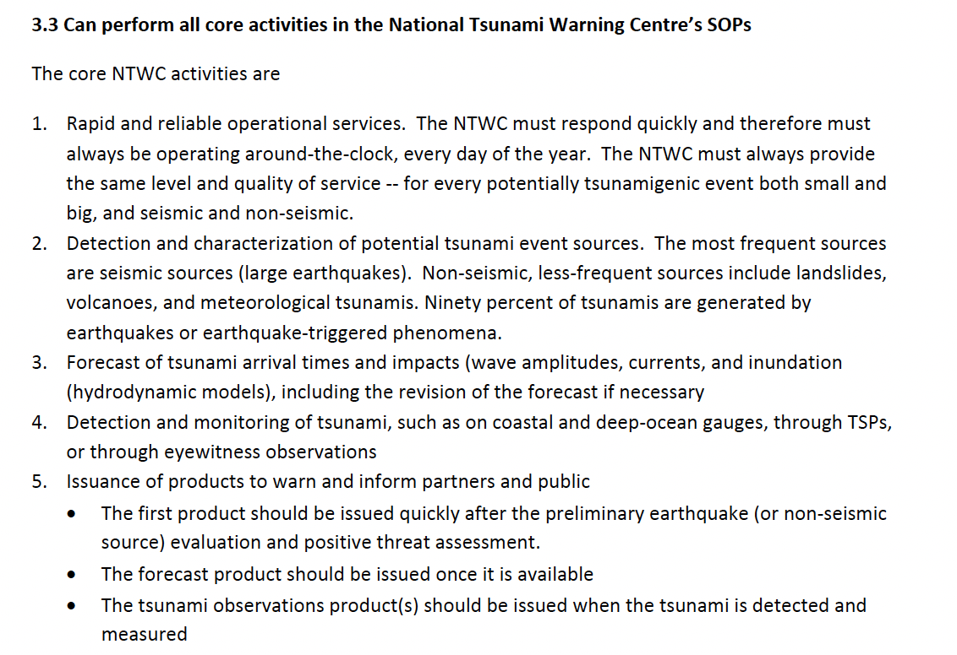
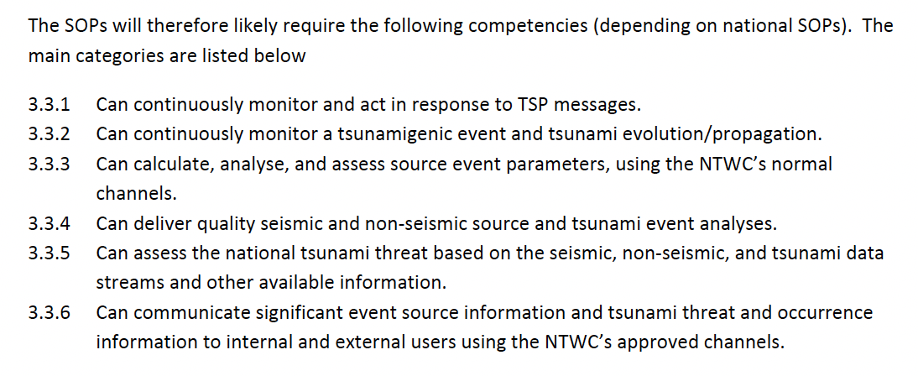

Slide 14
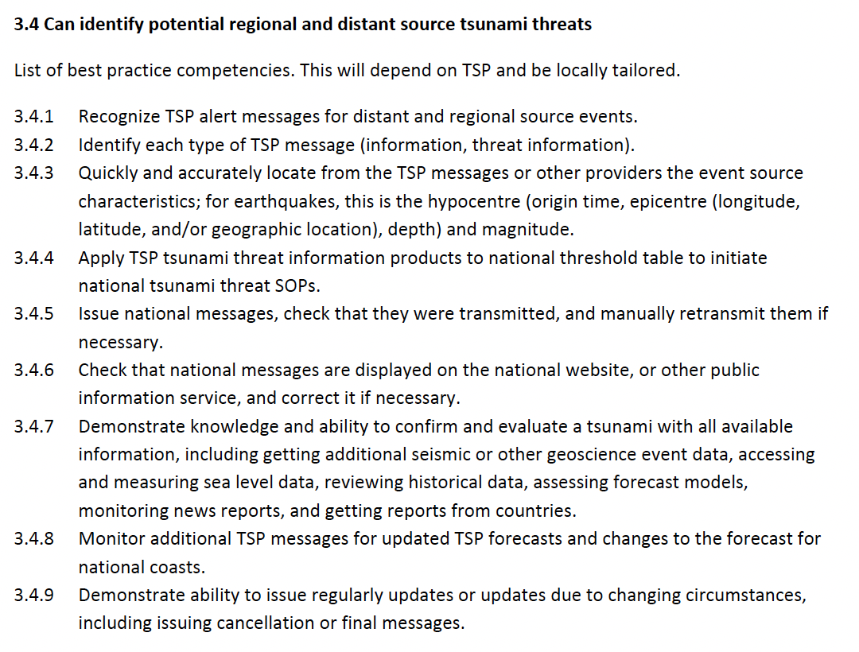

Slide 15
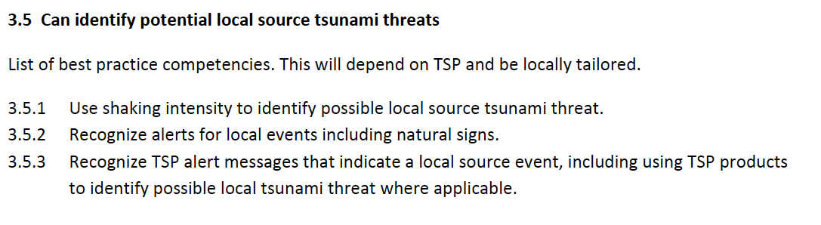
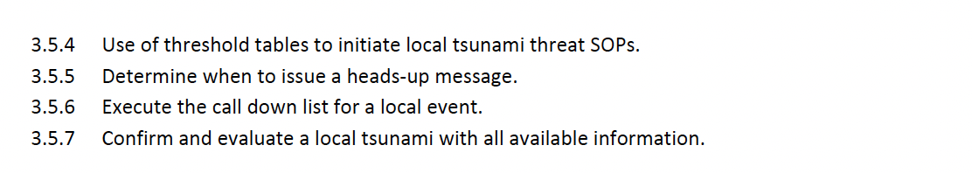

Slide 16
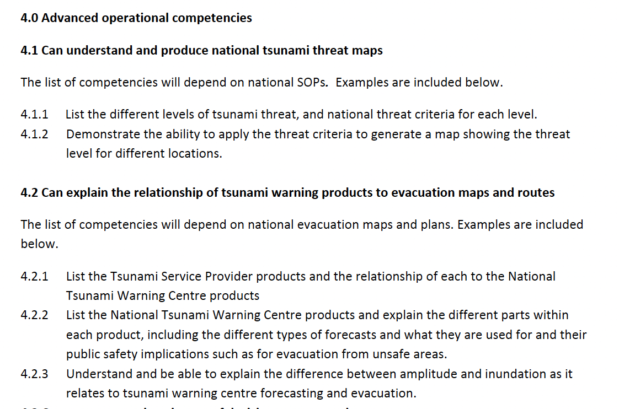

Slide 17
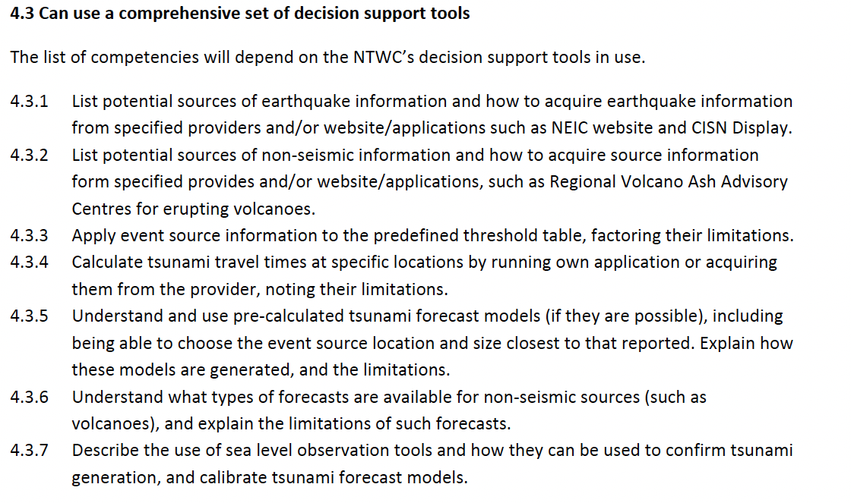
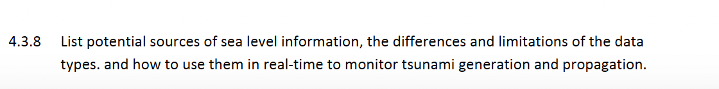

Slide 18
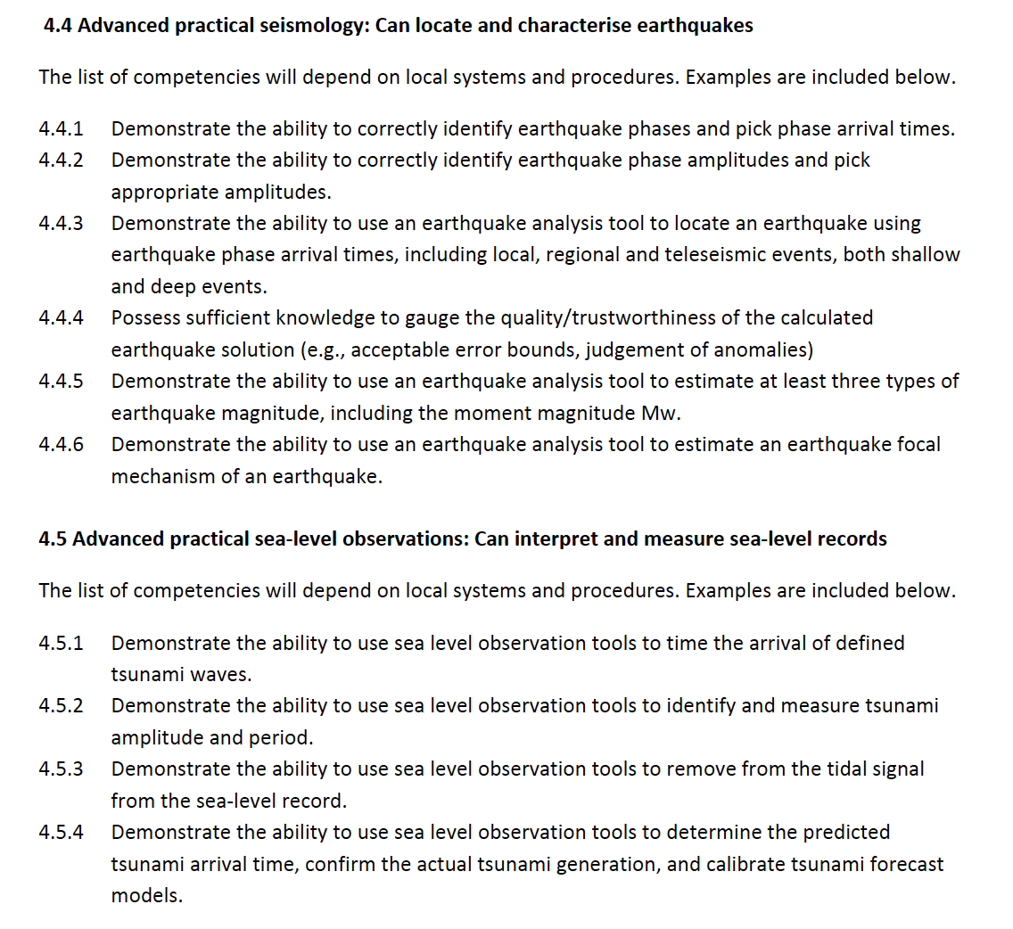

Slide 19
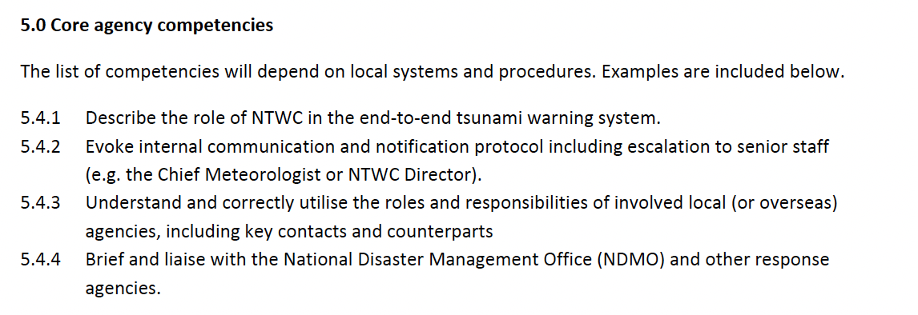
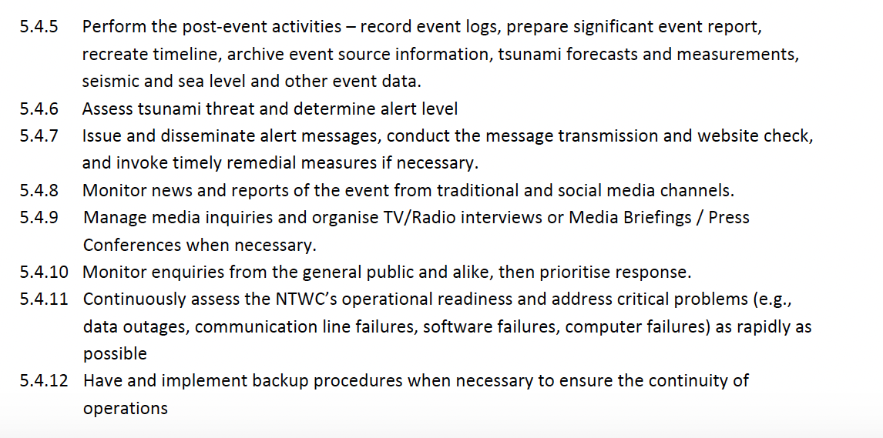

Slide 20
Available Resources and Progress
Feedback and needs – Pacific Island Countries
‘Competency’ training – existing
Global Interest
ITIC Training – past, present, future

Slide 21
1. Feedback and Needs – 15 January 2022
Competency Framework piloted, NTWC Training, Tonga 14-24 Oct 2019.
15 January 2022 HTHH event => Tonga from recent events:
  Gaps – need better understanding of volcano monitoring within NTWC;
  Need attachment of operational staff at PTWC in Hawaii or other NTWC;
  Met Svc operational staff familiarize with Seismic Monitoring
Solomon Islands Met Svc
  Following Impact Based Forecasting Training, identified forecasters need to understand DRR aspects in issuance of warnings => include in NTWC competency framework.

Slide 22
1. Feedback and Needs – Vanuatu perspective
Ms. Esline Garaebiti (Vanuatu), Chair PICT Working Group (Feb 2023):
PICT warning centers equipped with tools but staff needs to be trained
National initiative and support needed from international partners (for example, ITIC to implement, UNDRR, SPC to help scope issues in region)
Recommended;
Training the Trainer (TTT) might be useful - more sustainable for countries to maintain their staff through own capacity development to address staff turnover.
Need should be mapped and framework developed with PICTs.
Competency framework for PICTs should not be limited to seismic sources, but also volcanic sources as integrated approach

Slide 23
2. Competencies – Existing Schema
Task Team solicited Competency Information (and training) from advanced NTWCs
Profile of staff - background, experience for staff that are hired (such as degrees and specialities)
Length of NTWC training before they are officially designated as Duty Watch Standers
Training Information – syllabus (topics, length), how watchstander readiness is measured (tests, practicum, other measures), how training is accomplished (live observer, online, offline, hands-on, classroom, online, other)
Information received: USA (PTWC, USNTWC), Australia (BOM, GA), Chile (SHOA), New Zealand (GNS, NEMA), India (INCOIS, NTWC)

Slide 24
3. Global Interest and status : TOWS WG-XVI (Feb 2023)
Establishing a Global Framework
Appreciated intersessional progress
  Work of the Intergovernmental Coordination Group for the Pacific Tsunami Warning and Mitigation System (ICG/PTWS) to develop a National Tsunami Warning Centre (NTWC) Competency Framework (2019), and the ITIC’s leadership to pilot training courses based on the Framework;
Instruct the regional ICGs (PTWS)
  ITIC to pilot the Draft PTWS National Tsunami Warning Centre (NTWC) Competency Framework (2019) for endorsement by ICG/PTWS with the goal to develop a global framework for all ICGs to use.

Slide 25
3. Global Interest and status : TOWS WG-XV (Feb 2022)
Recommendation 13 for training competencies:
Notes with appreciation the work of the PTWS to develop a NTWC Competency Framework (2019), and the ITIC’s leadership to pilot training courses based on the Framework,
Noting the interest of other ICGs, requests the PTWS to share its document with other regions, and invite comments and feedback,
Also noting the challenges in developing and implementing a global competency framework.
Requests the TT TWO and TT DMP to continue to consider development of guidelines for a global NTWC competency framework based on the available set of documents and Pacific input, noting that implementation can be at a regional level

Slide 26
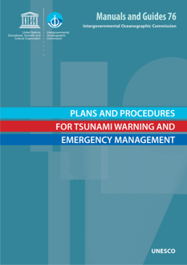
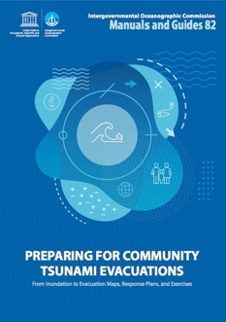
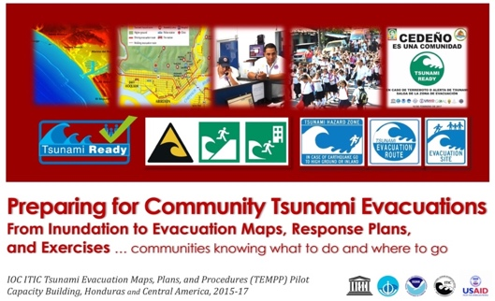

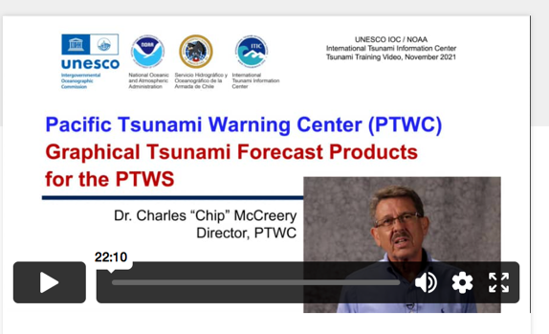
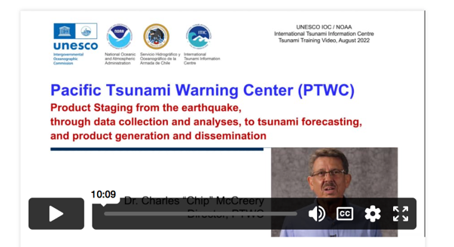

4. ITIC Existing
Standard Training based on IOC Manual and Guides
    TWC / TER SOP (MG 76); Evac Planning (TEMPP, MG 82)
    145+ trainings since 2005
Ocean Teacher Global Academy (OTGA) – online and hybrid. TEWS, SOPs, Decision Support Tools/Software, TEMPP
PTWC Products training videos

Slide 27
4. ITIC Plan - NTWC Competency Training
Requirements - Content and Training Modality
  Knowledge – do self-paced, hybrid
  Operational SOP – do self-paced, hybrid, in-person
  Real-life Experience – do by attachment to Advanced Centre, e.g., PTWC or others (Australia, Chile, Japan, New Zealand, ?? …)
  National Qualification / Certification – by country. IOC / ITIC does not provide certification for tsunami training and cannot certify staff
ITIC exploring funding for pilot for PTWS in 2024+ Pilot with PICT at PTWC.
Concept after US NWS Weather Pacific Training Desk (small cohort group staying 3 weeks -1 month, incl attachment, measured competency at end). Next Steps:
  Approve PTWS NTWC Min Competency / Framework & Training Req (PTWS-XXX)
  Develop Implementation Concept 2023 (modality, content details, assessment)
  Develop Training Course in 2024. Pilot 1 cohort Q4 of 2024 / Q1 of 2025

Slide 28
ICG/PTWS-XXX Recommendation
Recalling the requests from Pacific Island Countries in 2016 and at the Twenty-seventh Session of the ICG/PTWS-XXVII in 2017 for the PTWS Working Group Two to establish minimum competency levels for NTWC operations,
Recalling the Draft NTWC Competency Framework shared at the Twenty-eighth Session of the ICG/PTWS-XVIII in 2019, and the establishment of the Task Team on the Minimum Competency Levels for National Tsunami Warning Centre (NTWC) Operational Staff established under PTWS Working Group Two during this Session,
Recalling further the establishment of the Task Team on Capacity Development established under PTWS Regional Working Group for the Pacific Island Countries and Territories on Tsunami and Mitigation at Twenty-eighth Session of the ICG/PTWS-XXVII in 2019, to continue the development of competency framework for National Tsunami Warning Centres personnel and pilot it in Australia, Vanuatu, Fiji, Samoa and Tonga and report progress and lessons learnt to ICG/PTWS WG 1, 2 and 3,
Appreciating the initiative of Tonga, ITIC, PTWC, and IOC to pilot the Draft NTWC Competency Framework with the Tonga Meteorological and Geological Services and the Solomon Islands Meteorological Services in Nuku’alofa, Tonga in October 2019,
Appreciating feedback to the PTWS NTWC Competency Framework from Task Team on Capacity Development Report to the Ninth Session of PTWS PICT WG in February 2023,

Slide 29
ICG/PTWS-XXX Recommendation
Noting the TOWS WG-XV (2022) request to its Inter-ICG Task Teams on Disaster Management and Preparedness and Tsunami Watch Operations to consider development of guidelines for a global NTWC competency framework based on the available set of documents and Pacific input, noting that implementation can be at a regional level,
Noting the TOWS WG-XVI (2023) appreciation of the intersessional progress of the Intergovernmental Coordination Group for the Pacific Tsunami Warning and Mitigation System (ICG/PTWS) to develop a National Tsunami Warning Centre (NTWC) Competency Framework (2019), and the ITIC’s leadership to pilot training courses based on the Framework,
Noting the TOWS WG-XVI (2023) instruction to the regional ICG, notably the PTWS, and the ITIC to pilot the PTWS National Tsunami Warning Centre (NTWC) Competency Framework for endorsement by ICG/PTWS with the goal to develop a global framework for all ICGs to use,
Recommends the National Tsunami Warning Centre Competency Framework, described in IOC ICG/PTWS-XXX.xx Working Document (Agenda 4.5) and Appendix 2 of this document, is accepted as the framework for minimum competencies for NTWC for the PTWS.
Welcomes the ITIC proposal to pilot the PTWS Minimum NTWC Competency Framework through the development and conduct of a training course during the intersessional period, and report back on its outcome to the Thirty-first Session of the ICG/PTWS.
Recommends the ICG/PTWS WG 2 to report on the use of the Framework by Member States during the intersessional period to the Thirty-first Session of the ICG/PTWS.

Slide 30
Discussion – PTWS-XXX Recommendation
Approve
  Framework - 2 Tiers (1. TSP Products, 2. TSP + National analyses)
  Minimum Competencies. Consist of: Knowledge (Science), Operations, National / Agency
  Training Requirements, which are contents of competencies
Welcomes
ITIC proposal to develop Knowledge / Operations (non-specific) training programme through pilot, with global goal pertinent to all ICGs
  Include development of process for national competency certification considering WMO example

Slide 31
PTWS WG2 TT on the
minimum competency levels for
National Tsunami Warning Centre (NTWC) operations staff
ICG/PTWS-XXX, September 2023
TT Co-chairs: Laura Kong, ITIC
‘Ofa Fa‘anunu, Tonga

