Slide 1
4.11.1 PTWS procedures and products for the next
HTHH event
ICG-PTWS
11^{h}-15th September, 2023
Nuku’alofa,Tonga
François Schindelé, France
Chair ad hoc team
Charles McCreery
Director PTWC

Slide 2
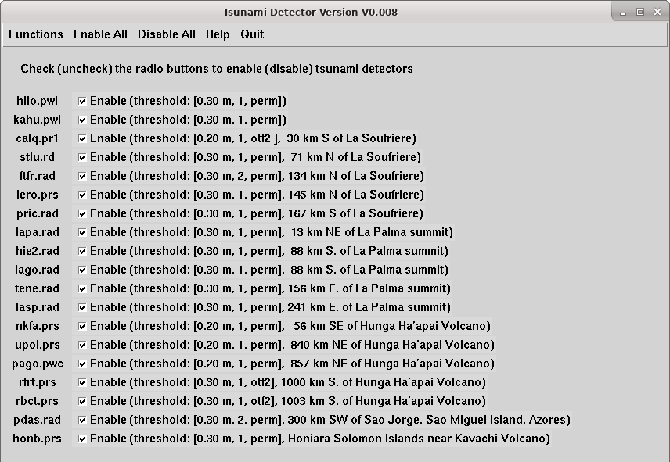
PTWC 19 Coastal Sea-Level Gauge Alarms for Volcanoes
Snapshot on 6/5/22
White Dots are Active
Mauna Loa
La Soufriere
Cumbre Vieja
Hunga Tonga
Sao Jorge
Kavachi

Slide 3
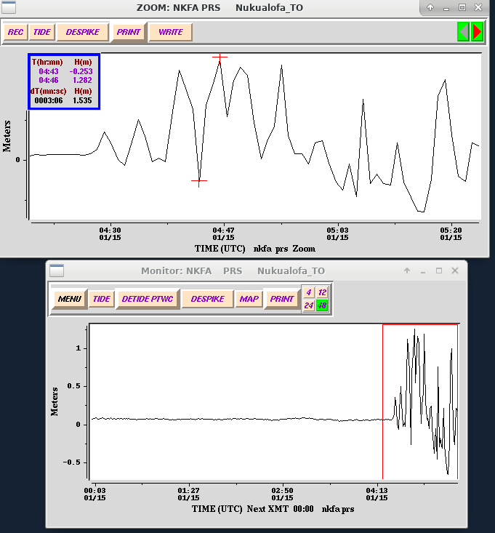
HTHH January 2022 Tsunami arrival at Nuku`alofa
Tsunami signal at Nuku`alofa following the explosive eruption of Hunga Tonga

Slide 4
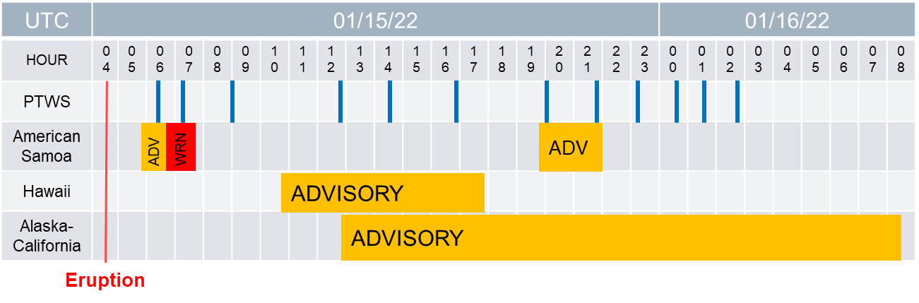
Timeline of Events

Slide 5
HTHH January 2022 Tsunami Amplitudes from Gauges (Size Order)

Slide 6
January 15th 2022 : HTHH explosion and tsunami
February 10th 2022 : establishment of HTHH ad hoc team on Volcano tsunami hazard response
March 16 2022 : IOC sent CL 2882 : PTWS Interim Procedures Implementation Plan
August 17 2022 : IOC sent CL 2902 : PTWC Interim Procedures and PTWS products User’s Guide

Slide 7
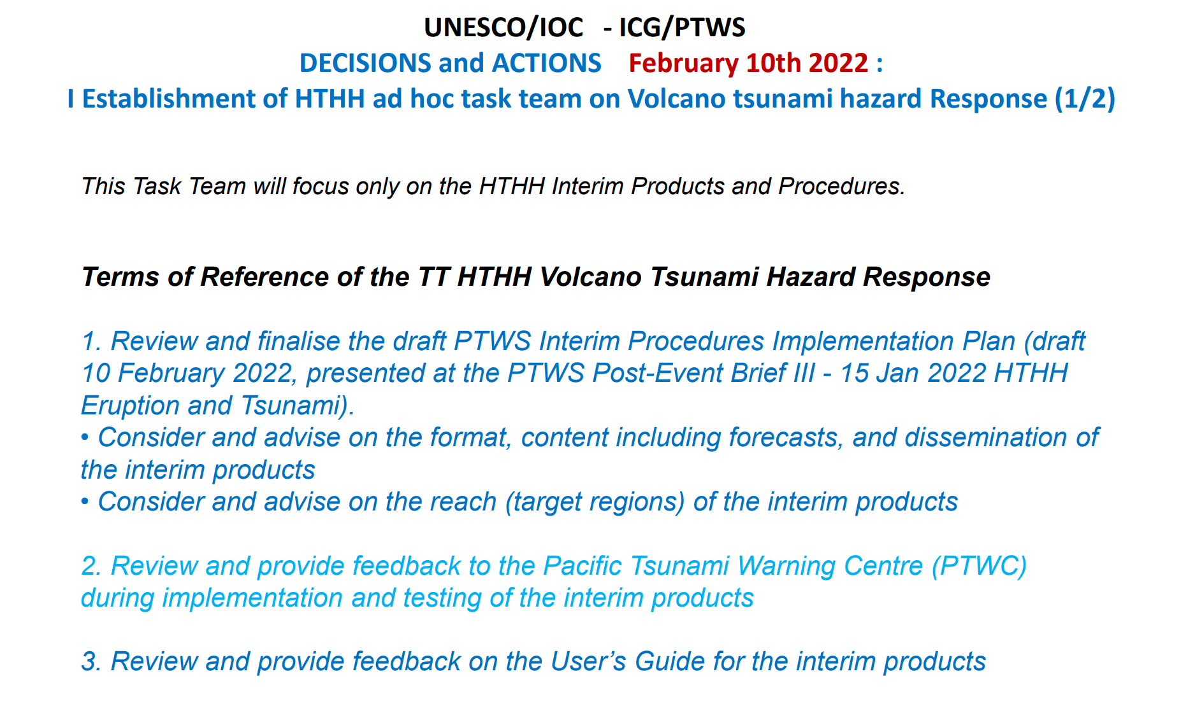
Task Team Seismic Data Sharing

Slide 8
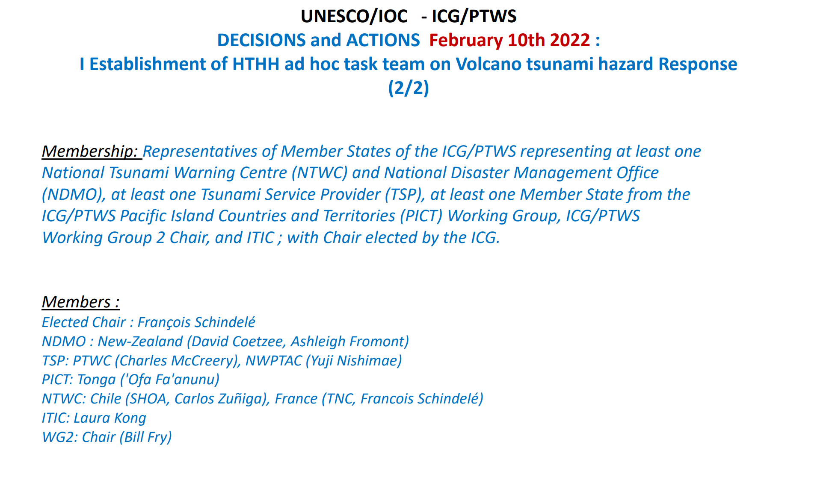

Slide 9
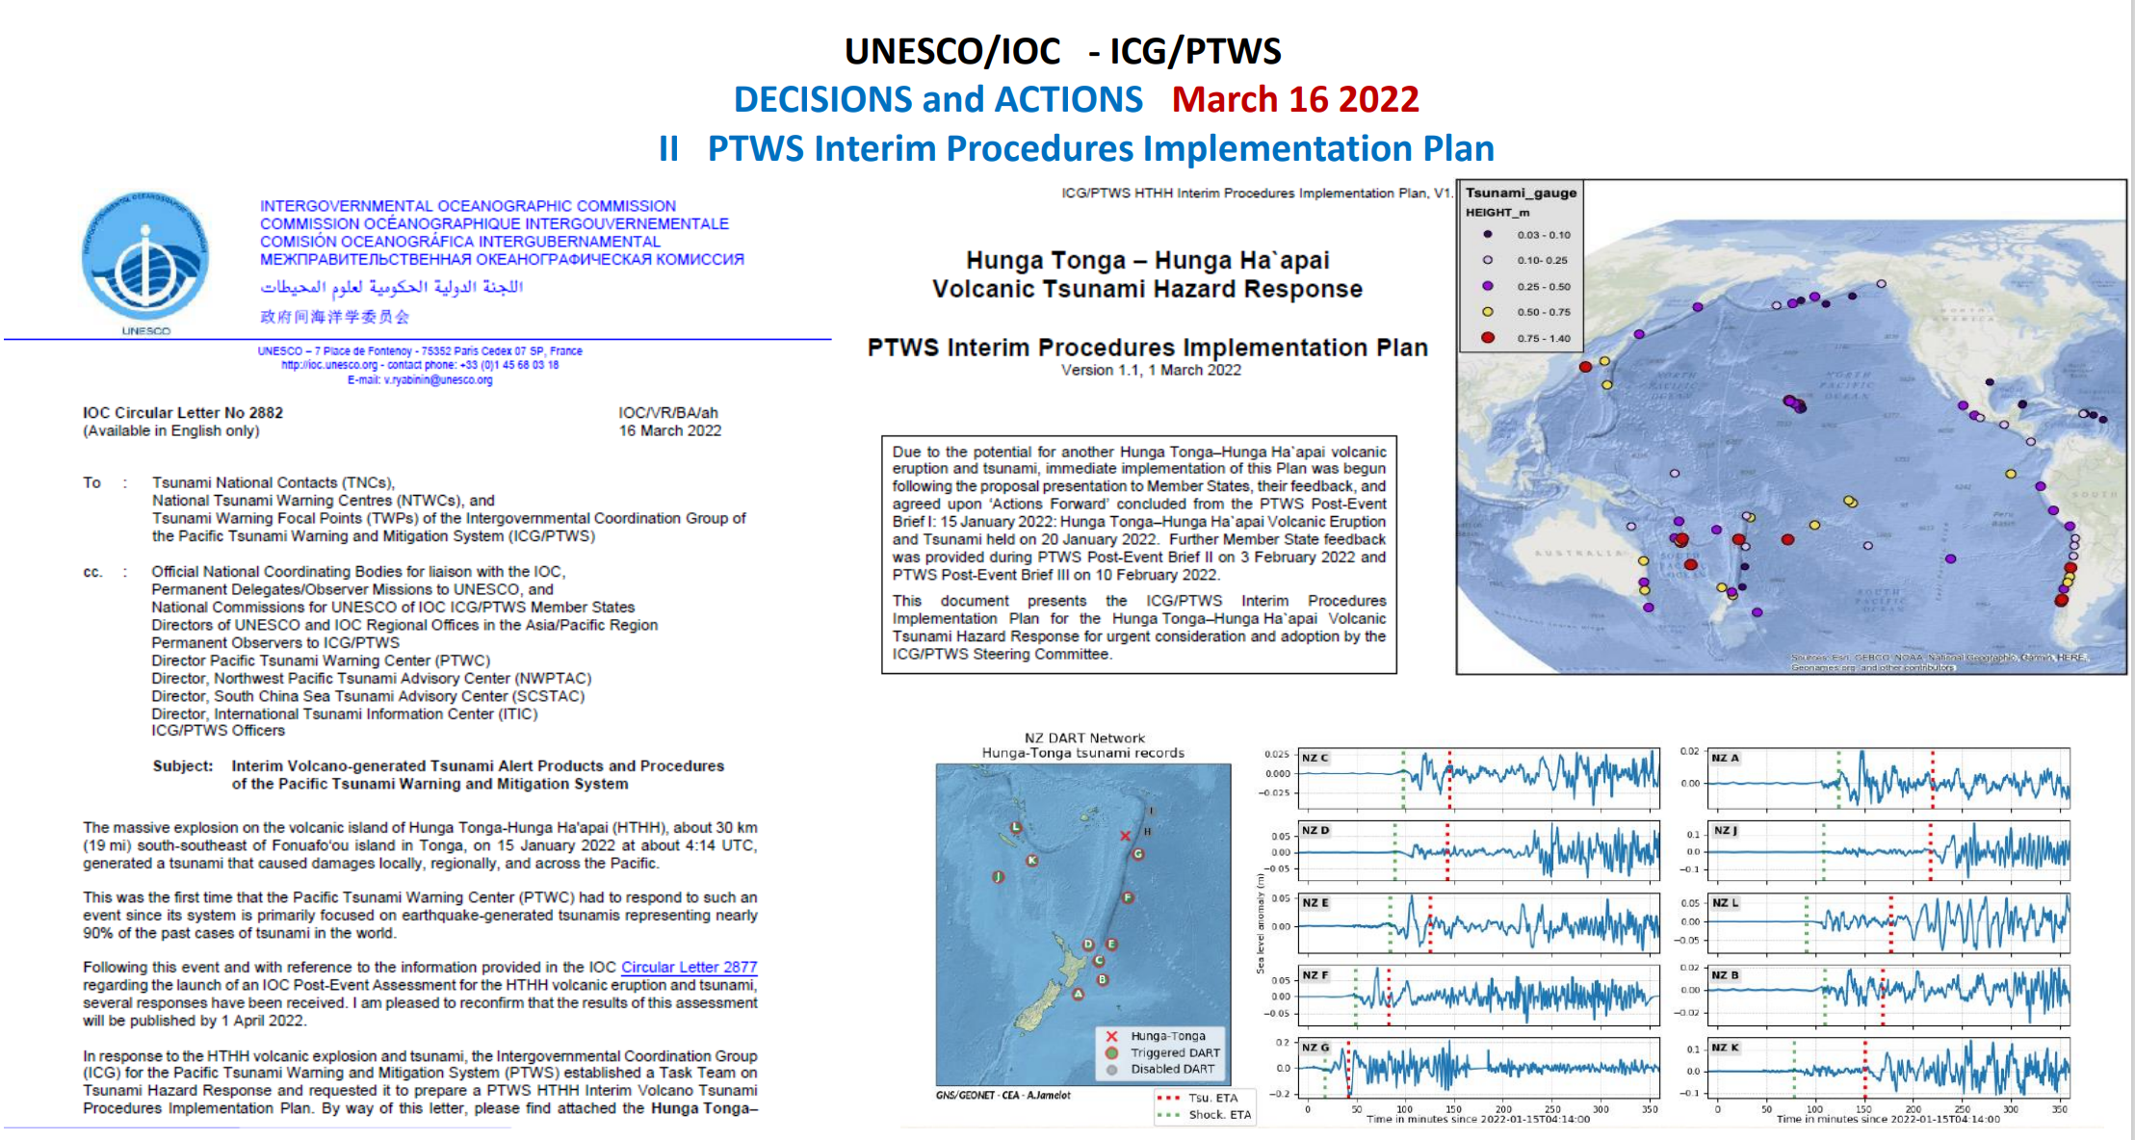

Slide 10
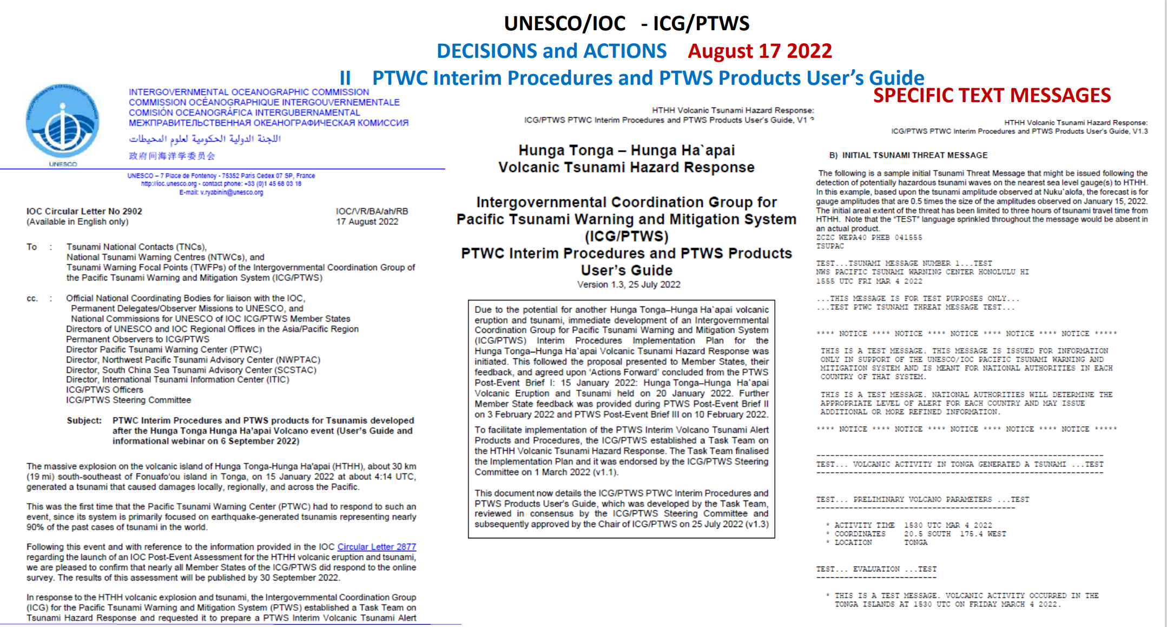

Slide 11
Alerting and Forecasting for Future HTHH Tsunamis
• Messages use the same PTWC Product IDs as PTWC uses for earthquake - generated tsunamis in the PTWS
• Message content is similar but modified for the HTHH source
• Amplitude forecast is based on scaling the 1/15/2022 observations to match current event observations
• This is a “Best Effort” forecasting approach with caveats
o Tsunami generation mechanism at the HTHH may not be the same as on 1/15/22
o Atmospheric pressure wave generation may or may not be present for a future event
o Scaling for either type of generation mechanism may not be linear (e.g., if half as big on one gauge then half as big every where)
o Amplitude forecasts are only for specific gauge locations, not entire coasts
o Estimated arrival times are only based on the normal tsunami
travel time calculation from the volcano

Slide 12
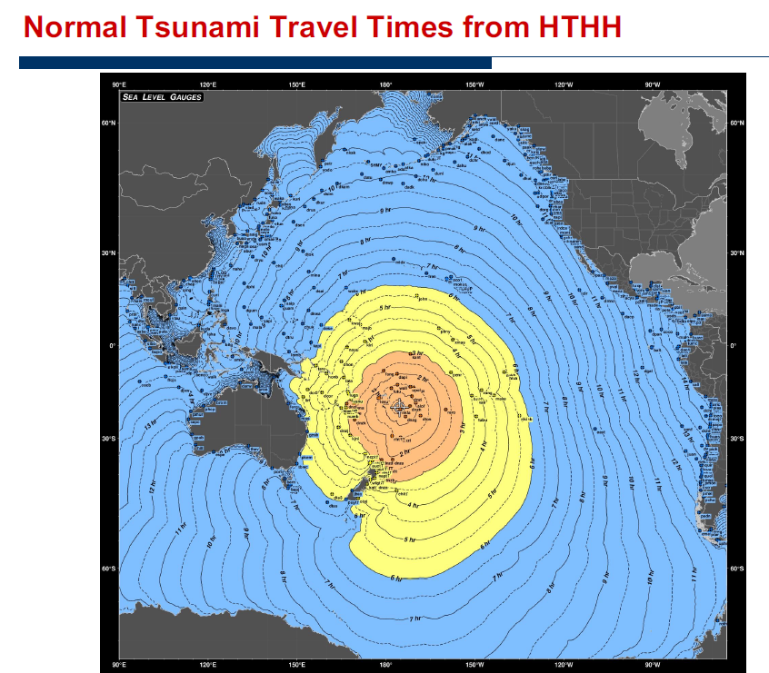

Slide 13
HTHH future Event Response at PTWC
PTWC will be alerted by tsunami waves at the Nuku`alofa gauge or any other nearby gauge (~15 minutes after volcanic event)
PTWC will immediately call the Tonga NTWC (Met Office) to report the waves
The first arrival time and tsunami amplitude at the Nuku`alofa gauge will be measured and recorded.
An initial PTWS Threat Message will be issued, nominally for all coasts within 6 hours tsunami travel time, that includes:
  Normal ETAs at tide gauges based on the Nuku`alofa arrival time
  An amplitude forecast at tide gauges (only those where 2022 event was recorded) based on scaling from the Nuku`alofa amplitude
  Normal ETAs at the usual warning points from HTHH

Slide 14
HTHH future Event Response at PTWC
Based on additional tide gauge readings:
  The forecast will be adjusted if necessary
  The threat area will be expanded or contracted
Dissemination will be through all the normal ways that current PTWS messages are sent
    GTS
    Email
    Fax
    AFTN
There are no graphical products
An SMS will be sent with the first message to alert key government officials in Tonga
Messages will appear on the tsunami.gov website, but will indicate an earthquake with a magnitude of 1
Messages will be issued at least once an hour until the threat has passed

Slide 15
Sample Message Product
ZCZC WEPA40 PHEB 041555
TSUPAC
TEST...TSUNAMI MESSAGE NUMBER 1...TEST
NWS PACIFIC TSUNAMI WARNING CENTER HONOLULU HI
1555 UTC FRI MAR 4 2022
...THIS MESSAGE IS FOR TEST PURPOSES ONLY...
...TEST PTWC TSUNAMI THREAT MESSAGE TEST...
**** NOTICE **** NOTICE **** NOTICE **** NOTICE **** NOTICE *****
THIS IS A TEST MESSAGE. THIS MESSAGE IS ISSUED FOR INFORMATION
ONLY IN SUPPORT OF THE UNESCO/IOC PACIFIC TSUNAMI WARNING AND
MITIGATION SYSTEM AND IS MEANT FOR NATIONAL AUTHORITIES IN EACH
COUNTRY OF THAT SYSTEM.
THIS IS A TEST MESSAGE. NATIONAL AUTHORITIES WILL DETERMINE THE
APPROPRIATE LEVEL OF ALERT FOR EACH COUNTRY AND MAY ISSUE
ADDITIONAL OR MORE REFINED INFORMATION.
**** NOTICE **** NOTICE **** NOTICE **** NOTICE **** NOTICE *****

Slide 16
Sample Message Product
ZCZC WEPA40 PHEB 041555
TSUPAC
--------------------------------------------------------------
TEST... VOLCANIC ACTIVITY IN TONGA GENERATED A TSUNAMI ...TEST
--------------------------------------------------------------
TEST... PRELIMINARY VOLCANO PARAMETERS ...TEST
-------------------------------------------
* ACTIVITY TIME 1530 UTC MAR 4 2022
* COORDINATES 20.5 SOUTH 175.4 WEST
* LOCATION TONGA
TEST... EVALUATION ...TEST
--------------------------
* THIS IS A TEST MESSAGE. VOLCANIC ACTIVITY OCCURRED IN THE
TONGA ISLANDS AT 1530 UTC ON FRIDAY MARCH 4 2022.

Slide 17
Sample Message Product
TEST... TSUNAMI THREAT FORECAST ...TEST
---------------------------------------
* THIS IS A TEST MESSAGE. HAZARDOUS TSUNAMI WAVES FROM THIS
VOLCANIC ACTIVITY ARE POSSIBLE ALONG SOME COASTS OF
TONGA... NIUE... AMERICAN SAMOA... WALLIS AND FUTUNA...
SAMOA... KERMADEC ISLANDS... FIJI... TOKELAU... COOK
ISLANDS... VANUATU... TUVALU... NEW ZEALAND... KIRIBATI...
HOWLAND AND BAKER... NEW CALEDONIA... FRENCH POLYNESIA...
JARVIS ISLAND... SOLOMON ISLANDS... PALMYRA ISLAND...
NAURU... MARSHALL ISLANDS... KOSRAE... JOHNSTON ISLAND...
PAPUA NEW GUINEA... AUSTRALIA... PITCAIRN... POHNPEI...
WAKE ISLAND... HAWAII AND NORTHWEST HAWAII
* THIS IS A TEST MESSAGE. BASED UPON THE INITIAL
OBSERVATIONS... THIS TSUNAMI IS FORECAST TO BE ABOUT 0.5
TIMES THE SIZE OF THE JANUARY 15 2022 TSUNAMI FROM THE SAME
VOLCANO IN TONGA.

Slide 18
Sample Message Product
* THIS IS A TEST MESSAGE. THE FOLLOWING ARE FORECAST MAXIMUM
TSUNAMI AMPLITUDES RELATIVE TO NORMAL SEA LEVEL AT COASTAL
GAUGES WITHIN CURRENT THREAT AREA. THE FORECAST FOR EACH
GAUGE IS BASED UPON SCALING THE MAXIMUM TSUNAMI AMPLITUDE
MEASURED ON THAT GAUGE FOR THE JANUARY 15 2022 TSUNAMI USING
THE SCALE FACTOR GIVEN ABOVE. TSUNAMI WAVES ALONG OTHER
COASTS IN THE REGION OF EACH GAUGE MAY BE LARGER OR SMALLER
THAN AT THE GAUGE. A SIMILAR SCALING OF ANY KNOWN JANUARY 15
IMPACTS ALONG THOSE COASTS CAN BE USED AS A GUIDE.
COORDINATES FIRST WAVE FORECAST MAX
GAUGE LOCATION LAT LON ETA (UTC) TSUNAMI AMPLITUDE
-------------------------------------------------------------
NUKUALOFA TO 21.1S 175.2W 03/04 1548 0.41M/ 1.34FT
DART 5401003 23.4S 173.4W 03/04 1612 0.10M/ 0.34FT
DART 5401002 29.7S 175.0W 03/04 1655 0.05M/ 0.16FT
PAGO PAGO AS 14.3S 170.7W 03/04 1656 0.31M/ 1.02FT
APIA UPOLU WS 13.8S 171.8W 03/04 1706 0.09M/ 0.28FT
SUVA VITI LEVU FJ 18.1S 178.4E 03/04 1712 0.13M/ 0.43FT
DART 5401001 36.0S 177.7W 03/04 1737 0.04M/ 0.11FT
RAROTONGA CK 21.2S 159.8W 03/04 1745 0.45M/ 1.48FT
DART 5501004 36.1S 178.6E 03/04 1757 0.05M/ 0.18FT
EAST CAPE NZ 37.5S 178.2E 03/04 1814 0.13M/ 0.43FT
FONGAFALE TV 8.5S 179.2E 03/04 1819 0.06M/ 0.20FT
MARE NEW CALEDONIA F 21.5S 167.9E 03/04 1822 0.38M/ 1.23FT

Slide 19
Sample Message Product
TEST... RECOMMENDED ACTIONS ...TEST
-----------------------------------
* THIS IS A TEST MESSAGE. GOVERNMENT AGENCIES RESPONSIBLE FOR
THREATENED COASTAL AREAS SHOULD TAKE ACTION TO INFORM AND
INSTRUCT ANY COASTAL POPULATIONS AT RISK IN ACCORDANCE WITH
THEIR OWN EVALUATION... PROCEDURES AND THE LEVEL OF THREAT.
* THIS IS A TEST MESSAGE. PERSONS LOCATED IN THREATENED COASTAL
AREAS SHOULD STAY ALERT FOR INFORMATION AND FOLLOW
INSTRUCTIONS FROM NATIONAL AND LOCAL AUTHORITIES.

Slide 20
Sample Message Product
TEST... ESTIMATED TIMES OF ARRIVAL ...TEST
------------------------------------------
* THIS IS A TEST MESSAGE. ESTIMATED TIMES OF ARRIVAL -ETA- OF
THE INITIAL TSUNAMI WAVE FOR PLACES WITHIN THE THREAT
REGION. ACTUAL ARRIVAL TIMES MAY DIFFER AND THE INITIAL WAVE
MAY NOT BE THE LARGEST. A TSUNAMI IS A SERIES OF WAVES AND
THE TIME BETWEEN WAVES CAN BE FIVE MINUTES TO ONE HOUR.
LOCATION REGION COORDINATES ETA(UTC)
------------------------------------------------------------
NUKUALOFA TONGA 21.0S 175.2W 1540 03/04
HOLEVA TONGA 18.6S 173.9W 1606 03/04
NIUE ISLAND NIUE 19.0S 170.0W 1631 03/04
NIUATOPUTAPU TONGA 15.9S 173.8W 1635 03/04
PAGO PAGO AMERICAN SAMOA 14.3S 170.7W 1652 03/04
FUTUNA ISLAND WALLIS AND FUTUN 14.3S 178.2W 1655 03/04
WALLIS ISLAND WALLIS AND FUTUN 13.2S 176.2W 1659 03/04
APIA SAMOA 13.8S 171.8W 1706 03/04
RAOUL ISLAND KERMADEC ISLANDS 29.2S 177.9W 1709 03/04
SUVA FIJI 18.1S 178.4E 1712 03/04
NUKUNONU ISLAND TOKELAU 9.2S 171.8W 1737 03/04
PUKAPUKA ISLAND COOK ISLANDS 10.8S 165.9W 1739 03/04
RAROTONGA COOK ISLANDS 21.2S 159.8W 1745 03/04

Slide 21
Sample Message Product
TEST... POTENTIAL IMPACTS ...TEST
---------------------------------
* THIS IS A TEST MESSAGE. A TSUNAMI IS A SERIES OF WAVES. THE
TIME BETWEEN WAVE CRESTS CAN VARY FROM 5 MINUTES TO AN HOUR.
THE HAZARD MAY PERSIST FOR MANY HOURS OR LONGER AFTER THE
INITIAL WAVE.
* THIS IS A TEST MESSAGE. IMPACTS CAN VARY SIGNIFICANTLY FROM
ONE SECTION OF COAST TO THE NEXT DUE TO LOCAL BATHYMETRY AND
THE SHAPE AND ELEVATION OF THE SHORELINE.
* THIS IS A TEST MESSAGE. IMPACTS CAN ALSO VARY DEPENDING UPON
THE STATE OF THE TIDE AT THE TIME OF THE MAXIMUM TSUNAMI
WAVES.
* THIS IS A TEST MESSAGE. PERSONS CAUGHT IN THE WATER OF A
TSUNAMI MAY DROWN... BE CRUSHED BY DEBRIS IN THE WATER... OR
BE SWEPT OUT TO SEA.

Slide 22
Sample Message Product
TEST... TSUNAMI OBSERVATIONS ...TEST
------------------------------------
* THIS IS A TEST MESSAGE. THE FOLLOWING ARE TSUNAMI WAVE
OBSERVATIONS FROM COASTAL AND/OR DEEP-OCEAN SEA LEVEL GAUGES
AT THE INDICATED LOCATIONS. THE MAXIMUM TSUNAMI AMPLITUDE IS
MEASURED WITH RESPECT TO THE NORMAL TIDE LEVEL.
GAUGE TIME OF MAXIMUM WAVE
COORDINATES MEASURE TSUNAMI PERIOD
GAUGE LOCATION LAT LON (UTC) AMPLITUDE (MIN)
-------------------------------------------------------------
NUKUALOFA TO 21.1S 175.2W 1550 0.39M/ 1.3FT 04

Slide 23
Sample Message Product
TEST... NEXT UPDATE AND ADDITIONAL INFORMATION ...TEST
------------------------------------------------------
* THIS IS A TEST MESSAGE. THE NEXT MESSAGE WILL BE ISSUED IN
ONE HOUR... OR SOONER IF THE SITUATION WARRANTS.
* THIS IS A TEST MESSAGE. FURTHER INFORMATION ABOUT THIS EVENT
MAY BE FOUND AT WWW.TSUNAMI.GOV.
* THIS IS A TEST MESSAGE. COASTAL REGIONS OF HAWAII... AMERICAN
SAMOA... GUAM... AND CNMI SHOULD REFER TO PACIFIC TSUNAMI
WARNING CENTER MESSAGES SPECIFICALLY FOR THOSE PLACES THAT
CAN BE FOUND AT WWW.TSUNAMI.GOV.
* THIS IS A TEST MESSAGE. COASTAL REGIONS OF CALIFORNIA...
OREGON... WASHINGTON... BRITISH COLUMBIA AND ALASKA SHOULD
ONLY REFER TO U.S. NATIONAL TSUNAMI WARNING CENTER MESSAGES
THAT CAN BE FOUND AT WWW.TSUNAMI.GOV.

Slide 24
4.11.1 PTWS PROCEDURES AND PRODUCTS FOR THE NEXT HTHH EVENT
CL 2882 : PTWS Interim Procedures Implementation Plan March 16 2022
CL 2902 : PTWC Interim Procedures and PTWS products User’s Guide August 17 2022

Slide 25
4 POLICY MATTERS
4.11.1 PTWS PROCEDURES AND PRODUCTS FOR THE NEXT HTHH EVENT
Proposal of RECOMMENDATION ICG/PTWS XXX/ :
Decision to « endorse » the PTWS Procedures and products for the next HTHH Event

Slide 26
Thank you very much for your kind attention.

