Slide 1
Tsunami Ready
ICG/PTWS-XXX, September 2023
Dr Laura Kong (ITIC), Ashleigh Fromont (WG3)
Two supporting Information Documents are available.

Slide 2
History of Tsunami Ready Programme
US National Weather Service establishes TsunamiReady® Programme in its states and territories
IOC Assembly approves Tsunami Ready Pilot Project to be implemented in other regions
IOC Assembly approves establishment of IOC Ocean Decade Tsunami Programme including Tsunami Ready
100% At-Risk Communities Tsunami Ready
2001
2015
2021
2030
US supports joint NWS and UNESCO-IOC TsunamiReady® Pilot in Caribbean.
Tsunami Evacuation Maps, Plans and Procedures (TEMPP) training supports Tsunami Ready
UNESCO/IOC establishes Tsunami Ready Recognition Programme
start in Pacific and Indian Ocean
2011
2015-2017
2022
Notes:
Insert a timeline? Double check the number of communities. This may have increased.

Slide 3
Tsunami Ready Policy Items
Tsunami Ready Governance
At the meeting of the ICG/PTWS Steering Committee 2023, it was agreed that WG3 would explore potential governance structures for PTWS to effectively support Tsunami Ready
Tsunami Ready Equivalency Approach
At ICG/PTWS-XXIX, WG3 was requested to ‘explore […] ways to recognise communities that choose not to implement the UNESCO / IOC Tsunami Ready Programme, as compliant with the TR indicators’.

Slide 5
Governance
Tsunami Ready implementation, monitoring and support would benefit from dedicated, centralised governance to support implementation in the ICG/PTWS.
This should also consider sustainability beyond the goals of the UN Ocean Decade. Options include:
Establishing
Task Team ‘Tsunami Ready
Establishing
Working Group ‘Tsunami Ready
Retention
within Working Group 3
RECOMMENDED

Slide 6
Task Team Tsunami Ready
WG3 recommends the establishment of a Task Team Tsunami Ready under Working Group 3 with Terms of Reference in the Information Document.
A Task Team Tsunami Ready would exist in the finite context of the UN Ocean Decade (similar to the UN OD TT)
This has precedence in the previous establishment of a Task Team Tsunami Ready during the pilot phase of the programme, prior to the launch of the UN Ocean Decade and the role of the TRRP in contributing to those goals.
Sustainability can be addressed by the integration of any remaining responsibilities into Working Group Three at the time of dissolution

Slide 7
Tsunami Ready ‘Equivalency’
A number of nations have existing tsunami DRR programmes, and may choose not the implement the formal TRRP.
Inclusion of these countries is critical to be able to accurately capture & report progress towards the UN Ocean Decade Goal
WG3 have prepared an Information Document with a proposed approach for further development of guidance

Slide 8
Tsunami Ready ‘Equivalency’
The principles of a TR ‘equivalency’ approach should include:
Countries have a strong motivation to ensure that their communities at risk of tsunami are prepared for and resilient to tsunamis.
Existing national strategies are used to measure progress towards the “100% Tsunami Ready’ goal.
Reporting on progress towards global preparedness targets is consistent with the Tsunami Ready Framework (12 indicators)
Effort to track and report towards global targets is concentrated at the national level.
Supports national reporting and ICG/PTWS KPI’s.

Slide 9
Proposed approach
The approach seeks to enable reporting on tsunami preparedness in a manner compatible with TRRP, using existing national frameworks and requirements.
Implementation workflow is proposed as follows:
Define the “community”
Cross-Reference programme with Tsunami Ready indicators
Identify existing community reporting
Establish governance to support communities

Slide 10
Implementation Workflow
Define the most appropriate level of ‘community’
The most practical definition must be considered to be consistently applied
This will likely align closely with the most fundamental level of organisation, and / or existing reporting requirements
Notes:
Prepared for and resilient to tsunamis
Considered for a few reasons:
Anything we are missing in our existing programme
Benefits the recognition might bring in our existing system
Support of the global tsunami community, at least measurement before.
CDEM Groups are the lowest legislated entity required to undertake comprehensive DRR planning.

Slide 11
Implementation Workflow
2. Undertake a cross-reference process at the national level
Review existing resources that contribute to community preparedness outcomes (e.g. frameworks, strategies, plans, legislation)
Identify where Tsunami Ready indicators are being met as a standard approach across communities
This enables reporting against some indicators without separate assessment for each community
Notes:
Prepared for and resilient to tsunamis
Considered for a few reasons:
Anything we are missing in our existing programme
Benefits the recognition might bring in our existing system
Support of the global tsunami community, at least measurement before.
CDEM Groups are the lowest legislated entity required to undertake comprehensive DRR planning.

Slide 12
Implementation Workflow
3. Utilise existing community reporting
Some indicators need to be assessed at the community level
Existing reporting requirements should be identified to consider
Whether these are already reported on at a national level OR
Where reporting considerations could be added within existing reporting
e.g. a community response plan may also include other readiness factors such as public education
Notes:
Prepared for and resilient to tsunamis
Considered for a few reasons:
Anything we are missing in our existing programme
Benefits the recognition might bring in our existing system
Support of the global tsunami community, at least measurement before.
CDEM Groups are the lowest legislated entity required to undertake comprehensive DRR planning.

Slide 13
Implementation Workflow
4. Empower community participation through governance
A National Tsunami Ready Board should be established to enable:
Consistency in reporting across ICG/PTWS
Local communities to progression of recognition through the formal TRRP should that be preferred /appropriate
It is possible that an existing body may be able to meet the requirements to act as a NTRB
Notes:
Prepared for and resilient to tsunamis
Considered for a few reasons:
Anything we are missing in our existing programme
Benefits the recognition might bring in our existing system
Support of the global tsunami community, at least measurement before.
CDEM Groups are the lowest legislated entity required to undertake comprehensive DRR planning.

Slide 14
Discussion
Next steps for this approach would be development of formal guidance for ICG/PTWS
Propose discussion in Intrasessional Working Group for Tsunami Ready.

Slide 15
New Zealand Case Study
ICG/PTWS-XXX, September 2023
Dr Laura Kong (ITIC), Ashleigh Fromont (WG3)
Two supporting Information Documents are available.

Slide 16
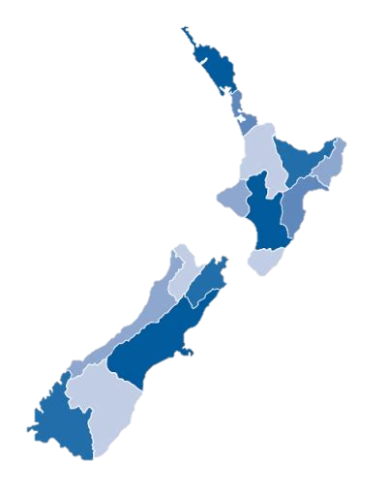
Tsunami Ready in New Zealand
New Zealand is not able to roll-out formal TR recognition as a national programme.
However, there is interest at a national level to encourage the measurement of Tsunami Ready Recognition Programme, in support of the Ocean Decade Goal of 100% of all at risk communities “Tsunami Ready”.
This would be preferentially undertaken at the Civil Defence Group Level - committees of local authorities within regional boundaries.
Notes:
Tsunami risk reduction and preparedness is incorporated in an multi hazards approach within existing risk reduction strategies and emergency plans, rather than explicitly.
We need a single national framework for this (avoiding multiple)
Ensuring that applying a global framework still empowers our ‘locally led, regionally coordinated, nationally supported’ approach to risk reduction and emergency response
Some Groups are already facing potential changes (with associated cost) as part of a push for national alignment – so have to be careful that extra work is truly to improve the tsunami readiness of a community and not to solely obtain recognition.
Considered for a few reasons:
Anything we are missing in our existing programme
Benefits the recognition might bring in our existing system
Support of the global tsunami community, at least measurement before.
CDEM Groups are the lowest legislated entity required to undertake comprehensive DRR planning.

Slide 17
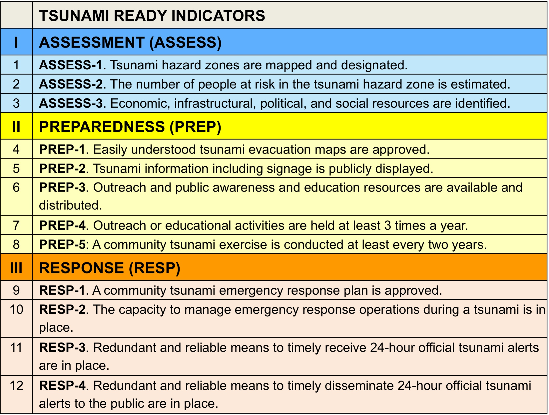
NZ: Comparison against indicators
Regionally done
Regionally done as part of risk assessment, not explicitly reported
Regionally done
Nationally supported
National exercise – but focused largely on earthquake preparedness
Regionally required / reported
National capability
Notes:
Broadly looking at the indicators, which already align in intent with existing mechanisms in NZ – many of the CDEM groups already do more than this minimum.
This affirms that the best level to apply would be regionally (CDEM Group).
Two indicators are not required under national planning – but are done by a number of Groups already.

Slide 18
Future implementation in NZ
Some indicators can be met “as standard” across the entire country as they are either national capability OR legislatively required to be reported in Regional Group Plans. Some work is required at the national level to describe how these cross-reference to the Tsunami Ready indicators.
Groups could then apply with supplemental information on remaining indicators, where these are optional national activities.
New Zealand’s Tsunami Reference Group (or sub set) can be designated as a NTRB
Notes:
The approach effectively is a ‘cross crediting’ approach – aligning and stating exactly how the existing national program fulfils the Tsunami Ready Programme indicators.
By having a cross-crediting framework established we can also track better nationally how ‘tsunami ready’ we are nationally, for reporting towards the Ocean Decade Goal.
Still have a lot of detail to work through and expect some smaller challenges to arise throughout, most related to this ‘translation’.
Some key issues include:
Who verifies our cross crediting?
How would the renewal period work with regards to the mismatch in timelines
The branding issue with existing brands relating to tsunami preparedness, and also mis-representing that there is a discrepancy between those Groups that chose to apply vs those that don’t.

