Slide 1
GOOS European National Focal Point Meeting
Friday 22 September 2023, 09:30 – 13:00 CEST
Room IX, UNESCO, Paris, France

Slide 2
Session 1 - Opening

Slide 3
National Focal Points
2023
2017
2019
2001
2021
2023
Apr
2023
CL 2666
Task Team
CL 2931
EOOS Operations Committee
GOOS Steering Committee
European NFP meeting
2030 Global Ocean Observing System Strategy
Request for designation or update of NFP
Requested revision of NFP ToRs and alignment with EOOS. Requested communications support
Task Team formed as a response to SC-9
NFP ToR updated
Circulation of updated ToR
Feedback received
Request NFPs updated
First meeting in person - EuroSea
Updated ToRs approved by GOOS SC
Prompted GOOS SC to consider the role of NFPs
23 GOOS NFP in Europe (27 in EOOS)
74 NFPs globally
25 October first global NFP Forum

Slide 4
NFP Role
focal point for communication between GOOS and the national organisations
promote and support nationally and regionally coordinated strategies
support the work of GOOS at the national level
foster connections
ensure that national needs and gaps are brought to the attention of GOOS
Report to GOOS on national plans, implementation status, and response priorities
advocate for sustained national ocean observing system activities that contribute to GOOS

Slide 5
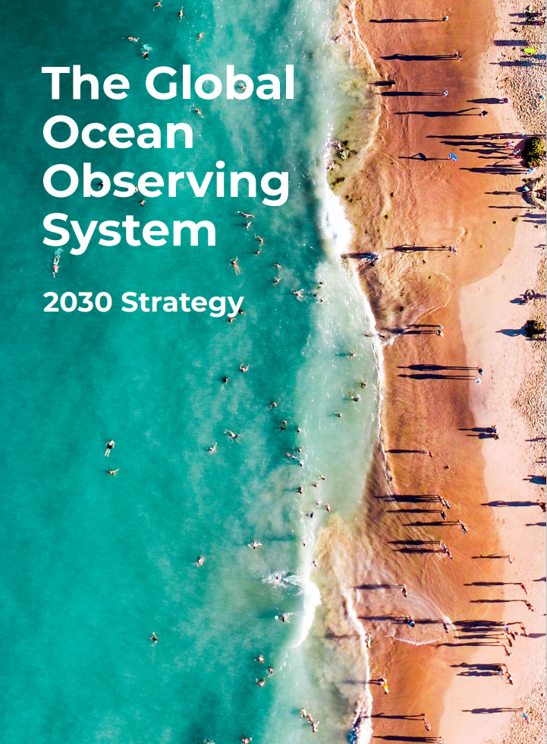
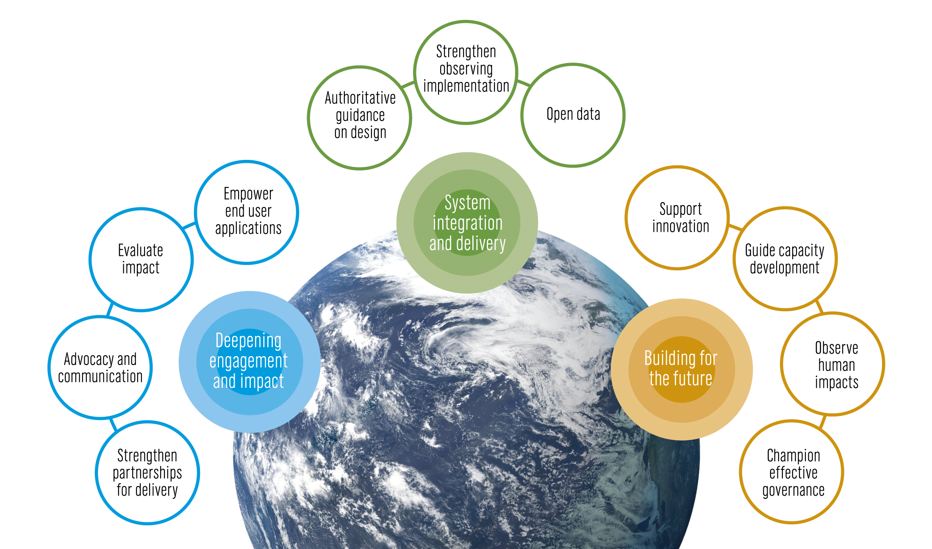
An integrated system supporting a wide range of applications
Notes:
GOOS National Focal Points
Important to success many of the strategic objectives
Opportunity to be an important locus for communication on national needs
partnership with key stakeholders

Slide 6
Importance of the GOOS NFP
Raised as vital by GOOS Steering Committee members - many from Europe
Raised as vital in GOOS structure - Report by Neville Smith
Integrated with EOOS through Operations Committee / EuroSea project
> AMRIT project includes the EOOS European OceanOPS work
Importance stressed by DG Mare yesterday!!!

Slide 7
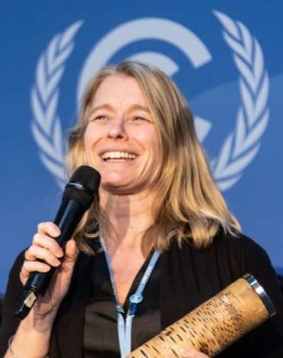
Joanna Post
On 1 September 2023 Joanna joined IOC as GOOS Director
Prior to joining GOOS, she was at the UNFCCC secretariat for over 10 years leading the research and systematic observation negotiations and managing the science-policy and ocean-policy agendas.
She has a long career in science/policy communications and holds a Ph.D. in biochemistry from the University of Newcastle Upon Tyne, UK.

Slide 8
GOOS Update
Toste Tanhua - GOOS SC Co-Chair
David Legler - Chair Observation Coordination Group
Sabrina Speich - Ocean Observing Physics and Climate Panel
Karen Evans/Gabrielle Canonico - BioEco Panel
Maciej Telszewski - Biogeochemistry Panel
Denis Chang Seng - GOOS Regional Alliances

Slide 9
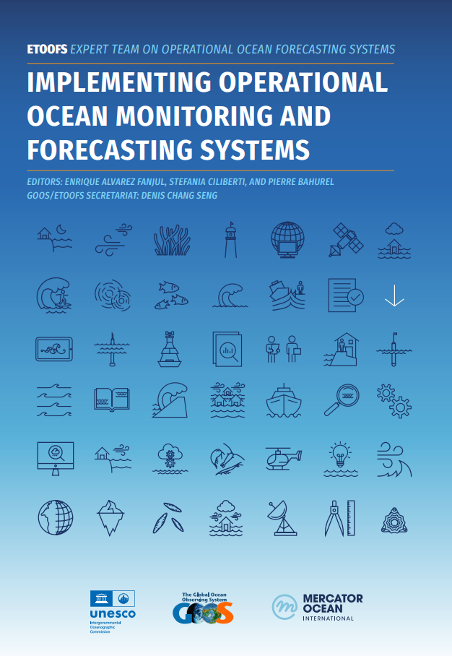
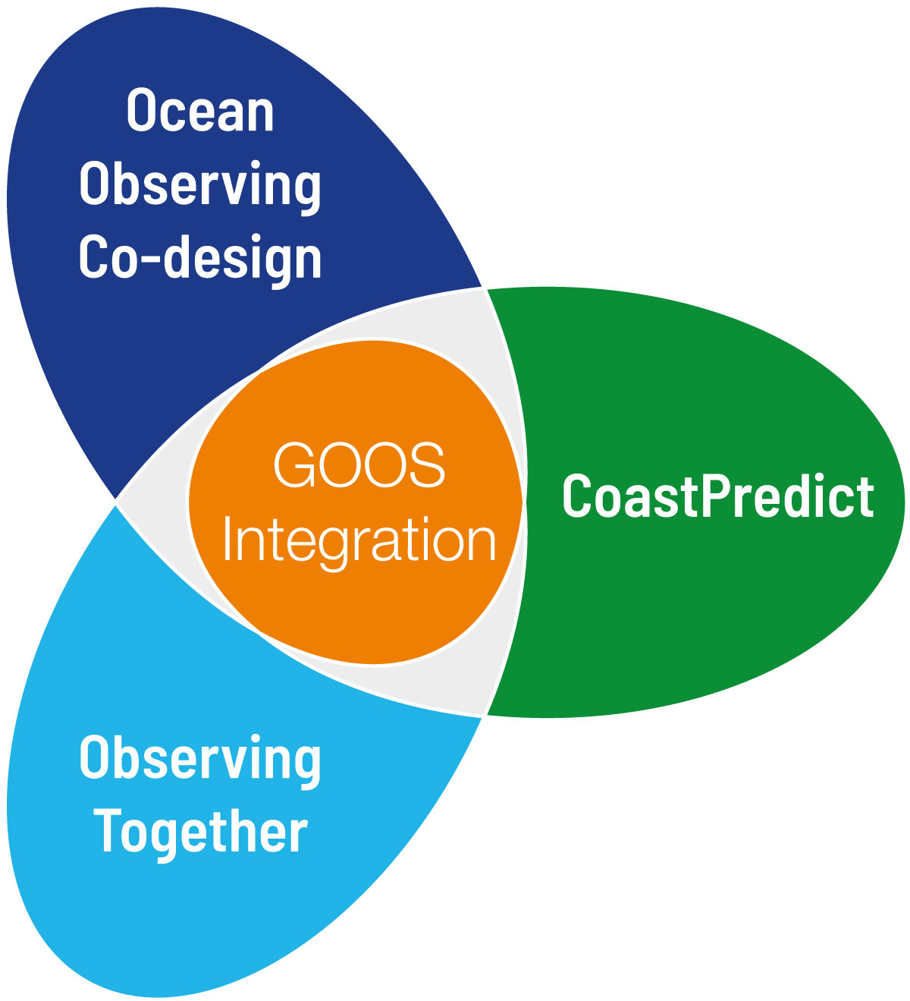
System Integration & Delivery
System integration and delivery
Structure and Standards
GOOS UN Decade Programmes
Open Data
Operational Ocean Forecasting
Essential Ocean Variables (EOVs)
Best Practices
Ocean Observing Co-Design
CoastPredict
Decade Coordination Office
Data Implementation strategy
BioEco Portal
Notes:
This Slide is GOOS core business
Expert Team on Operational Ocean Forecasting (ETOOFS) – new guide for operational ocean forecasting 2022
Essential Ocean Variables – to help observers structure observation systems and to deliver efficiently on reporting on indicators, policy etc.
Connecting observing and modelling, system design and users.
Operational Ocean Forecasting System launched, new EOVs in pilot and adopted, EOV Paper will be completed 2023, GOOS endorsed Best Practices OBPS.
Data Implementation Strategy (common across the networks - linked to IODE, WMO, future federated systems). BioEco Portal - visualisation of sustained BioEco observing programmes (towards OceanOPS) - vital for 2023-2025.

Slide 10
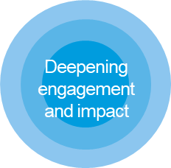
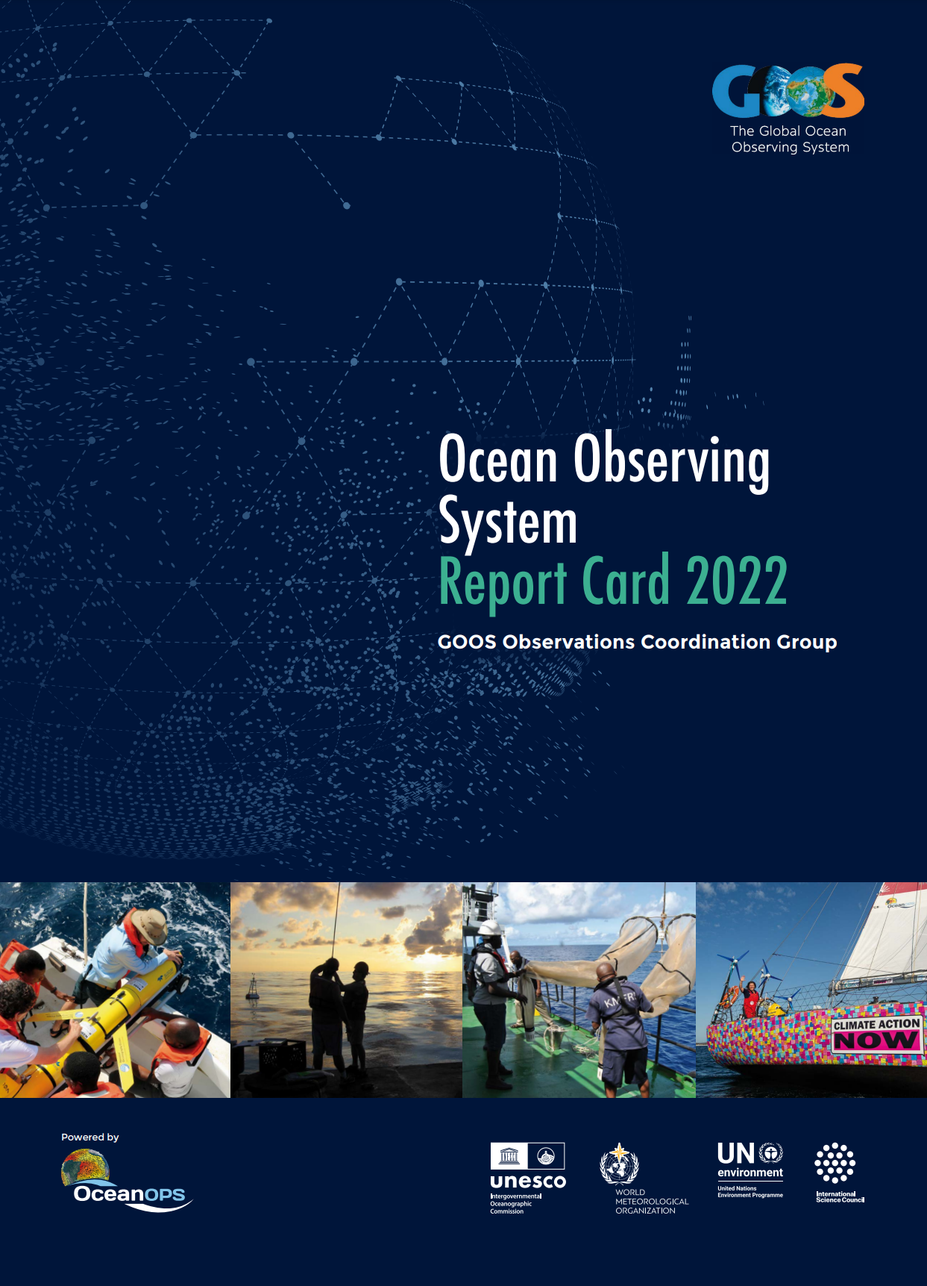
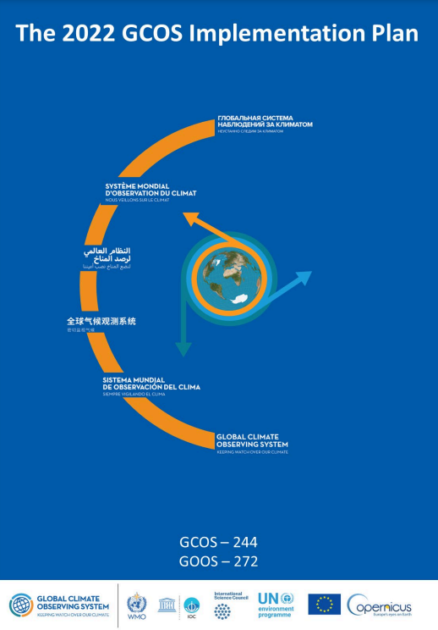
Deepening Engagement & Impact
Implementing GOOS Communication Plan
Advocacy within United Nations
Strengthened partnerships
Notes:
Implementing GOOS Communication Plan: Since August 2022, with a focus on both community and supporters/users, clear messaging and channels. Ocean Observing System Report Card is now fully cross GOOS.
Advocacy within UN: Increasing recognition of observing system and GOOS (e.g., Ocean Conference, COP27 and COP15).
Strengthened partnerships: WMO connection developed to the Rolling Review of Requirements, IODE and data, GCOS - ocean component of the GCOS Implementation Plan - work to strengthen with UNEP, GEO BON, MSP, and others.
Change: Building understanding need for ocean observing and GOOS - through consistent and clear messaging across communications and advocacy. We have adopted a professionally developed Communications Plan last August that channels and focuses our communications on both our observing community and on the supporters, users and funders (broader audience) on the observing system.

Slide 11
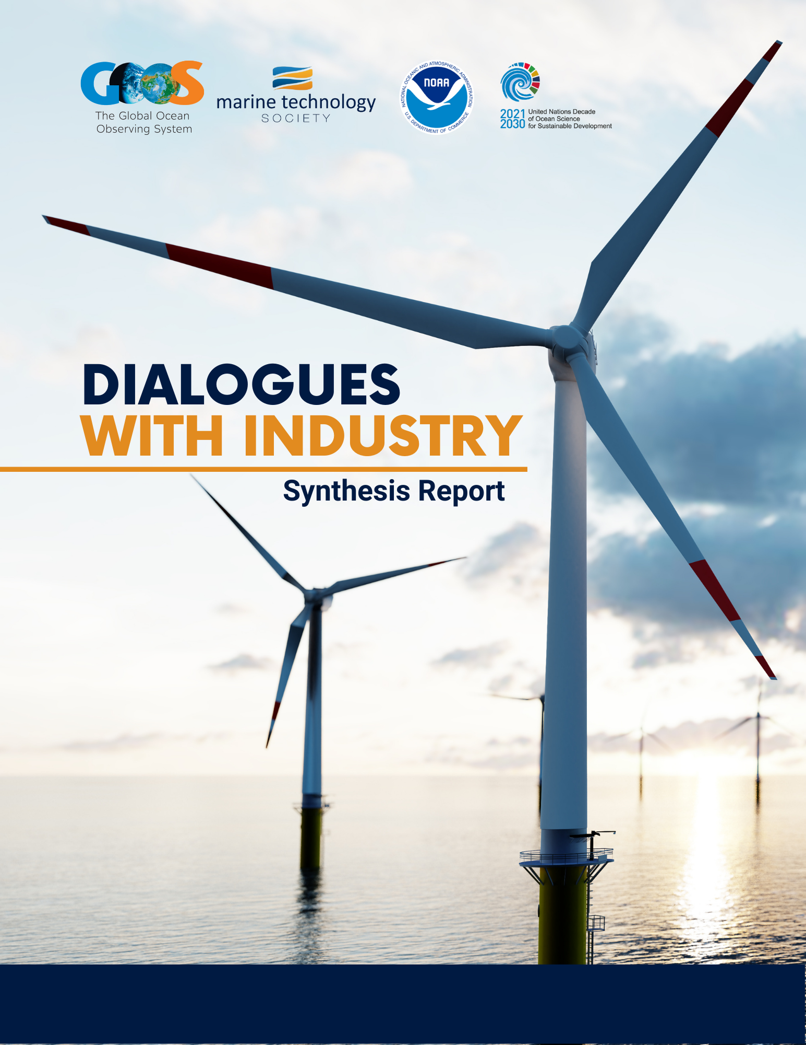
Building for the Future
Dialogues with Industry
Marine Debris Observing System
Notes:
Here is an example of what we are doing for the future
Governance (in report)
Industry-how to expand the ocean observing system and services with the private sector
Human Impact - IMDOS
Multiple partner funded - link to the plastics convention, UNEP

Slide 12
UN Decade: Ocean Observing Co-Design
*Each exemplar is at different levels of maturity
The Ocean Carbon Cycle
Tropical Cyclones
Storm Surge
Marine Life
Boundary Currents
Marine Heatwaves
Notes:
This is an example of the UN program – OCEAN SERVICES lifting the observing system in key areas for better forecasting and end users:
In general each exemplar will follow a similar development path. From the basics of initiating communications and a co-design process (engaging users, describing the value chain, etc) to full-scale globalization of their intended activities.
Different exemplar areas are at different readiness levels - some will mature to implementation within a year, others will need longer to determine the design and the value - often down to the maturity of the sector and the service - e.g. tropical cyclone forecasts are well connected to users - we are increasing the accuracy, but for carbon, and marine resource management the services do not yet exist.
They all share in common the common purpose of developing tools/diagnostics, and best practices and demonstrating their effectiveness through pilot projects that, if successful, could then be scaled to a more permanent and global scale system.
The Ocean Carbon Cycle: Improving carbon data to inform climate targets, such as net zero
Tropical Cyclones: Advancing tropical cyclone forecasting to save lives & property
Storm Surge: Improving predictions to minimise impacts on vulnerable communities & natural resources
Marine Life: Conserving marine biodiversity and supporting sustainable use of resources
Boundary Currents: Understanding key current systems that significantly influence productivity, weather and climate
Marine Heatwaves: Monitoring marine heatwave impacts on biodiversity and economies

Slide 13
GOOS Steering Committee April 2023
Focus areas for the next period:
Communications and advocacy
Regional coordination
UN Ocean Decade - Co-Design
Evolving GOOS Governance - key 2023
Strengthening GOOS core support is absolutely vital

Slide 14
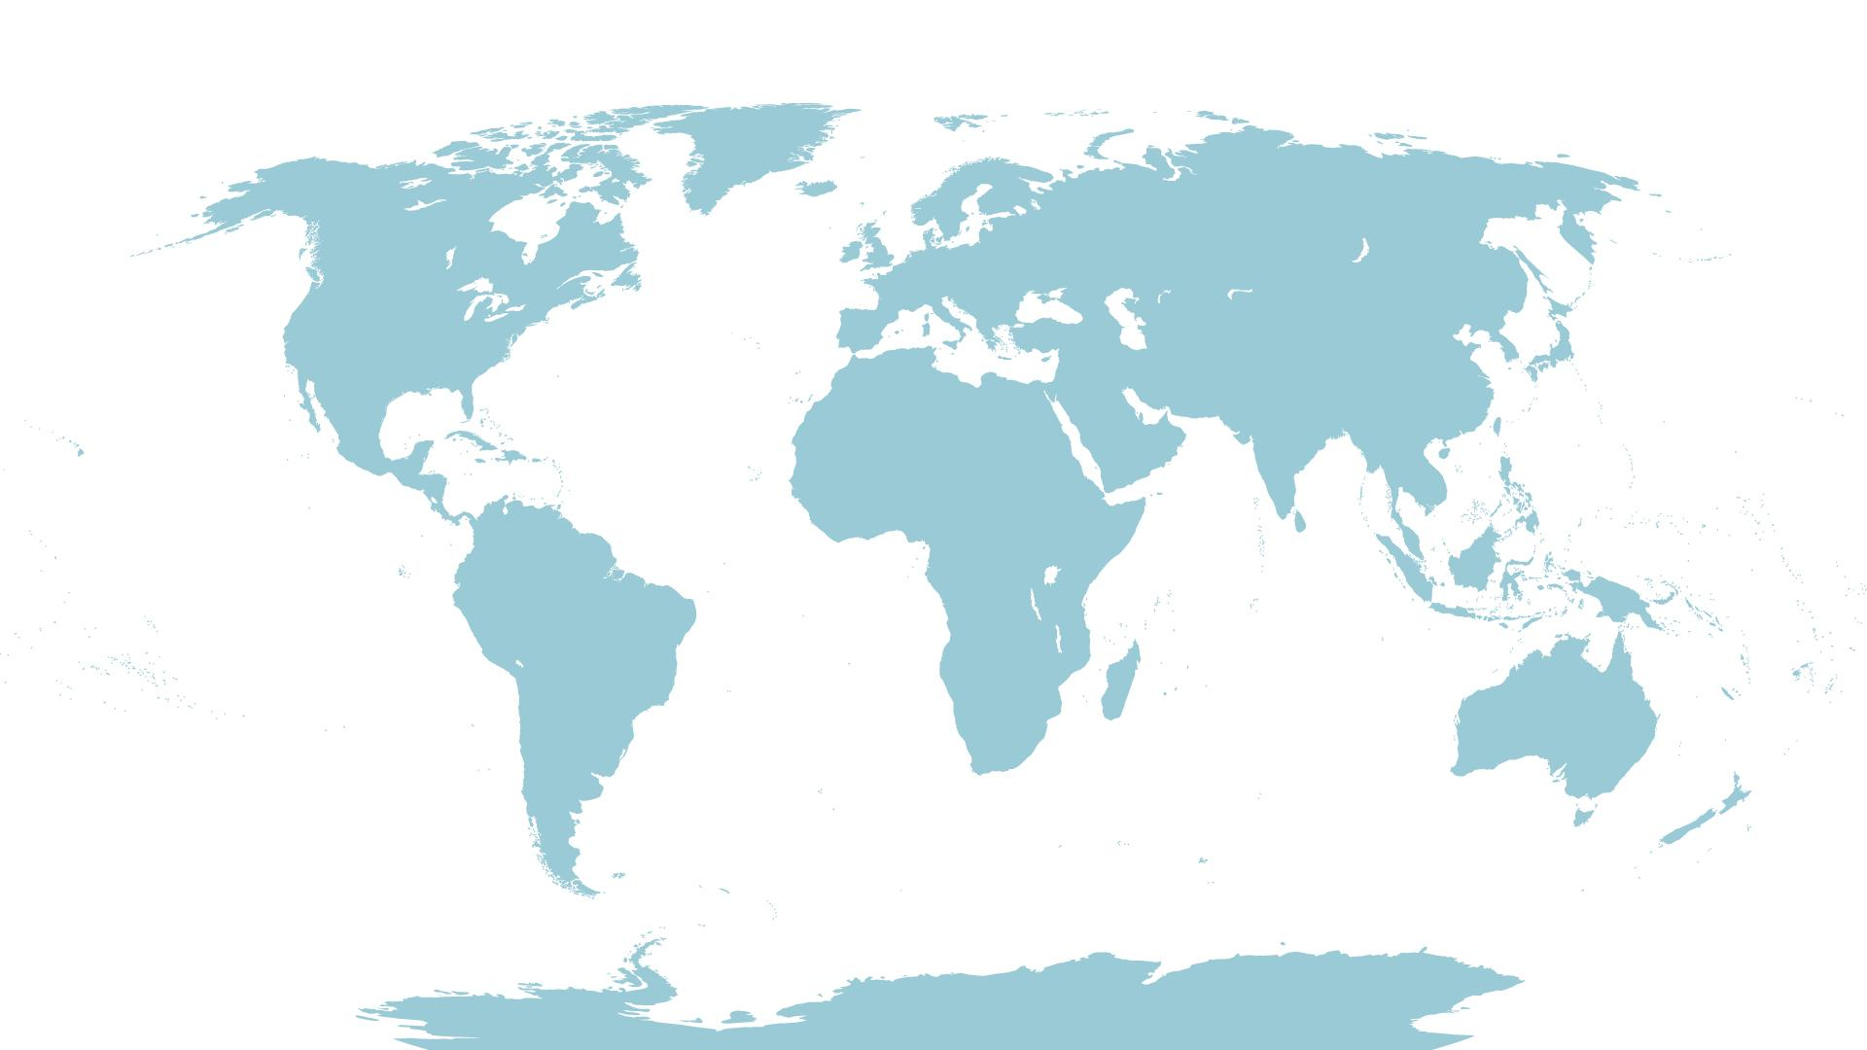
GOOS Support Structure (FTEs)
BioGeoChemical Panel
Now | 2024 | 2026
2 | 3.5 | 4
GOOS HQ Office
Now | 2024 | 2026
5.4 | 10 | 13
Ocean Obs Physics Climate Panel
OceanOPS
ETOOFS
Now | 2024 | 2026
1 | 2 | 2
Now | 2024 | 2026
8.5 | 12 | 16
Now | 2024 | 2026
0.25 | 1 | 1
Obs Coord Group
GOOS Regional Alliances
Now | 2024 | 2026
2.4 | 4 | 4.5
Now | 2024 | 2026
0.25 | 1 | 1.5
BioEco Panel
Ocean Decade Total
Now | 2024 | 2026
0.8 | 0.8 | 0.8
Now | 2024 | 2026
2 | 8 | 10
Now | 2024 | 2026
20 | 35 | 45
GOOS Total
Notes:
GOOS PEOPLE Core support has grown since 2021 (14 to 20 FTEs) with new secondments, loans and funders. GOOS wants to thank all those that are supporting GOOS coordination. BUT we need to do more & soon. GOOS needs to grow by 50% in the next 18 months and to double its staff by 2026.
Distributed global system that needs backbone of support in the Core Office.
Critical now are:
Core support staff for the BioEco Expert Panel
Core support staff for the Biogeochemistry Expert Panel
Support for OceanOPS
Increased support for data issues
GOOS Paris HQ needs help to execute and link across the core GOOS entities, as well as pulling in national focal points more effectively and communicating outwards to sponsors and supporters

Slide 15
IOC-32 Assembly,
June 2023
EEZ Decision:
to establish an ad-hoc intersessional Working Group on Ocean Observations in Areas under National Jurisdiction. and
to report to IOC-33 Assembly in 2025, with a progress report provided to IOC EC-57 in 2024.
Invites Member States to volunteer to be part of this ad hoc Working Group

Slide 16
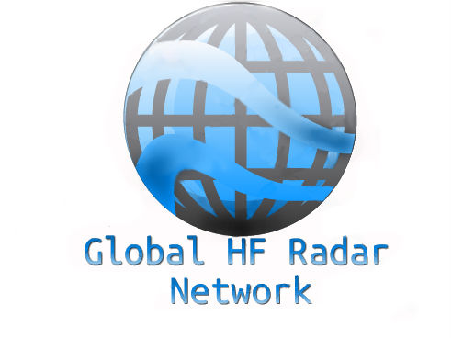
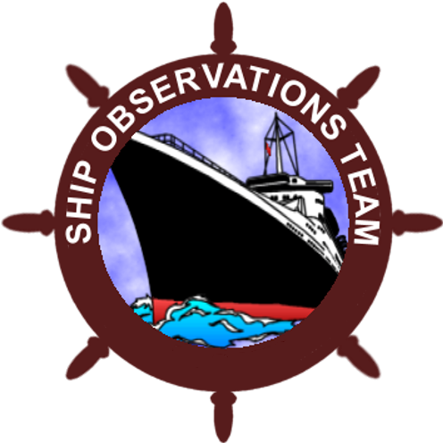
The Observations Coordination Group
…works to guide and strengthen, coordinating and developing relevant initiatives across the global ocean observing networks.
ACHIEVEMENTS
Engagement on RRR process
Request to be considered in WMO GBON
3 Emerging networks to mature status
Adopted Data implementation strategy
6 Best practices endorsed, 3+ in process
Across GOOS Report Card
Capacity development Webinar & workshops
OceanOPS strategic plan on track
NEXT STEPS
Implementation of the OCG data strategy
Coordination across groups to catalyze studies for WMO Impacts Workshop
Process development across GOOS to assess readiness and prioritize observing
Task Team to refine metrics of readiness and maturity of networks
Lower barriers w/ industry partnership via GOOS/MTS Dialogues
David Legler, OCG Chair & Director, GOMO, NOAA
Notes:
3 Emerging networks transitioning to mature status [AniBOS, OceanGliders, HF Radar]
Potential new networks interacting with OCG [Smart Cables, Ship based ocean time series, USV OASIS, Marine Debris]

Slide 18
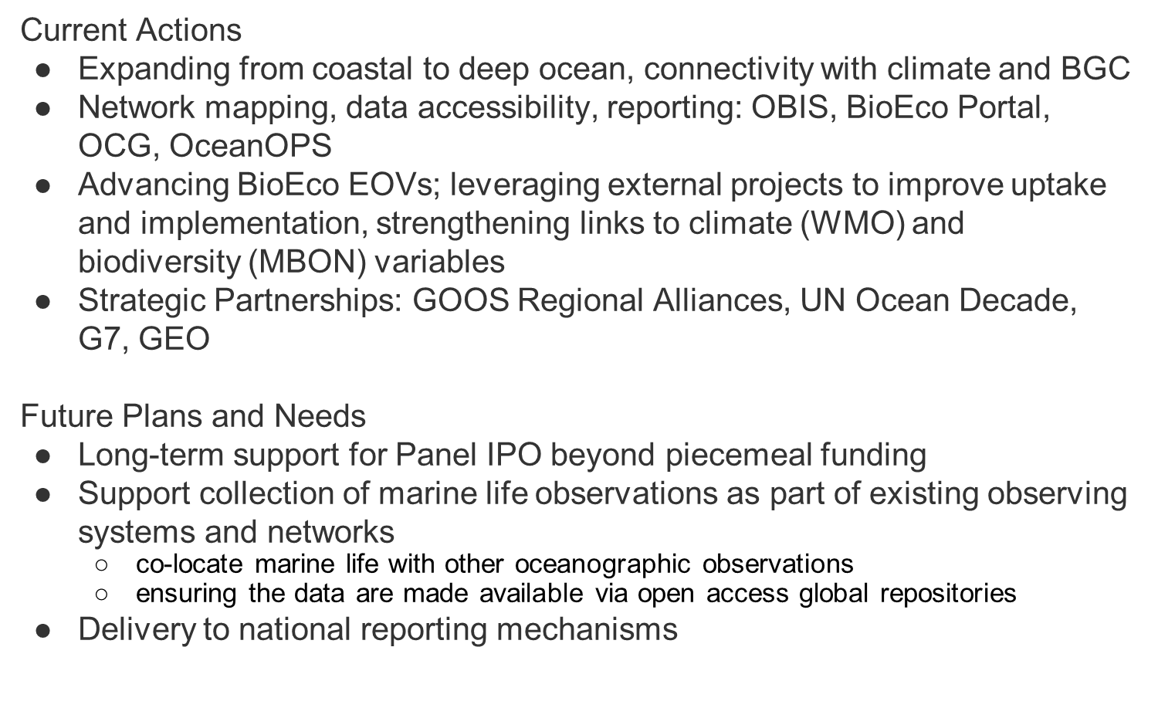
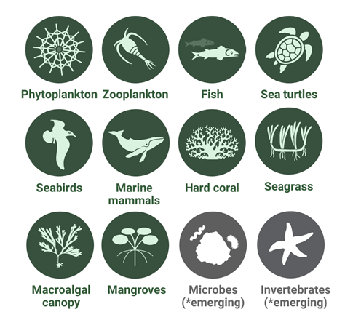
Notes:
●The BioEco Portal, completed in July 2022, is an online platform that provides essential metadata for the extent of BioEco observing networks in the global ocean to identify who is measuring what, where, how, and why for marine life
●This is a key starting point for coordinating and improving access to marine life observations, thereby bridging the gaps in data collection.
●This directly delivers on Strategic Objective 3, Task 3.5 in the GOOS Implementation Plan: Develop an interactive map of networks and metadata for biological monitoring.
●The ocean observing community can use the BioEco Portal to access information on BioEco observations and the sustained programs that collect them.
●A key objective is to establish an automated data and metadata flow from ocean observing programs to the portal and other data management systems like OBIS, and to build linkages to OceanOps to improve GOOS accounting of BioEco networks and progress.
●This latter point is one that we would welcome discussion about with the Steering Committee. What is the suitability of the Bioeco Portal from an Ocean Ops perspective? Is there a pilot effort we can undertake to engage with Ocean Ops to improve pathways for BioEco networks and variables to be more visible.
Background:
The Portal was developed using information from the global survey undertaken by the PEGASuS/Future Earth project and enhanced through the addition of European networks identified during surveys and workshops conducted by the
EuroSea project. The portal currently contains information from 634 programmes and programme contacts are further updating the information through the GeoNode edit interface of the GOOS BioEco Portal.

Slide 19
Operationalizing the Ocean Carbon Observing System
Maciej Telszewski (Director, IOCCP, Poland), Maria Hood (Head, G7-FSOI, EU Office)
Richard Sanders (Director, ICOS-OTC, Norway), Toste Tanhua (Co-Chair GOOS)
Notes:
One of the major elements of our mission delivery currently is assisting the ocean biogeochemistry community with operationalizing the ocean surface carbon value chain.
Drivers
•Past variability of ocean carbon flux is known to be large
•Future behaviour is uncertain, once we reach Net Zero ocean has potential to become a source of CO₂ back to the atmosphere
•Big implications for size, cost and timing of mitigation and adaptation measures
•Urgent decisions on climate mitigation, marine carbon dioxide removal, ocean health and emission reduction require a trustworthy, observation based air-sea CO₂ flux product
Status
•We have all the components of the value chain and when they occasionally work together, they have a demonstrated ability to estimate surface ocean CO₂ uptake to very high precision in near real time.
•Much of the system is supported by short term research funding rather than longer term operational funding (similar to Met obs.), which is rather counterproductive at the time of the climate emergency when we most need to know ocean carbon uptake in near-real time for a wide variety of purposes.
•Significant data gaps are appearing and key parts of the chain operate on a best endeavours basis – we are sliding back down the curve, just when we need to be climbing it.
•We are in a process of describing a fully operational Ocean Carbon Observing System capable of operationally delivering ocean carbon flux information. Strategy will include a tailored investment in suport of this operation.

Slide 20
GOOS GRA and NFP – Opportunities
Denis Chang Seng, PhD, Programme Specialist, GOOS/ IOC UNESCO

Slide 21
Questions?
Notes:
This statement sums up the ambition of the Ocean Observing Co-Design programme. By 2030 we want to have processes and tools that will be modular and globally applicable to design and evaluate observing systems in order to inform investment. Sponsors will be able to ask key questions about cost and benefit and receive clear answers. ANd the ocean observing systems will be more impactful

Slide 22
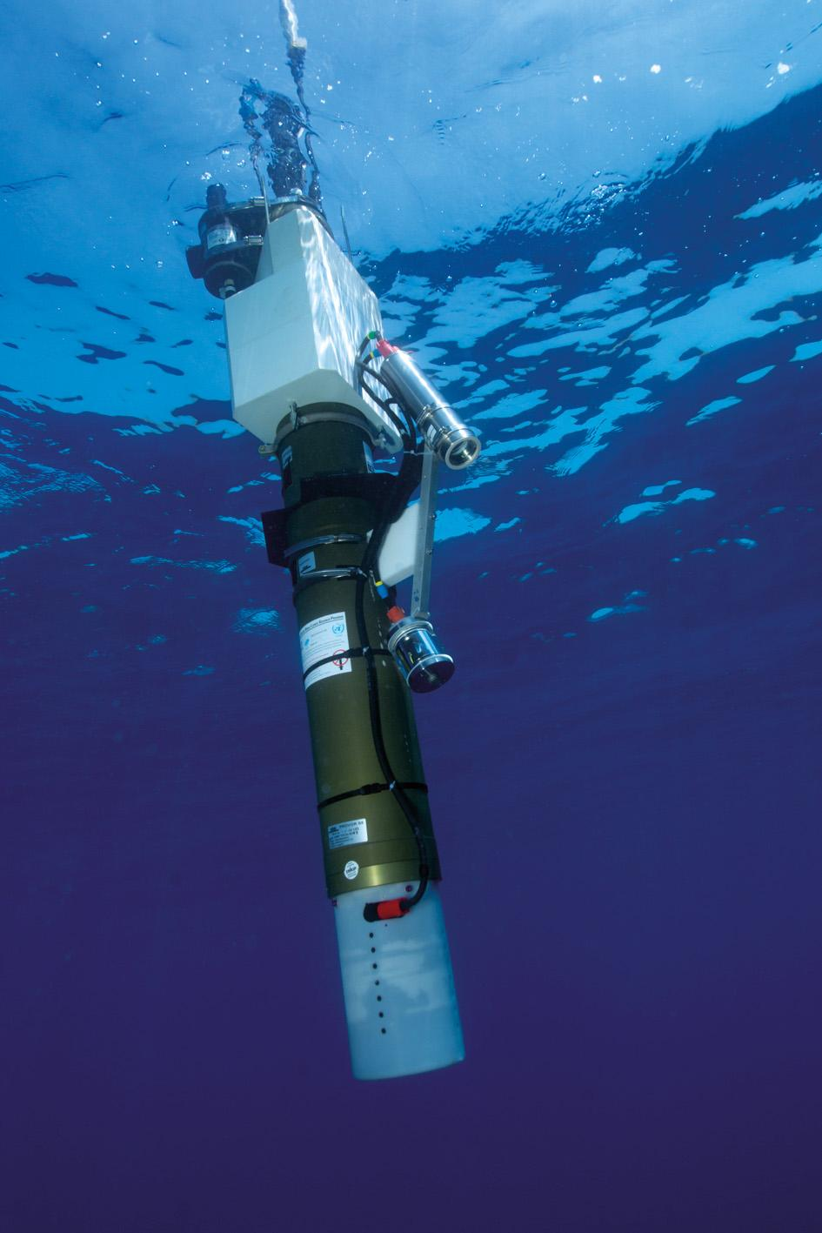
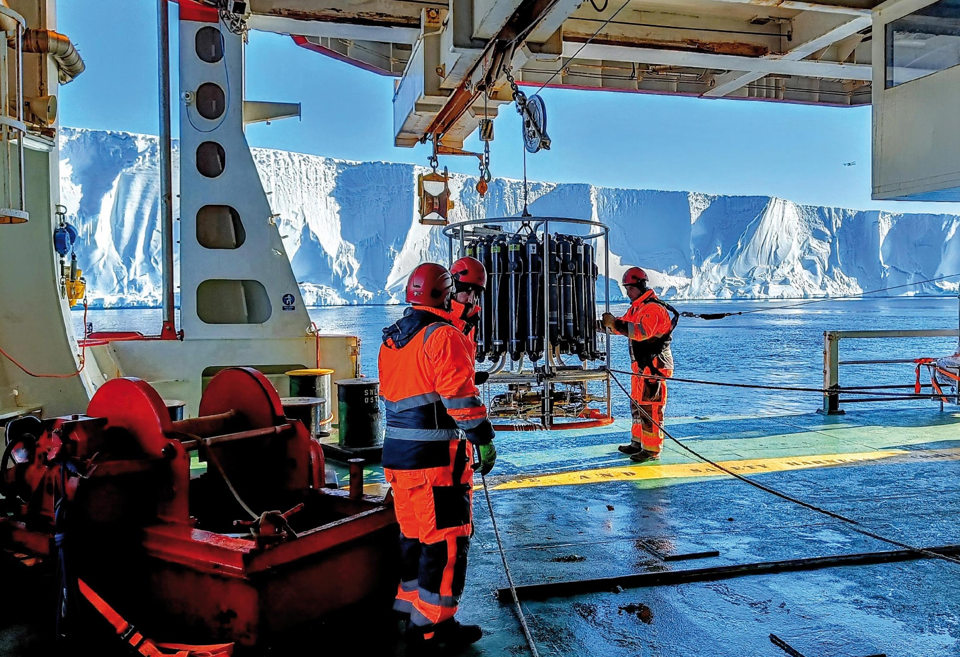
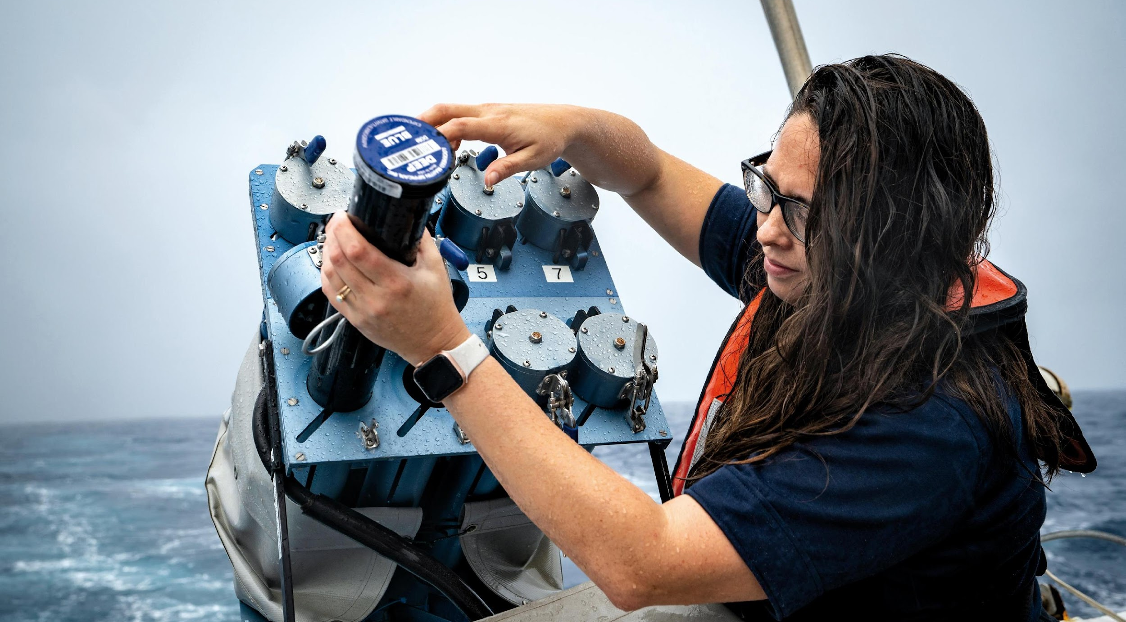
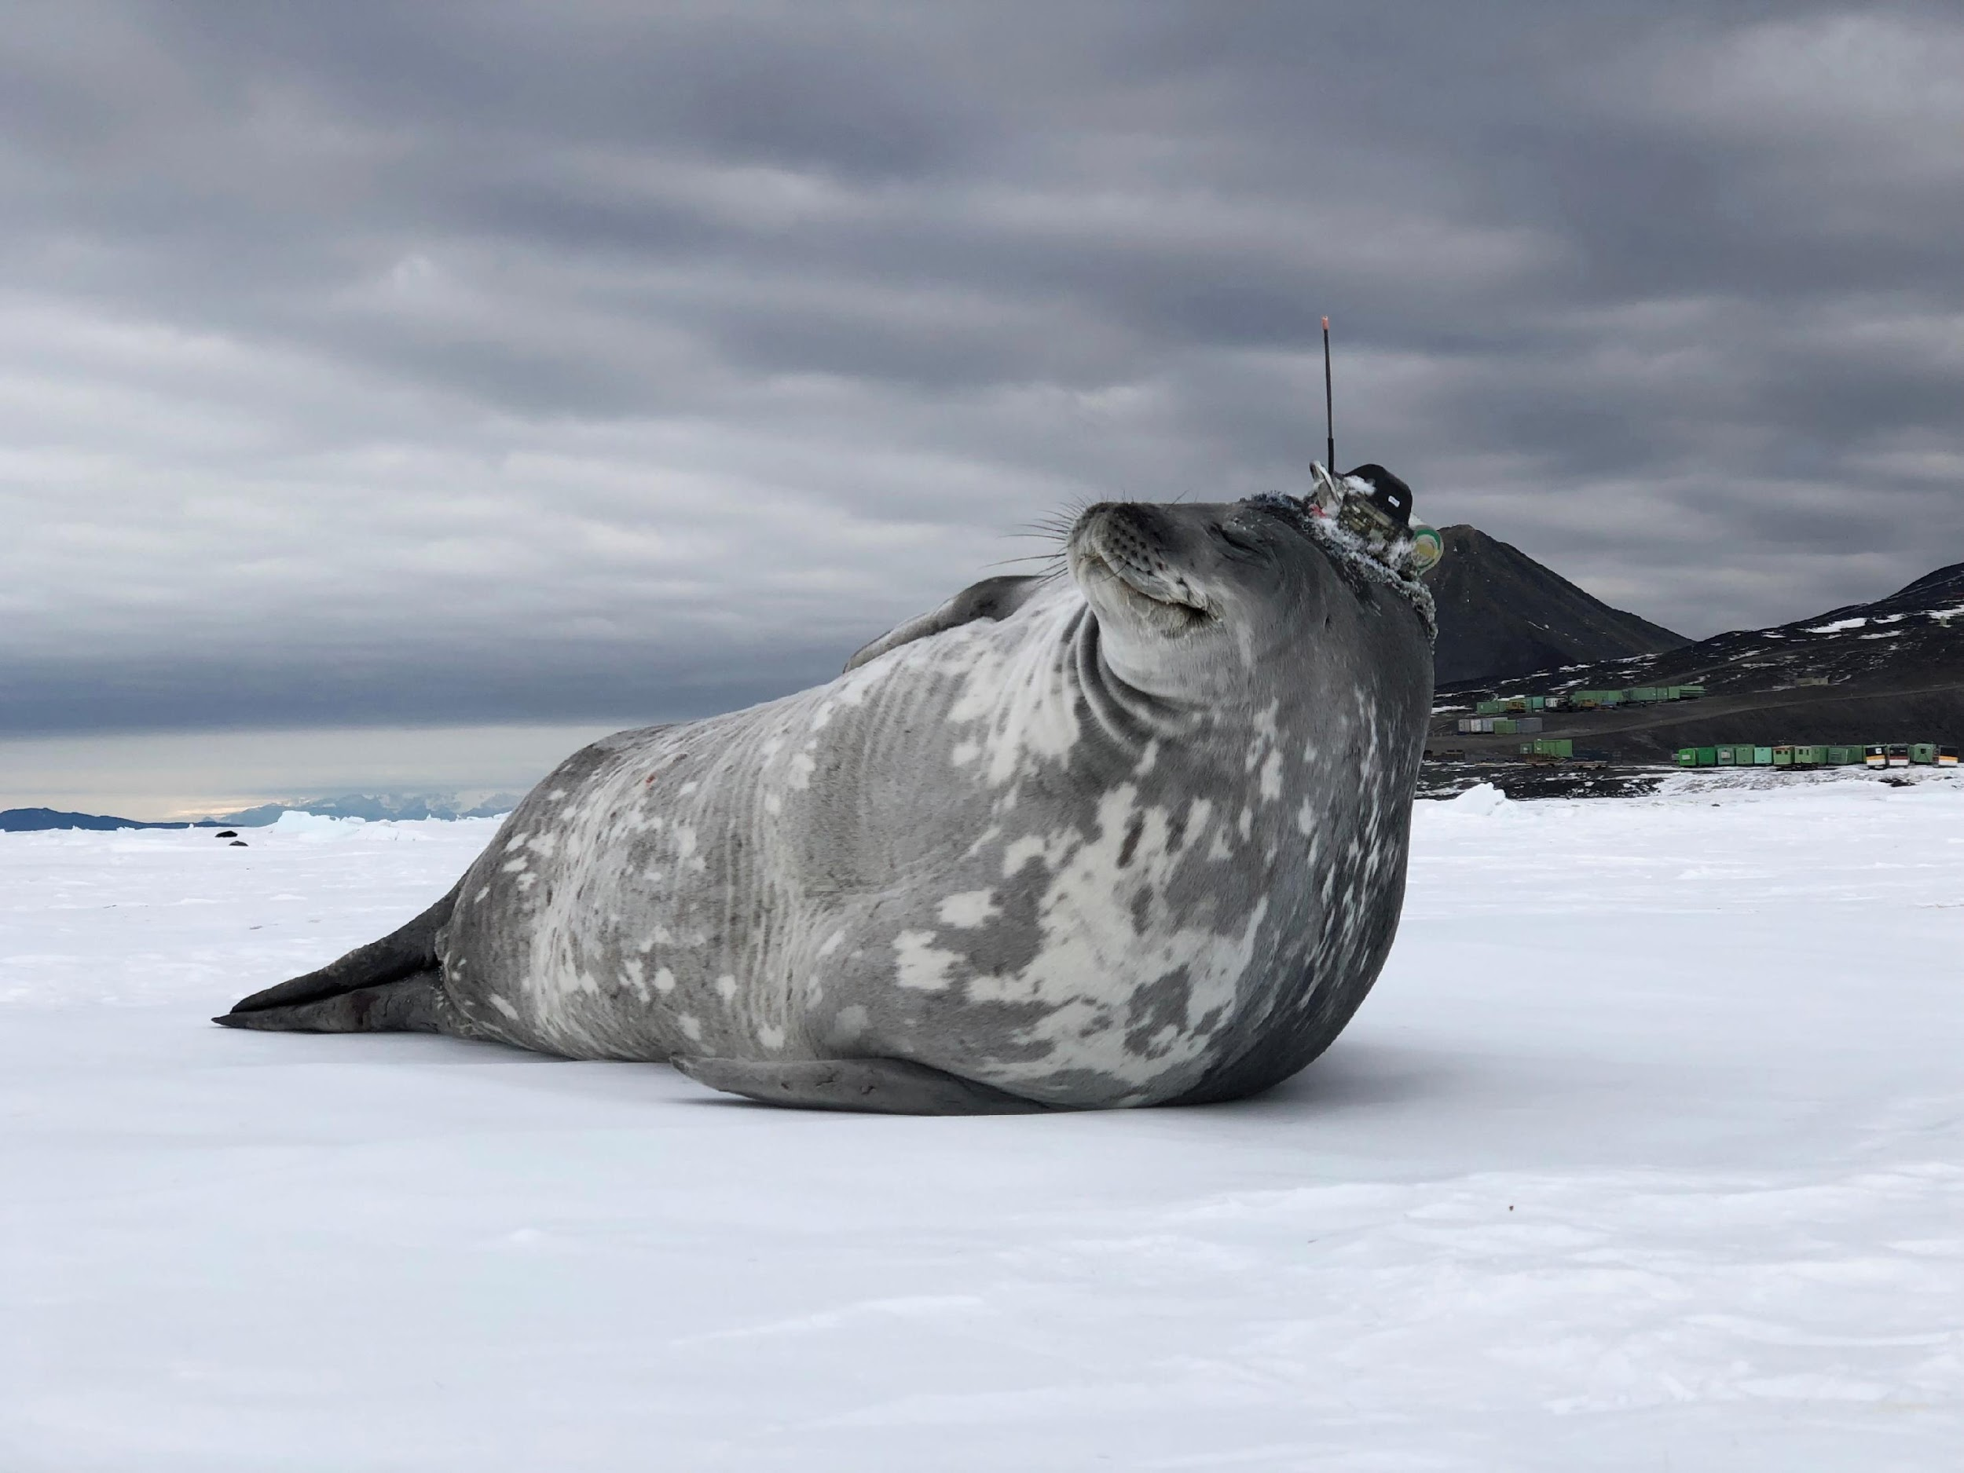
Thank you
goosocean.org

