Slide 1
Session 2: National Structures
National Committee & reporting
R Venkatesan & Mathieu Belbeoch
GOOS OceanOPS
Friday 22 September 2023, 09:30 – 13:00 CEST
Room IX, UNESCO, Paris, France

Slide 2
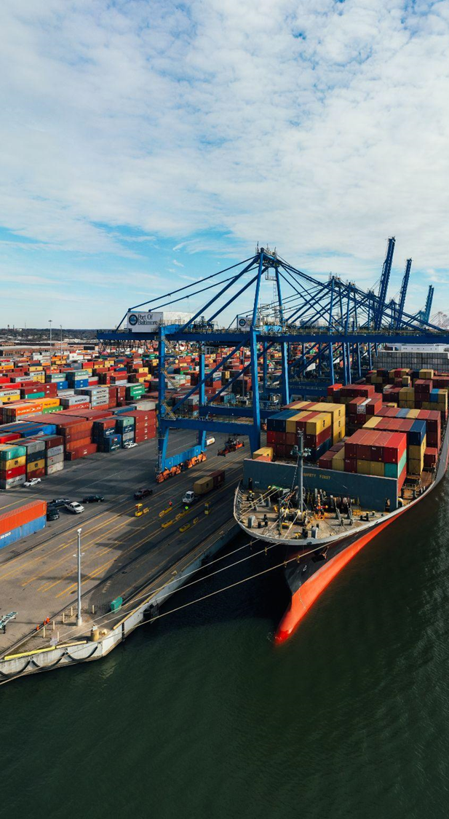
2.1 National Committee
Establishing National GOOS Committees and developing national connections and interaction with ocean observing value chain
What can GOOS do to support NFP in developing connections and/or committees?

Slide 3
Suggested Connections - NFP ToR
Rep of national ocean observing programmes or systems, across open ocean, coastal, physical, biogeochemical biological realms
National rep GOOS ocean observing networks, DBCP, Argo, GLOSS, SOT.
National rep of GOOS Regional Alliances (GRAs), where relevant
National rep of GOOS sponsors IOC, WMO, UNEP and ISC
National ocean data, modelling, ocean assessment activities,rep of IODE
National Committees for the Ocean Decade, if designated
Other relevant national committees such as for the GCOS
Government departments, research institutes, and national forecasting services with an interest in ocean issues and the use of ocean information
Rep from national marine industry/blue economy, with an interest in services derived from ocean observing and forecasting, e.g., industry associations

Slide 4
2.1 National Committee Continued
Questions/ Suggestions?

Slide 5
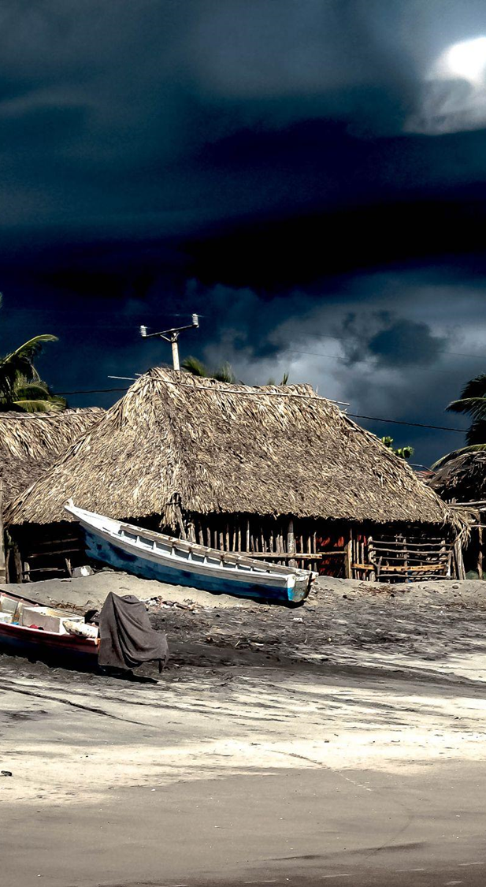
2.2 Reporting
NFP annual reporting
Practicalities, how to leverage existing reporting, visibility and value of GOOS and European projects that could support this action.

Slide 6
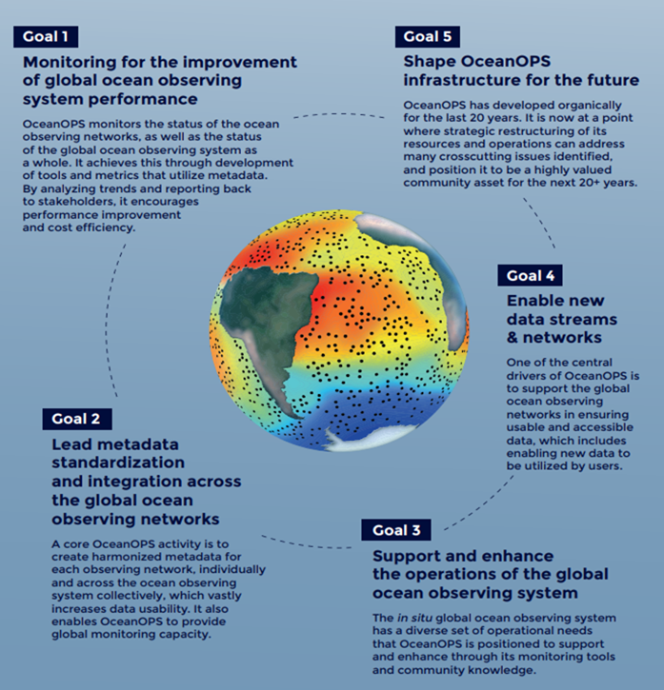
OceanOPS: GOOS operations monitoring and support centre
VISION: To be the international hub and center of excellence that provides vital services in monitoring, coordinating, and integrating data and metadata, across an expanding network of global oceanographic and marine meteorological observing communities.
5 strategic goals to achieve its vision & address GOOS evolving needs:
Monitoring: Regular reporting/monitoring (e.g. GOOS Report Card, OceanOPS Technical Bulletin, State of the Ocean Report, integrated website)
Metadata: Standard & API released, PID allocation, 80% WIGOS sync
Operations: Leading regular basin–based coordination meetings, developed tools for planning, fostering & exploring opportunities
New Networks: Providing services to e.g., emerging networks, piloting UN Odyssey third-party project, regional networks
Infrastructure: core workforce strengthened with some remaining challenges.

Slide 7
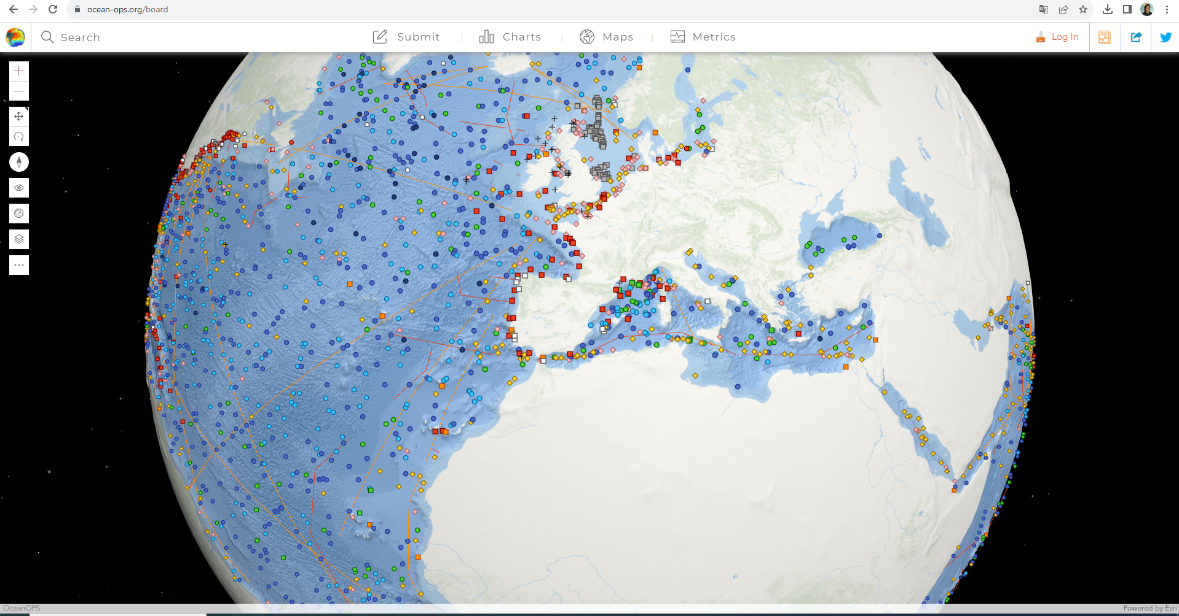
OceanOPS & GOOS National Focal Points
VISION: To be the authoritative and comprehensive monitoring and reporting tool for GOOS national programmes and focal points
A key tool to integrate various national GOOS components (complexe landscape), communicate, support and foster co-operation
Services for transparency (IOC Res. XX-6, XLI-4), efficiency, and visibility of Members (States) contributions
Reporting capability: integrated, national, regional, institutional, networks, EOV … through its website toolbox (www.ocean-ops.org)
Based on metadata gathered and quality controlled from operators and formally submitted to WMO/OSCAR for all ocean domain
ACTION: reporting capacity for GOOS NFP to be strengthened and automated (POC developed for Eurosea)

Slide 8
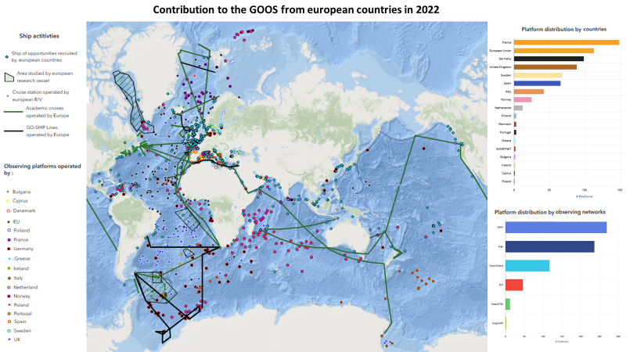
EU & GOOS

Slide 9
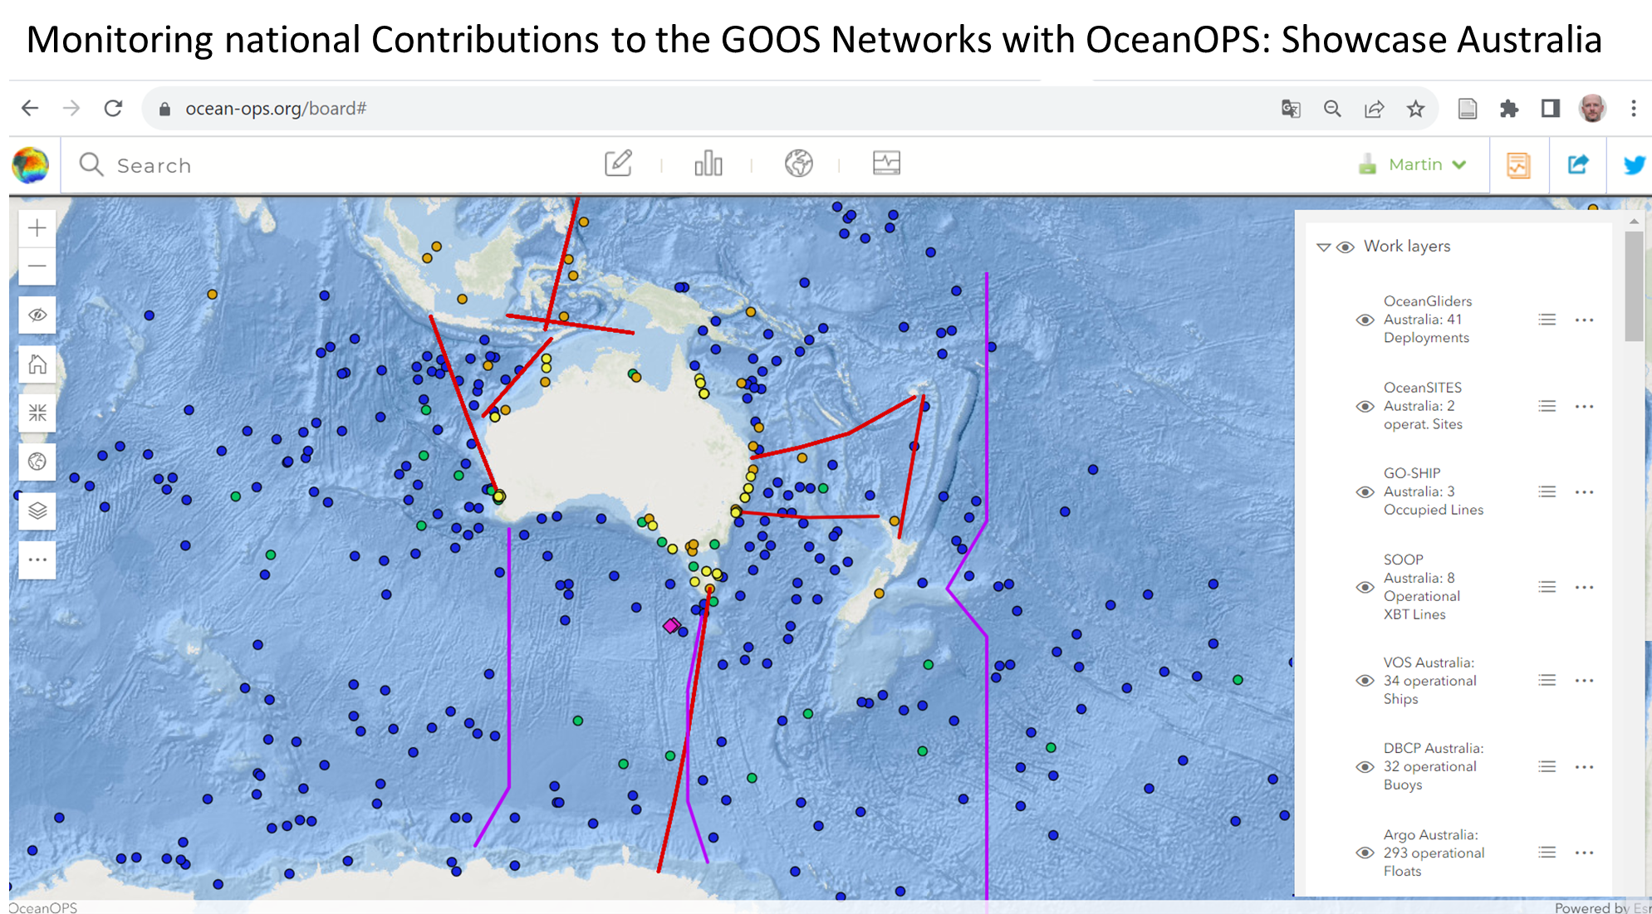

Slide 10
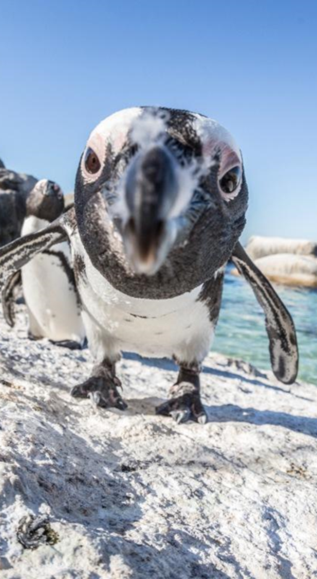
Reporting - Continued
Questions
What reporting can be leveraged now?,
How could this be achieved?,
What is the value to nations?
Discuss opportunities and challenges in developing national reporting to IOC

Slide 11
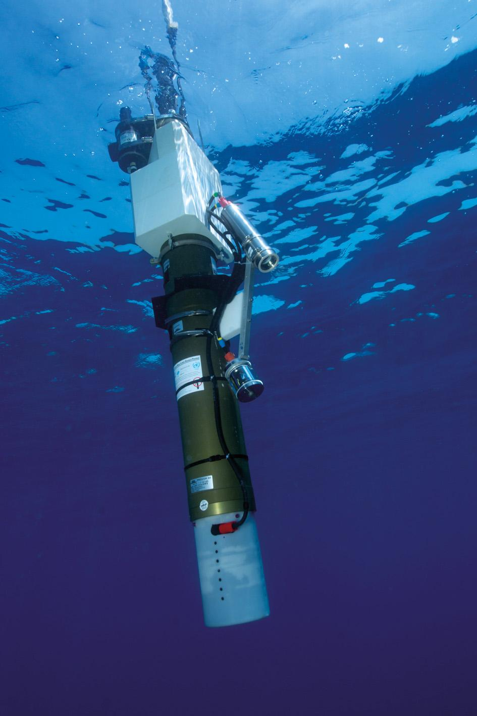
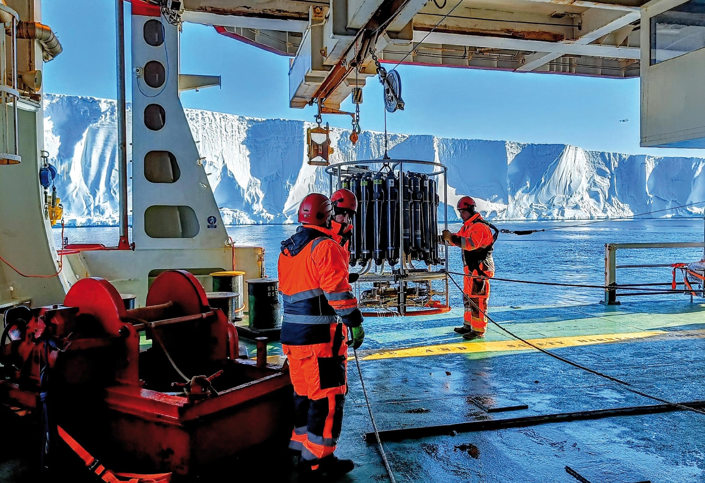
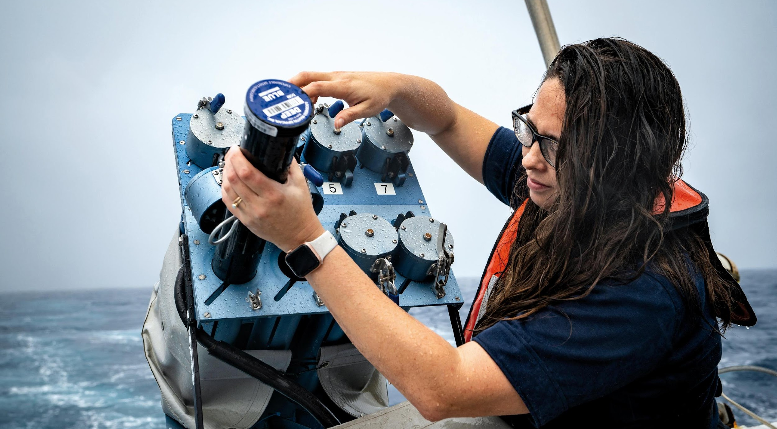
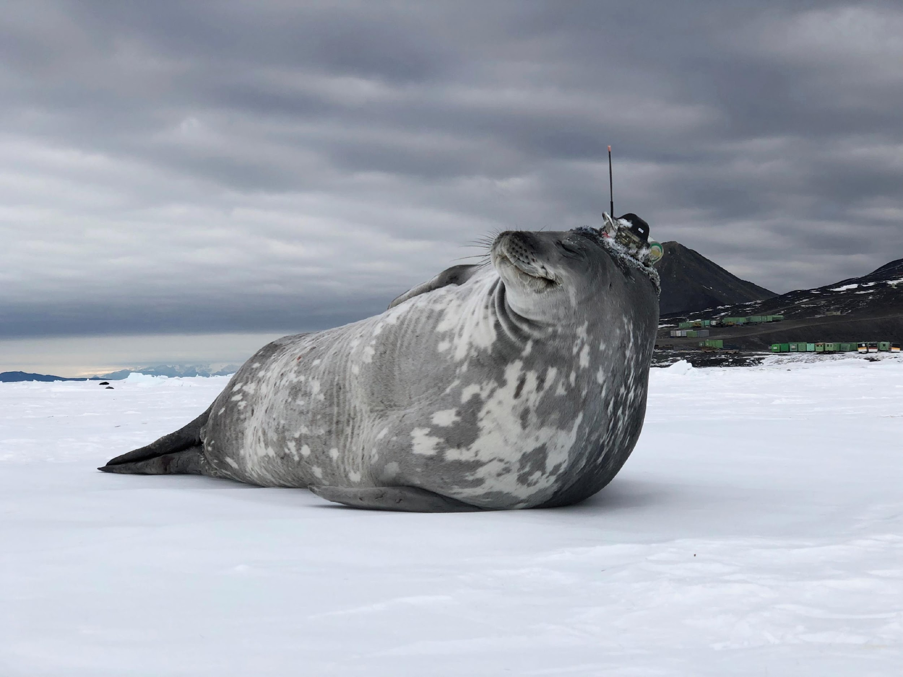
Thank you
goosocean.org

