Slide 1
Session 3: Communication
Laura Stukonyte, GOOS Junior communications consultant Emma Heslop, GOOS Programme specialist
Friday 22 September 2023, 09:30 – 13:00 CEST
Room IX, UNESCO, Paris, France

Slide 2
GOOS communications objectives
Producers / enablers of ocean data
Consumers / Users of ocean data
Strengthen the ocean observing community
Demonstrate the value of global coordination
Make the business case for sustained ocean observing
Show how critical ocean observing is to the success of the Ocean Decade
‹#›
Notes:
We can divide our audience into two main groups - the producers or enablers of ocean data, and those who consume or leverage the data. And through our communications, we then want to strengthen and champion the first group, and make the business case for sustained ocean observing to the second group. An overarching objective is to demonstrate the value of global coordination, or the work of GOOS, as well as show how critical ocean observing is to the success of the Ocean Decade.

Slide 3
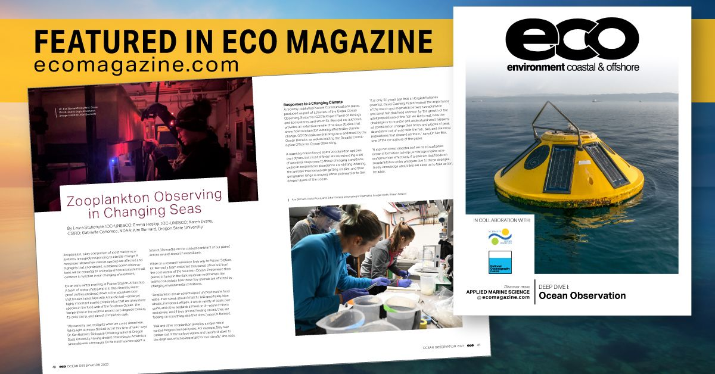
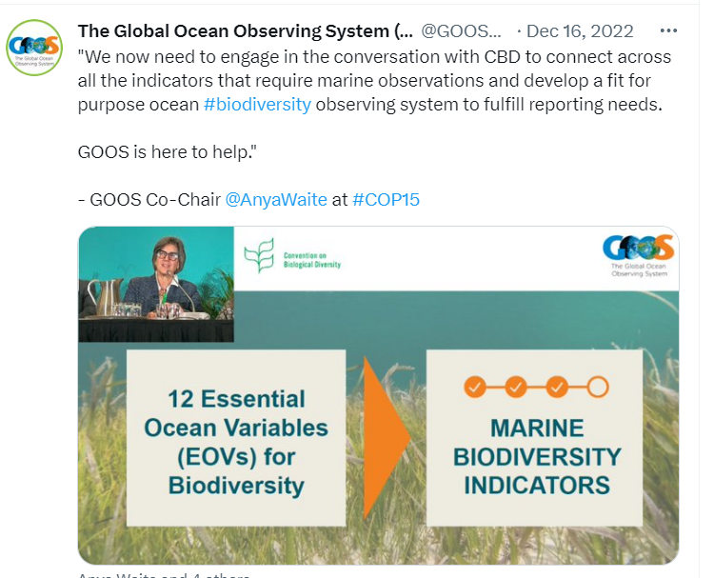
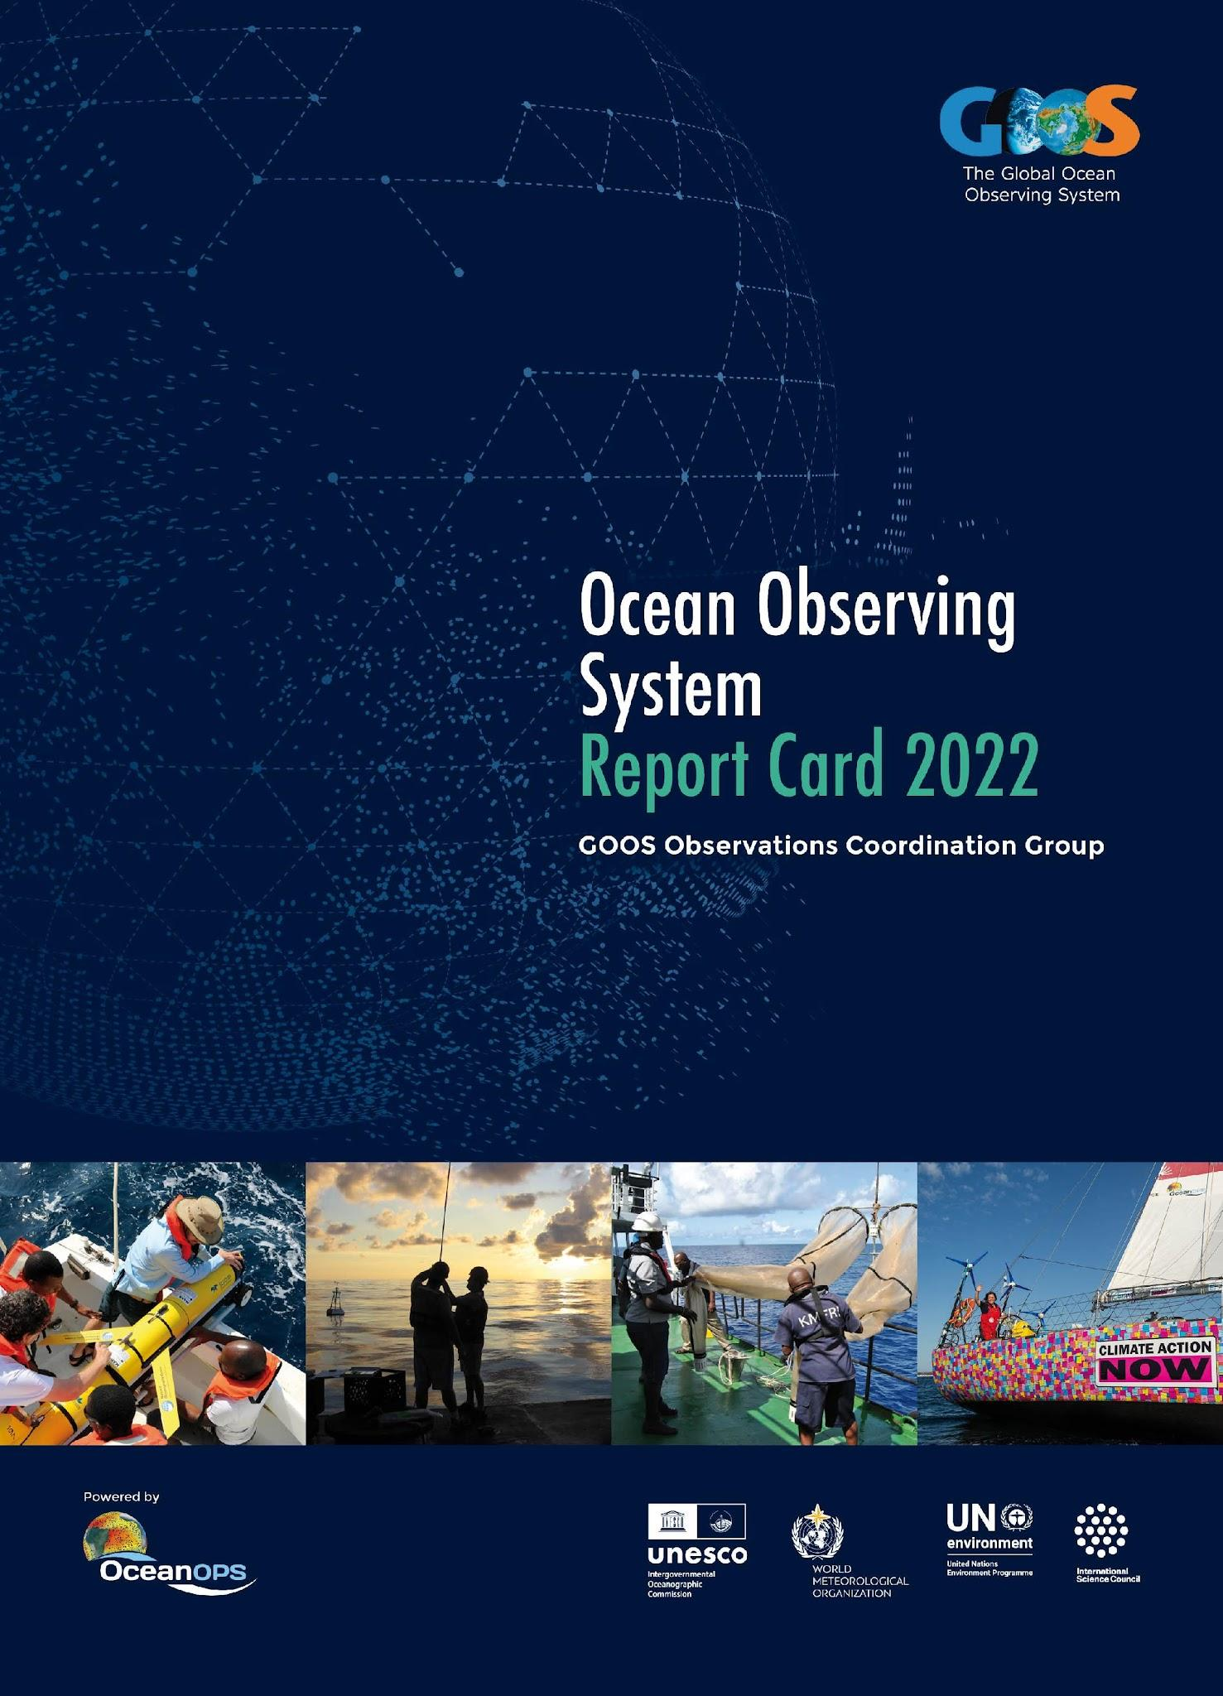
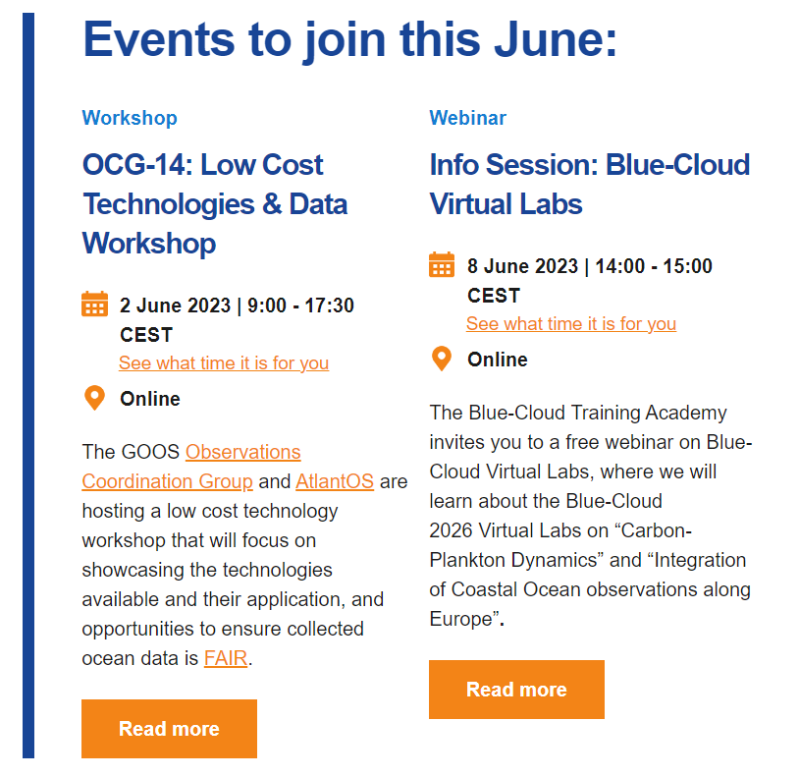
Reaching our audiences
TARGET AUDIENCE
Ocean observing community | Beneficiaries of ocean data
GOOS website
Feature stories
News articles from across GOOS | GOOS-OceanOPS Annual Report Card
Social media | Advocacy / UN
Mailing
Notes:
Feature stories: with ocean observers as champions & highlighting the value of sustained, coordinated ocean observing
News articles from across GOOS: to inform the community about recent events and advancements (e.g. GCOS conference, GOOS BioEco portal, Ocean Best Practices…)
Social media: Posts with latest news from GOOS and partner organizations (Twitter, Facebook, LinkedIn), live tweeting from key conferences
Mailing: Bi-monthly GOOS Updates and irregular GOOS Notes with announcements and events (~1850 subscribers)
Report card: Demonstrating how an integrated observing system adds value to society across the three GOOS Delivery areas: climate, operational services, and ocean health
UN Advocacy: Clear messaging on need for ocean observations (& frameworks/system) and how we help/solve - panels and presentations and flyers with GOOS, IOC, Ocean Decade - e.g. UN Ocean Conference, COP27, COP15, UN ICP

Slide 4
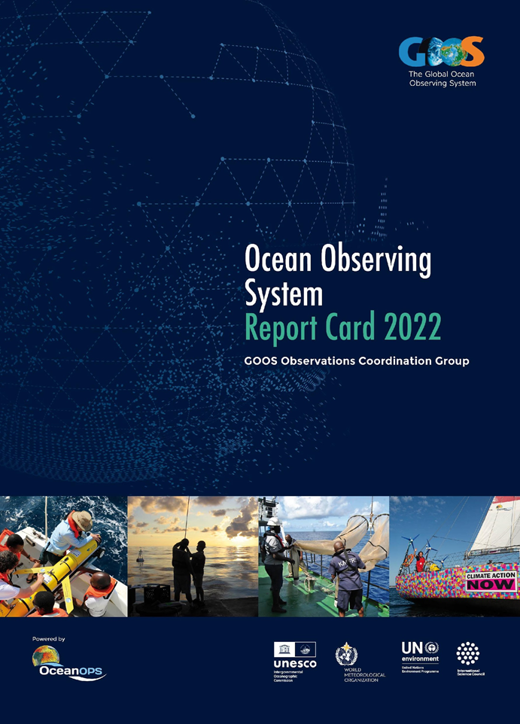
GOOS/OceanOPS Report Card
Annual report evaluating the current status of the Global Ocean Observing System.
Focuses on how an integrated ocean observing system adds value to society across the three GOOS Delivery areas: climate, operational services, and ocean health
Online version of the Report Card 2022 can be accessed here: https://www.ocean-ops.org/reportcard2022/
2023 edition to be published in October

Slide 5
goosocean.org

Slide 6
Messaging work to support NFPs
A set of easy to share messages for NFPs to use when communicating with their audiences
Consistent with GOOS overall communications
Short and long form messaging to be used in digital and printed communications (from emails to posters)
What has been done so far?
Interviewed with sample 6 NFPs conducted: Italy, Australia, India, Uruguay, South Africa and Maldives to understand needs

Slide 7
‘’Wherever they are, NFPs essentially have the same need’’
To explain the value of ocean observing, data collection and the work of GOOS to a variety of official bodies, industry and concerned audiences.

Slide 8
Next steps
Review synthesised findings with the NFPs interviewed
Develop content relating to the messages we need to communicate
Present new NFP messaging on 25 October meeting

Slide 9
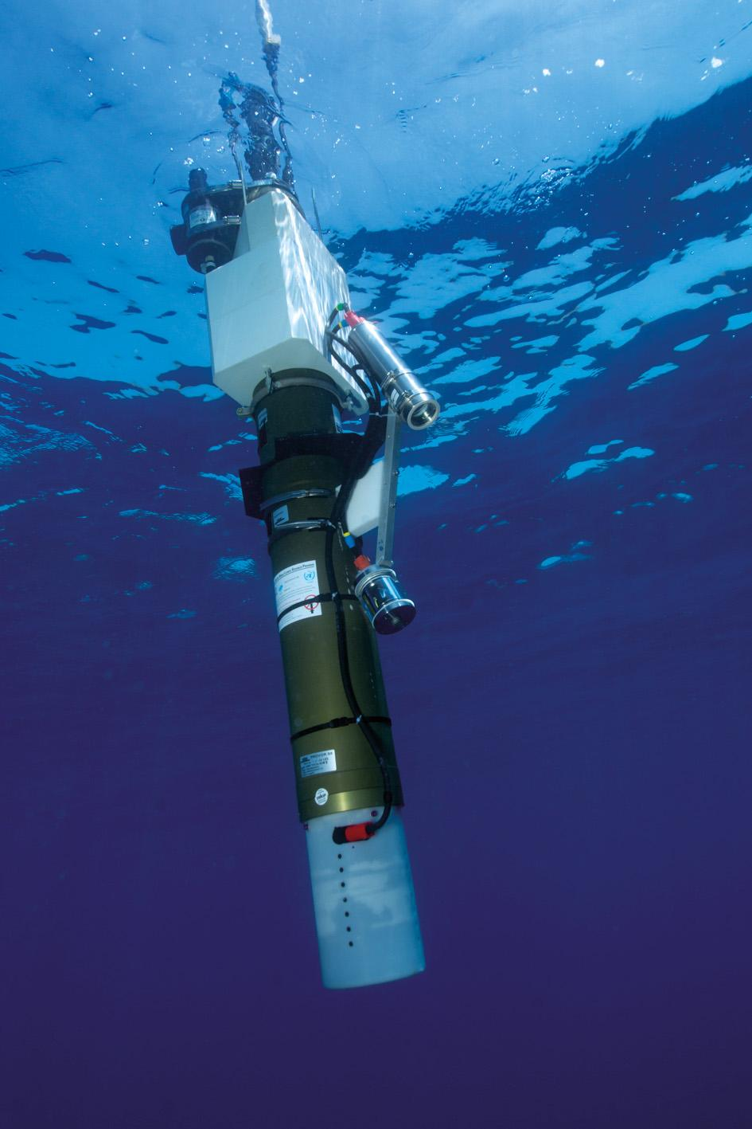
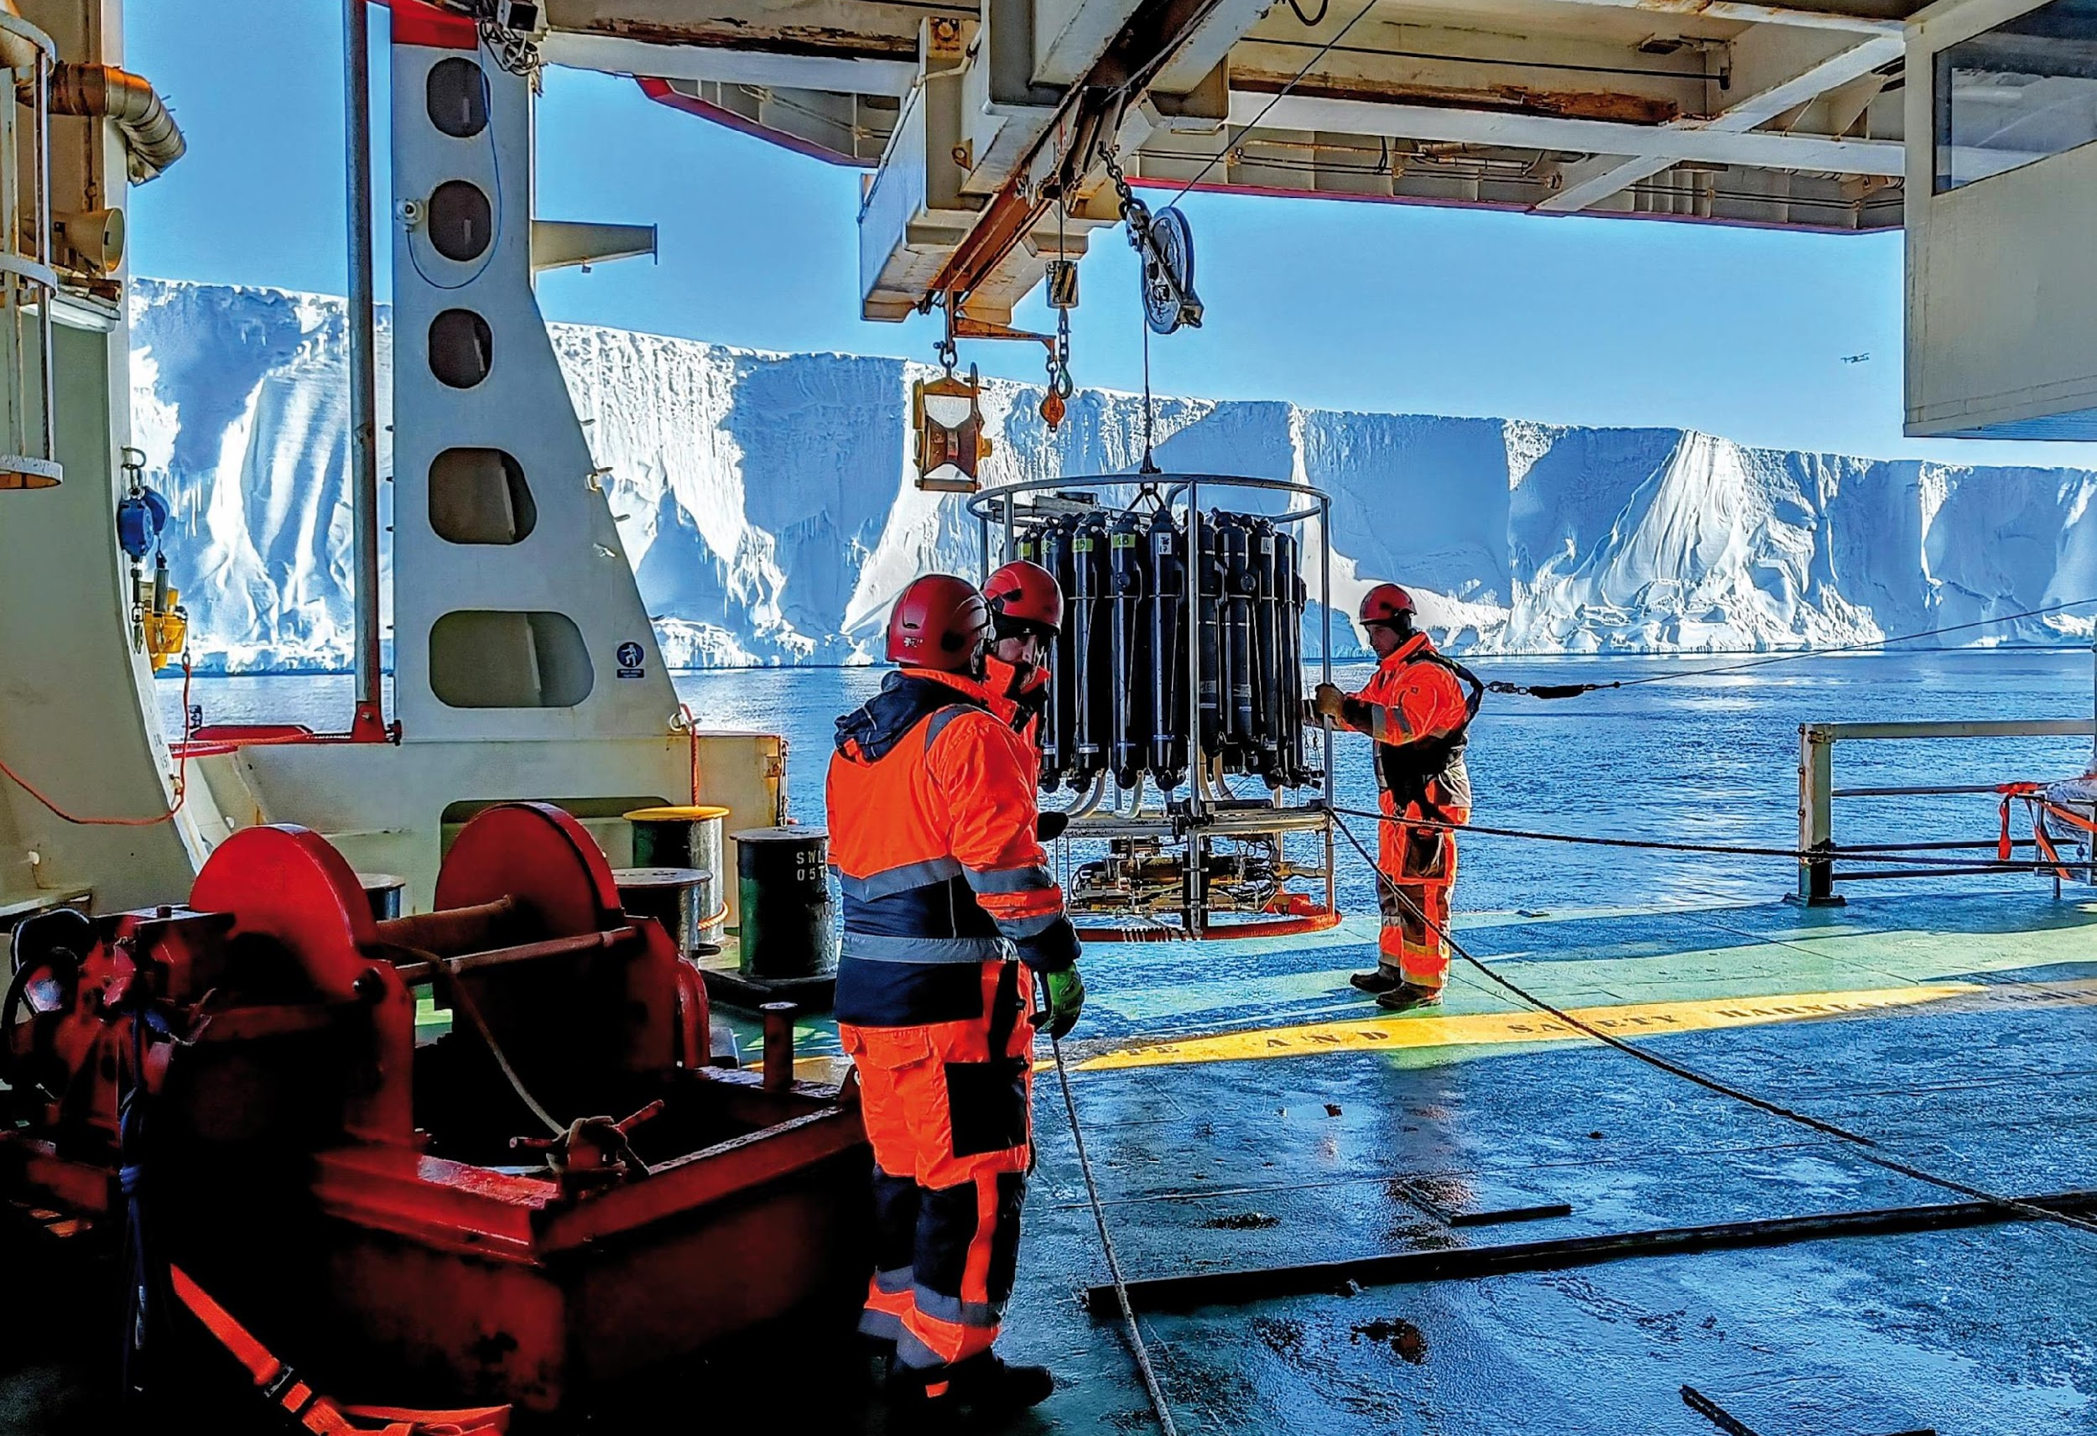
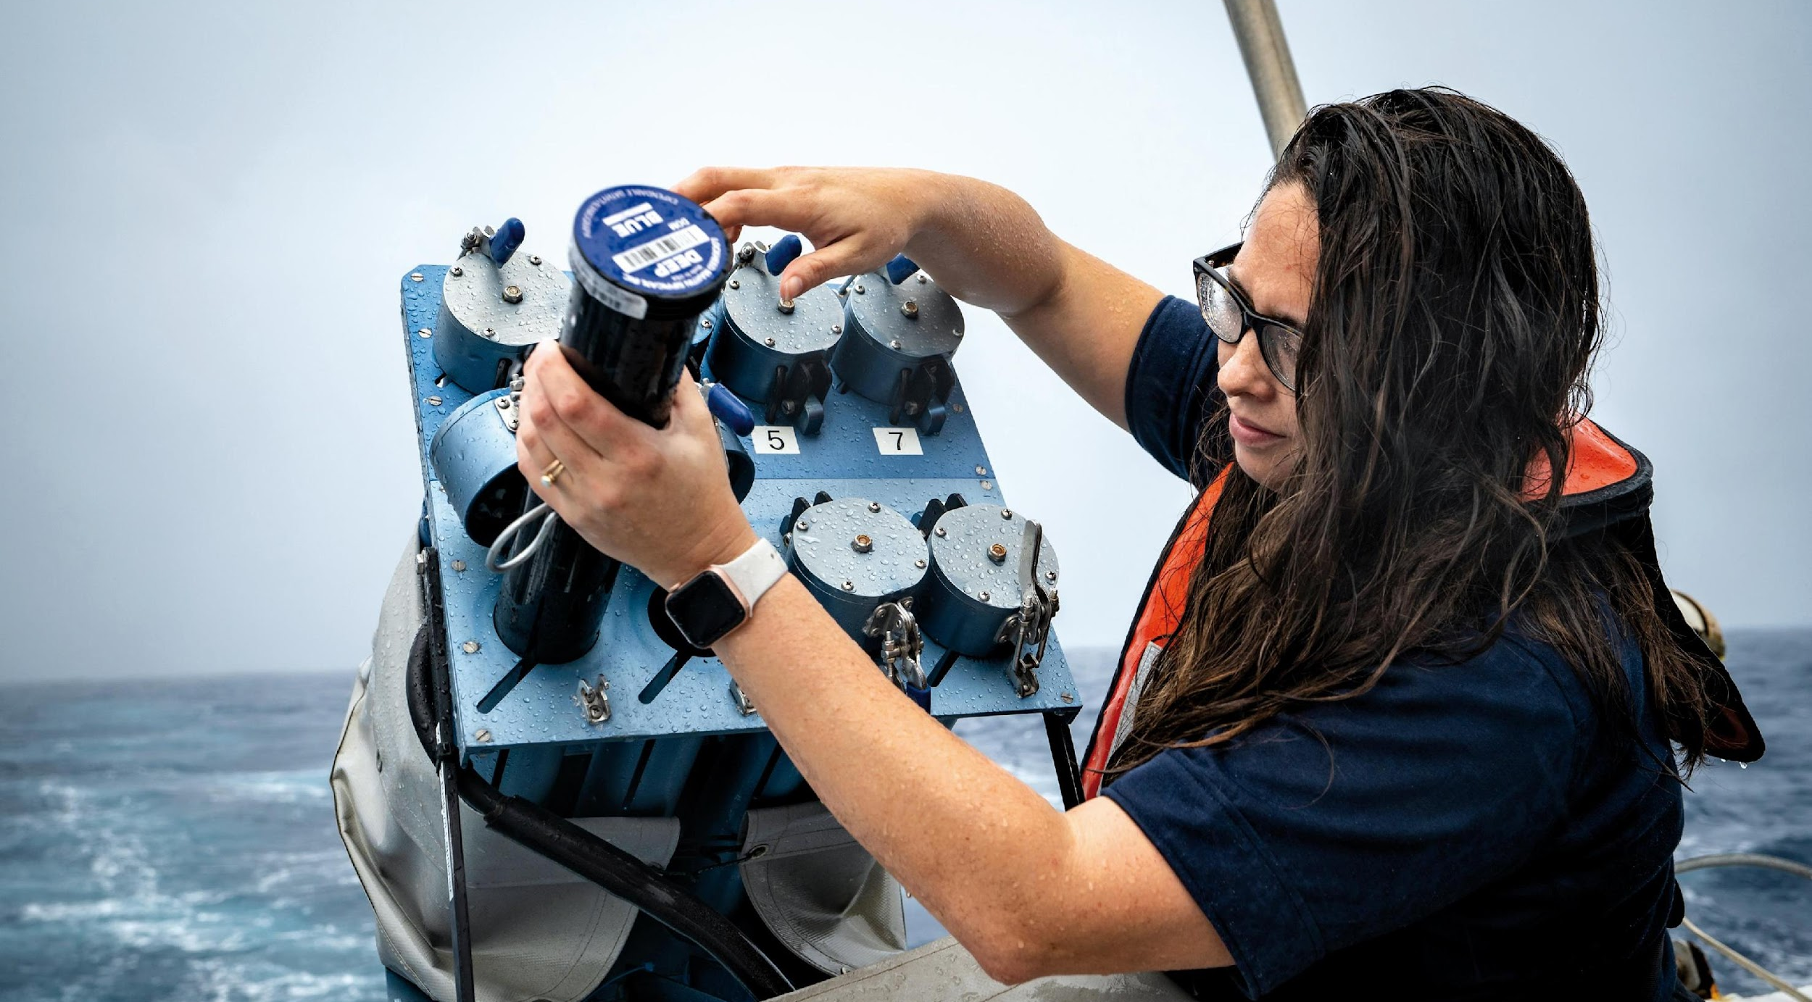
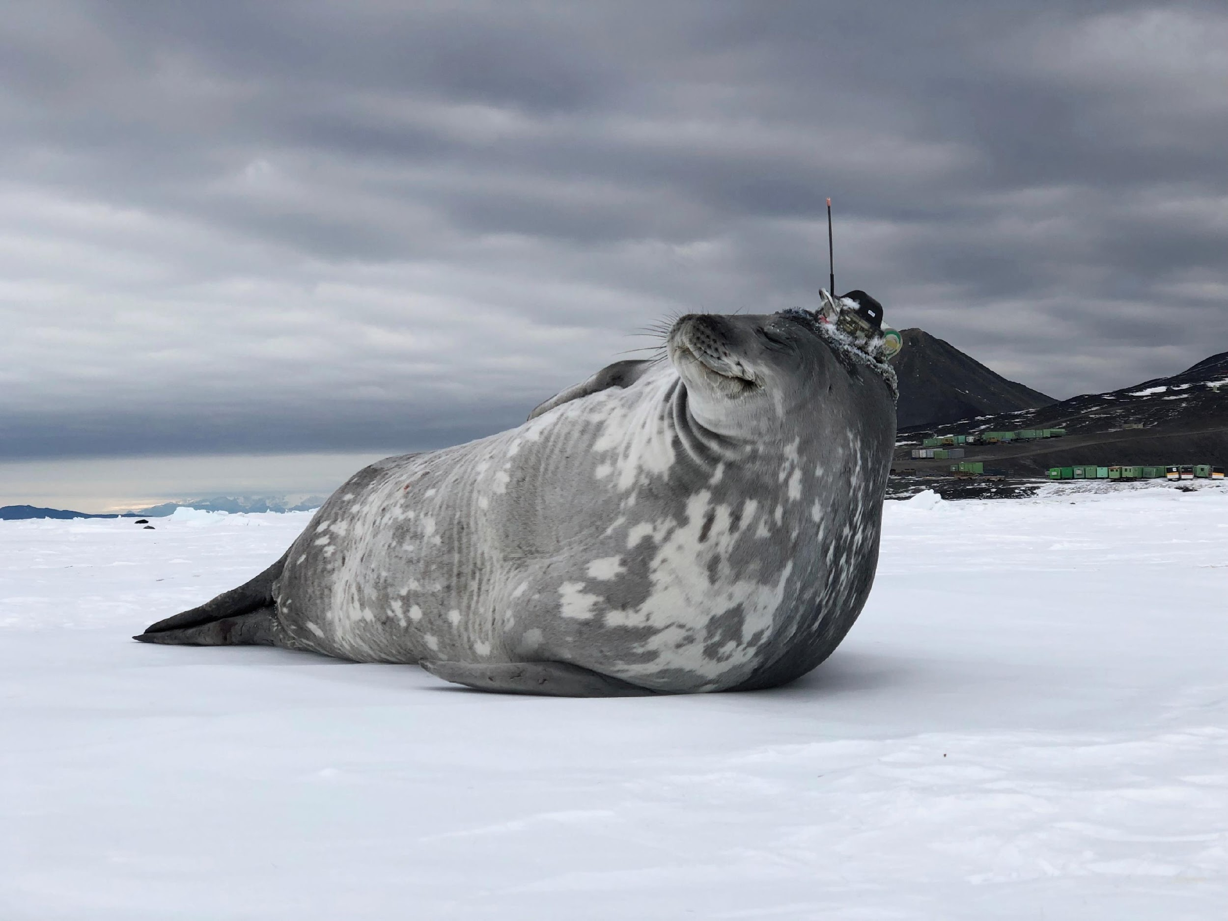
Thank you
goosocean.org

