Slide 1
GOOS NFP European Integration
European GOOS National Focal Point Meeting
Inga Lips
Friday, 22 September 2023

Slide 2
EOOS OC – GOOS NFP
OC key responsibilities are:
Provide information about relevant opportunities for EOOS;
Support the flow of information on ocean observing activities across national, regional and global scales;
Identify system requirements to meet user needs for sustainable ocean observing;
Support and enable the EOOS implementation plan where relevant and practicable, through liaising with implementers and policymakers at a national level, and seeking synergies with adjacent nations at regional and pan-European scales;
Provide advice to the EOOS Steering Group about changes in the ocean observing landscape at European and international level and identify actions for EOOS to further its goals and objectives;
Advocate for coordinated and integrated sustained ocean observing system that encompasses multiple scales, communities and disciplines at national and pan-European levels and for the role of EOOS as a coordinating framework;
Contribute to the mapping of infrastructure, technology and human capacity to help identify gaps in ocean observing system at regional and/or European level;
Identify shared priorities through the development of a work plan;
Provide advice on EOOS added value.
GOOS NFP meeting, 22 September 2023 1

Slide 3
EOOS IP for 2023
Activity 2 Understanding user and stakeholder needs and priorities
Action 2.1 Promote dialogue, across the ocean observing value chain, with remote sensing, modelling, forecasting, data management and marine services communities to inform the design of EOOS according to their needs and priorities
Questions
Are the national priorities for ocean observations defined?
Has the national observing system been evaluated/assessed to fit the needs of defined priorities?
GOOS NFP meeting, 22 September 2023 2

Slide 4
EOOS IP for 2023
Activity 3 Improving the visibility of ocean observing activities
Action 3.1 Streamline the online reporting and sharing of ocean observing planning with the development of an online tool
Action 3.2 Engage with European national authorities to promote participation in reporting ocean observing plans through the online tool
Action 3.3 Consult with MS & AC to assess OO and marine data coordination at the national level
Questions
Is there an information sharing system on planned ocean observing activities in place at national/regional level?
GOOS NFP meeting, 22 September 2023 3

Slide 5
EOOS IP for 2023
Activity 6 Advancing the transition to a well-connected, coordinated ocean observing system
Action 6.1a Launch survey to gather feedback on barriers to integration
Action 6.3 Foster the development and strengthening of national committees in support of GOOS NFPs
Questions
Is the national committee established for national ocean observing coordination?
Who is composing the ocean observations national committee?
GOOS NFP meeting, 22 September 2023 4

Slide 6
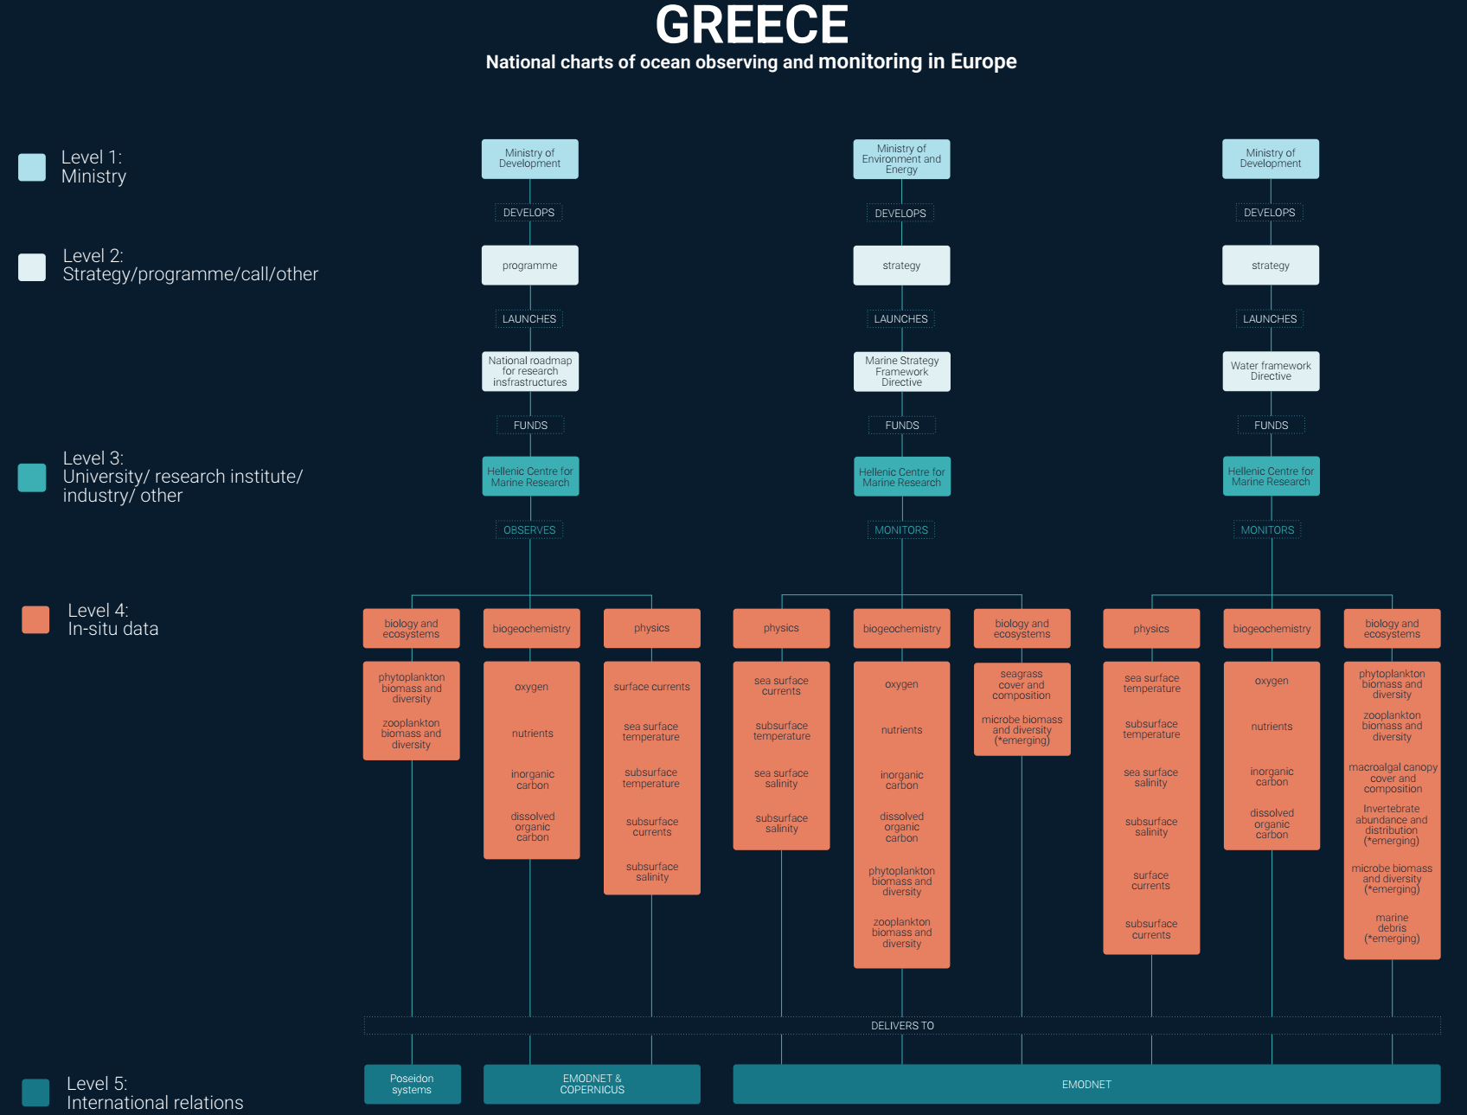
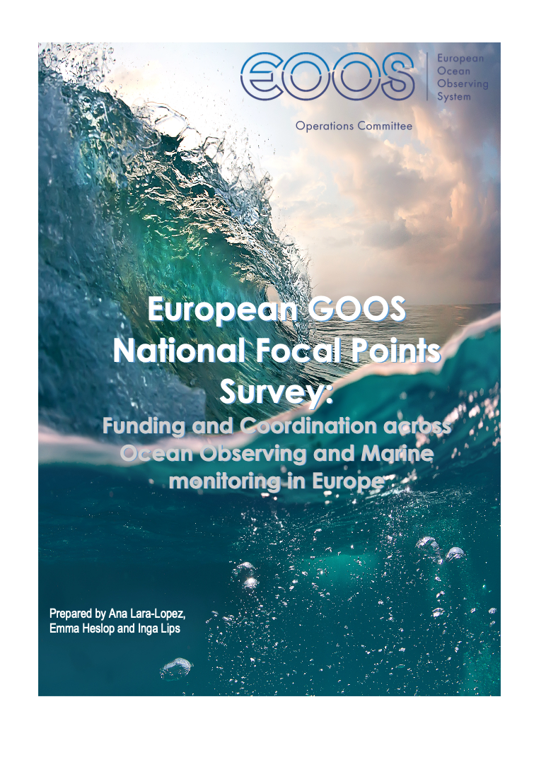
Collating national ocean observing responsibilities and data flows in Europe
EOOS Resource Forum

Slide 7
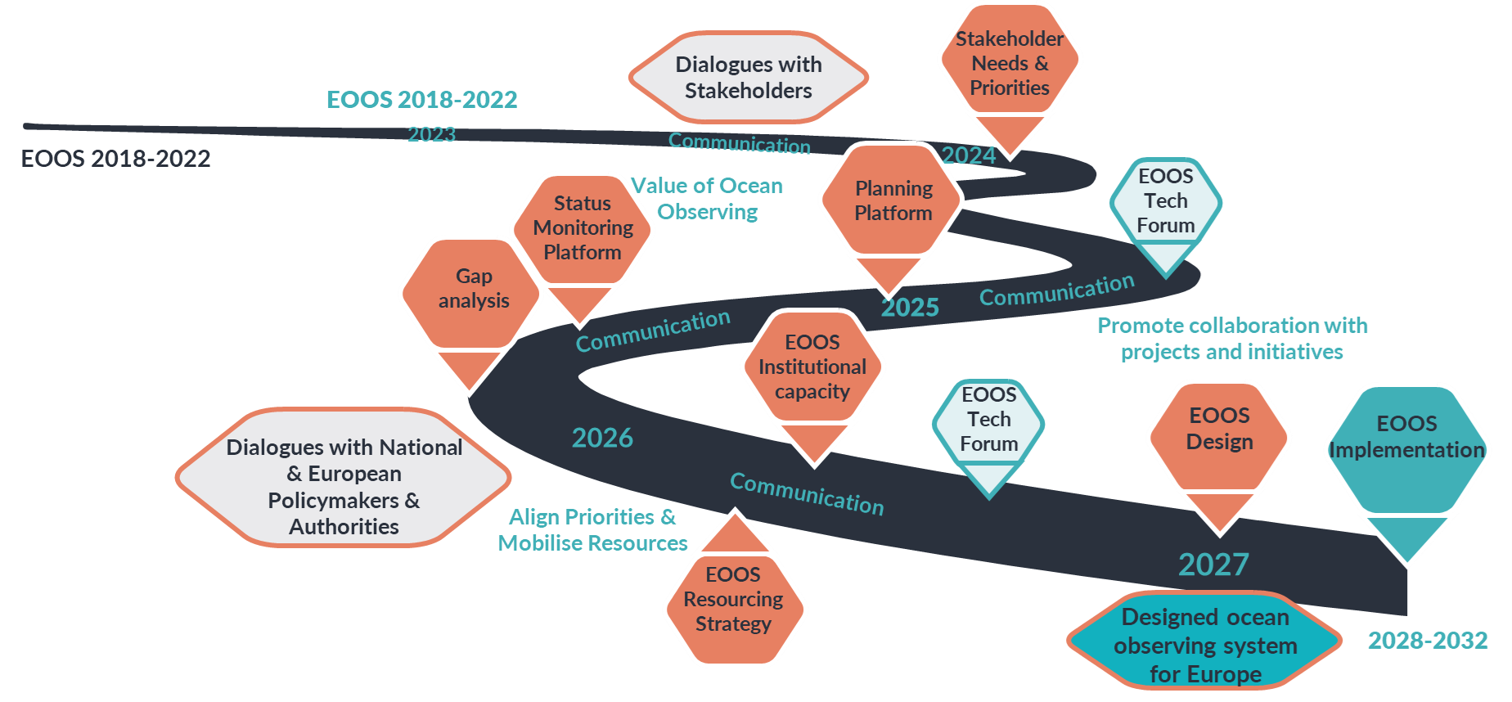
EOOS Roadmap for Implementation
GOOS NFP meeting, 22 September 2023 5

