Slide 1
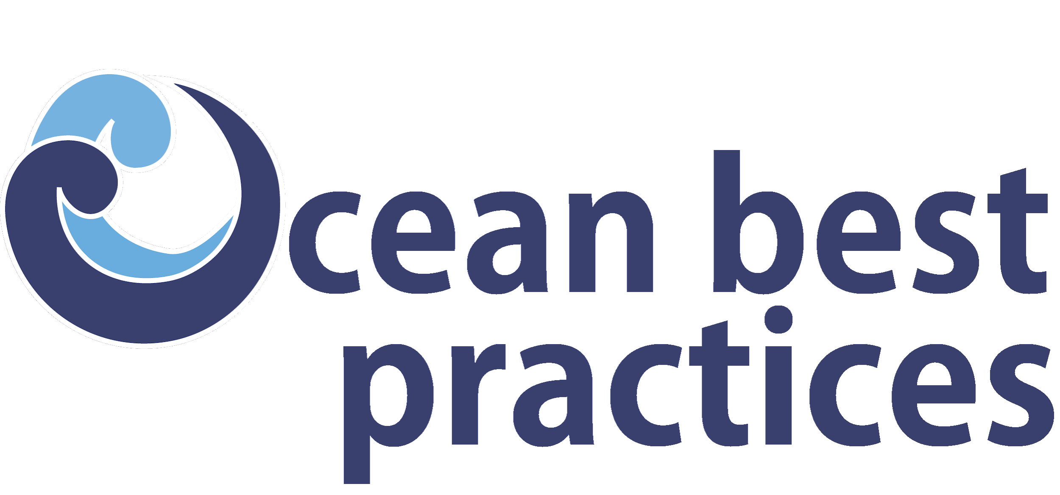
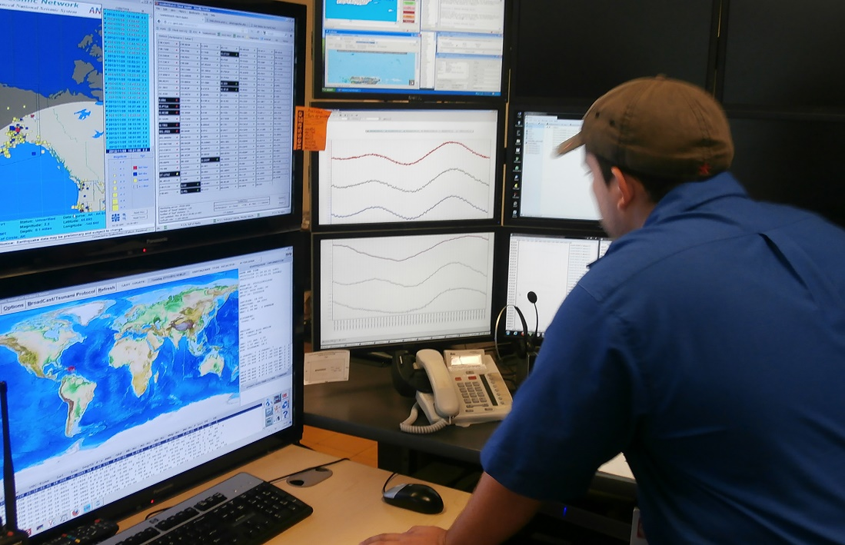

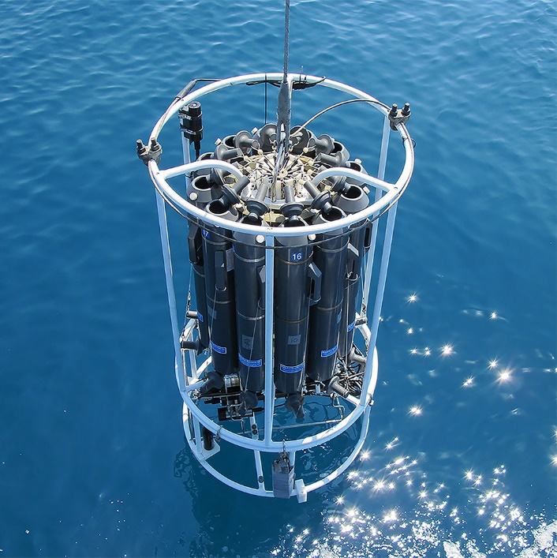
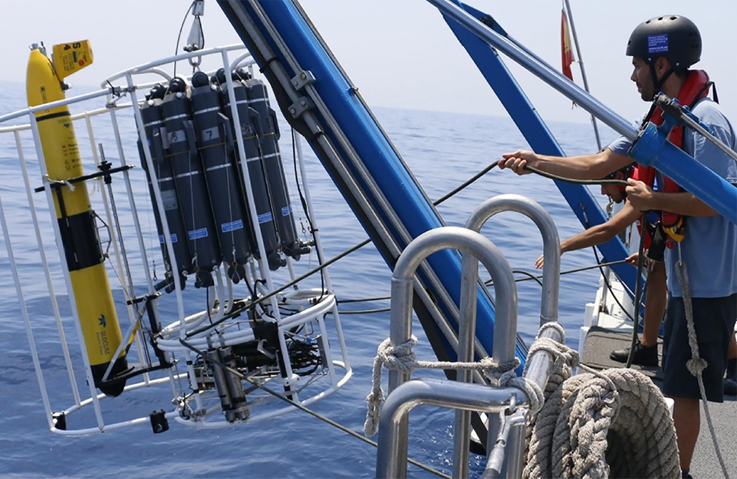
Strategic Plan 2021 - 2025
(Agenda Item 5a)
SG Meeting 12 – 14 December 2023
UNESCO - Paris
www.oceanbestpractices.org

Slide 2
Introduction
The Ocean Best Practices System (OBPS) has been created by members of the global ocean observing​ community, which includes observers, observing infrastructure engineers/designers/operators, data/information managers, modellers, and end users across applications – value chain.
OBPS is recognized by the global ocean community as a sustained operational service, serving as a methodological management system and as a facilitator for capacity development/training activities associated with best practice methodologies​.
The OBPS operations are supported by the Intergovernmental Oceanographic Commission (IOC) of UNESCO, while OBPS capabilities evolve through projects.
The existing IODE ​Ocean Data Practices repository was identified as a baseline capability.

Slide 3
Introduction (cont.)
The Ocean Best Practices System includes the repository with advanced search technology, a peer review journal on ocean best practices matters in Frontiers in Marine Science, support for training and capacity development, and an outreach and engagement programme with user/creator communities.
In June 2019, the ​IOC Ocean Best Practices System was approved as an Intergovernmental Oceanographic Commission (IOC) Project, jointly funded by the IODE and GOOS Programmes through Decision IOC-XXX/7.2.1
This strategic plan and its implementation plan are built on community input and support the OBPS vision and mission.
This strategic plan is for a period of 5 years consistent with a decadal vision and includes priorities for the ​United Nations Decade of Ocean Science for Sustainable Development (2021-2030).

Slide 4
Vision
To have agreed and broadly adopted methods across ocean research, operations and application​s
This vision will be achieved through the development, adoption, and use of best practices to increase efficiency, reproducibility, and interoperability of all “ocean research, operations and applications”, including the full spectrum of observations, data management, modeling and end-user applications.

Slide 5
Mission
To develop and sustain an evolving system which fosters collaboration, consensus building, and innovation by providing coordinated and global access to best practices and standards across ocean sciences and applications
The OBPS will accomplish the mission by engaging ocean observing communities in a joint and coordinated effort in producing, reviewing and sustaining BP documents and related material.

Slide 6
Key Strategic Service Areas
Convergence;
Information content in the OBPS repository;
OBPS repository;
Training and Capacity Development;
Endorsement;
Promoting peer-reviewed publications;
Community engagement.

Slide 7
Key Strategic Service Areas
Convergence: The OBPS will assist the community to find broader, potentially global, agreement on documentation on the various operations and practices. While the convergence process itself is conducted by the respective expert communities, the OBPS is a facilitator providing searchable content and metadata from the repository and by providing training and documentation on potential steps to follow for a successful convergence process, and by providing templates for best practices documentation and media.
Information content in the OBPS repository: ​The OBPS repository contains multiple types of methodological documentation and other media such as videos and mobile apps. In order to maintain the consistency of the inventory for very different users, submissions are reviewed for relevance, provenance, the capacity of individuals to provide input in the name of a community, file format and quality of metadata. In the next evolution of the repository, the submission process will enable an automated ingest of best practices documents and metadata.

Slide 8
Key Strategic Service Areas (cont)
OBPS repository: ​Users have identified easy discovery, access and feedback as areas of continuing development for the repository This includes support for convergence and rating of best practices.
Training and Capacity Development: The OBPS enables the provision and access to training videos, documents and tools created by the community for the community. Capacity development in the OBPS repository will take different forms, from webinars and video tutorials through to establishing links with training providers such as IOC/IODE OceanTeacher Global Academy to access full courses.
Promoting peer-reviewed publications​ on all aspects of best practices creation.

Slide 9
Key Strategic Service Areas (cont)
Endorsement: Identifying selected methods that have gone through a comprehensive community review process, supports users in selecting which methods to adopt. Endorsement is the process which elevates documentation and may be done with respect to a group’s internal quality standards or more universal standards. Different activities are required from the OBPS to support the endorsement process such as metadata enhancements, an adaptation of the search interface, formulating and reviewing the endorsement criteria against minimal standards and providing version control. Partnerships will be built with key global communities, such as GOOS, to create and maintain a rigorous process for endorsement.

Slide 10
Key Strategic Service Areas (cont)
Community engagement: raising awareness, presentations on the OBPS, facilitating exchange between different groups, highlighting the importance of BP and providing information to stakeholders. The OBPS provides an open platform (called the OBPS Community Forum) that enables the ocean community to share their experience in creating best practices and using best practices.

Slide 11
Challenges to be Addressed
The concept of best practices is increasingly necessary but remains inconsistently understood;
The importance of interoperability of observations as well as data systems needs to be more widely promoted and realized to study the ocean as a global system;
Documenting ocean best practices is under-incentivized in academia and research;
The interfaces and synergies between best practices and standards are insufficiently clear which limits interoperability of ocean methods and data;

Slide 12
Challenges to be Addressed (cont)
Tracing methods across the value chain of ocean-related data, information and knowledge is not transparent and may not currently exist;
There are limited processes to motivate and support the convergence of fragmented knowledge and documentation into coherent documentation;
Linguistic and cultural barriers to discovering, responsibly using, and co-developing methodologies are still high;
The endorsement of documentation by community groups needs to be formalized and facilitated for many areas of best practices;

Slide 13
Challenges to be Addressed (cont)
Methodology archives and management systems in many individual institutions or enterprises are still strongly siloed and often inaccessible (except internally);
Getting access to training materials on applying best practices is often difficult and individual mentoring is not scalable;
Policy makers and funders do not always understand or appreciate the need and importance of best practices.

Slide 14
Key Strategic Objectives
To secure the OBPS as a trusted system through which the ocean community persistently archives and converges their methods, standards, guides, and other methodological content into context-sensitive best practices
To accelerate the interoperability of observations, convergence of methodologies, and conventions across ocean communities into trusted, transparently-developed, context-sensitive and interoperable best practices and standards
To foster community - led and equitable capacity development in ocean best practices
To facilitate the creation of a federated network of interoperating ocean practices systems across all rights-holders and stakeholders

Slide 15
Strategic Objective 01:
To secure the OBPS as a trusted system through which the ocean community persistently archives and converges their methods, standards, guides, and other methodological content into context-sensitive best practices
SO-01 Outcomes
The OBPS is a trusted, certified, responsive and sustained community resource.
The OBPS hosts best practices that are tailored to a broad spectrum of resource / capability environments.
OBPS has broad community participation and ownership in the development and operations of the System.
The OBPS provides functionality which allows use by traditional knowledge holders and communities with multiple ways of storing and transmitting practical knowhow.

Slide 16
Strategic Objective 02:
To accelerate the interoperability of observations, convergence of methodologies, and conventions across ocean communities into trusted, transparently-developed, context-sensitive and interoperable best practices and standards
SO-02 Outcomes
Trusted protocols for creation, convergence and endorsement of best practices.
Interoperability across all dimensions of ocean stakeholders’ needs through propagation and linking of best practices, data and standards.
Broad community engagement in the creation and adoption of best practices.

Slide 17
Strategic Objective 03:
To foster community - led and equitable capacity development in ocean best practices
SO-03 Outcomes
Training resources provided by OTGA and other training providers available through the OBPS repository.
Provision of a portfolio of courses on best practice development, consensus building and submission created by the community for the community.
OBPS courses embedded in relevant university curricula and ​Continuing Professional Development (CPD)​ opportunities.

Slide 18
Strategic Objective 04:
To facilitate the creation of a federated network of interoperating ocean practices systems across all rights-holders and stakeholders
SO-04 Outcomes
A global collection of independent methodology management systems, seamlessly interoperating with the OBPS, that will provide the technology needed to support a cultural shift in how diverse ocean communities advance their practices.
The OBPS continuously exchanges (meta)data with related methodology management systems through ODIS2​ ​ and other digital infrastructures, federating queries across partner systems, promoting access to best-practices methodology content hosted elsewhere.
A process to identify, harness, and co-design cross-system technologies to detect gaps and opportunities for convergence in distributed ocean methodology holdings.

Slide 19
