Slide 1
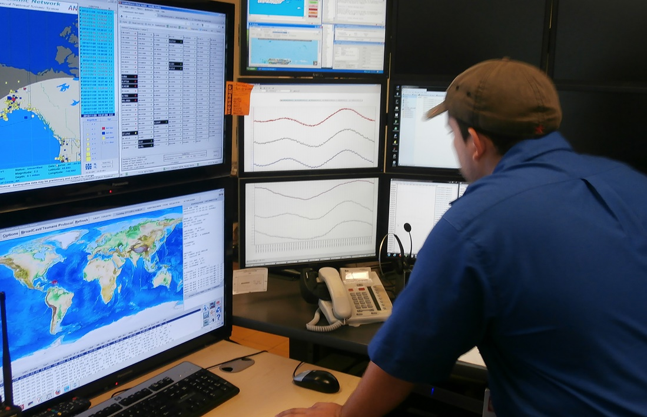
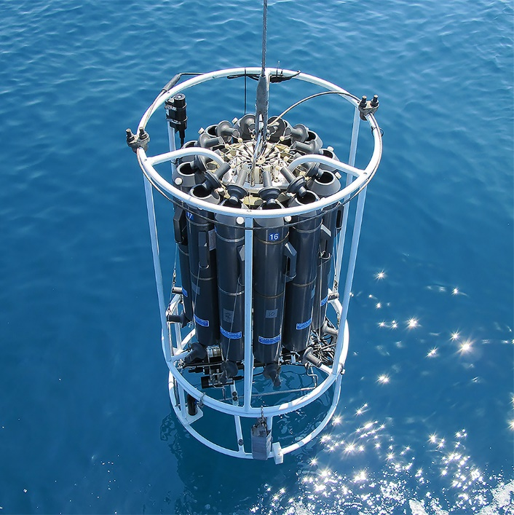
Implementation Plan 2021 - 2023
(Agenda Item 5e)
SG Meeting 12 – 14 December 2023
UNESCO - Paris
www.oceanbestpractices.org

Slide 2
Introduction
The implementation plan addresses priority actions for the next three years (2021-2023) (UNESCO biennium 2020-2021 and 2022-2023) for advancing toward the objectives of the OBPS Strategic Plan1 (also provided below) and responding to Ocean Decade needs related to best practices as resources allow.
In the 2021-2025 Strategy, the four Strategic Objectives and associated outcomes provide guidance on priorities for the development of a more user-focused, inclusive and technology-sophisticated Ocean Best Practices System.
The Decade Implementation Plan Guidance Note for Applicants No. 1/2020: “programmes responding to this call are encouraged to address interoperability and to develop and use best practices in their work. Further resources can be found at oceanbestpractices.org”.

Slide 3
Introduction (cont.)
OBPS anticipates that there will also be an evolution in the creation of best practices through the introduction of practices for co-design and co-development.
There will also be important changes in training and use of best practices beyond the traditional mentoring modalities, incorporating web services and adaptive training supporting local and regional capabilities.
The core operational areas of OBPS include
the repository with advanced search technology,
a peer review publication of Best Practices in Frontiers in Marine Science,
support for training and capacity development,
an outreach and engagement programme with user/creator communities.

Slide 4
From Strategic Objectives to Activities to Outcomes
The strategic OBPS objectives (OBPS Strategic Plan) define the longer term needs for the development and operation of an evolving system which fosters collaboration, consensus building and innovation by providing practices and standards across ocean sciences, engineering and applications for society.
We link Objectives, Outcomes, Activities and Deliverables within the timeframe of this Implementation Plan,
The Activities are technical advancement of the OBPS infrastructure, capacity development, and broader community engagement.
These priorities have been defined through dialogue with the community of OBPS stakeholders in a series of annual workshops and other events.

Slide 5
Strategic Objective 01:
To secure the OBPS as a trusted system through which the ocean community persistently archives and converges their methods, standards, guides, and other methodological content into context-sensitive best practices
SO-01 Outcomes
The OBPS is a trusted, certified, responsive and sustained community resource.
The OBPS hosts best practices that are tailored to a broad spectrum of resource / capability environments.
OBPS has broad community participation and ownership in the development and operations of the System.
The OBPS provides functionality which allows use by traditional knowledge holders and communities with multiple ways of storing and transmitting practical knowhow.

Slide 6
Activity SO-01 | Deliverable SO-01 | Completion Subject to Funding | Status
A1.1. Secure an ISO or other Repository Certification | D1.1.1.OBPS Repository Certification | 12/2022
A1.2.- Continue efficient fit-for-purpose operations of the OBPS repository including user-required technology enhancements | D.1.2.1 Operational online repository of ocean best practices available 24/7 | Ongoing
A1.3. Create improved content browsing and discovery functions, decision tree, apps | D1.3.1. Implement a decision tree for improved browsing and BP selection | 12/2022
 | D1.3.2. Assess the need, the market and cost for developing a mobile phone app. | 12/2023
A1.4. Expand BP submission processes to include automated submission including review of document style and completeness. | D1.4.1. Implement a user-tested automated submission system | 12/2023
A1.5. Enhance and expand machine-readable templates offered by the OBPS to cover methodology types submitted | D1.5.1. Update existing BP document templates and generate new topics with community advice | Ongoing

Slide 7
Strategic Objective 02:
To accelerate the interoperability of observations, convergence of methodologies, and conventions across ocean communities into trusted, transparently-developed, context-sensitive and interoperable best practices and standards
SO-02 Outcomes
Trusted protocols for creation, convergence and endorsement of best practices.
Interoperability across all dimensions of ocean stakeholders’ needs through propagation and linking of best practices, data and standards.
Broad community engagement in the creation and adoption of best practices.

Slide 8
Activity SO-02 | Deliverable SO-02 | Completion Subject to Funding | Status
A2.1. Provide guidance to communities on process for endorsing BP / develop rigorous OBPS criteria for acceptance | D2.1.1. Finalise endorsement first test case - GOOS | 06/2021
 | D2.1.2 Gain feedback on utility of approach and process | 11/2021
 | D2.1.3 Develop guidance document for endorsement process (first draft) and OBPS applications acceptance process | 09/2022
A2.2. Work with the community to identify areas of convergence and support champions in creating converged BPs | D2.2.1. Document areas of convergence | Ongoing
A2.3. Expand enhanced search including semantic capabilities to accommodate broader range of disciplines, languages and cultures | D2.3.1. Semantic capabilities to accommodate broader range of disciplines | 6/2022
A2.4. Expanded communication plans to broaden engagement of ocean communities in creation and use of BP | D2.4.1.Advocacy products for community outreach and report on status of engagement (e.g. BP submitted from new communities) | Ongoing
A2.5. Host annual workshops | D2.5.1. Proceedings of OBPS Workshops, with recommendations to feed into future iterations of the IP | 2022, 2023, 2024
A2.6. Increase contributions to the Frontiers in Marine Science: Research Topic Best Practices in Ocean Observation | D2.6.1. Report on the number of papers published. Highlight new additions in contributions? | Ongoing

Slide 9
Strategic Objective 03:
To foster community - led and equitable capacity development in ocean best practices
SO-03 Outcomes
Training resources provided by OTGA and other training providers available through the OBPS repository.
Provision of a portfolio of courses on best practice development, consensus building and submission created by the community for the community.
OBPS courses embedded in relevant university curricula and ​Continuing Professional Development (CPD)​ opportunities.

Slide 10
Activity SO-03 | Deliverable SO-03 | Completion Subject to Funding | Status
A3.1. Expand the OBPS portfolio of courses available from the Repository on best practice development and submission | D3.1.1 Formal linkage with OTGA with training course/s available on the OBPS. Case study: “How to create a best practice” | 12/2021
A3.2 Support external training and capacity development activities | D3.2.1 Four video courses on specific best practice development and submission. | 12/2022
A3.3 Engage formal and informal education institutions and sponsors to advance incorporation of best practices for ocean observing into education curricula | D3.2.1 An engaged educational institution pilot | 12/2021 and Ongoing

Slide 11
Strategic Objective 04:
To facilitate the creation of a federated network of interoperating ocean practices systems across all rights-holders and stakeholders
SO-04 Outcomes
A global collection of independent methodology management systems, seamlessly interoperating with the OBPS, that will provide the technology needed to support a cultural shift in how diverse ocean communities advance their practices.
The OBPS continuously exchanges (meta)data with related methodology management systems through ODIS2​ ​ and other digital infrastructures, federating queries across partner systems, promoting access to best-practices methodology content hosted elsewhere.
A process to identify, harness, and co-design cross-system technologies to detect gaps and opportunities for convergence in distributed ocean methodology holdings.

Slide 12
Activity SO-04 | Deliverable SO-04 | Completion Subject to Funding | Status
A4.1. Design a federation approach, to a global collection of independent methodology management systems | D4.1.1. Federated System Design | 12/2024
A4.2. Develop a pilot demonstration of a federated system so that queries across partner systems enable access to best-practices methodology content hosted elsewhere | D4.2.1. A pilot demonstration of a federated system of Methodology Management Systems | 12/2025
A4.3. A process to identify, harness, and co-design cross-system technologies to detect gaps and opportunities for convergence in distributed ocean methodology holdings | D4.3.1. Paper describing approaches to gap analyses | 12/2025

Slide 13
Work Packages support to Strategic Objectives
Work Package | SO1 Trusted system through which the ocean community persistently archives | SO2 To accelerate the interoperability of observations, convergence of methods | SO3 Foster community-led and equitable capacity development | SO4 To facilitate the creation of a federated network
WP1 Project Management | Support | Support | Support | Support
WP2 Operations (Repository) | Primary | Support | Support | Support
WP3 Advanced Technologies and Interoperability | Support | Support | Support | Primary
WP4 Publications, Convergence, Endorsement | Support | Primary | Support | Support
WP5 Communication & Outreach | Support | Support | Support | Support
WP6 User Communities | Support | Primary | Support | Support
WP7 Capacity Development & Training | Support | Support | Primary | Support

Slide 14
Indicators of impact
01 | Number of content items contributed to the Repository
02 | Usage of the OBPS (e.g. volume of downloads, searches, users, contributors etc )
03 | Number of endorsed BPs
04 | Number of papers published in Frontiers in Marine Science, RT Best Practices in Ocean Observation
05 | Number of citations to the OBPS in authored peer reviewed articles
06 | Number of participants to best practices webinars/workshops
07 | Number of subscribers to the OBPS Monthly Newsletter
08 | Number of available training courses through OTGA promoting the use of ocean best practices

Slide 15
Budget
RP (UNESCOI/OC regular programme funding External Funding (EXB) (other than IOC funds) NDC = No Direct Cost for RP Budget (in-kind contribution or implemented by project staff) | 2021 RP IODE | 2021 IODE Project Office budget contribution | 2021 RP GOOS | 2021 EXB REC’D | 2021 EXB TO FIND | 2022 RP IODE | 2022 IODE Project Office budget contributio n | 2022 RP GOOS | 2022 EXB REC’D | 2022 EXB TO FIND
WP1: Project Management
SG Meeting (assuming FtF in 2022 in Oostende) |  |  |  |  |  |  | 6,000
Project Manager/Repository Manager (EXB EuroSea and JERICO S3) and GOOS |  |  | 11,000 | 44,000 |  |  |  | 15,500 | 39,500
Workshop/Meeting travel (PM) (EXB rec’d EuroSea) |  |  |  |  |  |  |  |  | 3,500
WP2 (contributing to : SO-01: Trusted system through which the ocean community persistently archives
A1.1. Secure an ISO or other Repository Certification |  | 1,500 |  |  |  |  | 1,000
A1.2. Continue fit-for-purpose operations of the OBPS repository including user-defined technology enhancements | 20,000 |  | 7,000 | 4,500* |  | 14,000 |  | 2,500 | 4,000
A1.2. AWS Recurring Expenses |  | 2,200 |  |  |  |  | 2,300
A1.5. Enhance and expand machine-readable templates offered by the OBPS to cover methodology types submitted | NDC |  | NDC |  |  | NDC |  | NDC
One time investment AWS EDS 2021 Contract | 12,750 |  | 12,750

Slide 16
Budget
RP (UNESCOI/OC regular programme funding External Funding (EXB) (other than IOC funds) NDC = No Direct Cost for RP Budget (in-kind contribution or implemented by project staff) | 2021 RP IODE | 2021 IODE Project Office budget contribution | 2021 RP GOOS | 2021 EXB REC’D | 2021 EXB TO FIND | 2022 RP IODE | 2022 IODE Project Office budget contributio n | 2022 RP GOOS | 2022 EXB REC’D | 2022 EXB TO FIND
WP3 (contributing to: SO-02: To accelerate the interoperability of observations, convergence of methods. SO-04 To facilitate the creation of a federated network)
A1.3. Create improved content browsing and discovery functions decision tree, apps |  |  |  |  |  |  |  |  |  | EXB (2023)
A1.4. Expand BP submission processes to include automated submission including review of document style and completeness |  |  |  |  |  |  |  |  |  | EXB (2023)
A2.3. Expand enhanced search including semantic capabilities to accommodate broader range of disciplines, languages and cultures |  |  |  |  |  |  |  |  |  | EXB
A4.1. Design a federation approach, to a global collection of independent methodology management systems |  |  |  |  |  |  |  |  |  | EXB (2024)
A4.2. Develop a pilot demonstration of a federated system so that queries across partner systems enable access to best-practices methodology content hosted elsewhere |  |  |  |  |  |  |  |  |  | EXB (2025)
A4.3. A process to identify, harness, and co-design cross-system technologies to detect gaps and opportunities for convergence in distributed ocean methodology holding |  |  |  |  |  |  |  |  |  | EXB (2025)

Slide 17
Budget
RP (UNESCOI/OC regular programme funding External Funding (EXB) (other than IOC funds) NDC = No Direct Cost for RP Budget (in-kind contribution or implemented by project staff) | 2021 RP IODE | 2021 IODE Project Office budget contribution | 2021 RP GOOS | 2021 EXB REC’D | 2021 EXB TO FIND | 2022 RP IODE | 2022 IODE Project Office budget contributio n | 2022 RP GOOS | 2022 EXB REC’D | 2022 EXB TO FIND
WP4 (contributing to: SO-02 Convergence and Endorsement)
A2.1. Provide guidance to communities on process for endorsing BP / develop rigorous OBPS criteria for acceptance | NDC |  | NDC |  |  | NDC |  | NDC
A2.2. Work with the community to identify areas of convergence and support champions in creating converged BPs | NDC |  | NDC |  |  | NDC |  | NDC
A2.5. Increase contributions to the Frontiers in Marine Science: Research Topic Best Practices in Ocean Observation | NDC |  | NDC |  |  | NDC |  | NDC
WP5 (contributing to: all )
A2.4. Host annual workshops (EXB rec’d EuroSea) |  |  |  | 6,000 | EXB |  |  |  | 2,000 | EXB
WP6 (contributing to: SO2 Community Engagement +)
A2.4. Expanded communication plans to broaden engagement of ocean communities in creation and use of BP |  | 3,000 |  |  |  |  | 3,000
WP7 (contributing to: SO-03 Foster community-led and equitable capacity development)
A3.1. Expand the OBPS portfolio of courses available from the Repository on best practice development and submission | NDC |  | NDC |  |  | NDC |  | NDC

Slide 18
Budget
RP (UNESCOI/OC regular programme funding External Funding (EXB) (other than IOC funds) NDC = No Direct Cost for RP Budget (in-kind contribution or implemented by project staff) | 2021 RP IODE | 2021 IODE Project Office budget contribution | 2021 RP GOOS | 2021 EXB REC’D | 2021 EXB TO FIND | 2022 RP IODE | 2022 IODE Project Office budget contributio n | 2022 RP GOOS | 2022 EXB REC’D | 2022 EXB TO FIND
● A3.2 Support external training and capacity development activities |  |  |  |  |  |  |  |  |  | EXB
● A3.3 Engage formal and informal education institutions and sponsors to advance incorporation of best practices for ocean observing into education curricula | NDC |  | NDC |  |  | NDC |  | NDC
 | 2021 RP IODE | 2021 IODE Project Office budget contribution | 2021 RP GOOS | 2021 EXB REC’D | 2021 EXB TO FIND | 2022 RP IODE | 2022 IODE Project Office budget contributio n | 2022 RP GOOS | 2022 EXB REC’D | 2022 EXB TO FIND
TOTALS | 32,750 | 6,700 | 30,750 | 54,500 | EXB | 14,000 | 12,300 | 18,000 | 49,000 | EXB

Slide 19
