Slide 1

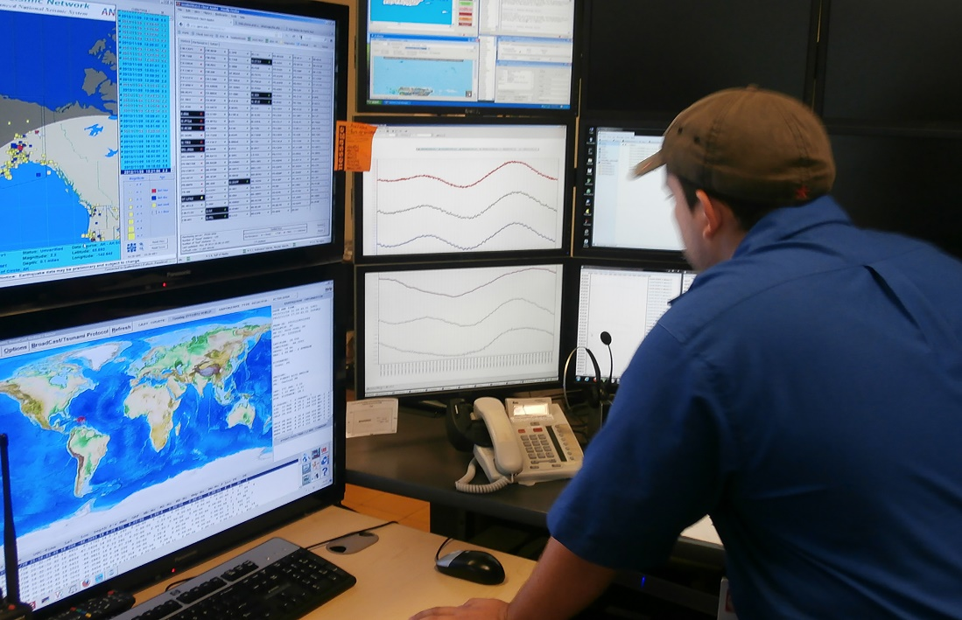

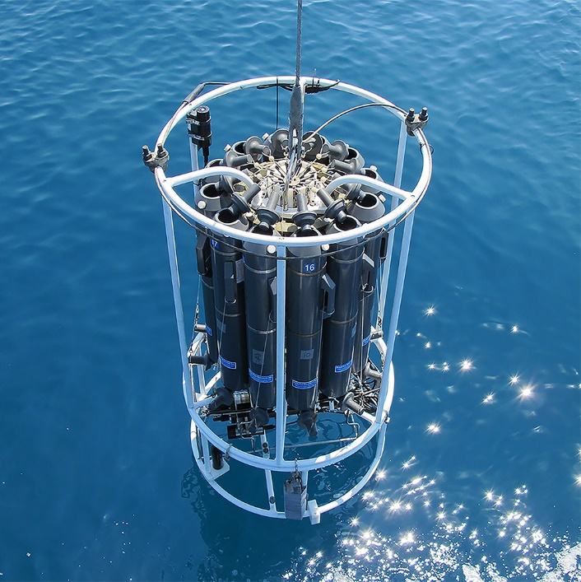
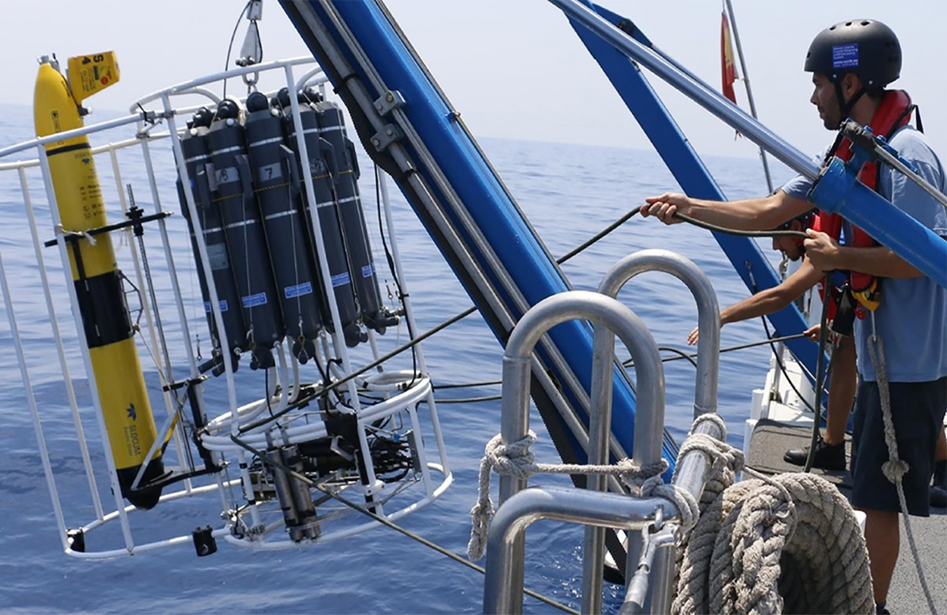
Ocean Practices (OP) AISBL
(Agenda Item 10)
SG Meeting 12 – 14 December 2023
UNESCO - Paris
www.oceanbestpractices.org

Slide 2
Rationale
Funding is key to ensure long term & stable operations and further development of OBPS
Core operations (repository, manager) as well as certain developments have been funded by IODE & GOOS but limitations exist:
  IOC minimum grant: $100K/year (often not the case)
  Participation to projects is through 3rd parties

Slide 3
Vision
Add to OBPS a flexible legal entity which can act as a full partner in EU and other grants
Enable direct and committed funding via:
research grants, donations, sponsorship, commercial/industrial operations (e.g. organizing paid lectures, seminars, selling products in order to gain publicity or to increase income), membership fees

Slide 4
Steps (identified in SG meting Dec. 2022)
Identify OBPS members with interest to get involved
Name of AISBL? (OBPS-AISBL?)
Identify partner in Belgium
Identify funding members (minimum two; one from Belgium)
Dialogue with lawyer
Drafting two documents
  Articles of Association -> mostly a lawyer/OBPS dialogue
  Internal Rules -> OBPS internal modalities
Develop governance model & modalities for membership
Publish documents
AISBL established – apply for grants!

Slide 5
Steps (identified in SG meting Dec. 2022)
Identify OBPS members with interest to get involved
Name of AISBL? (OBPS-AISBL?)
Identify partner in Belgium
Identify funding members (minimum two; one from Belgium)
Dialogue with lawyer
Drafting two documents
  Articles of Association -> mostly a lawyer/OBPS dialogue
  Internal Rules -> OBPS internal modalities
Develop governance model & modalities for membership
Publish documents
AISBL established – apply for grants!

Slide 6
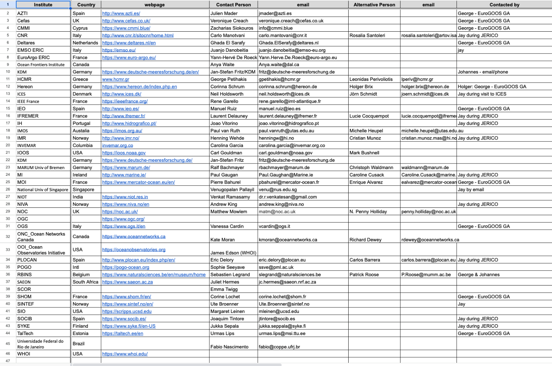
Flyer produced and disseminated through presentations at events (EuroGOOS GA, may 2022);
Potential partners were identified;
Emails sent – very positive response.

Slide 7
Steps (identified in SG meting Dec. 2022)
Identify OBPS members with interest to get involved
Name of AISBL? (OBPS-AISBL?)
Identify partner in Belgium
Identify funding members (minimum two; one from Belgium)
Dialogue with lawyer
Drafting two documents
  Articles of Association -> mostly a lawyer/OBPS dialogue
  Internal Rules -> OBPS internal modalities
Develop governance model & modalities for membership
Publish documents
AISBL established – apply for grants!

Slide 8
Ocean Practices (OP) AISBL

Slide 9
Steps (identified in SG meting Dec. 2022)
Identify OBPS members with interest to get involved
Name of AISBL? (OBPS-AISBL?)
Identify partner in Belgium
Identify funding members (minimum two; one from Belgium)
Dialogue with lawyer
Drafting two documents
  Articles of Association -> mostly a lawyer/OBPS dialogue
  Internal Rules -> OBPS internal modalities
Develop governance model & modalities for membership
Publish documents
AISBL established – apply for grants!

Slide 10
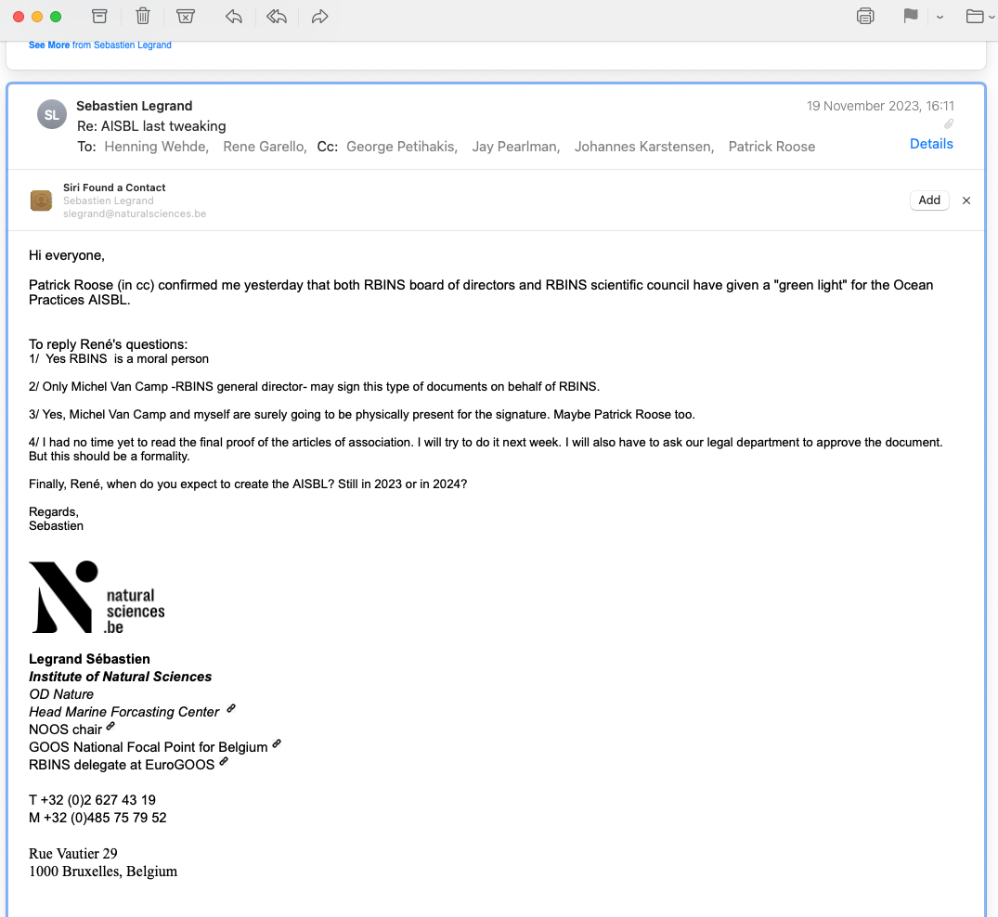

Institute of Natural Sciences (ex. RBINS) contacted
Funding partner
Registered Office
Approved 19 November 2023

Slide 11
Steps (identified in SG meting Dec. 2022)
Identify OBPS members with interest to get involved
Name of AISBL? (OBPS-AISBL?)
Identify partner in Belgium
Identify funding members (minimum two; one from Belgium)
Dialogue with lawyer
Drafting two documents
  Articles of Association -> mostly a lawyer/OBPS dialogue
  Internal Rules -> OBPS internal modalities
Develop governance model & modalities for membership
Publish documents
AISBL established – apply for grants!

Slide 12


Institute of Marine Research (IMR) contacted;
Funding partner;
IEEE France
Funding partner;

Slide 13
Steps (identified in SG meting Dec. 2022)
Identify OBPS members with interest to get involved
Name of AISBL? (OBPS-AISBL?)
Identify partner in Belgium
Identify funding members (minimum two; one from Belgium)
Dialogue with lawyer
Drafting two documents
  Articles of Association -> mostly a lawyer/OBPS dialogue
  Internal Rules -> OBPS internal modalities
Develop governance model & modalities for membership
Publish documents
AISBL established – apply for grants!

Slide 14
Statutes
Bylaws

Slide 15
Ocean Practices (OP) AISBL
Statutes

Slide 16
Statutes – 25 articles
Name: Ocean Practices (OP)
Registered office: Brussels-Capital Region at rue Vautier 29, 1000 Brussels
Purpose:
  To promote the association’s infrastructure, tools and services and the scientific and technological developments on which they are based;
  To encourage cooperation and coordination between its Members in the field of sharing, promoting, and creating best practice for the ocean research, monitoring and operations;
  Make resources available to its members for ongoing, targeted actions in the field of good practice for the ocean;
  Submit proposals driven by the association and its Members;
  To be a global forum that will strengthen community participation in the evolution of good practice for the ocean and its effective implementation;

Slide 17
Statutes – 25 articles
Purpose (cont.):
  To be a resource that facilitates training and encourages interaction between scientists and technologists in order to create and use best practices for the ocean;
  Offer recognition to technologists by increasing the visibility of their good practices for the ocean;
  To maintain the link with IODE (the International Oceanographic Data and Information Exchange) and GOOS (the Global Ocean Observing System) , through the "Ocean Practices for the Decade" programme;
  To carry out all acts relating directly or indirectly to its objects. In particular, it may provide assistance and take an interest in any activity similar to its own.
Duration: The Association is established for an indefinite period

Slide 18
Statutes – 25 articles
Members: The association is made up of the founding members and the members subsequently admitted. All Members of the association belong to the same single category of members and have the same rights and obligations.
Admission: Applications to the Chairman of the Board → General Assembly which will vote by a simple majority.
Resignation – exclusion: by death, voluntary or involuntary dissolution, insolvency, bankruptcy or any other similar event, by notice of resignation by the member, by exclusion from the association, by court order.
Membership fees: set by the General Assembly on the recommendation of the Board of Directors.

Slide 19
Statutes – 25 articles
Composition - Powers: General Assembly made up of all members
Meetings and convening: Once a year at the registered office or at any other place indicated in the notice of meeting, including virtually by teleconference or videoconference plus any Extraordinary GA
Voting rights – Representation: 1 vote / member
Deliberations: Half of the members need to be present or represented. If quorum not reached, the GS shall be reconvened with the same agenda within a minimum period of 15 days
Minutes: Taken and signed
Board of Directors (BD) – Composition: 3 – 7 people, elected for 3 yrs, can be re-elected, Chairman and, if necessary, a Vice-Chairman, a Secretary and a Treasurer

Slide 20
Statutes – 25 articles
BD – D2D management: broadest powers to manage and administer the Association, may entrust one or more persons, who may or may not be members of the Board of Directors, with the d2d management and representation of the Association
Meetings of BD – Representation: at least once (1) a year
Deliberations of the BD: Majority present or represented - in the event of a tie, the Chairman has the casting vote
Minutes: Taken and signed
Representation of the Association: Chairman, 2 directors, an ad hoc representative appointed by the Board of Directors or within the limits of daily management, by the person or persons to whom this management has been delegated

Slide 21
Statutes – 25 articles
Internal regulations: Internal rules specify the provisions of these Articles of Association and set out the practical procedures for the operation of the Association
Financial year - Annual accounts: Begins on 1 January and ends on 31 December
Control – Commissioner: Auditing system
Amendments: The GA can make amendments (2/3) of the members must be present and (2/3) of those present must vote in favor.
Liquidation: (2/3) of the members must be present and (2/3) of those present must vote in favor.
Applicable law: Code of Companies and Associations

Slide 22
Ocean Practices (OP) AISBL
Bylaws

Slide 23
Bylaws – 9 main articles
Status: supplementary and subordinate to the Articles of Association
Purpose: BPs etc.
Membership:
  Admission: Agencies, institutes, SMEs and other organisations fulfilling tasks in the field of oceanographic observations, data management, processing, dissemination, models or applications for this purpose (hereafter “Institutions”), with a strong current or planned involvement in the OceanPractices infrastructure, tools and/or services, may apply to become a member of OceanPractices AISBL.
  Rights of members: Eligibility to the BD, participation in all activities
  Obligations of members: engage with and promote the OceanPractices infrastructure, tools and/or services, regularly populate the OceanPractices repository, create and participate in the assessment of methods for ocean science and applications. Contribute to working groups and other subsidiary bodies. Contribute an annual membership fee.

Slide 24
Bylaws – 9 main articles
Membership:
  Resignation of a member: notification in writing
  Participation of non-members: The Board of Directors, upon request by an entity can grant the status of Observer (Candidates, Institutions unable to join) – no voting.
General Assembly:
  Representation: 1 Delegate plus experts – 1 vote
  Preparation of GA: notification 2 months in advance (agenda) – documentation 2 weeks in advance
  Meetings: Can invite external experts
The Board of Directors:
  Composition: High ranking representatives from members – 3 yrs term (re-election)
  Obligations of members of the BD: Pro-active manner, participation to meetings
  Meetings: As needed, normally 4 times/year

Slide 25
Bylaws – 9 main articles
The Board of Directors:
  Decisions in writing: Written consultation
  Tasks: Represent the Association, policies and practices are followed, setting strategic priorities, support implementation, preparation of the GA, fulfill assignments by the GA.
Chairs: Chair and Vice-chair are proposed by the BD to the GA – 3 yrs term (re-election).
Subsidiary bodies: The General Assembly or the Board of Directors upon authorisation by the General Assembly may establish and dissolve subsidiary bodies as seems appropriate
Policy matters: Equal opportunities, maximizing the benefit of the partners (especially when participating in the calls)

Slide 26
Bylaws – 9 main articles
Financial Regulations:
  Budget: Approved by the GA. The association can have a reserve fund income includes membership contributions, external funding from national, international or EU bodies, institutions or associations, private or non-governmental organizations and specific gifts or money, property or other assets (Art. 12) as well as income from secondary commercial and profitable activities (Art. 2 para 4). Members shall bear their own costs for attending meetings and participation in the activities of the Association.
  Contributions: Fees - first fee is set by the BD, then the GA decides. In – kind contributions

Slide 27
Steps (identified in SG meting Dec. 2022)
Identify OBPS members with interest to get involved
Name of AISBL? (OBPS-AISBL?)
Identify partner in Belgium
Identify funding members (minimum two; one from Belgium)
Dialogue with lawyer
Drafting two documents
  Articles of Association -> mostly a lawyer/OBPS dialogue
  Internal Rules -> OBPS internal modalities
Develop governance model & modalities for membership
Publish documents
AISBL established – apply for grants!

Slide 28
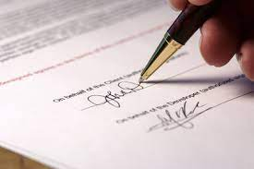
Light governance – no office, no secretariat;
First expenses covered by IEEE France
Minimum fees ~ 1K/year
Signing by funding members at the notary’s office ASAP

Slide 29
Steps (identified in SG meting Dec. 2022)
Identify OBPS members with interest to get involved
Name of AISBL? (OBPS-AISBL?)
Identify partner in Belgium
Identify funding members (minimum two; one from Belgium)
Dialogue with lawyer
Drafting two documents
  Articles of Association -> mostly a lawyer/OBPS dialogue
  Internal Rules -> OBPS internal modalities
Develop governance model & modalities for membership
Publish documents
AISBL established – apply for grants!

Slide 30


Slide 31



