Slide 1



ADAPT: Adapting Ocean Best Practices to the local context
(Caribbean Pilot Project)
Status and next steps
Ana Carolina Peralta
ADAPT Project Coordinator
OBPS SG meeting, December 2023

Slide 2
Introduction
1) What is ADAPT?
  Definition
  Goals
2) Current status of the project
3) Next steps
A. C. Peralta – OBPS – WP7

Slide 3
What is ADAPT?
ADAPT is a project designed to support the fundamental need to enable adoption and adaptation of best practices in marine observing strategies, managing data, and synthesizing outcomes. Its core goal is to provide training and support local monitoring programs, with two main activities planned for 2024: (1) promote in-person workshops covering important topics in ocean observation according to a regional network of member states interests; and (2) develop high-quality educational resources, for both in person and online training to be openly accessed and publicly available to a broader audience.
The project is a partnership agreement among the Programme Cooperation Agreement between NORAD and UNESCO and the collaboration of two partner institutions from the Caribbean, the INVEMAR (Colombia) and St George’s University (SGU), Department of Biology, Ecology and Conservation, Grenada, West Indies.
A. C. Peralta – OBPS – WP7

Slide 4
ADAPT Specific Objectives
Support the greater adoption of ocean best practices and create a basis for ownership and leadership across the Caribbean through training and collaboration.
Enable the use of best practices for critical observations for monitoring essential ocean variables (EOVs).
Improve ocean science capacity in the region, including the training of individuals involved in training and capacity development in ocean observing in the region, following the “train the trainer” approach.
Adapt best practices used for data collection to improve support of science information for regional applications.
A. C. Peralta – OBPS – WP7

Slide 5
Current status of the Project
The project has been going through a long administration process which includes the consultancy contract for the project coordinator and a Partnership Agreement contract or consultancy contract for the trainers and other personnel with coordination functions. This has delayed the progress of some of the activities.
Implementation strategy:
(i) Establishment of a group of ocean best practice experts from the IOC Ocean Best Practices System (OBPS) community: support local training, adaptation of existing methods or best practices to regional context, capabilities, and needs.
(ii) The co-development of tools and training materials to support the implementation of best practices in ocean observation at the local level, adapted to ongoing capacity development in the region.
A. C. Peralta – OBPS – WP7

Slide 6
Current status of the Project
(iii) Promote two in-person training workshops in the Caribbean (Colombia and Grenada), covering core topics in ocean observation in ocean observation
(iv) Document and synthesize the learning process in a Guide on “Developing Capacity in ocean best practice” and on “Adapting Best Practices to local context” to orient future replicate training and adaptation of best practices.
A. C. Peralta – OBPS – WP7

Slide 7
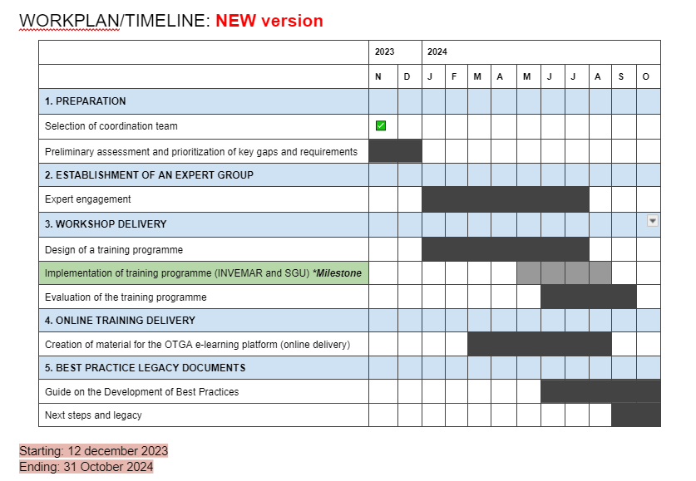
Current status of the Project
A. C. Peralta – OBPS – WP7
Notes:
The project has been going through a long administration process which includes the consultancy contract for the project coordinator and a partnership agreement or consultancy contract for the trainers and other personnel with coordination functions. This has delayed the progress of some of the activities.

Slide 8
Current status of the Project
 | Item | Costs (USD) | Support
1 | OBPS Project Coordination (20% staff time and travel) | 20,000 | Ana Carolina Peralta (OBPS – WP7)
2 | Local Coordinators with administrative functions | 3750 | INVEMAR & SGU
3 | Consultant contracts for the Trainers (2 trainers per workshop site) | 18000 | INVEMAR & SGU
5 | *IOCARIBE administration functions | 450 | IOCARIBE
6 | Online course preparation (Organization, Course editing, Material translation) | 5000 | IODE (OTGA) - INVEMAR
7 | Catering during the workshops | 4000 | INVEMAR & SGU
8 | Field Trips (boat/transportation, materials, etc) | 2000 | INVEMAR & SGU
9 | Professional videographers for online training material including post-processing | 2051 | INVEMAR
10 | *Flights (from the Caribbean/Latin America to the workshop and back) | 25000 | ADAPT training participants
11 | *DSA/Per Diem (Hotel Cost including breakfast, dinner, and incidentals) | 9000 | ADAPT training participants, project and local coordinators
12 | *Transportation (airport-hotel shuttle; hotel-venue shuttle) Is covered by DSA | 2538*move some money to item 10 and 11 | ADAPT training participants, project and local coordinators
 | TOTAL | * US$ 91,339 (Project Budget US$ 99,577)
*US$ 8,238 left to redistribute among items 5, 10, 11 and 12
A. C. Peralta – OBPS – WP7
Notes:
The project has been going through a long administration process which includes the consultancy contract for the project coordinator and a partnership agreement or consultancy contract for the trainers and other personnel with coordination functions. This has delayed the progress of some of the activities.

Slide 9
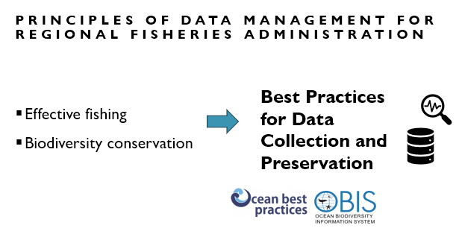
Current status of the Project
The ADAPT project has been mentioned in a presentation during the GCFI annual conference in the past November:
“Best practices for measuring marine biodiversity for wise management of local and regional fisheries.”
A. C. Peralta – OBPS – WP7
Notes:
The project has been going through a long administration process which includes the consultancy contract for the project coordinator and a partnership agreement or consultancy contract for the trainers and other personnel with coordination functions. This has delayed the progress of some of the activities.

Slide 10
Next steps
Identification of the CD priorities:
The team agrees on performing a second survey distribution, with the help of IOCARIBE secretariat who will spread it through their partners and participants of the past IOCARIBE CD webinar series.
IOCARIBE CD Mapping exercise, session 22 Nov NGOs, Industry and other partners
A. C. Peralta – OBPS – WP7

Slide 11
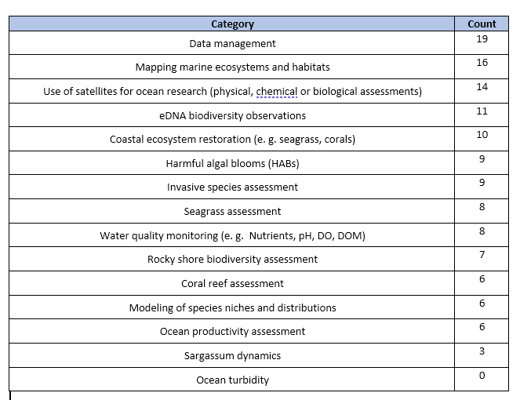
Next steps
Survey results:
Country, institution, or organization
Career level
Status within any current or future participation in a regional monitoring program
EOVs awareness
Ranking of training topics of interest
A. C. Peralta – OBPS – WP7

Slide 12
Next steps
Conclusion we would like to get from the survey:
How well was the Caribbean Region represented?
Which are the official Caribbean countries? Different answers according to different sources.
Institutions/organizations: academic institutions, Government agencies, Intergovernmental Organization, NGOs
Which should be the topics for the training and why? According to ranking + regional needs
A. C. Peralta – OBPS – WP7

Slide 13
Next steps
Survey results: January 2024
Identification of the experts and training plan co-development: February 2024 to July 2024
On-site trainings: May (Grenada) – June/July (Colombia)
On-line training course – FINAL: September 2024
Final report: October 2024.
A. C. Peralta – OBPS – WP7

