Slide 1
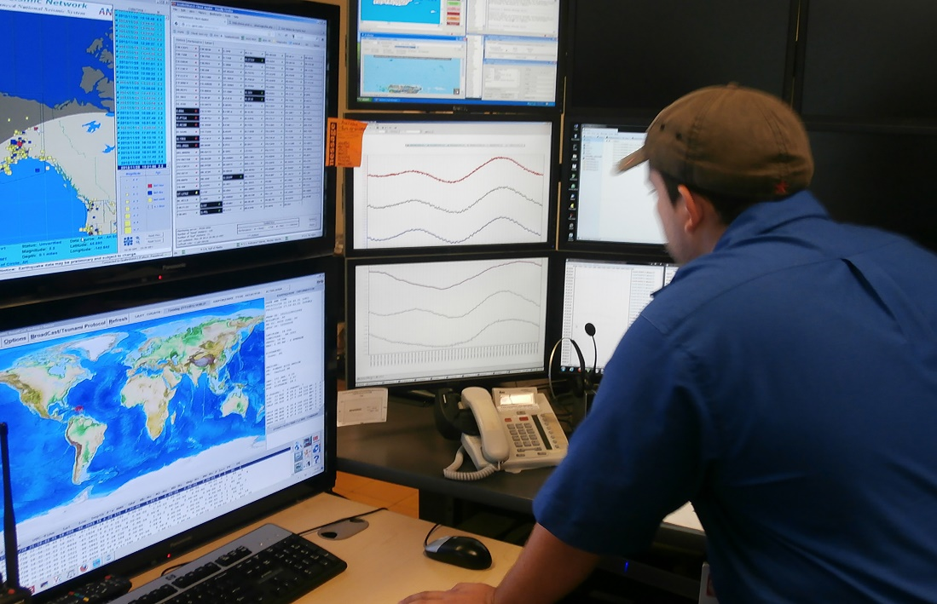
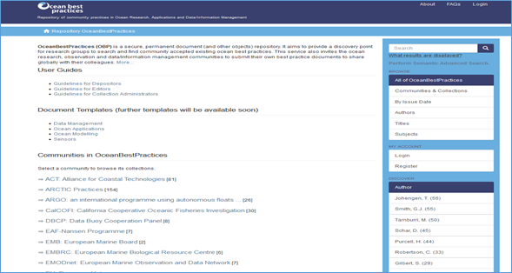
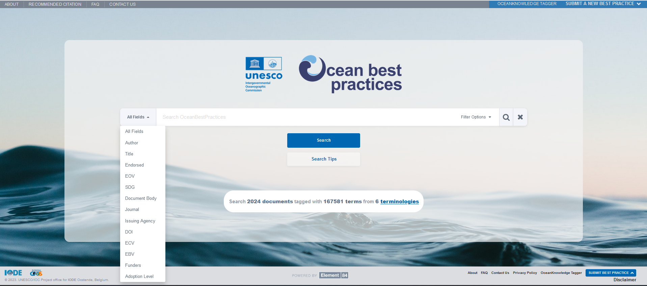
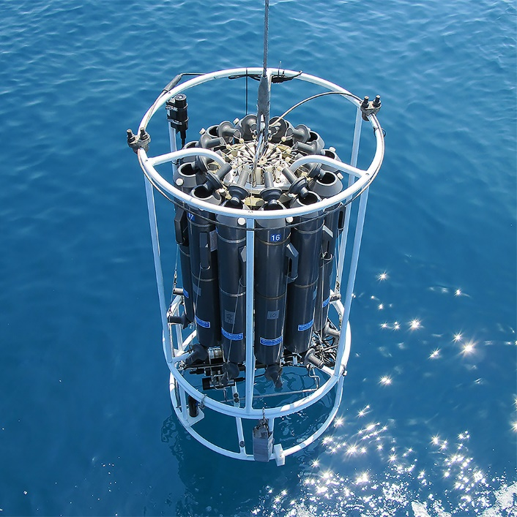
WP2 : Repository Operations
(Agenda Item 15)
Pauline Simpson
SG-OBPS-V, 12 – 14 December 2023
UNESCO - Paris
www.oceanbestpractices.org

Slide 3
DEPOSIT REPOSITORY - DSPACE
Hosted by IODE on VLIZ server
Backend is Java; Frontend is in Angular
IODE IT provide support but has no real time, (except for urgent or emergencies), for maintenance or enhancements
Some urgent maintenance required:
- two long term major issues:
DOI not being issued
Thumbnails not being system generated
- some 25 frontend enhancements waiting to be addressed

Slide 4
DEPOSIT REPOSITORY – USER FACING ENHANCEMENTS
Ocean Practices Federated Network (OPFN) pilot and portal – OBPS repository will provide an MMS to those organizations and communities who are unable to support their own methodological repositories.
Create and implement an EOV vocabulary – enable interface selection and population of EOV metadata field, rather than going out to the GOOS EOV webpage and copy and paste
Spatial Coverage - implement the Marine Regions API
Autoingest of Journal metadata - through CrossRef subscription and Text Data Mining /API implementation
Machine readable BP templates/auto ingest of metadata (Reports) - upload the method full text file including the metadata – one click deposit
AI translation of methods abstracts and population of Other language abstract metadata field

Slide 5
ENHANCED DISCOVERY SERVICE (EDS)
Hosted on Amazon Web Service
Uses ElasticSearch/OpenSearch
IODE IT provide basic support but contract required for maintenance or enhancements.
Some urgent requirements
- Search logic needs investigating – ‘google’ search offers too many results in
some metadata field searches but results numbers are not logical
- Some Boolean operators are not working correctly
- ‘Select all’ citations should select every record not just one screen at a time

Slide 6
ENHANCED DISCOVERY SERVICE (EDS) – USER FACING ENHANCEMENTS
Upload new vocabularies : ASFA/AGROVOC and WoRMS (and more)
Automated Semantic indexing tags to be added to the DSpace repository record metadata
Option to export selected search results in variety of bibliographic
management software formats: Bibtex; Endnote. Mendeley etc
Display download metric (from DSpace/GA) on EDS search results display

Slide 7
Budget Requirement 2024
DSpace & EDS Maintenance - outsourced (core budget) $15,000
DSpace & EDS Development/Enhancements (funded by EXB)
Repository Management (embedded in Project Manager Contract)

Slide 8
The repository is an OBPS primary service
It cannot achieve operational excellence without funding for
dedicated technology/IT support for both interfaces

