Slide 1


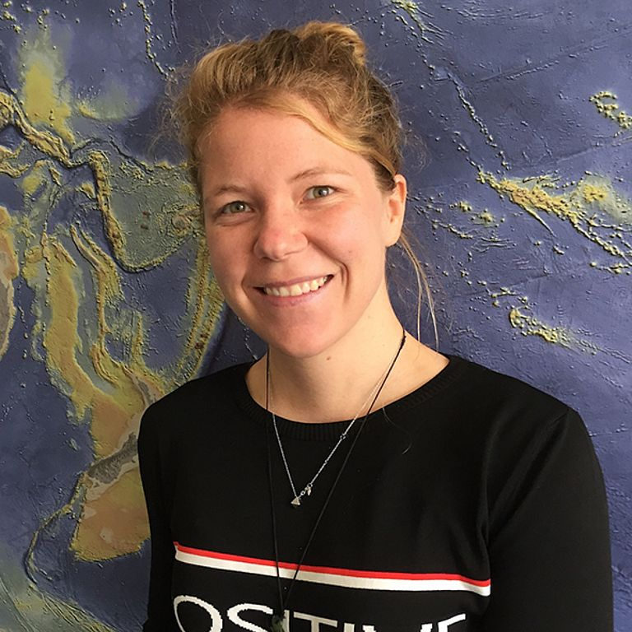

OBPS annual meeting
DECEMBER 12TH & 14TH
Ocean Practices for the Decade
Rebecca Zitoun
Aileen Hwai Tan
WP 8 - Lead
IMOS/GEOMAR
WP 8 - Lead
USM/CEMACS

Slide 2
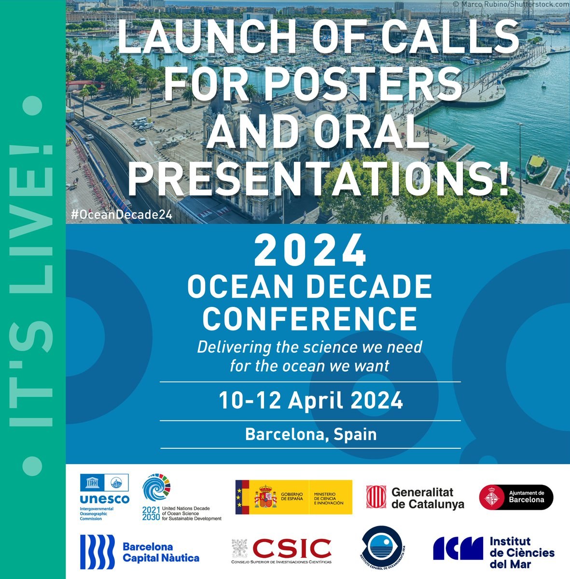
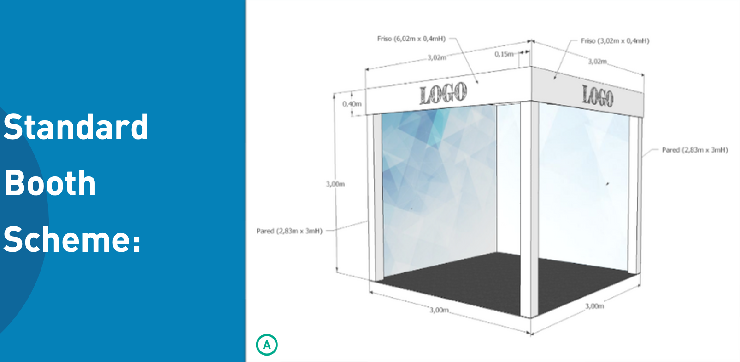

UN DECADE CONFERENCE - BARCELONA 2024
Oral Presentation
Booth
Satellite Event
Who submitted a satelite event ?
→ ODIS/OceanData2030: Data sharing
Possibility to share a booth: Ocean Decade Data Booth (ODIS, OceanData 2030)
Develop Poster/Flyer?
WHO IS GOING TO BARCELONA?

Slide 3
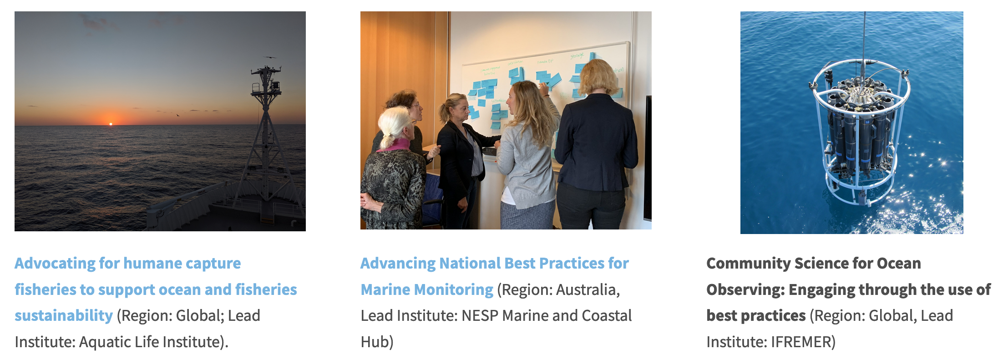
ENDORSED DECADE PROJECTS
3 Decade Projects and Actions hosted by OceanPractices

Slide 4
ENDORSED DECADE PROJECTS
Call for Decade Actions No. 05/2023
We received 8 submissions and the DCU send us 6 for review:
Surfside Science
Sathyabama Ocean Incubation Program
Innovative Solutions for Plastic Free EU Rivers
‘Healthcheck’ activates sustainability reporting
Cross sector collaboration grows circular economy
Creating Capability, Capacity & Culture Change

Slide 5
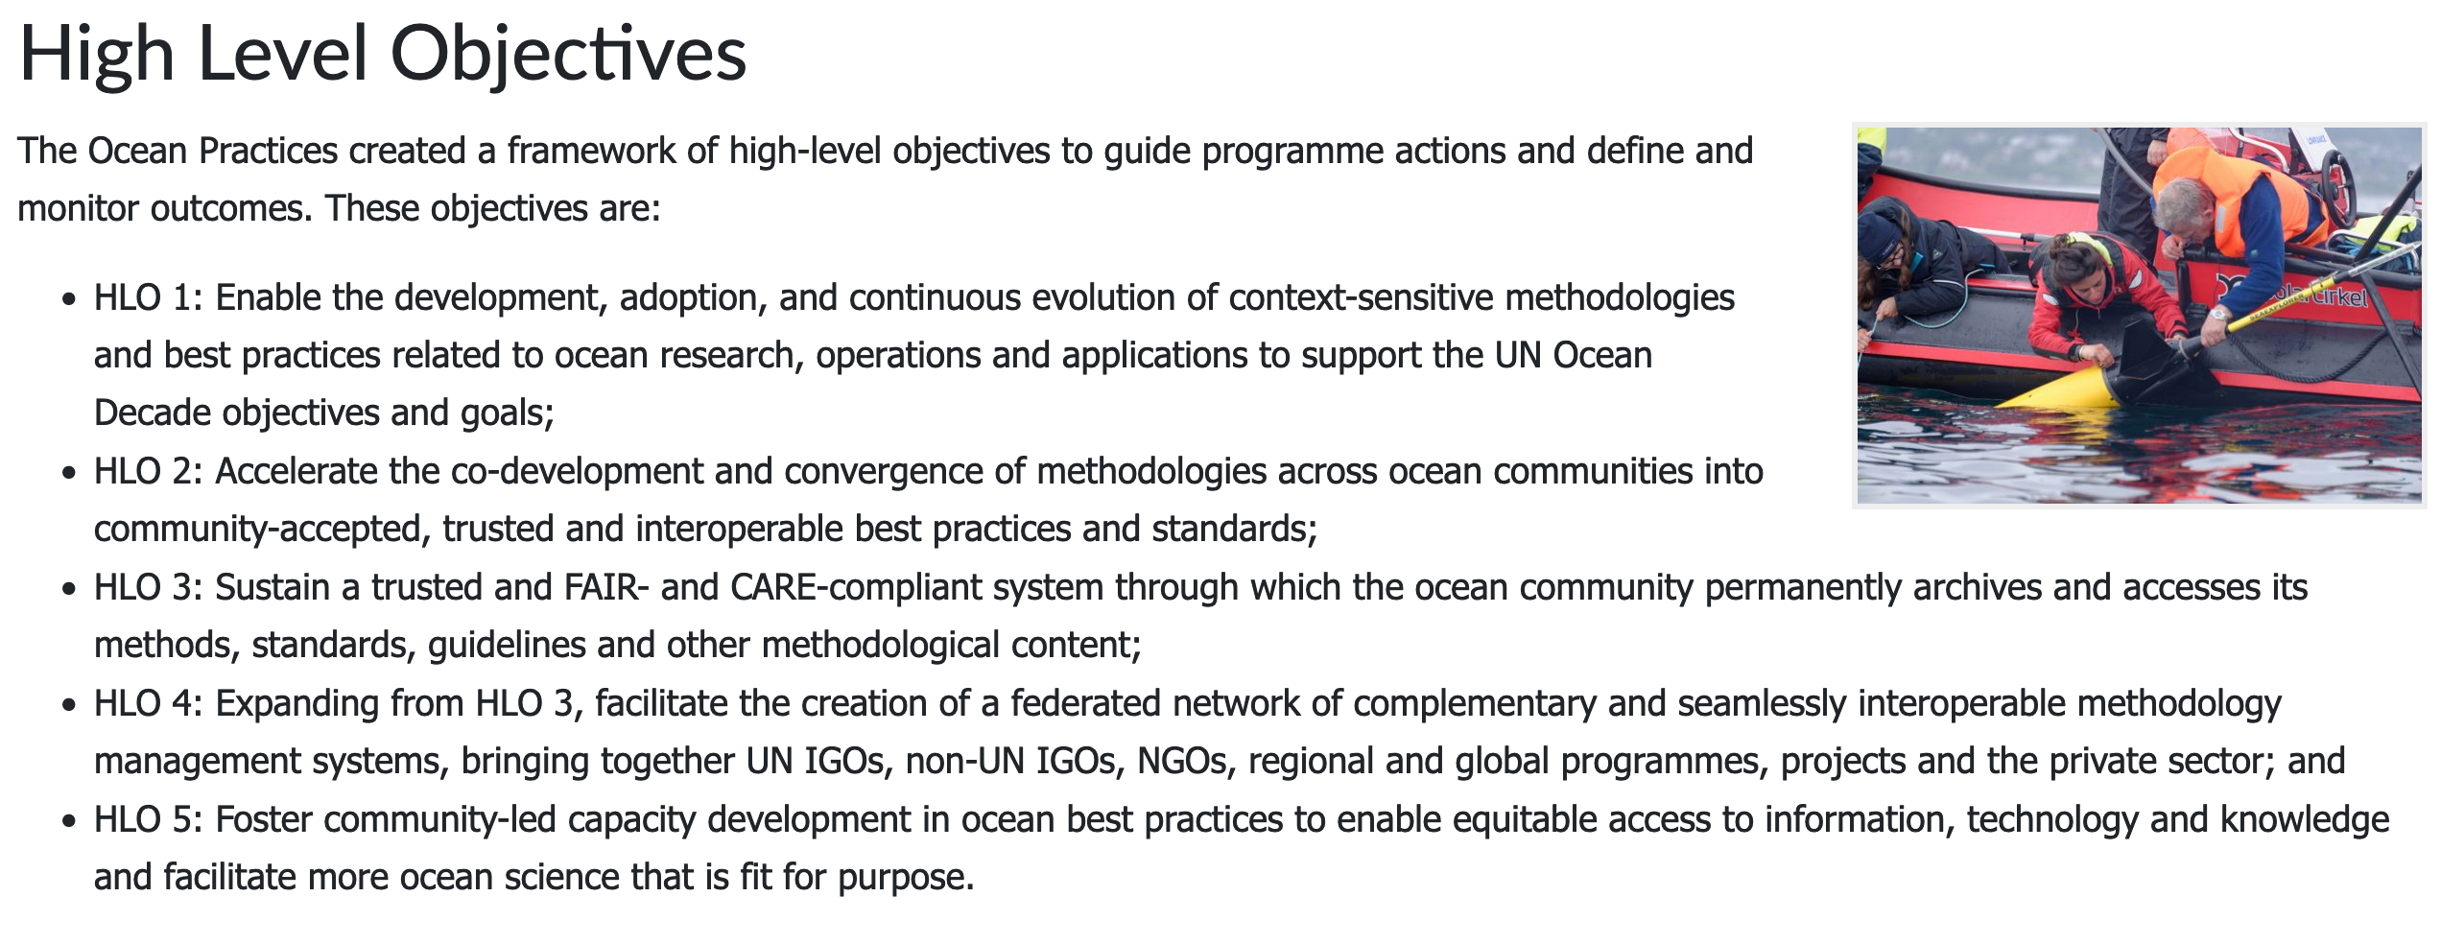
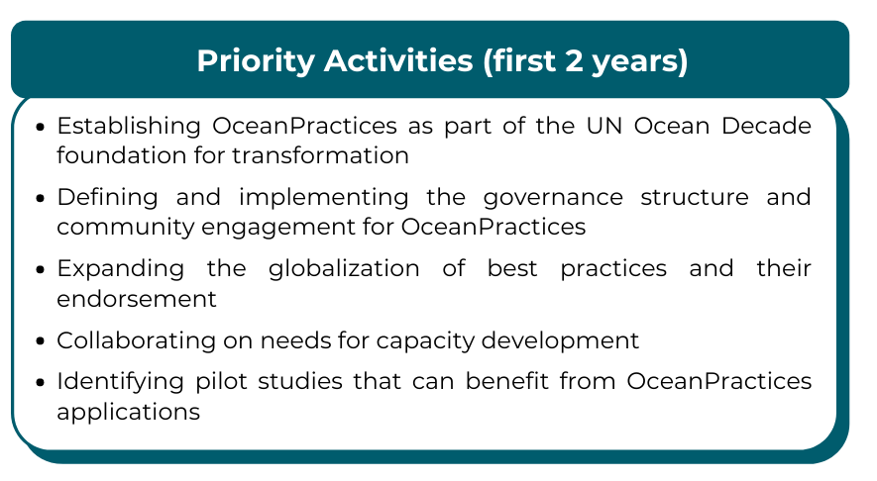
DISCUSSION: DECADE STRATEGY
What is our strategy to achieve the OP objectives?

Slide 6
DISCUSSION: DECADE STRATEGY
What is our strategy to achieve the OP activities?

Slide 7
DISCUSSION: DECADE STRATEGY
Monitoring and evaluation reporting
Knowlede products (type, number, citation)
New infrastructure (type, number)
Users (number, location)
Uptake of products/knowledge
Capacity development activities (number of activities and beneficiaries, country of origin of beneficiaries)
Inclusion of indigenous community
Partner institutions (number, location, sector, gender, professional age)
Qualitative assessment of behaviour change as a result of capacity development
Characterisation of the change in perception, priorities, and investments by our partners

Slide 8
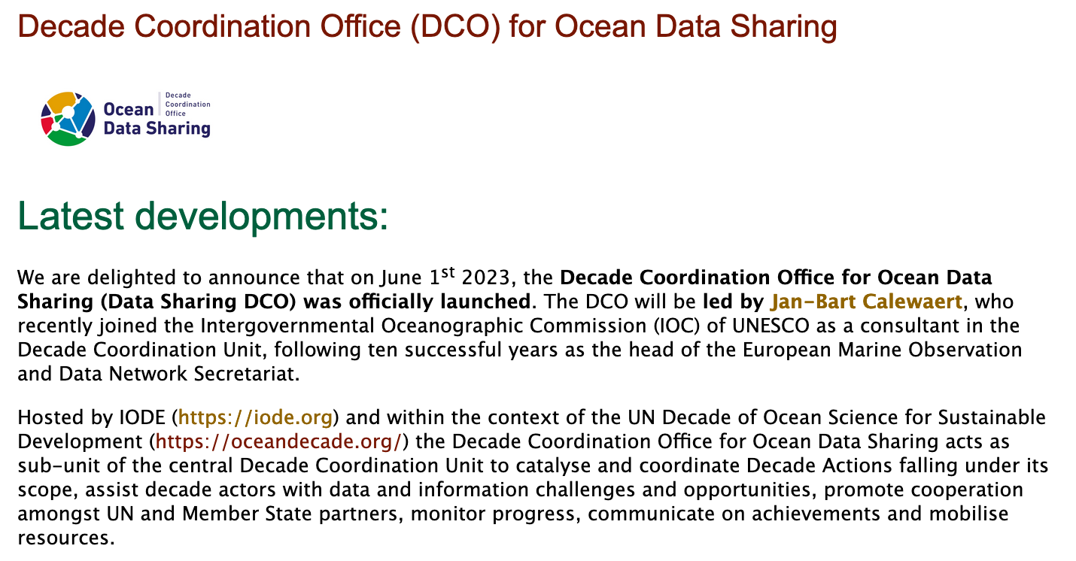
DCU VISION FOR BP

Slide 9

BUDGET REQUIREMENTS
Flyers, poster etc ($2000)
Video ($3500)
Ocean Decade 2024 Conference (T & S) for OP Coordinator ($4000)
Ambassadors Programme ($4000)

Slide 10

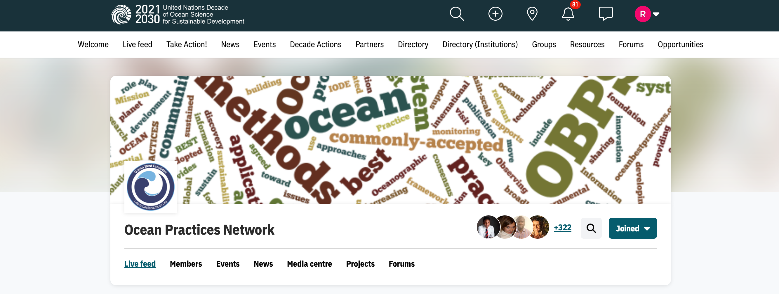
JOIN US ON THE OCEAN DECADE FORUM!

