Slide 1
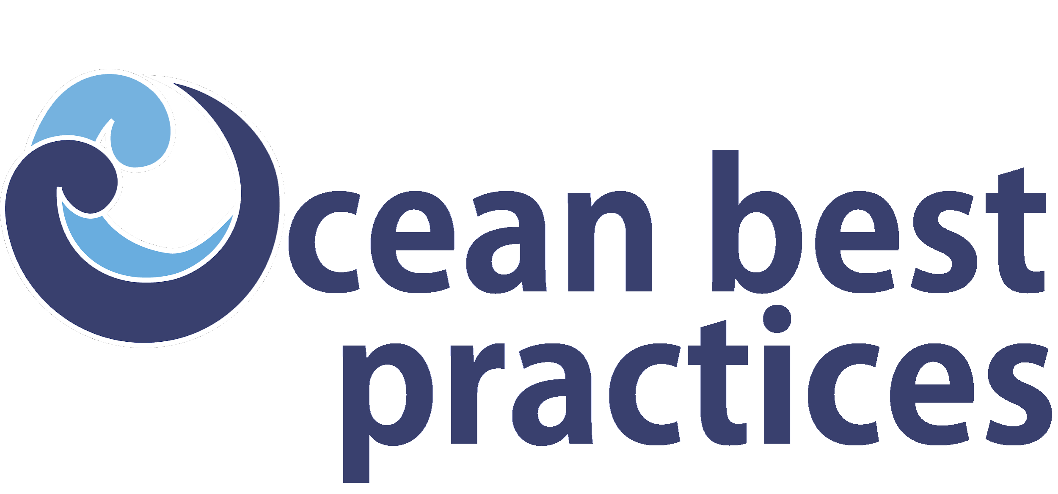
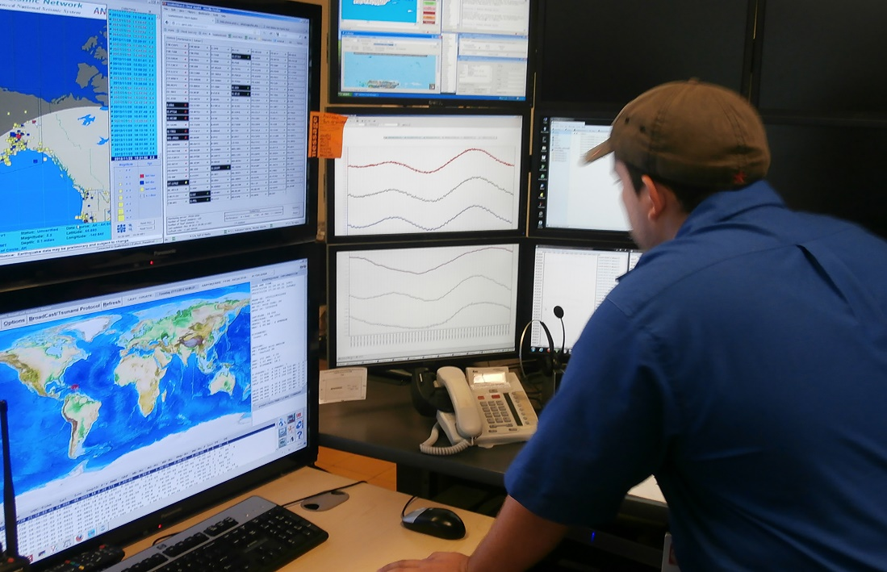
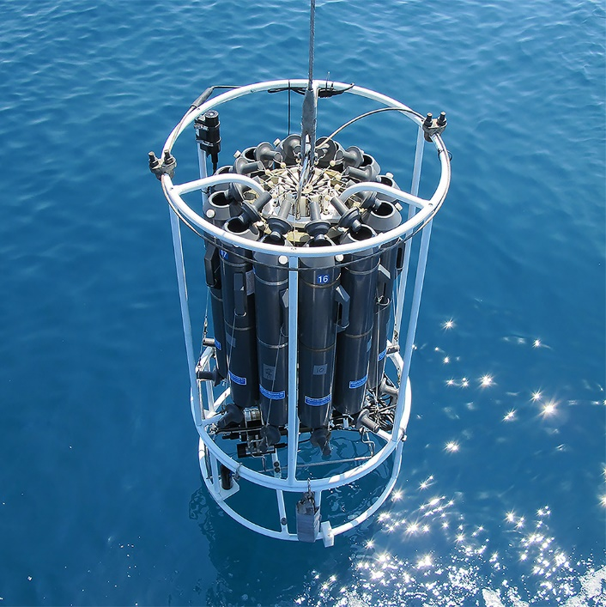
The Ocean Practices Federated Network (OPFN)
(Agenda Item 14)
SG Meeting 12 – 14 December 2023
UNESCO - Paris
www.oceanbestpractices.org

Slide 2
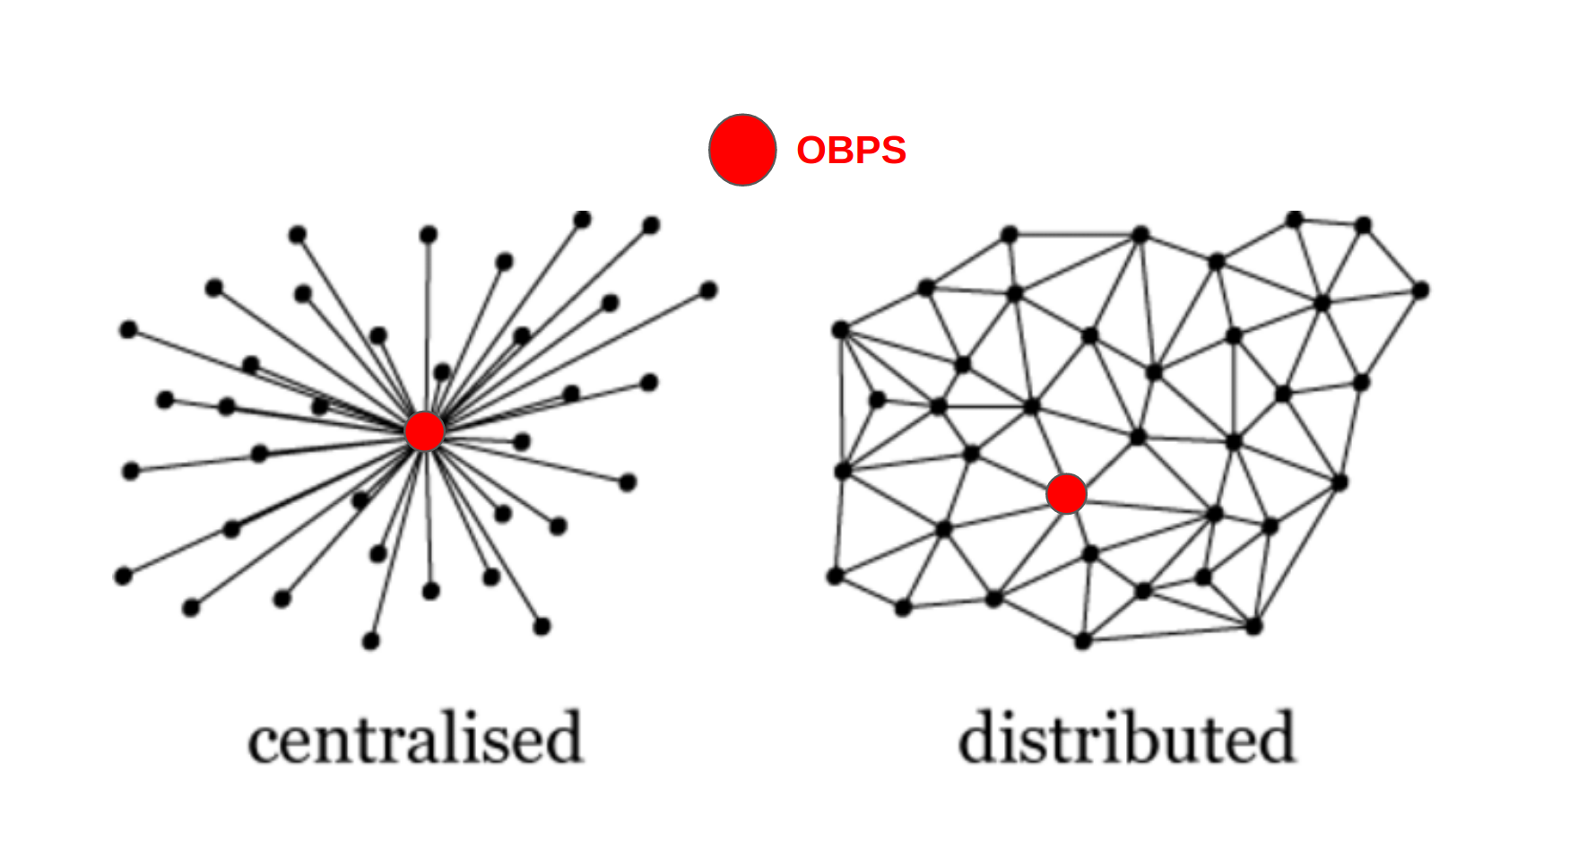
Change of paradigm

Slide 3
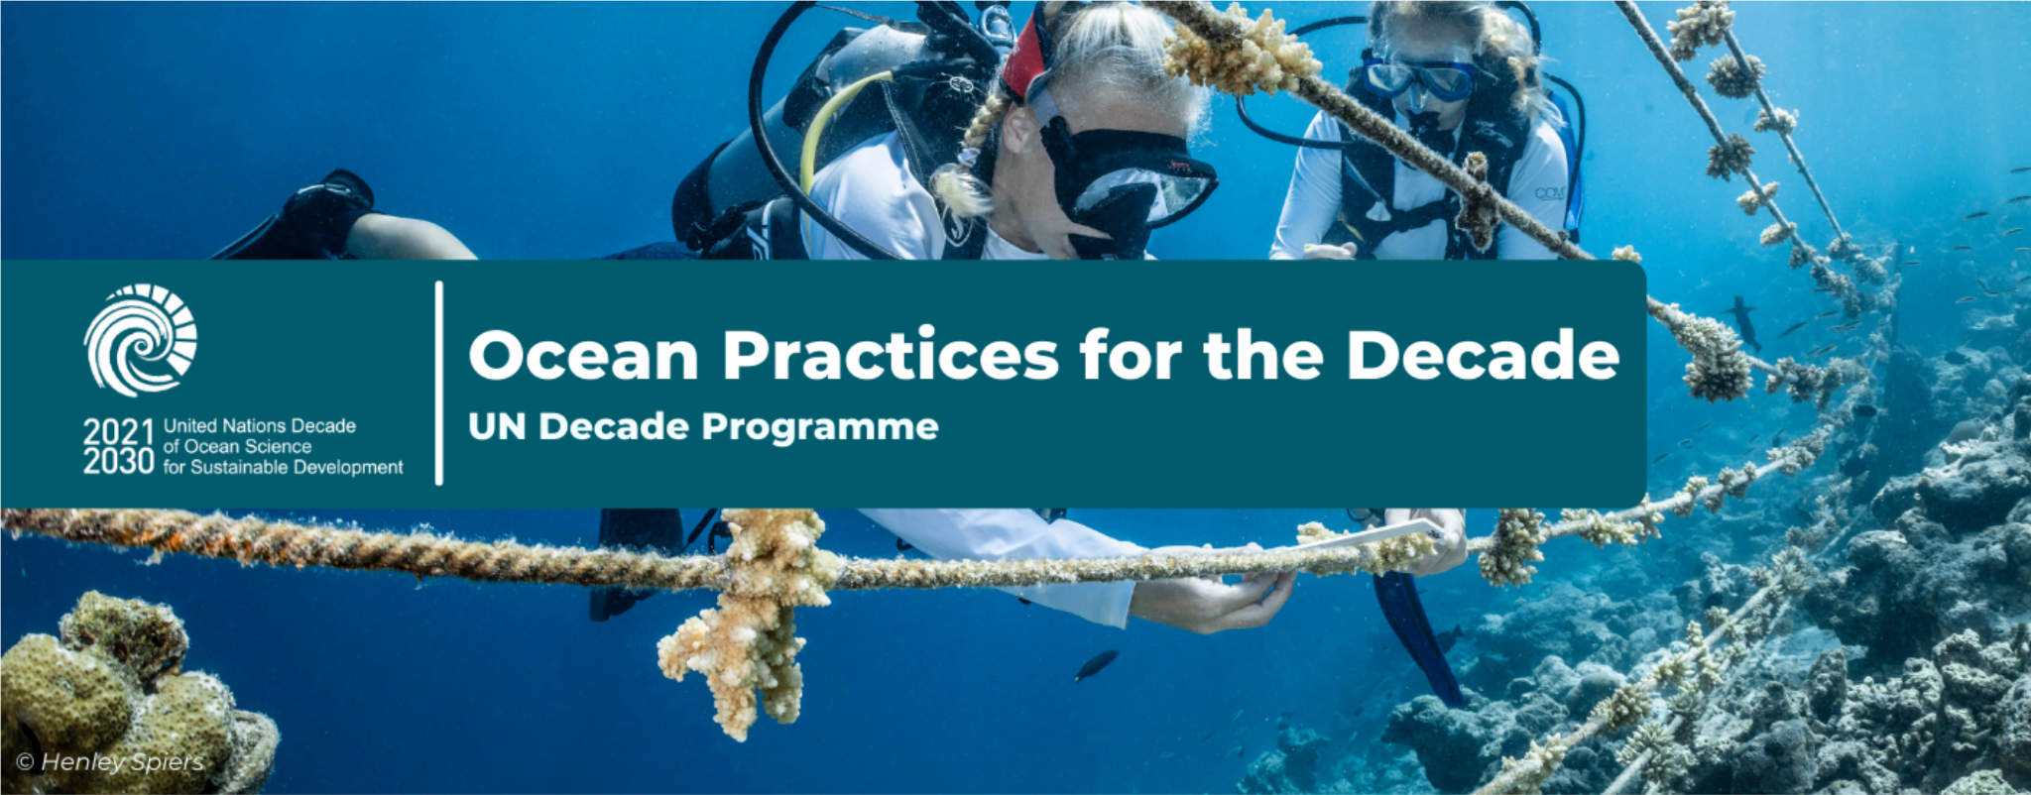
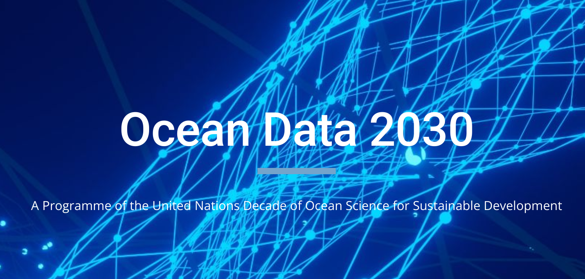
Ocean Practices
Federated Network (OPFN)
Support mechanism for
Engaging diverse communities of practice and
Interlinking their methodologies through FAIR digital technologies

Slide 4
ICES
Repository
FAO
Repository
EU AAM
OBPS
Repository
Other small institutionsRepository
Other small institutionsRepository
Other small institutionsRepository
Users

Slide 5
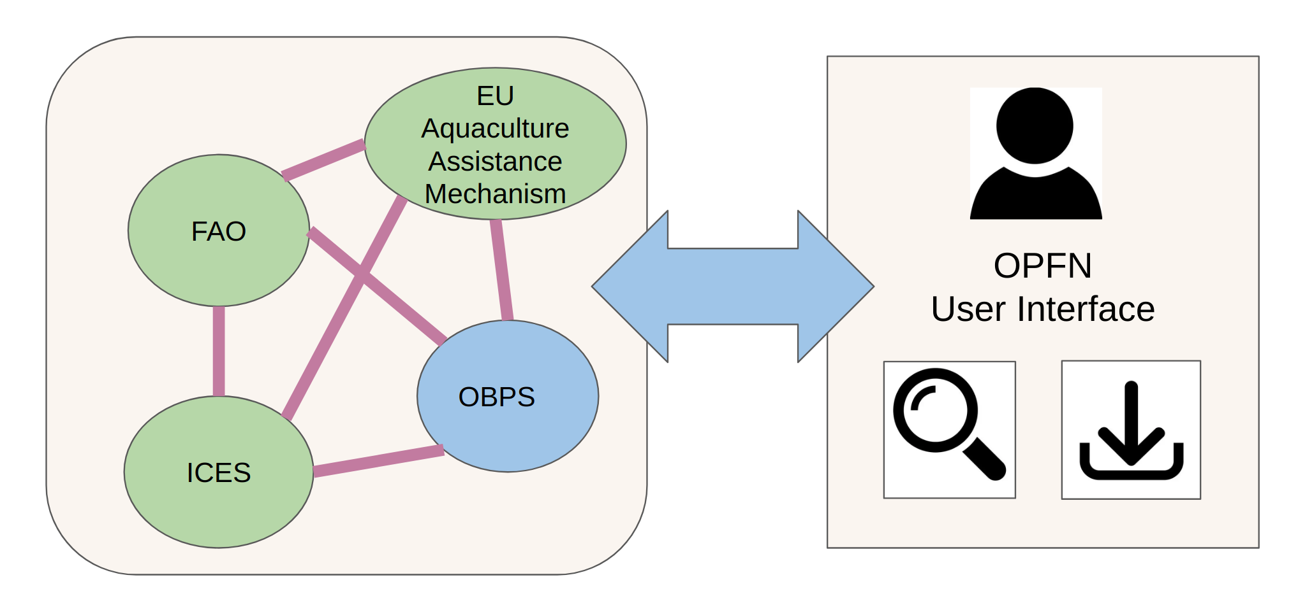
Federated Network of MMSs

Slide 6
Benefits of an OPFN
Reduce knowledge silos
Enhance and multiply discoverability of methods.
Increase traffic of users through the OPFN nodes.
Facilitate future endorsement and convergence processes from methods into Best Practices.

Slide 7
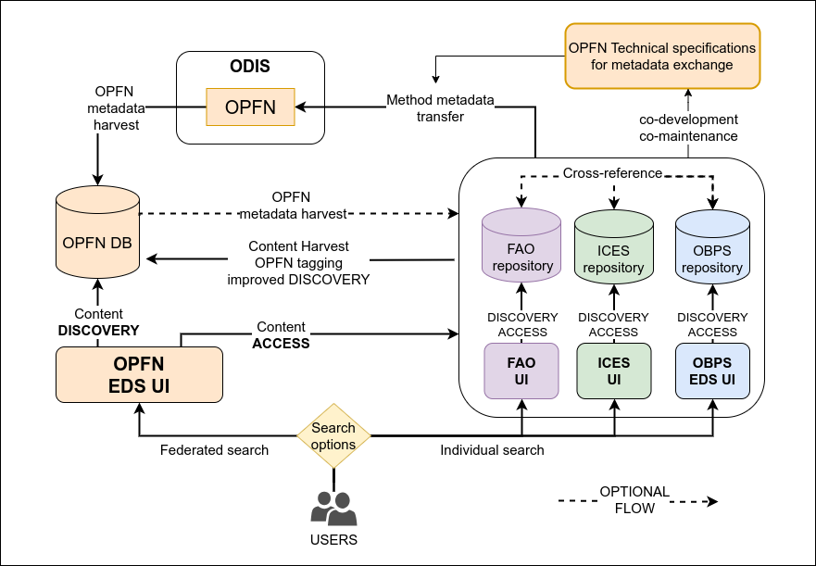
Conceptual
Architecture

Slide 8
Values of the OPFN
All methods are relevant
Methodological knowledge is transparent and accessible.
All nodes are aware of it.
Every node helps each other sharing methods.
Each node is free to share its methods
Exchange of knowledge is fair
Every node provides and retrieves.
Quality Assurance is guaranteed from node side.
Sovereignty of each node
OPFN not changing institutions or expertise from partners
Every node makes its own decisions
Every node to choose what is ingesting in its own system.

Slide 9
Current status and next steps
OCT 2023
DEC 2023
JUN 2024
DEC 2024
Working Group
Metadata template v1.0
Initial Governance
Pilot
OBPS, OIH, FAO, ICES
First version agreed within the working group
Aquaculture use case

